Slide 1
Grant Management & SEFA
Presented by:
Brenda Trevino, Wilson County Auditor
Melissa Jeter, Houston County Auditor

Slide 2
Learning Objectives
Understand the fundamentals of grant management
Develop knowledge in grant application research, application process, and evaluation
Understand compliance and reporting

Slide 3
Grant Management—What is it and Who does it?
What does grant management include?
Grant management is a process that helps administer, prioritize, and process grant applications.
This includes everything from researching funding opportunities, applying for grants, meeting the grant requirements, requesting reimbursement, and meeting compliance with all grant reporting requirements.
Every county does it differently!

Slide 4
Defining Grant Terminology
Grant Lifecycle—the beginning and ending dates of a grant. Note that expenditure dates and reporting dates may be different at the end of the cycle.
Compliance—there are many areas from procurement, authorized expenditures, reporting deadlines, and documentation.
Budgeting—very important to plan accordingly (matching funds, revenue, and expenses)

Slide 5
Research and Applying for Grants
Some counties have grant departments (some under the office of the County Auditor). Some utilize grant consulting firms. And some have both ☺
Grant Research—a strategic way to find grant funds that align with your county’s needs and goals. Examples are road and bridge grants provided by Department of Transportation, FEMA, and TDEM. Others may include grants for your sheriff’s departments such as Operation Lone Star. Utilize your COG (Council of Government) and the Office of the Governor (E-Grants portal)!
There is money to be had—data shows that federal grants can range anywhere from $500k to millions of dollars per grant. As of September 2015, there was $994 million in unspent grant funds. (U.S. Government Accountability Office)
Work with your elected officials to determine their needs. Get as much detailed information as you can. It will help you in the long run.
If you are not a grant writer and do not have one—hire one. Whether it is a firm or an individual, grant writing can be tedious. Some applications require pages of detailed narratives. Let the experts do this!

Slide 6
Schedule of Expenditures of Federal Awards (SEFA)
WHAT is a SEFA????
In 2013, OMB released guidance on administrative requirements, cost principles, and audit requirements for federal awards.
Streamlined eight circulars into ONE document.
Became effective in 2015 for Counties that received federal funding/awards.
Under 2 CFR 200.501—Audit Requirements
a single audit is required for an entity that expends $750,000 or more in federal awards during its fiscal year. The specifics are stipulated under Subpart F of 2 CFR.
Notes:
A SEFA provides transparency and accountability for using federal funds, providing information on how federal awards were spent to show the funds were used for their intended purposes.
SEFA PURPOSE: Report detailed documentation that supports the dollar amounts of federal award expenditures and note disclosures.
If your organization spends more than $750,000 in federal awards, a SEFA is required for that fiscal year.

Slide 7
Schedule of Expenditures of Federal Awards (SEFA)
The Single Audit Act establishes requirements for audits of States, local governments and Indian tribes that expend over a threshold amount in Federal awards during a fiscal year. Governments that are subject to the Single Audit Act are required to prepare and have audited a Schedule of Expenditures of Federal Awards (SEFA).
[1] The SEFA reports amounts expended, not the amount received, during the fiscal year.
[2] Uniform Guidance requires that the independent auditor performing a Single Audit render an in-relation-to opinion on the SEFA as part of the independent auditor’s report on the government’s financial statements.
[3] While preparing GAAP basis financial statements can be a daunting task, most of the necessary information (numbers) is located in the general ledger. A SEFA does contain financial statement numbers, but it also contains other information not typically found in a general ledger, such as federal agency assistance listings numbers, pass-through entities, program names, and subrecipient information.
Notes:
A SEFA provides transparency and accountability for using federal funds, providing information on how federal awards were spent to show the funds were used for their intended purposes.
If your organization spends more than $750,000 in federal awards, a SEFA is required for that fiscal year.

Slide 8
Schedule of Expenditures of Federal Awards (SEFA)
Under Code of Federal Regulations (2CFR 200.38), a federal awards are provided by federal agencies or indirectly from pass-through agencies, such as:
Grants
Cooperative agreements
Non-cash contributions
Property donations
Direct appropriations
Food commodities
Loans
Loan guarantees
Interest subsidies
Insurance
Direct appropriations
Other financial assistance

Slide 9
Schedule of Expenditures of Federal Awards (SEFA)
What do you need to prepare the SEFA?:
Grant agreement and notice of the award, as applicable
Type of grant (e.g., reimbursement basis or structured payments)
Program name and cluster title (if applicable)
Name of federal funding agency
Pass-through entity (if applicable)
Assistance listing number (formally known as the CFDA number)
Pass-through entity identifying number (if applicable)
Amount passed through to each subrecipient (if applicable)
Award amount
Award date
Match requirement (if applicable)
Period of performance

Slide 10
Schedule of Expenditures of Federal Awards (SEFA)
How do you prepare the SEFA?:
List program by Federal Agency and program
Cluster program must be listed by name, individual program and Federal agency name
Federal programs with multiple award years must list the amounts expended by each year separately
If award is as a subrecipient – list name of pass-through entity and identifying number from pass-through entity.
List each CFDA number or other identifying number when the CFDA is not available.

Slide 11
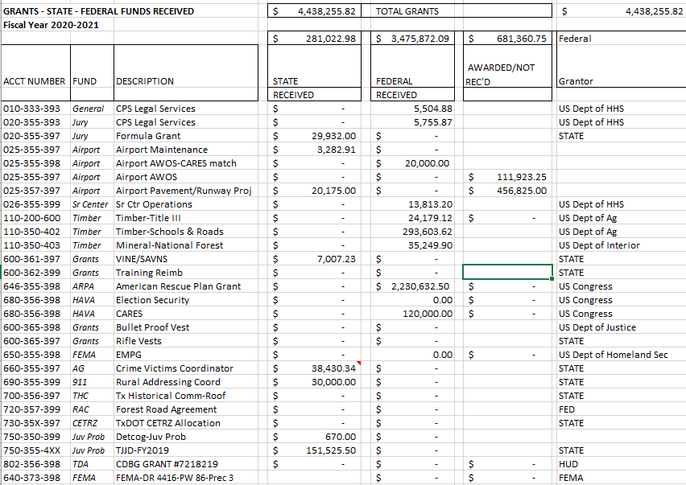
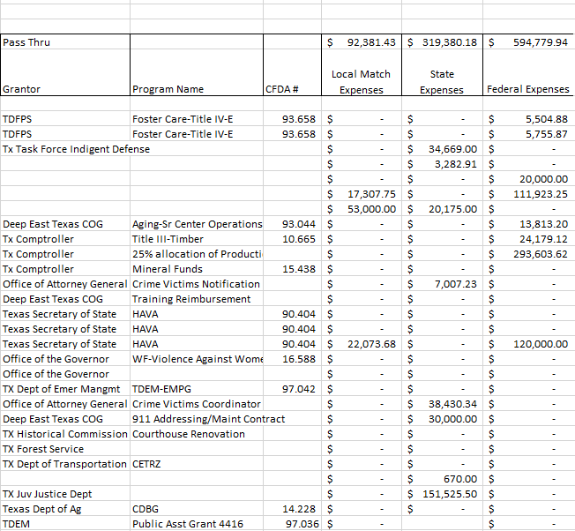
SAMPLE – Draft Form

Slide 12
SAMPLE – Draft form
GL Account Number
Fund Name
Description / Purpose
Federal or State Grantor / Pass Thru Grantor
Agency Program Name
CFDA # / Contract Number
025-357-397
Airport Fund
Pavement/Runway Project
US Dept of Transportation/Tx DoT
Airport Improvement Program
20.106 / 20CRCROCK

Slide 13
SAMPLE – Draft form
REVENUE
Amount Awarded
Amount Received
EXPENSES
Local Match Expenses
State Expenses
Federal Expenses
ACTIVITY THROUGH FISCAL YEAR
Award: $530,000
Received: $0.00
Local Match: $53,000
State Expenses: $0.00
Federal Expenses: $111,923.00
*Match was paid to TxDot Aviation and State Agency made actual payments. County received invoices as they were paid.

Slide 14
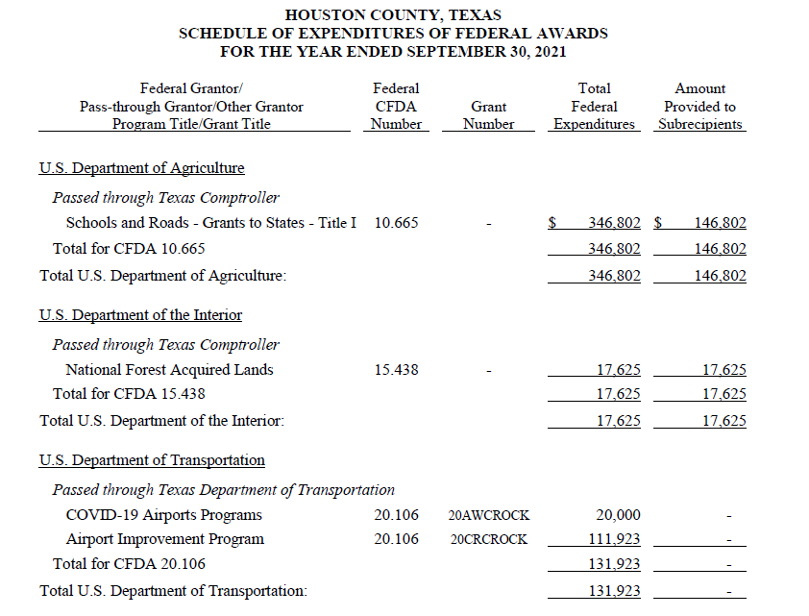
SAMPLE – Final form

Slide 15
Schedule of Expenditures of Federal Awards (SEFA)
Avoid common SEFA errors
Not separating programs
Including state and local funding in totals
“Double reporting”
Pass-thru payments not verified as Federal Awards…
Notes:
Not separating programs — COVID-19 programs and expenditures must be shown separately on the SEFA and in the data collection form. List the amounts under the section where the funding originated and label with “COVID-19” so readers can easily identify it.
Including state or local funding — Only list federal grants and expenditures on the SEFA. Exclude state or local funding because they are not federally derived funds. If you are unsure whether a grant is federally funded, you can look up the grant name or assistance listing number (ALN) on the Office of Management and Budget (OMB) Compliance Supplement.
“Double reporting” — Do not include interagency grants (IGAs) on the SEFA because that would “double report” the funds. For example, imagine Agency A received federal funding and entered into an agreement with Agency B who needs the funding. Agency B does not have the resources to properly expend the funds and asks Agency A for help to do so. Agency B should report the funds on their SEFA. Agency A should not report these funds, as they were not the intended recipient.

Slide 16
SEFA Error….
Pass-thru payments not verified as Federal Awards…
American Recovery and Reinvestment Act (ARRA)
2009
Federal Funds
MY Error / Lesson Learned
COG funding must be verified

Slide 17
SEFA Guidance
https://www.gfoa.org/materials/sefa-preparation
https://fmx.cpa.texas.gov/fmx/pubs/afrrptreq/sefa/index.php
https://www.claconnect.com/en/resources/articles/2023/sefa-prep-3-tips-to-avoid-errors-and-verify-accurate-federal-reporting
https://www.whitehouse.gov/wp-content/uploads/2023/05/2023-Compliance-Supplement-%E2%80%93-2-CFR-Part-200-Appendix-XI.pdf
https://us.aicpa.org/content/dam/aicpa/interestareas/governmentalauditquality/resources/auditpracticetoolsaids/downloadabledocuments/auditor_practice_aids_sefa_02082012.pdf

Slide 18
Questions??
Brenda Trevino, Wilson County Auditor 830-393-7365 btrevino@wilsoncountytx.gov
Melissa Jeter, Houston County Auditor 936-544-3255 ext 232 mjeter@co.Houston.tx.us

