Slide 1

County fraud schemes & scenarios
County Auditors Institute – April 18, 2024
PRESENTED BY: Janet S. Martin CPA, CFE & Leo S. Caldera, CIA, CGAP

Slide 2
DA Hot Check Section
Hot Check Section: The Check Section of the District Attorney’s Office is responsible for investigating and prosecuting the offense of “Theft by check.” It is one of the division at the District Attorney’s Office that is able to take reports of criminal conduct directly from the victim of the crime.
Audit Objectives - Audit Steps:
Ensure money collected from Hot Check Section is going to applicable victim or business – audit letter confirmations
Internal controls: check for appropriate segregation of duties and dual controls – observe and document controls

Slide 3
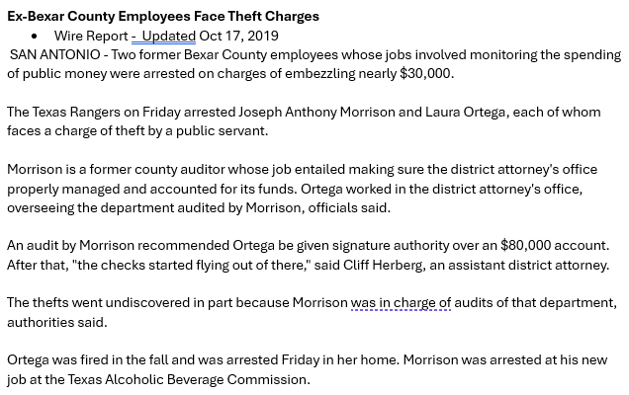

Slide 4
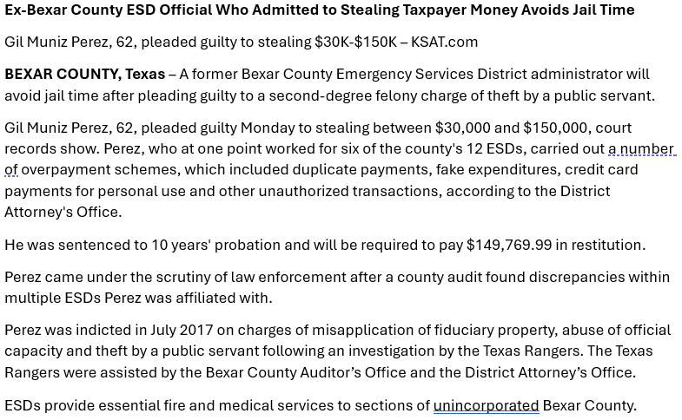

Slide 5
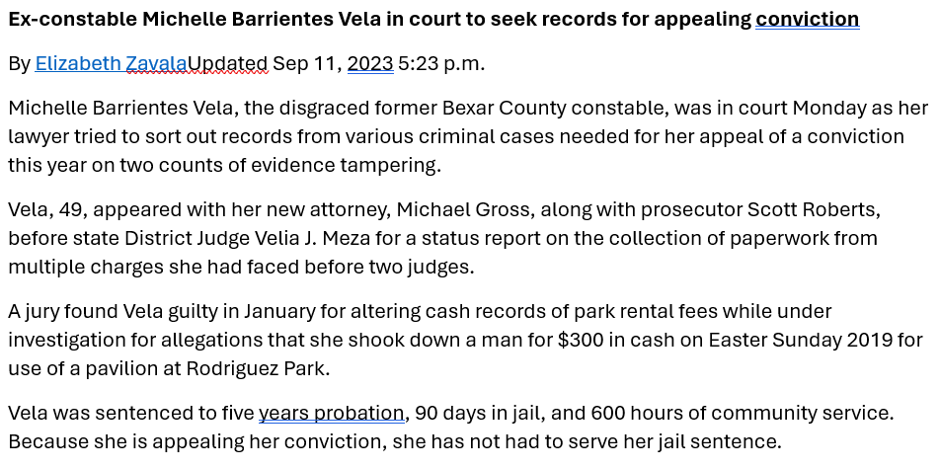

Slide 6
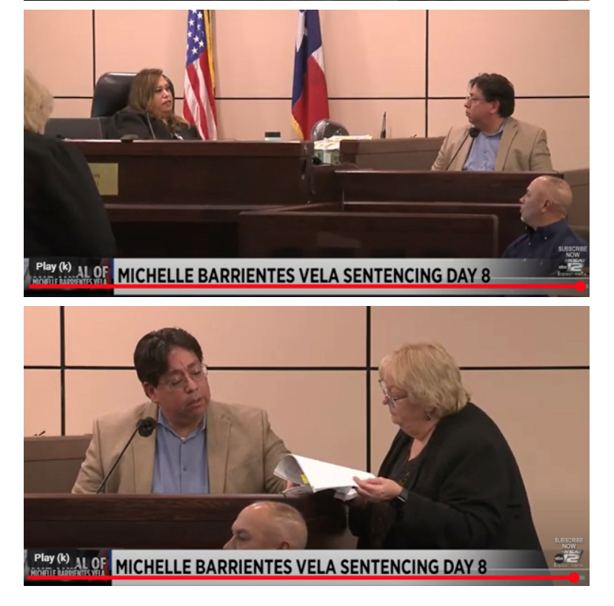

Slide 7
So…… what is FRAUD…….

Slide 8
Fraud is the legal term for any act, expression, omission, or concealment that I is calculated to deceive another to his or her disadvantage. Fraud is intentional and requires knowledge of reckless disregard of the falsity of the information and the intent to deceive. Fraud can involve breach of legal or equitable duty or trust or confidence.

Slide 9
Constable “Fife”
Running his security business from his County Office
Multiple years behind on his property tax – facing Sheriff’s Sale
Selling nutritional supplement from his office
Filing false TCOLE racial profiling reports
Purchased uniforms for his security jobs
Multiple checks in his office and his vehicle along with unserved papers
Bag of unvouchered evidence in his office including weapons and drugs
Pawned his AR15

Slide 10
Use of County Drone
SD card had video of drone used to make videos for a real estate agency.
Tip made by a utility worker

Slide 11
TIFs, TIRZs, and Tax Abatements not in compliance
When these economic development tools are misused is your tax rate correct?

Slide 12
Commissioners tried to use County Funds to repair his mistress’s car
Tip came from a mechanic who knew the Commissioner’s wife.

Slide 13
Association of Certified Fraud Examiners – Interivew Techniquest taught by FBI
If any doubt ALWAYS take law enforcement!!!

Slide 14
Coming home from the 2012 Auditor’s Conference
Multiple calls reporting a Commissioner using County equipment and materials on his person property……..
HE WAS INNOCENT!

Slide 15
Contact Information
Leo S. Caldera, CIA, CGAP
Bexar County Auditors Office
Phone#: 210-335-2441
Email: lcaldera@bexar.org
Janet S. Martin, CPA, CFE
Wichita County Internal Audit Manager
Phone #: 254-979-1131
Email: janet.martin@co.Wichita.tx.us
Thank You for Your Time – God Bless!

