Slide 1

Social Security:
With You Through Life’s Journey…
Produced at U.S. taxpayer expense
Notes:
GOOD MORNING! My name is Sheryl Schroeder.. I am a Public Affairs Specialist with the Dallas Region Public Affairs office. I’ve had the pleasure of working for Social Security for 20 plus years now. I AM EXCITED TO BE HERE WITH YOU TODAY AND HAVE THE OPPORTUNITY TO SHARE INFORMATION WITH YOU ABOUT SOCIAL SECURITY.
We do have a lot of information to cover. To ensure that we get through the entire presentation within our allotted time, please wait until the end to ask questions. If your question is very case specific or requires some research, I may need to speak with you one on one. If that is the case, please provide your question and contact information to the event coordinator.
I HAVE LOTS of good stuff to COVER TODAY, SO LETS GET STARTED.

Slide 2
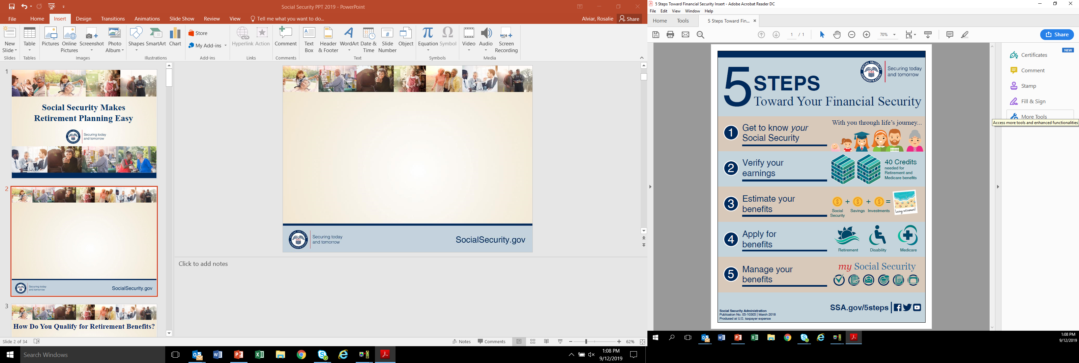
Notes:
I’d like to BEGIN BY TAKING A LOOK AT what SSA has identified as the Five Steps toward Your Financial Security.
AS you all well know - Planning for the future is intimidating to many, but we’ve broken the task down into five easy steps:
Step 1: Get to know your Social Security —there is so much you may not know about the benefits and services we provide.
Step 2: Verify your earnings — Your benefits are calculated using your employment records. You can use your personal my Social Security account to verify that your earnings are recorded accurately.
Step 3: Estimate your benefits —
Step 4: Apply for benefits — You can apply for retirement, Medicare, or disability benefits online – OR BY CALLING AND SETTING UP A TELEPHONE APPT.
Step 5: Manage your benefits —BY SETTING UP A my Social Security account.

Slide 3

We Wouldn’t Miss Your Retirement Party
Notes:
When most people think of Social Security, they think of retirement benefits —with good reason. Social Security is a lifeline for most retirees, keeping tens of millions out of poverty.

Slide 4
How Do You Qualify for Retirement Benefits?
By earning “credits” when you work and pay Social Security taxes
You need 40 credits (10 years of work) and you must be 62 or older
Each $1,730 in earnings gives you one credit
You can earn a maximum of 4 credits per year
Note: To earn 4 credits in 2024, you must earn at least $6,920.
ssa.gov/planners/credits.html
Notes:
Credits are the "building blocks" Social Security uses to find out whether you have the minimum amount of covered work to qualify for each type of Social Security benefit. If you stop working before you have enough credits to qualify for benefits, your credits will stay on your record. If you return to work later, you can add more credits so you can qualify.
No benefits can be paid if you do not have enough credits.
In 2024 you must earn $1,730 in covered earnings to get one Social Security or Medicare work credit and $6,920 to get the maximum four credits for the year.
When you work and pay Social Security taxes, you earn up to a maximum of four "credits" for each year.
During your lifetime, you will probably earn more credits than the minimum number you need to be eligible for benefits; however, these extra credits do not increase your benefit amount.
Your average earnings during your working years determine how much your monthly payment will be.
Publications:
ssa.gov/pubs/EN-05-10003.pdf (Update)
ssa.gov/pubs/EN-05-10072.pdf (How You Earn Credits)
Slide and Speaker Notes updated OISP/OAESP/OEEMP 11/3/2023 (SY)

Slide 5
How Social Security Determines Your Benefit
Benefits are based on earnings
Step 1 -Your wages are adjusted for changes in wage levels over time
Step 2 -Find the monthly average of your 35 highest
earnings years
Step 3 -Result is “average indexed monthly earnings”
Notes:
A QUESTION WE ARE OFTEN ASKED IS HOW WE DETERMINE YOUR RETIREMENT BENEFIT. =
UNLIKE OTHER PENSION PLANS THAT YOU MAY BE FAMILIAR WITH – THAT USE A HIGH 3 OR A HIGH 5 – WE USE YOUR HIGHEST 35 YEARS.
WE INDEX ALL OF YOUR EARNINGS FOR INFLATION – BRING YOUR EARNINGS UP TO TODAY’S DOLLARS AND USE YOUR HIGH 35.
This formula also makes clear how a worker who qualifies for a retirement benefit with just 10 years of work would have a low benefit payment. Since we are looking for his or her highest 35 years, in this example, we would be adding in 25 zero years.
We are looking for the highest 35 years during a worker's lifetime of earnings, regardless of when earned.

Slide 6
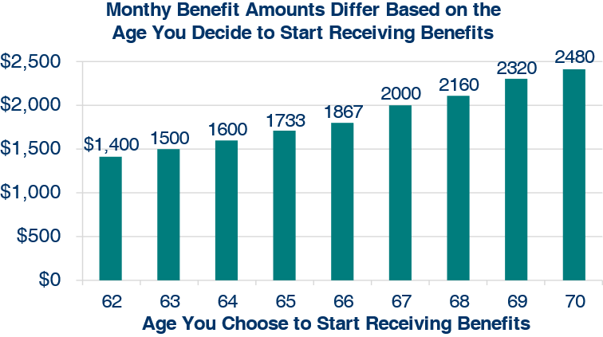
What Is the Best Age to Start Receiving Social Security Retirement Benefits?
Note: This example assumes a benefit of $2,000 at a full retirement age of 67
Notes:
Once you turn 62, you will have some important decisions to make. One of these decisions may involve your Social Security retirement benefits. You may continue to work, apply for benefits, do both, or do neither. Each choice comes with important considerations for you and your family.
Some of the Factors you should consider as you make this decision are
Your current cash needs;
Your health and family longevity;
Whether you plan to work in retirement;
YOUR NEED FOR HEALTH INSURANCE – MEDICARE AGE 65
Whether you have other retirement income sources;
How much will your Social Security benefits be.
TAXATION
As you can see from this chart, monthly benefit amounts differ based on the age you decide to start receiving benefits.
As you can see on this chart, your monthly retirement benefit will be higher if you delay starting it. We calculate your basic Social Security benefit — the amount you would receive at your full retirement age — based on your lifetime earnings.
However, the actual amount you receive each month depends on when you start receiving benefits. You can start your retirement benefit at any point from age 62 up until age 70, and your benefit will be higher the longer you delay starting it. This adjustment is usually permanent: it sets the base for the benefits you’ll get for the rest of your life.
You may receive an annual cost-of-living adjustments and, depending on your work history, may receive higher benefits if you continue to work.
Let’s say your full retirement age is 67 and your monthly benefit starting at that age is $2,000. If you choose to start getting benefits at age 62, we’ll reduce your monthly benefit 30 percent to $1,400, to account for the longer period of time you receive benefits. If you choose to delay getting benefits until age 70, you will increase your monthly benefit to $2,480. This increase is from delayed retirement credits you earn for your decision to postpone receiving benefits past your full retirement age. The benefit at age 70 in this example is 24 percent more than you would receive each month if you had chosen to start getting benefits at full retirement age.

Slide 7
Full Retirement Age Chart
Year of Birth | Full Retirement Age
1943-1954 | 66
1955 | 66 and 2 months
1956 | 66 and 4 months
1957 | 66 and 6 months
1958 | 66 and 8 months
1959 | 66 and 10 months
1960 and later | 67
The amount of benefits is affected by the age when your client decides to retire.
Early Retirement:
  Benefits as early as 62
  20 to 30 % reduction
Full Retirement:
  Full benefits at full retirement age
Delayed Retirement:
  Benefits increase automatically if retirement is delayed past full retirement age
Notes:
THE AGE AT WHICH YOU BEGIN DRAWING YOUR
SOCIAL SECURITY BENEFIT IS VERY IMPORTANT –
primarily BECAUSE THE AGE AT WHICH YOU BEING
DRAWING YOUR BENEFIT DETERMINES THE AMOUNT
THAT YOU WILL RECEIVE FOR LIFE.

Slide 8

We’re There For Your
Wedding
Notes:
Marriage is the start of a new chapter in your life. For some, a part of that new life may include a new name. If you legally change your name due to marriage, divorce, or any other reason, you can get an updated Social Security card. This is key so we can accurately continue to keep track of your earnings so you get the benefits you deserve.
We do not charge a fee for Social Security cards.

Slide 9
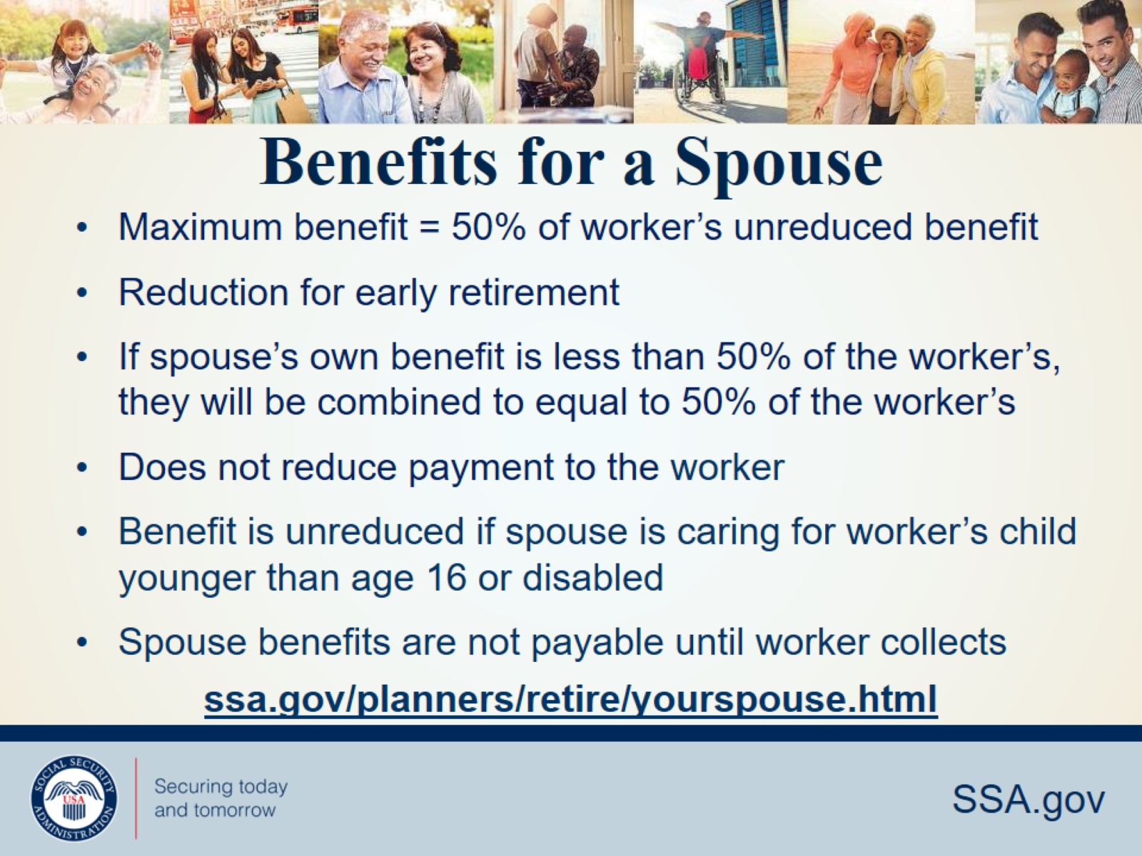
Benefits for a Spouse
Notes:
IN ADDITION TO THE RETIREE – BENEFITS ARE AVAILABLE ON YOUR RETIREMENT RECORD FOR FAMILY MEMBERS –
Spousal benefits were intended for the spouse who has not worked outside the home or who has considerably lower earnings.
A SPOUSAL BENEFIT IS A 50% BENEFIT –
The benefit is only payable if the claiming spouse’s own FULL RETIREMENT BENEFIT, based on their earnings history, is less than 50% of the worker’s FULL RETIREMENT BENEFIT.
REDUCED FOR EARLY RETIREMENT
A SPOUSAL BENEFIT DOES NOT REDUCE THE PAYMENT TO THE WORKER AND
SPOUSAL BENEFITS ARE NOT PAYABLE UNTIL THE WORKER IS ALSO COLLECTING his/her BENEFIT.
If you are eligible for both your own retirement benefits and for benefits as a spouse, we always pay your own benefits first. If your benefits as a spouse are higher than your retirement benefits, you will get a combination of benefits equaling the higher spouse benefit.

Slide 10
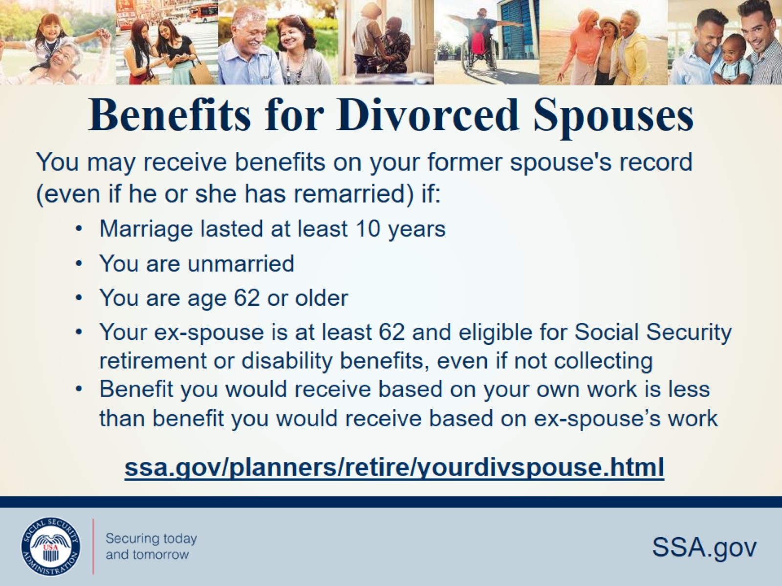
Benefits for Divorced Spouses
Notes:
SIMILAR TO A SPOUSAL BENEFIT, (AGE & COMP)
A DIVORCED SPO MUST BE AGE 62 OR OLDER IN ORDER TO BE ELIGIBLE AND
A DIVORCED SPOUSAL BENEFIT IS A 50% BENEFIT
Additional criteria for A DIV SPO include -
DURATION OF Marriage must have BEEN 10 years or longer
DIV SPO MUST BE UNMARRIED
Divorced for at least two years
AND last - A significant difference-
THE ex-spouse whose record you are drawing on DOES NOT HAVE TO BE RECEVING A SOCIAL SECURITY BENEFIT IN ORDER FOR A DIV SPO to be payable, THEY SIMPLY HAVE TO BE 62 YEARS OF AGE OR OLDER,

Slide 11
Auxiliary Benefits for Children
A child must have:
  A parent who’s disabled or retired and entitled to Social Security benefits; or
  A parent who died after having worked long enough in a job where they paid Social Security taxes.
The child must also be:
Unmarried;
Younger than age 18;
18-19 years old and a full-time student (no higher than grade 12); or
18 or older and disabled. (The disability must have started before age 22.)
Notes:
SOCIAL SECURITY ALSO PAYS BENEITS TO CHILDREN -
Your child can get benefits if they’re your biological child, adopted child, or dependent stepchild. (IN CERTAIN SITUATIONS, A child could also be eligible for benefits on their grandparents’ earnings.)
For a child to receive benefits -
(criteria above)
In a life case, a child can receive up to half of the parent’s full retirement or disability benefit.
If a child receives survivors benefits, they can receive up to 75 percent of the deceased parent’s full Social Security benefit.
There is a limit, however, to the amount of money that we can pay to a family. The family maximum

Slide 12

We’re There If You Lose A Loved One
Notes:
The loss of a loved one can be both emotionally and financially difficult.
Social Security provides a safety net to help if the unexpected happens.
Many children, widows, and widowers may receive survivors benefits to help them cope with the financial loss.

Slide 13
Survivor Eligibility Factors
Child | Can receive benefit if not married and under age 18 (or under age 19 if still in high school).
Disabled Child | Can receive benefits beyond age 18 if not married and was disabled before age 22.
Widow / Widower / Divorced Widow/er (Remarriage after age 60 will not affect benefits) | Can get full benefits at full retirement age – or reduced benefits at age 60 – or as early as age 50 if disabled – or at any age if caring for child under 16 or a disabled child.
Notes:
When you pass away, your family may be eligible for benefits based on your work record -
A child of a deceased worker can receive benefits if not married and under age 18 (or under age 19 if still in high school).
A disabled child can receive benefits beyond age 18 if not married and was disabled before age 22.
Your child can get benefits if they’re your biological child, adopted child, or dependent stepchild.
A child can receive up to half (50%) of the parent’s full retirement or disability benefit.
If a child receives survivors benefits, they can get up to 75 percent of the deceased parent’s basic Social Security benefit.
A widow or widower can get full benefits at full retirement age – or reduced benefits at age 60 – or as early as age 50 if disabled – or at any age if caring for child under 16 or a disabled child.
The length of marriage requirement for a widow or widower to be eligible for benefits is 9 months, and for a surviving divorced spouse it is 10 years. There are exceptions to the duration of marriage requirements.
Generally, you cannot get widow or widower benefits if you remarry before age 60. But remarriage after age 60 (or age 50 if you are disabled) will not prevent you from getting benefit payments based on your former spouse’s work. Also, at age 62 or older, you may get benefits based on your new spouse’s work, if those benefits would be higher.

Slide 14
Spouse vs. Surviving Spouse Benefits
Spouse (living) | Surviving Spouse (deceased)
May start as early as age 62 | May start as early as age 60 or as early as 50 if disabled
50% if you wait until FRA or later | 71.5% at age 60, increases each month you wait
Less than 50% if you start before FRA (reduction for each month you take benefit early) | 100% if you start at FRA or later
Certain conditions must be met.
ssa.gov/planners/survivors/ifyou.html#h6
Notes:
Note: Divorced spouses qualify if marriage lasted at least 10 years and other conditions are met.
Here is a side-by-side comparison of spousal and survivor benefits.
The worker and his or her spouse must be married for one year (continuously) immediately before the day on which the application is filed.
(Note: The one-year requirement can be waived if the spouse is the natural mother or father of the worker’s biological child or if the spouse was entitled or potentially entitled to certain auxiliary or survivor’s benefits in the month before the month of marriage to the worker).
If a spouse is caring for a child under age 16 of the worker, the spouse could qualify regardless of age. When the youngest child turns 16, the spouse’s benefit will stop, even though the child’s benefit will continue. However, if the child is disabled, the spouse’s benefits will continue as long as the child is under his or her care.
Slide updated 9/2/2020 (JP)

Slide 15
Choosing Between Retirement Benefits and Widow’s Benefits
You can switch to retirement on your own record as early as age 62 if that benefit is higher than your surviving spouse’s benefit.
OR
You can take retirement as early as age 62, then switch to surviving spouse’s at full retirement age if benefit is higher.
Notes:
If you begin receiving survivor benefits, we recommend that you contact us at age 62 to see if you are eligible for a higher benefit on your own record.
If we calculate your retirement benefit and it is lower than what you are already receiving as a survivor, then we are not going to switch you to over to retirement and reduce your monthly benefit. Remember, retirement and survivor benefits both fall under the same umbrella of financial protection offered by Social Security.
However, if we calculate your retirement and it is higher than what you are already getting as a survivor, YOU HAVE A CHOICE.
You can either switch over immediately for the higher monthly payment, or you can stay on survivor benefits and switch over to retirement later on down the road … when something comes up and you need more money coming in … or as late as age 70 if you want to completely max-out your retirement (by getting all possible delayed retirement credits added to your calculation).
Contact Social Security to find out if you can switch to get a higher benefit amount. SSA will review your individual situation and make a determination.
Slide updated 9/2/2020 (JP)

Slide 16
Other Survivor Benefits
Lump Sum Death Payment – A surviving spouse or child may receive a one-time lump-sum death payment of $255.00 if they meet certain requirements.
socialsecurity.gov/survivors
Notes:
We also have two other types of survivor benefits:
The first is Parents’ Benefits. For a parent who is age 62 and was receiving at least one-half of his or her financial support from the son or daughter who died. Although parents’ benefits are included in our survivor benefit program, the number of people who receive Parents’ Benefits is relatively small.
A surviving spouse or child may receive a one-time lump-sum death payment of $255.00 if they meet certain requirements.
For more information, go to SocialSecurity.gov and type in lump-sum death payment https://www.ssa.gov/planners/survivors/ifyou7.html
You may have seen misleading TV advertising that implies that the only benefit payable is the Lump Sum Death Payment, when in fact there may be a monthly widow or widower’s benefit available. Be sure to review the information about survivors benefits on our webpage.

Slide 17
Working While Receiving Benefits
If you are | You can make up to | If you earn more, some benefits will be withheld
Under Full Retirement Age | $22,320/yr. | $1 for every $2
The Year Full Retirement Age is Reached | $59,520/yr. before month of full retirement age | $1 for every $3
Month of Full Retirement Age and Above | No Limit | No Limit
Retirement Earnings Test Calculator:
ssa.gov/OACT/COLA/RTeffect.html
Notes:
The first thing we recommend is that you visit ssa.gov/pubs and search for the publication entitled, How Work Affects Your Benefits. It explains the rules you must follow in order to avoid an overpayment, and it gives some great examples for different scenarios that could apply to your individual situation.
You can get Social Security retirement or survivors benefits and work at the same time. However, if you’re younger than full retirement age, and earn more than certain amounts, your monthly benefit remains the same but the total amount of benefits you receive for the year will be reduced. The amount that your annual benefits are reduced, however, isn’t truly lost. Your monthly benefit will be increased at your full retirement age to account for benefits withheld due to earlier earnings.
Note that spouses and survivors who receive benefits because they have minor children or children in their care with a disability, don’t receive increased benefits at full retirement age if benefits were withheld because of work. I should also mention that different rules apply if you work outside the United States. Contact us if you’re working (or plan to work) outside the country.
But for most of you, here’s how this works. If you work, and are full retirement age or older, you may keep all of your benefits, no matter how much you earn.
If you’re younger than full retirement age, there is a limit to how much you can earn and still receive full Social Security benefits. If you’re younger than full retirement age, we must deduct $1 from your benefits for each $2 you earn above the annual limit. For 2024, that limit is $22,320.
If you reach full retirement age during 2024, we must deduct $1 from your benefits for each $3 you earn above $59,520 until the month you reach full retirement age.
Starting with the month you reach full retirement age, there is no limit on how much you can earn and still receive all of your Social Security benefits.
Note: If some of your retirement benefits are withheld because of your earnings, your benefits will be increased starting at your full retirement age to take into account those months in which benefits were withheld.
Source: OISP/OAESP
ssa.gov/pubs/EN-05-10069.pdf (How Work Affects Your Benefits)
Slide and Speaker Notes updated 11/6/2023 OAESP (SY)

Slide 18

What Income Counts Towards
the Earnings Test Limits
Income that Counts as Earnings
Gross wages from employment
and/or net earnings from self employment
Income that Does NOT Count as Earnings
Inheritance payments
Pensions
Income from investments
Interest and dividends
Capital gains
Other sources

Slide 19





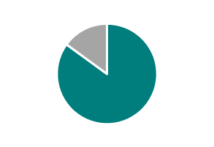
Taxation of Social Security Benefits
If you:
file a federal tax return as an "individual" and your combined income* is
  between $25,000 and $34,000, you may have to pay income tax on up to 50 percent of your benefits.
  more than $34,000, up to 85 percent of your benefits may be taxable.
file a joint return, and you and your spouse have a combined income* that is
  between $32,000 and $44,000, you may have to pay income tax on up to 50 percent of your benefits
  more than $44,000, up to 85 percent of your benefits may be taxable.
are married and file a separate tax return, you probably will pay taxes on your benefits.
  Your adjusted gross income
  + Nontaxable interest
  + ½ of your Social Security benefits
  = Your "combined income“
No one pays federal income tax on more than 85 percent of his or her Social Security benefits, based on Internal Revenue Service (IRS) rules
Visit IRS.gov and search for Publication 554, Tax Guide for Seniors, and Publication 915,
Social Security And Equivalent Railroad Retirement Benefits
Notes:
Some people have to pay federal income taxes on their Social Security benefits. This usually happens only if you have other substantial income (such as wages, self-employment, interest, dividends and other taxable income that must be reported on your tax return) in addition to your benefits.
Every January you will receive a Social Security Benefit Statement (Form SSA-1099) showing the amount of benefits you received in the previous year. You can use this Benefit Statement when you complete your federal income tax return to find out if your benefits are subject to tax.
If you lost or misplaced your SSA-1099, you can go online and request an instant replacement form with a my Social Security account at http://www.socialsecurity.gov/myaccount. The online replacement form is available beginning February 1, 2017.
For more information, call IRS at 1-800-829-3676.

Slide 20
The Windfall Elimination Provision (1983)
Before 1983, people whose primary job wasn’t covered by Social Security had their Social Security benefits calculated as if they were long-term, low-wage workers.
They had the advantage of receiving a Social Security benefit representing a higher percentage of their earnings, plus a pension from a job for which they didn’t pay Social Security taxes.
Congress passed the Windfall Elimination Provision in 1983 to remove that advantage.
ssa.gov/planners/retire/wep.html
Notes:
Prior to the 1983 Amendments when workers spent most of their careers in government jobs where they did not pay Social Security taxes (non-covered employment), they received the equal benefits of the weighted benefit formula. These workers, based on their Social Security earnings record, appeared to be low wage earners; primarily because the majority of their wages were not covered for Social Security purposes. These federal, state, or local employees effectively were receiving a windfall from Social Security.
The 1983 Amendments rectified this windfall. Since they had their 40 credits, they will continue to be eligible for a Retirement benefit, but their benefit will be computed differently. The benefit formula is identical to the normal computation with the exception of the first level of the formula. Instead of receiving 90% of the first level, they may receive as low as 40% of the first level based on the number of years of substantial earnings (see next slide).
A provision that can affect how we calculate your retirement or disability benefit.
WEP uses a formula to adjust the Social Security benefits for people who receive “non–covered pensions” and qualify for Social Security benefits based on other Social Security–covered earnings
If you work for an employer who doesn’t withhold Social Security taxes from your salary, such as a government agency or an employer in another country, any pension you get from that work can reduce your Social Security benefits.
This provision can affect you when you earn a pension from an employer who didn’t withhold Social Security taxes and you qualify for Social Security retirement or disability benefits from work in other jobs for which you did pay taxes.
If any part of your government pension is based on wages not covered by Social Security, then WEP will apply

Slide 21
Normal Benefit Computation Example
If your average indexed monthly earnings (AIME) = $2,500
Then your monthly benefit would be = $1,446
90% of First $1,115 | $1,115 | = $1,003.50
32% of earnings between $1,115 and $6,721 ($2,500 - $1,115 = $1,385) | $1,385 | = $443.20
15% of Earnings over $6,721 | $0 | $0
Total monthly benefit | $2,500 | $1,446.70
Notes:
Here is a worker without the windfall applied.
We will keep this slide but apply the windfall elimination provision in the next slide.
Explain in the next slide, not here.

Slide 22
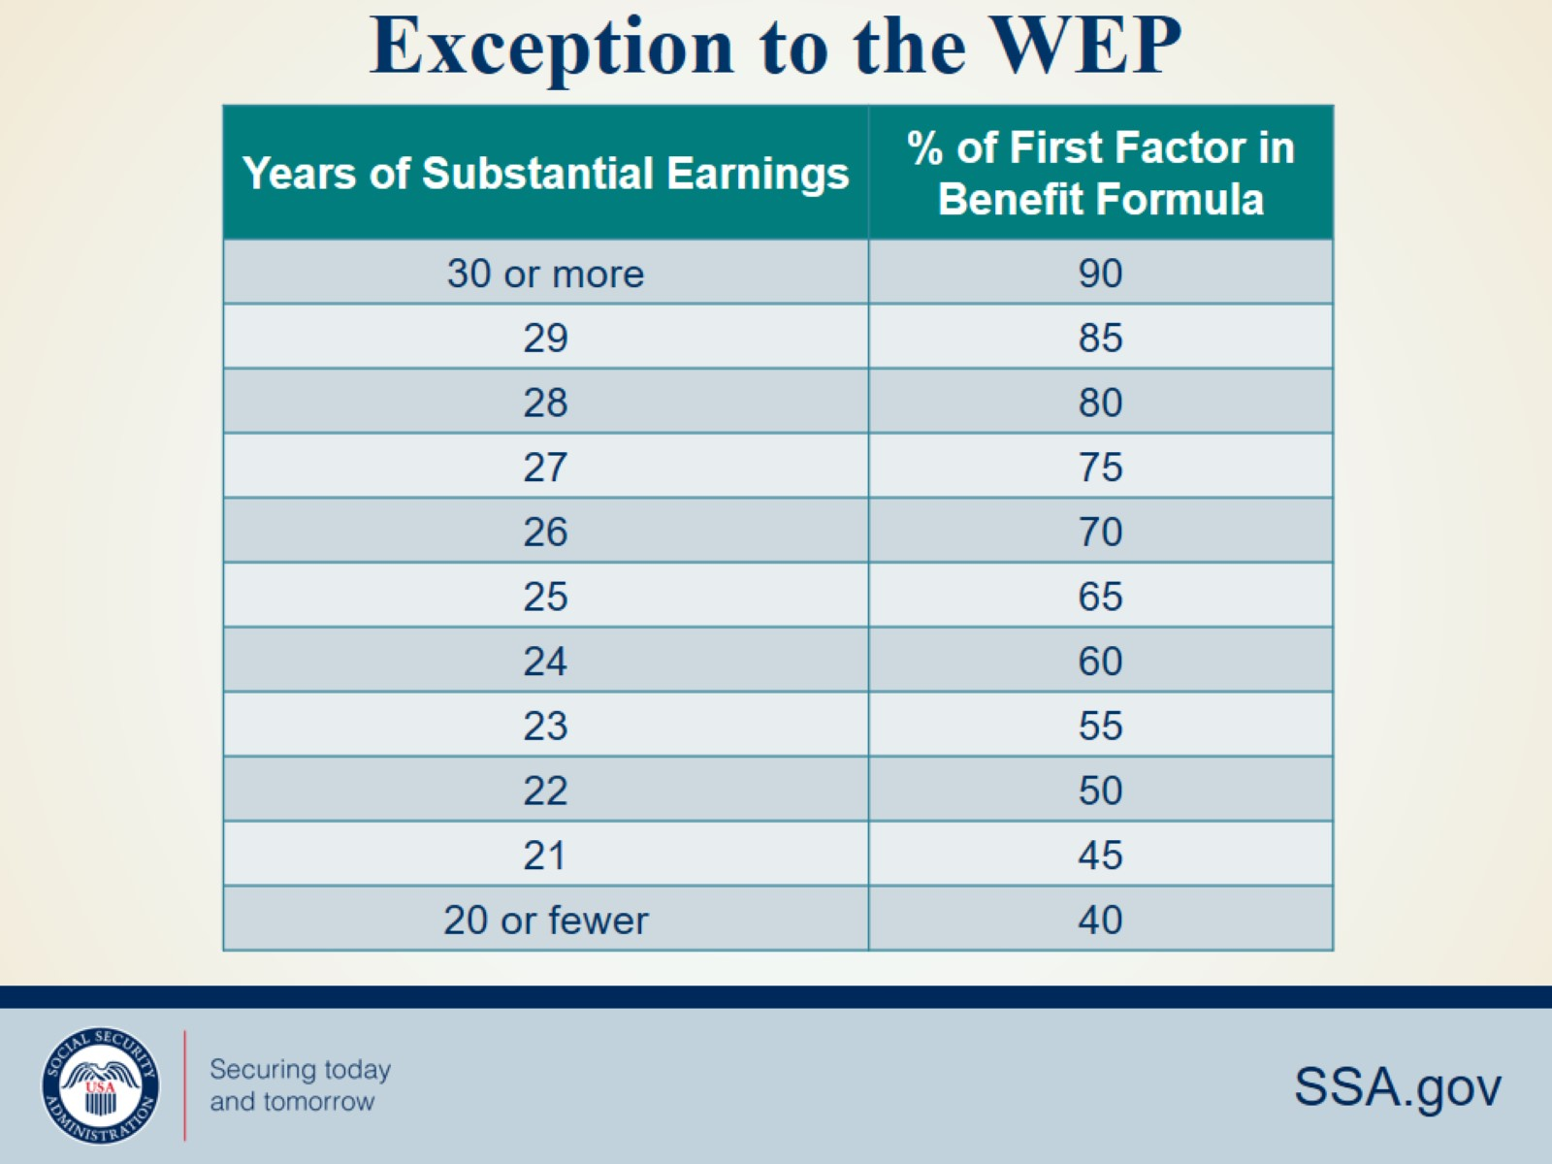
Exception to the WEP
Notes:
If you have 30 or more years of substantial earnings, we don’t reduce the standard 90% factor in our formula.
2023: 29,700 YOC // 2022: 27,300 YOC

Slide 23
WEP Benefit Computation Example
If your average indexed monthly earnings (AIME) = $2,500
Then your monthly benefit would be = $1,446 $889
90% 40% of First $1,115 | $1,115 | = $1,003.50 $446.00
32% of earnings between $1,115 and $6,721 ($2,500 - $1,115 = $1,385) | $1,385 | = $443.20
15% of earnings over $6,721 | $0 | $0
Total monthly benefit | $2,500 | $1446.70 $889.20
Notes:
Under the provision, we reduce the 90 percent factor in our formula and phase it in for workers who reached age 62 or became disabled between 1986 and 1989. For people who reach 62 or became disabled in 1990 or later, we reduce the 90 percent factor to as little as 40 percent.
558 Max WEP adjustment.
Source: OCACT
Slide updated: 11/23/2022 (JP)

Slide 24

Government Pension Offset
  A type of benefit reduction that may affect some spouses and widows or widowers
  If you receive a government pension based on work not covered by Social Security, your SS spouse’s or widow(er)’s benefits may be reduced.
socialsecurity.gov/gpo
Notes:
If you receive a pension from a federal, state, or local government based on work for which you didn’t pay Social Security taxes, we may reduce your Social Security spouses or widows or widowers benefits. We have a publication that provides answers to questions you may have about the reduction. It is available at SocialSecurity.gov/gpo.
We’ll reduce your Social Security benefits by two-thirds of your government pension. In other words, if you get a monthly civil service pension of $600, two-thirds of that, or $400, must be deducted from your Social Security benefits. For example, if you’re eligible for a $500 spouses, widows or widowers benefit from Social Security, you’ll get $100 a month from Social Security ($500 – $400 = $100).
Benefits we pay to spouses, widows, and widowers are “dependent’s” benefits. Set up in the 1930s, these benefits were to compensate spouses who stayed home to raise a family and were financially dependent on the working spouse. It’s now common for both spouses to work, each earning their own Social Security retirement benefit. The law requires a person’s spouse, widow, or widower benefit to be offset by the dollar amount of their own retirement benefit.
If you receive a pension based on work not covered by Social Security, your spouse’s, widow’s, or widower’s benefits may be reduced by the Government Pension Offset, or GPO.
To estimate your future benefits under GPO, use our Online GPO calculator at www.socialsecurity.gov/calc-gpo.

Slide 25
Government Pension Offset
2/3 of amount of non-covered pension will be used to reduce the Social Security spouse’s/widow(er)’s benefits.
Examples:
$1200 Non-covered Pension
2/3 = $800
If Social Security spouse’s or widow(er)’s benefit = $750,
no benefit payable due to offset
If Social Security spouse’s or widow(er)’s benefit =$1000,
$200 would be payable after offset
socialsecurity.gov/gpo

Slide 26
WEP/GPO Comparison Chart
WEP | GPO
Applies when you have 40 credits plus a non-covered pension and you’re filing for retirement or disability benefits | Applies when you are receiving a non-covered pension and filing for spouses, widows or widower’s benefits
Would never reduce a benefit to zero | Could reduce to zero
Change in computation | Offset

Slide 27
Medicare
Original Medicare | Medicare Advantage (aka Part C)
Part A (Hospital Insurance) Part B (Medical Insurance) | Part A (Hospital Insurance) Part B (Medical Insurance)
You can add: Part D (Prescription Drug Plan) | Most plans include: Part D (Prescription Drug Plan) Extra Benefits (e.g., vision, hearing, dental, and more)
You can also add: Supplemental insurance coverage (Medigap) | Some plans also include: Lower out-of-pocket costs
Medicare.gov
Notes:
Medicare is our country’s health insurance program for people age 65 or older. People younger than age 65 with certain disabilities, or permanent kidney failure, or amyotrophic lateral sclerosis (Lou Gehrig’s disease), can also qualify for Medicare. You have choices for how you get Medicare coverage – Original Medicare and Medicare Advantage.
Original Medicare includes Hospital (Part A) and Medical (Part B) insurance. If you want drug coverage, you can add a separate drug plan (Part D). You can also add a Medicare Supplement Insurance (Medigap) policy to help pay your out-of-pocket costs.
A Medicare Advantage Plan is an all-in-one alternative to Original Medicare. These "bundled" plans include Part A, Part B, and usually Part D. Most plans offer extra benefits— like vision, hearing, dental, and more.
==============
Medicare has 4 parts:
1. Part A is Hospital Insurance which covers most inpatient hospital expenses. The 2023 deductible for Part A is $1600.
2. Part B is Medical Insurance which covers 80% of doctor bills & other outpatient medical expenses after your first $226 in approved charges. The 2023 standard monthly premium is $164.90. There is no monthly premium for Part A if you are insured for retirement benefits. After you retire, your health insurance may require for Medicare to pay first. Many supplemental plans require you to sign up for Medicare Part B. The Medicare premium most beneficiaries pay represents 1/4 of the actual cost, and the Federal government covers the balance of the cost.
3. Medicare Advantage—also known as Part C— is an “all in one” alternative to Original Medicare. These “bundled” plans include Part A, Part B, and usually Part D. These plans may also have lower out-of-pocket costs and may offer extra benefits that Original Medicare doesn’t cover— like vision, dental, and more.
4. Part D is Medicare Prescription Drug coverage, which covers a major portion of your prescription drug costs. Your out-of-pocket costs—monthly premiums, annual deductible and prescription co-payments—will vary by plan. You enroll with a Medicare-approved prescription drug provider, not by contacting Social Security. Each Medicare Advantage plan can charge different out-of-pocket costs, but they must follow rules established by Medicare. Medicare-approved prescription drug plans cover a major portion of your prescription drug costs.
Learn more with our publication, Medicare, 05-10043. To learn more about Original Medicare, Medigap, or Medicare Advantage plans, visit medicare.gov/Publications/ to view CMS’ publication Choosing a Medigap Policy, Publication 02110, and Understanding Medicare Advantage Plans, Publication 12026.
Source: https://www.medicare.gov/basics/costs/medicare-costs
Speaker notes updated OISP/OEEMP 10/13/2022 (SY/JP)
Speaker notes updated 12/6/2022 (SY/JP)

Slide 28
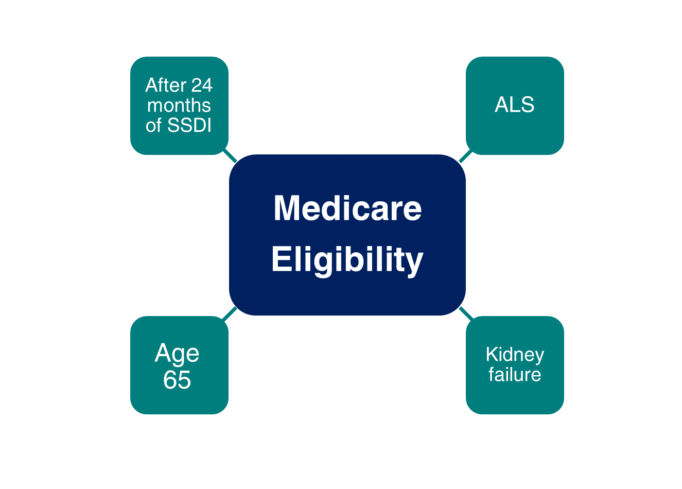
Medicare Eligibility
Notes:
Remember that although the full retirement age has increased above age 65, Medicare eligibility is still age 65. One of the most important things to remember is that you can apply for Medicare online, even if you are waiting past age 65 to apply for Social Security retirement benefits.
You should apply for Medicare 3 months before your 65th birthday, even when you plan to apply for your retirement or spouse’s benefits later.
If you are approved for Social Security disability benefits, you will be eligible for Medicare benefits 24 months from the month you were entitled to receive benefits, not from the first month you receive a payment.
If you are diagnosed with amyotrophic lateral sclerosis (Lou Gehrig’s disease) and you get disability benefits, you can get Medicare right away.
If you have permanent kidney failure and you receive maintenance dialysis or a kidney transplant – you may also be eligible for Medicare.
*Note to speaker: If an audience member asks about Medicare based on exposure to environmental health hazards,
provide this link: ssa.gov/OP_Home/ssact/title18/1881A.htm or HI 00803.001 https://secure.ssa.gov/poms.nsf/lnx/0600803001
Updated – OISP/OEEMP 10/13/2022 (SY/JP)
Speaker Notes updated 12/6/2022 (SY/JP)

Slide 29
Medicare
Enrollment
Initial Enrollment Period
Begins 3 months before your 65th birthday and ends 3 months after that birthday
Special Enrollment Period
If 65 or older, you & your spouse are still working, and you are covered under a group health plan
General Enrollment Period
January 1 – March 31
Notes:
Medicare has three enrollment periods:
Initial Enrollment Period-- your initial enrollment period has a 7-month enrollment period. It begins three months before your 65th birthday, includes the month you turn age 65, and ends three months after that birthday.
Special Enrollment Period-- If you are age 65 or older, you or your spouse are still working and you are covered under a group health plan based on that current employment, you may not need to apply for Medicare medical insurance (Part B) at age 65. You may qualify for a "Special Enrollment Period" (SEP) that will let you sign up for Part B a the time you retire.
General Enrollment Period - If you didn't sign up for Part A and/or Part B (for which you must pay premiums) when you were first eligible, and you aren’t eligible for a Special Enrollment Period, you can sign up during the General Enrollment Period between January 1–March 31 each year. You may have to pay a late enrollment penalty for as long as you have Part B coverage.

Slide 30
Medicare Part B Coverage - IEP
Beginning in 2023, if you enroll in the month of your Initial Enrollment Period: | Your Part B Medicare coverage starts:
One to three months before you reach age 65 | The month you turn age 65
The month you reach age 65, or one to three months after you reach age 65 | The first day of the month after you sign up
Notes:
This chart shows when your Medicare will become effective if you apply during your initial enrollment period.
If you apply during the 3-month window prior to the month you turn age 65, your Medicare is effective on the 1st day of the month you reach age 65.
NOTE – Important change for 2023 - If you sign up in your Initial Enrollment Period during the last 3 months of your IEP, your coverage begins the month after you enroll.
Updated OISP/OEEMP 1/31/2023 (JP/SY)

Slide 31
Medicare Part B Coverage - SEP
If you enroll in the month of your Special Enrollment Period: | Your Part B Medicare coverage starts:
Any time while you or your spouse have a group health plan based on current employment, or during the first full month you are no longer covered or employed | • On the first day of the month you enroll, or • By your choice, on the first day of any of the following 3 months
During any of the remaining 7 months of the SEP | The first day of the month after you sign up.
Notes:
You may have medical insurance coverage under a group health plan based on your or your spouse's current employment. In this case, you may not need to apply for Medicare Part B at age 65. You may qualify for an "SEP”.
If you apply online for Medicare Part A only – and refuse Part B (which does have a monthly premium) – you can enroll in Part B later anytime you are still covered by your employer’s group health plan or within 8 months after your coverage or employment ends.
Updated OISP/OEEMP 1/31/2023 (JP/SY)

Slide 32
Medicare Part B Coverage - GEP
Beginning in 2023, if you enroll in the month of the General Enrollment Period: | Your Part B Medicare coverage starts:
January 1 to March 31 (You might pay a late enrollment penalty) | The first day of the month after you sign up
Notes:
If you choose not to sign up for Medicare Part B but then decide to do so later, your coverage could be delayed. You may have to pay a higher monthly premium for as long as you have Part B. Your monthly premium will go up 10% for each 12-month period you were eligible for Part B but didn’t sign up for it.
If you don’t sign up for Medicare Part B during your IEP, you have another chance each year to sign up during the “General Enrollment Period” (GEP) from January 1 through March 31. Your coverage starts the 1st day of the month after you sign up. Read our publication, “Medicare” for more information.
Publication: Medicare - ssa.gov/pubs/EN-05-10043.pdf
Updated OISP/OEEMP 1/31/2023 (JP/SY)

Slide 33

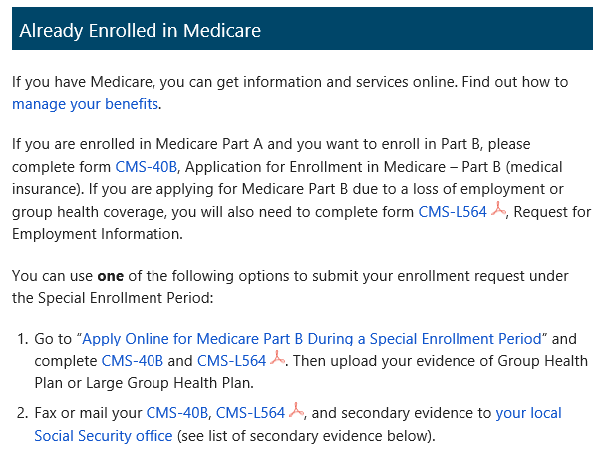
Medicare Applications
If you already have Medicare Part A and wish to add Medicare Part B, complete the online application, or fax or mail completed forms CMS-40B and CMS-L564 to your local Social Security office.
ssa.gov/benefits/medicare
Notes:
You can use our website to apply for Medicare Parts A and B along with Social Security retirement benefits. Most people apply for Medicare Part A along with their retirement benefits because you are required to enroll for Medicare Part A at the same time you start retirement benefits. (Medicare Part A has no monthly premium for those who have 40 work credits.) If you apply online for Medicare Part A only – and refuse Part B (which does have a monthly premium) – you can enroll in Part B later anytime you are still covered by your employer’s GHP or within 8 months after your coverage or employment ends, or during the General Enrollment Period (GEP), Jan-March of the current year. Your Part B coverage starts the first day of the month after you sign up.
If you don’t enroll in Medicare Part B during your initial enrollment period, you have another chance each year to sign up during a “general enrollment period” from January 1 through March 31. Your coverage begins the month after you enroll. Read our Medicare publication for more information – ssa.gov/pubs/EN-05-10043.pdf
If you are already enrolled in Medicare Part A and later you want to add Part B under the Special Enrollment Period, you have three options. You can visit ssa.gov/Medicare-PartB-SEP to complete the online application. You can also fax your completed CMS-40B, Application for Enrollment in Medicare – Part B (Medical Insurance) and CMS-L564 (Request for Employment Information), and proofs to your local Social Security office. Refer to HI 00805.295 Evidence of GHP or LGHP Coverage Based on Current Employment Status for secondary proofs if the CMS-L564 cannot be provided. Lastly, you can also mail your completed forms to your local Social Security office. The two forms are available on our homepage. Just click on the Forms button at the bottom of the page.
Field Office Locator: secure.ssa.gov/ICON/main.jsp
Speaker notes updated OISP/OEEMP 10/13/2022 (SY/JP)
Speaker notes updated 12/6/2022 (SY/JP)

Slide 34
Medicare Standard Part B Premiums for 2024
If you’re single and file an individual tax return, or married and file a joint tax return:
Modified Adjusted Gross Income (MAGI) | Part B monthly premium amount | Prescription drug plan monthly premium amount
Individuals with a MAGI of $103,000 or less Married couples with a MAGI of $206,000 or less | 2024 standard premium = $174.70 | Your plan premium + $0
Individuals with a MAGI above $103,000 up to $129,000 Married couples with a MAGI above $206,000 up to $258,000 | Standard premium + $69.90 | Your plan premium + $12.90
Individuals with a MAGI above $129,000 up to $161,000 Married couples with a MAGI above $258,000 up to $322,000 | Standard premium + $174.70 | Your plan premium + $33.30
Individuals with a MAGI above $161,000 up to $193,000 Married couples with a MAGI above $322,000 up to $386,000 | Standard premium + $279.50 | Your plan premium + $53.80
Individuals with a MAGI above $193,000 up to $500,000 Married couples with a MAGI above $386,000 up to $750,000 | Standard premium + $384.30 | Your plan premium + $74.20
Individuals with a MAGI equal to or greater than $500,000 Married couples with a MAGI equal to or greater than $750,000 | Standard premium + $419.30 | Your plan premium + $81.00
Notes:
This graphic shows the Medicare Part B and Part D premium amounts for each income bracket.
Most Medicare beneficiaries pay the standard premium for Part B - $174.70/month in 2024. It is automatically deducted from their Social Security check if they receive one.
If not getting a check, they can be billed or have the premium deducted from a checking or savings account.
People with higher incomes will pay more for Part B and their prescription drug plan premium. This is called IRMAA – Income Related Monthly Adjustment Amount.
We determine whether you pay the higher premium every year.
To decide your IRMAA, we ask the IRS for your Modified Adjusted Gross Income (MAGI). That equals your adjusted gross income + certain tax-exempt income from the federal income tax return you filed two years ago.
For example, your 2024 Part B premium is determined by your MAGI on your 2022 return. If your 2022 tax return is not available, we will use your 2021 tax return.
Health Savings Account (HSA) Information: You should not contribute to an HSA if you are enrolled in Medicare as there may be negative tax implications. Contact your tax professional for more information.
=====
Sources:
Part D premium amounts – see chart on the bottom: medicare.gov/drug-coverage-part-d/costs-for-medicare-drug-coverage/monthly-premium-for-drug-plans
Under Part B costs, select on “Who pays a higher Part B premium because of income?” to get the Part B premium amounts: medicare.gov/basics/costs/medicare-costs
IRMAA: https://secure.ssa.gov/poms.nsf/lnx/0601101035
Slide and Speaker Notes updated OISP/OEEMP 11/3/2023 (SY)

Slide 35
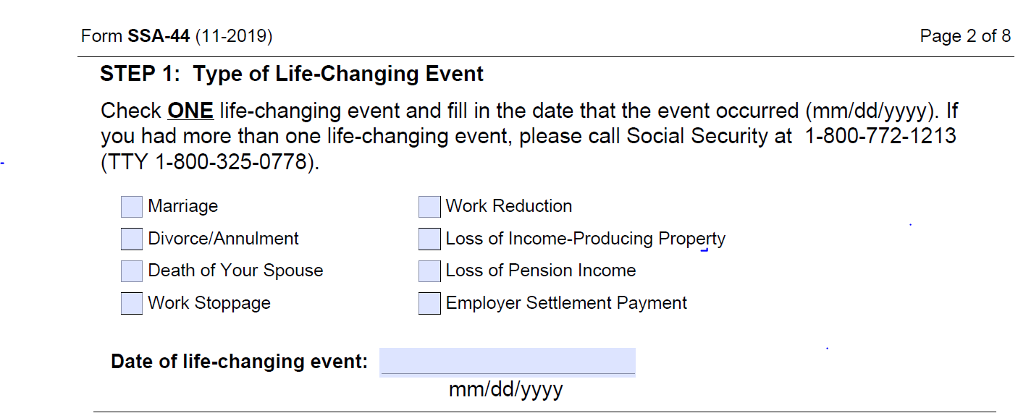
A Qualifying Life-Changing Event May Reduce Monthly Part B/D Premiums
ssa.gov/forms/ssa-44-ext.pdf
Notes:
If you are a higher-income Medicare beneficiary but you have had a major life changing event – you’ve stopped work or you have reduced your work, for example - and your income has decreased, you may ask Social Security to make a new determination on your premium.
Use form SSA-44 and provide proof of the life-changing event.

Slide 36
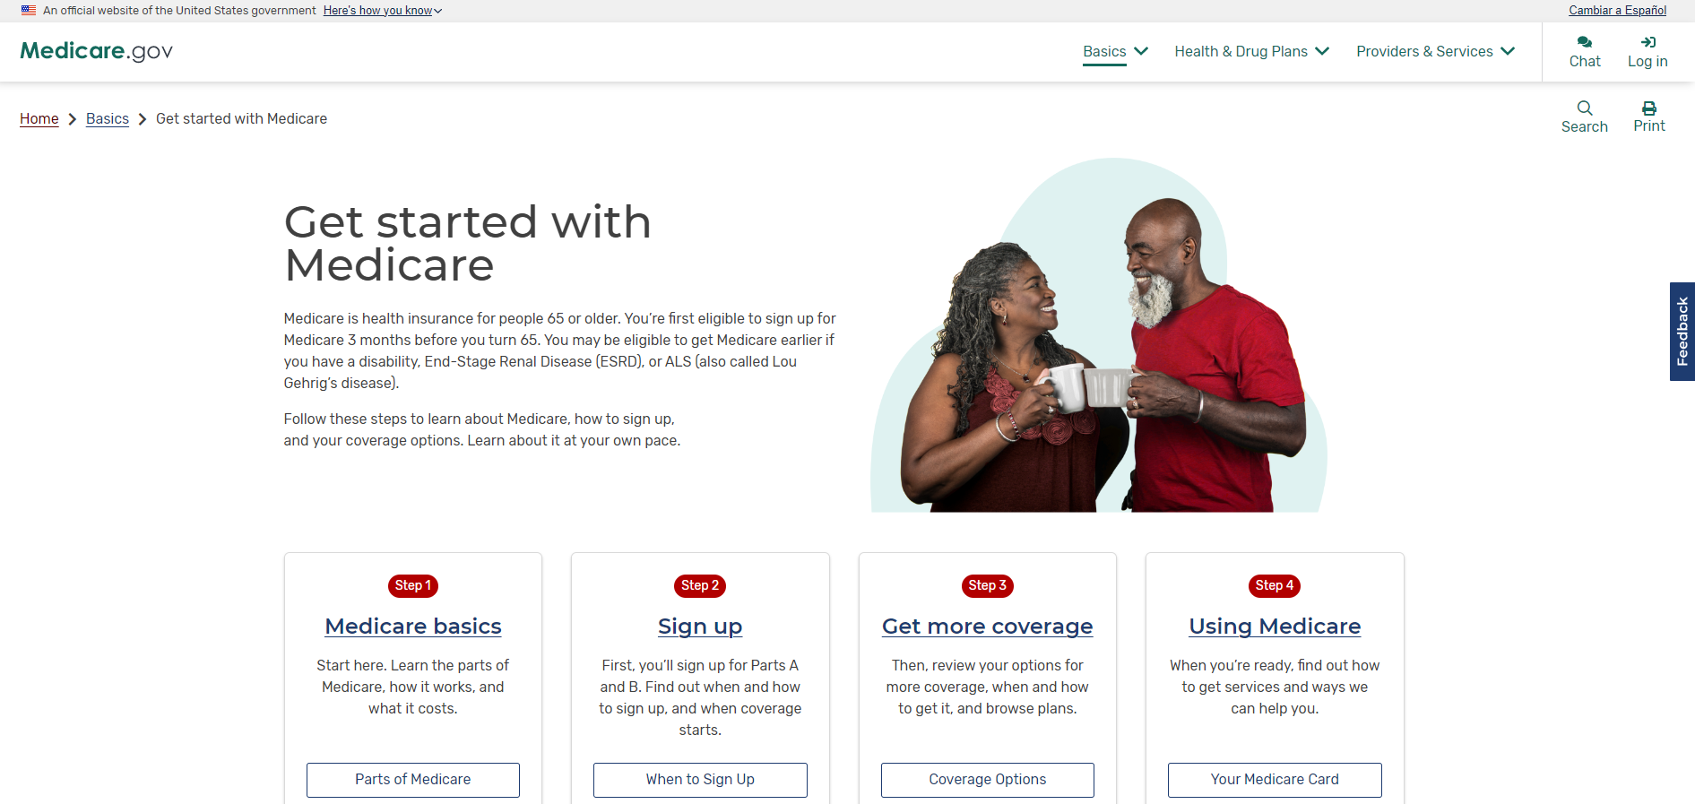
Medicare.gov
Create an account at Medicare.gov
Notes:
Medicare has a free, secure online service for accessing personalized information about your Medicare benefits and services with a Medicare.gov account. It is available at Medicare.gov.
After you create an account, you can fill out the Initial Enrollment Questionnaire (IEQ), view claims information, get quality information about your providers, and more.
For more information or help with the site, please contact the Centers for Medicare & Medicaid Services at 800-MEDICARE (800-633-4227).
Screenshot updated 10/13/2022 (SY/JP)

Slide 37
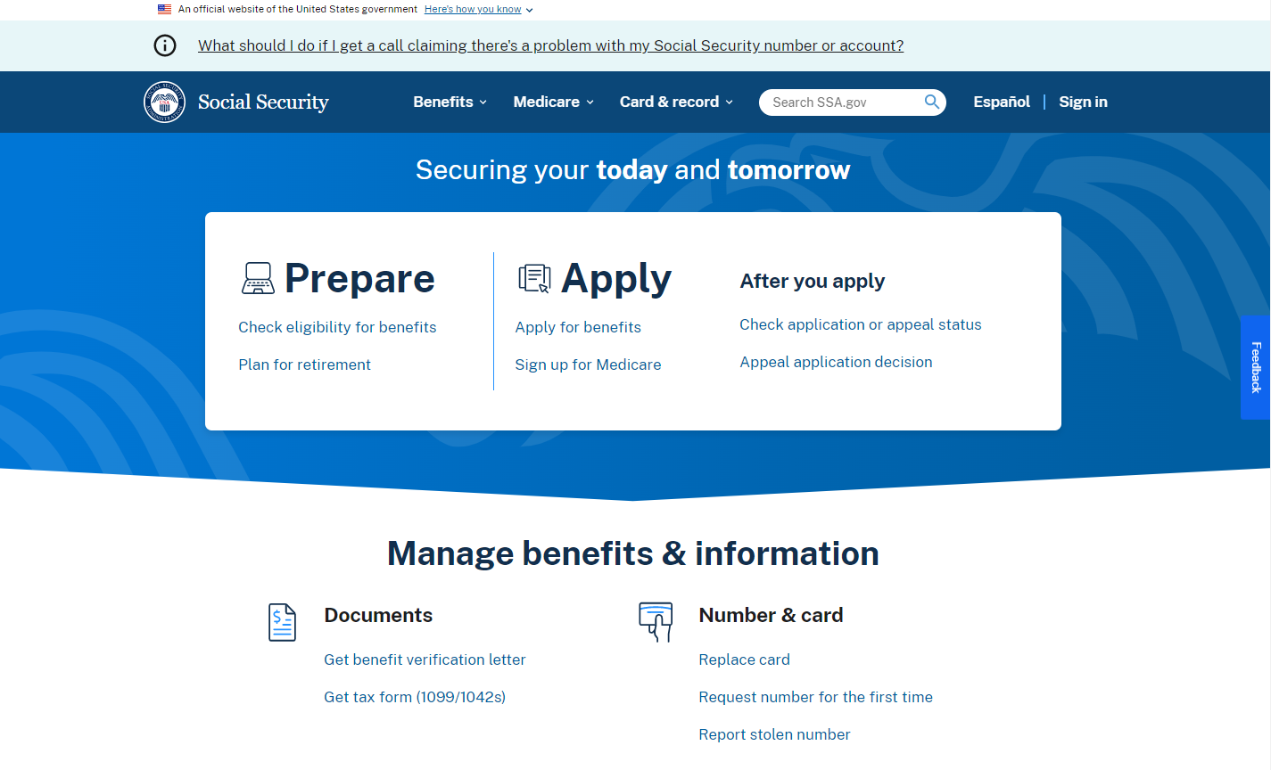
Social Security Website
Notes:
The Social Security website is a valuable resource of information about all of Social Security’s programs and is accessible from a computer, tablet and smartphone. We encourage you to use our online retirement planning tools to plan for a secure financial future.
Slide updated 12/6/2022 (SY/JP)

Slide 38

my Social Security
Notes:
my Social Security is a convenient and secure suite of services designed to put you in control of your personal Social Security information, as well as help you manage your benefits when you start receiving them. Your account gives you the information you need at your convenience - all without calling or visiting a local office.
You can only open a my Social Security account for yourself. You cannot open an account for another person, even if you have his or her written consent.
You may be unable to open a my Social Security account if you:
• Blocked electronic access to your personal Social Security information;
• Recently moved or changed your name; or
• Placed a freeze on your credit report.
Your online my Social Security account provides a variety of information to help you and your family.
Speaker notes updated (DRB) 6/8/2022 (JP/AJ)

Slide 39
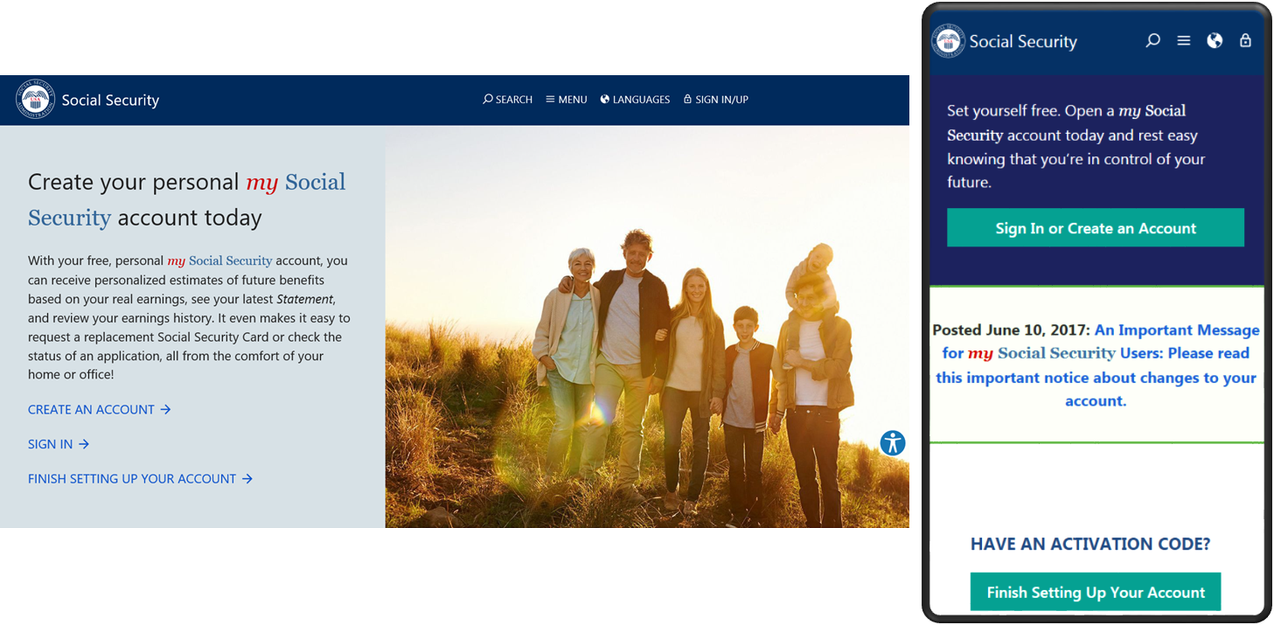
my Social Security
ssa.gov/myaccount
Notes:
my Social Security is a convenient and secure suite of services designed to put you in control of your personal Social Security information, as well as help you manage your benefits when you are ready. Your account gives you the information you need whenever you want. All without calling or visiting a field office.
You can only open a my Social Security account for yourself. You cannot open an account for another person, even if you have his or her written consent.
You may be unable to open a my Social Security account if you:
• Blocked electronic access to your personal Social Security information;
• Recently moved or changed your name; or
• Placed a freeze on your credit report.
Your online my Social Security account provides a variety of information to help you and your family. If you need help setting up your account, we have a 4-minute walkthrough video on our YouTube page.

Slide 40
my Social Security Services
If you receive benefits or have Medicare, you can:
  Opt out of mailed notices for those available online;
  Request a replacement Social Security card if you meet certain requirements;
  Report your wages if you work and receive Disability Insurance (SSDI) and/or Supplemental Security Income (SSI) benefits;
  Get a benefit verification letter as proof that you are getting benefits;
  Check your benefit and payment information and your earnings record;
  Change your address and phone number;
  Start or change direct deposit of your benefit payment;
  Submit your advance designation of representative payee request;
  Request a replacement Medicare card; and
  Get a replacement SSA-1099 or SSA-1042S for tax season.
Notes:
So what can you do with a my Social Security account? Your online my Social Security account provides a wealth of information to help you and your family plan for your financial future. If you receive benefits or have Medicare, you can:
Opt out of mailed notices for those available online;
Request a replacement Social Security card if you meet certain requirements;
Report your wages if you work and receive Disability Insurance (SSDI) and/or Supplemental Security Income (SSI) benefits;
Get a benefit verification letter as proof that you are getting benefits;
Check your benefit and payment information and your earnings record;
Change your address and phone number;
Start or change direct deposit of your benefit payment;
Submit your advance designation of representative payee request;
Request a replacement Medicare card; and
Get a replacement SSA-1099 or SSA-1042S for tax season.
Source: https://www.ssa.gov/myaccount/what.html#h1
Slide updatefd 5/19/2020 (JP)

Slide 41
my Social Security Services
If you do not receive benefits, you can:
  View retirement benefit estimates at different ages or dates when you want to start receiving benefits;
  View possible spouse’s benefits;
  Request a replacement Social Security card if you meet certain requirements;
  Check the status of your application or appeal;
  Get a benefit verification letter as proof that you are not getting benefits;
  Get your Social Security Statement to review:
    Estimates of your future retirement, disability, and survivor’s benefits;
    Your earnings record, to verify the amounts that we posted are correct; and
    The estimated Social Security and Medicare taxes you’ve paid.
  ssa.gov/myaccount/what.html
Notes:
If you receive benefits or have Medicare, you can:
Request a replacement Social Security card if you meet certain requirements;
Get your benefit verification letter;
Check your benefit and payment information and your earnings record;
Change your address and phone number;
Start or change direct deposit of your benefit payment;
Get a replacement Medicare card; and
Get a replacement SSA-1099 or SSA-1042S for tax season

Slide 42
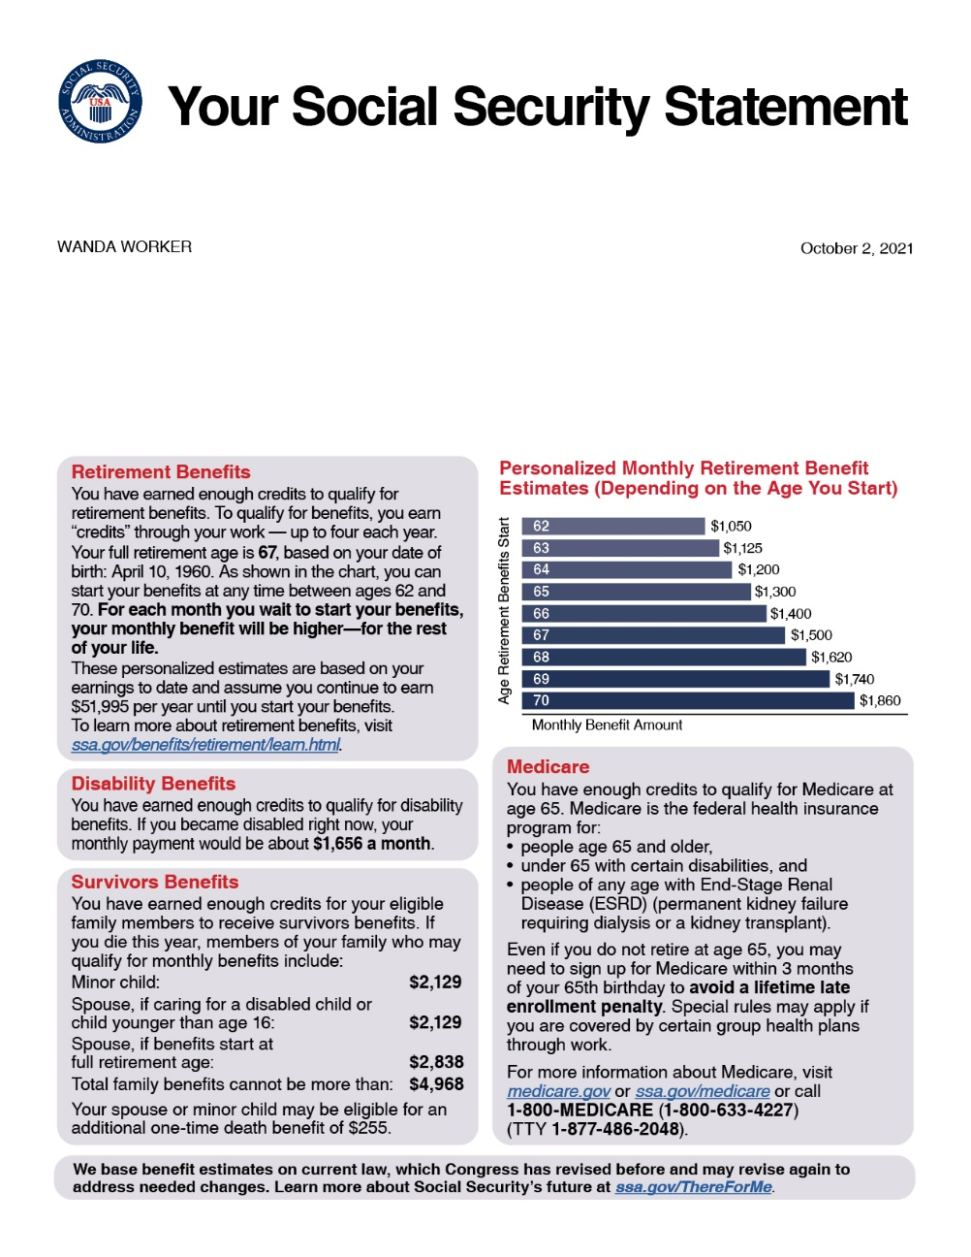
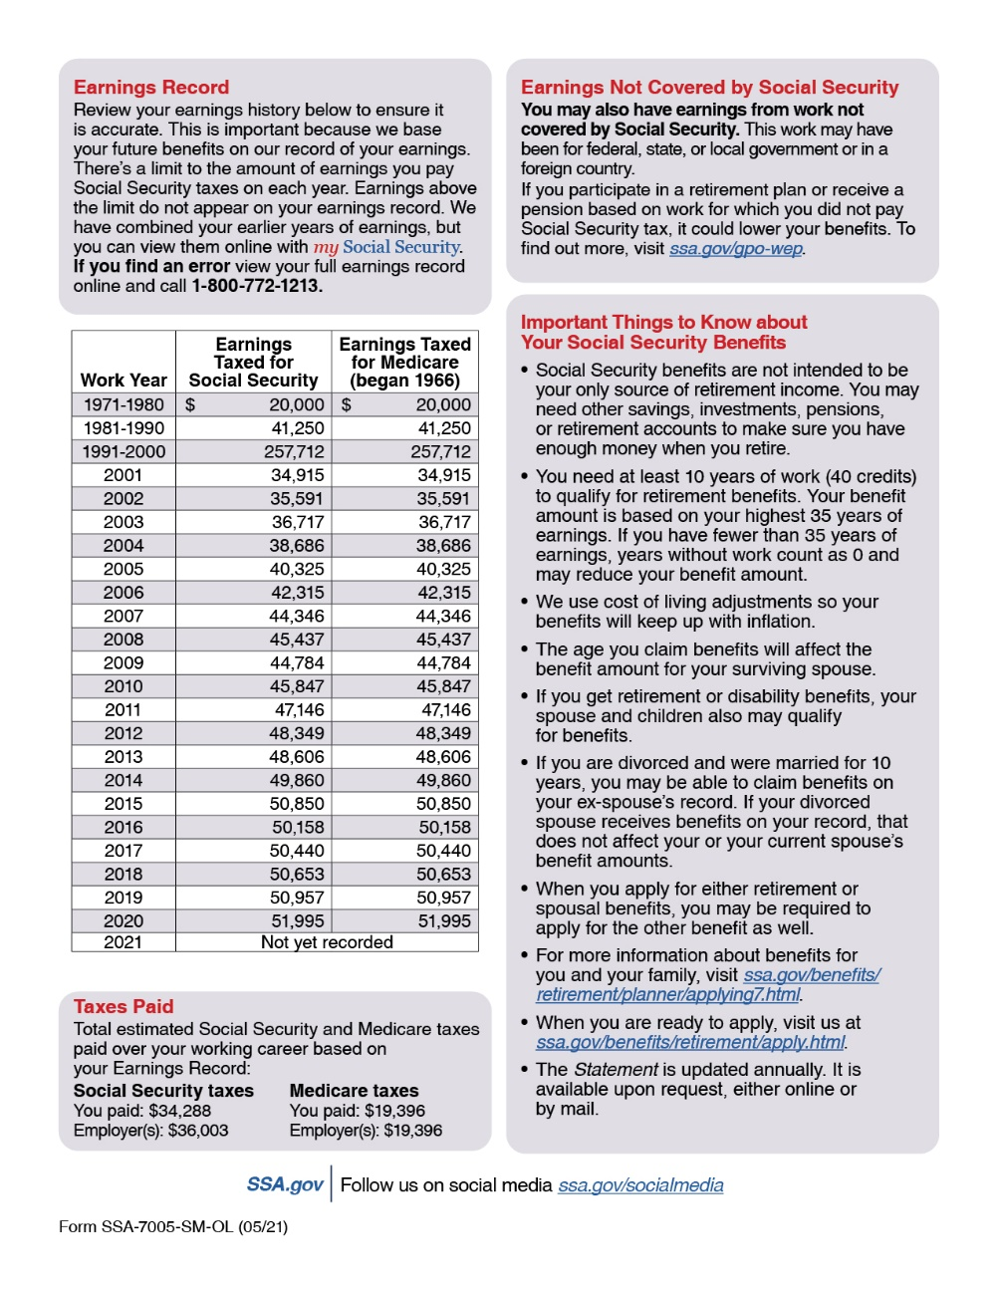

Slide 43
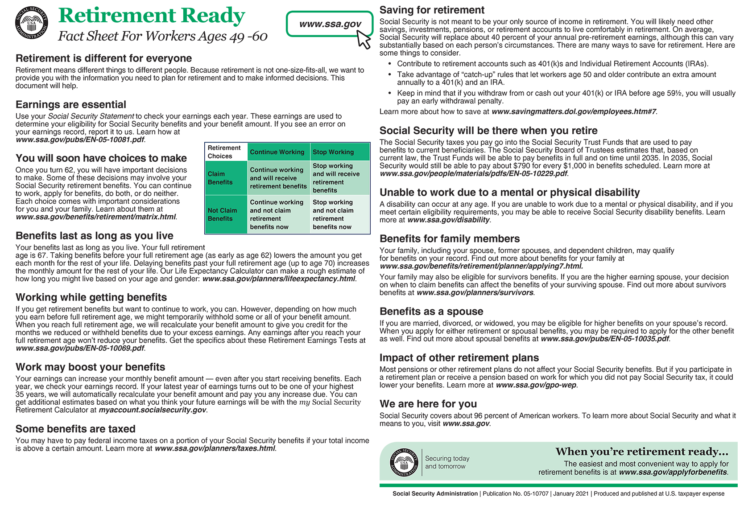
Fact Sheet for Workers Ages 49-60

Slide 44



How to Apply for Benefits
File online for Retirement, Spouse, Disability, or Medicare Only
If you are disabled, you can file for Retirement and Disability with same application if you are at least 62 but not yet FRA.
Survivor* application is not available online.
Schedule phone appointment at 1-800-772-1213
Schedule in-office appointment at 1-800-772-1213
*Child and survivor claims can only be done by phone or in office.
Notes:
You can apply for your Social Security within 4 months of when you want your benefits to begin.
You have three options, when it comes time to file:
Apply online at ssa.gov. This is the most convenient way to apply.
Call Social Security to schedule an appointment to apply over the telephone on a day and time that is convenient for you.
Call Social Security to schedule an appointment to apply in-person at your local Social Security office with a face-to-face interview.
You cannot file online for auxiliary child’s benefits, disabled adult child benefits, or survivors benefits.
Applying online is still the most convenient way to apply for benefits. You can apply for retirement benefits in as little as 15 minutes.

Slide 45

Questions?
If you have questions, a valuable resource on our website is our “FAQs”
or
Call Social Security toll-free at
1-800-772-1213
TTY 1-800-325-0778
7 am – 7 pm Monday – Friday
Automated Phone Service 24/7
Notes:
If you have questions, a valuable resource is our Frequently Asked Questions “FAQs” site at www.socialsecurity.gov/ask
or
Call Social Security toll-free at 1-800-772-1213. We provide automated phone service 24 hours a day. We can answer case specific questions from 7:00am—7:00pm, Monday through Friday.
Finally,

Slide 46
Thank You!
Notes:
Social Security is with you throughout life’s journey — from birth, to marriage, and into retirement. Social Security provides financial benefits, information, and tools to help you secure today and tomorrow.

