Slide 1
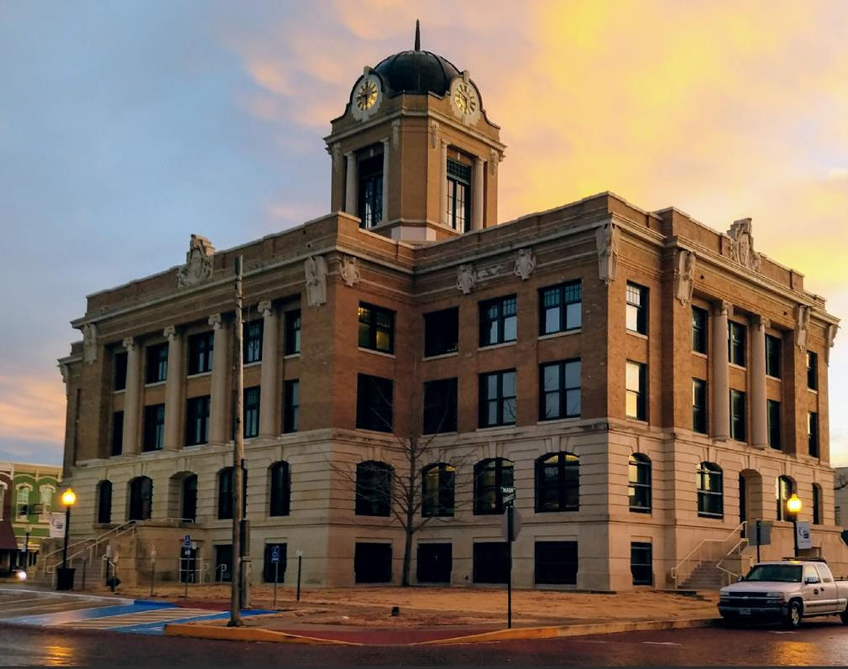
Basic
Purchasing
66th Annual County Auditors Institute

Slide 2
Overview
Terms
Local and State Laws
Ethics
PO Types
Bid Specifications
Vendor Compliance Bills
Purchasing Cooperattives
Assets
Online Guides and Resources

Slide 3
TERMS
Purchasing – the act, function, and responsibility for the acquisition of equipment, materials, services, and construction required by an organization to satisfy the needs of the requestor at the best value for the City while conforming to ethical business practices.
Requisition – an internal document the end user uses to request goods or services. The document used to identify need.
Purchase Order – a commercial document and first official offer issued by a buyer to a seller, indicating types, quantities, and agreed prices for products or services. A buyer-generated document that authorizes a purchase transaction. When accepted by the seller, it becomes a contract binding on both parties.
Purchasing Cooperative – a type of cooperative arrangement, often among businesses or governmental entities, to share procurement contracts. It helps to reduce the costs of procurement. (Examples – BuyBoard, HGAC, Optima)
)

Slide 4
TERMS
Invitation to Bid (ITB) and Request for Proposal (RFP) – a solicitation requesting submittal of a proposal response to the required specifications
Request for Qualifications (RFQ) – a solicitation requesting the submittal of a proposal response to the required specifications, but does not ask for a price. Typically used for a professional service.
Bid – an offer to contract with the County, submitted in response to an Invitation to Bid.
Proposal – an offer submitted by a vendor in response to a Request for Proposal where price can be negotiated with one vendor unless an agreement could not be reached. Then you move on to the next vendor.

Slide 5
LOCAL & STATE LAWS
COUNTY PURCHASING ACT – Local Government Code 262
Gives the Commissioners’ Court of a County the authority to establish how a County purchases services and commodities. This includes establishing the authority of the Purchasing Agent.
LGC 263 Sale or Lease of Property by Counties (specific to surplus)
LGC 271 Purchasing & Contracting Authority of Municipalities, Counties, and Certain Other Local Governments
LGC 272 Sale or Lease of Property by Municipalities, Counties & Certain other Local Governments
Government Codes – 2269, 2253, 2254, 2258

Slide 6
FEDERAL LAW
CODE OF FEDERAL REGULATIONS
2 CFR 200
TYPES OF FEDERAL / STATE FUNDS –
RESTORE ACT – US TREASURY
ARPA – AMERICAN RESCUE PLAN ACT – US TREASURY
GLO – GENERAL LAND OFFICE
TCEQ – TEXAS COMMISSION ON ENVIRONMENTAL QUALITY

Slide 7
Local Government Code
Sec. 113.901. REQUIREMENTS FOR APPROVAL OF ACCOUNTS AND REQUISITIONS. (a) Except as provided by Subsection (c), a county auditor may not audit or approve an account for the purchase of supplies or materials for the use of the county or of a county officer unless a requisition, signed by the officer ordering the supplies or materials and approved by the county judge, is attached to the account. The requisition requirement is in addition to any other requirements of law.
(b) The requisition must be made, signed, and approved in triplicate. The original must be delivered to the person from whom the purchase is to be made before the purchase is made. The duplicate copy must be filed with the county auditor. The triplicate copy must remain with the officer requesting the purchase. This subsection does not apply to a county that operates an electronic requisition system.
(c) The commissioners court of a county that has the office of county auditor may, by a written order, waive the requirement of the county judge's approval of requisitions. The order must be recorded in the minutes of the commissioners court. If the approval of the county judge is waived, all claims must be approved by the commissioners court in open court.
(d) The commissioners court of a county may establish an electronic requisition system to perform the functions required by Subsection (a). The county auditor, subject to the approval of the commissioners court, shall establish procedures for administering the system.
(e) An electronic requisition system established under this section must be able to electronically transmit data to and receive data from the county's financial system in a manner that meets professional, regulatory, and statutory requirements and standards, including those related to purchasing, auditing, and accounting.
Acts 1987, 70th Leg., ch. 149, Sec. 1, eff. Sept. 1, 1987. Amended by Acts 1997, 75th Leg., ch. 1197, Sec. 10, eff. June 20, 1997.
Amended by:
Acts 2005, 79th Leg., Ch. 936 (H.B. 731), Sec. 1, eff. June 18, 2005.

Slide 8
Local Government Code
Sec. 111.093. APPROPRIATIONS FOR PURCHASES, CONTRACTS, SALARIES, OR LABOR EXPENSES IN COUNTY WITH POPULATION OF MORE THAN 225,000. (a) This section applies only to a county with a population of more than 225,000.
(b) The county auditor shall charge all purchase orders, requisitions, contracts, and salary and labor allowances to the appropriation accounts.
(c) A requisition issued or a contract for work, labor, services, or materials and supplies that is entered into in the manner provided by law by a proper authority is not binding until the county auditor certifies that the budget contains an ample provision for the obligation and that funds are or will be available to pay the obligation when due.
(d) The amount allocated in the budget for a purchase order, requisition, contract, special purpose, or salary or labor account may not be allocated for any other purpose unless an unexpended balance remains in the account after full discharge of the obligation or unless the requisition, contract, or allocation is canceled in writing by the commissioners court or a county officer for a valid reason.
Acts 1987, 70th Leg., ch. 149, Sec. 1, eff. Sept. 1, 1987.

Slide 9
Ethics in Purchasing
Things to Avoid When Making a Purchase for the County:
Accepting Gifts from Vendors – anything of significant value that is not available to other employees
Reciprocity – awarding a contract to a vendor because they promised something of value in return
Conflicts of Interest – employees cannot be involved in any purchase if a conflict of interest exists – relationship with a vendor by blood (consanguinity) or marriage (affinity)

Slide 10
Ethics in Purchasing
Things to Avoid When Making a Purchase for the County:
Incremental Purchases – avoid making smaller purchases of one whole to circumvent purchasing polices
Any appearance of impropriety. Employees of the County are expected to be fair and objective. Any appearance of impropriety can have the same consequences as an actual impropriety.
Guidelines for avoiding perceived impropriety: Maintain a standard of professionalism with vendors. Promote actions in the organization that would alleviate suspicion of impropriety.

Slide 11
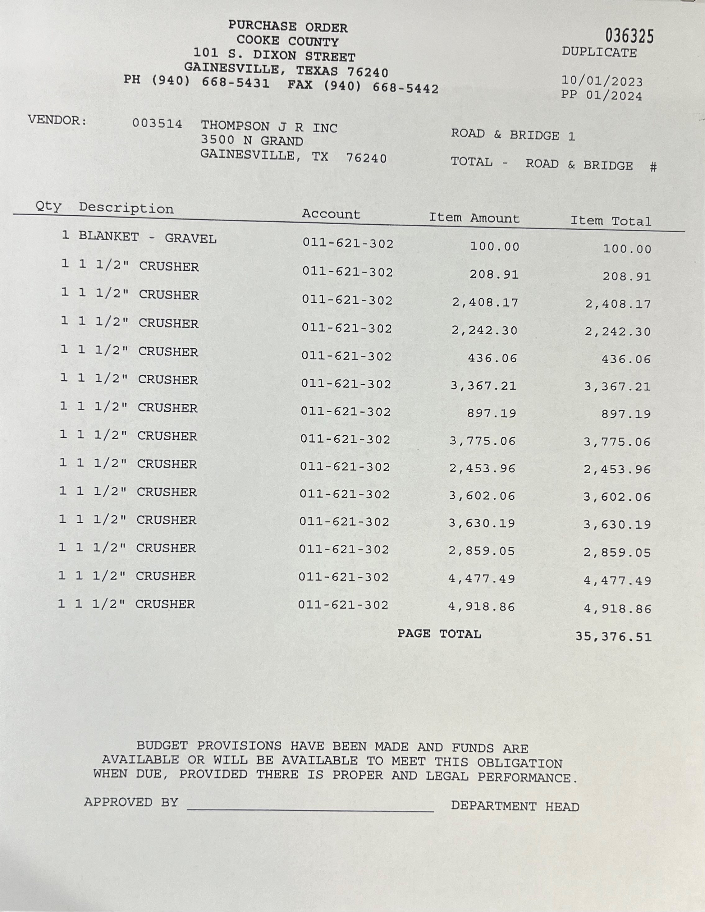
PO TYPES
Blanket

Slide 12
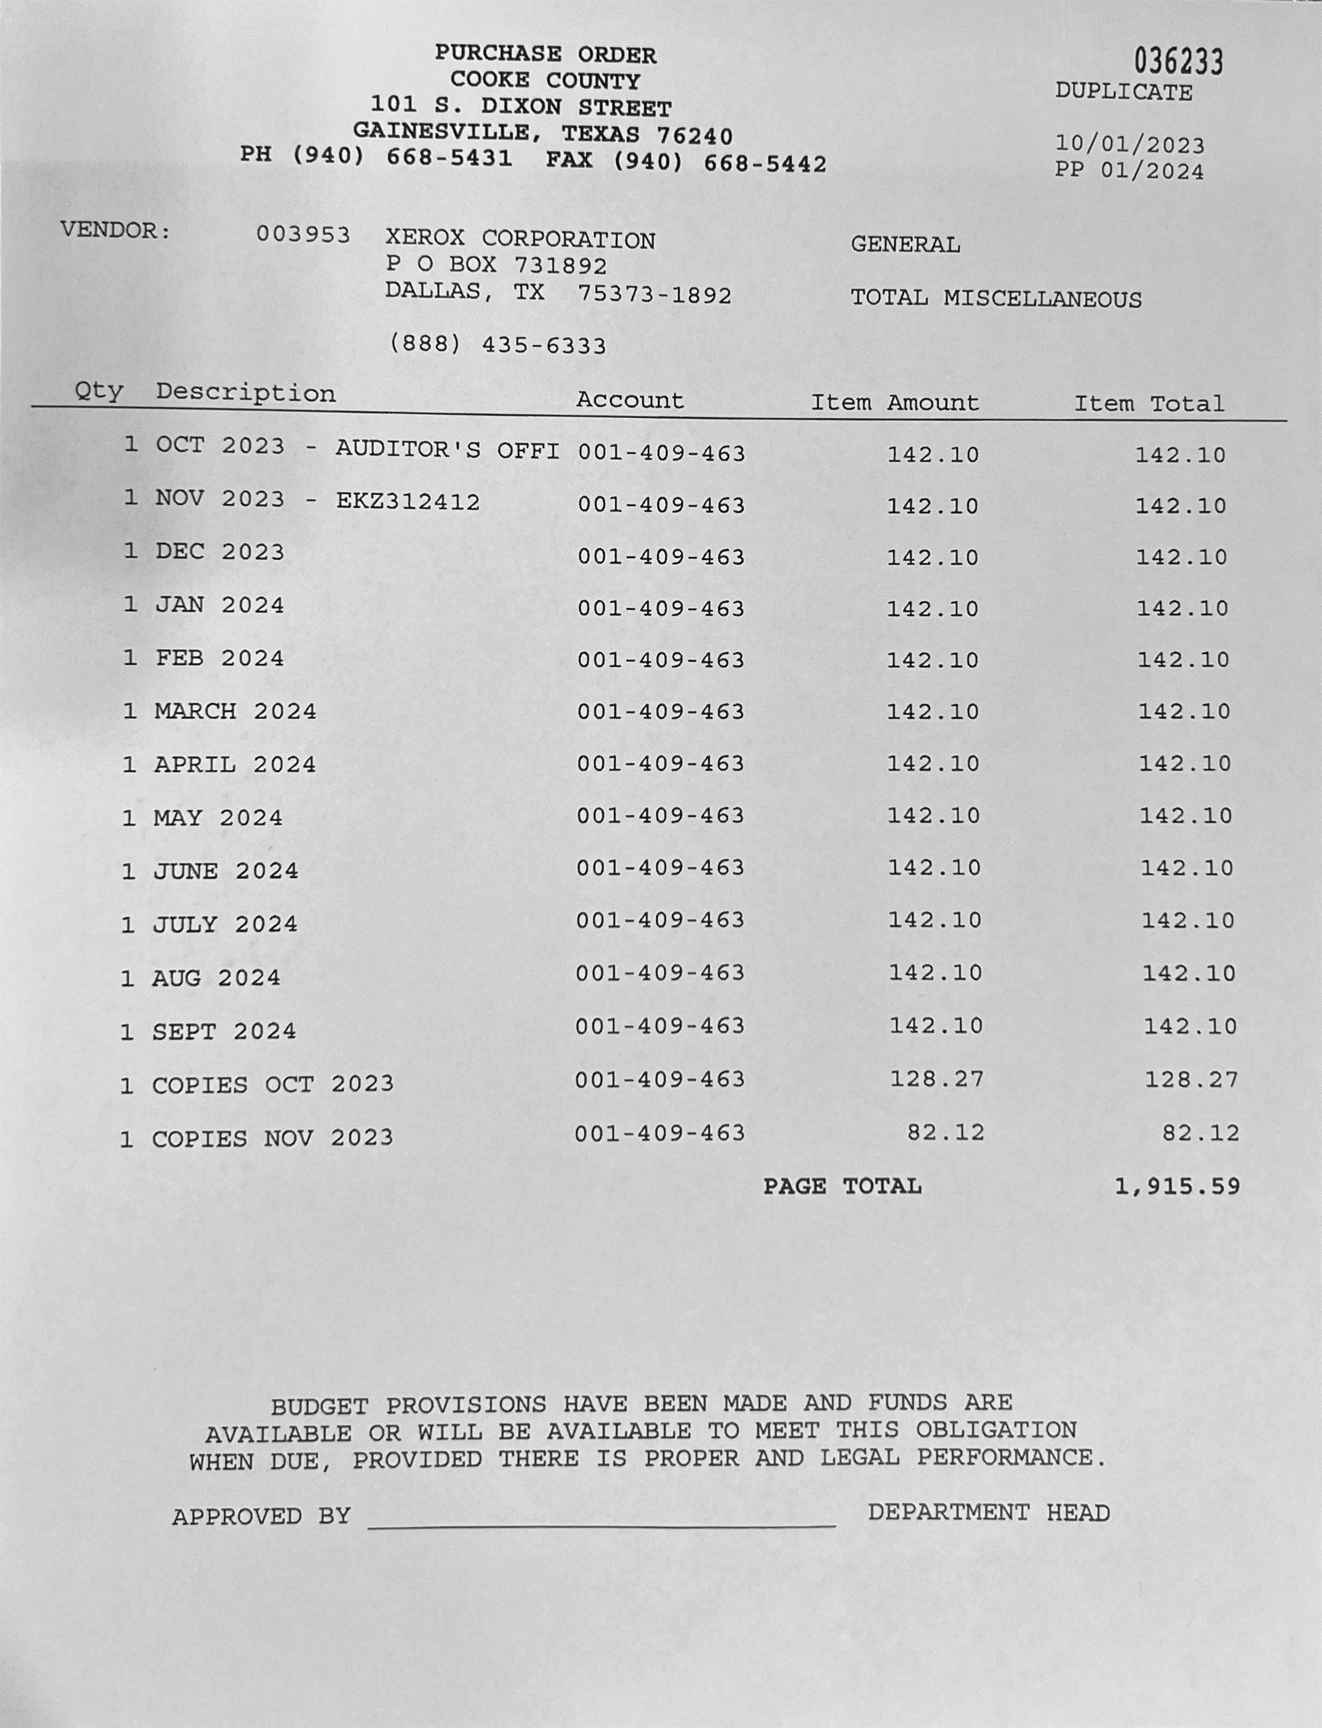
PO Types
Monthly

Slide 13
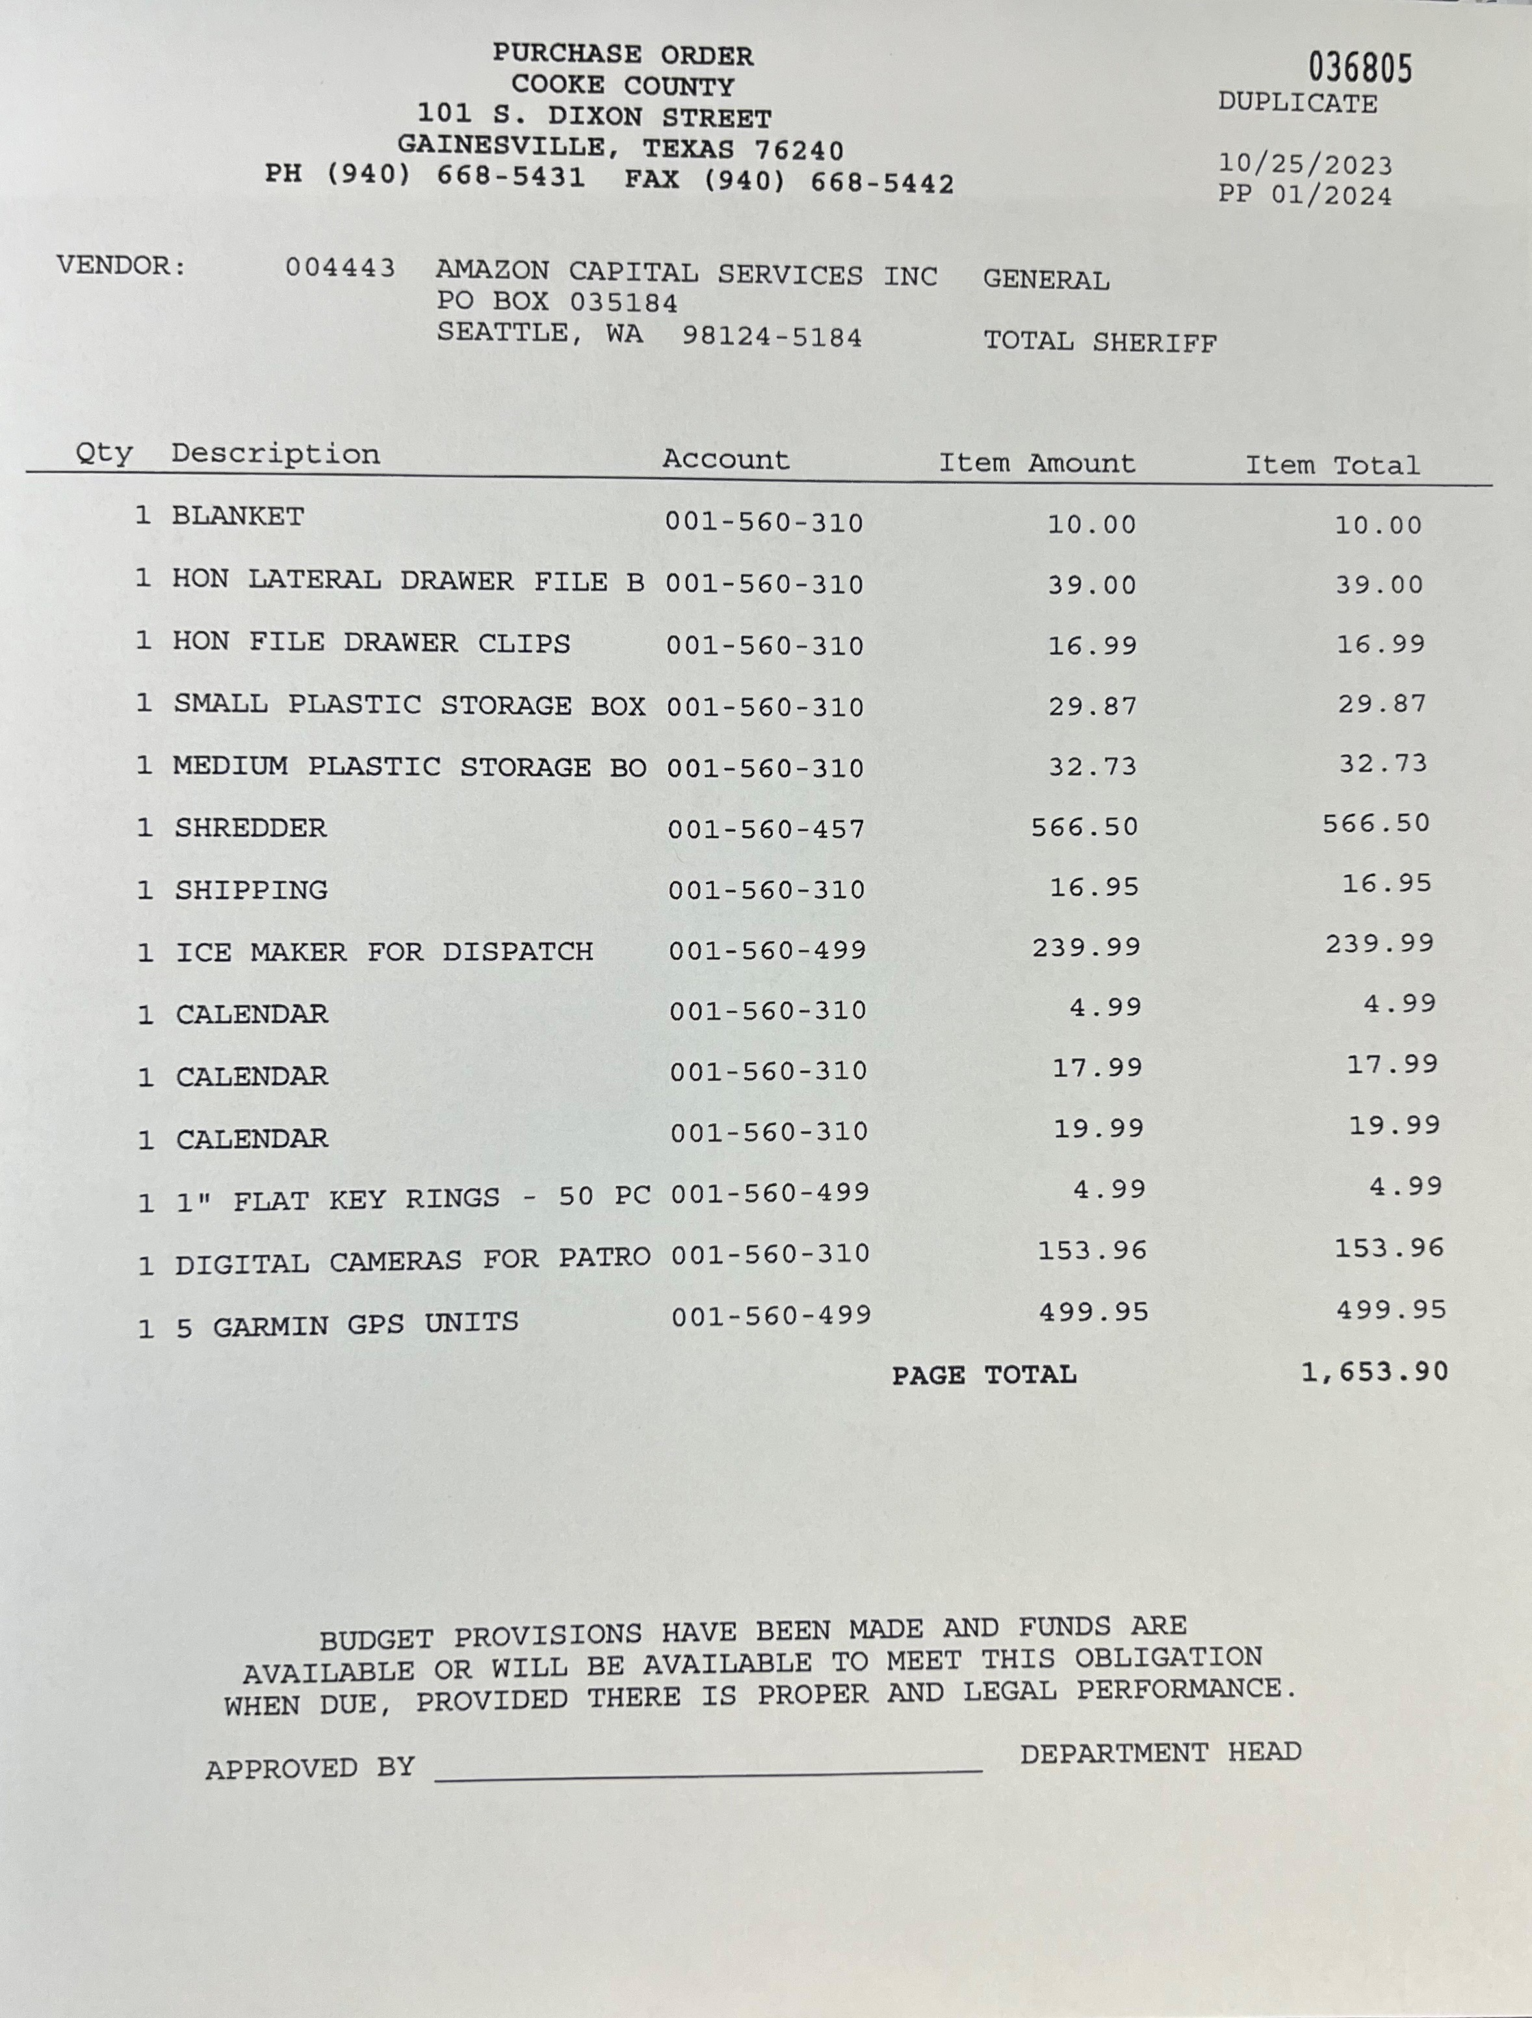

PO Types
High Department Usage Blanket

Slide 14
Specifications
Also referred to as a Scope of Work or Scope of Services
  A concise description of a good or service the City seeks to buy and the requirements a vendor must meet to be considered for award.
  It’s purpose is to provide personnel with clear guides to purchasing and vendors with firm criteria of minimum product or service standards.
  Characteristics of a good specification:
    Flexible – doesn’t prevent the acceptance of an offer that could provide a better value for the City
    Accurate – Uses units of measure that compatible with industry standards, identifies all quantities, and describes packing requirements
    Clear – Uses terminology that is understandable, avoids the use of jargon or “legalese” whenever possible

Slide 15
Specifications
    Competitive – Identifies at least two commercially available brands (whenever possible), avoids unneeded extras, and avoids details that not necessary to the purpose
    Simple – Avoids unnecessary detail and redundancy, but is complete enough to ensure the service, or product, serve its purpose
  Preparing a specification can be done by the user department, Purchasing, or by a consultant hired by the City. The ultimate responsibility for accurate specifications rests with requesting department.

Slide 16
HOUSE BILL 1295
Disclosure of Interested Parties – House Bill 1295 Section 2252.908 of Texas Gov’t. Code
  A business entity must file online with the Texas Ethics Commission a Form 1295.
    The contract requires an action or vote by the governing body of the entity, or agency;
    Or has a value of at least $1 million.
    Applies to changes to an existing contract by amendment, change order, or extension of a contract.
  Purchasing is responsible for collecting and acknowledging 1295s from the vendor.
  The form must be filed no later than the 30th day after the date the contract binds all parties to the contract.
  You can find more information by reading the Frequently Asked Questions Section on the Texas Ethics Commission website here: https://www.ethics.state.tx.us/whatsnew/FAQ_Form1295.html#Q1

Slide 17
Boycotting Energy Companies
Government Code 2276
Contracts with Governmental Entities must include a written verification from the company that it does not and will not during the term of the contract boycott energy companies.

Slide 18
Boycotting Israel
Government Code 2271
A governmental entity may not enter into a contract with a company for goods or services unless the contract contains a written verification from the company that it:
(1) does not boycott Israel; and
(2) will not boycott Israel during the term of the contract.

Slide 19
Boycotting Firearms
Government Code 2274
A governmental entity may not enter into a contract with a company for the purchase of goods or services unless the contract contains a written verification from the company that it:
(1) does not have a practice, policy, guidance, or directive that discriminates against a firearm entity or firearm trade association; and
(2) will not discriminate during the term of the contract against a firearm entity or firearm trade association.

Slide 20
Purchasing Cooperatives
Texas Public Purchasing Association
https://www.txppa.org
TxSmartBuy
https://www.txsmartbuy.com
Texas Department of Information Services
https://dir.texas.gov
Houston/Galveston Area Council (HGAC)
https://www.h-gac.com
BuyBoard
https://www.buyboard.com
Omnia
https://www.omniapartners.com
TIPS
https://www.tips-usa.com

Slide 21
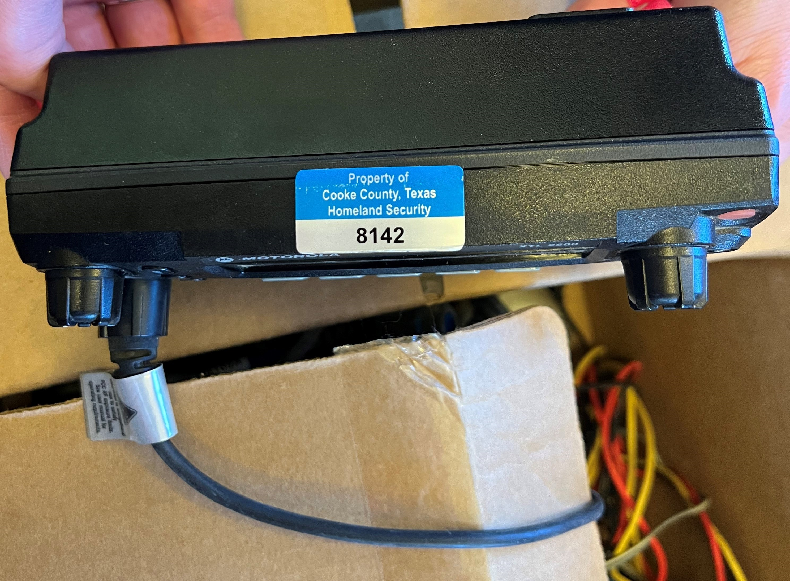
Fixed Assets
The Purchasing Department (or whoever is assuming that role) is responsible for the proper disposition of surplus property through inter department transfers, online auctions, or sealed bids where appropriate, as well as physical asset management.

Slide 22
Online Guides & Resources
Purchasing Resources
https://www.bickerstaff.com/wp-content/uploads/Purchasing-Law-Basics-for-Counties-00875814x7A30F.pdf
V.G.Young

Slide 23
Thank You
Shelly Atteberry shelly.atteberry@co.cooke.tx.us 940-668-5493

