Slide 1
Insurance and Coverage – Caveat Emptor – it is all about the terms and conditions.
Presented by:
Lisa McCaig, ARM
Ernesto Galindo, CRM
Risk Management Consultants
Texas Association of Counties Risk Management Pool
Notes:
Today presentation will be enhanced by your participation and sharing your knowledge today so please do not be shy and feel free to elaborate on our presentation where you see appropriate.
One of your greatest resources is each other….your questions and commentary are encouraged.

Slide 2
Disclaimer
The information in this presentation and accompanying handouts is for informational purposes only. The information presented is intended as best practices in risk management. In all legal matters and when seeking legal advice, you should always consult with your Counsel.
Any insurance description or certificate of insurance discussed in this presentation is for educational purpose only. It is your responsibility to request and verify the most current version of any insurance policy or endorsement. Information which is copyrighted by and proprietary to Insurance Services Office, Inc. (“ISO Material”) is included in this presentation.
Notes:
Ernesto
Read the disclaimer-reference the Title of Today’s Presentation “Insurance and Coverage – Caveat Emptor – it is all about the terms and conditions.” Caveat Emptor- the principal that the buyer is responsible for checking the quality and suitability of goods before a purchase is made.

Slide 3
2015138
Notes:
Ernesto

Slide 4
Today’s Learning Objectives
Attendees will have a better understanding of the Risk Management Process and where purchasing, and procurement aligns within this process.
Attendees will be provided with information to help manage the procurement of Property & Casualty Insurance for both the short term and long term.
Attendees will gain an understanding of the different lines of insurance and coverage.
Notes:
Lisa
Ernesto and I objective today is to provide risk management information and the various lines of insurance coverage the county has and contractual requirements. Hopefully you can learn to be able to “ask the right questions”

Slide 5
Insurance
Insurance is one of many ways to
manage risk…
Notes:
Ernesto
You can also self insure (if you do make sure you finance for self insuring), use contracts to transfer risks to others, you can also use WOL’s. Insurance is full of terms, conditions, and exclusions.
If you have not already, I highly encourage you to make relationships with insurance professionals to help you navigate all these terms, conditions, and exclusions.
Today, from your perspective I hope you can look at today’s experience from two points of view.
If you are securing insurance and coverage for your entity.
If you are reaching out to contractors, and vendors for services they will be providing to your entity.
The next slide gives some general examples of some different entities and their differing Property & Casualty insuring programs…
Waiver of liability to transfer risk,. This is a tool to encourage someone to use your facilities responsible make sure it’s your contract is written in simple and clear terms.

Slide 6
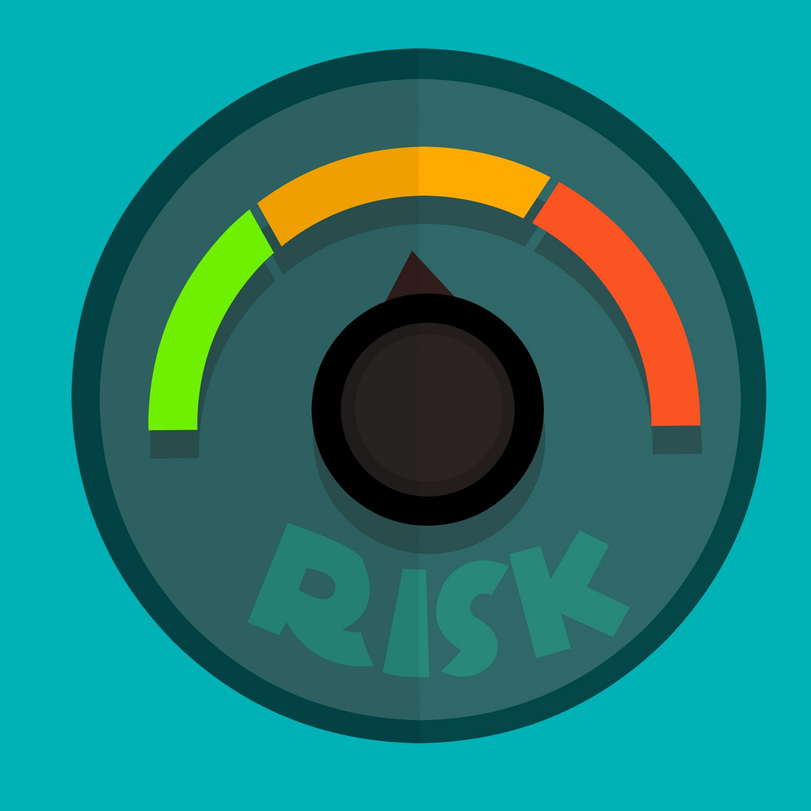
Risk Appetite
The level of risk an organization is willing to retain or transfer to achieve their strategic goals.
Notes:
Ernesto
Let's talk about risk appetite what is risk appetite.
Basically, what it means is the level of risk an organization is willing to retain or transfer to achieve their strategic goals.
If you think about it, we all have at one point, or another exercise our own risk appetite on personal decisions. For instance, how many of you have a high deductible on your personal vehicle policy? I personally, opted for a higher deductible to reduce my insurance premium.
My decision was based on my financial capacity. Some of you, may have higher deductibles than I do because you can afford to take that chance in other words you have a greater risk appetite.

Slide 7
The Risk Management Process
IDENTIFY
FINANCE
ADMINISTER
ANALYZE
CONTROL
Notes:
Lisa and Ernesto
LM Why do Counties Manage Risk? Overall goal is to minimize or prevent losses.
Proactively protect the county from internal and external forces and exposures.
Limit uncertainty in the budgeting process.
LM Identify What are your exposures? Employees, Data, Finances, Property, Autos. Risk Exposures. Policy & Procedures
EG Analyze Analyze Loss Data: Loss Frequency, Loss Severity, Root Cause, Risk Assessment, Total Paid
LM Control Risk Control Techniques: Training, Accident Prevention, Claims Management, Environment, Checklists
EG Finance Coverage & Limits, Deductibles, Contractual Transfer, Retained Risk, Trainings
LM Administer Execute Action Plan, Follow up on results of Trainings, Revise Action Plan as needed

Slide 8
How can the Risk Management Process help your entity?
ⓘ Start presenting to display the poll results on this slide.
Notes:
The Risk Management Process can be customized to examine risk in all areas of public sector.

Slide 9
Three Entities, Three Different Insurance Programs
Fully insured for WC, Auto, GL, LE, PO aka D&O/EPL, Cyber, Property, Inland Marine, Professional Liability, and Maintain Bonds.
Excess for WC. Self insured for Auto, GL, LE, PO aka D&O/EPL, Cyber, and IM. Purchases some Professional Liability and Maintains Bonds.
Fully insured for WC, Auto, GL, Property, and Cyber. Self insured for LE, PO aka D&O/EPL. Purchases some Professional Liability and Maintains Bonds.
Notes:
Ernesto
Abbreviated here on purpose, simply to T up today. If you handle the insurance for your entity, here are 3 general examples. Do you see recognize your own entity??? 1 is most small, medium, and large entities 20 to 2500 employees. 2 might be a larger entity, and 3 might be large or could be set up to handle their own insurance and risk management.

Slide 10
Workers’ Compensation and Employers Liability
Provides Coverage for Expenses Incurred when Injured in the Course and Scope of their Duties
Medical Expenses
Rated on Class Code and Loss Experience
Lost Wages
Others May be Endorsed
Notes:
Lisa
Your employees are your biggest asset. Workers’ Compensation coverage protects the safety of employees when they are injured in the course and scope of their job duties.
The coverage ensures the employee receives the best medical care available and is receiving Temporary Income Benefits while out of work.
Endorsements for Optional Coverage on your WC program may include Elected Officials and/or Volunteers (Jurors, Election Workers, Volunteer Fire Fighters, Volunteer Law Enforcement (Reserves) or could be a Volunteer All Others which includes volunteer at museum or unpaid intern.
Alliance – TASB, TML, TAC , Texas Water Conservation Association and TX Council Risk Management Fund – serve 3000 employers

Slide 11
Automobile Liability
Provides Coverage for Bodily Injury and Property Damage Caused by Negligent Use of a Covered Automobile.
Medical Payments or Personal Injury Protection (PIP)
Hired and Non-Owned Automobile (HNO) Liability Coverage
Damage to Another Party
Underinsured and Uninsured Motorist Protection (UMUIM)
Notes:
Ernesto
Auto liability pays for the injury and damages by a covered auto. This include :
Damages top others
Medical Payments or Personal Injury protection
Hired and Non-Owned
Uninsured and underinsured

Slide 12
Automobile Physical Damage
Provides Comprehensive and Collision Coverage to a Covered Vehicle
Damage to Your Automobiles
Permanently Attached Equipment.
Notes:
Ernesto

Slide 13
How are Your Automobiles Covered?
ⓘ Start presenting to display the poll results on this slide.

Slide 14
General Liability
Provides Liability Coverage for Bodily Injury or Property Damage Arising Out of a Negligent Act to Another Party.
Products and Completed Operations
Medical Payments
Libel or Slander
Notes:
Lisa
Provides Liability Coverage for Bodily Injury or Property Damage Arising Out of a Negligent Act to Another Party.
Use example of my fall from the haunted house.

Slide 15
Law Enforcement Liability
Provides Coverage for Claims Arising from the Performance of Law Enforcement Duties.
Excessive Force
Wrongful Arrest
Failure to Provide Medical Care
In-custody Deaths
Notes:
Lisa
Law Enforcement is one of the largest areas of exposure for the county.
Here are some examples of claims that can potentially be large: Jail Suicide, Excessive Force, Wrongful Arrest, Failure to Provide Medical Care

Slide 16
Professional Liability and Specialty Type Insurance
Directors & Officers (D&O) and Employment Practices Liability (EPL)
Public or Elected Official Liability
Cyber Liability Insurance, Computer Fraud and Funds Transfer Insurance, Crime Insurance
Medical Malpractice Insurance
Errors & Omissions (E&O):
Architect and Engineers Liability Insurance
Lawyers Professional Liability Insurance
Tech E&O
Pollution Liability
Notes:
Ernesto
Professional liability may include:
PO
D&O and Employment Practices Liability
Errors and Omissions
Architects and Engineers
Lawyers, professional liability
Technology errors and omissions – help pay for damages if the technology fails

Slide 17
Property
Provide Coverage for Physical Damage to Structures and Buildings, Contents/Business Personal Property, Mobile Equipment
Business Income and Extra Expense
Flood, Earthquake, Named Storm. MEQ and Wind can have Different Limits and Deductibles
Boiler and Machinery aka Equipment Breakdown
Inland Marine
Contractors Equipment
Lab Equipment
Works of Art, Static Displays, Communication Towers, Monuments
Builders Risk Insurance
Notes:
Lisa
Just like the county’s auto schedule, the Property schedules are also large due to the multiple property locations throughout the county. This includes your courthouse, which in many cases is a historic building, along with Annex Building.
Jail
Precinct barns
Expo and Fairground Buildings
Do you know what type of Property Maintenance Program your county has? Who is inspecting these buildings on a regular basis?
When was the last time you had your property appraisal done on your county buildings? We provide appraisal every 4 years for members? Why do you believe this might be important to keep your schedules updated?

Slide 18
Bonds
A bond is a three-party contract in which the surety company guarantees the performance or honesty of the contractor or individual to the entity.
Statutory Bonds
Notes:
Ernesto
Bid Bonds: Meant to protect the entity again frivolous or lowball bids.
Performance bonds: Posted by GC for the benefit of the public entity. If the contractor is not able to finish the project, the entity can file a claim against the performance bond.
Payment Bonds: These bonds are meant to protect everyone the payment chain. GC will post the bond to guarantee that all subs and suppliers will get paid.

Slide 19
Bid Bonds
Submitted with the bid and guarantees that if the contractor is awarded the job, it will agree to perform the work at the price quoted and will provide additional bonds as required by the construction contract.
If the contractor declines to enter a contract to perform the work at the agreed upon price, the bid bond will reimburse the entity the difference between the defaulting contractor’s bid and the next lowest bid, up to the bid bond penal amount.
Notes:
Ernesto
Very important for the financial security of the entity (principal). Bid Bonds holds the price and avoids low ball bids then change orders…

Slide 20
Performance bond guarantees that the contractor:
Will perform the work in accordance with the construction contract and related documents
Protects the entity from financial loss up to the bond limit in the event the contractor fails to fulfill its contractual obligations.
Payment bond guarantees:
Suppliers and subcontractors will be paid for materials and labor furnished to the contractor.
Payment bond purpose is to guarantee the entity is free of any liens.
Notes:
Ernesto
Both used for many types of projects including road expansion and new building projects. Protects the entity (principal) if the contractor goes belly up…Payment bond, same thing if contractor goes belly up, the contractors will be paid and not knocking on your door…

Slide 21
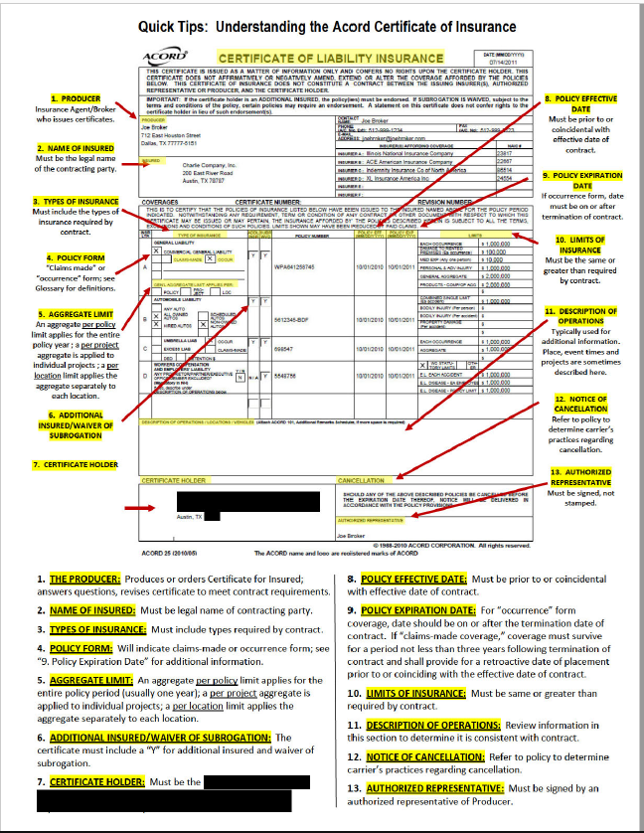
Notes:
Lisa/ Ernesto
Certificate of Insurance - This document provides evidence that the required insurance coverage and limits have been purchased by the company required to furnish the certificate.
Additional Insured: A person or organization that is added as an insured under the policy at the request of the named insured.
When do you request Certificate of Insurance?
When another party (contractor) will be performing a service for you or is leasing a county owned building.
Why do you need this form? To provide proof that the contractor have insurance to cover a claim should it arise.
Important Reminders:
Know who at the county is managing this important process. Who makes sure you are receiving an updated copy when the COI expires?
Verify Policy Effective Dates
Verify Right Insurance Coverage and Limits

Slide 22
Organizing the Project File
Keep current contract or interlocal agreements for scope of work
Include copies of warranties, and contacts for follow up if needed
Keep copies of current certificate of insurance and the endorsements and policies
List of vendors, service providers and contractors
Notes:
Ernesto
Keep Copies :
Contract and statement of work
Warranty contracts
COI, remember the COI is a snapshot in the time when the certificate was obtained, if necessary, continue to monitor coverage is still in place
List of vendors and providers

Slide 23
Resources & References
Texas Public Purchasing Association
www.txppa.org
County Attorney Coverage and Insurance Professional
International Risk Management Institute (IRMI)- www.irmi.com
Texas Public Risk Management Association (TX PRIMA)- www.texasprima.org
Notes:
Lisa

Slide 24
Questions
This Photo by Unknown Author is licensed under CC BY

