Slide 1

‹#›
THE BASICS OF COUNTY PURCHASING
Karen L. Davidson, MPA,CTCM
Purchasing Agent
County of El Paso, Texas

Slide 2
LEARNING OBJECTIVES
  IDENTIFY STATUTES PERTAINING TO PURCHASING
      Brief overview of applicable portions on TLGC
      Focus on primary TLGC chapter 262
  DETERMINE PROCUREMENT THRESHOLDS AND PROCESSES
      The Purchasing Act
      Sealed Bidding, RFPs, RFQs, RFI, Discretionary exemptions
      RFP Process – Step by Step
  Cooperative Purchasing
    Interlocal Agreements
    Piggybacking

Slide 3
‹#›
IDENTIFY STATUTES PERTAINING TO PURCHASING

Slide 4





TEXAS LOCAL GOVERNMENT CODES
TLGC 262
TLGC 271
A
C
GENERAL PROVISIONS
COMPETITIVE BIDDING
A. PUBLIC PROPERTY FINANCE ACT
B. COMPETITIVE BIDDING IN CERTAIN PW
C. CERTIFICATES OF OBLIGATION
D. STATE COOPERATION IN LOCAL PURCHASING
E. STATE INTERCEPT TO INCREASE CREDIT RATING
F. COOPERATIVE PURCHASING PROGRAM
G. PURCHASES FROM FEDERAL SCHEDULES
I. ADJUDICATION OF CONTRACT CLAIMS
J. DESIGN-BUILD PROCEDURES IN CIVIL WORKS
Z. MISCELLANEOUS PROVISIONS
TLGC 263, 270,272,
273, & 280
PURCHASING AGENTS
B
RELATED TO PUBLIC PROPERTY: SALES, LEASE, ACQUISITION, & GENERAL PROVISIONS

Slide 5
Texas Local Government Code 262
Purchasing & Contracting Authority of Counties
  SUBCHAPTER A: General Provisions
      262.001 Appointment of Agent to Make Contracts
      262.002 Authority to Purchase Road Equip./Tires through
      the Comptroller
      262.003 Small, Sole-Source Purchase Exempt from Bidding
      262.004 Contracts and Other Instruments; Vest Rights
      262.005 Application of Other Law
      262.006 Least Cost Review Program
      262.007 Suit Against County Arising Under Certain Contracts
GENERAL PROVISIONS
A

Slide 6
Texas Local Government Code 262
Purchasing & Contracting Authority of Counties
  SUBCHAPTER B: Purchasing Agents
      262.011 Purchasing Agents
      262.0115 Purchasing Agents in Counties with Populations
      of More than 100,000
      262.012 County Auditors as Purchasing Agents in Certain
      Counties
PURCHASING AGENTS
B

Slide 7
Texas Local Government Code 262
Purchasing & Contracting Authority of Counties
  SUBCHAPTER C: Competitive Bidding in General
  262.021 Short Title
  262.022 Definitions
  262.0225 Additional Competitive Process
  262.023 Competitive Requirements for Certain Purchases
  262.0235 Procedures Adopted / Electronic Bids and Proposals
  262.024 Discretionary Exemptions
COMPETITIVE BIDDING
C

Slide 8
‹#›
DETERMINE PROCUREMENT THRESHOLDS AND PROCESSES

Slide 9




Basic Purchasing Guidelines
‹#›
DETERMINE PROCUREMENT THRESHOLDS AND PROCESSES
Departments need goods and services to meet operational requirements.
The Purchasing Agent is the only authorized route.
Procurement processes are strictly defined and controlled by Texas law.
The Purchasing Agent is the only person who can authorize a purchase, regardless of the dollar amount (1 ).
The County Auditor is prohibited from paying for anything the Purchasing Agent has not officially approved.
No County employee can authorize or make a purchase without formal approval from the Purchasing Agent.
Do not place orders or pay for anything out of pocket without prior written approval from the Purchasing Agent, as no reimbursement can occur.
15

Slide 10
Basic Purchasing Guidelines (cont’d)
‹#›
DETERMINE PROCUREMENT THRESHOLDS AND PROCESSES
AVAILABLE PROCESSES:
Written Quotation ( 1 $50,000)
Formal Solicitation ($50,000.01 )
Cooperative Purchasing
Court-Authorized Exemptions
15

Slide 11
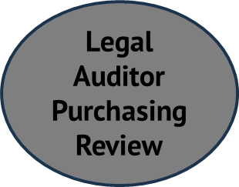



Process Overview (cont’d)
‹#›
DETERMINE PROCUREMENT THRESHOLDS AND PROCESSES
Formal Solicitation ($50,000.01 )
Create specifications or Scope of Work (specs)
Fill out Request for Bid/RFP form attach specs
Turn in to Formal Bid Division (PA or Assistant PA)
Formal Solicitation process begins
Legal Auditor Purchasing Review
Submit Project
BID – RFP
Process
Evaluation
Court Approvals
15

Slide 12
Competitive Bid – Gold Standard
Texas Local Government Code 262
Purchasing & Contracting Authority of Counties
  SUBCHAPTER C: Competitive Bidding in General
  Also known as The County Purchasing Act
  Requires any purchase of an item greater than $50,000 undergo one of the following:
          Competitive bid or proposal process as outlined in the act
          Comply with Gov’t Code Chapter 2269
          Use of the reverse auction procedure as described in 2155.085
          ITEM= any service, equipment, good, or other tangible/intangible personal property, to include insurance and high technology. *§262.022(5)
          Does not Include: Professional Services as defined by Gov’t Code Section 2254

Slide 13
Texas Local Government Code 262
SUBCHAPTER C: Competitive Bidding in General (cont’d)
Notice Procedures *§262.025
  Bids and Proposals greater than $50K must be advertised
  Must be in a newspaper of general circulation
  Advertised no less than 14 days between first advertisement and opening
  If no newspaper of general circulation is available, must post in courthouse for the same advertisement time
  Bids may not be opened earlier than the advertised date.
  Note: Although commonly done, advertising on web pages is not required.

Slide 14
Competitive Bid – Gold Standard
Texas Local Government Code 262
SUBCHAPTER C: Competitive Bidding in General (cont’d)
Required Processes to spend >$50K
  BID = defined/known characteristics; easily definable and price is main factor. Also known as: Sealed Bid, SB, ITB, IFB
  PROPOSAL = unknown or harder-to-define characteristics; Price is only one consideration and not necessarily the most important. Also known as: Request for Proposal, RFP
17

Slide 15
Texas Local Government Code 262
SUBCHAPTER C: Competitive Bidding in General (cont’d)
Discretionary Exemptions to Required Processes
  Emergency *262.024(1) – (3) Public Calamity, Public Safety, Unforeseen Damage *Determination of public safety is at court discretion
  Professional Service *262.024(4) Defined under common law; discretion of commissioners court Does NOT apply to those professional services listed in 2254
  Sole/Single Source *262.024(7)

Slide 16
STAGES OF THE FORMAL SOLICITATION PROCESS
In the County of El Paso, the process generally consists of 8 or 9 defined stages (depends on whether vendor demos are required/requested). The stages are delineated step-by-step below. The tasks/items needed from departments are highlighted and the general purchasing timelines are listed in red.
Basically, Departments are heavily responsible for the timing of steps 1,2, and 7.
STEP 1: Coordinate Vendor Demos (to gather must-haves for specification finalization)
1. Department: Provide names of all known vendors to invite
2. Department: Provide names of required department attendees
3. Purchasing: Coordinate vendor showings, evaluations, and scheduling
[Depends on # and duration]
STEP 2: Finalize Specifications
1. Department: Copy of Final Specs to Elvia/Joe
2. Department: Form 176 and Request for Bid Forms to Elvia/Joe
3. Department: Provide list of 6 evaluators [3-5 will be used]
4. Purchasing: Receive/Prep Bid Packet/Submit to PRC [usually <5 business
days

Slide 17
STAGES OF THE FORMAL SOLICITATION PROCESS (cont’d)
STEP 3: Legal/Audit Review prior to release [usually <10 business days, if no problems]
STEP 4: Solicitation on the Street [3.5 weeks; includes Q&A requirement; longer for RFPs]
STEP 5: Processing of solicitation responses [3 business days]
STEP 6: Set-up of Evaluation Team, Documents, and Schedules [<5 business days]
STEP 7: Response Evaluation [generally < 3 weeks if under 10 responses; add 3 business days
for each additional 5 responses; also, strongly dependent on scheduling availability of the
evaluation team. Advised to not assign folks with limited scheduling capacity.]
STEP 8: Legal/Audit Review prior to award [usually <10 business days, if no problems]
STEP 9: Submit to Courts for Award [next available court date after receipt from Legal/Audit
review]

Slide 18
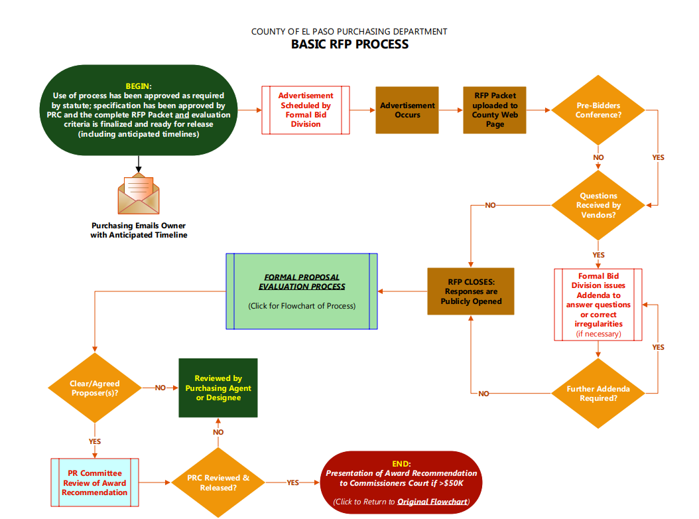
Basic RFP Process

Slide 19
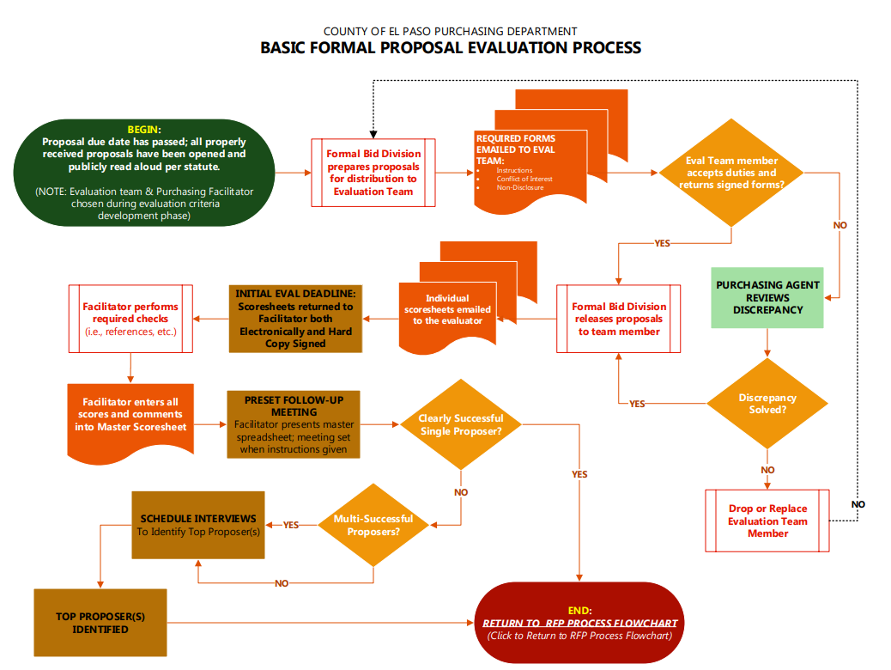

Slide 20
OTHER CHAPTERS AFFECTING PROCUREMENT
CONTRACTING
  Length of contracts *§271.009
  Creation of multi-year contract without creating unconstitutional debt *§271.903
  Contracting lease financing must comply with the Purchasing Act *§271.006
  COOPERATIVE PURCHASING *Chapter 791
  Subchapter F; Meets competitive bidding requirements

Slide 21
‹#›
WHICH PROCUREMENT PROCESS SHOULD I USE?

Slide 22
Competitive Bid vs Request for Proposal
Competitive Bid is used when the specifications of a product, service or software are already known and when price is the main or only factor in selecting the successful bidder. A contract is awarded on the basis of price of the lowest responsive and responsible bidder.
In contrast, a Request for Proposal (RFP) involves more than a request for price.
 | Competitive Bid | RFP
Value | Lowest Cost; Good Value | Not always the lowest cost; Best Value
Terms & Conditions | Minimum requirements – no exceptions | Compliance exceptions may be allowed; questions may be submitted for clarification of exceptions
Specifications | Specific minimum requirements for performance or design. Indicating exactly what you want | The results are determined by the Scope of Work. Asking for respondent to develop and provide a solution.
Evaluation Process | Compare costs; compare specs to bid; evaluate bidder | Evaluation team; Evaluation criteria set forth in RFP; Respondent demonstrations
Evaluation Criteria | Low bid; must meet specs; lowest responsive and responsible bidder; no changes allowed | Understanding of requirements; meets minimum requirements; approach and work plan; qualifications and experience; identification of risk; resources; forward-thinking ability, etc.

Slide 23
Request for Proposal (RFP) vs Request for Qualifications (RFQ)
Request for Qualifications (RFQ) is a formal solicitation process for professional services, as defined by law (2254; architects, engineers, land surveyors) by case law or AG opinion (doctors, lawyers, nurses, teachers, etc.)
Price cannot be a determining factor of award and may not be discussed until after determination of most qualified firm/vendor.
Award is based on the vendor deemed “most qualified”.
Two Step process - Pricing is only requested after the qualifications are determined
If identified by law, the services cannot be purchased in any manner other than what is specified in the statue.
If pricing is a determining factor, do not use the RFQ process. The RFP process is a better method if pricing is going to be a determining factor

Slide 24
Request for Information - RPI
This is an officially and publicly advertised all-call to the vendors in a specific industry to weigh in on an idea for product or service. It if often used when an organization does not know all the available information about a project, item, or service and needs all available information from the expert (vendor community).
No award can occur from this event
Used to determine future specifications or definition of agency needs
This instrument is used to identify information needed

Slide 25

PURCHASING / AUDITOR COLLABORATION
‹#›
SOLID PARTNERSHIP IN CHECKS AND BALANCES
AUDITOR
PURCHASING
COMMISSIONERS
COURT
FUNCTIONS IN ALL COUNTY PROCESSES VIA BUDGET, ACCOUNTING, AP, RECORD KEEPING, TAXES, PAYROLL, and REPORTING
FUNCTIONS IN PLANNING & BUYING PROCESS, ENSURING CORRECT PROCESS FOR PROJECT IN ACCORDANCE WITH STATUTORY REQUIREMENTS
FUNCTIONS IN APPROVALS OF POLICY, PURCHASES, BUDGETS, CODES & REGULATIONS, and GENERAL COUNTY GOVERNMENT.
A strong centralized Purchasing Department, with proper procedures grounded in applicable statute and familiarity with County Auditor requirements can serve as an excellent partner in the overall checks and balances needed for proper County financial management.

Slide 26
‹#›
DISCUSSION
Q&A
Karen L. Davidson
County of El Paso, Texas Purchasing Agent
E: purchasingagent@epcountytx.gov T: (915) 273-3349

