Slide 1


Doing Retirement Right
Amy Bishop
TCDRS Executive Director

Slide 2



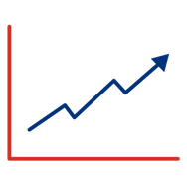

TCDRS By the Numbers
Nearly
850
employers
More than
360,000
members & retirees
89%
funded
9.0%
40-year return
$42B
in assets
As of Dec. 31, 2022

Slide 3

Set Up for Success
Created in 1967 by the Texas Legislature
Managed independently by a nine-member board of trustees
Operating costs average 0.21% of assets
Receive no funding from the State of Texas

Slide 4
Unique Features That Make TCDRS
Financially Strong
Responsible Plan Funding
Flexibility & Local Control
Savings-Based Benefits

Slide 5




Savings-Based Benefits
Members save for their own retirement, automatically.
Savings grow at an annual, compounded rate of 7% interest, set by statute.
Final account balance matched at retirement. Converted to a lifetime benefit.

Slide 6

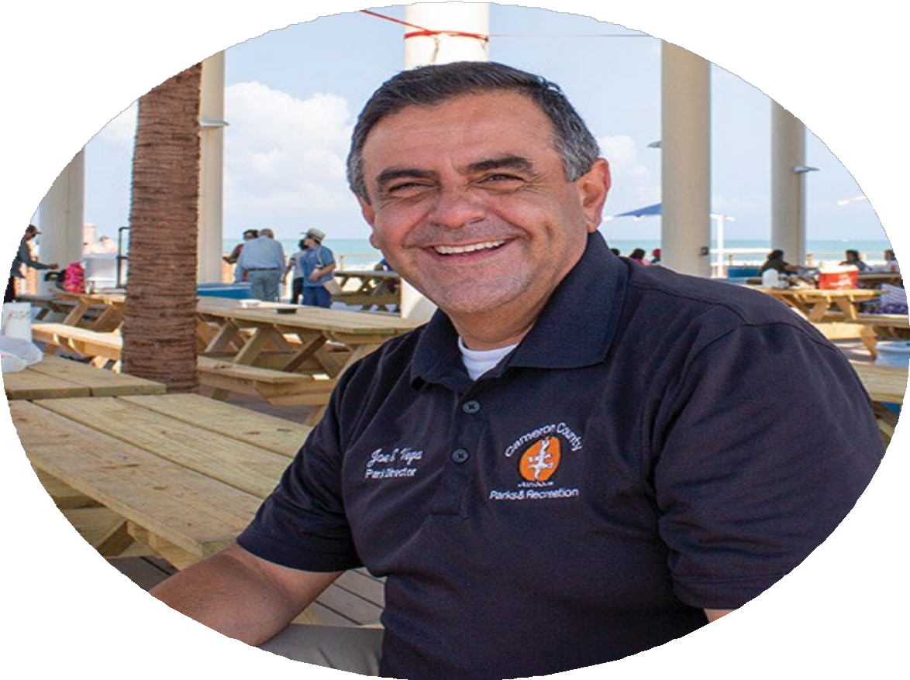

System-Wide Average Retiree Profile
Age | Years of Service | Annual Benefit ¹
61 | 18 | $27,120
As of Dec. 31, 2022
¹Includes cost-of-living adjustments adopted by employers.

Slide 7
TCDRS Benefits Texas
In 2022, paid out $2.1 billion in benefits
96% paid to Texas residents
Benefit payments supported
$3 billion in additional economic activity

Slide 8


Importance of Investments

Slide 9

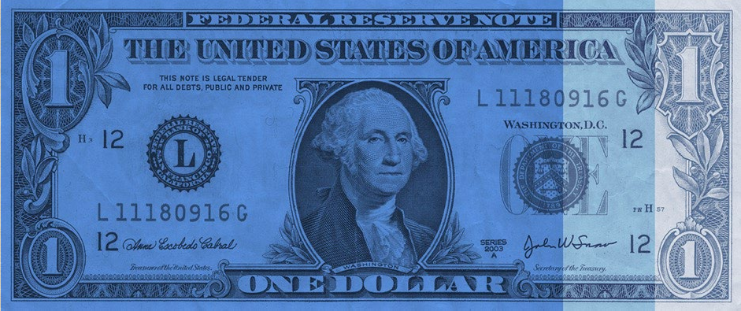
74¢
Investment Earnings
15¢
Employer Contributions
Investment Income Funds Benefits
11¢
Employee Deposits

Slide 10

TCDRS' Investment Strategy
Maximize Returns

Slide 11
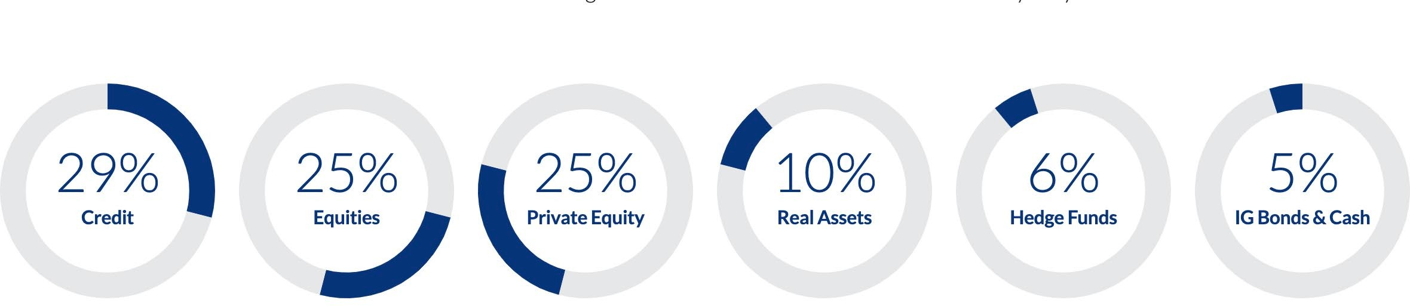
Diversified Portfolio Reduces Risk
Target Asset Allocation

Slide 12
Investment Returns
(Net of All Fees)
As of Dec. 31, 2022
Annualized Returns | 5 Year | 10 Year | 20 Year | 30 Year | 40 Year
Total Fund | 7.8% | 8.3% | 7.8% | 7.6% | 9.0%
Benchmark | 6.1% | 6.8% | 6.9% | 6.5% | 7.8%

Slide 13
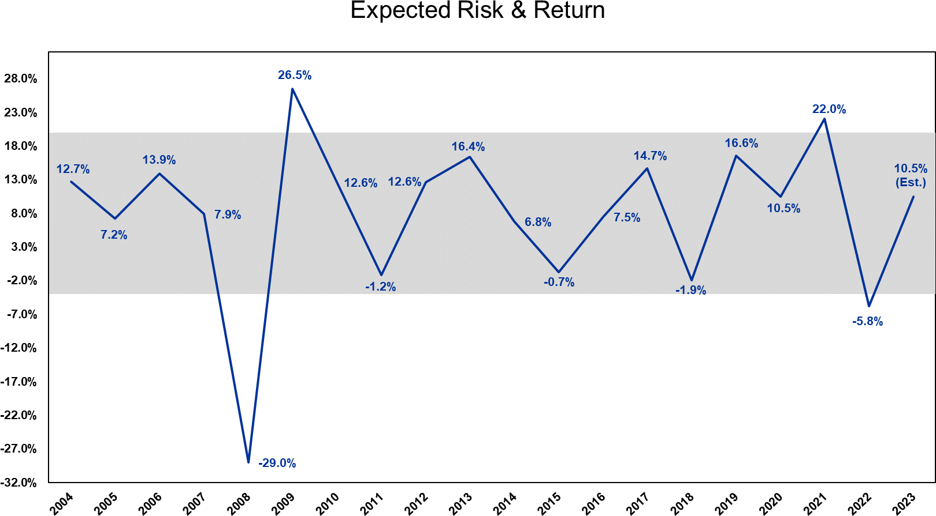
Investment Returns 2004–2023
(Net of All Fees)

Slide 14
Private vs. Public
Equity & Credit
20.00%
18.00%
16.00%
14.00%
12.00%
10.00%
8.00%
6.00%
4.00%
2.00%
0.00%
10.00%
9.00%
8.00%
7.00%
6.00%
5.00%
4.00%
3.00%
2.00%
1.00%
0.00%
5 yr
Private Equity
10 yr
Public Equity
5 yr
Direct Lending [Private Credit]
10 yr
Investment Grade Bonds [Public Credit]
Returns are net of fees as of 9/30/2023 Source: BNY Mellon

Slide 15
Responsible Plan Funding
Employers’ contributions are calculated annually
Must pay 100% of required contributions
2023 weighted-average required employer contribution rate was 12.38%. Unweighted average was 9.64%
Board has a conservative funding policy.

Slide 16
Flexibility and Local Control
Employers choose benefit levels based on their local needs and budgets
Employers may increase or reduce benefits annually by adjusting:
  Employee deposit rate; and/or
  Employer matching

Slide 17
Other Tools to Stabilize Rates
TCDRS maintains a reserves fund that may be used to offset adverse experience.
Employers have options to make additional contributions:
  Over one-third of employers pay an elected rate and/or make additional contributions

Slide 18



Stay Informed Stay Involved Get to know your Employer Services Representative Keep an eye out for TCDRS-hosted educational events Meet our new Director of Governmental Affairs Jay Dyer Read the latest legislative updates at TCDRS.org/legislation.
TCDRS.org/legislation

Slide 19


Q U E S T I O N S ?
Any

