Slide 1
89th Legislative Session

Slide 2
STRUCTURE

Slide 3
Notes:
Left box: Executive Branch, statewide elected officials, 4-year term of office, no term limits, last statewide Democrat 1994

Slide 8
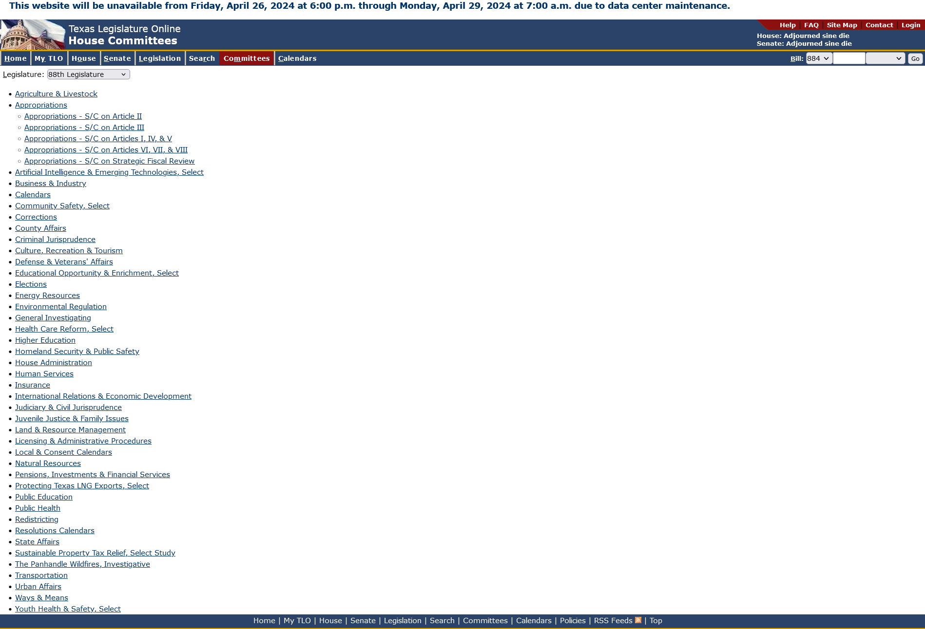
Two New Committees:
House Committee on The Panhandle Wildfires, Investigative
House Committee on Artificial Intelligence & Emerging Technologies, Select

Slide 9
Notes:
Sen. Pete Flores new Chair of Criminal Justice, Artificial Intelligence, Grid Resiliency

Slide 10
https://www.ltgov.texas.gov/wp-content/uploads/2024/04/2024-Interim-Legislative-Charges.pdf
Notes:
Border security, bail reform, property tax reduction ($18b passed in special session--$100k homestead exemption), expanding mental health services, ARPA expenditures, housing affordability, squatters, HOT taxes (accountability and transparency). What DON’T we see? Taxpayer funded lobbyist ban. Also, Lt. Gov. has asked TCEQ not to to issue any new batch plant permits after visit to Grayson County where proposed 600 acre new facility was set for approval

Slide 11
Legislature’s activity over time
Notes:
Last session: 11,807 total bills filed! BUT, around the same number passed, 1,246. 77 vetoes though, higher than any on this chart.

Slide 12
WHAT’S NEXT

Slide 13
89TH TEXAS LEGISLATURE
MAY 28: RUNOFF ELECTION
NOVEMBER 8: GENERAL ELECTION
NOVEMBER 11: FIRST BILLS MAY BE FILED, BY LEGISLATORS AND LEGISLATORS-ELECT
EARLY JANUARY: COMPTROLLER PROVIDES BIENNIAL REVENUE ESTIMATE (~JANUARY 11)
JANUARY 14: 89TH LEGISLATURE CONVENES
JANUARY: OATH OF OFFICE, SPEAKER ELECTION, GOVERNOR’S STATE OF THE STATE, COMMITTEE ASSIGNMENTS
MARCH 14: 60TH DAY, LAST DAY TO FILE (MOST) BILLS
JUNE 2: 140TH & FINAL DAY, SINE DIE.
Notes:
Chambers adopt rules, speaker elected

Slide 14
A CHANGING LEGISLATURE

Slide 15
Incumbents who lost their primary
Rep. Jill Dutton (R-Ben Wheeler), House District 2
Rep. Travis Clardy (R-Nacogdoches), House District 11
Rep. Ernest Bailes (R-Shepherd), House District 18
Rep. Jacey Jetton (R-Richmond), House District 26
Rep. Hugh Shine (R-Temple), House District 55
Rep. Glenn Rogers (R-Graford), House District 60
Rep. Reggie Smith (R-Sherman), House District 62
Rep. Kronda Thimesch (R-Lewisville), House District 65
Rep. Steve Allison (R-San Antonio), House District 121

Slide 16
Incumbents headed to a runoff
Rep. Gary VanDeaver (R-New Boston), House District 1
Rep. Dade Phelan (R-Beaumont), House District 21
Rep. Justin Holland (R-Rockwall), House District 33
Rep. John Kuempel (R-Seguin), House District 44
Rep. DeWayne Burns (R-Cleburne), House District 58
Rep. Frederick Frazier (R-McKinney), House District 61
Rep. Lynn Stucky (R-Denton), House District 64
Rep. Stephanie Klick (R-Fort Worth), House District 91
Rep. Shawn Thierry (D-Houston), House District 146

Slide 17
Lawmakers who decided not to run for reelection or who have sought or are seeking another office:
Rep. Matt Schaefer (R-Tyler), House District 6
Rep. Kyle Kacal (R-College Station), House District 12
Rep. John Raney (R-College Station), House District 14
Rep. Ed Thompson (R-Pearland), House District 29
Rep. Geanie Morrison (R-Victoria), House District 30
Rep. Abel Herrero (D-Robstown), House District 34
Rep. Andrew S. Murr (R-Junction), House District 53
Rep. Charles “Doc” Anderson (R-Waco), House District 56
Rep. Evelina “Lina” Ortega (D-El Paso), House District 77
Rep. Tracy King (D-Uvalde), House District 80

Slide 18
…PAGE 2 NOT RUNNING OR SEEKING OTHER OFFICE
Rep. Four Price (R-Amarillo), House District 87
Rep. Craig Goldman (R-Fort Worth), House District 97
Rep. Victoria Neave Criado (D-Dallas), House District 107
Rep. Carl Sherman (D-DeSoto), House District 109
Rep. Rhetta Andrews Bowers (D-Rowlett), House District 113
Rep. Julie Johnson (D-Farmers Branch), House District 115
Rep. Jarvis Johnson (D-Houston), House District 139
Sen. John Whitmire (D-Houston), Senate District 15
Sen. Drew Springer (R-Muenster), Senate District 30

Slide 19
RESOURCES

Slide 21
Texas Legislature Online capitol.texas.gov

Slide 22
Legislative Reference Library lrl.texas.gov

Slide 24
EMAIL AURORAF@COUNTY.ORG OR KELSEYB@COUNTY.ORG

Slide 26
Call or email me :]

Slide 28
Q & A

