Slide 1
1099s 2024 County Auditors Institute Hilton College Station & Conference Center

Slide 3
1099 vs W-2
Common Law Rules: Facts that provide evidence of the degree of control and independence fall into three categories:
Behavioral Control: Does the company control or have the right to control what the worker does and how the worker does his or her job?
Financial Control: Are the business aspects of the worker’s job controlled by the payer? (these include things like how worker is paid, whether expenses are reimbursed, who provides tools/supplies, etc.).
Type of Relationship: Are there written contracts or employee type benefits? Will the relationship continue and is the work performed a key aspect of the business? Source: www.irs.gov Independent Contractor (Self-Employed) or Employee?

Slide 4
Form W-9
Revised March 2024
Section 3 separated into two parts
Instructions located on the form
update

Slide 5
Form W-9
Helps identify payee.
Helps to determine if payee is reportable.
Certifies under the penalty of perjury that:
The information input is accurate.
The payee is not subject to back-up withholding.
The individual signing is a U.S citizen or entity.
The Foreign Account Tax Compliance Act (FATCA) code(s) entered (if any) indicate you are exempt from FATCA reporting.
Do not expire and are valid unless something changes.
Failure to obtain could lead to a back-up withholding of 24%.
Substitute Form W-9 is possible but must meet IRS specifications.
Generally, must keep Form W-9 for 3 years (recommended 7 years) after the last reporting year payment.

Slide 6
“Eyeball Test”
Exempts Form W-9 requirement for specific payees.
The name must unquestionably identify the payee as non-reportable.
Must determine the payee is a U.S. based entity or citizen.
Recommended to still obtain a W-9.
Examples: Government entities, public schools, churches.

Slide 7
E-Services IRS Verification
Allows organizations to verify their payee’s taxing name and tax identification number (TIN) combination.
Returns results that either match IRS records or identifies issues with the information that was inputted on the W-9.
Entered based on what is inputted by payee on Form W-9.
Extensive vetting process to obtain a login to the system.
Must sign-in with an ID.me.
Refer to IRS Publication 2108-A for additional details on how it can be setup and used.

Slide 8
Payee Setup
Run TIN matching through IRS website. If it matches, then…
Input vendor information into your Accounts Payable system.
Setup as reportable or non-reportable.
If reportable, determine which 1099 they would be receiving.
Identify 1099 address, if applicable.
Save Form W-9 and additional vendor forms, under vendor profile.

Slide 9
What is 1099 Reportable?
Factors: - What is on the W-9? - Why are you paying your vendor? - How much are you paying the vendor for a calendar year?
Assume the payment is reportable, unless you have specific reasons why they would not be reported (ex: purchase of goods only).
Assume payee is reportable, unless they provide you documents showing otherwise or pass the “eyeball test”.
When in doubt, report the payment/vendor. Reportable does not always mean taxable.

Slide 10
Examples of 1099 Reportable Payments
All rent payments and temporary easements with terms less than 30 years: 1099-MISC, Box 1
Deceased employee’s final “gross pay” amount on the check made to the estate or acceptable beneficiary: 1099-MISC, Box 3
All medical providers, counseling, psychologist, health care payments, expert witnesses for medical professionals (IRS Chief Counsel Advice letter 003470 has more info), and veterinarian services regardless of what the W-9 indicates: 1099-Misc, Box 6
All court appointed attorney payments regardless of what the W-9 indicates: 1099-NEC, Box 1
Gross proceeds paid to an attorney: 1099-MISC, Box 10
Membership dues: 1099-NEC, Box 1
Printing services: 1099-NEC, Box 1
Commissary fund payments, depending on type of purchase.

Slide 11
What is not 1099 reportable?
Goods (no services included)
Supplies
Telecommunication services
Transactions completed on a County P-Card or single use cards (reported by credit card merchant)
Relocation costs associated with eminent domain
Child welfare payments (when housing under 10 children)
Extradition
Restitution payments
Prescriptions drugs
Freight/Shipping

Slide 12
Types of 1099 – Reported BY WILCO
1099-MISC
1099-NEC
1099-S
1099-INT
1042 and 1042-S (not 1099s, but need to be aware of reporting requirements)
Additional 1099 Types: https://www.irs.gov/businesses/small-businesses-self-employed/a-guide-to-information-returns

Slide 13
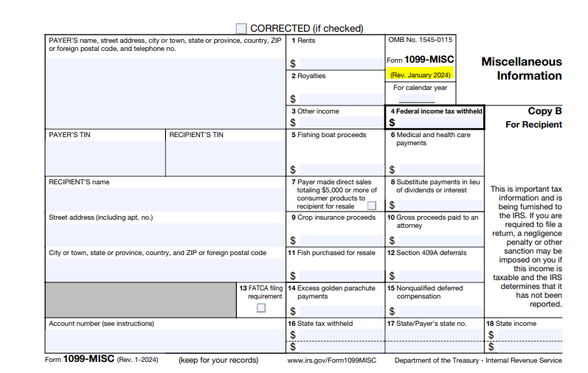
1099-MISC (Revised form Jan 2024)
Payment Types: miscellaneous income
Amounts to report: $600 or more per year
Due to Recipient: January 31
Due to IRS: February 28 (paper); March 31 (electronic)
Examples: rent, medical services, lawsuit settlements, royalties

Slide 14
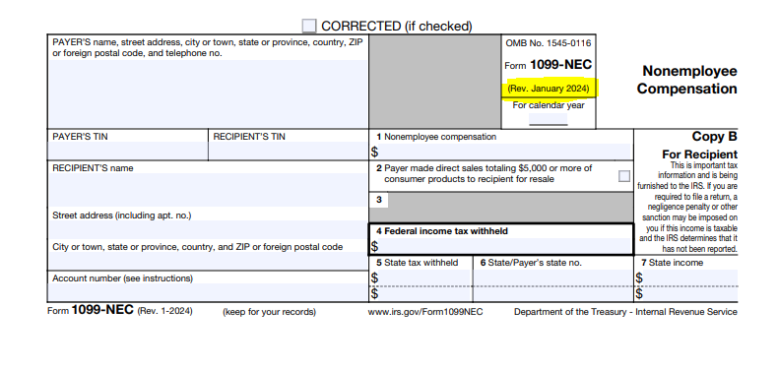
1099-NEC (Revised form Jan 2024)
Payment Types: non-employee compensation
Amounts to report: $600 or more per year
Due to Recipient: January 31
Due to IRS: January 31
Examples: most general services

Slide 15
1099-S
Payment Types: gross proceeds from real estate transactions
Amounts to report: $600 or more per year
Due to Recipient: February 15
Due to IRS: February 28 (paper); March 31 (electronic)
Example: land purchased directly from individuals
No updates to1099-S Form for January 2024

Slide 16
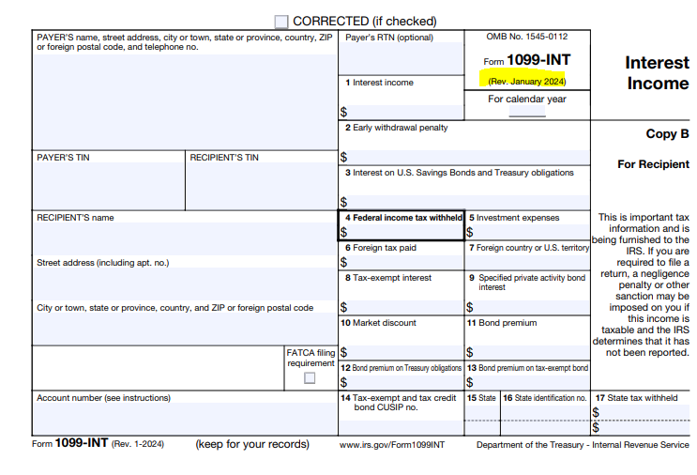
1099-INT (Revised form Jan 2024)
Amounts to report: $10 or more per year
Due to Recipient: January 31
Due to IRS: February 28 (paper); March 31 (electronic)
Example: interest accrued on county invested funds held by courts

Slide 17
Reporting to the IRS
ELECTRONIC FILING
Required if filing 10 or more.
Electronic filing options: FIRE (filing information return electronically) system filing via output from your AP system or other software. IRIS (Information Returns Intake System) filing via CSV template and is available for all 1099 types
Third-party filer – hire entity to file 1099s on your behalf. ***Extensions requests (Form 8809) not eligible due to hardship related to new filing process
PAPER FILING
Can only be used when filing 10 or less (calculated by aggregating all information returns).
Use Form 1096 to report summary of 1099 information being submitted.
Include Copy A of each 1099 form.
Format must meet requirements, per instructions on the form.
Mailed to IRS.

Slide 18
Electronic Filing via FIRE
Must apply for an Information Return (IR) Application to receive a transmitter control code (TCC).
Two different roles: Transmitter: a third-party sending returns on behalf of another business or an organization that transmits your own company AND for another business. Issuer: a business filing their own information returns only.
Must sign-in with an ID.me account.

Slide 19
Electronic Filing via FIRE (Continued)
File is typically generated from AP system or other software. Upload files are very technical and would be very difficult to manually create.
Can submit test files, prior to loading, but must create a new account on the test site using your existing TCC. Test Link: https://fire.test.irs.gov/ Production Link: https://fire.irs.gov/
Users can complete the following Tasks using FIRE: - Send Information Returns - Check File Status - Extension of Time Request
Easy to use, IF everything works.
Specifications are listed in IRS Publication 1220.

Slide 20
Electronic Filing via IRIS
IRIS was created as a result of the Taxpayer First Act and was developed to provide a free online method for taxpayers to electronically file forms.
Must apply for an IRIS Taxpayer Portal TCC to use online system.
Users can either enter data, upload a CSV file, or use an Application 2 Application (A2A) software for filing 1099s.
Can file up to 100 returns at a time, unless using A2A (limit of 100MB file).
Specifications are listed in IRS Publication 5717 and 5718 (for A2A)

Slide 21
IRIS Formatting – What we learned
The formatting is VERY specific with the CSV upload.
Download the specific file template for each 1099 type, not just the general instructions. Link: https://la.www4.irs.gov/irportal/tfa1099/formattingguidelines/
Save the template as spreadsheet and then copy/paste to a CSV file.
Create a personalized template with your payer information saved on it.

Slide 22
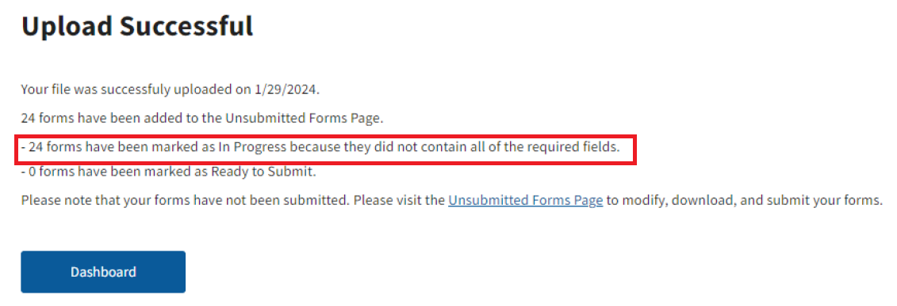
IRIS – Submitting TO IRS
Uploading to IRIS, does not mean you submitted the forms to the IRS.
Submitting forms to the IRS, does not mean the forms were accepted by the IRS.

Slide 23
IRIS Takeaways
There was a learning curve using IRIS.
A2A solution was not available to use with our AP software – maybe next year?
The submitting/upload process was challenging with the CSV file.
The enter data option is easy, if filling a limited number of 1099s.
1099 Corrections could be easier in IRIS, than FIRE.
Year 2 should be better?!?!?

Slide 24
Third-party filer
Outsource reporting for some or all of your 1099s.
Some outside audit firms can help.
Various e-filing companies offer these services online.
We used https://www.tax1099.com/ for filing 1042s this year and may use it for other things in the future.

Slide 25
1099 Follow-ups
Returned 1099s
1099 Corrections
B-Notice

Slide 26
Best Practices
Obtain Form W-9, prior to making payment.
Keep your vendor file current.
IRS TIN matching before payment and submission to the IRS.
When in doubt, report payee/payment.
Have e-filing options and apply for your TCCs early.
Use your resources.
Start early and plan for issues.

Slide 27
1099 Resources
IRS Website: https://www.irs.gov/
IRS E-Filing Guidance: https://www.irs.gov/filing/e-file-information-returns
Master Guide to Form 1099 Compliance
Institute of Finance & Management
External Auditor Firm with tax specialists
Third party filers
Contact us!

Slide 28
Questions?

Slide 29
Contact Information
Nate Zinsmeyer Payroll/Operations Manager
Williamson County Auditor’s Office
Ph. # 512-943-1561 Email: nzinsmeyer@wilco.org
Karen Knightstep Accounts Payable Manager
Williamson County Auditor’s Office
Ph. # 512-943-1563 Email: kknightstep@wilco.org

