Slide 1
Ratio Studies and What They Mean to Me PTI Conference 2021
Shane Docherty: dochertys@dcad.org
Michelle Berdeaux: michelle.Berdeaux@atascosacad.com

Slide 2
Ratio Studies What They Mean to Me
Statistical Testing
Model Calibration
Mass Appraisal Report
Performance Tests (Sales Ratio Studies)
Statistical Analysis

Slide 3
Statistical Testing Model Validation
Internal:
Ratio Studies (Residential Neighborhood, Commercial Improved Market Areas)
Income Analysis by Property Type by IMA
Quality Control Division: Statistical Analysis: USPAP Validation
External:
Property Tax Assistance Division (PTAD): Property Value Study (PVS).
University of Texas at Dallas (UTD): Residential ISD Ratio Study

Slide 4
Dallas CAD Mass Appraisal Report: Residential
PERFORMANCE TESTS
Sales Ratio Studies
The primary analytical tool used by the appraisers to measure and improve performance is the ratio study. DCAD ensures that the appraised values that it produces meet the standards of accuracy in several ways. Overall sales ratios can be generated by building class, by neighborhood, by city, and by ISD to allow the appraiser to review general market trends within their area of responsibility, and provide an indication of market appreciation over a specified period of time. These sales ratio statistics are available under the MARS Reappraisal Analysis module and typically cover a 18 month time frame.
The Quality Control Division also undertakes performance testing annually to insure accuracy and uniformity.

Slide 5
Dallas CAD Mass Appraisal Report: Residential
Statistical Analysis
The residential appraisal staff performs statistical analysis annually to evaluate whether values are equitable and consistent with the market. Ratio studies are conducted on each of the approximately 5,199 residential neighborhoods to the level of assessment and whether the neighborhood and associated building classes are in need of reappraisal. The level of appraised values is determined by the weighted mean for individual properties within a neighborhood and also by building class within a neighborhood. Every neighborhood is reviewed annually by the appraisal supervisory staff through the sales ratio analysis process. The first phase involves neighborhood ratio studies that compare the recent sales prices of neighborhood properties to the appraised values of these sold properties. This set of ratio studies affords the appraiser an excellent means of judging the present level of appraised value and uniformity of the sales. The University of Texas at Dallas also conducts an annual regression and census ratio analysis by neighborhood and ISD to determine the level of assessment within these market areas. The UTD Study in conjunction with in-house ratio analysis is used to target neighborhoods in need of reappraisal for the current appraisal year.

Slide 6
Dallas CAD Mass Appraisal Report: Residential Model Calibration
Market Adjustment or Trending Factors
Neighborhood, or market adjustment, factors are developed from appraisal statistics provided from ratio studies and are used to ensure that estimated values are consistent with the market. The district’s primary approach to the valuation of residential properties uses a hybrid cost-sales comparison approach. This type of approach accounts for neighborhood market influences not specified in the base building class cost tables.
The following equation denotes the hybrid model used:
MV = LV + ((RCN x BCLF) – D)
Whereas the market value (MV) equals land value (LV) plus the replacement cost new (RCN) times the neighborhood building class location factor (BCLF) less depreciation (D). As the cost approach separately estimates both land and building values and uses depreciated replacement costs, which reflect only the supply side of the market, it is expected that adjustments to the cost values are needed to bring the level of appraisal to an acceptable standard. Therefore, market, or building class location factors are applied uniformly by building class by neighborhood to insure equitable and accurate market values within these market areas. The MARS Neighborhood Analysis module is where the appraiser undertakes these calculations and documents the neighborhood trends and findings for the given reappraisal effort.

Slide 7
DCAD Residential Ratio Reports
Neighborhood
Neighborhood by Building Class
ISD
City
Building Class (All)
Land

Slide 8
DCAD Residential Neighborhood Ratio Reports

Slide 9
DCAD Residential ISD Ratio Reports

Slide 10
DCAD Residential City Ratio Reports

Slide 11
DCAD Residential Building Class Ratio Reports

Slide 12
Dallas CAD Mass Appraisal Report: Commercial
PERFORMANCE TESTS
The primary tool used to measure mass appraisal performance is the ratio study. A ratio study compares appraised values to market values. In a ratio study, market values (value in exchange) are typically represented by sales prices (i.e. a sales ratio study). Independent, expert appraisals may also be used to represent market values in a ratio study (i.e. an appraisal ratio study). If there are not enough sales to provide necessary representativeness, independent appraisals can be used as indicators for market value. This can be particularly useful for commercial, warehouse or industrial real property for which sales are limited. In addition, appraisal ratio studies can be used for properties statutorily not appraised at market value, but reflect the use-value requirement. An example of this are multi-family housing projects subject to subsidized rent provisions or other governmental guarantees as provided by legislative statutes (affordable housing) or agricultural lands to be appraised on the basis of productivity or use value.

Slide 13
Dallas CAD Mass Appraisal Report: Commercial
Sales Ratio Studies
Sales ratio studies are an integral part of establishing equitable and accurate market value estimates, and ultimately assessments for this taxing jurisdiction. The primary uses of sale ratio studies include the following: to determine the need for general reappraisal; to prioritize selected groups of property types for reappraisal; to identify potential problems with appraisal procedures; to assist in market analyses; and to calibrate models used to derive appraised values during valuation or reappraisal cycles. However, these studies cannot be used to judge the accuracy of an individual property’s appraised value. The Appraisal Review Board of Dallas County may make individual value adjustments based on unequal appraisal (ratio) protest evidence submitted on a case-by-case basis during the hearing process.
Overall sales ratios are generated by use type annually (or more often in specific areas) to allow appraisers to review general market trends in their area of responsibility. The appraisers utilize many MARS applications to evaluate subsets of data by economic area or a specific and unique data item. In MARS, this may be customized and performed by building class and age basis. In many cases, field checks may be conducted to insure the ratios produced are accurate and the appraised values utilized are based on accurate property data characteristics. These ratio studies aid the appraisers by providing an indication of market activity by economic area or changing market conditions (appreciation or depreciation).

Slide 14
DCAD Commercial Ratio Reports

Slide 15
DCAD Commercial Ratio Reports Apartment

Slide 16
DCAD Commercial Ratio Reports City Apartment

Slide 17
DCAD Commercial Ratio Reports ISD Apartment

Slide 18
Dallas CAD Commercial Model Calibration
Income Component Adjustments
Rental Rate
Vacancy & Collection Loss
Expenses
Cap Rate
By Improved Market Areas by Comp Codes (A+, A, A-, B+, B, B-, C+, C, C-)
Retail
Multi-Family
Industrial
Office
Other

Slide 19
Atascosa CAD Ratio Study Procedures
Sales Information
A sales file for the storage of snapshot sales data at the time of sale is maintained. Residential vacant land sales, along with commercial improved and vacant land sales are maintained in a separate sales information system. Residential improved and vacant sales are collected from a variety of sources, including: appraisal district questionnaires sent to buyer and seller, field discovery, protest hearings, Board of Realtor’s MLS, various sale vendors, builders, and realtors. A system of type, source, validity and verification codes was established to define salient facts related to a property’s purchase or transfer. School district or neighborhood sales reports are generated as an analysis tool for the appraiser in the development of value estimates.

Slide 20
ACAD Statistical Analysis
Statistical Analysis
The residential field appraisers perform statistical analysis annually to evaluate whether values are equitable and consistent with the market. Ratio studies are conducted on each of the approximately 546 residential valuation neighborhoods in the appraisal district to judge the two primary aspects of mass appraisal accuracy level and uniformity of value. Appraisal statistics of central tendency and dispersion generated from sales ratios are available for each stratified neighborhood within an ISD and summarized by year. These summary statistics including, but not limited to, the weighted mean, median, standard deviation, coefficient of variation, and coefficient of dispersion provide the appraisers a tool by which to determine both the level and uniformity of appraised value on a stratified neighborhood basis. The level of appraised values is determined by the weighted mean for individual properties within a neighborhood, and a comparison of neighborhood weighted means reflect the general level of appraised value between comparable neighborhoods. Review of the standard deviation, coefficient of variation, and coefficient of dispersion discerns appraisal uniformity within and between stratified neighborhoods.
The appraiser, through the sales ratio analysis process reviews every neighborhood annually. The first phase involves neighborhood ratio studies that compare the recent sales prices of neighborhood properties to the appraised values of these sold properties. This set of ratio studies affords the appraiser an excellent means of judging the present level of appraised value and uniformity of the sales. The appraiser, based on the sales ratio statistics and designated parameters for valuation update, makes a preliminary decision as to whether the value level in a neighborhood needs to be updated in an upcoming reappraisal, or whether the level of market value in a neighborhood is at an acceptable level.

Slide 21
Performance Testing
Sales Ratio Studies
The primary analytical tool used by the appraisers to measure and improve performance is the ratio study. The appraisal district ensures that the appraised values that it produces meet the standards of accuracy in several ways. Overall sales ratios are generated for each ISD by quarter to allow the appraiser to review general market trends within their area of responsibility and provide an indication of market appreciation over a specified period of time. The neighborhood descriptive statistic, along with frequency distributions and scatter diagrams are reviewed for each neighborhood being updated for the current tax year. In addition to the mainframe sales ratios by school district and neighborhood, quarterly sales ratios are generated from a PC-based statistical application in Microsoft EXCEL. Reported in the sales ratio statistics for each school district is a level of appraisal value and uniformity profile by land use, sales trends by quarter and 12-month time frame, and appraisal value ranges. The PC-based ratio studies are designed to emulate the findings of the Texas Comptroller of Public Accounts, Property Tax Assistance Division’s (PTAD) bi-annual PVS.

Slide 22
Examples

Slide 23
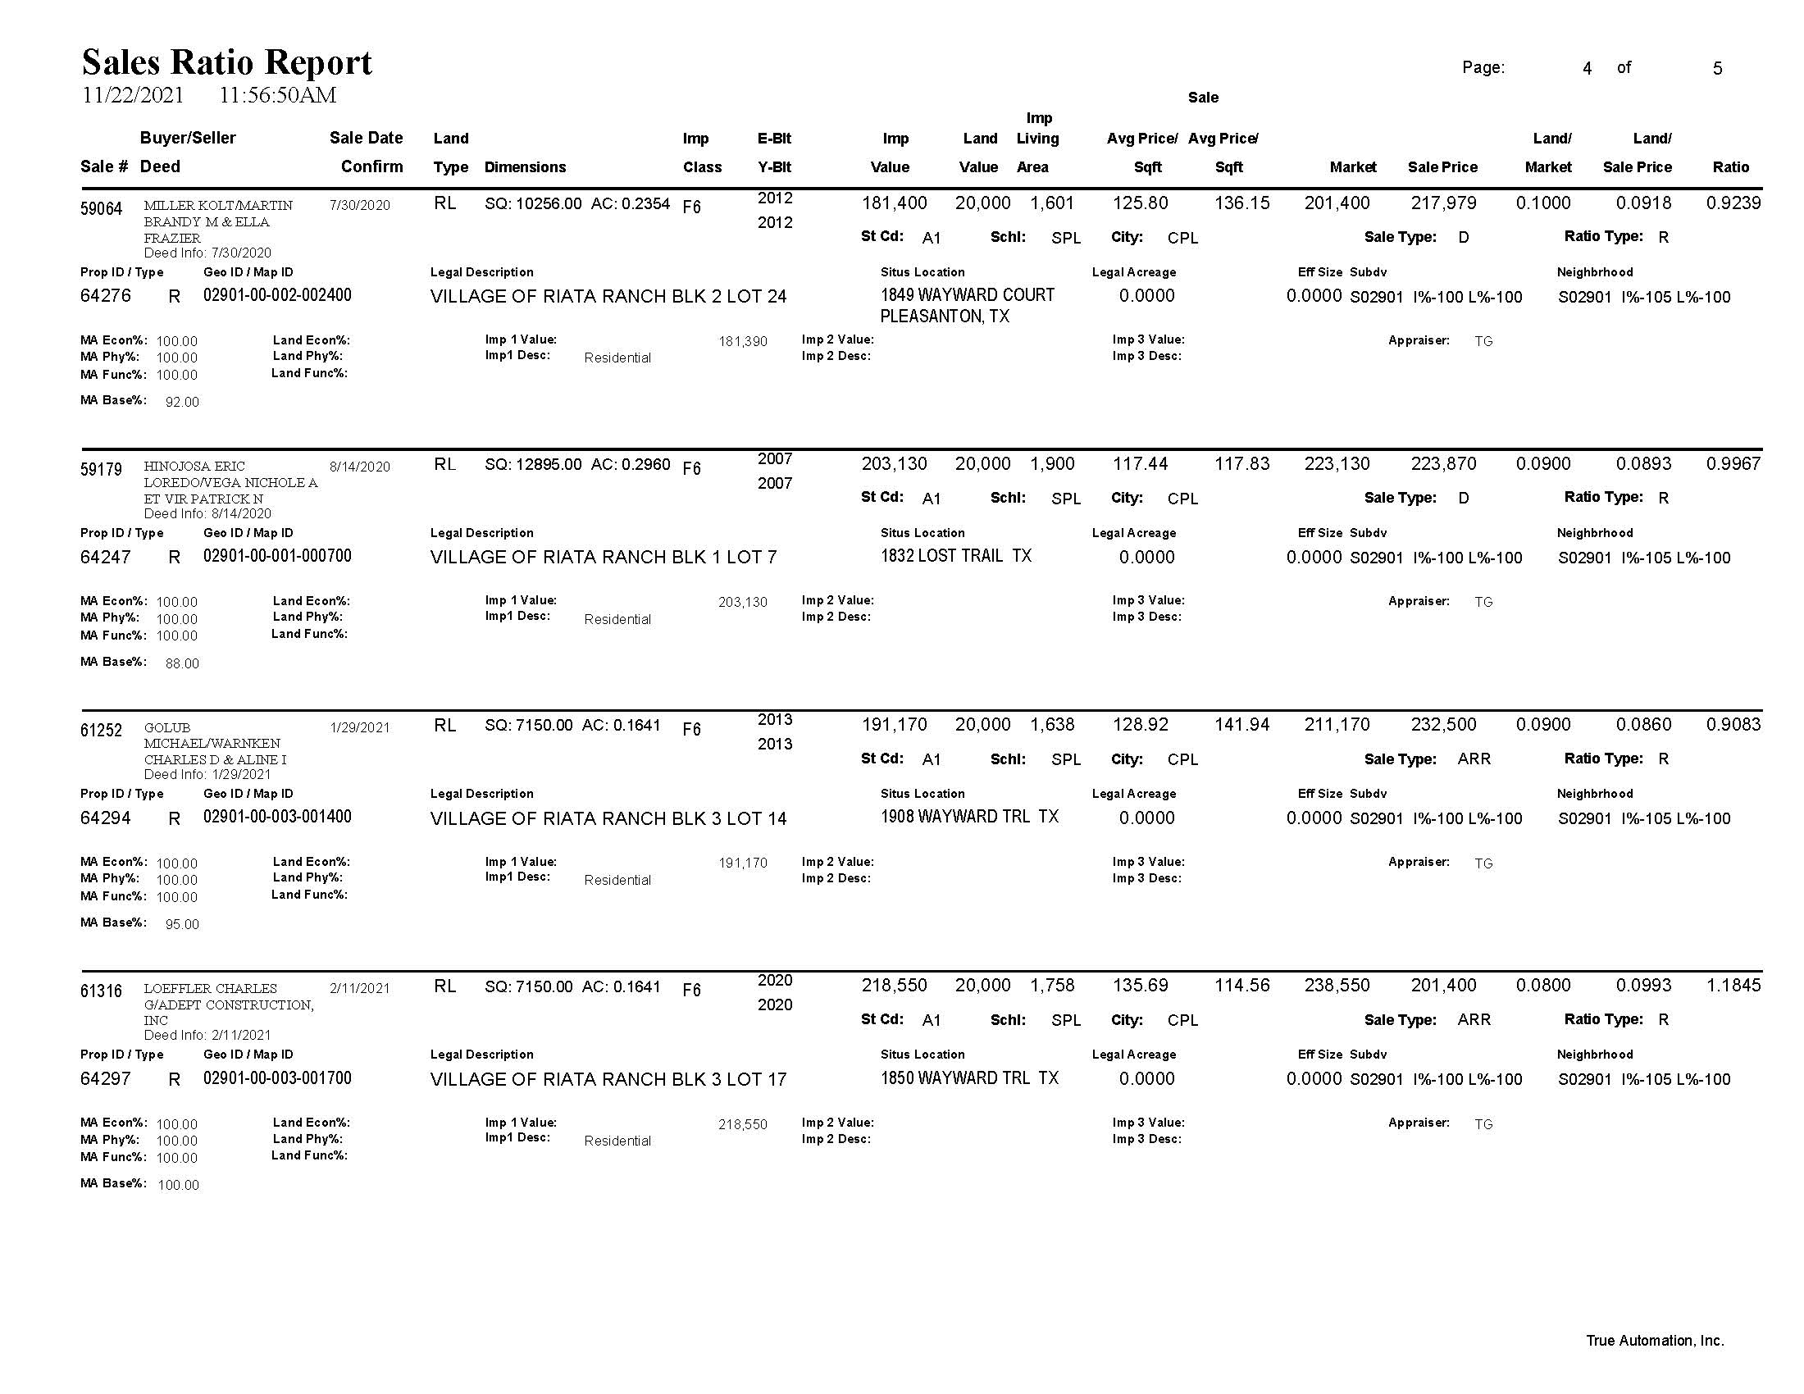

Slide 24
Cost Schedule Calibration

Slide 25
Market NBHD Adjustments

Slide 26
Overall Recap
Limited data may affect the ability to rely on a ratio study for a given strata, class or neighborhood.
Reasonable assumptions may need to be made when data is limited.
The overall quality of the data going in can greatly affect the outcome of the ratio study.
Ratio studies are an essential tool in verifying schedules, market areas and trending in both residential and commercial appraisals.

Slide 27
Thank you for joining us today!!
Shane Docherty
Michelle Berdeaux
DochertyS@DCAD.org
michelle.berdeaux@atascosacad.com

