Slide 1
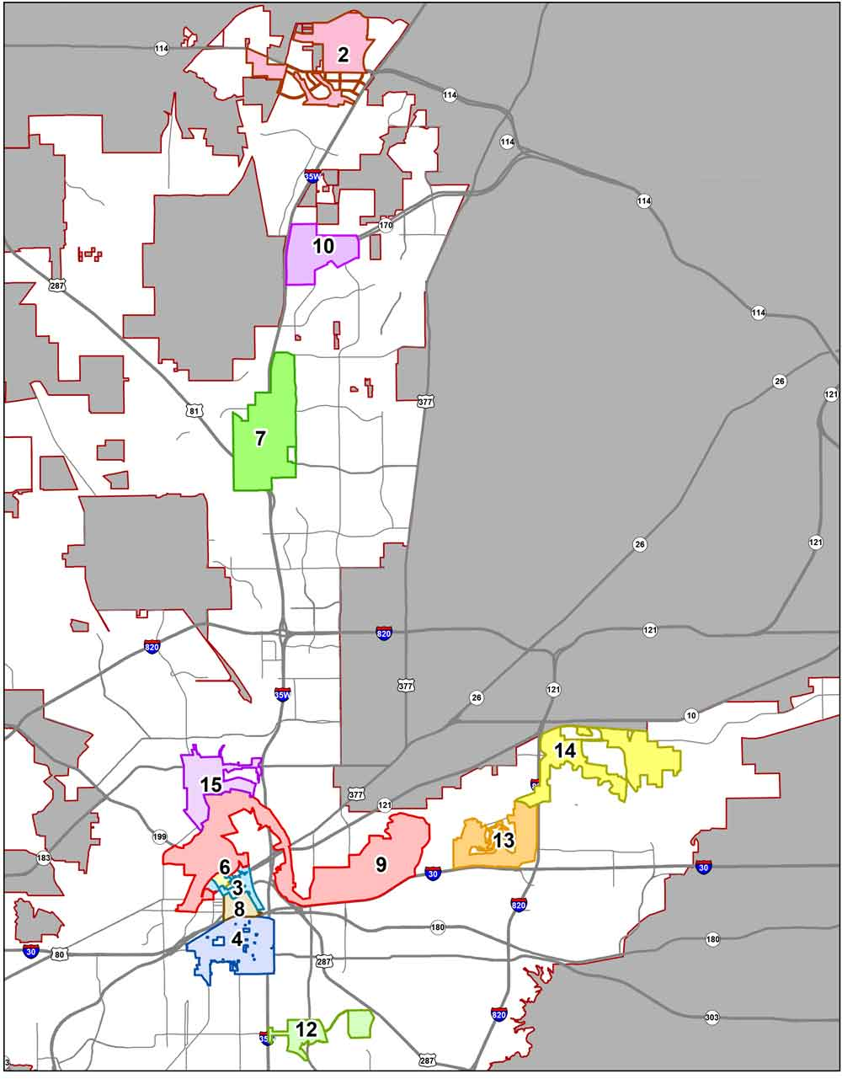
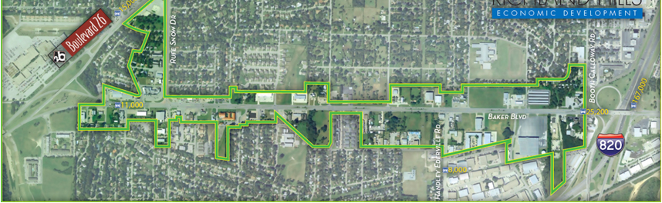
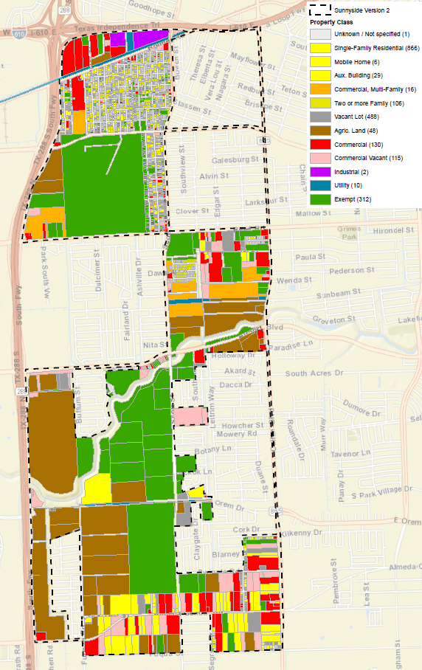
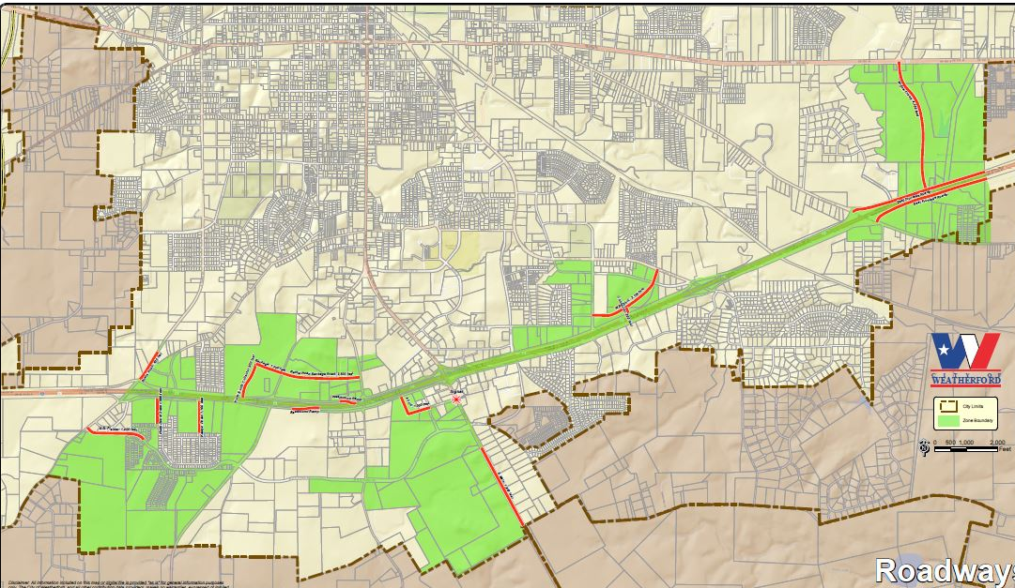
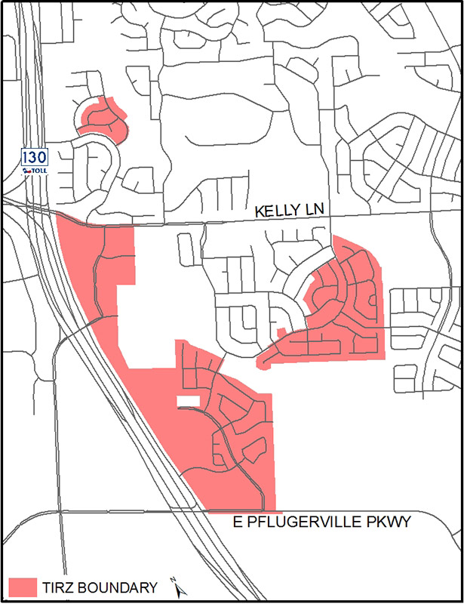
TIRZs Are Us
Data Analysis & Transparency Division
Notes:
This is the Texas Comptroller of Public Accounts webinar presentation on Tax Increment Reinvestment Zones as authorized by Tax Code, Chapter 311.
Before I get into the details of what is TIF and TIRZ are and how they work, let me make a brief comment about the recently ended legislative session. The legislature took no action to amend Tax Code, Chapter 311 regarding TIFs and TIRZs.

Slide 2

Introduction to TIRZs

Slide 3
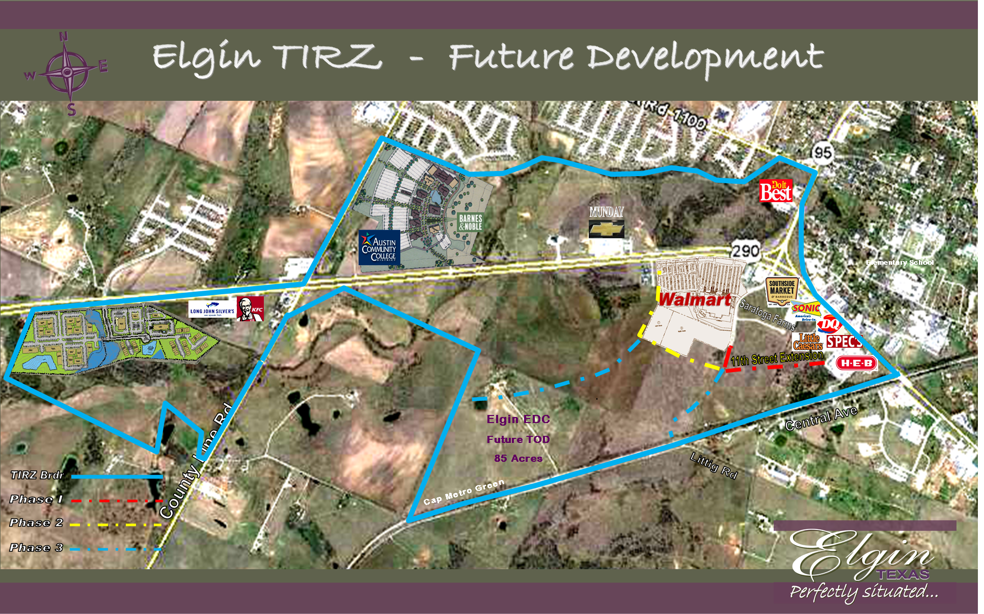
What is a TIF and a TIRZ?
Notes:
Tax increment financing (TIF) is a financing method local governments can use to pay for improvements that will draw private investment to an area. Tax increment financing redirects some of the ad valorem tax from property in a geographic area designated as a Tax Increment Reinvestment Zone (TIRZ) to pay for improvements in the zone. A TIRZ is created by a municipality. State law also allows counties to create tax increment reinvestment zones, but this is currently prohibited by the state constitution. It is important for counties in particular to keep in mind that there are two Attorney General opinions, GA-1076 and KP-0004, which have ruled that counties can not initiate or create of TIRZ because this would violate the “equal and uniform taxation requirement in article VIII, section l(a) of the Texas Constitution.”

Slide 4
TIRZ Registry Status
Total Number of TIRZs
Jul. 2021 # of TIRZs: 382
Dec. 2020 # of TIRZs: 364
Jun. 2020 # of TIRZs: 353
Jun. 2019 # of TIRZs: 337
Dec. 2018 # of TIRZs: 317
Number counties with a TIRZ
Jul. 2021 – 59
Dec. 2020 – 59
Jun. 2020 – 60
Jun. 2019 – 60
Dec. 2018 - 54
Number cities with a TIRZ
Jul. 2021 - 175
Dec. 2020 – 165
Jun. 2020 – 170
Jun. 2019 – 159
Dec. 2018 – 145
Other TIRZ Facts
City with most TIRZs – 27 TIRZs located in Houston
City with largest fund balance of all TIRZs combined – Houston $467.4 billion
Largest city with most active TIRZs and the smallest combined debt – Ft. Worth with a combined $0
5 Smallest cities with a TIRZ
1) Iowa Colony - 3,233 2) Aubrey - 4,895 3) Wolfforth - 5,486 4) Sansom Park - 5,748 5) Palmview - 5,774
Top 5 active TIRZs with the longest terms
  1) Houston TIRZ #1 – 55 years 2) El Paso TIRZ #13 – 52 years 3) Houston Memorial Heights TIRZ #5 – 52 years
  4) Houston TIRZ #10 - 52 years 5) Waco TIRZ #1 - 50 years
5 Oldest active TIRZs
1) Waco TIRZ #1 - 1982 2) Waco TIRZ #2 -1983 3) Waco TIRZ #3 - 1986
4) Houston Lamar Street TIRZ #1 -1991 5) Dallas Oak Cliff Gateway TIRZ #3 – 1992 5) Dallas TIRZ Cedars #4 - 1992
TIRZs with the shortest terms – Town of Northlake TIRZs 2 thru 4 - 5 years each
5 Largest TIRZs (in acres)
1) Houston TIRZ #24 - 7,743 2) El Paso TIRZ #13 - 6,879 3) Houston Hiram Clark TIRZ #25 - 5,736
4) El Paso TIRZ #10 - 3,970 5) Pearland TIRZ #2 - 3,932
5 Smallest TIRZs (in acres)
1) Austin TIRZ #15 - 5 acres 2) Trophy Club TIRZ #1 – 6 acres 3) Austin TIRZ #18 – 14 acres
4) Bay City TIRZ #3 – 20 acres 5) Sherman Legacy Village TIRZ #7 – 22 acres
Notes:
Here we have gathered a series of numbers regarding TIRZs. Since December 2018 the number of TIRZs has steadily increased to 382 as of July 2021. These TIRZs are located in 59 counties across Texas and were created by 175 different cities.
Other interesting TIRZ facts include : the city of Houston having more active TIRZs than any other Texas city with 27 of them. These 27 TIRZs have a combined fund balance of $467.4 billion.
Meanwhile, the city of Ft. Worth has 12 TIRZs. Ft. Worth is the largest Texas city with multiple TIRZs with a combined debt of $0.
The five smallest cities in Texas based on population numbers which all have a TIRZ are: #1 – Iowa City with 3,233; #2 – Aubrey with 4,895; #3 – Wolfforth with %,486; #4 – Sansom Park with 5,748; and #5 is Plainview with 5,774 people.
The top 5 active TIRZs with the longest terms or terms longest terms that have been amended are Houston TIRZ #1 lasting 55 years, followed by El Paso TIRZ #13 lasting 52 years, Houston Memorial Heights TIRZ #5 also lasting 52 years, Houston TIRZ #10 lasting 52 years and Waco TIRZ #1 lasting 50 years.
The five oldest TIRZs that are still active are: Waco TIRZ #1 was created in 1982, followed by Waco TIRZ #2 created in 1983, Waco TIRZ #3 created in 1986, Houston Lamar Street/St. George TIRZ #1 created in 1991 and Dallas Oak Cliff Gateway TIRZ #3 and Dallas Cedars TIR #4 which were both created in 1992.
What is interesting in the next stat is the length of time of these TIRZs, Northlake TIRZs 2 thru 4 all have a length of 5 years which is unusual.
The next to the last grouping relates to the largest TIRZs as measured in acres. The top five largest TIRZs are: Houston TIRZ #24 with 7,743 acres, El Paso TIRZ #13 with 6,879 acres, Houston Hiram Clark TIRZ #25 with 5,736 acres, El Paso TIRZ #10 with 3,970 acres and Pearland TIRZ #2 with 3,932.
The last category identifies the five smallest TIRZs as measured in acres which are: Austin TIRZ #15 with 5 acres, Trophy Club TIRZ #1 with 6 acres, Austin TIRZ #18 with 14 acres, Bay City TIRZ #3 with 20 acres and lastly is Sherman Legacy Village TIRZ #7 with 22 acres.

Slide 5
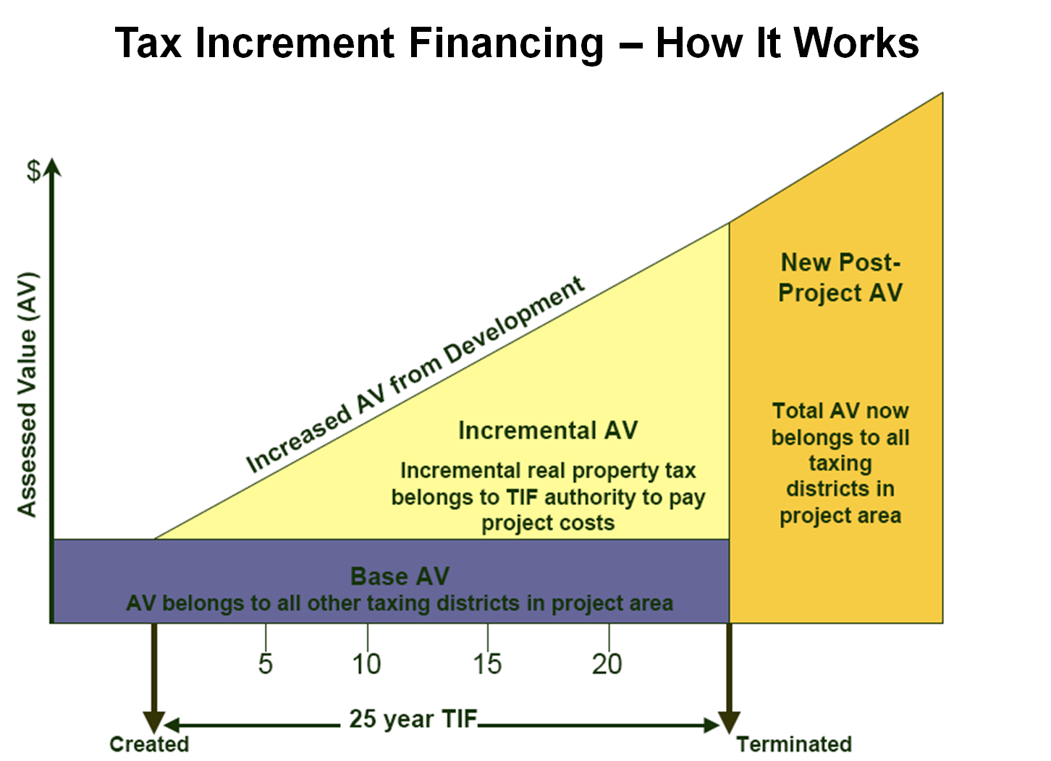
Simply Put - How Does a TIRZ Work?
Notes:
When a municipality or county creates a TIRZ, it records the total taxable value of all real property within the zone. This is a snapshot of the zone’s base value. So lets go through each element in a clear manner.
First, the participants in a TIRZ dedicate a Tax Increment to finance TIRZ improvement projects. This percentage is a portion of the taxes collected that is contributed to fund the improvements.
Second, the year in which a TIRZ is created is the “Base Year,” and the appraised value of TIRZ real property in the Base Year is the “Base Year Value.”
Third, as development or redevelopment occurs, the appraised value of the property in the TIRZ increases as seen in the growth of the yellow area on the chart as time goes by as you move further to the right on the chart.
Fourth, the difference between the increased appraised value of property in the TIRZ and the Base Year Value is defined as the “Captured Appraised Value.” Or another words, the Captured Appraised Value = (Current Year Value or Total Appraised Value) - (Base Year Value). When looking at the chart, the yellow amount of the captured appraised value increases when you move further to the right over time away from the creation date that established the base value.
Fifth, taxes levied and collected on the Base Year Value remain with the participating taxing units.
Sixth, some portion of the taxes levied and collected on the Captured Appraised Value as set by the tax. increment is sent to the municipality and deposited in the Tax Increment Fund. Revenues in the Tax Increment Fund can only be used to pay for TIRZ improvement projects.

Slide 6
Steps & Criteria to Create a TIRZ

Slide 7

Beginning the TIRZ Process: Step 1
Prepare a preliminary financing plan (Tax Code, Section 311.003(b))
  Formation Process & Politics
  Up-Front TIF Sizing
  Site Specific v. Project Specific TIRZ
  Determining the TIF Boundary
  Working with affected taxing jurisdictions
Notes:
The process to creating a tax increment reinvestment zone is a simple eight step process:
(Press Individually for Bullet Point to Appear) The creation of a TIRZ includes a number of planning, feasibility, legal and strategic considerations. These issues should be considered at the beginning of the process to avoid a waste of time, effort and expense. Hence, the first step of the process is to begin putting together a preliminary finance plan.
(Press Individually for Bullet Point to Appear) So, what are some of those considerations? Firstly, is knowing the process of putting together a TIRZ and being a aware of the politics surrounding this issue. What are the existing plans, goals and codes? What would be some of the benefits to the people/benefits within the TIRZ and the larger community as a whole? Who are the leaders and stakeholders that may be for and against the formation of a TIRZ? What would be any legal ramifications? What would be some of the costs for the proposed improvements?
(Press Individually for Bullet Point to Appear) Next in the planning process “up-front TIF sizing” which is an analysis of the revenues and determining if those revenues support the proposed plan of public project improvement expenditures. Is your wish list to large and need to be scaled back, do some of the desired projects need to be spaced out over time? What kind of projected revenues would each property in the proposed TIRZ look like over the next 5-10 years?
(Press Individually for Bullet Point to Appear) In the process of reviewing, underwriting and structuring TIF transactions the taxing units should consider expenditures in terms of the “whole site” or more limited to “specific projects.” Taxing units should thoroughly understand the project and proposed expenditures to accurately size the TIRZ district when it is created by doing the following: (a) review the proposed plan for public improvements; (b) review/develop cost estimates for the improvements with built-in contingencies and (c) carefully underwrite the TIF amount to determine whether that amount is sufficiently or excessive.
(Press Individually for Bullet Point to Appear) A significant factor in the success of a TIRZ is the fixing of the boundaries of the TIRZ. Determining the boundaries of the TIRZ should factor in these considerations: (1) how can the TIF be used to provide key project(s) with derived resources without locking up future revenues; (2) what revenue sources can be generated within the TIRZ to make sure it can pay for the anticipated costs; and (3) consider each individual property whether they each should be in the TIRZ, be a benefit to the TIRZ.
(Press Individually for Bullet Point to Appear) Lastly, is where we need to determine if and how the creation of a TIRZ might impact other taxing jurisdictions. Would the inclusion of one or more other taxing units as “participating taxing units” help generate a significant amount of tax increments into the fund in future years? Would it create a burden on other taxing units? Would the creation of a TIRZ impact traffic patterns in adjacent areas and communities? Are there other projects underway in adjacent taxing units/zones? Could the inclusion of a taxing unit as a “participating taxing unit” in the TIRZ meet a need of there’s by ensuring some of the TIF funds go toward a project they have in mind?

Slide 8
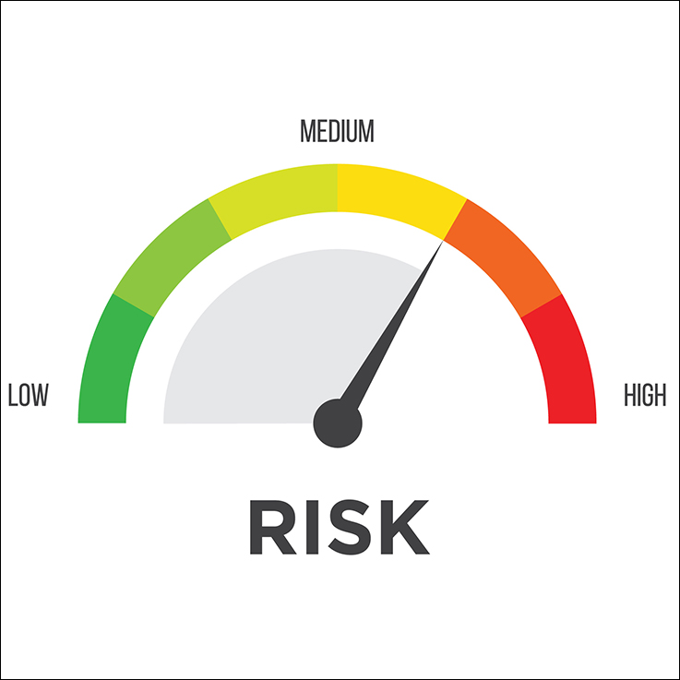
Addressing Risks
Construction Risk
Timing Risk
Sale/Lease-Up Risk
Assessment/Taxation Risk
Ongoing Operational Risk
Notes:
Not all TIRZ deals are wonderful. Depending on the type of project funded or the structure of the transaction, public financial risk can range from minimal to levels similar to those experienced by lenders or equity investors. Local taxing units need to properly assess risk early in the process and determine any potential mitigations. All TIRZ deals rely on a set of projections and assumptions regarding things that are not set in concrete such as the tax system ad the real estate market over time.
(Press Individually for Bullet Point to Appear) The first potential risk is construction. If you have built a home or remodeled a home and extrapolate it out on a larger scale to a local taxing unit(s) public project improvement plan, you will realize that you often make project upgrades, project additions which can lead to increased construction cost or cost overruns if project upgrades/additions are excessive. This can lead to future project delays due to a lack of funds or mismanagement.
(Press Individually for Bullet Point to Appear) Second, project delays typically occur when developments include multi-phases. These occur before and during construction as well as during the sale/lease-up phases of the project. Delays will cause TIF revenues to lag behind projections and in some cases permanently.
(Press Individually for Bullet Point to Appear) Third, if sales/lease-ups lag significantly behind developer expectations, then the developer may reach the end of the construction loan term and be unable to retire the debt, which could lead the construction lender to foreclose on the project and dispose of the asset at a discounted price. Conversely, sales/rents could be at lower prices or vacancy levels persist at higher rates than what is expected.
(Press Individually for Bullet Point to Appear) Fourth, remember that TIRZ revenues are generated from increased future valuations which produce increased revenue for the TIRZ. TIR projections are based on assumptions related to how newly developed properties will be assessed and how property values will appreciate or depreciate over time and how the tax rates may change in the near to mid-term future.
(Press Individually for Bullet Point to Appear) Fifth, TIRZ projections are based on a stable occupancy rate for the project for 15 or more years. Due to management or market issues, projects may begin to underperform over time thereby leading to sudden and/or irrational changes in property use, stagnant growth, and increased vacancy rates.

Slide 9

Steps 2-3: The Mechanics
Step 2
Publish the hearing notice
  Wording
  Time frame
(Tax Code, Sections 311.003(c), (d) and (e))
Step 3
Hold a public hearing
  People speak for and against
(Tax Code, Section 311.011(e))
Interfacing with Affected Taxing Jurisdiction
Notes:
Step 2) (Press Individually for Bullet Point to Appear) Notice of the hearing must be published in a newspaper having a general circulation in the municipality, not later than the seventh day before the date of the hearing. There is no statutorily required word for the notice. The notice must be given at least seven days in advance of the called public meeting.
Step 3) (Press Individually for Bullet Point to Appear) The municipality must hold a public hearing on the creation of the zone and its benefits to the municipality and to property in the proposed zone. Both sides of the proposal are to be heard.
NOTE: During this time frame and prior to the vote to designate the TIRZ, the lead taxing unit should be working with other taxing units with jurisdiction over the property within the boundaries of the TIRZ to determine if they will “participate” and if so what tax increment level they might be willing to consider and if those other taxing units would bring up their “participation” in the TIRZ for a vote at a time close to the vote by the lead taxing unit.

Slide 10

Step 4: Designating the Zone
Approving by ordinance or order
Filing required form and documents with the Comptroller
(Tax Code, Sections 311.011 and 311.004)
Notes:
(Press Individually for Bullet Point to Appear) Step four is when the ordinance comes before the governing body to consider designating or creating a TIRZ. If the governing body does approve the creation of the TIRZ, then the city needs to submit Comptroller form 50-807.

Slide 11

Criteria to Create a Reinvestment Zone
Tax delinquency exceeding the fair value of the land;
Deteriorated structures;
Inadequate sidewalks or streets;
Poor platting;
Unsanitary or unsafe conditions;
Deterioration of site;
Defective or unusual conditions;
Conditions that endanger life or property by fire or other disaster; or
Tax Code, Section 311.005
Notes:
To create a reinvestment zone, as a part of the project plan, a city must determine if at least one of these required criteria apply to the area being considered as identified in Tax Code, Section 311.005. The area must substantially arrest or impair the sound growth of the municipality designating the zone, retard the provision of housing accommodations, or constitute an economic or social liability and be a menace to the public health, safety, morals, or welfare in its present condition and use because of the presence of:
(Press Individually for Bullet Point to Appear) A substantial number of substandard, slum, deteriorated, or deteriorating structures;
(Press Individually for Bullet Point to Appear) Tax or special assessment delinquency exceeding the fair value of the land;
(Press Individually for Bullet Point to Appear) The predominance of defective or inadequate sidewalks or streets;
(Press Individually for Bullet Point to Appear) Faulty size, adequacy, accessibility or usefulness of lots;
(Press Individually for Bullet Point to Appear) Unsanitary or unsafe conditions;
(Press Individually for Bullet Point to Appear) Deterioration of site or other improvements;
(Press Individually for Bullet Point to Appear) Defective or unusual conditions of improvement;
(Press Individually for Bullet Point to Appear) Conditions that endanger life or property by fire or other cause; or

Slide 12

Continued - Criteria to Create a Reinvestment Zone
Any combination of these factors:
  Federally assisted new community;
  Located in a home-rule city;
  Impaired growth; and
  Sign relocation.
Notes:
Lastly, any combination of these factors could be considered in the designation of a reinvestment zone such as:
(Press Individually for Bullet Point to Appear) Be in a federally assisted new community in a home-rule city or adjacent to a federally assisted new community;
(Press Individually for Bullet Point to Appear) Located in a home-rule city;
(Press Individually for Bullet Point to Appear) Primarily due to obsolete platting, deteriorated structures impairing or arresting growth; and
(Press Individually for Bullet Point to Appear) Encompass signs, billboards, or outdoor advertising structures the governing body of the city designates for relocation.

Slide 13

Step 5a - Appointing & Composition of the TIRZ Board
5-15 members
1 per “participating” taxing unit
Lead Taxing Unit Appointments
Other Participating Units Combined Total
2 Year Terms
Staggered Terms
Chairman
Vice Chairman
  Tax Code, Section 311.009(a) and (e)-(f)
Notes:
The board of directors of a TIRZ;
Must consist of at least 5 and not more than 15 members;
Participating taxing units in the TIRZ may appoint one member of the board if their governing body approves payment of all or part of the tax increment into the TIF fund for the zone.
Also,
The lead governing body of a city may appoint no more than 10 directors to the board;
If other participating taxing units appoint a combined total less than 5 directors then the designating municipality may appoint more than 10 directors.
Based on Tax Code Sections 311.009(e) – (f), the governing body would:
determine if the board members serve two year terms.
determine if the board member terms are staggered or not and
fill the Chairman position for a term of one year, beginning on January 1 of the following year.
The TIRZ board would elect one of its members to serve as vice-chairman.

Slide 14
Step 5b – The Project and Finance Plans
PROJECT PLAN
Description and map showing existing and proposed uses of property
Proposed changes to zoning ordinances, the master plan
A list of estimated non-project costs
Statement of a method to relocate displaced persons, if any, resulting from implementation of the plan
FINANCE PLAN
Detailed list of estimated project costs;
List the proposed kind, number and location of all public works or public improvements to be financed;
A plan showing economic feasibility and producing an economic feasibility study
Bond indebtedness estimate to be incurred
Estimated time when related costs or monetary obligations are to be incurred
Annual estimated captured appraised value of the zone
Current total appraised value of taxable real property
Describe: (a) financing methods of all estimated project costs, and (b) sources of revenue to finance or pay project costs and (c) the percentage of tax increment derived from each taxing unit(s) property taxes contributing to the zone’s tax increment
Duration of the zone
(Tax Code, Section 311.011(b) and 311.011(c)
Notes:
The TIRZ Board is to prepare, approve and implement the plans and submit the plans to the governing body. The approval of the plans must be by ordinance, in the case of a municipality, or by order in the case of a county.
(Press Individually for Bullet Point to Appear) Statutorily, the “project plan” is to contain the following elements:
Description and map showing existing and proposed uses of property;
Proposed changes to zoning ordinances, the master plan;
A list of estimated non-project costs; and
Statement of a method to relocate displaced persons, if any, resulting from implementation of the plan.
(Press Individually for Bullet Point to Appear) Statute requires the following elements in a “finance plan:”
Detailed list of estimated project costs in the zone;
Statement listing the proposed kind, number and location of all public works or public improvements to be financed by the zone;
Finding that the plan is economically feasible and an economic feasibility study;
Bond indebtedness estimate to be incurred;
Estimated time when related costs or monetary obligations are to be incurred;
Annual estimated captured appraised value of the zone;
Current total appraised value of taxable real property;
Describing methods of financing all estimated project costs and expected sources of revenue to finance or pay project costs, including the percentage of tax increment to be derived from property taxes of each taxing unit anticipated to contribute tax increment to the zone; and
Duration of the zone.

Slide 15



Steps 6-8: Contribution to the Fund & its Implementation & Reporting
Step 6
Lead taxing unit contribution
Participating taxing unit(s) contribution
(Tax Code, Section 311.013)
Step 7
Creation of a separate fund account
Collecting and depositing tax increments
(Tax Code, Section 311.010(a))
Step 8
Submitting required Comptroller form and filing annual reports
(Tax Code, Section 311.016(a)-(b))
Notes:
(Press Individually for Bullet Point to Appear) Step 6 - The city may enter into an agreement at any time before or after the zone is designated. After the board of directors and the governing body has approved the project plan and the reinvestment zone, the other taxing units with property within the zone may set the percentage of their increased tax that would be dedicated to the tax increment fund.
(Press Individually for Bullet Point to Appear) Step 7 - Once the reinvestment zone is established, the zone’s board of directors must make recommendations to the governing body on implementing the tax increment financing as it relates to levying the taxes, collecting the taxes and depositing the tax increments.
(Press Individually for Bullet Point to Appear) Step 8 - The municipality shall send a copy of the annual report to
the comptroller.

Slide 16
Operation & Function
of a TIRZ

Slide 17
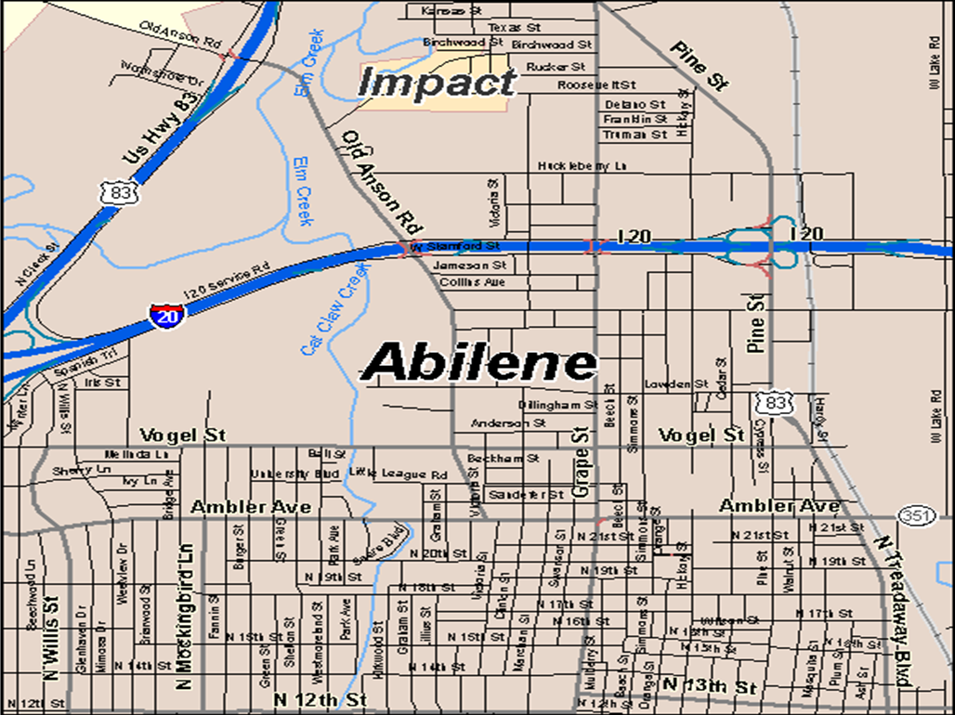


Zone Development & Enlargement
Original Zone
Treadway Sub-Zone
13th Street Sub-Zone
Abatement 1
Notes:
A zone can be enlarged by including new areas or sub-divisions at different times during its existence. Each new addition should be a part of an updated master project plan and the finance plan. However, on the Comptroller annual report form 50-806, you will need to show the tax increment base value, captured appraised value and total appraised value for each zone, sub-zone separately then add them up together at the end of the form.

Slide 18

TIRZ Financing
Using tax increments in the TIF Fund to make payments directly
Municipality issues tax increment bonds
Municipality creates a Local Government Corporation
Tax Increments are pledged as security
Public/Private Financing
Counties may not issue Tax Increment Bonds
Notes:
Traditional TIRZ Financing can occur under one of these scenarios such as:
(Press Individually for Bullet Point to Appear) Using tax increments in the TIF Fund to make payments directly
(Press Individually for Bullet Point to Appear) A municipality may directly issue Tax Increment Bonds.
(Press Individually for Bullet Point to Appear) A municipality may create a Local Government Corporation (“LGC”) under Chapter 431, Transportation Code, to issue bonds on behalf of the municipality and manage the affairs of the TIRZ.
(Press Individually for Bullet Point to Appear) Tax Increments can be pledged as security for Tax Increment Bonds, the proceeds of which are used to pay for TIRZ Improvements.
(Press Individually for Bullet Point to Appear) A TIRZ can enter into an agreement with a private developer to construct TIRZ Improvements. The developer agrees to construct and pay for the cost of construction of a particular TIRZ Improvement. In turn, the TIRZ agrees to reimburse the developer for the project costs of such TIRZ Improvement, if and when funds are available for such purpose. Thus, the financial risk is shifted from the TIRZ to the developer.
(Press Individually for Bullet Point to Appear) It is important to note that counties may not issue Tax Increment Bonds.

Slide 19
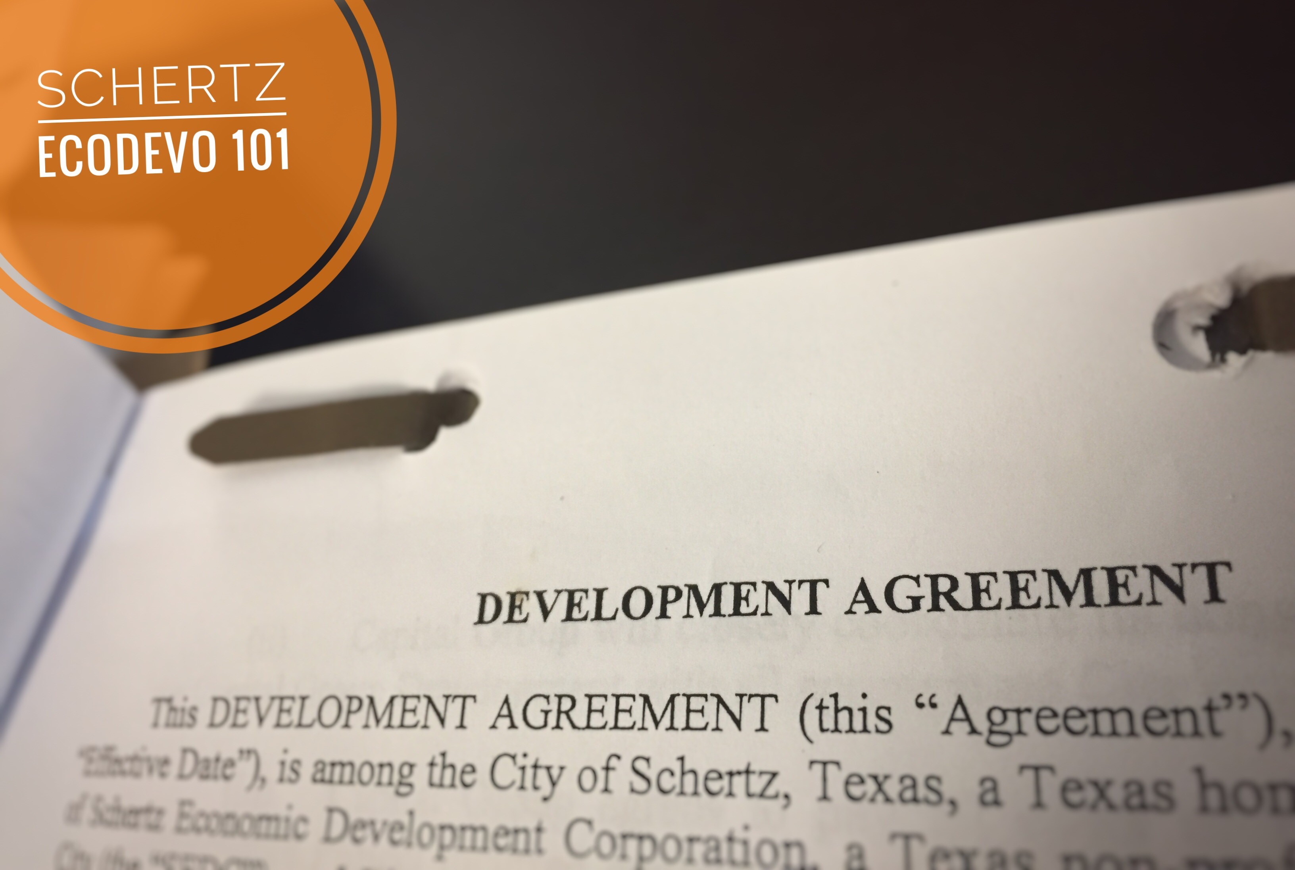
Abatement Agreements within the TIRZ
Any taxing unit except a school district may enter into an agreement; and
Board and Governing Body Approval
Tax Code, Section 311.0125
Notes:
In Tax Code, Section 311.0125 pertaining to abatement agreements within a TIRZ;
Any taxing unit except a school district may enter into an agreement with the owner of real property in a reinvestment zone; and
A tax abatement agreement can become effective only with the approval of the reinvestment zone board of directors and the governing body of each taxing unit that participates in the TIF project.

Slide 20
Comptroller Role, Forms & Available Materials

Slide 21

Comptroller Role
Central registry for TIRZs (Tax Code, Section 311.019(a)).
Submit a report to the Legislature and the Governor no later than December 31 of each even- numbered year (Tax Code, Section 311.020(a)).
Technical assistance (Tax Code, Section 311.063(a)).
Notes:
(Press Individually for Bullet Point to Appear) The Comptroller is required to maintain a central registry as per Tax Code Section 311.019(a) that provides a list of all reinvestment zones, abatements, TIRZs, project plans and finance plans throughout the state that have been adopted and submitted.
(Press Individually for Bullet Point to Appear) This information is to be compiled and submitted as a report to the Legislature and to the Governor no later than December 31 or each even-numbered year.
(Press Individually for Bullet Point to Appear) Another role for the Comptroller is to assist local governments and the public with questions about TIRZs, reinvestment zones, abatements and the forms required to be filled out.

Slide 22
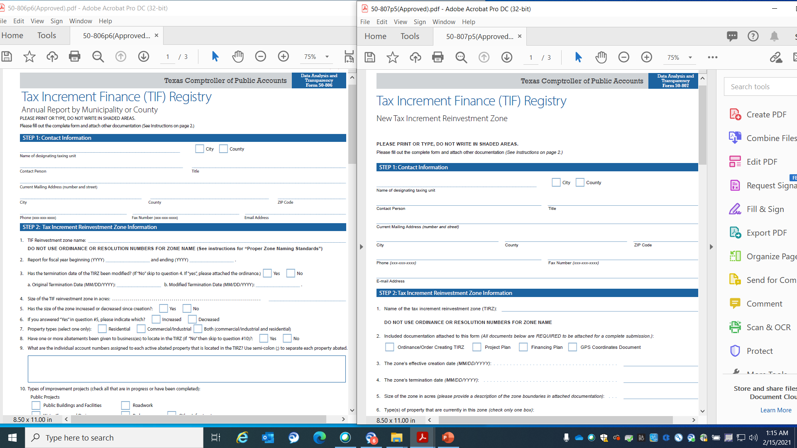
Key Portions of the Forms
Form 50-806
Form 50-807
Notes:
Xxxxxxxxxxxxxxxx
There are currently two Comptroller forms required of local governments to complete – forms 50-807 and 50-806. The forms have just been updated to match and parallel the new electronic reporting system that is being developed and to be used as the new reporting system come August 2021.
Depending on which form you are submitting you will need to follow these particulars as found in the instructions within these forms. The forms can be found on the Comptroller website until August 2021 which is - https://comptroller.texas.gov/economy/local/ch311/reporting.php.

Slide 23

General Reporting Requirements
New TIRZ
  Form 50-807
  Ordinance
  Project Plan & Finance Plan
  Due April 1 of the year following the year in which the zone is designated
Modified TIRZ
  Ordinance
  Project Plan
  Finance Plan
  Due before April 1 of the year following the year the amendment is made
Annual Report
  Form 50-806
  Annual Report
  Due on or before the 150th day following the end of the city’s fiscal year
Reporting Party
Recommended - Submit the forms ASAP
Forms- www.comptroller.texas.gov/economy/local/ch311/reporting.php
Tax Code, Sections 311.016(b) and 311.019(b), and 311.019(c)
Notes:
(Press Individually for Bullet Point to Appear) Cities must notify the Comptroller’s office of the creation of all TIRZ before April 1 of the year following the year in which the zone is designated. Notice must include form 50-807, the ordinance designating the zone, the project plan and the financing plan.
(Press Individually for Bullet Point to Appear) A city that amends or modifies a tax increment reinvestment zone, a project plan, or a financing plan adopted under this chapter must deliver a copy of the ordinance and any amended documents to the comptroller before April 1 of the year following the year the amendment is made.
(Press Individually for Bullet Point to Appear) On or before the 150th day following the end of the city’s fiscal year, the governing body must produce an annual report on the status of the zone and send a copy to the Comptroller. The annual report must be accompanied by Comptroller form 50-806.
(Press Individually for Bullet Point to Appear) From a best practice perspective, it is highly recommended that cities submit all documentation immediately rather than waiting. This minimizes lost paperwork and helps us connect each zone’s creation filings to the annual reports.
(Press Individually for Bullet Point to Appear) Also, all local government entities that create a TIRZ are the sole responsible party for submitting all required documents and forms. The CADs are not responsible nor are the participating taxing units for sending the forms to the Comptroller.
(Press Individually for Bullet Point to Appear) Lastly, here is the link to the Comptroller website which currently contains all forms that all taxing units can use who are the primary taxing units for these TIRZs as well as attach the required documents to the requisite Comptroller forms.

Slide 24
New Reporting Requirements: Spring 2022
All reporting will be done electronically on the Comptroller website.
All reporting for new TIRZs, modified TIRZs and Annual Reports will be done online and ALL supporting documents will be expected to be submitted with those forms as well.
All submissions of TIRZ data will be made recorded and made public in real time in a Comptroller database.
Notes:
Please review this slide closely. The Comptroller office is currently developing an online electronic reporting tool for local taxing units to use to enter the required data and to make this information public in real time in a Comptroller database.

Slide 25
Contact Information
Data Analysis & Transparency Division
Call: 1-844-519-5672
Email: econ.dev@cpa.texas.gov
Frank Alvarez – ext. 6-9231
frank.alvarez@cpa.texas.gov
Notes:
If you have additional questions about tax increment reinvestment zones, tax increment funding or the proper process to follow and what forms to use, please contact the Data Analysis & Transparency Division. Thank you.

