Slide 1


TIME TO PAY THE PIPER
Matthew Tepper
Mccreary veselka bragg and allen, pc

Slide 2

NEW COLLECTIONS LAWS

Slide 3

HB 3833 – Rollback Taxes
A rollback tax on 1-d-1 land or timberland will not include interest.
Recreational, park or scenic land; airport property; and restricted use timberland changes of use are now subject to a three-year (not five-year) rollback with no interest.
Applies to a change of use that occurred before June 15, 2021.

Slide 4
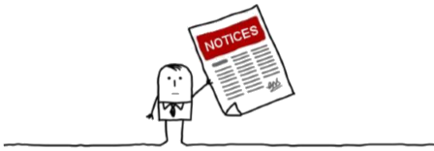
HB 3629 – Deferral Notices
The collector will have to deliver a notice of delinquency in order to trigger the beginning of the 180-day period before collection activities can begin.
Effective September 1, 2021

Slide 5

SB 1764 – Payments Before Sale
A collector is no longer required to accept a personal check to get property pulled from a court ordered sale.
The collector may adopt by written policy to only accept:
  Cash
  Cashiers Check
  Electronic Funds Transfer
  Effective June 16, 2021

Slide 6

SB 12 – Second Special Session
School Tax Ceiling Compression
School Tax Ceilings Are Compressed to Account for the 2019 School Tax Rate Compression
Multiply 2018 Value by Difference Between 2018 and 2019 Maximum Compressed Rate.
Subtract that amount from the actual tax imposed in 2019
Add In Taxes Attributable to New Improvements for 2019.
Repeat for 2020, 2021, 2022 and 2023.

Slide 7

Installment payments

Slide 8

SB 742 –
Disaster Installment Payments
Certain Properties located in a disaster area, or an emergency area are entitled to quarter pay.
Damaged property is state mandated.
Non-damaged property is local option.
Applies to taxes imposed before the first anniversary of the disaster or emergency.

Slide 9
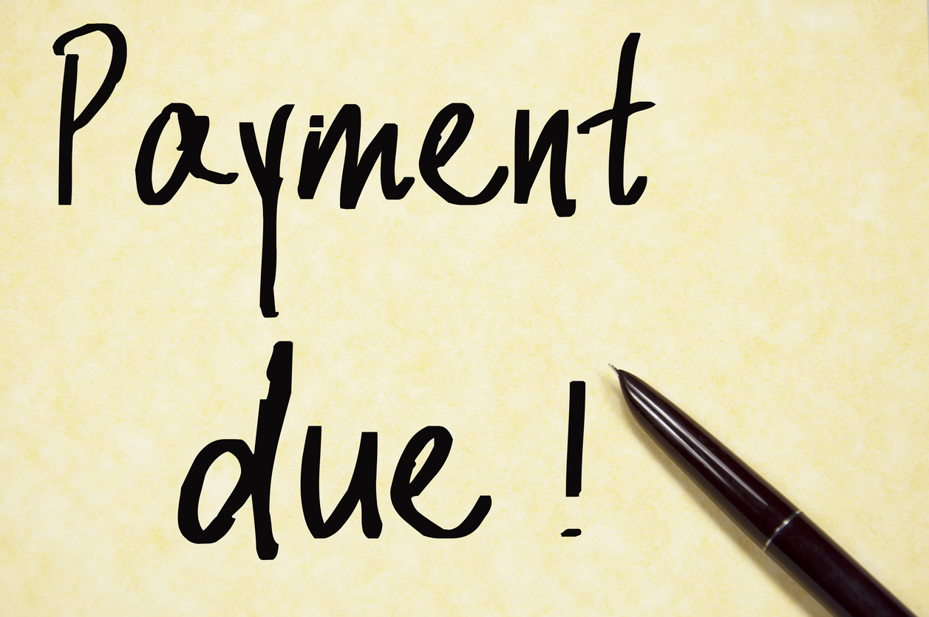
Tax Code, Sec. 31.032 –
Disaster Installment Payments
Must pay first ¼ payment of taxes and provide notice of ¼ by February 1.
Late payments and notice accepted until March 1.
Other ¼ payments are due before April 1, June 1, and August 1.

Slide 10

Tax Code, Sec. 31.031 –
Quarter Payments
Who Qualifies:
  Disabled Person
  O65
  Disabled Veteran
  Surviving Spouses of DV
  Must qualify under 11.13(c); 11.132; or 11.22
  Works like 31.032 except that the payment schedule shifts if the delinquency date is delayed under 31.031.
  Unpaid amounts incur a penalty of 6%.

Slide 11

Tax Code, Sec. 31.03 –
Split Payment of Taxes
Local option to allow property owners to pay half their taxes before December 1, and the other half of their taxes before July 1 without any penalty or interest.
Applies to all taxes for which the adopting taxing unit collects.
Requires resolutions from a majority of an appraisal district’s collecting entities to adopt in an appraisal district that collects.

Slide 12
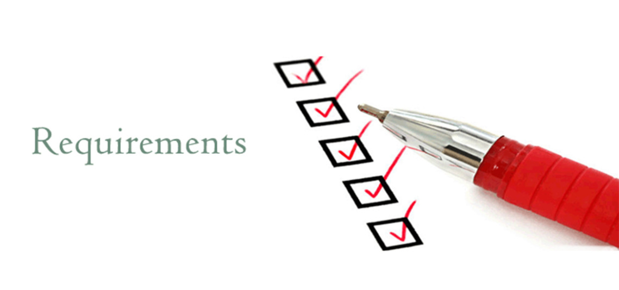
Tax Code, Sec. 33.02 –
Installment Payments of Delinquent Taxes
The collector is required to enter into an installment agreement for the payment of delinquent taxes if the property is the property owner's residence Homestead.
Unless the property owner has entered into an installment agreement with the collector in the preceding 24 moths.
Otherwise, an installment payment agreement for delinquent taxes is optional.

Slide 13
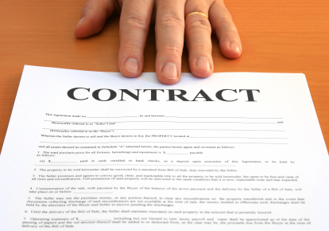
Tax Code, Sec. 33.02 –
Installment Payments of Delinquent Taxes
An installment agreement must:
  Be in writing
  Provide for monthly installment payments (no longer requires equal installments).
  Extend at least 12 months, if a residence homestead.
  May not extend longer than 36 months.

Slide 14

Tax Code, Sec. 33.02 –
Installment Payments of Delinquent Taxes
No 33.01(a) penalty accrues on a residence homestead that is the subject of an installment agreement.
If a property owner fails to make a payment as required by the agreement, the 33.01(a) penalty accrues from the original delinquency date.
Non-residence homestead properties accrue normal penalty and interest.

Slide 15

Tax Code, Sec. 33.02 –
Installment Payments of Delinquent Taxes
Notice of default is required to all owners of the property on the delinquent tax roll before the property may be seized or sold, or a suit to collect a delinquent tax can be filed.
A judgment in an existing suit can still be taken.

Slide 16

Delinquent collections

Slide 17

Notices of Delinquency
Notices Sent To Property Owner
Tax Bill – October 1 – Texas Tax Code, section 31.01
February Notice – After Delinquency Date – Optional
Notice Of Delinquency – Once A Year – Texas Tax Code, section 33.04
May Notice – May – Texas Tax Code, section 33.07
Notice of Intent To File Suite – After July 1 – Optional
Served With Lawsuit/Notice of Trial/Notice of Sale

Slide 18
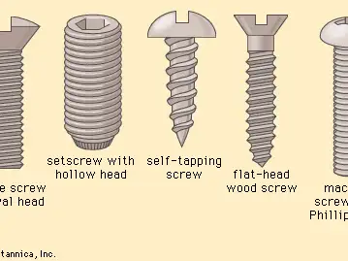
Collection Process
Lawsuits
Tax Warrants
Service of Process
Court Date/Notice of Trial
Notice of Judgment
Notice of Sale
Redemption Period

Slide 19

Order of Distribution
The Proceeds of A Tax Sale Shall Be Applied In The Following Order:
Costs of Advertising the Tax Sale
Attorney Ad Litem Fees
Original Court Costs Payable To the Clerk Of The Court
Fees Payable The Officer Conducting The Sale
Abstract Fees
Tax, Penalties, Interest and Attorney’s Fees
Any Other Amount Awarded Under The Judgment

Slide 20

Excess Proceeds
The Officer Conducting A Sale Shall Pay Any Excess Proceeds To The Clerk Of The Court Issuing The Order Of Sale.
District Clerk Must Send Notice of Excess Proceeds To All Parties To the Judgment.
People Have Two Years To File A Petition Claiming Excess Proceeds with The Court.
After Two Years Any Remaining Excess Proceeds Are Distributed To The Taxing Units.

Slide 21
TIME TO PAY THE PIPER
Matthew Tepper
Mccreary veselka bragg and allen, pc

