Slide 1
Economic & Housing Outlook
COVID-19 Looms Over Recovery
Dr. Luis Torres, Research Economist
43rd Annual Property Tax Institute
December 14 ,2021

Slide 2
The Great Lockdown
  Crisis like no other
    Severity
    Uncertainty surrounding duration, impact

Slide 3
Pandemic’s economic impact
Pandemic’s economic impact
  2020 accelerated trends already prevalent before the pandemic
    income inequality: low-educated/low-skill hardest hit by the health crisis
    working from home
    online purchases of goods and services
    automation and digitalization of the economy

Slide 4
Pandemic’s economic impact
Note: Seasonally adjusted
Sources: Texas Real Estate Research Center at Texas A&M University

Slide 5
Pandemic’s economic impact
Number of jobs (thousand) gained and lost during COVID-19 pandemic
 | U.S. | Texas | Austin | DFW | Houston | San Antonio
Mar-Apr 20 | -22,362 | -1,453 | -142 | -451 | -371 | -142
May - Oct 21* | 18,450 | 1,393 | 166 | 429 | 257 | 132
Net gain/lost | -3,912 | -60 | -24 | -22 | -114 | 11
(%) Recovered jobs | 82.5% | 95.9% | 117.0% | 95.2% | 69.2% | 92.4%
Note: Seasonally adjusted. U.S. employment numbers are up to November. Sources: Bureau of Labor Statistics and Texas Real Estate Research Center at Texas A&M University

Slide 6
Pandemic’s economic impact
Jobs Recovered by MSA to Pre-pandemic Levels
(%)
Note: Seasonally adjusted. Compared to Feb-20 job numbers.
Source: Bureau of Labor Statistics and Texas Real Estate Research Center at Texas A&M University

Slide 7
Pandemic’s economic impact
Jobs Recovered by Industry to Pre-pandemic Levels
(%)
Note: Seasonally adjusted. Compared to Feb-20 job numbers.
Source: Bureau of Labor Statistics and Texas Real Estate Research Center at Texas A&M University

Slide 8
Pandemic’s economic impact
Unemployment Rate
(%)
Note: Seasonally adjusted
Source: Bureau of Labor Statistics and Texas Real Estate Research Center at Texas A&M University

Slide 9
Pandemic’s economic impact
Texas Job Openings and Number of Unemployed
(Thousands)
Note: Seasonally adjusted
Source: Bureau of Labor Statistics and Texas Real Estate Research Center at Texas A&M University

Slide 10
Pandemic’s economic impact
Texas Employment Growth
(%)
Note: Seasonally adjusted
Source: Bureau of Labor Statistics and Texas Real Estate Research Center at Texas A&M University

Slide 11
Pandemic’s economic impact
Average Hourly Earnings, All Employees: Total Private
(Year-over-Year Percent Change)
Average Hourly Earnings Oct-21
U.S. $31.0
Texas $29.1
Austin $32.2
Dallas $33.2
Fort Worth $31.0
Houston $30.2
San Antonio $26.2
Source: Bureau of Labor Statistics and Texas Real Estate Research Center at Texas A&M University

Slide 12
Pandemic’s economic impact
Texas Residential Coincident and Leading Index
(Jan2000=100)
Sources: Dallas Federal Reserve and Texas Real Estate Research Center at Texas A&M University

Slide 13
Pandemic’s economic impact
Major Metros Residential Construction Leading Index
(Jan2000=100)
Sources: Texas Real Estate Research Center at Texas A&M University

Slide 14
Pandemic’s economic impact
Texas Single-Family Housing Permits
(# units)
Note: Seasonally adjusted.
Sources: U.S. Census Bureau and Texas Real Estate Research Center at Texas A&M University

Slide 15
Pandemic’s economic impact
Texas Urban Triangle Vacant Developed Lots by Price Cohort
(# units)
Note: Seasonally adjusted. The sum of Austin, DFW, Houston and San Antonio.
Sources: Zonda and Texas Real Estate Research Center at Texas A&M University

Slide 16
Pandemic’s economic impact
PPI: Inputs to Single-Family and Multifamily Residential Construction, excluding food and energy
(Dec14=100, year-over-year %)
Note: Seasonally adjusted. Producer Price Index Inputs to Construction, excluding food and energy, Dec14=100
Sources: Bureau of Labor Statistics and Texas Real Estate Research Center at Texas A&M University

Slide 17
Pandemic’s economic impact
PPI: Softwood Lumber
(year-over-year %)
Note: Seasonally adjusted. Producer Price Index for Selected Commodity Groupings of Intermediate Demand, 1982-84=100
Sources: Bureau of Labor Statistics and Texas Real Estate Research Center at Texas A&M University

Slide 18
Pandemic’s economic impact
PPI: Steel Mill Products
(year-over-year %)
Note: Seasonally adjusted. Producer Price Index for Selected Commodity Groupings of Intermediate Demand, 1982-84=100
Sources: Bureau of Labor Statistics and Texas Real Estate Research Center at Texas A&M University

Slide 19
Pandemic’s economic impact
Texas Average Weekly Wage ($/Week): Residential Building Construction
(y-o-y %)
Note: Seasonal adjustment. Includes existing and new home sales.
Source: Bureau of Labor Statistics and Texas Real Estate Research Center at Texas A&M University

Slide 20
Pandemic’s economic impact
Texas Housing Sales
(#)
Note: Seasonal adjustment. Includes existing and new home sales.
Source: Texas Real Estate Research Center at Texas A&M University

Slide 21
Pandemic’s economic impact
Texas Housing Sales by Price Cohort
(%)
Note: Seasonal adjustment. Includes existing and new homes.
Source: Texas Real Estate Research Center at Texas A&M University

Slide 22
Pandemic’s economic impact
Texas Days on Market by Price Cohort
(# days)
Note: Seasonal adjustment. Includes existing and new homes.
Source: Texas Real Estate Research Center at Texas A&M University

Slide 23
Pandemic’s economic impact
Dallas-Plano-Irving Listings
(# days)
Note: Seasonal adjustment. Includes existing and new homes.
Source: Texas Real Estate Research Center at Texas A&M University

Slide 24
Pandemic’s economic impact
Months of Inventory
(Months)
Note: Seasonal adjusted.
Source: Texas Real Estate Research Center at Texas A&M University

Slide 25
Pandemic’s economic impact
Texas Months of Inventory by Price Cohort
(Months)
Note: Seasonal adjustment. Includes existing and new homes.
Source: Texas Real Estate Research Center at Texas A&M University

Slide 26
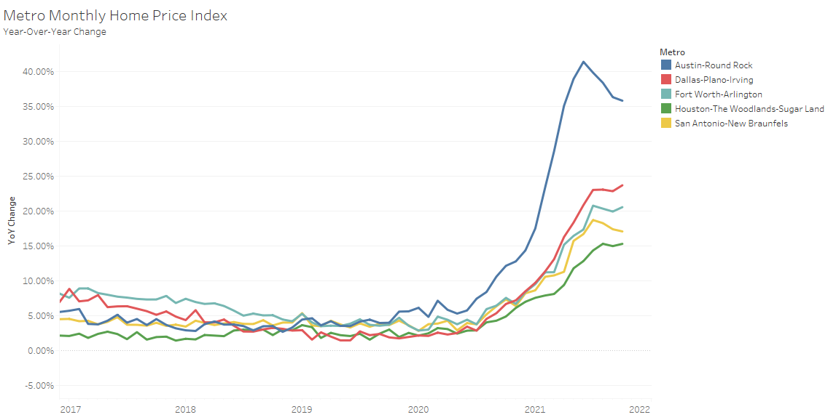
Pandemic’s economic impact
Repeat Sales Housing Price Index
(Year-over-Year Percentage Change)
Median House Price Oct-21
Texas $310,000
Austin $455,000
Dallas $379,000
Fort Worth $320,000
Houston $305,000
San Antonio $302,500
Note: Seasonally adjusted. Monthly House Price Index.
Source: Texas Real Estate Research Center at Texas A&M University

Slide 27
Pandemic’s economic impact
Texas Median Home Price
($)
Note: Seasonally adjusted.
Source: Texas Real Estate Research Center at Texas A&M University

Slide 28
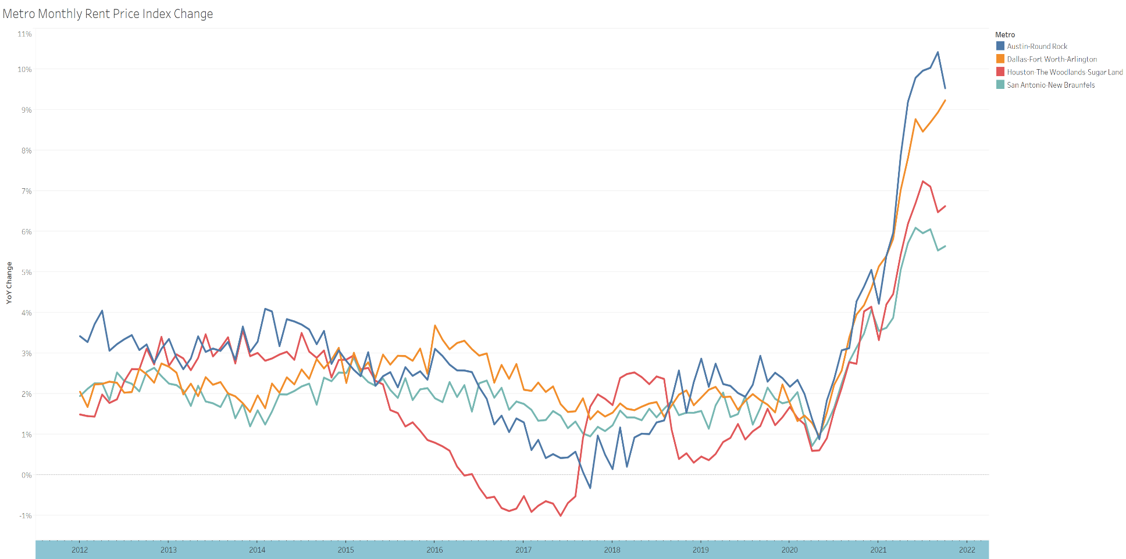
Pandemic’s economic impact
Rent Price Single-Family Housing Price Index
(Year-over-Year Percentage Change)
Note: Seasonally adjusted. Monthly Rent Single-Family Price Index.
Source: Texas Real Estate Research Center at Texas A&M University

Slide 29
Pandemic’s economic impact
30-Year Mortgage Rate, 10-Year Bond Yield and Annual Inflation
(Percent)
Note: Seasonally adjusted. CPI All Urban Consumers 1982-84=100.
Sources: Federal Home Loan Mortgage Corporation, Federal Reserve Board, and Bureau of Labor Statistics

Slide 30
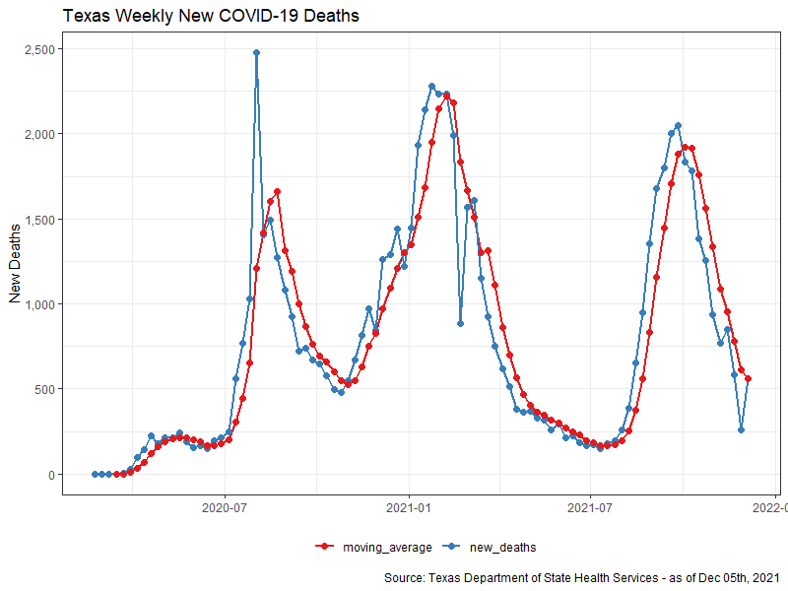
Pandemic’s economic impact
Road to recovery depends
on health outcomes
Source: Texas Department of Health Services and Texas Real Estate Research Center at Texas A&M University
Source: Texas Department of Health Services and Texas Real Estate Research Center at Texas A&M University

Slide 31
Pandemic’s economic impact
  Majority renters who cannot afford to buy houses.
  Some first-time homebuyers lost during pandemic.
  Accelerated working-from-home trend.
  Preference to purchase a home increased.
  Housing supply lag will continue, especially starter homes in short-run.

Slide 32
Renter/owner demographics
Table 1. Income of Renter and Owner Households
 | Renter | Owner
Mean | $63,854 | $122,005
Median | $49,400 | $93,000
Table 2. Age of Renter and Owner Households
 | Renter | Owner
Mean | 33 | 43
Median | 30 | 46
Sources: U.S. Census Bureau Public Use Microdata Sample American Community Survey 2019 and Texas Real Estate Research Center at Texas A&M University

Slide 33
Renter/owner demographics
Table 3. Race Percentage (%) of Renter and Owner Households
 | Renter | Owner
White | 65.1 | 78.3
Black | 19.2 | 7.9
Other races | 15.7 | 13.9
Table 4. Education of Owner and Renter Households
 | Renter | Owner
1 or more years of college | 34.5 | 42.0
Grade 12 | 25.2 | 24.9
Sources: U.S. Census Bureau Public Use Microdata Sample American Community Survey 2019 and Texas Real Estate Research Center at Texas A&M University

Slide 34
Renter/owner demographics
Table 5. Percentage (%) of Renter and Owner Households with/without Children
 | Renter | Owner
No children | 71.8 | 67.1
1 or more | 28.2 | 32.9
Table 6. Occupation of Renter and Owner Households
Renter | Owner
Cashiers, Cooks, Retail Sales Person, Customer Service Representative | Other Managers, Elementary and Middle School, Paint Manufacturing
Sources: U.S. Census Bureau Public Use Microdata Sample American Community Survey 2019 and Texas Real Estate Research Center at Texas A&M University

Slide 35
National Migration Trends 2020
Most moves within state not between states.
  Renters did not move dragging down overall migration count.
  Homeowner moves grew!
Most moves within same metro but into less dense areas.
  Growth mainly to suburb areas instead of rural areas.
  Movers likely wanted more space but still enjoy city amenities.
  Movement out of principal cities (i.e. the actual cities of Dallas, Austin, Houston) were already in decline but COVID pushed that trend further.
Source: U.S. Census Bureau

Slide 36
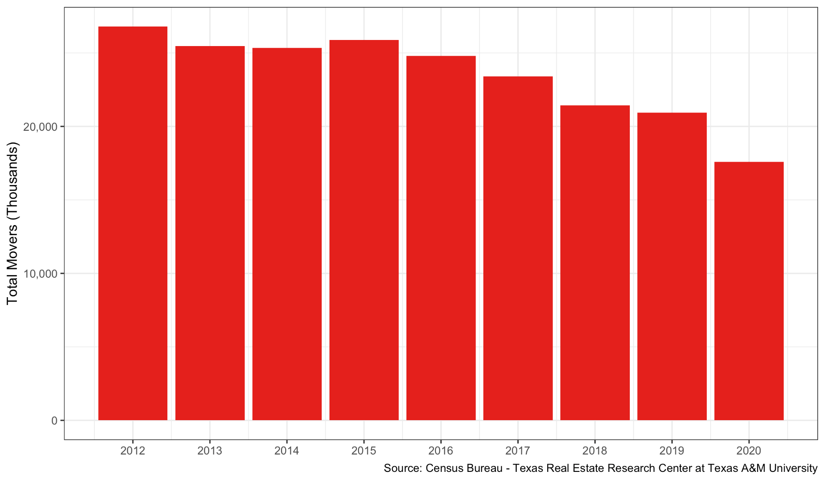
National Total Mover Count for Renters

Slide 37
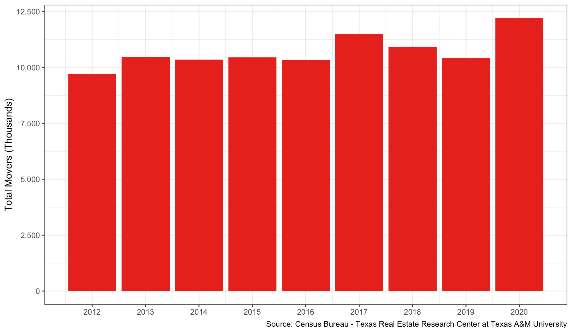
National Total Mover Count for Homeowners

Slide 38
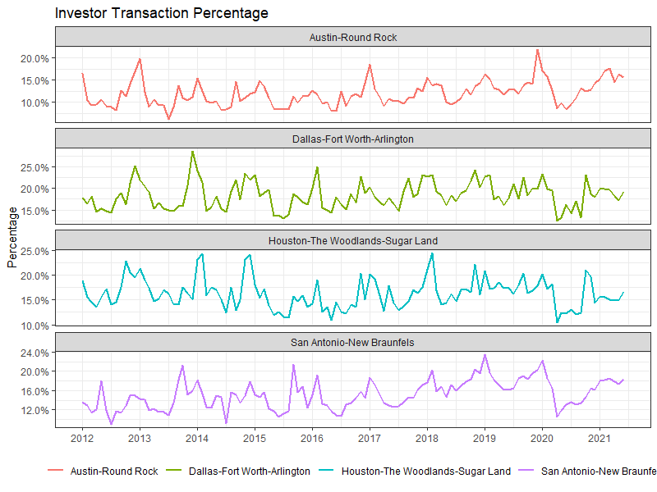
Investor Transactions Remain Around Past Decade Average
Notes: Corelogic investor transactions are deed transactions with LLC, LTD, LP, etc. in the name. Single-family detached homes.
Sources: Texas Deed Transaction Data and Texas Real Estate Research Center at Texas A&M University

Slide 39
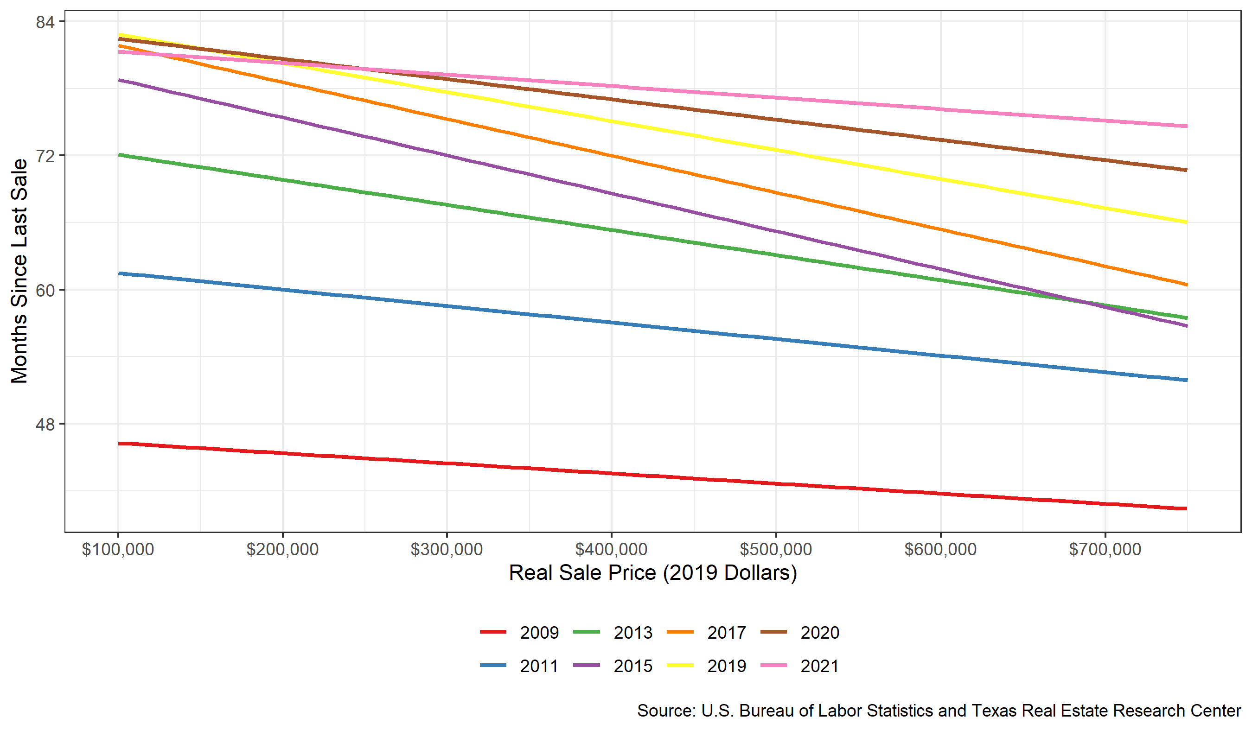
Holding period increased over time, lately for higher priced homes too
DFW Holding Period by Real Sales Price
(Months)
Source: Texas Real Estate Research Center at Texas A&M University

Slide 40
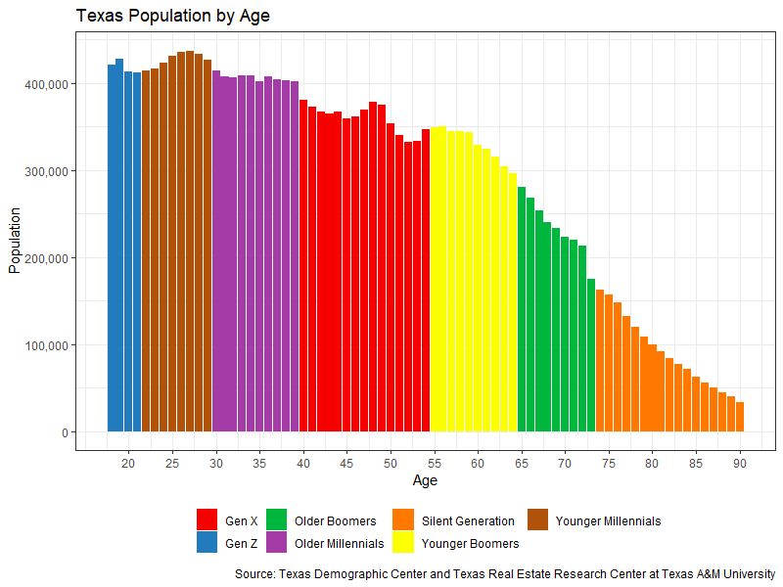
Millennials strong housing demand push
Note: Texas Population by Age, 2019
Sources: U.S. Census Bureau and Texas Real Estate Research Center at Texas A&M University

Slide 41
Majority moving to Texas from California
State Migration into Texas during 2020
(Percent)
Sources: Census Bureau, Infutor and Texas Real Estate Research Center at Texas A&M University

Slide 42
Southern Californians moving to Texas
Out-of-State County Migration into Texas during 2020
(Percent)
Sources: Infutor and Texas Real Estate Research Center at Texas A&M University

Slide 43
Californians moving to
Top Texas MSAs
California Migration into Texas Counties during 2020
(Percent)
Sources: Infutor and Texas Real Estate Research Center at Texas A&M University

Slide 44
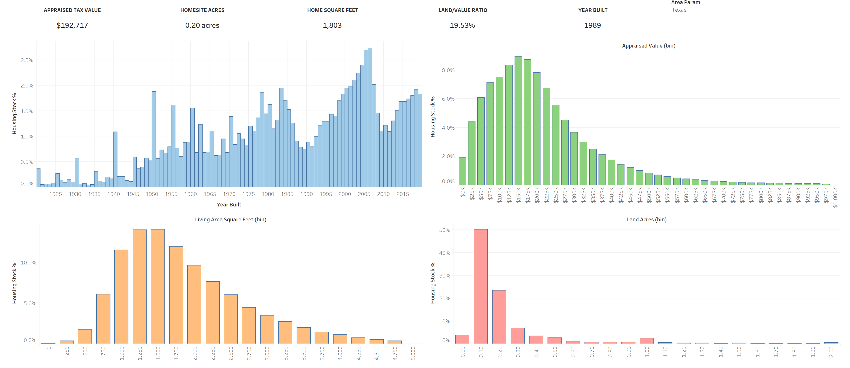
Texas Housing Stock
Sources: Corelogic and Texas Real Estate Research Center at Texas A&M University

Slide 45
Economic and Housing Outlook
Path to recovery depends on COVID-19 outcomes.
Economic recovery could be hindered going forward by possible upsurges in COVID-19 cases.
Further waves of infections can reverse increased mobility and spending, affecting path to recovery.

Slide 46
Economic and Housing Outlook
Economy to slow down after 2Q2021
  After pandemic bounce back.
  Employment should continue to expand in 2021
    All industries possible returning to pre-pandemic levels.

Slide 47
Economic and Housing Outlook
Housing market will be characterized by low inventories and strong price growth.
  Low inventories will be especially prevalent for homes less than $300,000, affecting home sales in the price range.
  Price growth will be positive due to stable demand.
    Economic recovery will continue
    More millennials entering market.
    Lack of housing inventory is major headwind.

Slide 48
Economic and Housing Outlook
Builders trying to build homes to satisfy demand.
  New-home supply will continue to lag.
  Building new homes in the suburbs or outer city borders where land costs are lower, especially to build lower-priced homes.
  Trend was prevalent prior to pandemic but has accelerated due to COVID-19.

Slide 49
Economic and Housing Outlook
Mortgage rates expected to increase somewhat due to increasing inflation expectations and tapering by Federal Reserve .
  Fed Funds rate are expected to increase possible in 2022
    Inflation worries have changed from temporary ones.
  Mortgage refinancing will slow as mortgage rates rise and pool of households able to refinance diminishes.

Slide 50
Economic and Housing Outlook
A housing bubble forming?
Characteristics of the 2006-2007 housing bubble
    Loose lending standards
    Lax oversight, and
    Exuberant speculation (investment motive)
      Not currently prevalent.

Slide 51
Economic and Housing Outlook
FHFA House Price Index Dallas-Plano-Irving
(1Q1995=100, y-o-y %)
Sources: Federal Housing Finance Agency and Texas Real Estate Research Center at Texas A&M University

Slide 52
Economic and Housing Outlook
Mortgage Bankers Association reports 1 million homeowners (2.2 percent of all home loans) are in forbearance (11/08/21).
  Once forbearance ends, share of homeowners able to make mortgage payments is unknown.
  Expect delinquencies and foreclosures to increase.
  So far kept low despite recession due to government policy.
  Housing market could absorb given low inventories.

Slide 53
Economic and Housing Outlook
178,967 mortgages were past due in Texas in 3Q2021, around 6,210 of these were 90 days or more past due.
  11.2 % of active listings and 17.8% of pending listings
Note: Seasonally adjusted.
Sources: Mortgage Bankers Association, Haver Analytics and Texas Real Estate Research Center at Texas A&M University

Slide 54
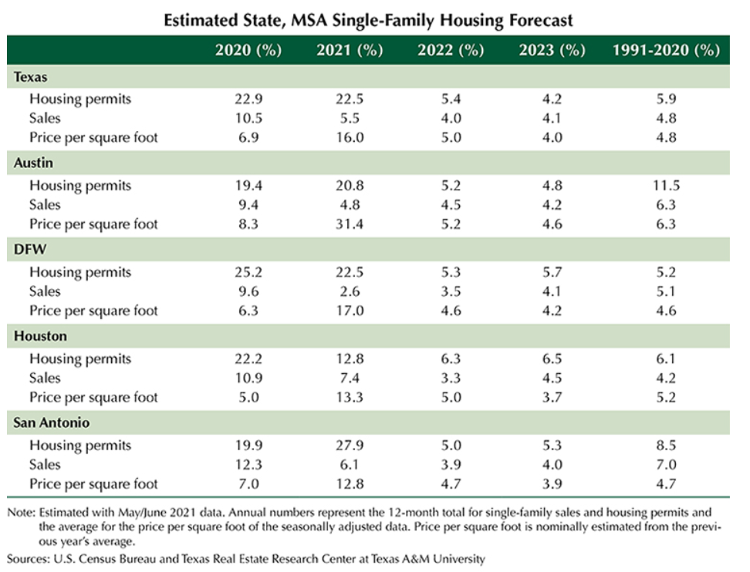
Economic and Housing Outlook

Slide 55
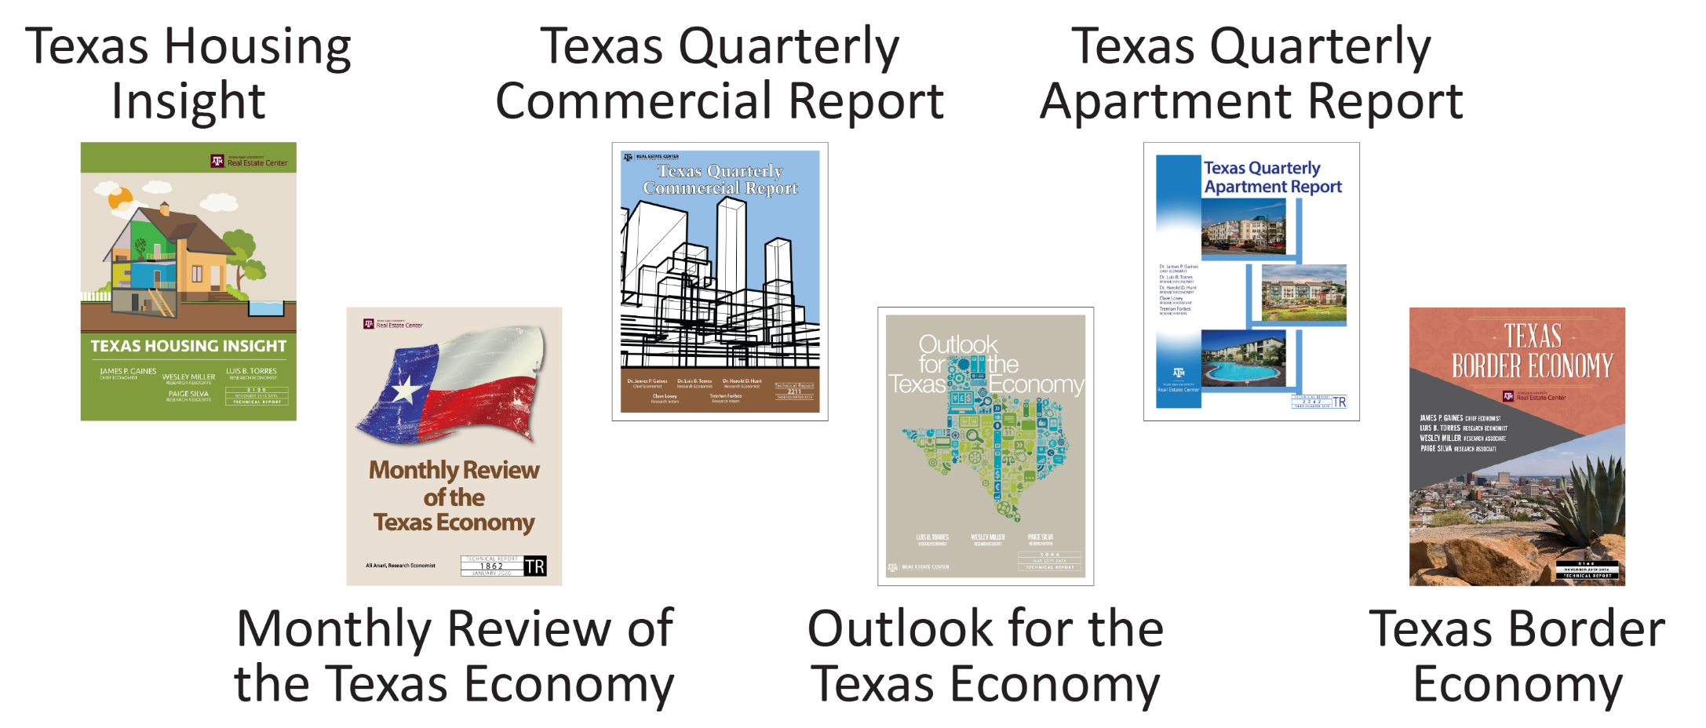
The Texas Economy
www.recenter.tamu.edu/research/the-Texas-economy/

Slide 56
Please visit us online
www.recenter.tamu.edu

