Slide 1
VG Young Presentation
Transportation Safety & Tort Liability
Greg Brinkmeyer, P.E.
TEEX

Slide 2
Overall Texas Statistics
Average of 10 Deaths/Day on Texas Roadways for the last 20 years
Last Deathless Day on Texas Roadways- November 7, 2000

Slide 3
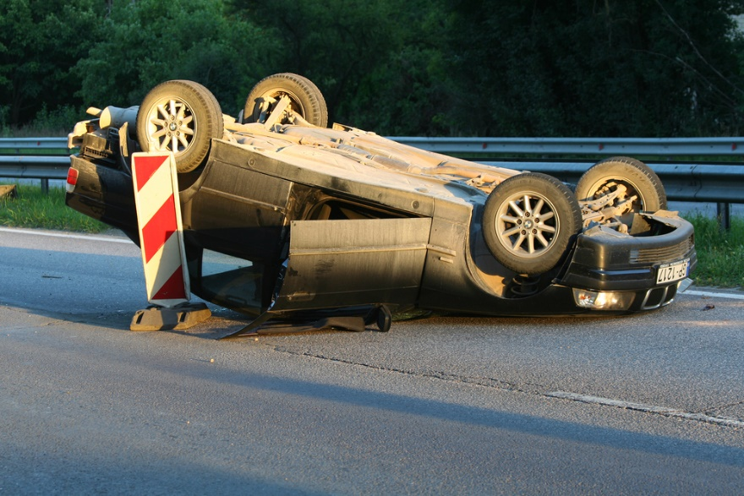
Work Zone Statistics
Trends in Texas
Increase in work zone fatalities
Economic and population growths increase road work projects
Source: Shutterstock
Notes:
Texas' continued economic and population growth has put stress on the roadway infrastructure. Growing traffic demands and the necessary rehabilitation of roadways has resulted in the increase in road work projects throughout Texas.
In 2017, there were 202 fatalities in Texas work zones, continuing an upward trend in work zone fatalities over the last eight years. (TxDOT Traffic Operations Division, 2018).

Slide 4
Notes:
What is the difference between On-System vs. Off-System?
“On-system” means TxDOT maintained.
“Off-system” means city/county maintained.

Slide 5
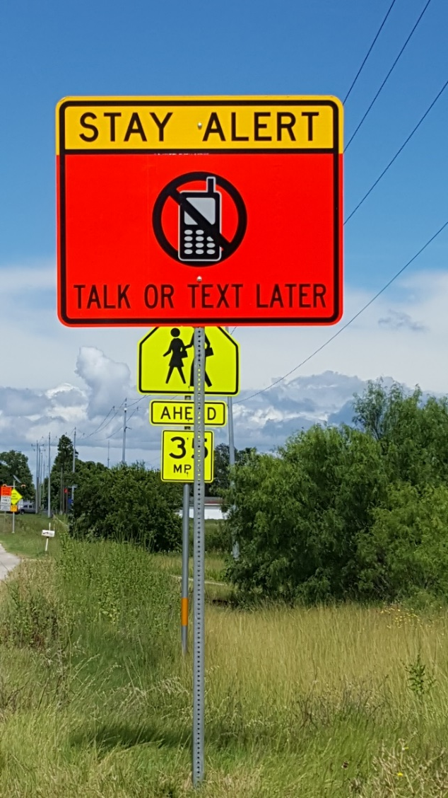
Work Zone Statistics
Contributing factors:
Distracted driving
Poorly implemented/maintained temporary traffic control (TTC)
  Source: TEEX
Notes:
Unfortunately, work zone crashes and fatalities have escalated.
Many factors may contribute to these statistics, most notably the increase in distracted driving.
Another factor is poorly implemented and maintained temporary traffic control.
By knowing and following temporary traffic control regulations, workers can have a positive impact on the safety of work zones.

Slide 6
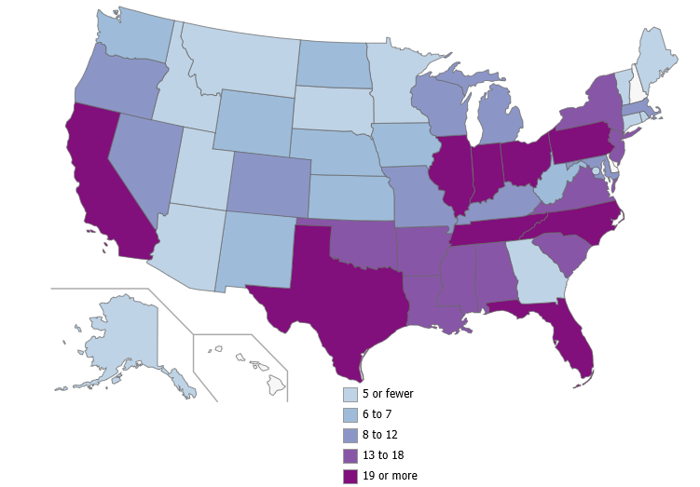
Work Zone Statistics
Workers killed at road work zones in U.S., 2011–2015
38
21
19
25
32
25
22
7
16
18
67
16
38
Total for all of U.S.: 609
  Source: U.S. Bureau of Labor Statistics, 2017
Notes:
According to U.S. Bureau of Labor Statistics (April 5, 2017):
“From 2011 to 2015, 609 workers were killed from injuries at road work zones in the United States. These work zones include construction, maintenance, or utility work on a road, street, or highway. Workers in Texas, Florida, Pennsylvania, and California incurred the most fatal injuries at road construction sites during the 5-year period.”
Bureau of Labor Statistics, U.S. Department of Labor, The Economics Daily, “Fatal Injuries at Road Work Zones,” on the Internet at http://www.bls.gov/opub/ted/2017/fatal-injuries-at-road-work-zones.htm (visited November 06, 2018).

Slide 7
Work Zone Statistics
Workers killed
in pedestrian vehicular incidents, 2011–2015
Vehicle or Mobile Equipment | Fatalities
Total number of fatalities | 279
Automobile | 79
Dump truck | 49
Pickup truck | 48
Semi, tractor-trailer, tanker truck | 26
SUV, sports utility vehicle | 26
Passenger van | 8
Delivery truck or van | 5
Backhoes, trackhoes | 3
Rollers, compactors – construction | 3
Skid steer loaders, mini loaders | 3
Street sweeping and cleaning machinery | 3
All other vehicles and mobile equipment | 26
  Source: U.S. Bureau of Labor Statistics, 2017
Notes:
About 46 percent of these [609 fatalities] workers were killed in pedestrian vehicular incidents, which include being struck by a vehicle or mobile equipment. Workers were most frequently struck by automobiles or dump trucks. Of the 79 workers struck by an automobile, the automobile was moving forward in 72 cases. Of the 49 workers struck by a dump truck, the dump truck was backing up in 40 cases.”
Bureau of Labor Statistics, U.S. Department of Labor, The Economics Daily, “Fatal Injuries at Road Work Zones,” on the Internet at http://www.bls.gov/opub/ted/2017/fatal-injuries-at-road-work-zones.htm (visited November 06, 2018).

Slide 8
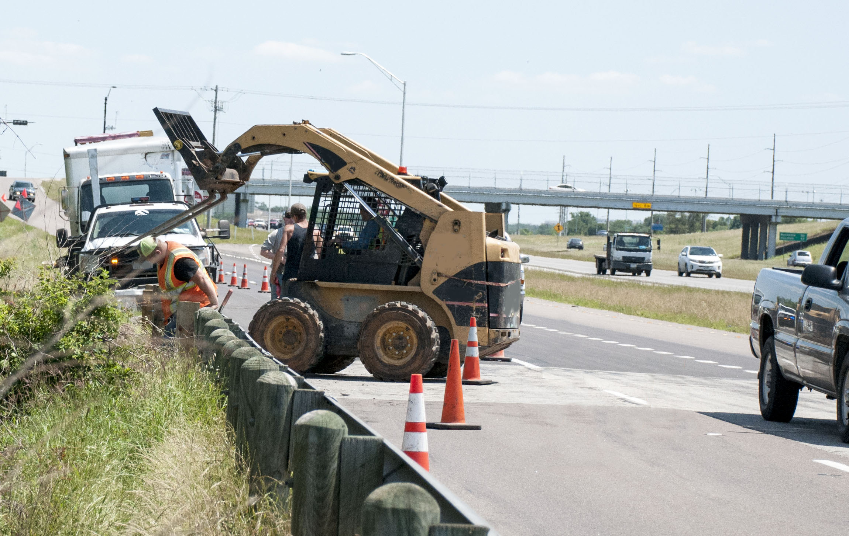
Work Area Awareness
Source: TEEX
Notes:
Cones need to be adjusted.

Slide 9
Risk Management
8%
7%
85%
Notes:
Of the 27,148 work zone crashes that occurred in Texas in 2017, “the leading causes of work zone crashes statewide—speeding and driver inattention—are entirely preventable.” https://www.txdot.gov/driver/share-road/work-zones.html
“Rear-end crashes are the most common type of work zone crash.” https://safety.fhwa.dot.gov/wz/resources/fhwasa03012/
Note: if all vehicles in the U.S. were equipped with lane departure sensing and automatic breaking to prevent rear-end crashes, driver contributing crashes would be significantly reduced.
“Crash avoidance technologies have shown to decrease crashes and can reduce occurrences of driver injury and fatalities by up to 57 percent.” (U.S. Department of Transportation 2018, https://www.itsknowledgeresources.its.dot.gov/its/bcllupdate/
CrashPrevention/)
Study shows that with a 90% market share of autonomous vehicles, there would be 4,220,000 fewer crashers and 21,700 lives saved per year. (U.S. Department of Transportation 2017, https://www.itsknowledgeresources.its.dot.gov/its/bcllupdate/pdf/
BCLL_Automation_2017_FINAL.pdf)

Slide 10

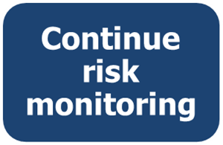

Risk Management
Safety
Identify potential counter-measures
Source: TEEX

Slide 11


Slide 12
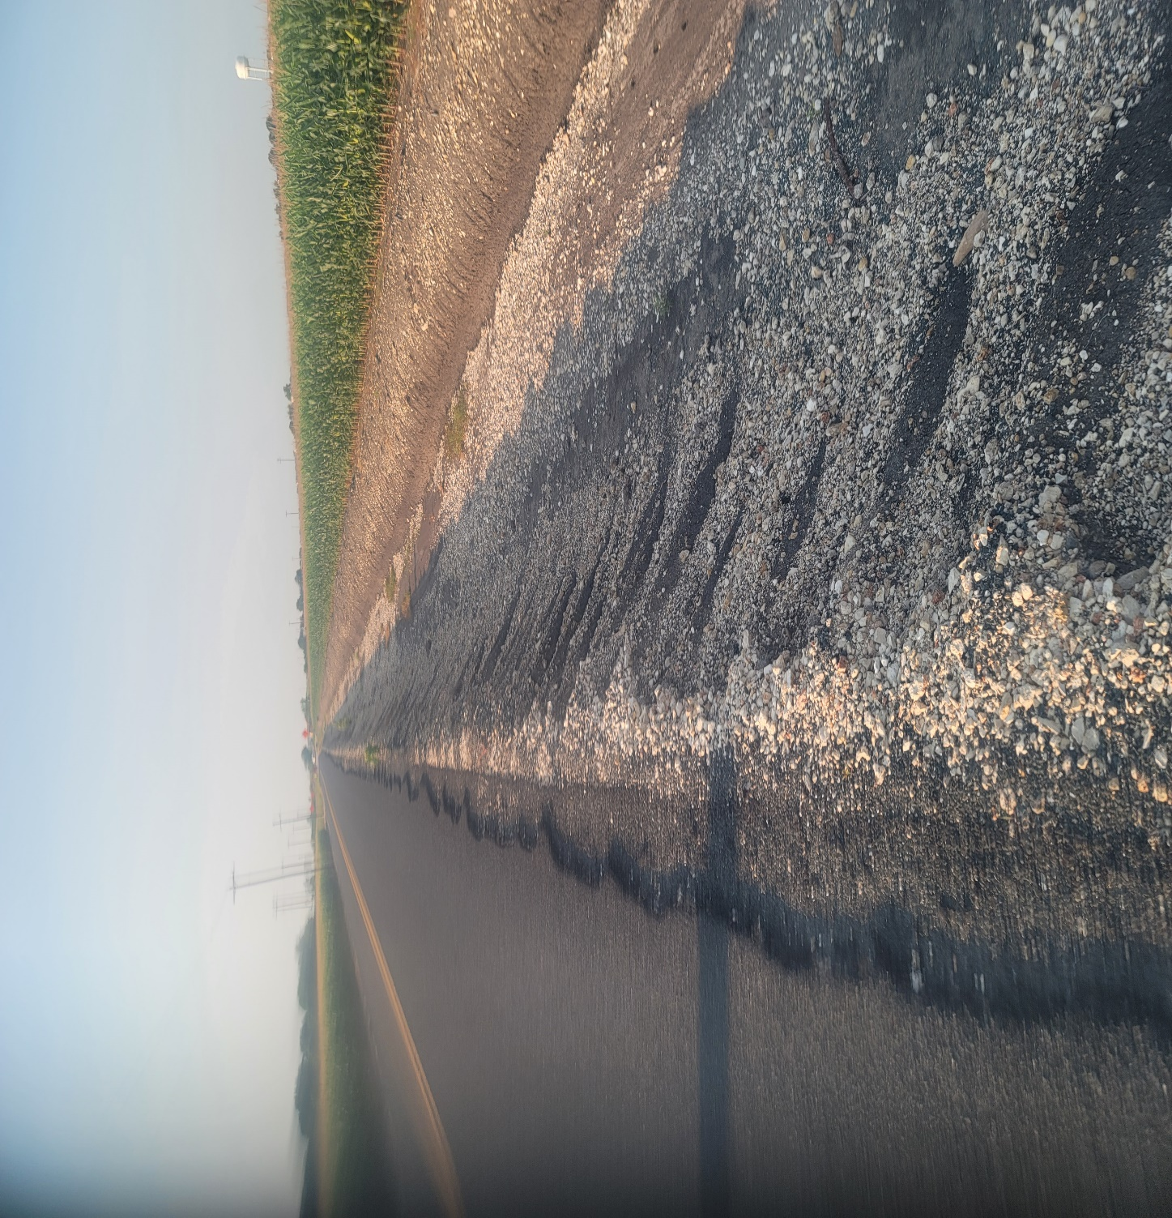

Slide 13
TTC Regulations
TMUTCD requires emphasis on:
TTC training to address worker safety
Road-user mobility through TTC zone
Pedestrian/bicyclist mobility; Americans with Disabilities Act (ADA) compliance
Inspection TTC zone
Improved public relations
Notes:
In the development of the 2014 Texas Specifications for Roadway Construction, TxDOT and the Federal Highway Administration (FHWA) wanted greater emphasis on:
Temporary traffic control training to address worker safety;
Road user mobility through the temporary traffic control zone;
Pedestrian and bicyclist mobility including American Disability Act (ADA) compliance;
Inspection of the temporary traffic control zone; and
Improved public relations to inform road users of work activities and potential delays which may be incurred.

Slide 14
PRINCIPLES OF TRAFFIC CONTROL DEVICES

Slide 15
Fundamental Principles of TTC
Primary function of TTC
(Section 6A.05.TMUTCD )
Provide for the reasonably
safe and effective movement
of road users through or
around TTC zones
Reasonably protect road users,
workers, responders to traffic incidents,
and equipment
Source: ©TxDOT
Notes:
According to the TMUTCD (2014):
The primary function of TTC is to provide for the reasonably safe and effective movement of road users through or around TTC zones while reasonably protecting road users, workers, responders to traffic incidents, and equipment.
Of equal importance to the public traveling through the TTC zone is the safety of workers performing the many varied tasks within the work space.
TTC zones present constantly changing conditions that are unexpected by the road user.

Slide 16
Fundamental Principles of TTC
TTC selection depends on
Type of highway
Road user conditions
Duration of operation
Physical constraints
Nearness of work space to road users
Notes:
TMUTCD, pg. 569, Sect. 6A.01.08
“No one set of TTC devices can satisfy all conditions for a given project or incident. At the same time, defining details that would be adequate to cover all applications is not practical. Instead, Part 6 displays typical applications that depict common applications of TTC devices. The TTC selected for each situation depends on type of highway, road user conditions, duration of operation, physical constraints, and the nearness of the work space or incident management activity to road users.”

Slide 17
Fundamental Principles of TTC
Seven Fundamental Principles
General plans
Road-user movement
Clear, positive guidance
Inspections
Maintenance
Training
Public relations/communications
Notes:
Guidance: pg. 572
07 The following are the seven fundamental principles of TTC:
1. General plans or guidelines should be developed to provide safety for motorists, bicyclists,
pedestrians, workers, enforcement/emergency officials, and equipment, with the following
factors being considered:
The basic safety principles governing the design of permanent roadways and roadsides should also govern the design of TTC zones. The goal should be to route road users through such zones using roadway geometrics, roadside features, and TTC devices as nearly as possible comparable to those for normal highway situations.
A TTC plan, in detail appropriate to the complexity of the work project or incident, should be prepared and understood by all responsible parties before the site is occupied. Any changes in the TTC plan should be approved by an official who is knowledgeable (for example, trained and/or certified) in proper TTC practices.
2. Road user movement should be inhibited as little as practical, based on the following
considerations:
TTC at work and incident sites should be designed on the assumption that drivers will only reduce their speeds if they clearly perceive a need to do so (see Section 6C.01).
Frequent and abrupt changes in geometrics such as lane narrowing, dropped lanes, or main roadway transitions that require rapid maneuvers, should be avoided.
Work should be scheduled in a manner that minimizes the need for lane closures or alternate routes, while still getting the work completed quickly and the lanes or roadway open to traffic as soon as possible.
Attempts should be made to reduce the volume of traffic using the roadway or freeway to match the restricted capacity conditions. Road users should be encouraged to use alternative routes. For high-volume roadways and freeways, the closure of selected entrance ramps or other access points and the use of signed diversion routes should be evaluated.
Bicyclists and pedestrians, including those with disabilities, should be provided with access and reasonably safe passage through the TTC zone.
If work operations permit, lane closures on high-volume streets and highways should be scheduled during off-peak hours. Night work should be considered if the work can be accomplished with a series of short-term operations.
Early coordination with officials having jurisdiction over the affected cross streets and providing emergency services should occur if significant impacts to roadway operations are anticipated.
3. Motorists, bicyclists, and pedestrians should be guided in a clear and positive manner while
approaching and traversing TTC zones and incident sites. The following principles should be
applied:
Adequate warning, delineation, and channelization should be provided to assist in guiding road users in advance of and through the TTC zone or incident site by using proper pavement marking, signing, or other devices that are effective under varying conditions. Providing information that is in usable formats by pedestrians with visual disabilities should also be considered.
TTC devices inconsistent with intended travel paths through TTC zones should be removed or covered. However, in intermediate-term stationary, short-term, and mobile operations, where visible permanent devices are inconsistent with intended travel paths, devices that highlight or emphasize the appropriate path should be used. Providing traffic control devices that are accessible to and usable by pedestrians with disabilities should be considered.
Flagging procedures, when used, should provide positive guidance to road users traversing the TTC zone.
4. To provide acceptable levels of operations, routine day and night inspections of TTC elements
should be performed as follows:
Individuals who are knowledgeable (for example, trained and/or certified) in the principles of proper TTC should be assigned responsibility for safety in TTC zones. The most important duty of these individuals should be to check that all TTC devices of the project are consistent with the TTC plan and are effective for motorists, bicyclists, pedestrians, and workers.
As the work progresses, temporary traffic controls and/or working conditions should be modified, if appropriate, in order to provide mobility and positive guidance to the road user and to provide worker safety. The individual responsible for TTC should have the authority to halt work until applicable or remedial safety measures are taken.
TTC zones should be carefully monitored under varying conditions of road user volumes, light, and weather to check that applicable TTC devices are effective, clearly visible, clean, and in compliance with the TTC plan.
When warranted, an engineering study should be made (in cooperation with law enforcement officials) of reported crashes occurring within the TTC zone. Crash records in TTC zones should be monitored to identify the need for changes in the TTC zone.
5. Attention should be given to the maintenance of roadside safety during the life of the TTC
zone by applying the following principles:
To accommodate run-off-the-road incidents, disabled vehicles, or emergency situations, unencumbered roadside recovery areas or clear zones should be provided where practical.
Channelization of road users should be accomplished by the use of pavement markings, signing, and crashworthy, detectable channelizing devices.
Work equipment, workers’ private vehicles, materials, and debris should be stored in such a manner to reduce the probability of being impacted by run-off-the-road vehicles.
6. Each person whose actions affect TTC zone safety, from the upper-level management through
the field workers, should receive training appropriate to the job decisions each individual is
required to make. Only those individuals who are trained in proper TTC practices and have a
basic understanding of the principles (established by applicable standards and guidelines,
including those of this Manual) should supervise the selection, placement, and maintenance
of TTC devices used for TTC zones and for incident management.
7. Good public relations should be maintained by applying the following principles:
The needs of all road users should be assessed such that appropriate advance notice is given and clearly defined alternative paths are provided.
The cooperation of the various news media should be sought in publicizing the existence of and reasons for TTC zones because news releases can assist in keeping the road users well informed.
The needs of abutting property owners, residents, and businesses should be assessed and appropriate accommodations made.
The needs of emergency service providers (law enforcement, fire, and medical) should be assessed and appropriate coordination and accommodations made.
The needs of railroads and transit should be assessed and appropriate coordination and accommodations made.
The needs of operators of commercial vehicles such as buses and large trucks should be assessed and appropriate accommodations made.
This course will provide information and guidance on how to successfully implement these seven fundamental principles in a variety of different projects.

Slide 18
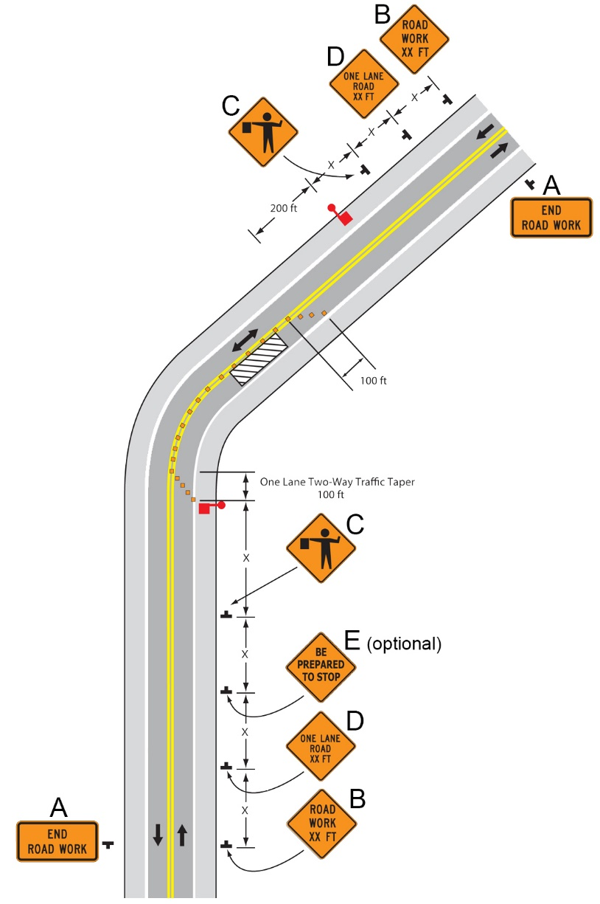
Flagger Operations
Source: TEEX

Slide 19
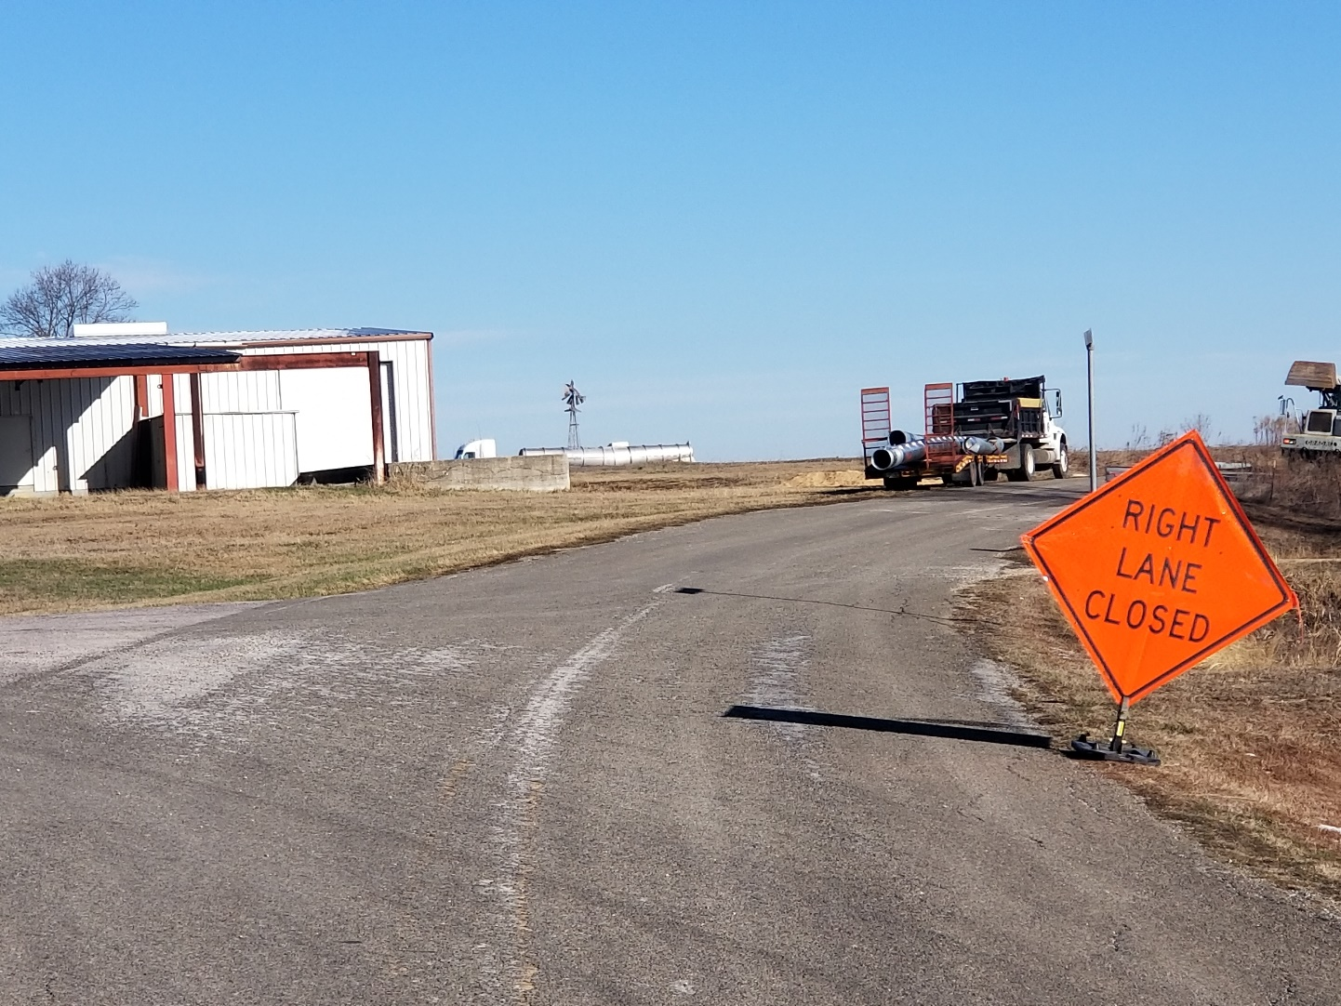

Slide 20
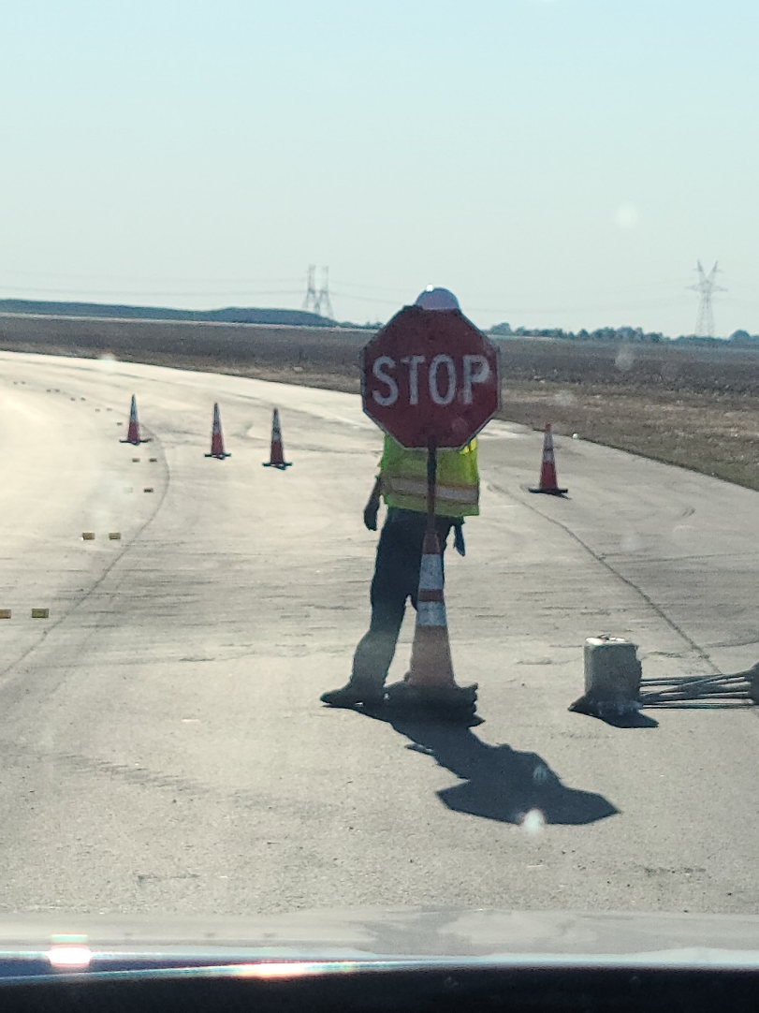

Slide 21
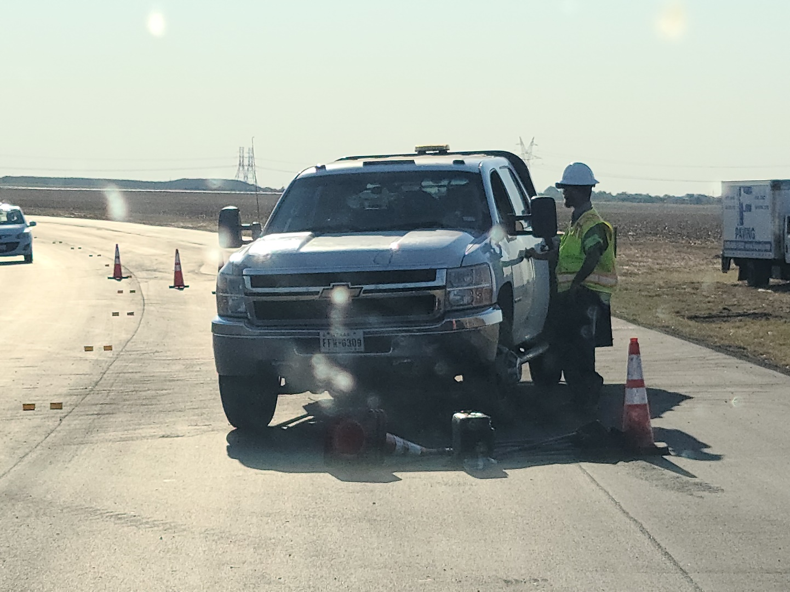

Slide 22
Roadway Inspection

Slide 23
TO BE EFFECTIVE DEVICES SHOULD:
FULL A NEED
COMMAND ATTENTION
COMMAND RESPECT
CONVEY A CLEAR, SIMPLE MEANING
COMMAND RESPECT FROM ROAD USERS
GIVE ADEQUATE TIME FOR PROPER RESPONSE

Slide 24
Recognizing Deficiencies in TCDs
All items must
Be clean
Be installed straight and plumb
Meet retro-reflectivity requirements
Notes:
All construction activities within the right-of-way along a public roadway must have a traffic control plan (TCP). Properly designed and installed temporary traffic control (TTC) zones alert, guide, and separate road users from the work area and protect workers and their equipment.
The TxDOT Construction Contract Administration Manual along with Item 502 “Barricades, Signs, and Traffic Handling” provide guidance on the installation and maintenance of the TTC devices, as well as their inspection and documentation.
Retro-reflective means that light-scattering is reduced which results in highly visible devices at night and with oncoming headlights.
All TTC devices, such as signs, barricades, drums, and cones, must be in good condition to provide clear and understandable warning and notices to the road users. Item 502 requires devices to be cleaned and installed straight and plumb and to meet retro-reflectivity requirements for day or night in all weather conditions.

Slide 25

Recognizing Deficiencies in TCDs
Deficiencies?
Source: TEEX
Notes:
Answer: Dirty—impaired retroreflectivity

Slide 26
Performing Inspections
Inspections should be performed after:
Initial traffic control installation
Traffic alignment changes
Implementation of major traffic control phases
Notes:
The District Responsible Person (DRP) will perform formal inspections of all traffic control devices twice a month at approximately 2-week intervals.
At least one of these inspections should be done at night as soon as possible after the initial project set-up with overnight traffic control.
It is good practice to have the Contractor Responsible Person (CRP) accompany the DRP on the inspections.

Slide 27
Performing Inspections
Inspections should also occur after:
High winds or storms
A traffic incident, device movement to accommodate construction activities, or other activities that could cause the displacement

Slide 28
Performing Inspections
Perform informal inspections
At the:
  Beginning of each work period
  End of each work period
When deficiencies are found, take immediate corrective action
Notes:
In addition to formal inspections, the CRP should conduct informal inspections at the beginning and end of each work period to ensure all devices are in the correct place and in acceptable condition.
For the safety of everyone involved, all workers should try to be aware of the condition of the work zone and report any problems to the appropriate supervisor.

Slide 29
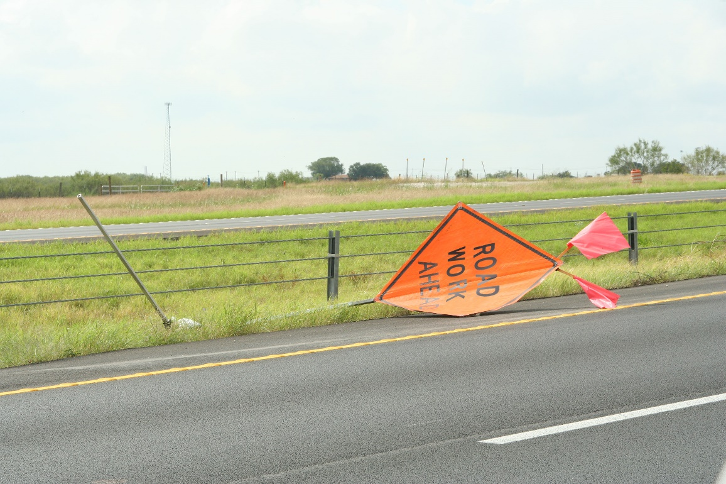
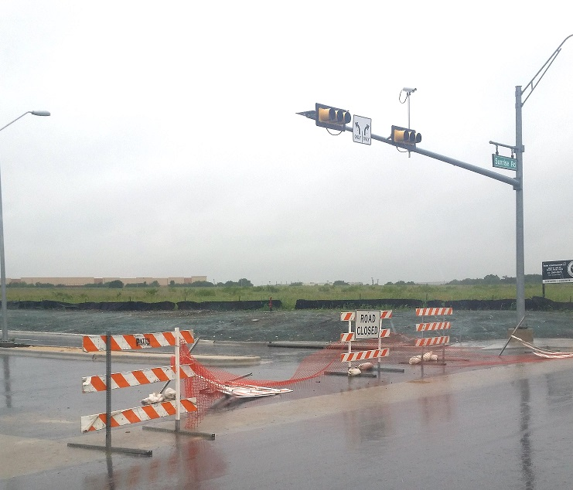
Performing Inspections
Source: TEEX
Notes:
Weather-related disruptions

Slide 30
Performing Inspections
Source: TEEX
Notes:
Tree is blocking visibility.
Any sign that has lost nighttime visibility/retro-reflectivity should be replaced as well.

Slide 31
Thank You
TEEX Appreciates the Opportunity to be a part of this Event

