Slide 1
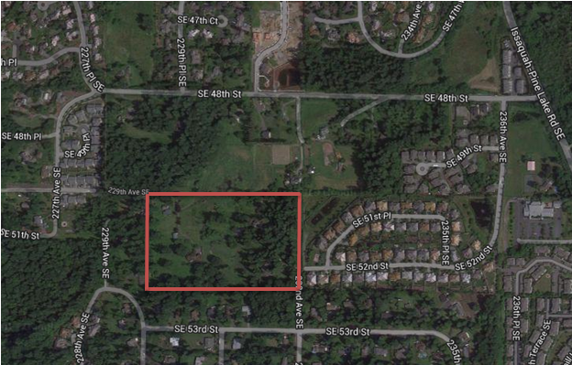
Subdivision Regulations
Presented by Allison, Bass & Magee, LLP, Austin, Texas

Slide 2
Chapter 232, Local Government Code
Plat required if:
  Land is outside of municipality.
  Divided into two or more parts.
  If a subdivision of the tract or lots provides for streets, alleys, squares, parks, or other parts of the tract intended to be used by the public, or for the use of purchasers of the lots.
  Plat must be filed of record in accord with law.

Slide 3
Exceptions to Plat Requirements
Land does not provide for streets or other common areas.
Land use for agricultural purposes as defined by Article VIII, Section 1-d, Texas Constitution.
Land is sold to family members.
Land contains more than ten (10) acres, and contains no streets, etc.
All lots are sold to veterans.

Slide 4
General Powers under
Subdivision Regulations
May require standards for roads and drainage.
May require a bond to insure compliance.
May not require a higher standard than standards county imposes upon itself in the “construction” of new roads.
May require groundwater standards if ordinance is already in place.
Under separate authority, if qualified, may regulate waste water infrastructure.

Slide 5
County Must Adopt a Subdivision Regulation to Impose Additional Requirements
232.003-An Order adopting a subdivision regulation requires a public hearing, after notice in a newspaper of General Circulation.
  As a rule that may impose requirements that affect private property, a “Takings Impact Assessment” is required. See 2007.003, Texas Government Code. This section waives sovereign immunity, so caution is warranted.
  Requires at least 30 days notice of Intention to adopt a proposed action subject to the act.

Slide 6
Areas Within Scope of County Authority
Standards for Roads and Streets within Subdivision
  Provisions for Transportation Corridors
  Require Access by Emergency Vehicles (in subdivisions of 1000 lots or more, two ingress/egress).
Requirements for use of sub-surface Groundwater
Impose Construction/Performance Bonds to assure compliance with regulation.
Additional powers for counties near an International Border, (Subchapter B) or in Economically Distressed Counties (Subchapter C),
Subchapter E allows for broad powers designed to promote “health, safety, morals, or general welfare of the County…”

Slide 7
Additional Areas Where County Has Authority to Regulate Subdivisions
Chapter 251, Transportation Code grants authority over roads that are within the County maintenance program (but subdivision roads may be taken into system optionally).
Chapter 364, Health and Safety Code-Solid waste disposal.
Chapter 181, Utilities Code-Utilities in street right-of-ways.
Chapter 366, Health and Safety Code-On-Site Sewerage Facilities
Chapter 365, Health and Safety Code-Litter and public nuisance
Chapter 122, Health and Safety Code-Public health regulations.
Chapter 16,26 and 54, Texas Water Code-Floodplain and Model Subdivision rules, Water Quality Control, and Municipal Utility Districts

Slide 8
Areas of Limited Authority
Within the Exterritorial Jurisdiction of an Incorporated Town or City (unless there is an agreement with that town or city for authority or joint authority).
Where TCEQ has primary responsibility for septic regulation.
Where County has a subdivision regulation, and the County decides to open up a new road on virgin ground, the County should use the same standards for the new road with a similar type and amount of traffic at least equal to the subdivision standards for developers. See Section 251.0031 Local Government Code

Slide 9
Logical Steps toward Adoption of Subdivision Regulation
Gather existing regulations from similarly sized or situated counties.
Carefully review all aspects of your local circumstances, and try to look into the future as far as reasonable.
Retain qualified assistance to provide counsel and guidance, identify required expertise for plat review.
Hold workshops to seek out and receive comments from interested parties, i.e. developers, lending institutions, city and regional governments affected by regulation.
Draft and carefully review any proposed regulation, including any specifications or standards in light of TIA and property rights concerns.
Base all regulations on well reasoned, easily explained factual grounds.

Slide 10
Once you Have a Draft Ordinance
Conduct a TIA Assessment, and file of record.
Establish a reasonable fee for copies of both TIA and Draft Ordinance, and proposed fees for permitting, etc.
Publish Notice of a Public Hearing at least 30 days in advance, and inform public of TIA and Draft Ordinance, and intention to take up for consideration and possible action on subdivision regulation, including fees for copies.
Open public hearing. Explain the need for subdivision regulation. Present the contents of the proposed Regulation in summary form, but with enough detail that interested persons can understand what will be required.
Receive public comment. Use speaker forms to identify speakers, or to record those in favor or opposition.
Close the public hearing. Take up the matter for action, either following the public hearing, or at a later date, but if to a later date, give separate notice of that date. Does not have to be 30 additional days.

Slide 11
County Has Authority to Discontinue Maintenance, Close or Vacate Road
Road must be a “county road”, i.e. under the County’s jurisdiction.
County has limited authority to amend plats, thereby giving authority over platted, but never opened roads in private subdivision.
Chapter 251, Transportation Code, for provisions on discontinuance, closure and vacating roads in county maintenance system.

Slide 12
Caution:
Mere dedication in plat imposes no duty to maintain streets upon County.
  Langford v. Kraft, 498 S.W.2d 42, (Tex.App.—Ft. Worth, 1973), Comm. Ct. v. Jester, 199 S.W.2d 1004 (Tex.App.-Dallas, 1948).
Acceptance of road(s) should be reflected in an Order which specifically describes the road to be accepted for public maintenance.
Beware of Kunefke v. Calhoun County, 2006 WL 1553261, where the Commissioners Court accepted the dedication of roads for public use, but not for maintenance until such time as the roads were actually constructed and placed into use. Court held this was acceptance for all purposes.
When reviewing Subdivision Plats, use term “Approve the Plat for filing purposes only.”
Use separate order/language to specifically accept roads for maintenance.

Slide 13
I move that the Commissioners Court of ____ County, Texas, pursuant to §232.002 of the Texas Local Government Code, approve for filing purposes only, a plat of the _________________ subdivision, upon the following condition:
In accordance with Langford v. Kraft, 498 S.W.2d 42, Commissioners Court v. Jester Development Co, 199 S.W.2d 1004, and Miller v. Elliott, 94 S.W.3d 38, that the filing and approval of a plat which dedicates streets and roads does not make them county roads subject to county maintenance, since the dedication is a mere offer and the filing of a plat for approval by the County Commissioners Court does not constitute an acceptance of any dedication contained in the plat, I hereby move that the Court expressly approve the filing of the plat of the _________ subdivision, with the following Note inserted upon the face of the Plat:

Slide 14
Notation on Plat
"No road, street or passageway set aside in this Plat shall be maintained by __________ County, Texas in the absence of an express Order of the Commissioners Court entered of record in the minutes of the Commissioners Court of _______ County, Texas specifically identifying any such road, street or passageway and specifically accepting such road, street or passageway for county maintenance."

Slide 15
Pre-existing Sub-Standard
Subdivisions
Chapter 253 of Transportation Code provides for County authority to improve roads in sub-division.
  Election of Property Owners required.
  Owners can be assessed for initial costs.
  But, County thereafter responsible for road maintenance.

Slide 16
Substantial Revisions to Chapter 232, Effective 9/1/2019
Timeline for review and action on a plat application reduced from 60 to 30 days.
A written list of the documentation and other information required must be prepared, and the requirements must related to a requirement under “applicable law”.
Any missing information must be identified within 10 days by the County, and notification to the applicant with cited section of regulation must be given within 10 days.
Options for action: (a) Approve if in compliance with regulation
        (b) Approve with conditions (articulate the conditions)
        (c) Disapprove. Again if the plat application complies with
        County Subdivision Regulation, you cannot disapprove.
30 day deadline can only be extended if requested by the applicant and agreed to
in writing and approved by Commissioners court or designee.
6. Failure to meet the 30 day deadline by county results in approval of plat.

Slide 17
Catch 22 contained in 232.00285
Texas Local Government Code
(a) In this section, “development plan” includes a preliminary plat, preliminary subdivision plan, subdivision construction plan, site plan, general plan, land development application, or site development plan.
(b) Unless explicitly authorized by another law of this state, a county may not require a person to submit a development plan during the plat approval process required by this subchapter. If a county is authorized under another law of this state to require approval of a development plan, the county must comply with the approval procedures under this subchapter during the approval process.

Slide 18
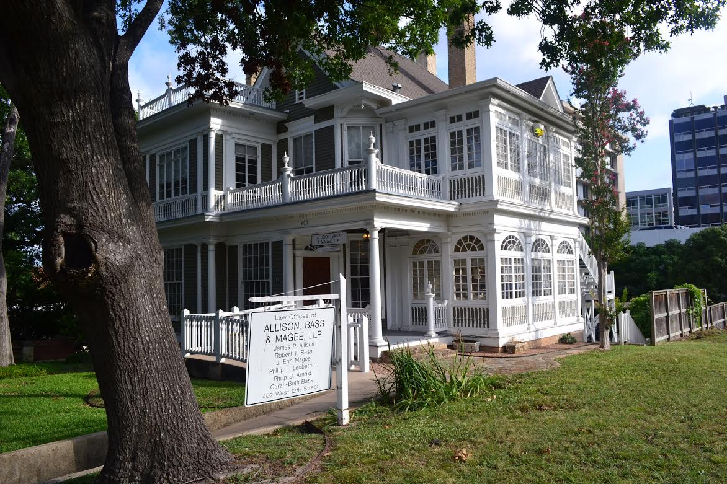
For More Information:
Texas Association of Counties-Publications-County Subdivision Regulation Sourcebook, 2010.
Allison, Bass & Magee, LLP
  402 West 12th Street
  Austin, Texas 78701
  512/482-0701

