Slide 1
Strategic Budget Planning 87th Annual South Texas Judges and Commissioners Association Annual Conference Rebekka Dudensing, PhD Extension Economist – Community Economic Development
June 28-July 1, 2021, South Padre, Texas

Slide 2
1. What is the most important line/item in your budget?

Slide 3
2. List the top 3 items you’d love to include in next year’s budget?

Slide 4
3. How do you currently prioritize departments’ budget requests?

Slide 5
4. What do you want to be known for at the end of your term?

Slide 6
P L A N N I N G
P A N N I N G
L
2020

Slide 7
Strategic Planning
“is intended to ensure that an organization maintains a dynamic balance with its external environment, so that its resources are used to the fullest in responding to environmental opportunities and problems”¹
Focuses on change.
Tries to understand the external environment

Slide 8
Types of Strategic Planning¹
Global Blueprint - vision of the future and broad courses of action; extensive citizen participation and heavy business input
Anteroom to Budget - departmental long-range goals that tend to have little relations to budget or operational plans; often ineffective
Strategic Issue Management - “selection of a small number of strategic issues (problems and opportunities) and the formulation of strategies to address them”
¹Commissioners Court Advanced Curriculum. Strategic Planning. 4.021.

Slide 9
Planning Efforts
Strategic Budget Planning
Board Planning
Initiative Planning
Comprehensive/ Economic Development Plans
Focus on first three types in early 2021

Slide 10
Barriers to Strategic Planning
Often political
Election cycles
Fear of failure / feedback
Sometimes technical
Often time

Slide 11
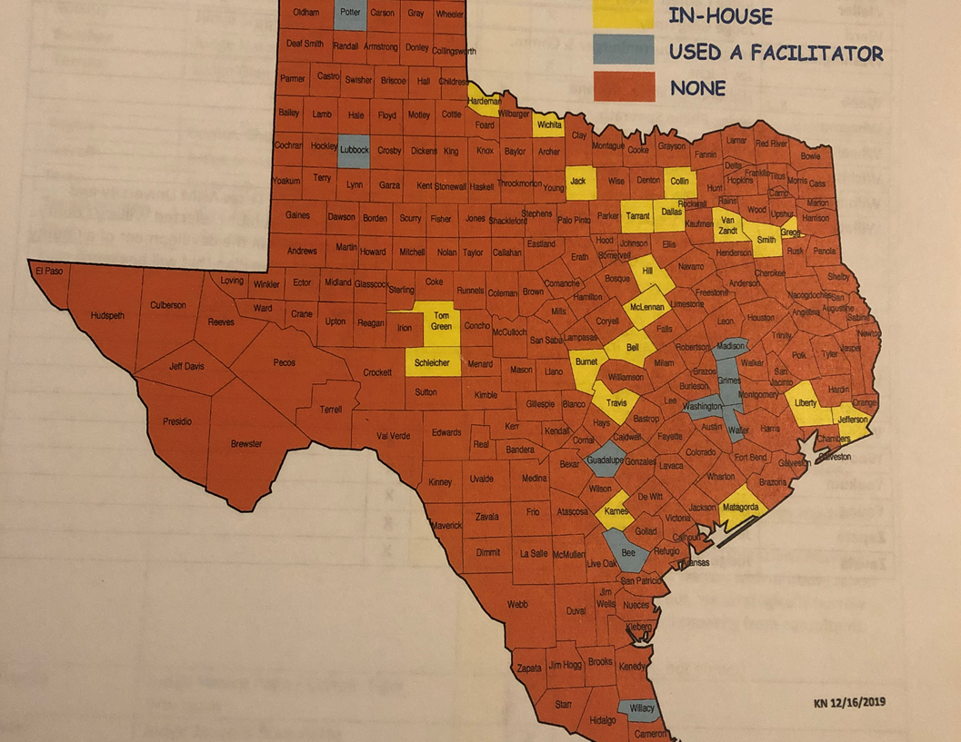
Strategic Budget Planning
Kaufman County approached us in Spring 2020 about a budget plan
TAC showed 30 counties with an SBP
9 used a facilitator
21 did the SBP in-house
Others interested

Slide 12
Our Team
Rebekka Dudensing
Peter McGuill
Twinkle Singh
Blane Counsil
Valeria Jauregui
Tara Glasscock

Slide 13
Why Budget Planning
You work for what you measure.
You get what you pay for.
The budget helps keep you focused on your goals.

Slide 14
Project Goals
Identify resource needs to serve Kaufman County’s growing population over the next 5+ years and
Plan strategic investments in labor and infrastructure to meet those needs over the 5-year period
Create a template and best practices for other counties

Slide 15
The SBP Process
Project introduction (Today)
Departmental input
Interdepartmental discussion
Department/AgriLife interviews (Zoom/in-person?)
AgriLife SB calculations
Departmental SB vetting (email and Zoom)
AgriLife revision
Strategic budget prioritization workshop (in-person?!?!)
Strategic budget “finalization”
Evaluation and revision

Slide 16
Topics
Two paradigms
Current levels of service
Enhanced service
Spending areas
Staff (and training)
Physical space
Equipment (vehicles, office equipment, security)
IT needs

Slide 17
Budget Questions
Will you need to add staff? What types (e.g., clerk, auditor, legal)? How many?
What additional equipment is needed for that staff (computers, cars, etc.)? Training? Travel?
What routine IT/non-IT equipment replacements or upgrades will be needed?
What major equipment or technology upgrades or enhancements will be needed?
What changes in contracted services are likely?
What are your expectations for departmental revenues?
Do your needs have specific timeframes?

Slide 18
Broader Questions
What challenges and opportunities may be on your horizon?
How could state mandates or population pressure change how your department functions?
How do you prioritize your goals and your budgetary needs?
Plus a couple of surprise questions:
What do you hope people are saying about your department in 5 years? What will be your biggest accomplishment?
What items in your budget do you most prioritize? What do you consider essential to continued success?

Slide 19
1. What is the most important line/item in your budget?

Slide 20
2. List the top 3 items you’d love to include in next year’s budget?

Slide 21
3. How do you currently prioritize departments’ budget requests?

Slide 22
4. What do you want to be known for at the end of your term?

Slide 23
Basics of Strategic Planning
Issue identification
Resource assessment
Strategy (& measurement) formulation
Budgeting
Transition to Doing
Relies on data and input

Slide 24
Strategic Management
Formulation of strategy (Strategic Planning)
Implementation of strategy (Strategic Doing²)

Slide 25
Essential Components of Plans
Evidence-Based
Practical
Team’s
Regional Plan
Aligned with Goals
Broadly Supported
Focused on Regional Economic Development
Notes:
Goal: Set the expectation of writing a High Quality Plan and establish expectation that the group will have responsibility of writing the plan with a segment being developed at each session.
Someone has to write our ideas into a plan. The plan must include each of these components. (The Producing a High Quality Plan handout provides additional detail.)
Evidence-based: The plan builds on the region’s economic strengths – including its current and emerging economic clusters (if any), a clear understanding of the demographics of the region, and other relevant assets.
Practical: The plan is logical and clear, has a well-developed timeline, indicates who is responsible for carrying out the various components of the plan, and indicates outcomes to be achieved over the short, medium, and long-term basis. Additionally, the plan is focused on a manageable set of realistic goals.
Broadly Supported: Having support of a wide range of people, governments, and community-based organizations is essential for the plan. Not only is it important to have a plan that is supported by economic development and local government leaders, but also one that has buy-in from people representing the region’s education, health, business, faith-based, and nonprofit sectors, as well as key demographic groups.
Focused on Regional Economic Development: The central focus of the plan must be on strategies that directly or indirectly advance regional economic development. That is, the economic development blueprint must be designed to benefit the economy of the whole region rather than a single community, county or sub-area of the region.
Aligned with the goals: The plan must be connected and consistent with the regional team’s specific goals they have developed.
Facilitator Note: Remind the group that a region needs a writing team. If the team has been identified, introduce the members. If not, discuss with the regional leadership team how the team will be established. Writing should begin now.
Time: 5 Minutes
Handout: Producing a High Quality Plan (Handout 2)

Slide 26
SMART Planning
Specific
How do you plan to measure progress toward the goal?
What is the end result and milestones along the way?
Attainable
Relevant
Time Framed
When do you want to achieve your goal?
What is the target date for accomplishing the goal?
What do you want to achieve?
Where will you focus your efforts?
Do you have the resources to achieve the goal?
Is this important for your region?
Does this matter or bring benefit to the region?
Measurable
What factors might prevent achieving these goals?
Adapted from: Heathfield, S.M. (2011)
Notes:
Goal: To define the elements of a SMART goal.
SMART is an acronym that helps define a solid goal. This slide outlines the characteristics of SMART goals and provides a few guiding thoughts for each.
S means Specific: Knowing what you wants to achieve and where they want to focus their efforts is important. As you develop specific goals, think through exactly what you hope to accomplish. Be clear.
M means Measurable: Develop measures that will allow you to document whether you are moving in the right direction in terms of achieving your goals. Think about the ultimate outcomes you want to achieve and the measures you want to use to document your progress along the way.
A means Attainable: Avoid embracing goals at odds with the current or anticipated resources that will be available in your region. Consider goals that align with the assets of your region. These assets are those you identified using the Community Capitals framework.
R means Relevant: Is the goal something that your SET team is truly committed to tackling? Since you may have a variety of goals that you want to pursue related to the region, taking a hard look at the importance and relevance of each specific goal is vital. Consider whether each goal will bring the greatest benefit to the region. In addition, ask yourself as a team, “Are we the right or appropriate group to address this goal or is there another entity in the region that is better equipped to tackle tis goal?”
T means Time Framed: Having timelines for each of your goals is important. If you don’t have target dates or time frames, then you are likely going to muddle along, having no clear sense of what key actions need to be undertaken and by when. In order to keep things on track, build a timeline of when your team goals are to be accomplished.
Adapted from the following source: Heathfield, S. M. (2011). Beyond smart goals. About.com Human Resources. Retrieved from http://humanresources.about.com/cs/performancemanage/a/goalsetting.htm
Handout: SMART Goals
Time: 5 minutes

Slide 27
SMART Goals
Specific
Example:
The number of residents in poverty will decrease by 20% by 2050.
Measureable
Attainable
Relevant
Time-Framed
Notes:
Instructions:
This slide is a reminder of the SMART acronym. Review this slide so participants are prepared to write SMART goals.
Script:
“You may remember this acronym from Module Four. The acronym SMART refers to the five components critical to the development of sound goals. Let’s take a minute to review these quickly:
S means Specific: It’s very important to know exactly what your team wants to achieve. Someone looking at your goal from outside the group should be able to understand exactly what you hope to accomplish.
M means Measurable: Given the increasing attention to accountability, developing measures that allow you to document whether you are moving in the right direction in terms of achieving your goals is vital. Keep in mind that you need to be able to measure the goal you write.
A means Attainable: Avoid embracing goals at odds with the current or anticipated resources available in your region. As we have discussed, the climate is important in achieving goals.
R means Realistic: Pursue goals your team honestly believes it can accomplish. Avoid wishful thinking or a ‘pie in the sky’ types of goals (those that are unlikely to ever be realized).
T means Time-Framed: It is important to have timelines for each of your goals. Let’s face it, if you don’t have target dates, then you’re likely to muddle along, having no clear sense of what key actions need to be undertaken and by when. Build a timeline to keep things on track.
Developing regional goals using SMART principles will help your team be more effective and persuasive.”
Source: Heathfield, S. M. (2011). Beyond smart goals. About.com Human Resources. Retrieved from http://humanresources.about.com/cs/performancemanage/a/goalsetting.htm

Slide 28
SMART Planning
Success
Attitude, Knowledge or skill
Behavior
Conditions
http://communities.tamu.edu
Notes:
Goal: To help region identify short term outcomes, which tend to be centered on changes in Attitudes, Knowledge or Skills.
Generally, behaviors change when people think differently. This can include new knowledge, changed attitudes, or gaining a new skill. This can happen fairly quickly, so tend to be short term outcomes. One note that is sometimes challenging here is the difference between learning a new skill and a behavior change. Going back to the simple example of losing weight, I might take a class and learn to cook in more healthful ways. That is a skill. However, if I take that skill home and begin using it on a regular basis, then I am practicing a behavior change.
Continuing to build backwards on the chart, ask the participants to identify the attitudes/knowledge/skills needed to prompt the behavior changes they hope to foster. List these in the column to the right of behaviors. Be sure to prompt participants to think carefully about all three kinds of ‘brain power’ – attitudes, knowledge, and skills. All three may spark some new angles to help guide the success of the plan.
Stop at this point, and ask for any questions or clarification on these three levels of outcomes. The next slide will change gears toward selecting appropriate strategies. Thus, these outcomes need to be clearly defined before attempting to select a strategy that is appropriate. This is also a good time to stop and check in with other groups working on other goals if you have not already stopped to hear feedback.
Time: 15 minutes

Slide 29
Strategies: What We Do
Assets
Strategies
Participants
Do
Things
To, for, or with People
We use Assets to
ABCs
Materials
Equipment
People skills
Buildings
Workshops
Counseling
Technical Assist.
Materials
Clients
Stakeholders
Partners
Businesses
Notes:
Goal: To identify the strategies needed to move the goal forward
This slide transitions to the strategies the regional team will contribute to the process. The regional partners will need to intentionally select actions that lead their target audience toward the outcomes (ABCs) they have identified. This involves two parts: (1) the action the regional team plans to take to reach the outcomes and (2) the target audience for that action. The regional partnership will need to do some things to, for, or with the people so that you can help move them toward the identified ABCs. The things the regional team does (such as provide workshops, counseling or technical assistance) are actions the team takes to help guide people (participants) toward the ABCs identified. These participants usually involve a specific target group (such as high school seniors, small business owners, local elected officials, etc.)
In order to reach a complex goal, chances are quite good that the participants will identify more than one strategy and more than one target audience. The next few slides will help clarify the strategies that will make the most sense for the regional initiative.
Time: 2 minutes

Slide 30
Points for Course Correction
_{Stronger}
_{Small}
_{Business}
Web training
Participants
learn the value of website
A
Participants
build website
B
Participants see increased revenue
C
Scores on Post Assessment
Number of Websites Started
Number of New Websites Generating Income
Number of Trainings & Participants
Wins
Feedback to improve
Notes:
Goal: To provide an example of appropriate measures along the way toward a goal.
This slide assembles all the check points that can help re-direct or refine a strategy, which can ultimately help the team reach its goals successfully. Talk through how each of these can help identify a potential course correction to keep the initiative on track toward the goal. Have participants consider how they could correct a course at any of these steps with information from the potential measures.
For instance:
Measuring the number of trainings and participants tells us whether or not our marketing materials are working to bring people to the sessions. It may also tell us whether our choices of dates/times/locations are ideal.
Post assessments can give us an idea whether or not the participants understood the material presented.
Number of websites started gives us a glimpse at potential needs for technical assistance or other implementation needs.
Websites generating income may help in tweaking the quality of sites as business owners progress.”
Time: 3 minutes

Slide 31
Strategies: What We Do
Assets
Strategies
Participants
Do
Things
To, for, or with People
We use Assets to
ABCs
Materials
Equipment
People skills
Buildings
Workshops
Counseling
Technical Assist.
Materials
Clients
Stakeholders
Partners
Businesses
Notes:
Goal: To identify the strategies needed to move the goal forward
This slide transitions to the strategies the regional team will contribute to the process. The regional partners will need to intentionally select actions that lead their target audience toward the outcomes (ABCs) they have identified. This involves two parts: (1) the action the regional team plans to take to reach the outcomes and (2) the target audience for that action. The regional partnership will need to do some things to, for, or with the people so that you can help move them toward the identified ABCs. The things the regional team does (such as provide workshops, counseling or technical assistance) are actions the team takes to help guide people (participants) toward the ABCs identified. These participants usually involve a specific target group (such as high school seniors, small business owners, local elected officials, etc.)
In order to reach a complex goal, chances are quite good that the participants will identify more than one strategy and more than one target audience. The next few slides will help clarify the strategies that will make the most sense for the regional initiative.
Time: 2 minutes

Slide 32
Decision-Making Sweet Spot
Publically Acceptable
Financially
Viable
Scientifically Compatible
Technically Feasible
Environmentally Responsible
Politically/ Legally
Aligned
Notes:
Goal: To help participants understand how the various pieces of information come together in shaping the direction of the plan.
Talk through this simple Venn Diagram model explaining how each of the interlocking circles are valuable. For instance, “publically acceptable” was a central focus of the civic forum while Session 2, data, focused on the scientific compatibility as well as some evidence of financial viability.
However, those decisions that are placed at the intersection of each of the circles have the greatest chances of surviving and thriving. Use this framework, then, to help the participants consider how to narrow down the opportunities to the 3-5 that make most sense going forward. The next slide will provide additional discussion points.
Time: 5 minutes
Handouts: none

Slide 33
Feedback and Adjustment
Solicit input from a broad range of stakeholders
Engage them in the planning process (especially potential naysayers)
Keep people informed of progress
News media
Social media
Conversation
Solicit (and incorporate) feedback on an early draft

Slide 34
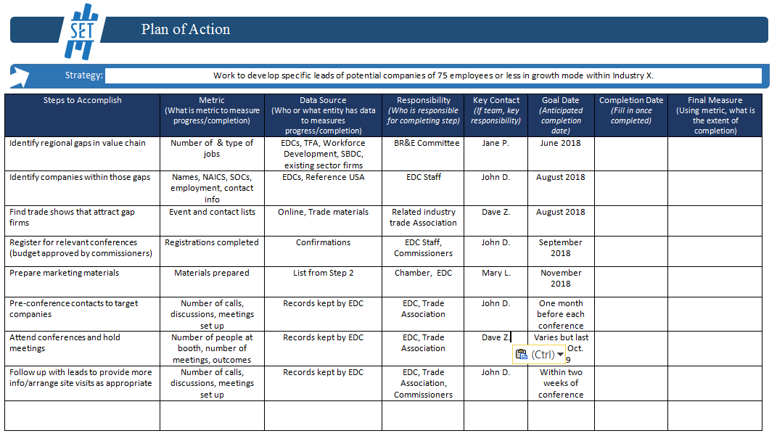
Planning to Do and Measure

Slide 35
Special Considerations for Local Government
Strategies begin to incur costs in current year budget and will need to be allocated on a contingency basis
Costs for multi-year strategies must be included in future year’s budgets
Human resource time should be considered along with material costs
Cost/benefit analysis is critical (so costs need to be tracked)

Slide 36
Why SBP/board/initiative in 2021
Social distancing - small board/big table
People at the table are comfortable enough with each other and technology to deliberate on Zoom
Go for the quick wins with initiatives
Get feedback---but be cautious in bringing everyone to the table or thinking that we are seeing everyone in the current environment

Slide 37
Documenting success
Document the plan and the outcomes
Note the wins
Learn from the feedback
Ask to implement what you learned
(But you have to have the plan and the evaluation metrics.)

Slide 38
Community Economic Development
Department of Agricultural Economics
Rebekka Dudensing, PhD
Associate Professor & Extension Economist
Tel. 979.845.1719
rmdudensing@tamu.edu
@rmdudensing
http://ruralcommunities.tamu.edu

Slide 39
The Ten Commandments of Community Leadership*
Thou shalt create a vision for the future.
Thou shalt develop a strategic plan.
Thou shalt build a sustainable economy for the next generation.
Thou shalt seek public/private partnership.
Thou shalt invest in education and training.
Thou shalt promote respect.
Thou shalt demonstrate a high standard of ethical behavior.
Thou shalt value history, art, and culture.
Thou shalt prepare for a global environment.
Thou shalt develop future leaders.
*Maury Forman and Michelle Harvey, 2007, Association of Washington Cities, Inc.

