Slide 1
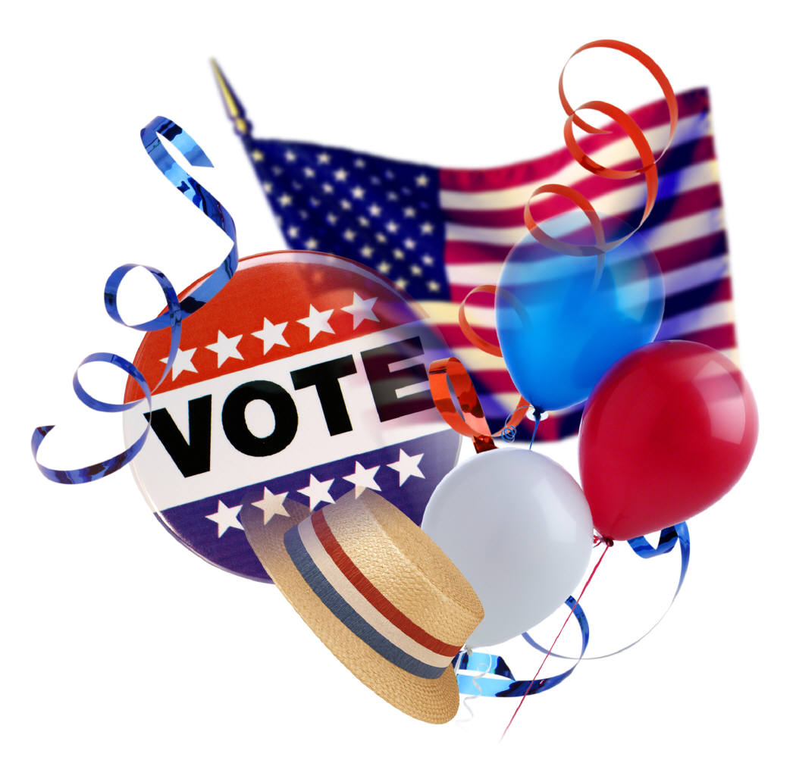

REDISTRICTING 2021
A GUIDE THROUGH THE PROCESS
Allison, Bass & Magee, L.L.P

Slide 2
“No right is more precious in a free country than that of having a voice in the election of those who make the laws under which, as good citizens, we must live. Other rights, even the most basic, are illusory if the right to vote is undermined.”--Earl Warren, Reynolds v. Sims

Slide 3
‘One Person-One Vote’
The conception of political equality from the Declaration of Independence, to Lincoln’s Gettysburg Address, to the Fifteenth, Seventeenth and Nineteenth Amendments could mean only one thing: One Person, One Vote.--Justice Douglas, Gray v. Sanders (1963)

Slide 4
Avery v. Midland County (1968)
Periodic reapportionment extended to Texas Commissioners Courts (JP Precincts do not require balance, but must comply with Voting Rights Act)
Texas Constitution and Statutes amended to comply. Art. III, Section 28, Texas Constitution, 42.005 Tex. Elec.Code
Balance between Commissioner Precincts must be within a maximum deviation of 10% (based upon an ideal precinct, i.e. total county population divided by number of single member precincts)
10% is top to bottom deviation, plus or minus, as compared to the county population divided by 4, the number of “single member” districts, i.e. ideal size.

Slide 5
Texas Constitution …
Art. III Sec. 28. The Legislature shall, at its first regular session after the publication of each United States decennial census, apportion the state into senatorial and representative districts…
Art. V, Sec. 18: Sec. 18. (a) Each county in the State with a population of 50,000 or more, according to the most recent federal census, from time to time, for the convenience of the people, shall be divided into not less than four and not more than eight precincts. Each county in the State with a population of 18,000 or more but less than 50,000, according to the most recent federal census, from time to time, for the convenience of the people, shall be divided into not less than two and not more than eight precincts. Each county in the State with a population of less than 18,000, according to the most recent federal census, from time to time, for the convenience of the people, shall be designated as a single precinct or, if the Commissioners Court determines that the county needs more than one precinct, shall be divided into not more than four precincts.
(b) Each county shall, in the manner provided for justice of the peace and constable precincts, be divided into four commissioners precincts in each of which there shall be elected by the qualified voters thereof one County Commissioner, who shall hold his office for four years and until his successor shall be elected and qualified. The County Commissioners so chosen, with the County Judge as presiding officer, shall compose the County Commissioners Court, which shall exercise such powers and jurisdiction over all county business, as is conferred by this Constitution and the laws of the State, or as may be hereafter prescribed.

Slide 6
Voting Rights Act of 1965
Section 2- A plaintiff may sue for actual or potential discrimination under the Act.
Section 5- Required evaluation of the plan to dilute or discriminate against minority voters by Department of Justice. (Vacated by Supreme Ct.)
Department of Justice “preclearance” no longer required, but compliance still enforced by Section 2.
Judicial by-pass option available, but difficult.

Slide 7
Shaw v. Reno (1993)
Race may not be a predominant factor in reapportionment
If race is considered (as it must to some extent under Voting Rights) the plan must be narrowly tailored to achieve racial opportunity to elect representatives of choice
Maximized minority precincts no longer required
Benchmarks established under prior law may be suspect or impossible.
‘Bizarre’ districts will draw scrutiny

Slide 8
Summary
Essentially, redistricting is the periodic readjustment of political boundaries (precinct-lines) to accomplish precincts –wards-districts of essentially balanced population, while at the same time avoiding adverse affect on the voting rights of recognized minority groups.

Slide 9
STEPS INCIDENT TO REAPPORTIONMENT
Prepare for release of census data
  Assemble current maps of election precincts
  Identify existing polling places
  Locate incumbent residences
  Assemble election history for prior 10 years
  Evaluate accuracy of maps/boundary descriptions for existing precincts

Slide 10
Additional Steps
Develop Criteria for Reapportionment
  1. Compact and Contiguous
  2. Well defined boundaries
  3. Preserve neighborhoods and communities of interest
  4. Comply with Voting Rights Act
  5. Facilitate governmental functions: a. Election Administration
  b. Road/Budget Balance
  c. Delivery of Services

Slide 11
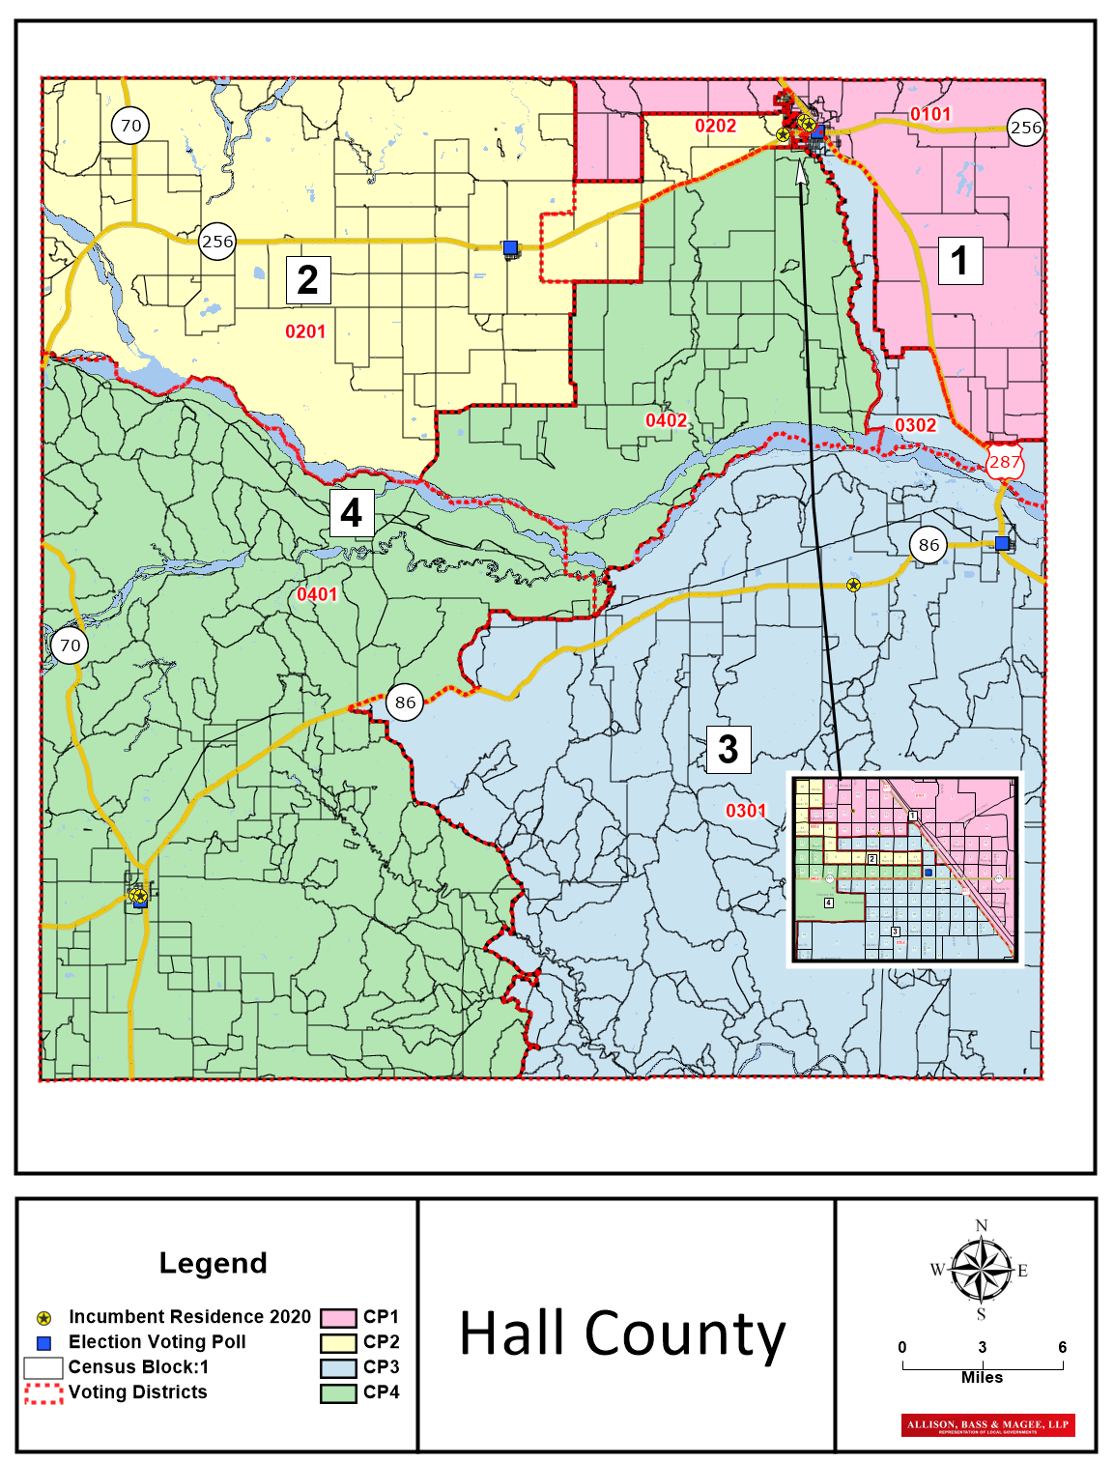
Polling Place
Major highway
Incumbent residence
Election Precinct boundary
Census Block boundary

Slide 12
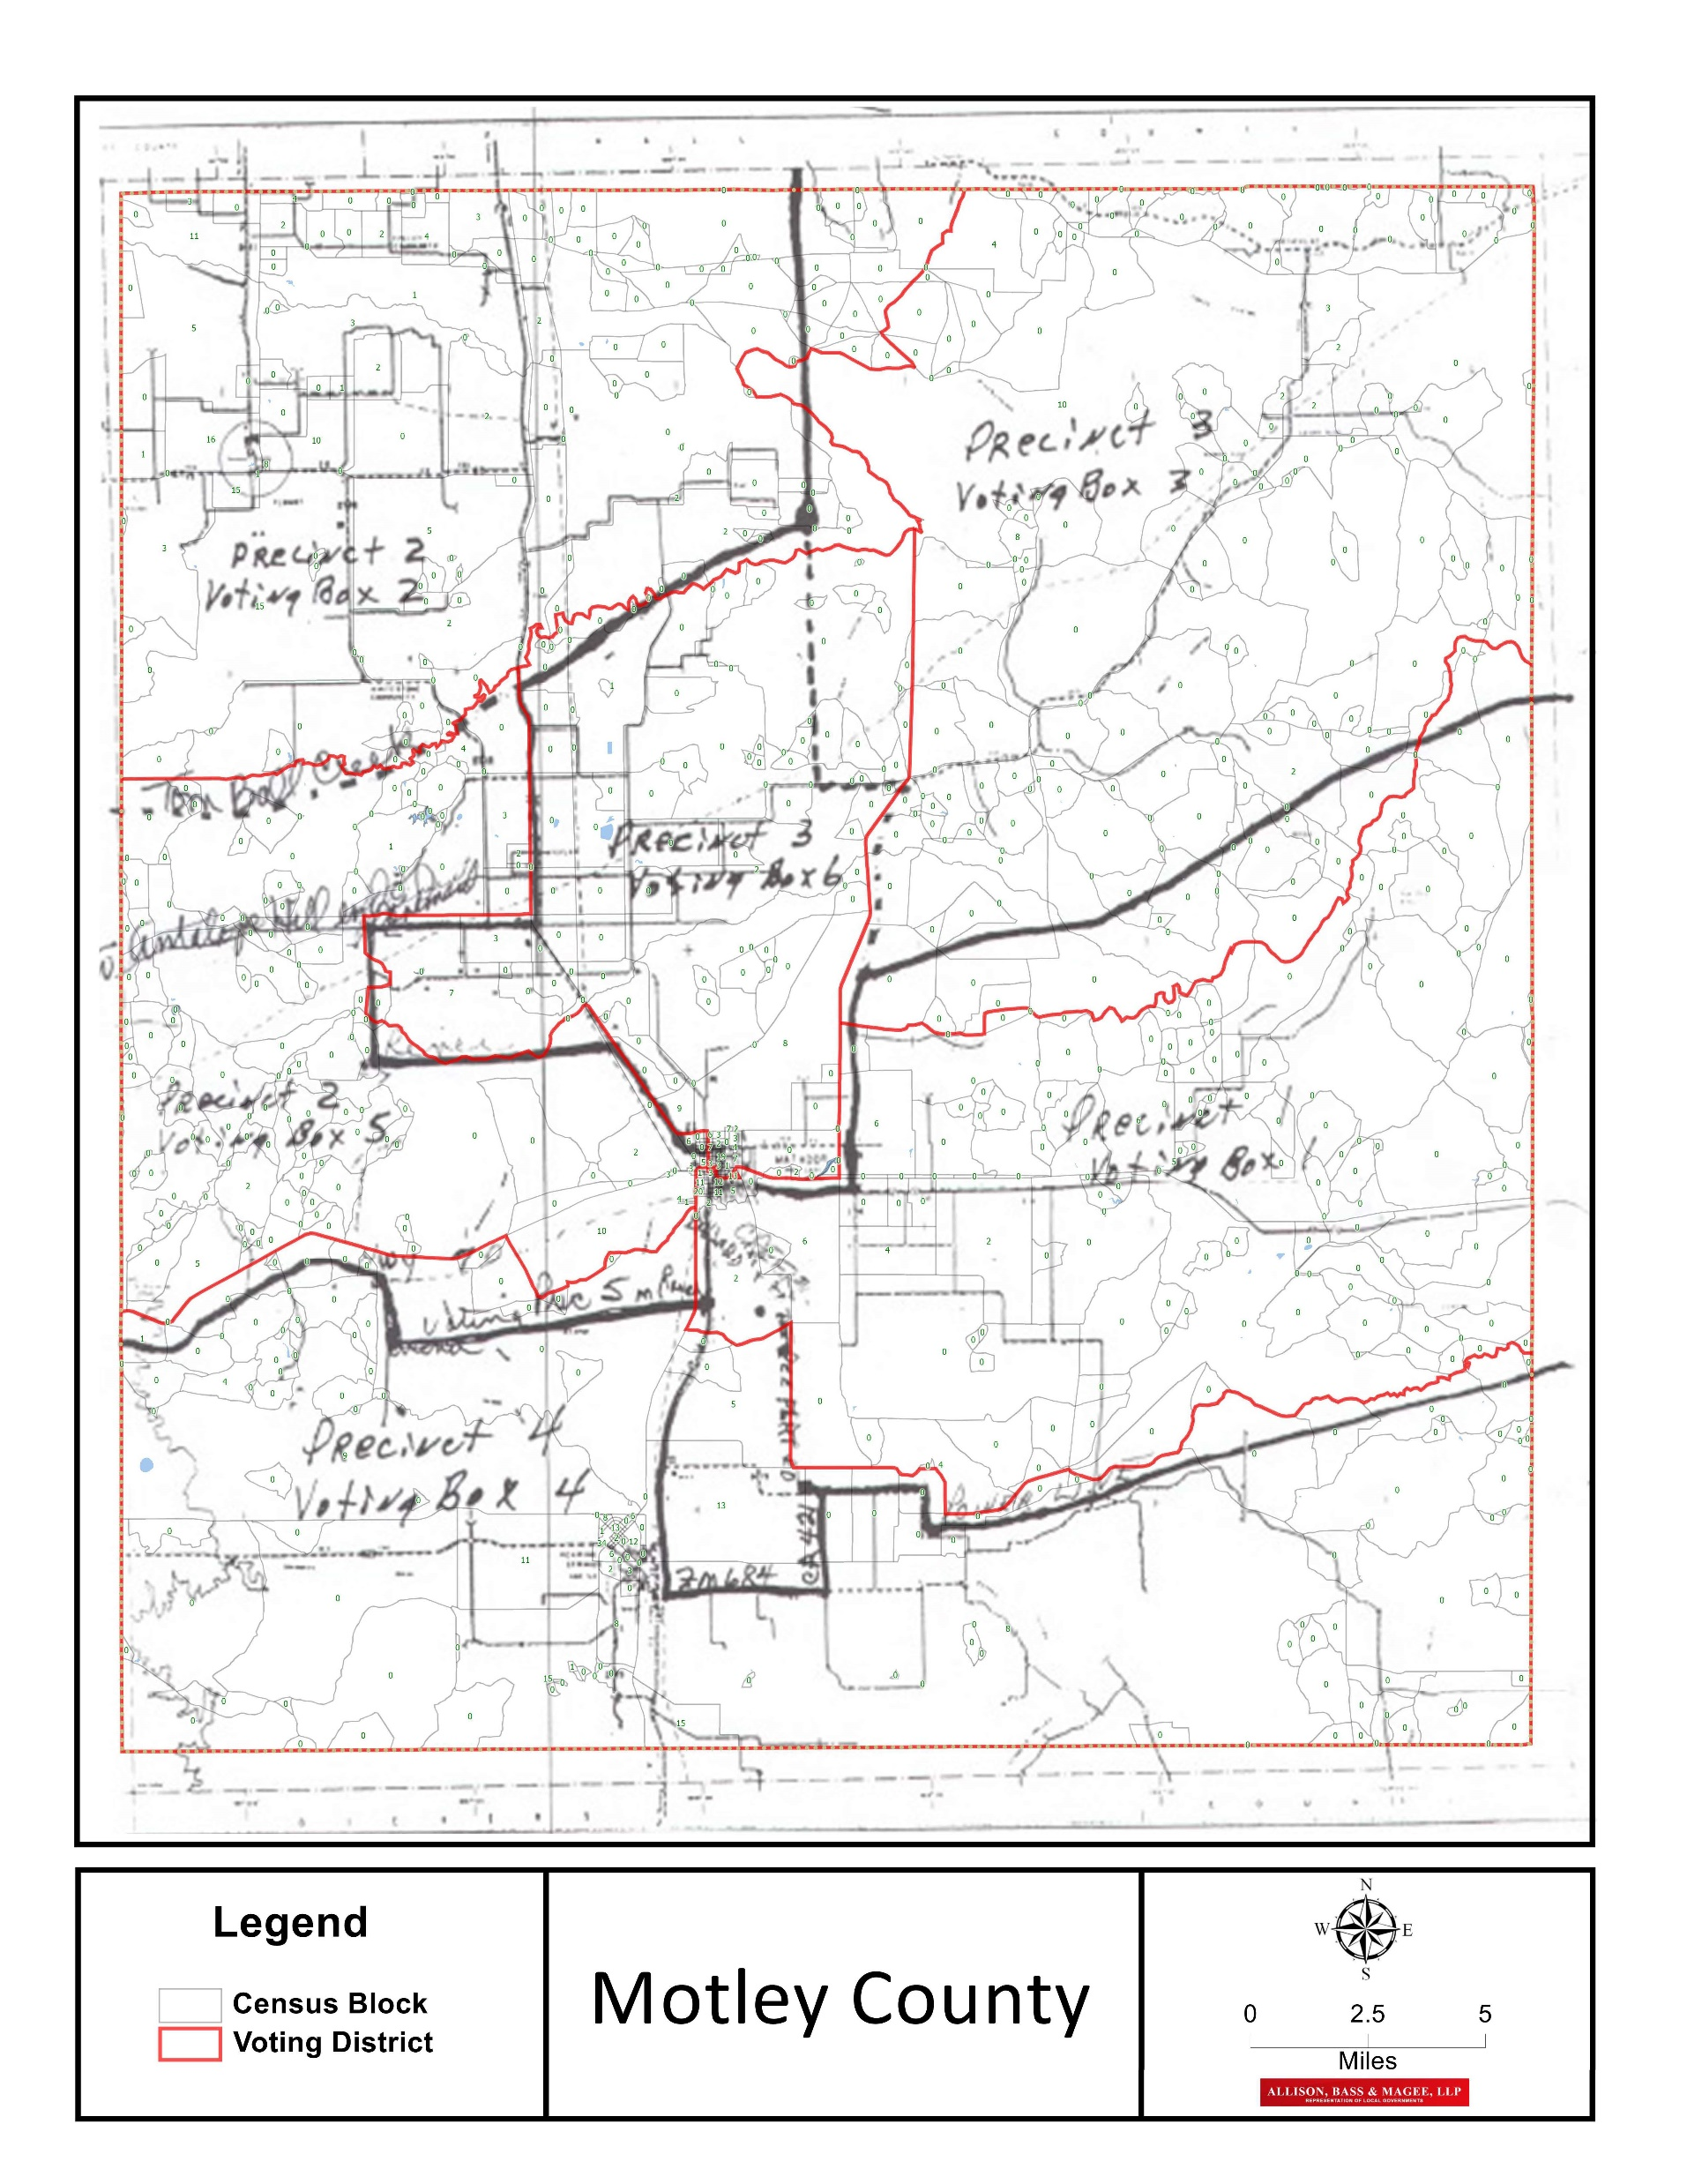
Some counties have used “arbitrary boundaries” for election precinct lines, such as abstracts, or merely drawn lines on a map.
The census is based on census blocks, which use “physical” lines, typically highways, streams, easements (which are not always visible) and municipal boundaries (which are not always physical).
Here, Motley County used arbitrary boundaries, i.e. the black lines. The Secretary of State substituted Voter Tabulation Districts in red, which are based on census blocks.

Slide 13
Once Census Data Released
  Initial Assessment- A demographic assessment of the existing political boundaries with 2020 Census data. Assessment will identify:
    Population shifts in terms of number, balance, i.e. one-person-one-vote analysis
    Racial makeup of electorate, i.e. packing, fragmenting, age and race voting block analysis

Slide 14
Permissible Standards
Population Balance-a total deviation of 10% top to bottom from an ideally balanced population, i.e. Total population/# of Precincts.
Each representative precinct-ward-district should be as equal as possible in terms of numerical balance, with a tolerance of no more than 5% above or below the ideal.
Closer tolerance to 0% is desired to allow for population change over next ten years.

Slide 15
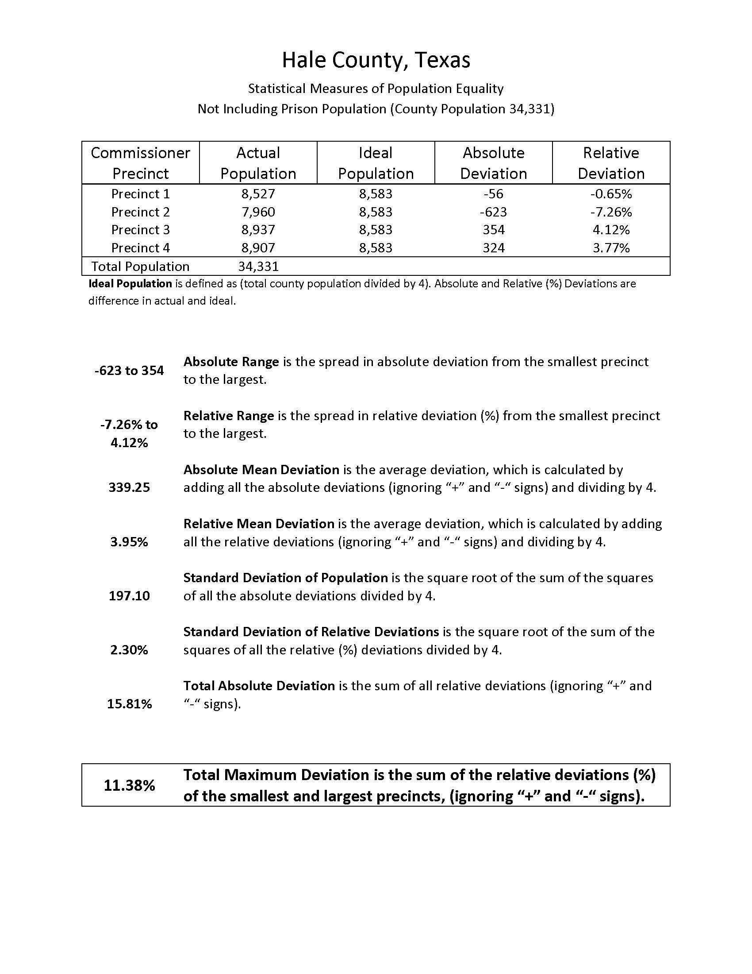

Slide 16
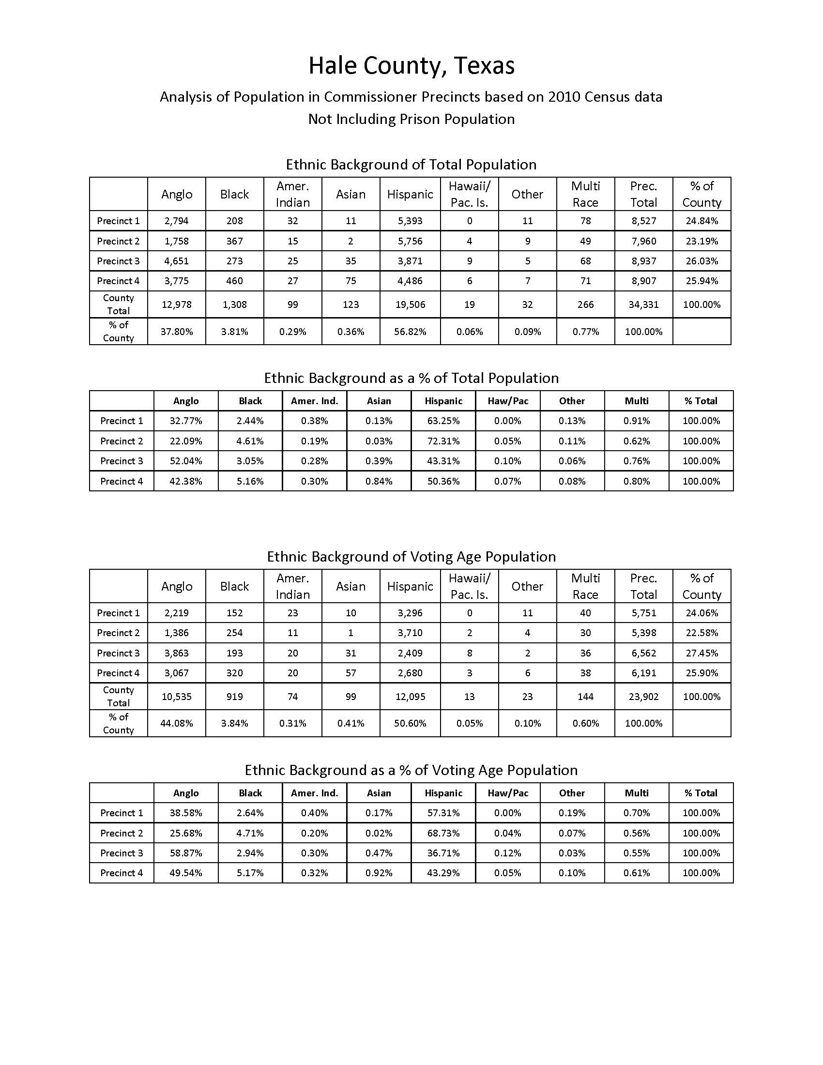

Slide 17
Additional Criteria
Incumbent Office Holders retained in office where possible
Minority representation established by prior DOJ pre-cleared plan should be maintained if possible without retrogression, unless benchmark established by prior plan would offend Shaw v. Reno doctrine. (excessive race-based consideration or extremely irregular boundaries will draw scrutiny)
Avoid dilution/fragmentation

Slide 18
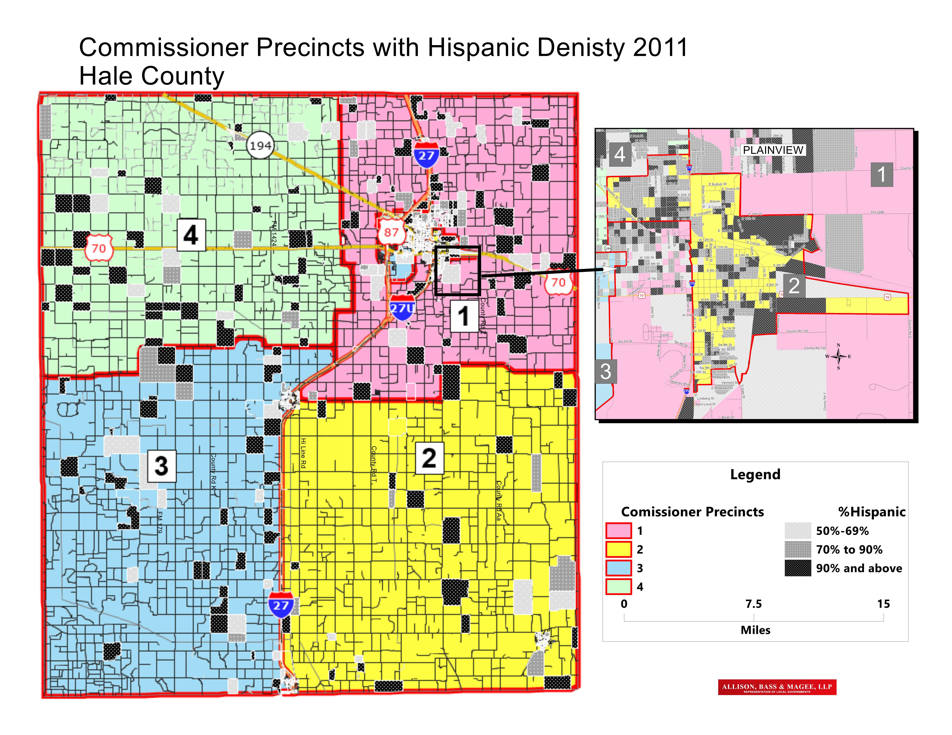

Slide 19
Race Demographics
Race cannot be the controlling factor in redistricting, but it is a significant factor, i.e. racial blocks within the political jurisdiction should not be grouped in such a manner as to dilute or weaken the ability of minority voters to elect candidate of choice.

Slide 20
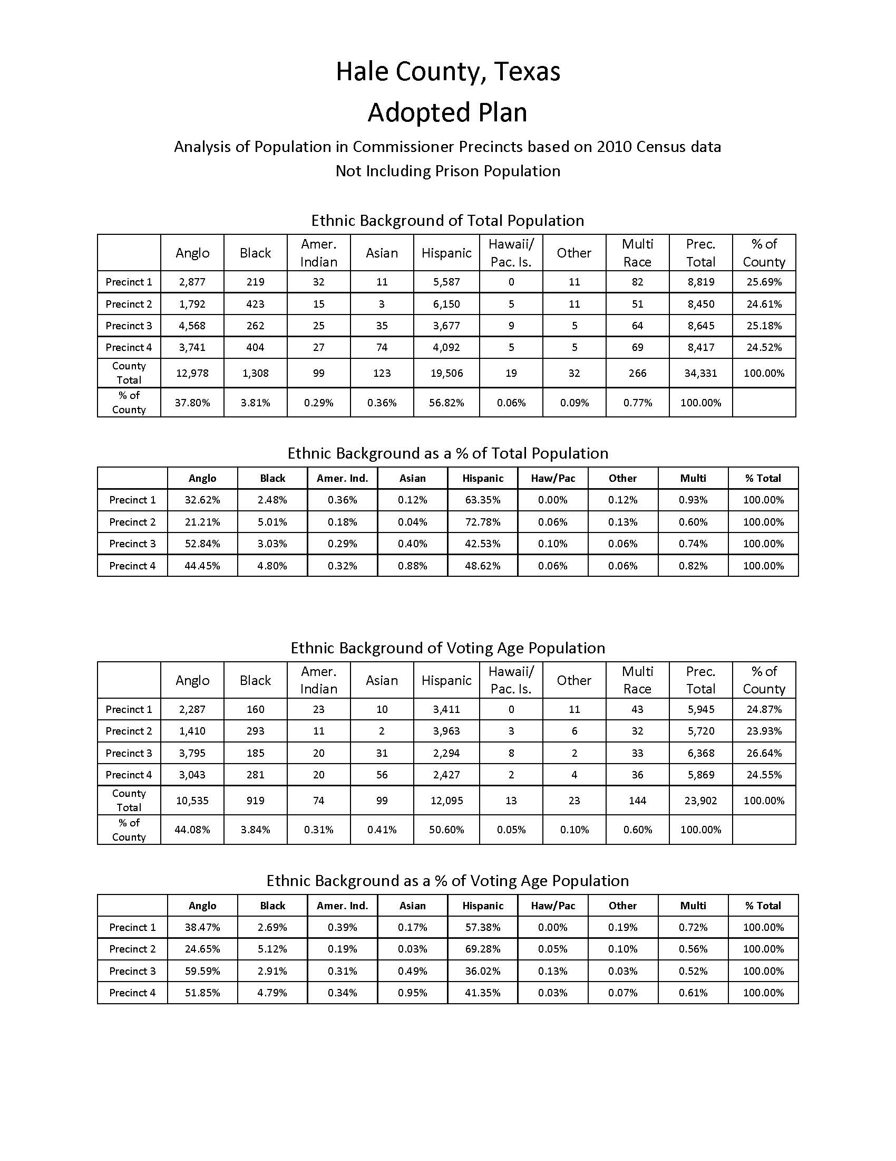
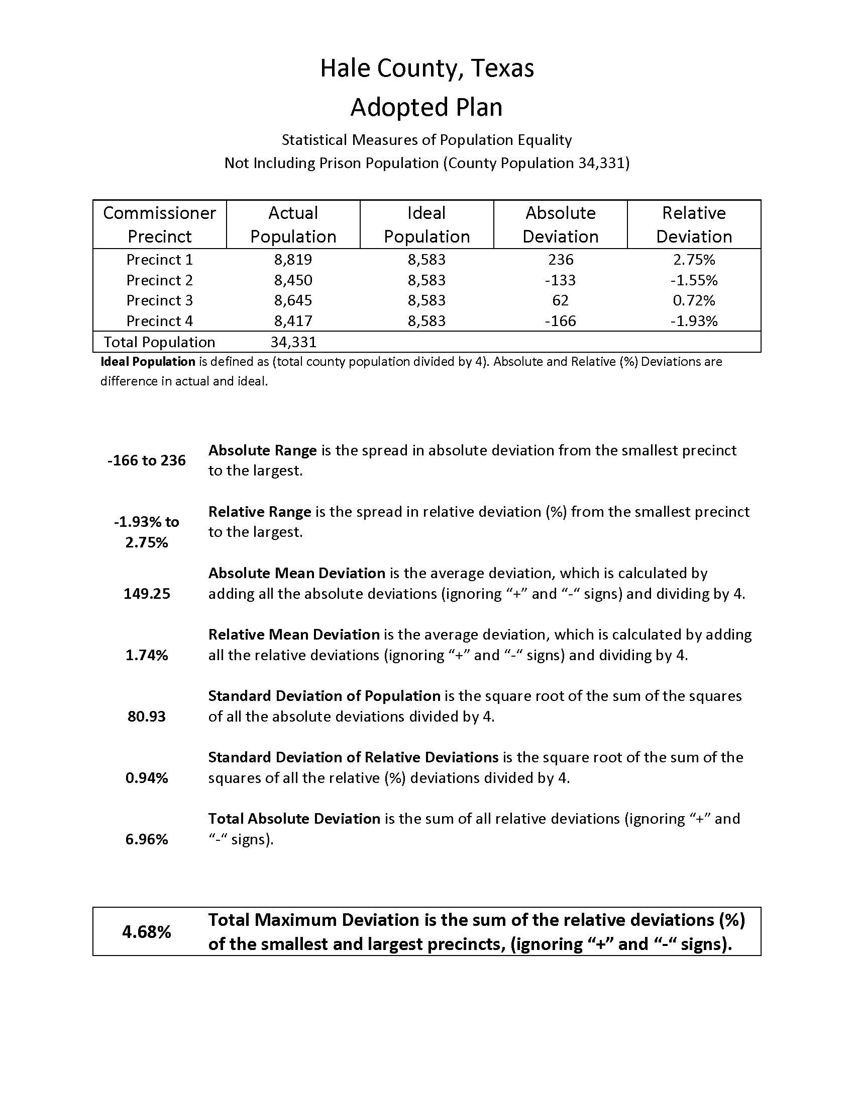

Adopted Plan

Slide 21
Citizens Committee?
The governing body of a political subdivision may wish to appoint a Citizens Committee.
Citizens Committee allows for wider voice of the community in drawing political boundaries, shifts political pressure from elected officials, avoids claims of favoritism, cronyism, etc. Committee should reflect demographic make-up of County.

Slide 22
Election Precinct Requirements
Commissioners Courts required divide the county into compact and contiguous numbered election precincts.-42.001 Tex. Elec. Cd.
Election Precincts may not contain territory from more than one:
  Commissioner Pct.
  Justice Ct. precinct
  Congressional Dist.
  State Rep. District
  State Senate Dist
  State Board of Ed
    42.005 Tex.Elec.Code
  Former requirement re: city wards dropped, but may still want to honor for ease of election administration.

Slide 23
Election Precinct Requirements-continued
Election Precincts can be combined to reach a threshold of 500 voters per combined precinct- 42.0051 Tex.Elec.Code, trumps 42.005 Tx.Elec.Code, but such consolidation cannot dilute minority voting rights.
Election precinct changes as result of redistricting shall be done by 10.1.21. Tex.Elec.Code 42.032(other wise May of odd numbered years).
42.006 Tex.Elec. Code requires at least 50 registered voters, but not more than 5000.
42.007 Tex.Elec.Code-Incorporated and incorporated areas should not be in one election precinct, unless necessary.
All boundaries should use natural boundaries, or artificial boundaries or survey lines. 43.063 Tex.Elec.Code (Census blocks typically conform)

Slide 24
Polling Place Standards
Reasonably convenient to voters in election precinct
ADA compliant (access) 43.034 Tex.Elec.Code.
Public buildings cannot charge for use if otherwise open on election date 43.033 Tex.Elec.Code
If no public building available, polling place should be reasonably open to the public.
As last resort, private structures can be used as a polling place, but not the home of a candidate.
Notice at prior polling place if changed required. 43.062 Tex.Elec.Code.

Slide 25
Preclearance No Longer Required
The Voting Rights Act, passed originally in 1964, required jurisdictions covered by the Act to submit their plans for any change to voting procedures, including political boundaries, in advance of implementation for a review by the Department of Justice, to insure that the plan does not have the effect of discrimination upon the voting rights of minority voters.
Shelby County v. Holder, 2013, invalidated Section 4, which applied the preclearance provisions in Section 5 to only certain jurisdictions, based on what the Supreme Court considered outdated formula. The congress has not re-enact Section 4, and as a consequence, the requirement for preclearance is no longer in effect.
It should be noted that immediately after the Shelby decision, many states, including Texas, implemented restrictive voting measures that in all likelihood would not have survived preclearance.

Slide 26
Final Commissioners Precincts

Slide 27
Inset of Urban Detail Desirable

Slide 28
Final Election Precincts

Slide 29
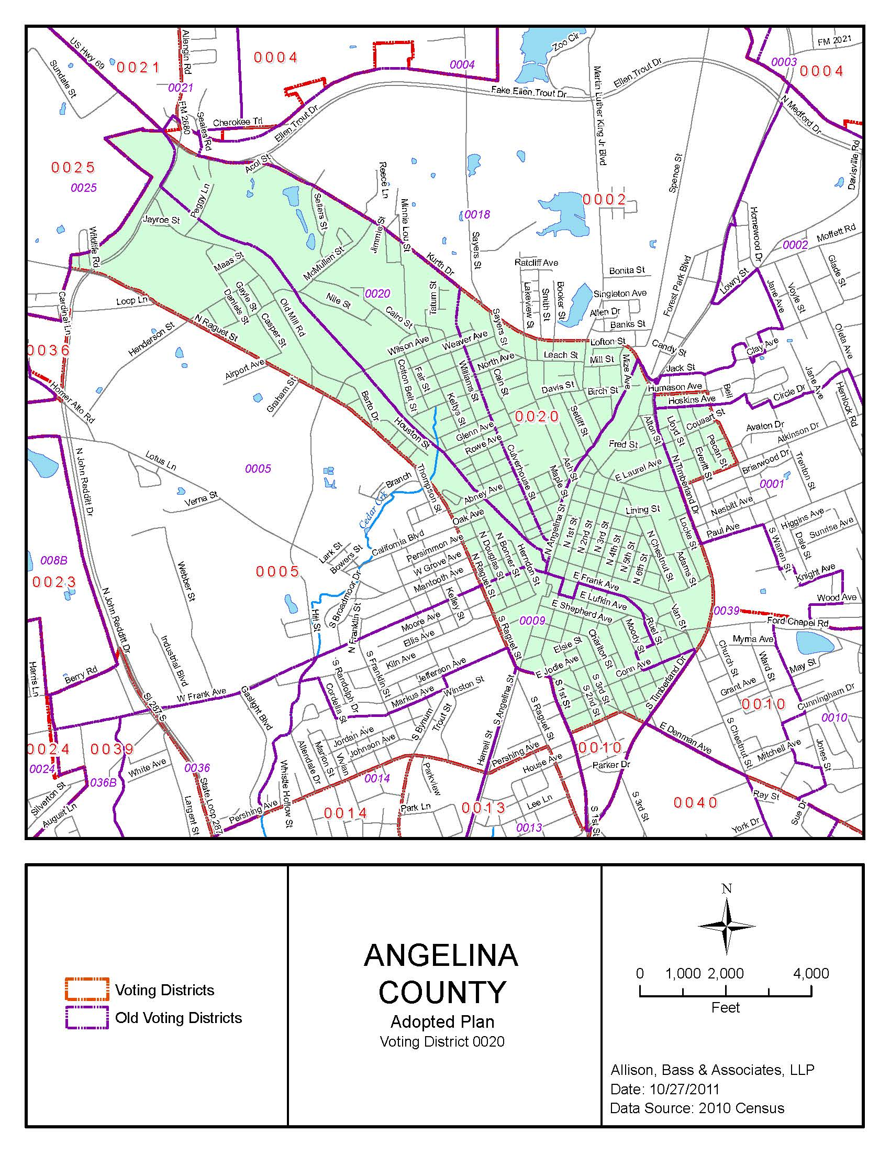
Election Precinct Detail

Slide 30
By merging the county poll list (voter registration number and address only) with the GIS software, we should be able to “move” voters when we change boundaries, and provide the County Clerk or Election Administrator with a list of the voters who have been moved from one election precinct to another. The level of accuracy and correct address matching necessary to make this function useful will have to be determined once we receive the census data.
Likewise, we can now produce a “metes and bounds” description of each precinct, describing the census block boundaries that are used to define the outer portion of each precinct (election, JP or Commissioner) if desired.

Slide 31
Depending on the available time, we will work with you in person and on-line
We normally have the necessary data from the Census Bureau by late January-mid February, certainly no later than April 1.
But the Census Bureau demographic/population data will not be available this cycle until September 30, 2021.
Statutory deadline for political boundaries is 10/1/2021
Impossible to perform the redistricting work within the existing statutory timeline.
Legislature or Federal Courts will impose timelines for a delayed Primary Election in 2022. HS 2025 by Hunter only billed passed regarding redistricting, requires action not later than 1st day of 1st month after 150th day of the publication of census report. That would be October 1, 2021.
There may be need to do more of the work on-line to meet the shortened time period between the release of the data and the beginning of filing for the primary.

Slide 32
Timeline ???
April 2020-Census count conducted
  Retention of legal counsel to assist
Map Files for 2020-TIGER
  Overlay existing political boundaries on 2020 TIGER file map.
  Normally the Pl. 94-171 data, or the “Demographic” data is released no later than March 2021, but this year, 9/31/21. Deadlines will need to be pushed back by Legislature or Federal Courts
2021-August
  Establish criteria for plan evaluation
  Appoint Citizens Committee, if any
  Review and confirm current boundaries
2021-2022-Between October 1st and February 28, 2022, develop and approve Plan (150 days or sooner)
Primary Election: Unable to predict at this time, but most likely the 2022 primary will be sometime in May, 2022.

Slide 33

A Complex Process-But You Can Do It!

Slide 34
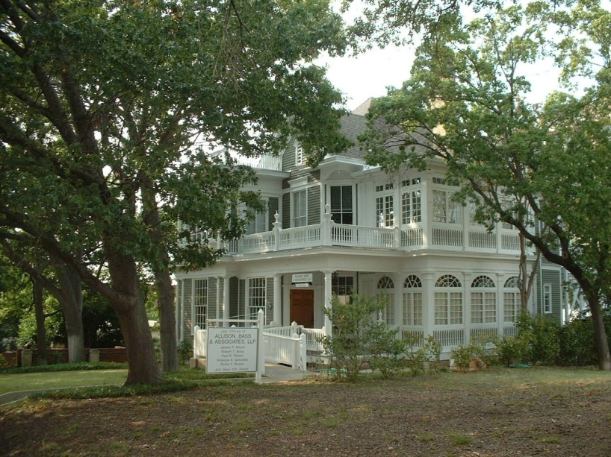
402 West 12th Street
Austin, Texas 78701
512/482-0701
Law@Allison-Bass.com
Allison, Bass &
Magee, LLP

