Slide 1
DRUG IMPAIRED DRIVING
87th Annual South Texas County Judges and Commissioners Association Conference
June 29, 2021
HON. ROBERT S ANCHONDO
ABA REGION 6 RJOL

Slide 2
Learning Objectives
After this session you will be able to:
  Discuss current issues that arise in impaired driving cases
  Identify the different challenges presented in impaired driving cases
  Recognize factors to consider when making a sentencing decision in drugged driving cases

Slide 3
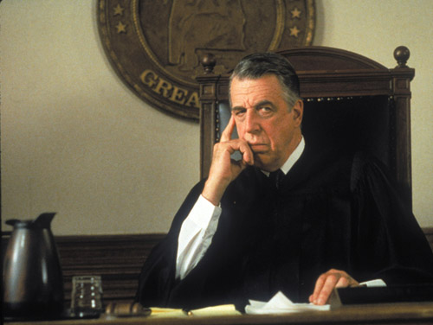
What do I do with these people?

Slide 4
Hypothetical
Tom is operating their vehicle at 8:30 p.m. on a 2-lane road, with his 5-year-old son as a passenger
He is driving erratically, loses control of their vehicle and hits another vehicle causing significant property damage but fortunately no serious injuries
Tom has an odor of alcohol on him, has a small baggie of marijuana in his pocket, along with a prescription slip for benzodiazepine.

Slide 5
Polling Question
Assuming that Tom is under the influence, what substance is he under the influence of?
  alcohol
  marijuana
  cocaine
  benzodiazepine
  we don’t know
Notes:
The participants can only select one answer in this type of question.

Slide 6
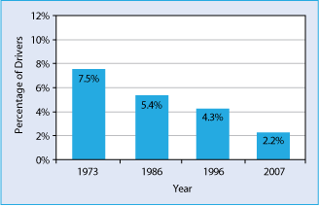
Decline in Alcohol-Impaired Driving
Estimated Percentage of Weekend Nighttime Drivers with BACs ≥ 0.08
Latest Survey (2013-2014): 1.5%

Slide 7
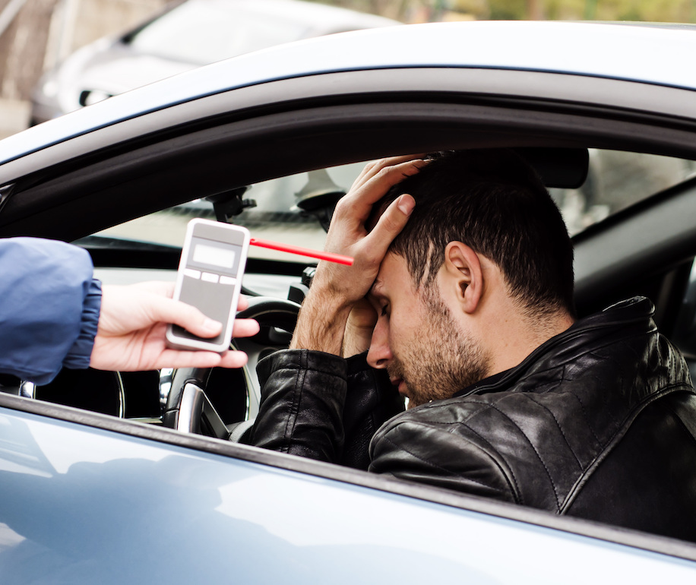
Good News But . . .
> 1 million arrests for impaired driving annually
> 111 million self-reported alcohol-impaired driving episodes annually
Source: Centers for Disease Control and Prevention, National Center for Injury Prevention and Control

Slide 8
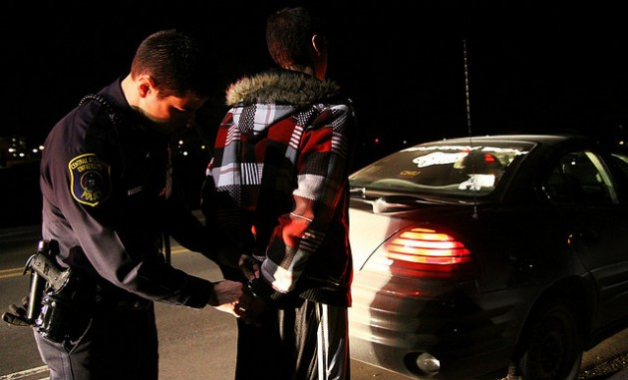
The Bad News:
The Changing Face of the Impaired Driver
Alcohol Use
  1973: 35.9%
  2007: 12.4%
  2013/2014: 8.3%
Marijuana Use
  2007 marijuana use (THC): 8.6%
  2013/2014 marijuana use (THC): 12.6%
Overall Drug Use (all categories): 22.5%
Source: Results of the 2013-2014 National Roadside Survey of Alcohol and Drug Use by Drivers, NHTSA Research Note (DOT HS 812 118)(February 2015)

Slide 9
Survey: DUI in Past Year
20 million reported DUI alcohol in 2019
12.8 million reported DUI marijuana in 2019
13.7 million reported DUI illicit drugs in 2019
  marijuana, cocaine, heroin, hallucinogens, inhalants,
  methamphetamine
2019 National Survey on Drug Use and Health: Detailed Tables (SAMHSA 2020)

Slide 10
Fatality Analysis Reporting System (2016)
Of deceased drivers with known test results:
  38% tested positive for alcohol (any BAC)
  43% tested positive for drugs
    41% marijuana
    51% of the drug-positive drivers were positive for two or more drugs
    40.7% were positive for alcohol
Source: GHSA Drug Impaired Driving: A Guide for States (April 2017)

Slide 11
MARIJUANA USE
Estimated 3.8% of global population age 15- 64 consumed marijuana in 2017.
In the US % of people age 12 and older have used cannabis in the past year has increased from 11% in 2002 to 15.9% in 2018 (SAMHSA)
According to SAMHSA numbers in the past year for marijuana have gone down among youth ages 12-17 but nearly doubled among adults 26 or older from 7% to 13.3% (2019)

Slide 12
The Problem
Legalized Medical Marijuana (34 States & D.C.)
Legalized/Decriminalization of Marijuana (32 States & D.C.)
Increased use and abuse of Rx
Continued use of illegal & designer drugs
Aging population
↑ Public acceptance of use
↓ Public perception of harmfulness

Slide 13
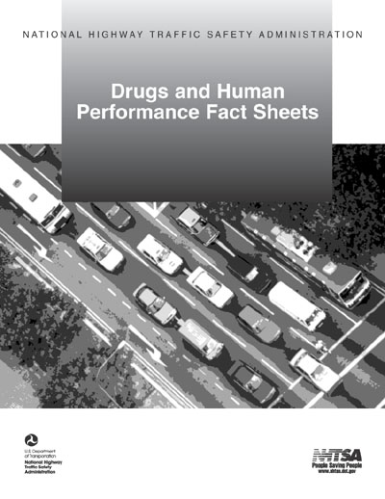
Effects of Drugs on Driving:
A Resource
http://www.nhtsa.gov/people/injury/research/job185drugs/
(NHTSA, April 2014)

Slide 14
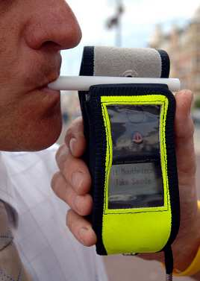
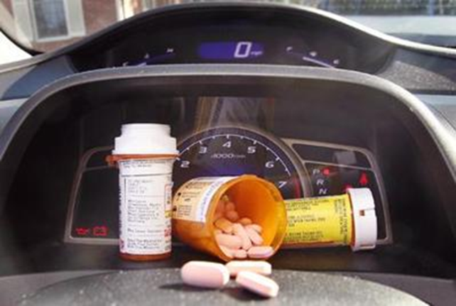
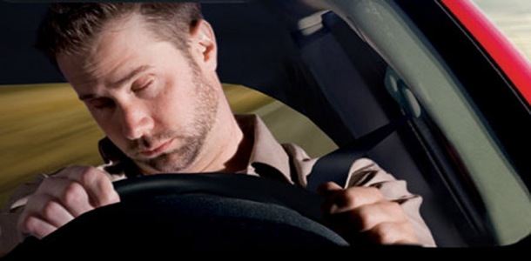
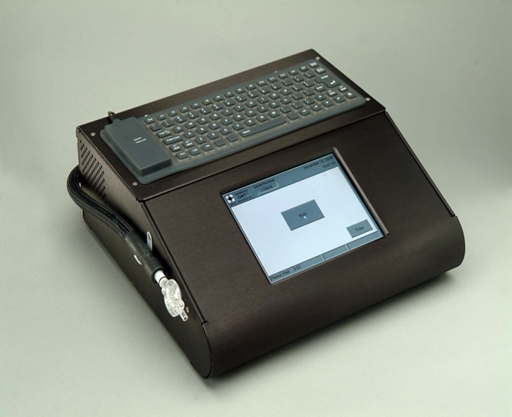
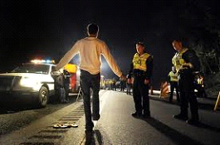
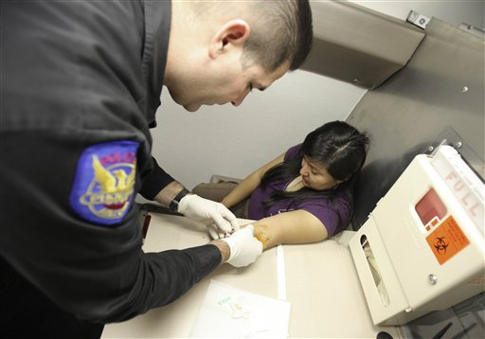
Impaired Driving Laws

Slide 15
Impaired Driving Laws
Per se laws/zero tolerance laws
  Level of impairment need not be proven
Non-per se laws
  Driving while intoxicated
  Driving while abilities impaired by consumption
    alcohol and/or drug use
    level of impairment must be proven

Slide 16
Drug-Impaired Per Se Laws:
Alcohol Framework Doesn’t Apply to Drugs
Alcohol
  Alcohol in blood/breath = alcohol in brain = impairment = crash risk
Drugs
  Drugs in blood/urine ≠ drug in brain ≠ impairment ≠ crash risk

Slide 17
Science: Presence vs. Impairment
“The development of impairment standards for drugs similar to the .08 per se standard for alcohol has failed, not for want of trying and not for want of serious research. This is because no standard relationship between blood levels of a drug or drug metabolites and impairment has been established.”
DuPont, R.L., Voas, R.B., Walsh, J.M., et al. (2012). The need for drugged driving per se laws: a commentary, Traffic Injury Prevention 13(1), 31-42.
Notes:
Resource:
DuPont, R.L., Voas, R.B., Walsh, J.M., et al. (2012). The need for drugged driving per se laws: a commentary.
Traffic Injury Prevention 13(1), 31-42. As cited in Governor’s Highway Traffic Safety Association, Drug Impaired Driving: A Guide for States (2017).

Slide 18
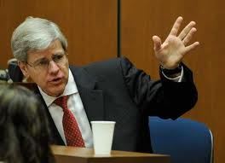
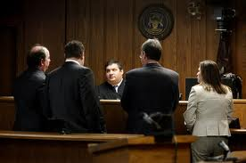
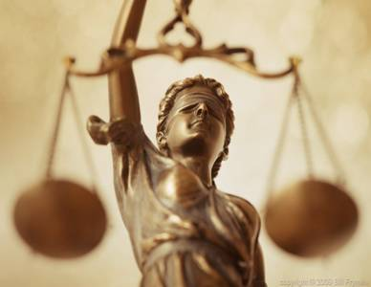
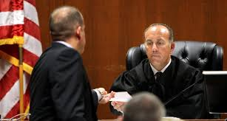
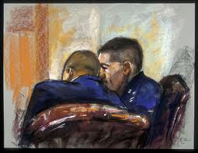
Driving Under the Influence Trials

Slide 19
Texas DWI Law
Unlawful to operate a motor vehicle while “intoxicated”
"Intoxicated" means:
  (A) not having the normal use of mental or physical faculties by reason of the introduction of alcohol, a controlled substance, a drug, a dangerous drug, a combination of two or more of those substances, or any other substance into the body; or
  (B) having an alcohol concentration of 0.08 or more.

Slide 20
Evidence of Intoxication in DWI Cases
Driving observations
Post-stop observations from stop to release
  Performance on SFSTs
  Other “FSTs”
  Coordination & other subjective signs
  Presence and/or odor of drugs
Admissions
Officer’s opinion
DRE testimony
Breath and blood testing

Slide 21
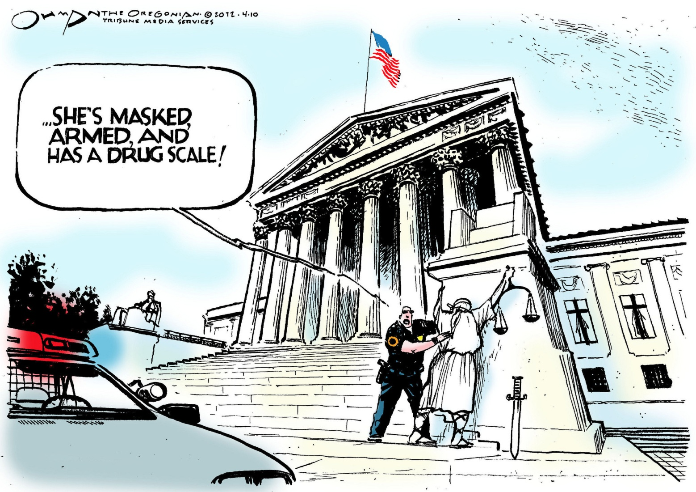
Fourth Amendment Issues

Slide 22
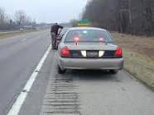
Traffic Stops: Investigative Stops
Stopping a vehicle is a seizure under 4th Amendment
Stop is permissible if based on reasonable articulable suspicion based on totality of circumstances
  Pretext stops permissible
  But stops based on mere hunch or speculation are not
Whren v. U.S., 517 U.S. 806 (1996)

Slide 23
Rodriguez v. U.S.
135 S.Ct. 1609 (2015)
Once stopped, officer may conduct an investigation “reasonably related” to scope of stop
  Duration determined by the seizure’s “mission”
Stop may be extended for unrelated investigation with “reasonable, articulable suspicion” (e.g. drug dog scan, SFSTs)

Slide 24
Allowable Warrantless Searches
Search incident to arrest
Exigent circumstances
Automobile search
Consent
Inventory search

Slide 25
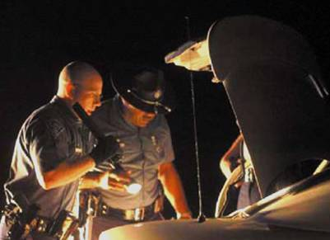
Search Incident to Arrest for DUI
A Quick Review
Chimel v. California, 395 U.S. 752 (1969)
N.Y. v. Belton, 453 U.S. 454 (1981)
Arizona v. Gant, 556 U.S. 332 (2009)

Slide 26
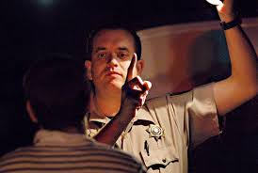
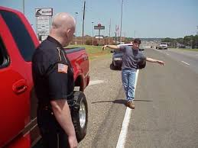
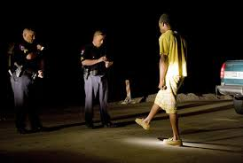
Admissibility of Standardized Field Sobriety Tests

Slide 27
Admissibility of SFSTs – In General
Generally admissible – e.g. City of West Bend v. Wilkens, 278 Wis.2d 643 (2005)
  observational tools
  not scientific tests
  relevant & probative
Generally not admissible as to level of intoxication
No “pass” vs. “fail”

Slide 28
Admissibility of SFSTs – DUI Mj
Com. v. Gerhardt, 477 Mass. 775 (2017)
SFSTs admissible in operating under the influence of marijuana case
Lay witness may testify concerning observable behavior:
    Bloodshot eyes
    Lack of coordination/poor balance
    Reaction times, slow speech, paranoia
See also State v. Mueller, 386 Wis.2d 351 (2019)

Slide 29
Collision of Implied Consent and the 4th Amendment:
The Taking of Breath & Blood Samples

Slide 30
Noteworthy Supreme Court Decisions
Missouri v. McNeely, 133 S.Ct. 1552 (2013)
Birchfield v. North Dakota, 136 S.Ct. 2160 (2016)
Mitchell v. Wisconsin, 139 S.Ct. 2525 (2019)

Slide 31
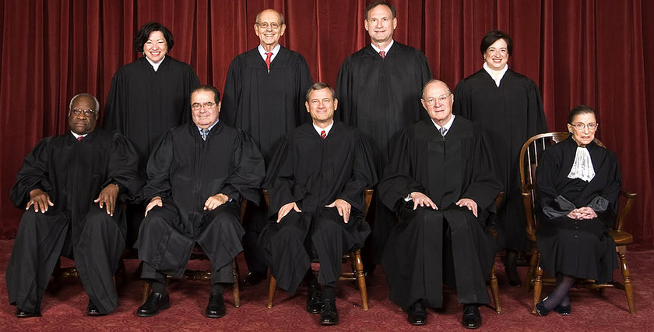
Missouri v. McNeely, 133 S.Ct. 1552 (2013)
Exigent Circumstances
Issue presented: whether the natural dissipation of alcohol in the bloodstream creates a per se exigency
31
Notes:
At 2:08 a.m. McNeely is observed speeding and repeatedly crossing the centerline. When stopped, police developed probable cause to arrest for DUI; Refused PBT; refused breath test; refused blood test; Blood drawn at hospital at 2:35 a.m. over objection; BAC = 0.154
Search Warrants for Blood Tests
In the case of Missouri v. McNeely, 569 U.S. 141 (2013), the Supreme Court of the United States held that the dissipation of alcohol is not a sufficient exigent circumstance by itself to justify a warrantless, non-consensual blood test of a suspected impaired driver. As a result, standard impaired driving investigations require a search warrant to conduct a blood test if the driver does not consent to a test. In Birchfield v. North Dakota, 579 U.S.____ (2016), the Supreme Court held that a warrantless breath test may be conducted as a ‘search incident to arrest’ but the more intrusive blood test requires a search warrant, if consent is not given.
Further, because breath tests do not show the presence of drugs other than alcohol, blood tests are essential in investigating the ever-increasing crime of drug-impaired driving. Caselaw makes it clear that if a defendant does not consent to a blood test, a warrant must be obtained, meaning impaired driving investigations now require more search warrants than in the past.
Obtaining a search warrant can be a time consuming and cumbersome process that requires cooperation and coordination of a number of criminal justice stakeholders. As was argued by the State of Missouri in McNeely, time is of the essence in impaired driving investigations and the inevitable delays in procuring a warrant will result in the loss of evidence. In rejecting the per se warrant exception for blood testing in drunk-driving cases, the Supreme Court noted that there have been many advances in processing warrant applications and while technological innovations will not eliminate all delay, streamlined approaches would help resolve the problem.
In spite of the innovations and advances noted in the McNeely case, a number of jurisdictions still do not have an efficient warrant process for impaired driving investigations. In an effort to address the issue, the National Highway Traffic Administration has released a 62-page publication entitled: “Practices for Implementing Expedited Search Warrant Programs for Obtaining Evidence from Impaired Drivers.”
The publication, released in April of this year, explains how a jurisdiction may develop an expedited warrant procedure, but also sets forth the advantages of such an approach to the criminal justice system. Although considerable focus is given to how an expedited warrant process addresses law enforcement interests in reducing delay, it should be noted that defendants also benefit by receiving the Fourth Amendment protection of a neutral and detached judicial officer determining the validity of the requested search.
The publication is an excellent guide on why and how to develop a comprehensive, system-wide impaired driving warrant approach, but it is also worthwhile for individual judges who seek practical pointers on meeting the responsibilities of processing search warrant requests for blood tests.

Slide 32
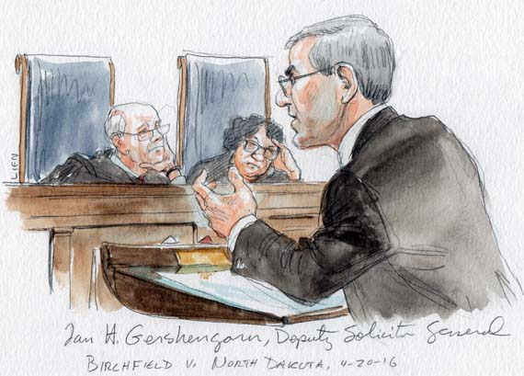
Birchfield v. North Dakota, 136 S.Ct. 2160 (2016)
Search Incident to Arrest
Issue Presented:
  Whether, in the absent of a warrant, a State may make it a crime for a person to refuse to take a chemical test ?

Slide 33
Birchfield v. North Dakota, 136 S.Ct. 2160 (2016)
HELD: Motorists may not be criminally punished for refusing a blood test based on legally implied consent to submit to them.
It is one thing to approve implied-consent laws that impose civil penalties and evidentiary consequences but quite another for a State to insist upon an intrusive blood test and then to impose criminal penalties on refusal to submit.

Slide 34
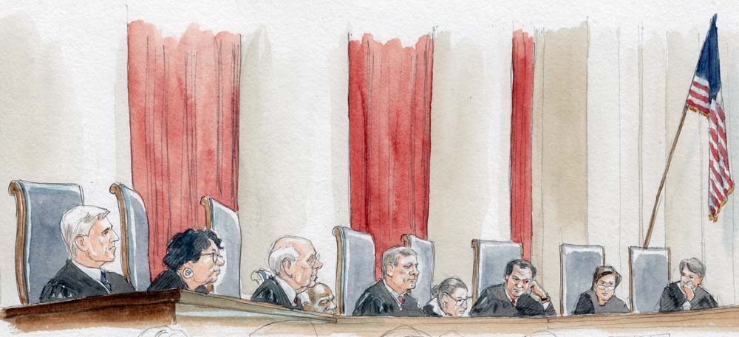
Mitchell v. Wisconsin
139 S.Ct. 2525 (2019)

Slide 35
Mitchell v. Wisconsin, 139 U.S. 2525 (2019) The exigent circumstances exception to the Fourth Amendment almost always permits a blood test without a warrant where the driver was suspected of drunk driving and unconscious. State v. Ruiz, 13-13-00507-CR on second remand see State v. Ruiz 581 S.W.3d 782 (Tex. Crim. App. 2019) The record undisputedly shows that Ruiz was involved in a car crash, fled the scene, and was found unconscious in a nearby field. Ruiz remained unconscious for the remainder of the night. Further, Ruiz’s unconsciousness required that he be carried by “several officers” from the field where he was found to one of the officer’s patrol units. EMS personnel unsuccessfully attempted several times to wake him by performing sternum rubs. Moreover, once at the hospital, physicians wanted to keep Ruiz hospitalized overnight “due to his condition.” Under the current caselaw, these circumstances establish exigency.

Slide 36
Mitchell v. Wisconsin
U.S. Supreme Court
Issue: whether implied consent statute provides exception to the 4th Amendment warrant requirement
State v. Mitchell, 2018 WI 84, 914 N.W.2d 151 (2018):
  “Mitchell voluntarily consented to a blood draw by his conduct of driving on Wisconsin’s roads and drinking to a point evidencing probable cause of intoxication.
  Further, through drinking to the point of unconsciousness, Mitchell forfeited all opportunity … to withdraw his consent.”

Slide 37
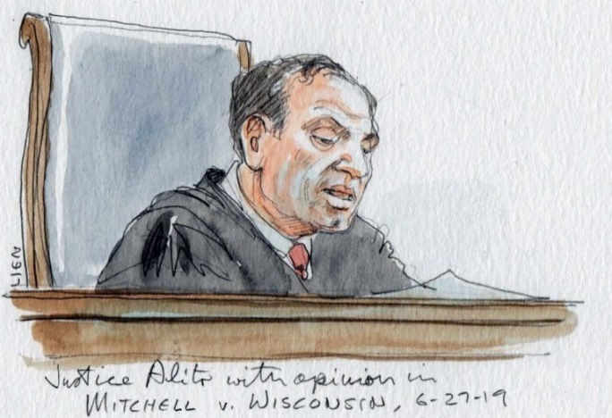
Mitchell v. Wisconsin
“BAC tests must be prompt because it is a biological certainty that alcohol dissipates from the bloodstream literally disappearing by the minute.”
“when the driver’s stupor or unconsciousness deprives officials of a reasonable opportunity to administer a breath test using evidence-grade equipment, a blood test will be essential for achieving the goals of BAC testing.”

Slide 38
Mitchell v. Wisconsin
Plurality Opinion
HELD: exigent circumstances exist when natural dissipation is combined with other pressing police duties
When person’s stupor requires trip to hospital, State may “almost always” order a warrantless blood test

Slide 39
Exigent Circumstances
Possible Examples
Officer delayed by need to investigate crash
Officer had to go to hospital to begin DWI investigation
Suspect was being treated for injuries
Alcohol/drug dissipation
Time necessary to obtain warrant
Unavailability of magistrate/judge

Slide 40
Sentencing Approach in the 21st Century
“There is a better way. We need to move from anger-based sentencing that ignores cost and effectiveness to evidence-based sentencing that focuses on results — sentencing that assesses each offender’s risk and then fits that offender with the cheapest and most effective rehabilitation that he or she needs.”
Former Missouri Chief Justice William Ray Price State of the Judiciary Address (2010)

Slide 41
Commonwealth v. Eldred
480 Mass. 90, 101 N.E.3d 911 (2018)
“. . . judges should act with flexibility, sensitivity, and compassion when dealing with people who suffer from drug addiction.”

Slide 42
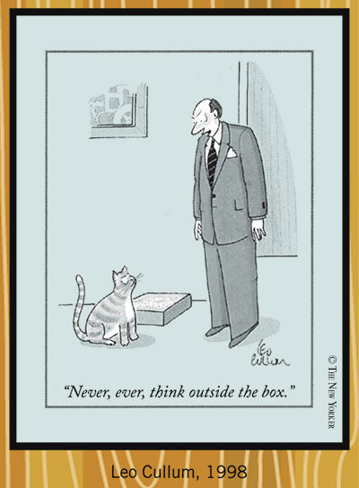
Think Outside the Box

Slide 43
What Information Is Needed?
Additional facts about the offense?
Additional facts about the defendant?
Drug/alcohol assessment?
Need for treatment?
  Alcohol/drug
  Mental health
  Other

Slide 44
More Information = Better Outcomes
"Every judge understands that with more information about an offender's circumstances, a sentence can be better tailored to the person to ensure he or she doesn't repeat the offense.”
One size does not fit all
David Wallace, Highway to Justice, at p. 5-6 (a publication of the American Bar Association, Summer 2015).

Slide 45
Fines & Jail
“Traditional DUI sanctions of fines and jail are shown to be among the least effective DUI countermeasures.”
DUI Countermeasures in California: What Works and What Doesn’t, with Recommendations for Legislative Reform Report to the Legislature (Sept. 2002)

Slide 46
“Evidence-Based” - What Does it Mean?
Two different forms of evidence
  Anecdotal evidence – what we think works
  Empirical evidence
    what has been proven to work
    based on controlled studies

Slide 47
DWI Courts in General
Developed as a more effective judicially coordinated treatment-focused program to help reduce recidivism
The Court directly manages, oversees and supervises treatment and recovery
The Court recognizes day-to-day success and failure on the spot with a system of sanctions and incentives while working with treatment providers to enforce and adjust treatment plans

Slide 48
DWI Courts:
Reasons for Success
Team approach
Ongoing judicial interaction & encouragement
Close supervision & accountability
Close coordination between treatment & supervision
Ability to identify & overcome barriers to success

Slide 49
The Goals of Utilizing Evidence-Based Practices
To reduce recidivism
To improve public safety by:
    implementing practices based on empirical research to transform probation into a more efficient, effective, and meaningful arm of the court

Slide 50
Texas cases of interest
Crider v. State, 607 S.W.3d 305 (Tex. Crim. App. 2020) cert. denied “…the State obtained the blood sample by way of a magistrate’s determination that probable cause existed to justify its seizure—for the explicit purpose of determining its evidentiary value to prove the offense of driving while intoxicated.” That magistrate’s determination was sufficient in this case to justify the chemical testing of the blood. And this is so, we hold, even if the warrant itself did not expressly authorize the chemical testing on its face

Slide 51
Stephen Ramirez v. State, 14-19-00433-CR 10/27/20 PDR ref’d The three-day requirement for the execution of a search warrant sets the limit for the actual search for and seizure of the evidence by a peace officer, not the timing for any subsequent forensic analysis that may be conducted on the seized evidence. Schneider v. State, 03-19-00732-CR 3/10/21 PDR filed PD-0238-21 analyzed Martinez v State and held that it did not require a second search warrant to test blood and did not require that a timely collected sample be subjected to testing within three days.

Slide 52
State v. Mendez, 05-20-00307-CR 3/23/21 No PDR
  While the blood must be seized within three days, it need not be tested and analyzed in the three-day period mentioned in Article 18.07(a)(3). Execution of the warrant under Article 18.07 refers to the blood draw itself, not the subsequent testing and analysis.
Latest Decision Balderas v. State, 01-20-00174-CR 4/29/21 Based on Crider, the magistrate’s determination that probable cause existed to justify the seizure of appellant’s blood sample, without expressly providing for the eventual forensic analysis of the specimen, was sufficient to justify the chemical testing of the blood seized

Slide 53
If a driver crosses a clearly marked lane but does not do so when other vehicles are present. Does a peace officer have reasonable suspicion to stop?
Yes
b) No

Slide 54
Yes
(9th COA) Dugar v. State 09-19-00098-CR 4/7/21 a reasonably objective police officer could have interpreted Transportation Code §545.060 to prohibit “failing to maintain a single lane when it [is] practical for the driver to do so.” Based on this interpretation, the officer could have formed reasonable suspicion required for the stop.
Also Yes
Leming v. State, 493 S.W.3d 552 (Tex. Crim. App. 2016) plurality opinion State v. Meras, 10-18-00345-CR 01/08/20 PDR filed 3/10/2020 Reyes v. State, 08-18-00145 CR 6/18/20 no PDR

Slide 55
No
State v. Hardin PD-0799-19 PDR granted 10/2/19 (submitted 2/26/20) State v. Bernard, 503 S.W. 3d 685 (Tex. App.-Houston [14th Dist.] 2016, rev’d on other grounds, 512 S.W.3d 351 (Tex. Crim. App. 2017) Hernandez v. State, 983 S.W.2d 867 (Tex. App.-Austin 1998, pet. ref’d)

Slide 56
Are two 911 calls from the same caller indicating that a F-150 pickup traveling on a specific stretch of a highway whose driver seemed “possibly intoxicated” and almost hit a guardrail sufficient for an officer to make a traffic stop?
Yes
No

Slide 57
Yes
State v. Adrian, 09-20-00041-CR 2/3/21 no PDR Arresting officer was the only witness at the MTS hearing. Officer testified that he observed the truck make an unsafe maneuver.
The caller pulled over at the scene and confirmed for the officer that the F-150 stopped was the subject of the calls.
The information provided by the caller from two calls to the 911 operator, coupled with the arresting officer’s experience, when viewed objectively from the totality of the circumstances, demonstrate an “indicia of reliability” sufficient to provide the officer with reasonable suspicion that Adrian was possibly impaired

Slide 58
Does the good-faith exception to the Texas exclusionary rule allow the admission of blood evidence seized in accordance with a search warrant with a signed but unsworn probable cause affidavit?
Yes
No

Slide 59
No
Wheeler v. State, PD-0388-19 2/10/21
CCA held: the officer in this case was objectively unreasonable in executing a search warrant he knew was unsupported by a sworn probable-cause affidavit, such that he cannot be said to have acted in objective good-faith reliance upon the warrant. The officer admitted that he did not swear an oath before Magistrate Del Carmen or anyone else. But, he claimed that he believed an oath was not required pursuant to Pantego Police Department policy. Bonner testified that in the fourteen months he had been employed with the Pantego Police Department, he had not sworn to a single probable-cause affidavit. Bonner also stated that he understood that the facts in his affidavit were not properly sworn but that he was not aware of any defects in the warrant and believed it to be valid at the time of execution

Slide 60
The officer admitted that he did not swear an oath before Magistrate Del Carmen or anyone else. But, he claimed that he believed an oath was not required pursuant to Pantego Police Department policy. Bonner testified that in the fourteen months he had been employed with the Pantego Police Department, he had not sworn to a single probable-cause affidavit. Bonner also stated that he understood that the facts in his affidavit were not properly sworn but that he was not aware of any defects in the warrant and believed it to be valid at the time of execution

Slide 61
Is there sufficient evidence to find that the defendant was “operating” a motor vehicle when the defendant was found asleep in the driver’s seat of a vehicle with the engine running. The vehicle was parked in a busy lane of highway traffic. Both defendant and his passenger were buckled into their seats, and defendant had an open can of beer sitting between his legs. Further, Defendant informed the arresting officer that he had driven from Coppell to Corinth in order to drop off his uncle in Denton.
Yes
No

Slide 62
Yes
Wilkins v. State, 02-10-00324-CR 1/28/21 No PDR
Courts may examine both direct and circumstantial evidence in the same manner; reasonable inferences are not to be disregarded when they can be drawn from circumstantial evidence. Considering the evidence in the light most favorable to the verdict, the totality of the circumstances supports an inference that Wilkins operated the Mustang when he was intoxicated.

Slide 63
Harrell v. State PD-0985-19 4/21/21
Police receive a call of a gray minivan being driven erratically. The caller followed the minivan to a gas station, told police where it had been parked, relayed the license plate information and hung up.
When police found the minivan a few minutes later, the motor was off and Appellant was in the driver’s seat with the seatbelt buckled. Appellant admitted he had been driving. There were two passengers in the back of the minivan and all three people were intoxicated.

Slide 64
Dallas COA reversed the conviction of the trial court and rendered an acquittal finding that the evidence was legally insufficient to show that Appellant operated the minivan. CCA found that the evidence was legally sufficient under Jackson and to satisfy the corpus delecti doctrine. Cause was reversed and remanded to the COA to consider Appellant’s remaining issue. (?)

Slide 65
Corpus Delecti
The corpus delecti of DWI is that someone operated a motor vehicle in a public place while intoxicated. In a corpus delecti analysis, the extrajudicial confession of a defendant is not considered and identity need not be proven.

Slide 66
1. Blood does not need to be tested within 3 days after the search warrant is issued.
2. An unconscious driver involved in an accident will almost always be considered exigent circumstances allowing a warrantless blood draw.
3. Failure to stay in a single marked lane may be sufficient reasonable suspicion for a stop without considering the safety of other vehicles depending on your COA.
4. The good faith exception to the Texas exclusionary rule does not apply to a search warrant with an unsworn affidavit for probable cause.
5. The corpus delecti of DWI is that someone operated a motor vehicle in a public place while intoxicated.
6. In a corpus delecti analysis, the extrajudicial confession of a defendant is not considered and identity need not be proven.

Slide 67

What Lies Ahead?
Legalization/decriminalization of mj + other drugs
Roadside drug testing
Oral fluid drug testing
New field sobriety tests
Research on marijuana
Per se drug-impaired driving laws

Slide 68
Questions?

Slide 69
Contact Information
Judge Robert S. Anchondo
ABA Region 6 RJOL
rsanchondo@aol.com

