Slide 1

“Helping Veterans Starts Here”

Slide 2

Mission
Since 1927 the mission is to advocate for and provide superior service to veterans that will significantly improve the quality of life for all Texas veterans, their families, and survivors.

Slide 3
Programs & Services
  Education
  Employment Services
  Entrepreneurship
  Women Veterans
  Mental Health
  Health Care Advocacy
  Claims Department
  Veteran County Service Officers - Support
  Fund for Veterans’ Assistance
  Communications and Outreach

Slide 4

Education
G.I. Bill® benefits
Hazelwood Act Tuition Exemption
School and training program approval
Veterans Education Coordinators

Slide 5
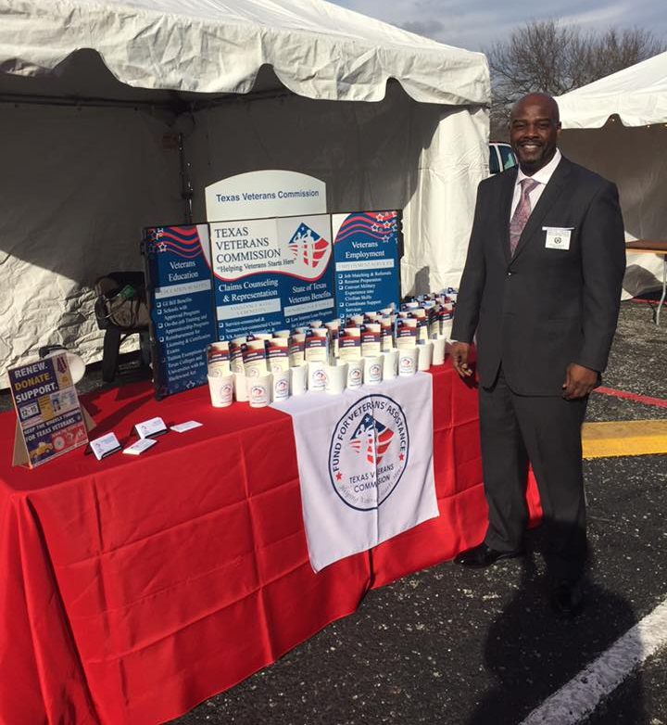
Employment Services
Located in Workforce Solution Centers across Texas
Veteran Career Advisor (VCA) assist with:
  Job matching and referrals
  Resume and interview preparation
  Translate military experience into civilian skills
  Case Management
Veteran Employer Liaison (VEL) assist with:
  Educating companies on the benefits of hiring veterans
  Informing federal contractors the process to recruit qualified veterans
  Statewide career fairs
  advocacy efforts with hiring executives to increase employment opportunities for veterans and encourage the hiring of disabled veterans.
  **Rural Veteran Career Advisor (RVCA)**
Family Career Advisor (FCA) assist with:
  Qualified Spouses & Dependents

Slide 6
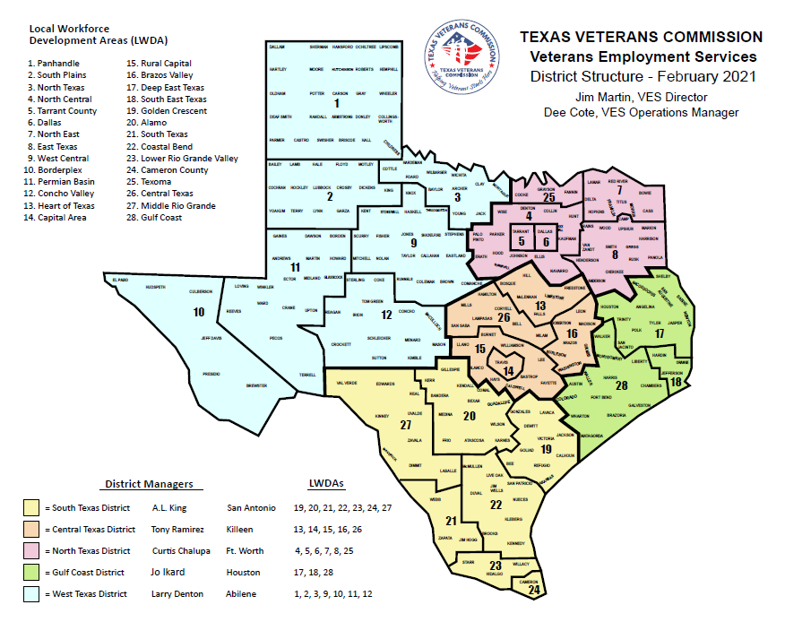

Slide 7
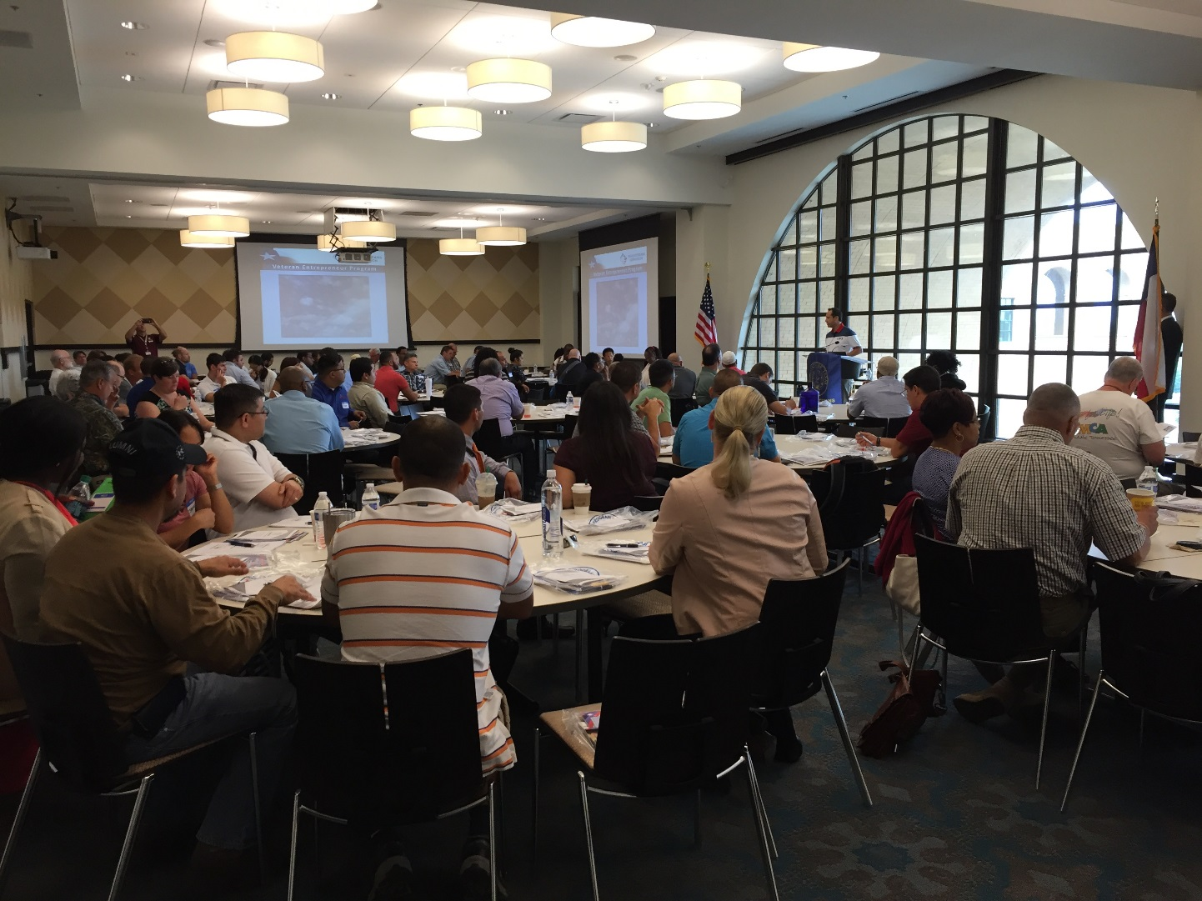
Entrepreneurship
Provides training, support, and consultation to veterans on:
  Business development
  Business plans and marketing strategies
  Access to capital
  Government contracting
  Mergers and acquisitions

Slide 8
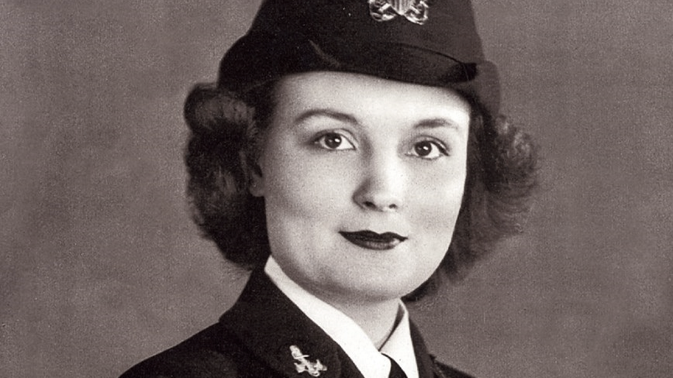
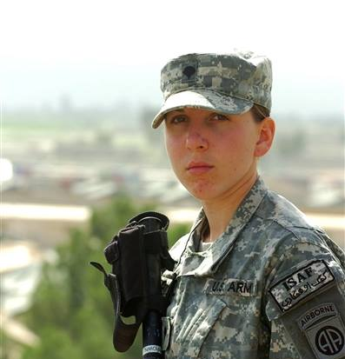
Women Veterans
Educate women veterans about benefits and services
Connect women veterans to benefits and services
Raise public awareness of women veterans’ contributions
Recommend legislation for equitable access to benefits and services
Manage the Women Veterans Professional Network

Slide 9
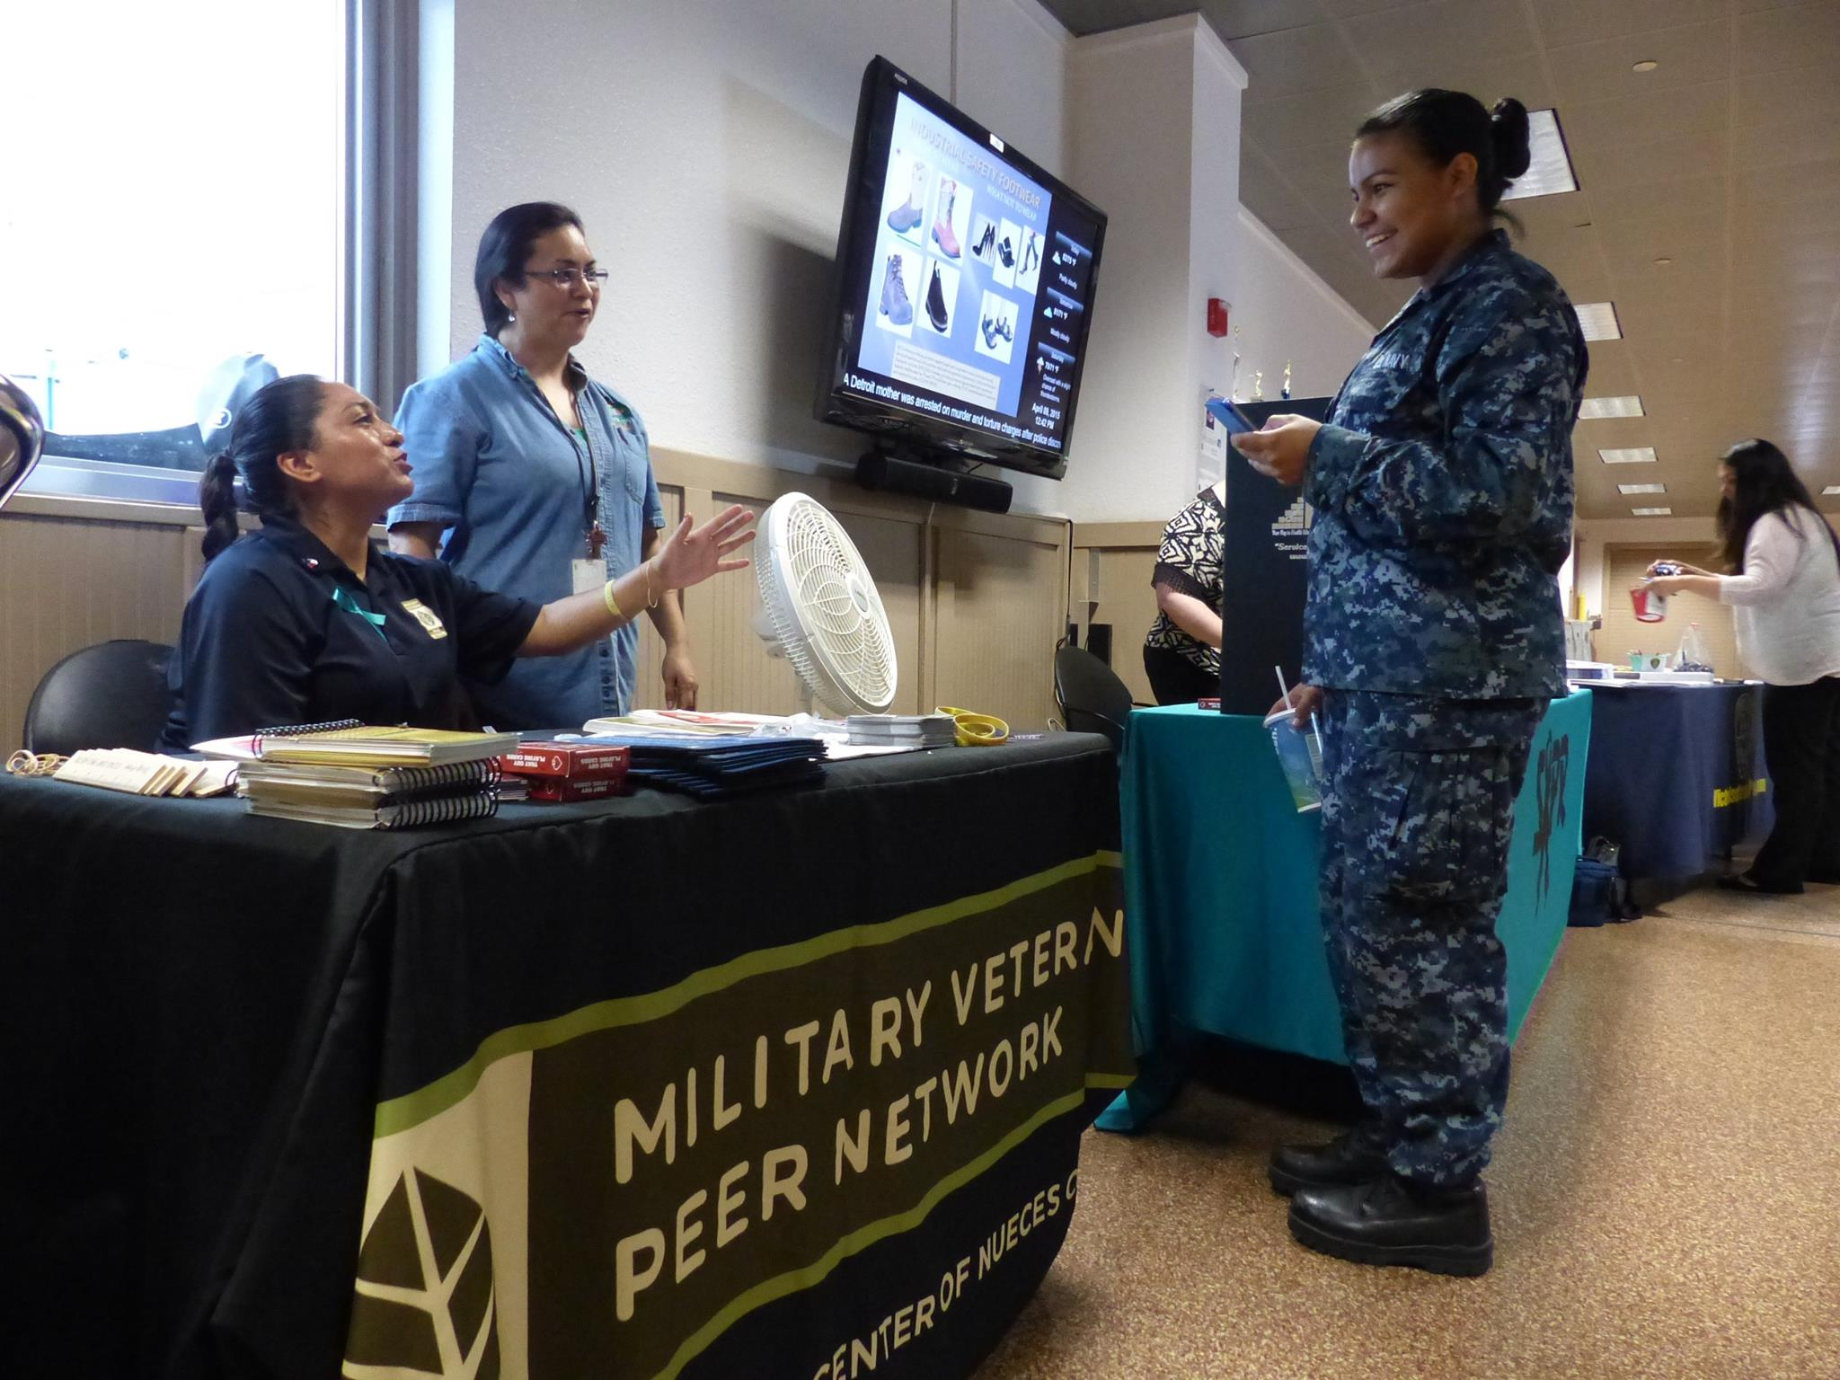
Mental Health
Assist service members, veterans, and their families in accessing needed mental health care and support.

Slide 10

Health Care Advocacy – Gary Lee
TVC’s Health Care Advocacy Department (HCAD) acts on the veteran’s behalf as a liaison between them and the Veterans Health Administration (VHA) to resolve access issues involving VA health care related services, such as:
Enrollment / Eligibility
Appointments
VA billing issues
Prescription / Pharmacy assistance
Care in the Community / MISSION Act assistance
MRIs, X-rays, or lab tests
Other VA health care concerns

Slide 11
Health Care Advocacy – Gary Lee

Slide 12
Health Care Advocacy Dept. (HCAD)
-San Antonio Region - Paul Rodriguez
Audie L. Murphy VAMC, San Antonio, TX
Cell: 210.823.4406, or Paul.Rodriguez@tvc.texas.gov
-Corpus Christi Region – Philip Davila
Corpus Christi VA Specialty Outpatient Clinic (OPC), Corpus Christi, TX
Cell: 361.445.1733, or Philip.Davila@tvc.texas.gov
-McAllen Region – Alfredo “Freddy” Salazar
McAllen VA Outpatient Clinic (OPC), McAllen, TX
Cell: 956.310.2405, or Alfredo.Salazar@tvc.texas.gov
HCAD – HealthCare@tvc.texas.gov or www.tvc.texas.gov/Health-Care-Advocacy

Slide 13
Claims Department – Mike Jaeger
Claims Benefit Advisors assist with:
Service connected and non-service-connected claims
VA appeals preparation & representation
VA pensions and survivors' benefits
Death and burial benefits
Offices located within VA
Medical Centers
Outpatient Clinics
Community Based Outpatient Clinics

Slide 14
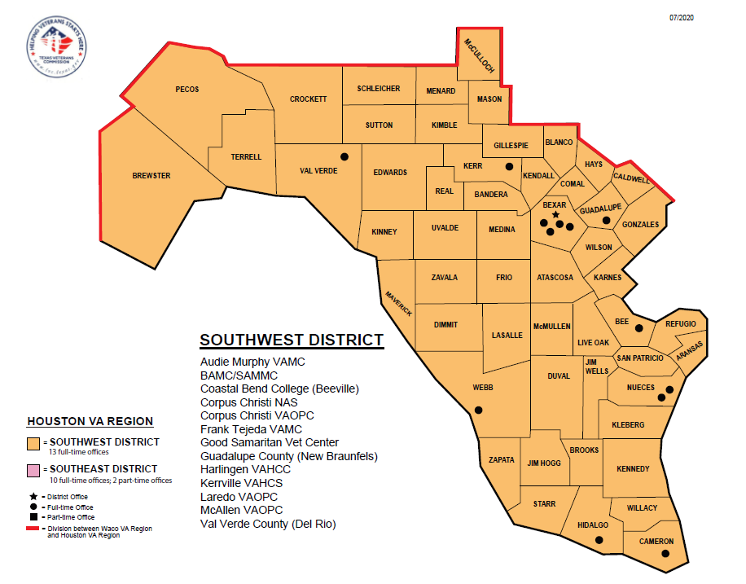
Southwest District

Slide 15
South Texas Contact Numbers
District Manager: Michael Jaeger 210-303-4490 michael.jaeger@tvc.texas.gov
Area Supervisor: Bryan Brown 956-254-9189 bryan.brown@tvc.texas.gov
Harlingen OPC: Bryan Brown 956-254-9189 bryan.brown@tvc.texas.gov
McAllen OPC: Roberto Dimas 956-236-7484 roberto.dimas@tvc.texas.gov
Laredo OPC: Daniel Flores 956-43-4235 Daniel.flores@tvc.texas.gov
Appointments: southwestclaims@tvc.texas.gov

Slide 16
County Veteran Service Officers
Assist veterans with:
Disability Claims to the VA
Qualified Compensation and Pension
Health Care
Education & Training
Employment
Burial & Survivor
Housing
Transportation
Military Records
https://www.texvet.org/cvso

Slide 17
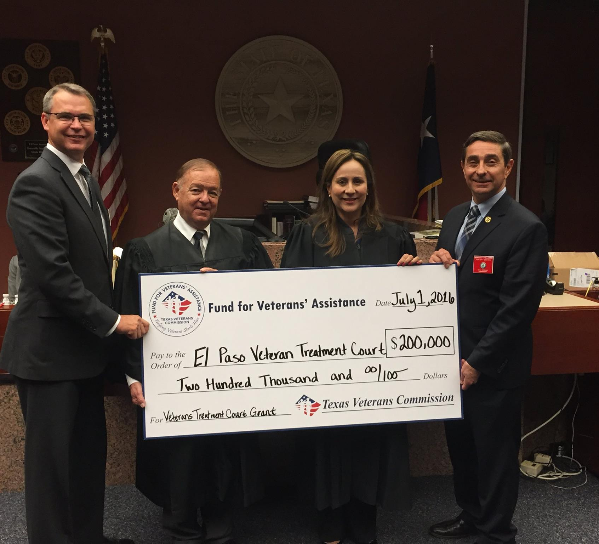
Grants – Fund for Veterans’ Assistance
Organizations providing direct services to Veterans and their families:
  General Assistance Grants
  Housing Grants
  Mental Health Grants
  Treatment Court Grants
  Veterans County Service Officer Grants

Slide 18
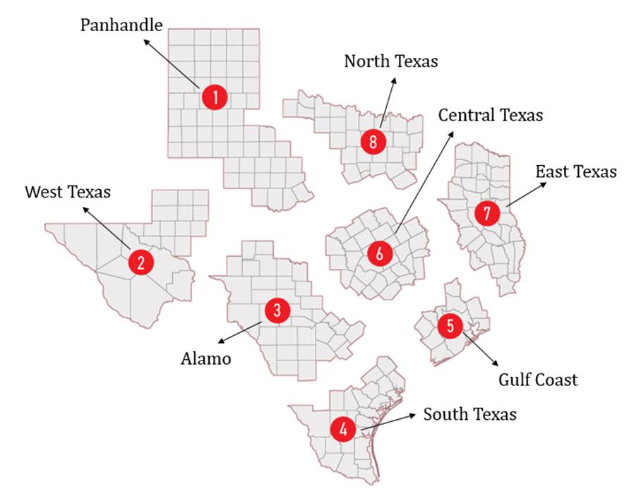
Fund for Veterans’ Assistance Regions
Notes:
FVA has 8 Regions

Slide 19

2021-2022 Programs & Service Categories
General
Assistance
Program
Financial Assistance (short-term & temporary)
Supportive Services (longer-term, integrating & stabilizing)
Employment Support
7 Service Categories
within GA
4 x Grant Programs
1 x VCSO funding opportunity
Grant Programs & Service Categories are designed based on Veteran Needs Assessment Study (TX Govt Code § 434.017 )
Pro Bono Legal Services
Transportation Programs & Services
Referral Services
Veteran Homeless Support
Housing for
TX Heroes
Program
Home Modification Assistance
Veterans
Mental
Health
Program
Clinical Counseling for diagnosed condition or co-occurring conditions, provided by or under licensure of a licensed mental health professional (LMHP) using evidence-based practice(s) - EBP.
(Treatment may include non-clinical services in support of EBP modalities)
2 Service Categories
within VMH
Peer Support Services
(Services provided by trained or certified individual with shared experience)
Veteran Treatment
Court Program
Veteran Treatment Courts
VCSO Funding
Opportunity
VCSOs eligible to apply for 3 grant programs
Veteran County Service Office Grants
General Assistance Program
Housing for TX Heroes Program
Veterans Mental Health Program

Slide 20
More Information
TVC Programs
Elaine Zavala
TVC Communications Coordinator
E-Mail:
Elaine.Zavala@tvc.texas.gov
www.TVC.Texas.gov
Fund for Veterans’ Assistance
(Grants)
Elisabeth Webster
FVA Communications Coordinator
Email:
Elisabeth.Webster@tvc.Texas.gov
www.TVC.Texas.gov/grants

Slide 21
Questions ?

