Slide 1

Economic Development: Resources for Counties
V.G. Young School for
Commissioners Courts
February 20, 2019

Slide 2
The Evolution of
Economic Development Strategies

Slide 3
Quote of the Day
“The best way to provide real property tax relief to homeowners and business owners is to increase your property tax base through economic development.”
--Lonnie Hunt

Slide 4
Key Points
Community development is economic development
Tourism is economic development
Counties have broad authority to support economic development
County-City cooperation is essential
Regional cooperation is essential

Slide 5
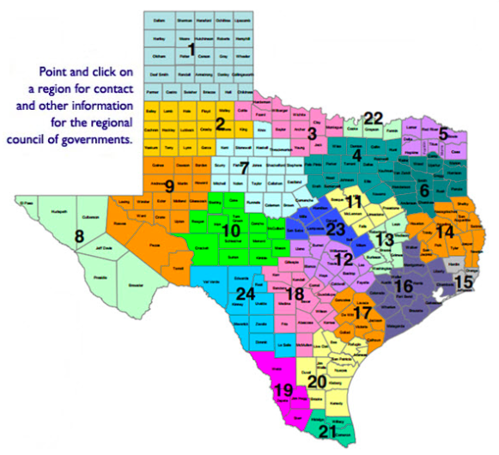
Regional
Councils
Formed Under
LGC Chapter 391
AKA:
Council of Governments (COG)
Association of Governments
Development Council
Regional Planning Commission

Slide 7
Economic Development Districts
In Texas

Slide 8
Comprehensive Economic Development Strategy (CEDS)
Is a prerequisite for designation as EDD
Must be updated at least every five years
Locally-based, regionally-driven process
Strategic blueprint for regional collaboration
EDA bases funding decisions on the CEDS
New emphasis on resiliency

Slide 9
EDA Grants
Must support economic development
Target economically distressed areas
Generally used to build physical infrastructure
Counties are eligible grantees
Local match can range from 20 to 50 percent
Examples of Projects Funded
$4 million for Lufkin Economic Dev Corp (design & development of industrial park)
$4 million for Polk County Commerce Center (college classrooms, convention facility)
$1 million for new DETCOG building
$950k for City of San Augustine water storage

Slide 10
EDA Revolving Loan Programs
Ark-Tex COG (Northeast Texas E.D.D.)
City of Beaumont
Brazos Valley Council of Governments
Central Texas Certified Development Co.
Gulf Coast Economic Development District
LIFT Fund
Moore County
City of San Antonio
South Plains Association of Governments
South Texas Development Council
Tyler Economic Development Council

Slide 11
Other Regional Partners
Economic Development Partnerships
Texas Forest Country Partnership
Rio Grande Valley Partnership
Southeast Texas Economic Development Foundation
The High Ground of Texas
Regional Transportation Organizations
MPO: Metropolitan Planning Organizations
RTPO: Rural Transportation Planning Organizations
Regional Workforce Development Boards
Certified Development Corporations
Affiliated with Small Business Administration (SBA)
Financing to construct/acquire commercial real estate

Slide 12
Where can the County get the money to invest in economic development?
Special & Dedicated Funds (Refer to TAC Handbook)
County Economic Development Program
- LGC Chapter 381
Hotel Occupancy Tax – Tax Code Chapter 352
Government and Private Grants
County Assistance Districts - LGC Chapter 387

Slide 13
Authority for County
Economic Development Program
Local Government Code Chapter 381
Sources of Funding:
Electric Co-op Unclaimed Capital Credits
Chapter 381 Agreements
Other County Funds (including taxes)
Contributions from organizations & individuals
Hotel Occupancy Taxes (if tied to tourism)

Slide 14
Sec. 381.004. COMMUNITY AND ECONOMIC DEVELOPMENT PROGRAMS. (Excerpts)
(a) In this section:
(1) "Another entity" includes the federal government, the State of Texas, a municipality, school or other special district, finance corporation, institution of higher education, charitable or nonprofit organization, foundation, board, council, commission, or any other person.

Slide 15
(b) To stimulate business and commercial activity in a county, the commissioners court of the county may develop and administer a program:
(1) for state or local economic development;
(2) for small or disadvantaged business development;
(3) to stimulate, encourage, and develop business location and commercial activity in the county;
(4) to promote or advertise the county and its vicinity or conduct a solicitation program to attract conventions, visitors, and businesses;
(6) to support comprehensive literacy programs for the benefit of county residents; or
(7) for the encouragement, promotion, improvement, and application of the arts.

Slide 16
(c) The commissioners court may:
(1) contract with another entity for the administration of the program;
(2) authorize the program to be administered on the basis of county commissioner precincts;
(3) use county employees or funds for the program; and
(4) accept contributions, gifts, or other resources to develop and administer the program.

Slide 17
(e) The legislature may appropriate unclaimed money the comptroller receives under Chapter 74, Property Code, for a county to use in carrying out a program established under this section. To receive money for that purpose for any fiscal year, the county must request the money for that fiscal year. The amount a county may receive under this subsection for a fiscal year may not exceed an amount equal to the value of the capital credits the comptroller receives from an electric cooperative corporation on behalf of the corporation's members in the county requesting the money less an amount sufficient to pay anticipated expenses and claims. The comptroller shall transfer money in response to a request after deducting the amount the comptroller determines to be sufficient to pay anticipated expenses and claims.

Slide 18
(g) The commissioners court may develop and administer a program authorized by Subsection (b) for entering into a tax abatement agreement with an owner or lessee of a property interest subject to ad valorem taxation. The execution, duration, and other terms of the agreement are governed, to the extent practicable, by the provisions of Sections 312.204, 312.205, and 312.211, Tax Code, as if the commissioners court were a governing body of the municipality.
(h) The commissioners court may develop and administer a program authorized by Subsection (b) for making loans and grants of public money and providing personnel and services of the county.

Slide 19
Chapter 381 Incentive Agreements
Tax abatements
Tax rebates
Job creation incentives
Payments in lieu of taxes
Sales & Use Tax agreements
Get creative!

Slide 20
Hotel Occupancy Taxes
Governing Law: Tax Code Chapter 352
Generally speaking*
Requires passage of bill in Legislature
Revenue must be used to promote tourism
Includes B&Bs, Cabins, Rooming Houses
Not an “automatic” – requires advance work
Important to gain support of local hotels
Talk to Texas Hotel & Lodging Association
(Scott Joslove, President/CEO)
- * There are always exceptions

Slide 21
Hotel Occupancy Taxes
Potential uses of revenue
General Advertising & Promotion
Fairs, Festivals, Other Events
Fairgrounds, Arenas, Civic Centers
County Museums
County Historical Commission
Historic Courthouses
Parks & Recreation
Suggestion: “Make a finding” that supports how you use the money.

Slide 22
Government & Private Grants
Be selective
Do your homework & have a plan
Look for grants with no local match
Target real needs
Use grant funds to replace tax dollars
Private foundations have less strings
Don’t forget Walmart, McDonalds, etc.
Software tools available to find grants
Find federal grants at www.grants.gov

Slide 23
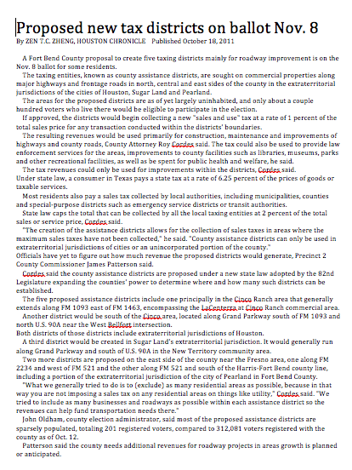
County Assistance Districts
Local Government Code Chapter 387

Slide 24
County Assistance Districts
Local Government Code Chapter 387
Combined local sales tax cap is 2%
Option for counties with no sales tax
Not a property tax offset
County can have multiple districts
Can use funds for almost anything
Commissioners Court retains control
Requires approval of voters
Requires LOTS of public education

Slide 25
County Assistance Districts - 2018
Crane (countywide) ½ cent $ 753,364
Fort Bend (10 districts) 1-2 cents $ 8,943,760
Jim Hogg (countywide) ½ cent $ 195,633
Potter 2 cents $ 1,644,499
Randall ½ cent $ 911,886
Rockwall ½ cent $ 403,443
Zapata (countywide) 2 cents $ 1,546,032
Zavala (countywide) ½ cent $ 169,369

Slide 26
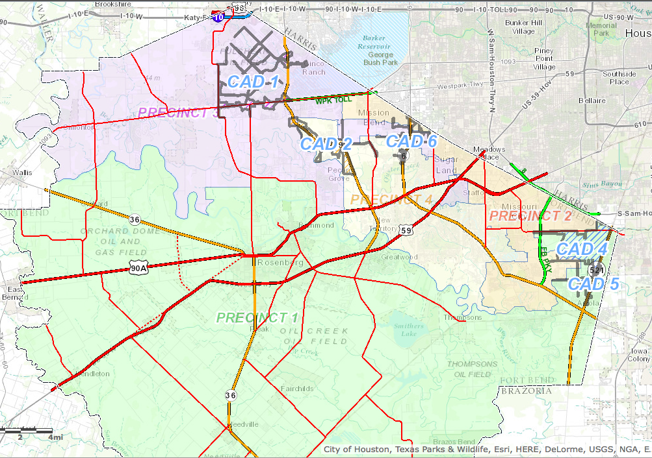
Fort Bend County CADs

Slide 27
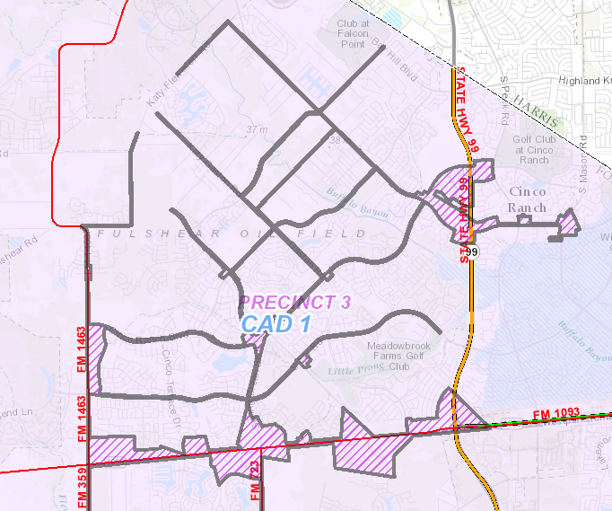
Fort Bend County CAD 1

Slide 28
Uses of County Assistance District Funds
Construction, maintenance, or improvement of roads or highways;
Provision of law enforcement and detention services;
Maintenance or improvement of libraries, museums, parks or other recreational facilities;
Provision of services that benefit the public health or welfare, including the provision of firefighting and fire prevention services; or
Promotion of economic development and tourism.

Slide 29
Latest Success Story:
Potter County Assistance District
Insights from Judge Nancy:
Wording on ballot was major factor in failed vote
Citizens committee was key factor in passage
People listen to people who aren’t in government
Key points in Public Education Campaign:
This is not “assistance for the poor”
Funds were earmarked to support fire protection
Just means you’ll pay same sales tax you pay in city (8.25% total)

Slide 30
Required Ballot Language
“Authorizing the creation of the _________________ County Assistance
District No. ______ and the imposition of a sales and use tax at the rate of _______ percent for the purpose of financing the operations of the district.”
https://comptroller.texas.gov/economy/docs/96-1172.pdf

Slide 31
Other Economic Development Partners
Governor’s Office
Texas Department of Agriculture
USDA Rural Development
Texas Parks & Wildlife
National Park Service
Environmental Protection Agency (EPA) www.epa.gov/smartgrowth

Slide 32
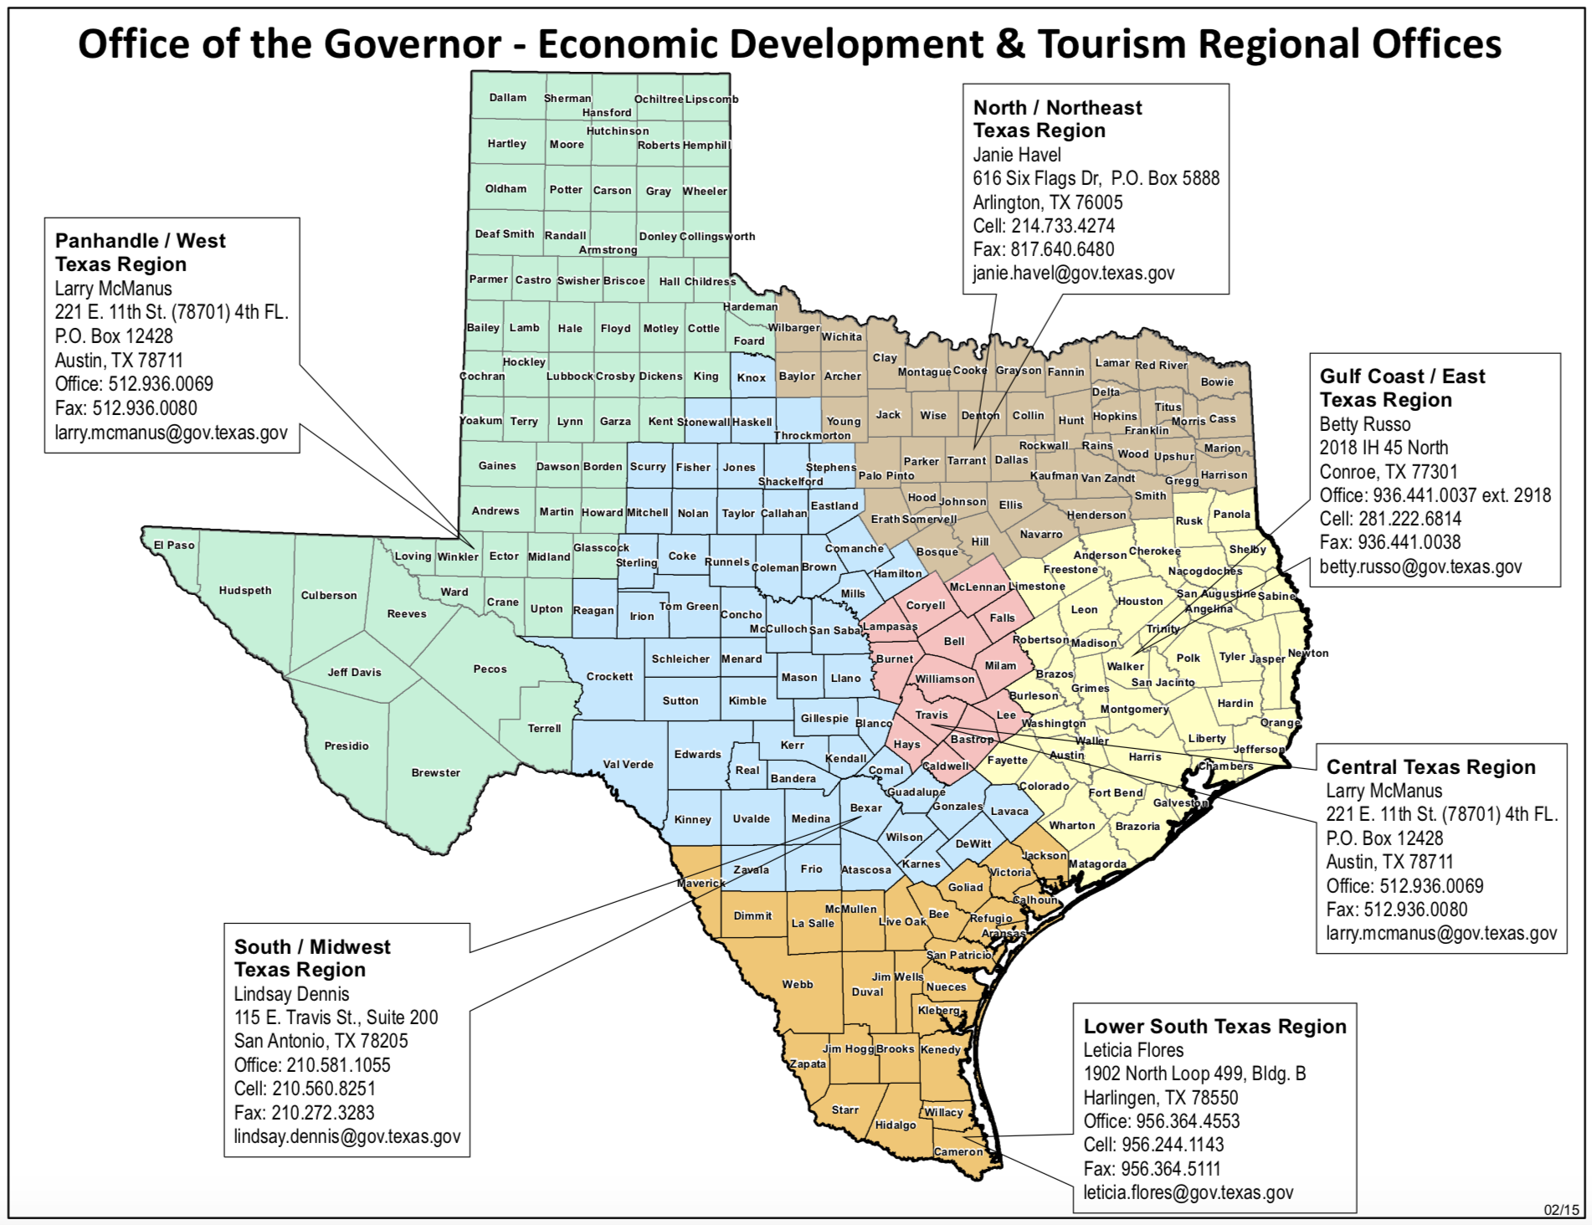

Slide 33
Texas Department of Agriculture Programs
CDBG Community Development Grants
Texas Capital Fund
  Infrastructure Development
  Real Estate Development
  Downtown Revitalization Program
  Main Street Improvement Program
  Small & Microenterprise Revolving Fund
Planning & Capacity Building Fund
Colonia Funds

Slide 34
USDA Grant & Loan Program
Housing – Single & Multi-Family
Water & Sewer Projects
Community Facilities
Rural Business Development
Rural Broadband

Slide 36

Email me:
Lonnie Hunt
lhunt@detcog.org
Deep East Texas Council of Governments
and Economic Development District

