Slide 1
3.015 Effective Meetings:
Getting the Most Out of Commissioners Court and Other Gatherings
Rick Avery
County Relations Officer
Texas Association of Counties
Notes:
As leaders and decision makers in local government, county officials spend a substantial amount of time in meetings. Making those meetings as productive as possible is what I will be visiting with you about today. Now, I know what you are thinking: “I’m attending meetings all the time. Now I’m at another meeting listening to someone talk about meetings!” Well, I get it. But, if you stick with me for the next little bit, I promise I will have you out of here in time for you to enjoy a nice lunch before afternoon classes begin, and you might even pick up a few nuggets of information that will help you be more effective when you are setting up and participating in your next gathering, whether it be Commissioner Court, or any other group you might be part of.

Slide 2
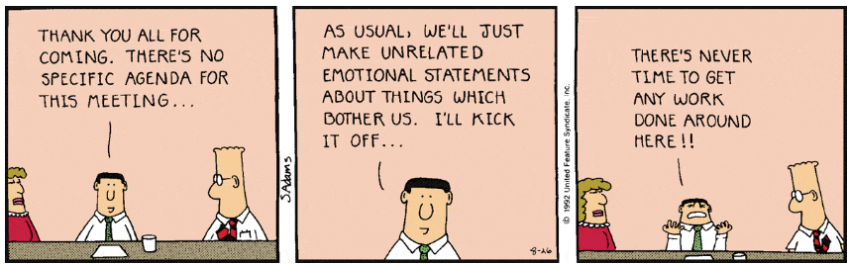
Notes:
Most of you are probably familiar with Scott Adam’s Dilbert cartoons and the “Dilbert Principle.” Perhaps many of you can also draw a connection between the cartoon and a meeting you have recently attended. The fact is, as many studies support, much of the time we spend in gatherings with other people disappoints us. The 2015 State of Enterprise Work survey found, as Adam illustrates, that “wasteful meetings: were employees’ top obstacle to getting work done. As much as our gathering disappoint us, though, we tend to keep gathering in the same tired ways.
When we try think of ways to improve meetings, we often focus on the mechanics of gathering, inadvertently shrinking a human challenge down to a logistical one. We reduce the question of what to do with people to a question of what to do about things surrounding meetings like PowerPoints, invitations, AV equipment, and refreshments.

Slide 3
Effective Meetings
Planning and conducting meetings
Public Meetings (Commissioners Court)
Getting the most out of future gatherings
Notes:
I would like to start by talking about the basics of how to plan and conduct a successful meeting. Then we will looks at how the principles of effective meetings may be integrated into Commissioners Court, as well as briefly review the statutes governing the conducting of court. I’ll conclude our session with some ideas about making your future gatherings more effective and purpose filled.

Slide 4
We Meet To…
Solve problems we can’t solve on our own
Convey and/or solicit information
Make group decisions
Build companies, schools, and neighborhoods
Show support for others
Notes:
There are so many good reasons we come together (read and discuss slide).
Other times, we spend our days in back-to-back meetings, some of which could be replaced with email or brief ‘stand-up’ meetings. And sometimes, because of our aversion to imposing on other peoples’ time, we don’t meet when we should!
Often we don’t know precisely why we are meeting. When we do gather, we use a template of gathering (what we assume a meeting should look like) to substitute for our thinking. We get caught up in the logistics of meetings but we don’t know precisely “WHY” we are meeting. When we do gather, it should be for a clearly defined purpose. The art of gathering begins with purpose and by answering the questions: when should we meet and why?

Slide 5
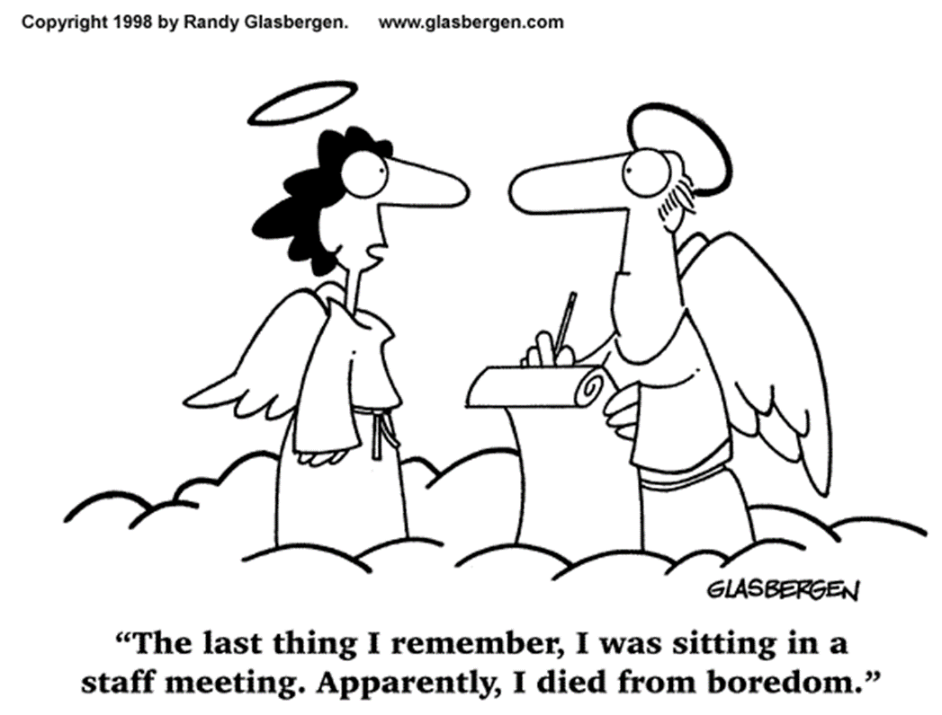
Do You Need to Meet?
Notes:
In our work lives, many of us conduct or attend regular staff meetings. The question we should continually ask is, do we really need to meet? Or, are we just meeting as a matter of routine?

Slide 6
Is a Meeting Necessary?
Why is a meeting being scheduled?
Do you need a meeting to accomplish this objective?
What information needs to be exchanged or decisions made to reach the objective?
Notes:
If answering these questions leads you determining a meeting is necessary, then you need to proceed to the planning stage.

Slide 7
Meeting Planning Basics
Organize
Prepare
Execute
Follow Through

Slide 8
Organize
Plan with a purpose
Participant selection
Structure
Location and time
Notes:
The backbone of having effective meetings is preparation.
Successful meetings require time and effort on the part of the County Judge, County Commissioner, president, chairperson, presiding officer or whoever is responsible for a meeting. Early planning should establish the purpose of the meeting, identify needs, assign responsibilities, and arrange for many details that will require attention. Plan with a purpose – What do you plan to accomplish? Share this purpose with attendees. Good planning and preparation for each meeting will do much to increase satisfaction of participants and also provide opportunities for capitalizing on individual talents and special interests. Well planned meetings will increase overall effectiveness of the county, build good public relations, develop leadership and eliminate the needless waste of time, money, and energy.
Participant Selection – The rule of how many: invite six people is you want an intimate conversation; invite 12 if you want diversity of viewpoints; invite 120 if you want to create a larger organism that can move as one. Who needs to attend the meeting to accomplish its purpose? If they need to be there, get them there! If they don’t need to be there, don’t invite them!
Structure – What will have the greatest impact to accomplish the objective? Guest speakers, brainstorming session, panel discussions, discussion groups, demonstrations?
Location and Time – Convenient place? Time of Day? Size and comfort of meeting space, room set-up?

Slide 9
Prepare
Agenda
Responsibilities
Confirmation
Notes:
Agenda – Prepare and distribute a least three days in advance: clarifies the objectives of the meeting; helps attendees plan and prepare to make effective contributions; and provides direction and focus for the discussion.
Responsibilities – assign individual responsibilities to attendees. Prepare written assignment of duties to communicate these responsibilities.
Confirmation – Email, call, or otherwise contact participants to ensure that they will be in attendance

Slide 10
Execute: Leading Effective Meetings
Manage time
Use an agenda
Establish ground rules
Control dominating individuals
Summarize
Notes:
Manage time – begin and end on time
Use an agenda – You’ve sent an agenda out; stick to it; store off topic ideas for another time
Establish ground rules – Ex: arrive and start on time; stick to the agenda; everyone participates; respect different viewpoints; ect.
Control dominating individuals – don’t let any one person dominate discussion; seek input and dialog from quiet individuals; use a timer to limit talk time
Summarize – summarize the discussion; reaffirm decisions made; recap plans for follow-up

Slide 11
Follow Through
Check back with participants individually
Do what you say you are going to do
Expectation others will follow through

Slide 12
Commissioners Court Meetings
Terms of Court
Open Meetings Act
Model Rules
Quorum
Agenda
Public Comment

Slide 13
Terms of Court
Local Gov. Code Section 81.005 – Last meeting of fiscal year, CC shall designate by ORDER a day of the week each month for court to convene in a regular term during the next fiscal year
County judge or 3 commissioners may call a special term of court

Slide 14
Open Meetings Act (OMA) – Chapter 551 of the Texas Government Code
Meetings of governmental bodies must be open to the public, except for expressly authorized executive sessions, and the public must be given notice of the time, place, and subject matter of meetings of governmental bodies.
Notes:
I am not a lawyer, and I am not going to get in to the finer points of the Open Meetings Act, but I just wanted to remind you Chapter 551 of the Texas Government Code provides the statutory guidance under which CC operates as a governing body.
In Texas, the Attorney General’s Office is charged with the responsibility for ensuring that the public’s business is conducted openly. Thomas Jefferson wrote that “a public office is a public trust.”
Openness in government is the hallmark of a free and democratic society. Actions taken by public officials must be open to scrutiny by the people they serve. This principle is written into Texas law in the Open Meetings Act.
In 1998, the Texas Court of Criminal Appeals ruled that it is the duty of public officials to hold open meetings and that meetings may be closed to the public only in certain circumstances. The court upheld the principle that ignorance of the law is no defense.
Many elected officials seek guidance in complying with this important law. The Attorney General’s Office has prepared an Open Meetings Handbook as a guide for those who want to know the proper way to conduct public meetings and to avoid unintentional legal violations. This handbook is available not only in print, but also on the Internet at www.oag.state.tx.us. Also, TAC has a very good publication on the Open Meetings Act, which can be accessed on our web site.
A well-informed public is the key to ensuring an ethical and accountable government.

Slide 15
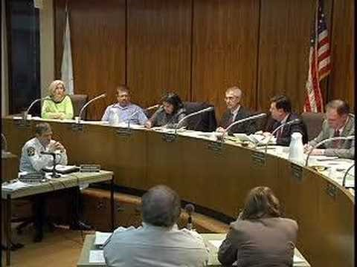
Parliamentary Confusion
Notes:
Sometimes parliamentary procedure can be confusing. This is highlighted in this dysfuntional council meeting.
I didn’t show the whole video but you can find it by searching for “Worst Public Meeting Ever.” Trust me, it gets worse.

Slide 16
Model Rules
Five Basic Parliamentary Rules or Principles for a Commissioners Court Meeting
  Each proposition due full and free debate
  All members have equal rights
  One subject at a time
  Majority rules, while maintaining minority rights
  It takes 3 votes to do anything
Notes:
Each CC adopts their own rules. Parliamentary procedure is an organizational tool, that although simple in principle and based on common sense and courtesy, it seems technical because of special vocabulary developed to discuss it. Parliamentary procedure enables groups of people to reach conclusions and to plan work in a short period of time and without confusion. It should be applied to determine the will of the majority and to also protect the rights and privileges of the minority. To achieve these purposes, these five basic principles of parliamentary procedure should be considered, understood, remembered, and practiced at all times. A model for Rules of Procedure can be found in the TAC publication on the Open Meetings Act. These model rules were provided by Jim Allison.
Advice: don’t adopt Roberts Rules of Order as your rules of procedure – we too complicated!
But more important than these five principles is the “Golden Principle:”
The best interest of the county is of the greatest importance- When a Commissioner sits on Commissioners Court, they not only represent the citizens residing in their precinct, BUT those citizens/residents of the entire county.

Slide 17
Quorum
  Local Gov. Code Sec. 81.006
    must have 3 members present
    unless levying a county tax – must be at regularly scheduled meeting with 4 members present;

Slide 18
Tips for Productive Agendas
Always start and end on time
Send participants meeting materials in advance to save meeting time
County judge or chairperson is responsible for following time allowances as closely as possible
Arrange issues on the agenda allowing for uniting early and debate/diversion later in the meeting
Notes:
The meeting agenda is the skeleton of all meetings and is critical for effective, efficient and productive meetings. A well planned agenda provides organization and promotes efficiency. An agenda is essentially an organized list of matters to be taken up at a meeting. In organizing your agenda, keep in mind the group you are organizing.
The most successful meetings are organized to fit the group. Usually, issues which require imagination, innovativeness and creativity should be placed early (or first) on the agenda. Issues such as new projects, redefining objectives and resolving existing problems require clear heads and fast thinking. It is better to cover these issues early in the meeting while the group is alert. Lastly, it is often a smart tactic to put items which “unite” the group first on the agenda. These items would be issues which are fairly non- controversial, can be agreed upon quickly with little debate, and set the stage for a productive meeting.
Similarly, more controversial issues should be placed toward the end of the agenda to allow participants time to organize their views and prepare for a possible “heated” discussion. It is the responsibility of the chairperson to control the groups’ emotions, ensure that no one individual or group dominates the discussion and that each person participating in the meeting is given an opportunity to express his or her views.
Above all else, is the importance of staying on schedule. By putting an ending time on the agenda, the group will be reluctant to prolong matters which can be taken care of quickly.

Slide 19
Agendas – Order of Business
Call to Order
Roll Call
Reading and Approval of Minutes
Reports of the Officers
Committee Reports
Unfinished Business
New Business
Adjournment
Notes:
Call to Order- The County Judge or other Chairperson raps the table and says, “The meeting will please come to order.”
Role Call- The Chairperson says, “the clerk or secretary will call the roll.” The clerk or secretary calls rolls and reports whether or not a quorum is present. Sometimes it is appropriate to take the roll silently and report to the chairperson that a quorum is present.
Reading and Approval of Minutes- Every organizational meeting has a clerk or secretary who keeps the minutes which should record an exact record of decisions or results of discussion. Once the minutes have been read and approved, they become the official record of transactions. Oftentimes, there is a motion to dispense with the ready of the minutes.
Officials and Committee Reports- these reports give members an understanding of the subject dealt with and any action desired. The report consists of material, oral or written, that has been agreed upon by the committee, county official or department head.
Unfinished and New Business- Unfinished business is any business which was pending but not disposed of at a previous meeting. Members may introduce new items of business.
Adjournment- The chairperson simply states, “Do I hear a motion to adjourn?” A member can make the motion by saying, “I move that we adjourn.” The motion is seconded and meeting is adjourned.

Slide 20
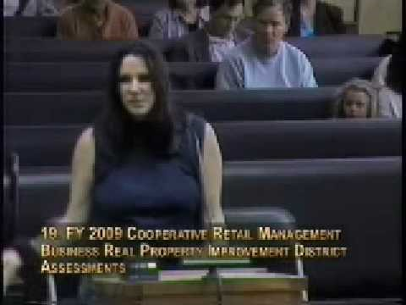
Public Comment

Slide 21
Public Comment
OMA does not entitle the public to speak
Court may adopt procedures to give public opportunity to speak
If so, must be done in evenhanded manner
Laws requiring public hearings may have additional requirements
Notes:
The Act does not entitle the public to choose the items to be discussed or to speak about items on the agenda.
The court may adopt procedures to give members of the public an opportunity to speak at court meetings.
If so, the opportunity must be made available in an evenhanded manner. For example, reasonable restrictions on the number of speakers and the time allowed to them are permissible. The opportunity of a person to address the body may not be restricted because of what the person may have to say.
If a law requires a public hearing, that law may impose additional requirements for members of the public to be heard.

Slide 22
Ideas for More Effective Meetings
Why Are We Really Gathering?
Commit to Meet About Something
Moving from the What to the Why
Notes:
I’ll conclude with some ideas about making your future meetings more productive.
Too often we get caught up in the logistics of meetings but we don’t know precisely “WHY” we are meeting. Logistical considerations are important and help create a good environment for a successful meeting, and we will talk about that a little later. But when we do gather, it should be for a clearly defined purpose. The art of gathering begins with purpose and by answering the questions: when should we meet and why? We often choose the format of meetings before we’re clear on our purpose.
Set routines in meeting can be a great enemy of a meaningful gathering. There is nothing inherently wrong with using set templates for meetings. But remember, those that set up the template did so to meet their needs. We should take time to reflect on current needs and purposes and determine if the old templates serve current needs. Perhaps the current structure of Commissioners Court best serves your purpose, but it might be helpful to imagine ‘What if?’
Most everyone is familiar with the old sit-com Seinfeld…it was a show, famously, about nothing. While the show was funny, you can do some things that assure your meetings are NOT about nothing.
Having a purpose simply means knowing WHY you’re gathering and doing your participants the honor of being convened for a reason. And once your have the purpose in mind, you will suddenly find it easier to make all the decisions that a gathering requires.
Specificity – the more focused a particular gathering is, the more narrowly it frames itself and the more passion it arouses.
Uniqueness – What sets your meeting apart? How is your meeting or dinner or conference unique among the other meetings, dinners, and conferences?
Tips on moving from the What to the Why:
Zoom out – think big (Chemistry Teacher)
Drill down – Take the reasons you think you are gathering and keep drilling below them. Ask why you are doing it. Every time you get to another, deeper reason, ask why again. Keep asking why you are doing something until you hit a belief or value. (Pot luck example)
Think about what larger needs might be addressed
Reverse engineer an outcome – every meeting should be organized around a “desired” outcome.
When there really is no purpose: have a casual hang out, or give people their time back

Slide 23
References
Attorney General – Open Meetings Handbook
Texas Association of Counties – Open Meetings Act
Texas A&M AgriLife Extension Service – Effective Meetings for County Officials: Using Parliamentary Procedure and Other Practices
Priya Parker – The Art of Gathering

