Slide 1
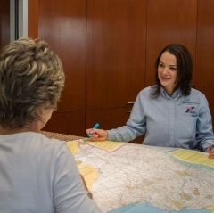
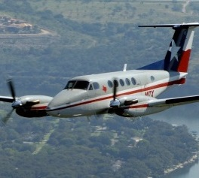
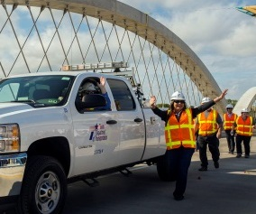
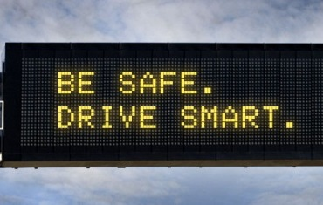
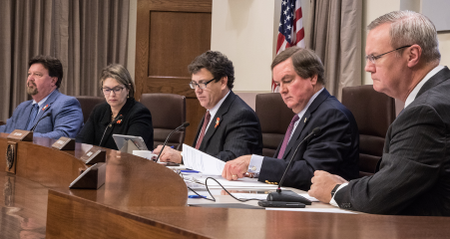
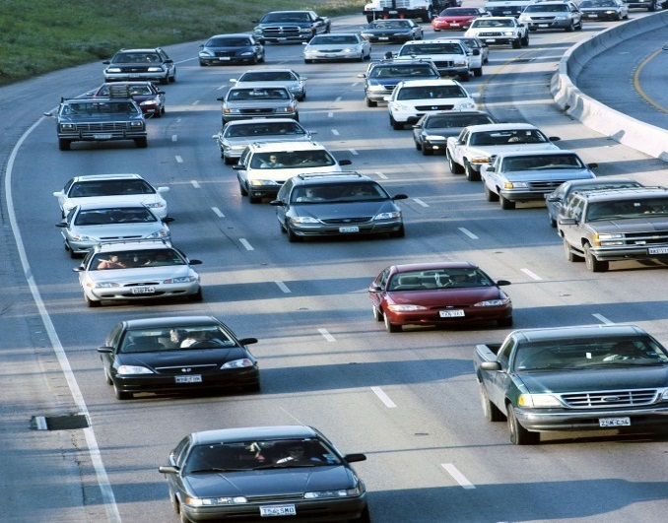
Judge & County Commissioners Conference
11/7/2018

Slide 3
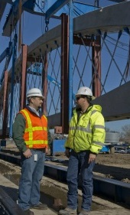
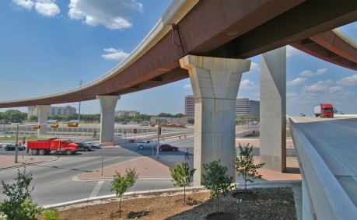
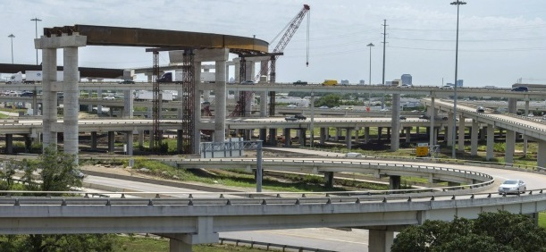
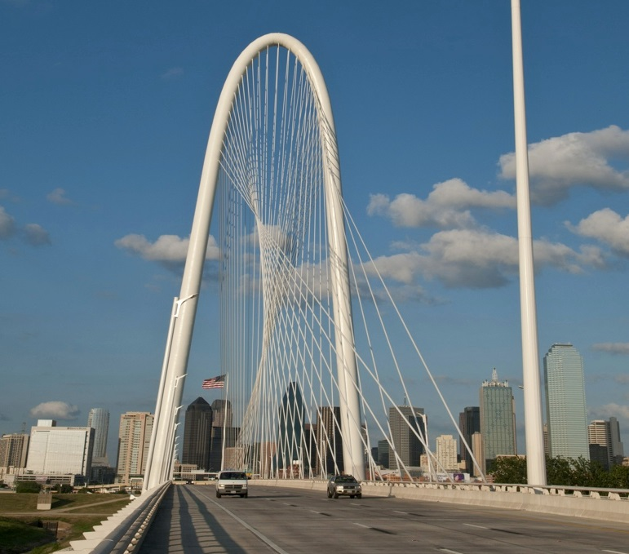
Txdot and counties
Erika Karlik
Katelyn Kasberg
Stephen Kasberg, P.E.
Jason Duncan, P.E.

Slide 4
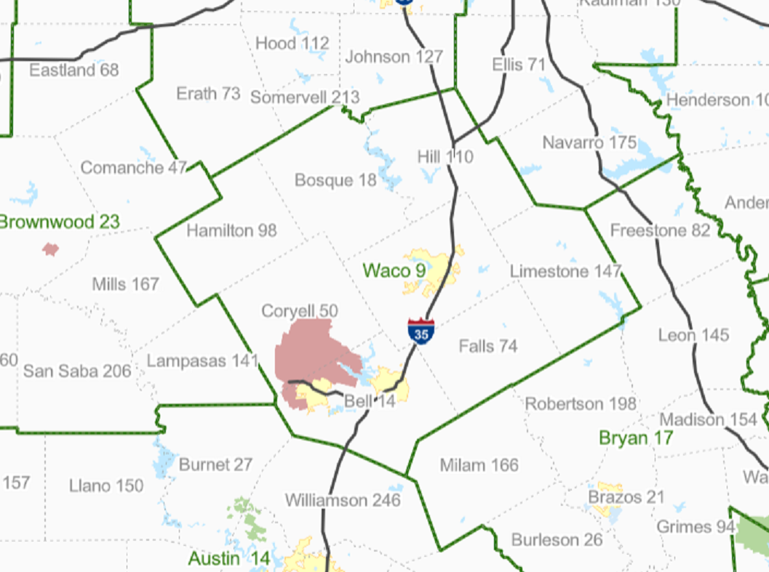
TxDOT Districts
Fort Worth
Dallas

Slide 5
TxDOT Values, Vision, Mission
Values:
People People are the Department’s most important customer, asset, and resource. The well-being, safety, and quality of life for Texans and the traveling public are of the utmost concern to the Department. We focus on relationship building, customer service, and partnerships.
Accountability We accept responsibility for our actions and promote open communication and transparency at all times.
Trust We strive to earn and maintain confidence through reliable and ethical decision-making.
Honesty We conduct ourselves with the highest degree of integrity, respect, and truthfulness.
Vision:
A forward-thinking leader delivering mobility, enabling economic opportunity, and enhancing quality of life for all Texans
Mission:
Through collaboration and leadership, we deliver a safe, reliable, and integrated transportation system that enables the movement of people and goods.

Slide 6
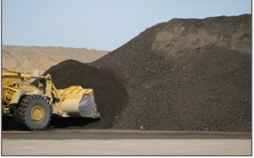
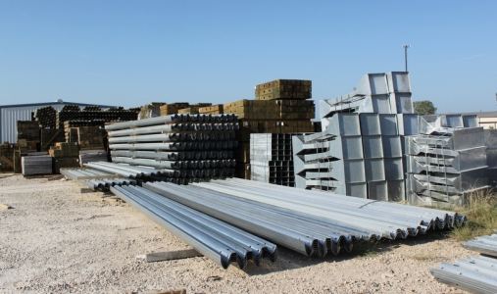
County Assistance Program
Annual notification letter of assistance available, material and location, in the Fall.
TxDOT has a minimum goal, not a maximum limit.
The dollar amount listed is for accounting purposes, for the minimum goal.
Example materials, RAP, crushed concrete, MBGF, pipe, etc.

Slide 7
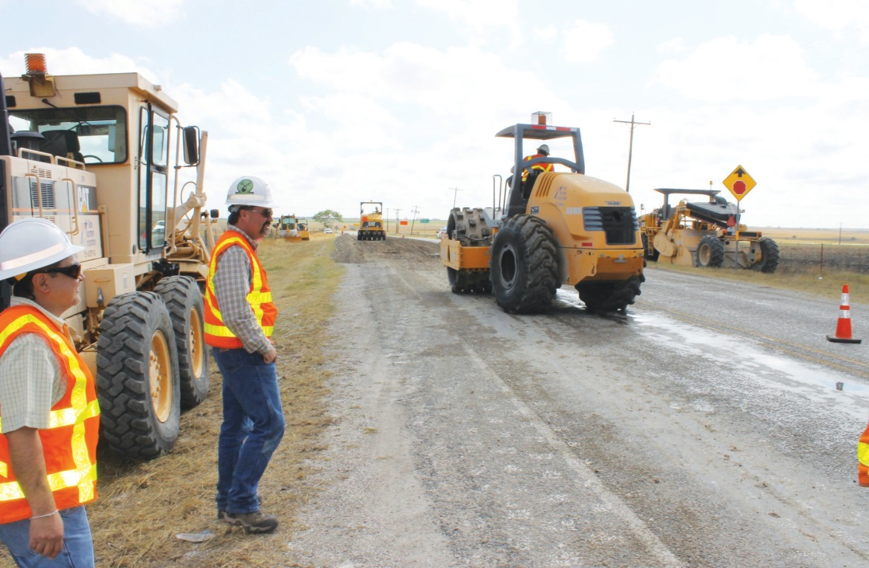
Technical Advice
TxDOT can provide engineering and maintenance expertise, ie standards, specs and oral advice upon written request
Assist in training
TxDOT has a wide array of training courses

Slide 8
Four-Year Plan
TxDOT districts annually create and modify their four year plan.
Every on-system road is evaluated annually.
Every road is included, either as a construction or maintenance project
Goal to meet with each Judge every year and discuss the respective four year plan.
TxDOT is responsible for developing the plan, but Judges can provide valuable insight into the current and future needs of their County.

Slide 9
Traffic Safety Program
Traffic Safety Specialist
Program Funding
STEP (Selective Traffic Enforcement Program)
General Traffic Safety
Project Celebration Mini-Grants
Request for proposals starts November 9th, 2018
Proposals due January 10th , 2019
Public Education and Awareness
Child Safety Seat Program
Speak to schools, community organizations, employers
Notes:
Traffic Safety Specialist- Every District has one, please see handout

Slide 10
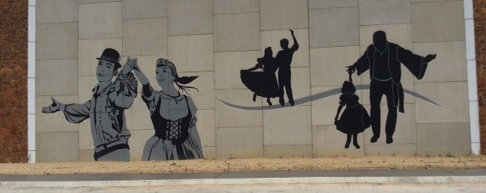
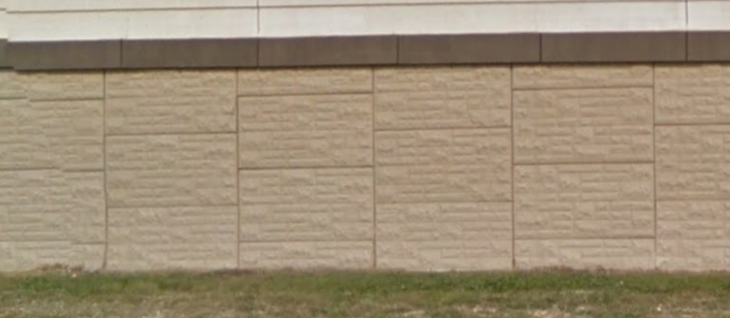
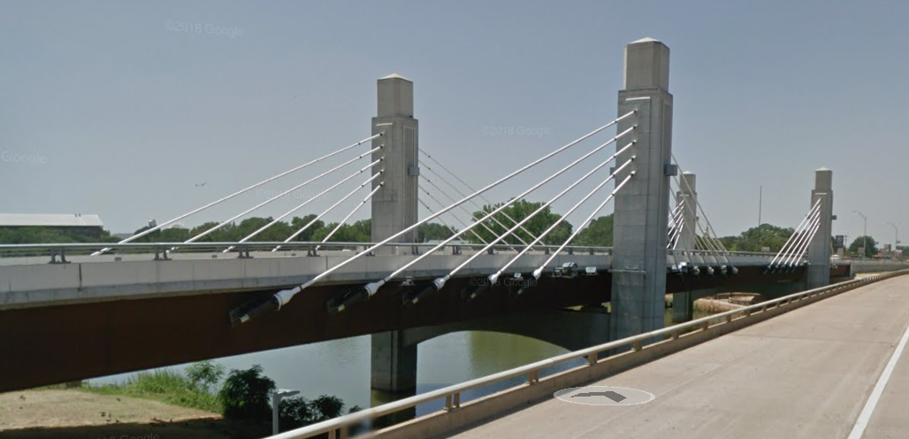
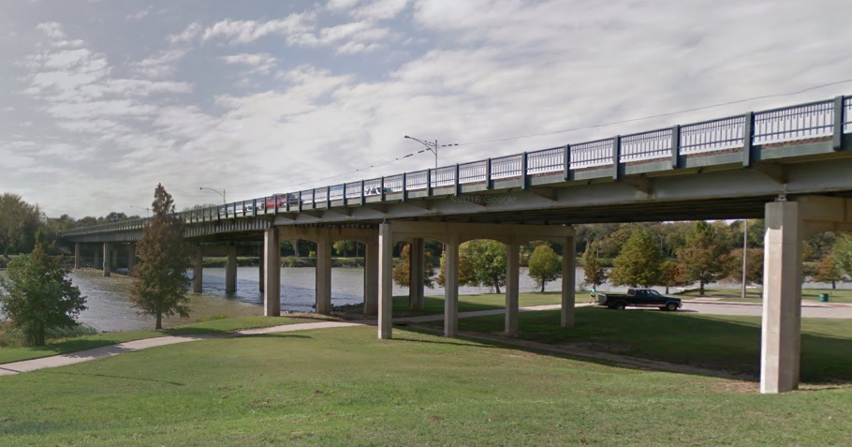
Aesthetics
Local communities often partner with TxDOT for aesthetics.
Local community only responsible for the cost of the betterment, TxDOT covers the remainder.

Slide 11
Grants & Programs
Many TxDOT Districts have a Local Government Project Coordinator
Check in with your TxDOT point of contact as grants come through periodically.
Grants can be 100% funded, 80% / 20% , or some other percent.
Programs
Safe Route to Schools
Transportation Alternatives Program
Governor’s Community Achievement Award
Landscape Partnership Program
Highway Safety Improvement Program
Economically Disadvantaged County Program

Slide 12
Transportation Alternatives/Safe Routes to Schools Call for Projects
Call opened February 8, 2019
Eligibility
Deadlines
Preliminary Application Due April
Full Application Due August
Workshops
Contact your local TxDOT District Office

Slide 13
Highway Bridge Program
Bridge inspections: on a two-year cycle.
HBP Funding Selection: TxDOT and Local Officials review list annually
Funding: Local Government responsible for 10% of the cost.
Equivalent Match Projects
Economically Disadvantaged Counties Program
State Infrastructure Bank

Slide 14
Erika Karlik District Local Government Projects Coord, WACO
Erika.Karlik@txdot.gov 254-867-2728 Office
Katelyn Kasberg District Local Government Projects Coord, WACO
Katelyn.Kasberg@txdot.gov 254-867-2733 Office
Stephen Kasberg, P.E. Gatesville Area Engineer
Stephen.Kasberg@txdot.gov 254-865-7115 Office
Jason Duncan, P.E. Hillsboro Area Engineer
jason.duncan@txdot.gov 254-582-5432 Office

