Slide 1

Building Disaster-Resilient Places

Slide 2
A Mini-Quiz
72 hours =
3 days
What is
minimum amount
of time
you should be prepared
to survive
on your own
in a disaster?
The first 3
is on me
Notes:
This tiny mini-quiz is designed to set the stage for the planning process. Many individuals may not be aware that FEMA recommends a minimum of 3 days’ supplies on hand to sustain you and your family.
The first mouse click will bring up the question. Get responses from the participants.
After hearing from a few people, show the answer (2nd mouse click.) Often the standard is stated in hours. The 3rd click of the mouse translates that into days.
The final click of the mouse gives an easy rhyme to help people internalize the recommendation: The first three (days) is on me.
The reality, though, is that for rural places involved in a large scale disaster that covers a lot of territory, three days may not be enough. The next slide continues this thought.

Slide 3
Rural Challenges
Harder to Plan
Longer to Receive Aid
Rural places seldom have dedicated staff support.
Emergency planners often wear multiple “hats.”
Remote locations are more difficult to reach.
Communication may be more difficult.
Help begins where the greatest number of people are impacted.

Slide 4
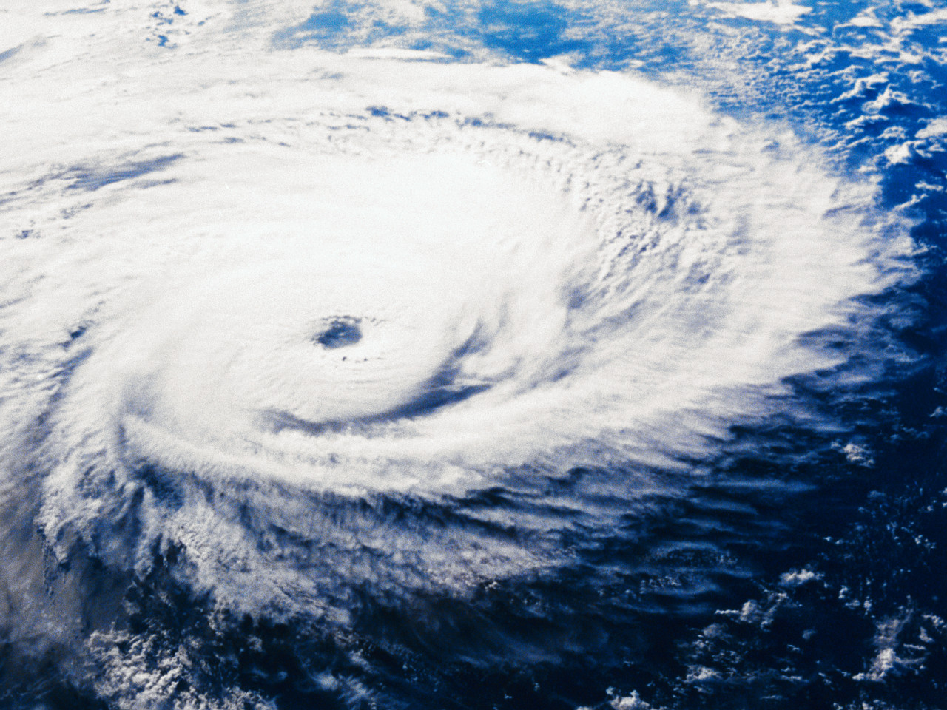
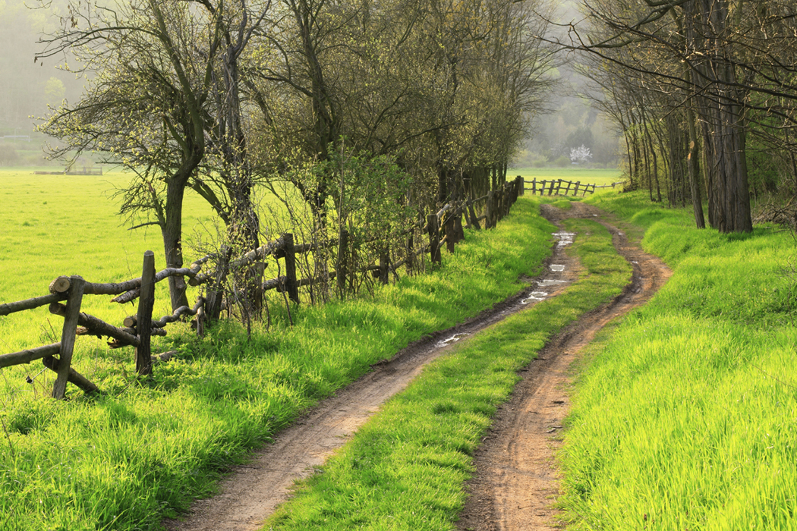
Ready Community Background
Hurricanes Katrina and Rita: Raising visibility of the nation’s most disadvantaged and vulnerable populations
Emergency Preparedness Initiative: Seeking focused strategies to help communities be better prepared
Roundtable Discoveries: Responding to the challenges of rural communities

Slide 5
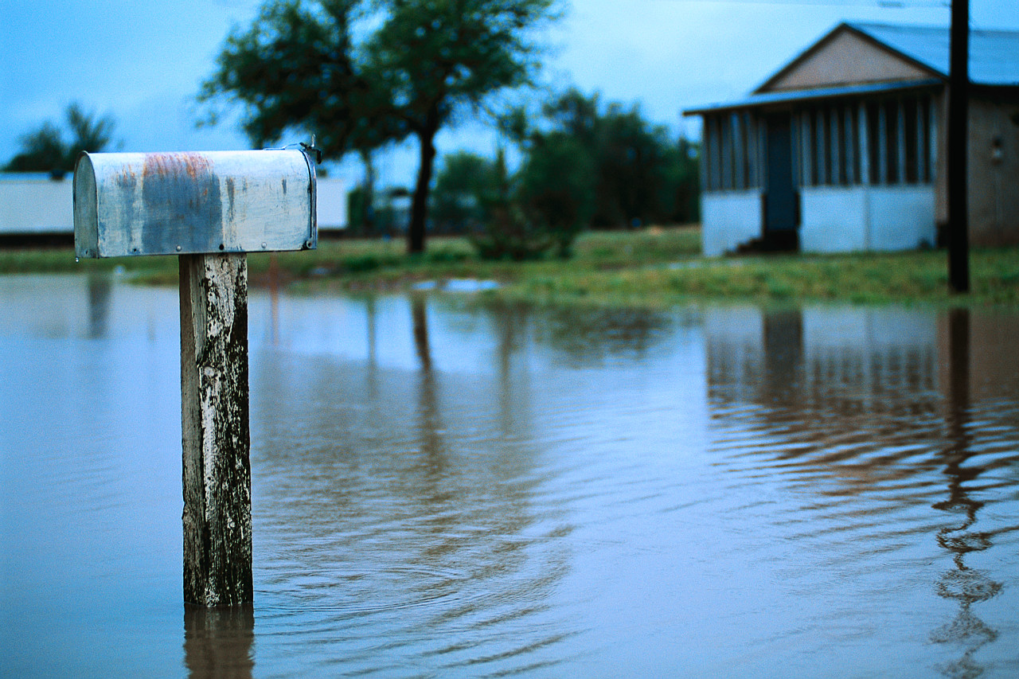
Disaster Debrief
DISCUSSION.
What went well?
What didn’t go well?
Did you identify solid goals?
Did you have the resources you needed?
What questions did this raise?
Notes:
Now that you have gone through the scenario planning, let’s take a few minutes to examine the following questions:
What went well?
What didn’t go well?
Sound disaster planning requires solid goals and specific actions. Were these evident during your scenario planning activity? If not, would having goals and actions clearly developed prior to experiencing a flood been of help to you?
Did you have the resources you needed? (Note: We will discuss this in more detail in Step Four of ReadyCommunity).

Slide 6
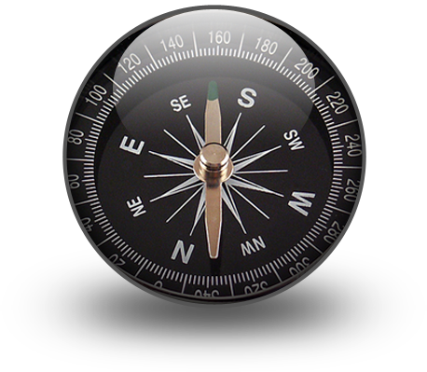
About ReadyCommunity
What ReadyCommunity offers:
A process to guide the work
Facilitation by a neutral community coach
Ideas for broad civic participation to ensure buy-in
Assessment of local assets and resources
Access to current data for strategy selection
A plan to move forward

Slide 7

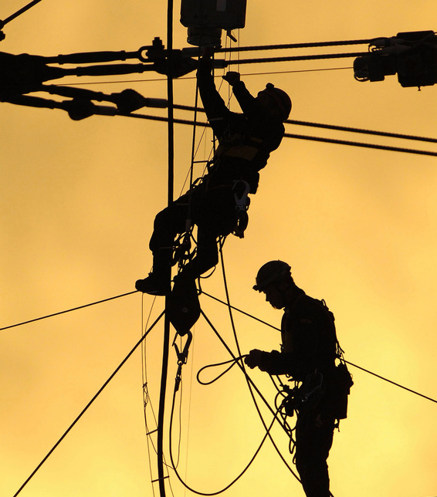
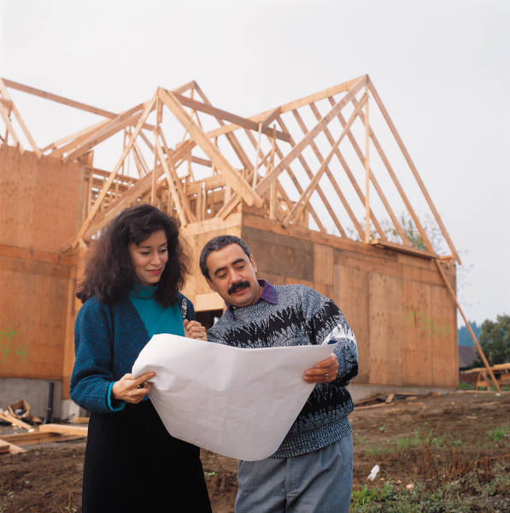
Potential Local Benefits
Decreases chances of loss of life and property – Most Important
Assists in meeting state/federal requirements for planning
Expedites the flow of recovery assistance after a disaster
Identifies strategies to prevent or lessen loss and damage

Slide 8
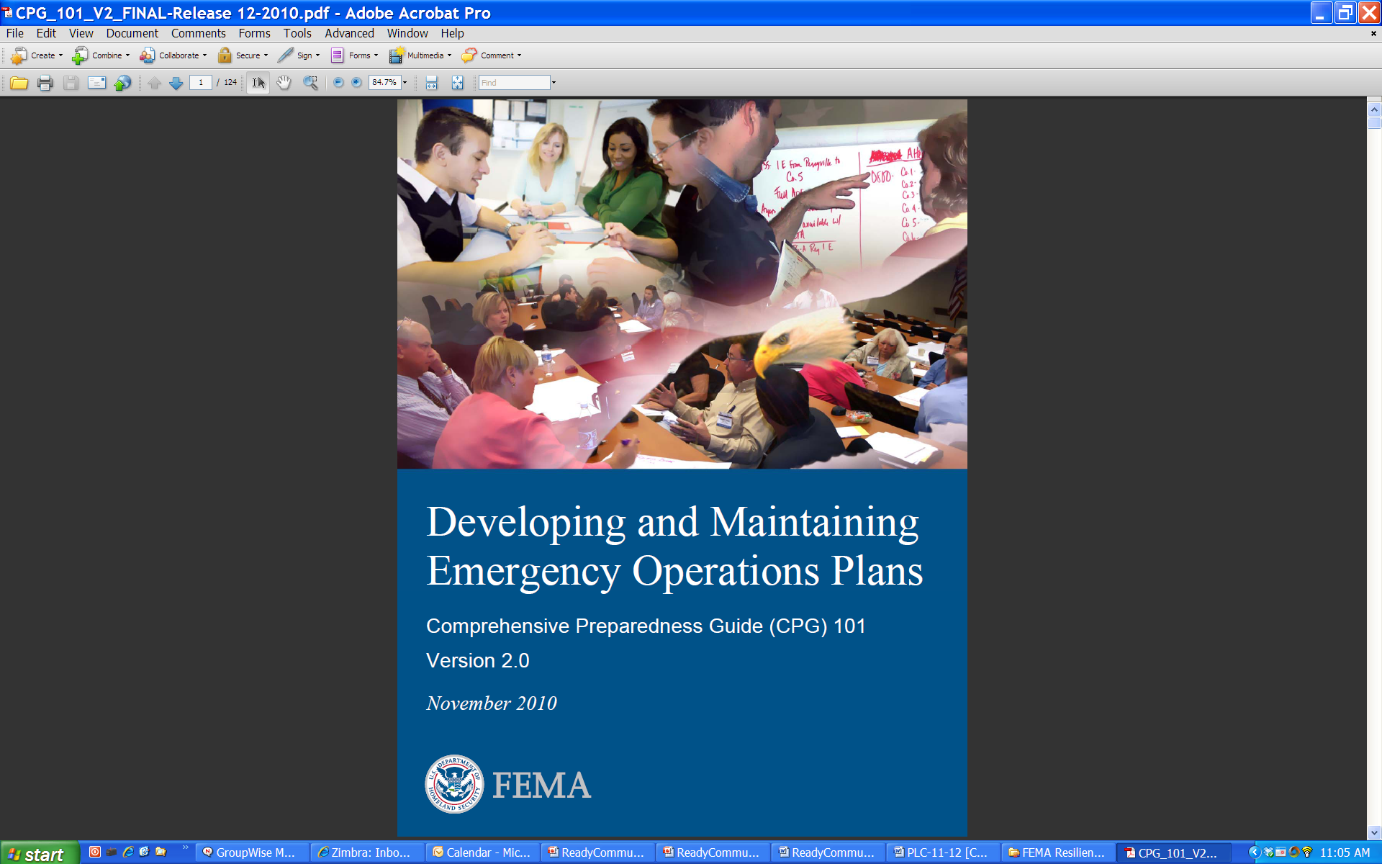
FEMA’s CPG 101 Comprehensive Preparedness Guide
Purpose of CPG 101:
Conduct community-based planning that engages the whole community
Ensure plans are developed through an analysis of risk
Identify operational assumptions and resource demands
Prioritize plans and planning efforts to support their seamless transition from development to execution for any threat or hazard
Integrate and synchronize efforts across all levels of government

Slide 9
What is Involved?
Step 1: Form a Collaborative Planning Team
Step 2: Understand the Situation
Step 3: Determine Goals & Actions
Step 4: Plan Development
Step 5: Plan Preparation, Review, & Approval
Step 6: Plan Implementation & Maintenance
Step 1: Form a Collaborative Planning Team
Step 2: Understand the Situation
Step 3: Determine Goals & Actions
Step 4: Develop the Plan
Step 5: Prepare, Review, & Approve the Plan
Step 6: Implement & Maintain the Plan

Slide 10
Layers of Involvement
Community
Planning Team
Core Team
Community
Coach

Slide 11

Purpose of a Community Coach
Supports the planning effort, from start to finish
Helps organize the Core Team and Planning Team
Facilitates the process that aids the Team in preparing a plan
Helps coordinate community involvement
Provides links to data and expertise available through the partners

Slide 12
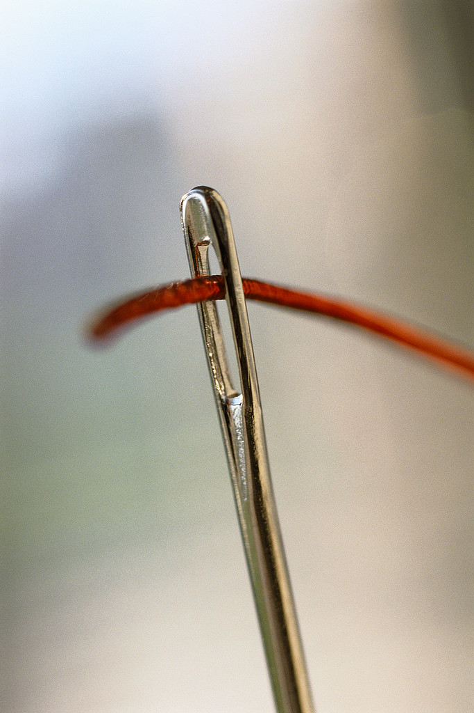
Organizing a Local Team
Why Do We Need a Team?
“…the common thread found in
successful [disaster] operations
is that participating organizations
have understood and accepted their roles.”
FEMA CPG 101, page 4-2

Slide 13
Core Team Responsibilities
Guide the overall process
Recruit others
Commit to participating in sessions
Work as a team
Prepare Emergency Operation Plan
Community
Planning Team
Core Team

Slide 14
Planning Team Responsibilities
Community
Planning Team
Core Team
Participate in planning sessions
Contribute to community assessments
Help involve community
Assist in designing the emergency plan
Commit to keeping the plan current

Slide 15

Goals of the Planning and Core Team
Build and expand relationships
Bring creativity and innovation to planning
Define roles to be taken during a disaster
Understand roles and abilities of others
Establish a planning routine

Slide 16

Who Should Be at the Table?

Slide 17
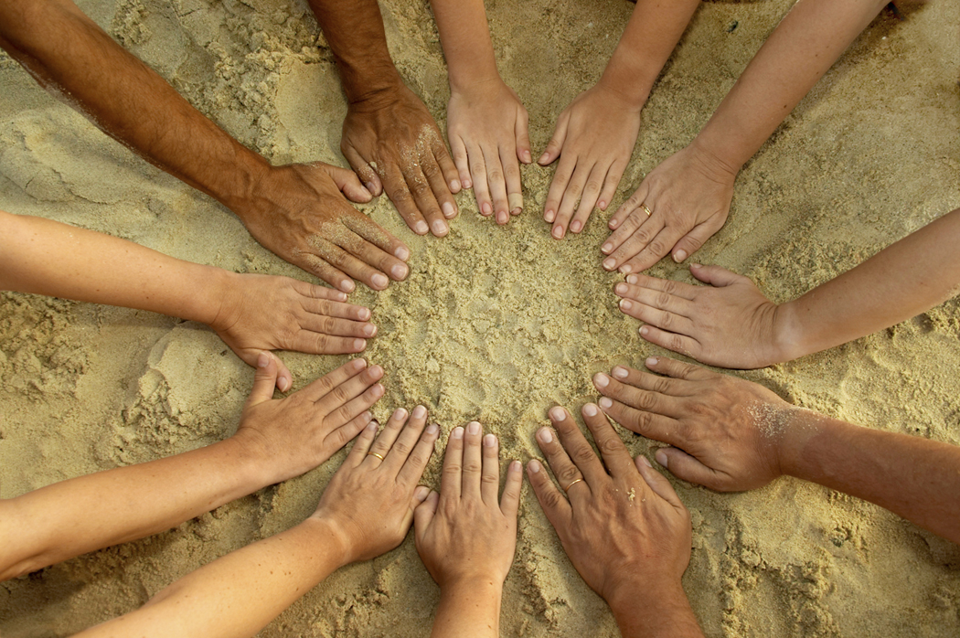
Engaging the Community in Planning
“Planning that is for the whole community and involves the whole community is crucial to the success of any plan.”
CPG 101, Page 4-4

Slide 18
FEMA Suggests…
Who else
is missing?
Planning Team
Fire Services
Emergency Manager
Law Enforcement
Health Services
Utilities
Education
Social Services
Agriculture & Farming
Children’s Services
National Guard
Civic Organizations

Slide 19
Goals of Community Involvement
Validate assumptions
Identify resources
Foster community trust and respect
Share responsibility
Increase effective responses
Improving community support and buy-in
Improve the quality of the decisions
Community
Planning Team
Core Team

Slide 20
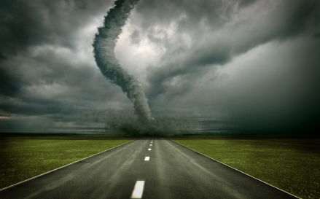
Considering Special Needs
What people or groups are most likely to have difficulty responding to a disaster in your community?

Slide 21
How to Involve Others in Planning
What can the core team learn or gain from their involvement?
What can the partners learn or gain from their involvement?
Disaster
Core Team
Community Organizations and Individuals
Creating a Win-Win Partnership

Slide 22
When to Involve the Community
Three Touch-Points in the Planning Process
Step 1: Form a Collaborative Planning Team
Step 2: Understand the Situation
Step 3: Determine Goals & Actions
Step 4: Plan Development
Step 5: Plan Preparation, Review, & Approval
Step 6: Plan Implementation & Maintenance
Verify and strengthen information gathered
Review the plan. Identify additional assets. Make suggestions to strengthen
Communicate the plan. Involve the community in staying ready
*Assets can include volunteers, equipment, facilities, etc.

Slide 23

Are We Ready?

Slide 24



Ready Programs
Ready Family

Slide 25
Ready Family
Making a disaster plan
If/when to evacuate
Essentials for evacuation or sheltering (disaster kit or go-pack)
Pet care
Food safety and meal planning
Financial preparedness
Stress management
Tips for returning home and beginning recovery safely
Staying connected to your community

Slide 26

Related Programs
Disasters increase stress and anxiety.
Ongoing effects of disasters may increase anxiety, depression, and or substance use.
MHFA helps community members identify, understand and respond to signs of mental illnesses and substance use disorders.
Adult and Youth programming available.

Slide 27

Related Programs
USDA Rural Development / Extension partnership
Economic development action plans
Multi-community/multi-county rural regions
Asset based
Data- and resident-driven
Guides overall regional planning and disaster recovery

Slide 28
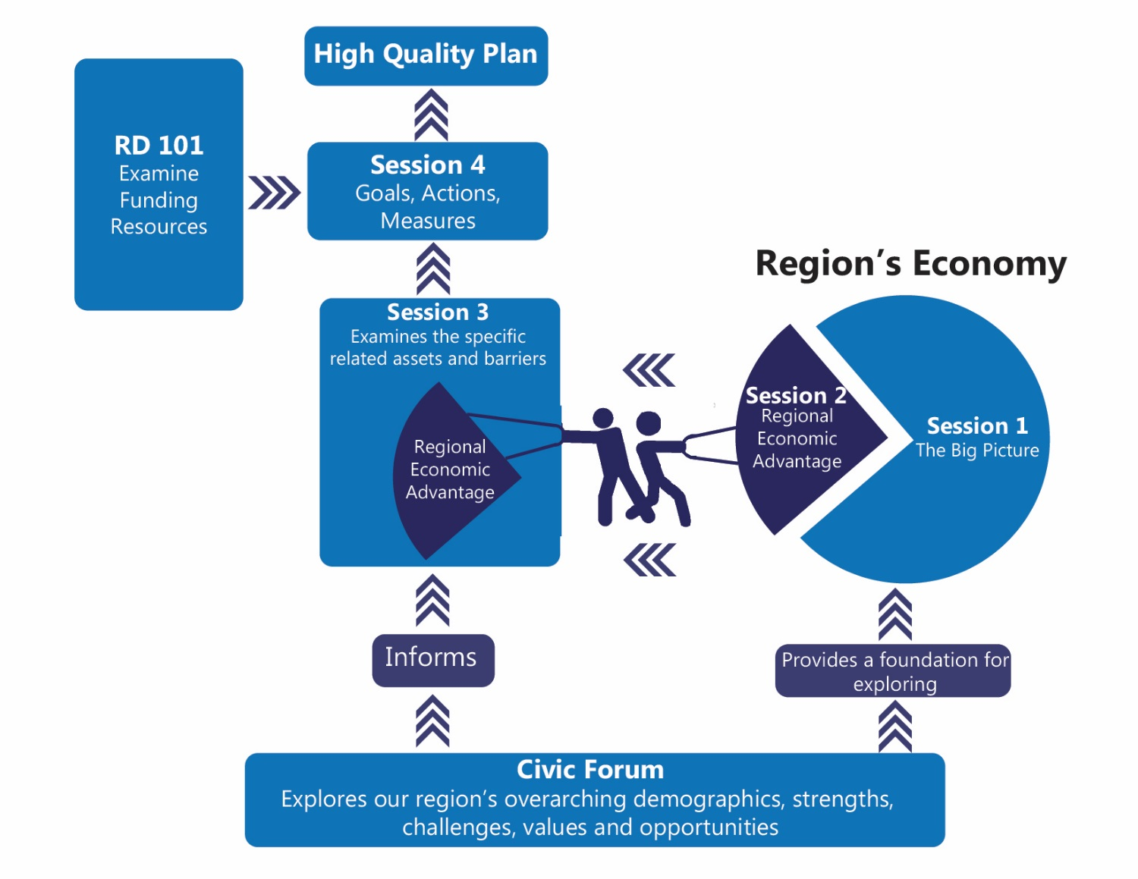
Related Programs

Slide 29
Similarities
Specific
Planning Team
Fire Services
Emergency Manager
Law Enforcement
Health Services
Utilities
Education
Social Services
Agriculture & Farming
Children’s Services
National Guard
Civic Organizations
Measurable
Community
Planning Team
Core Team
Attainable
Relevant
Time Framed

Slide 30
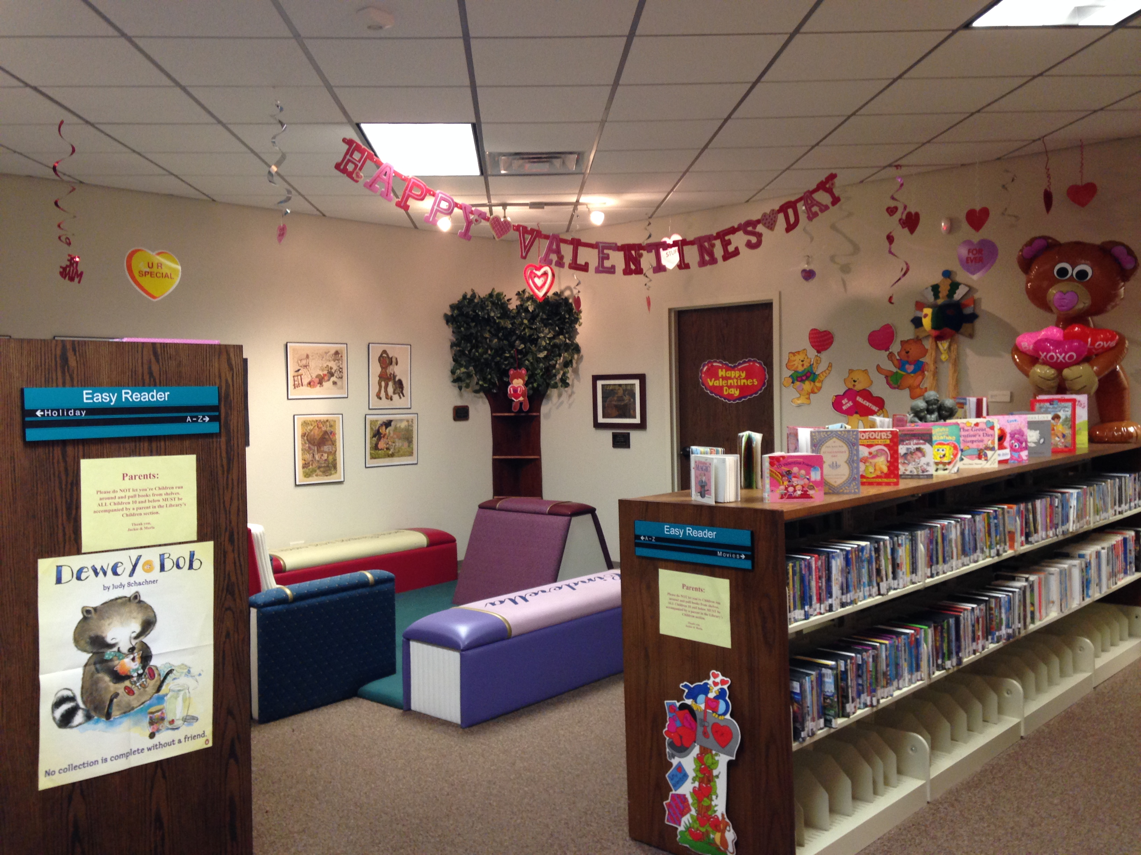
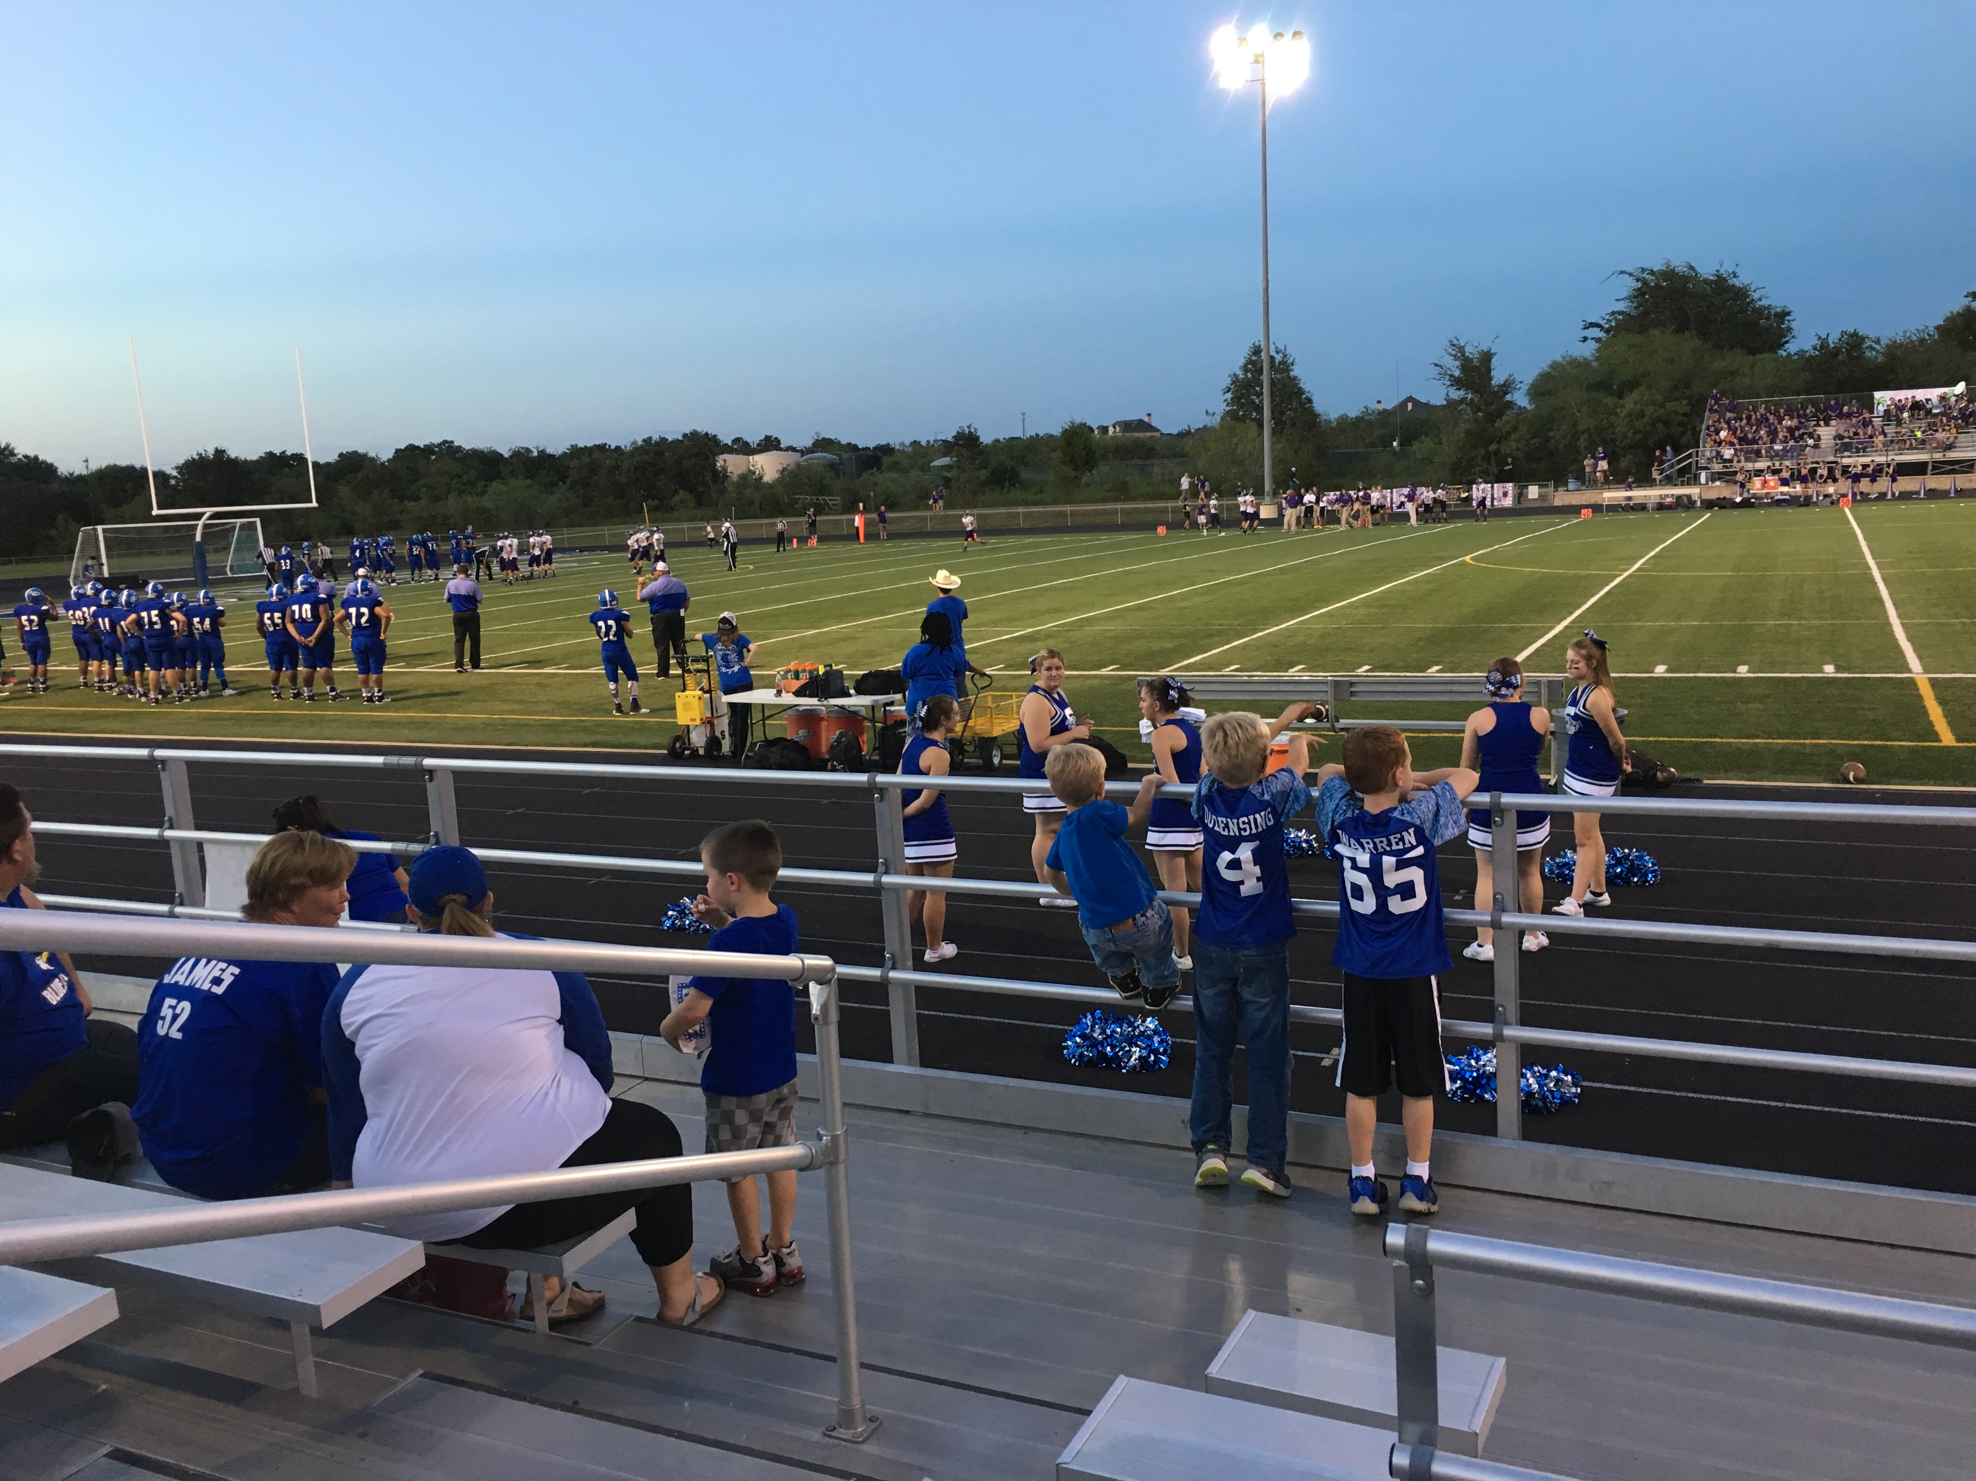
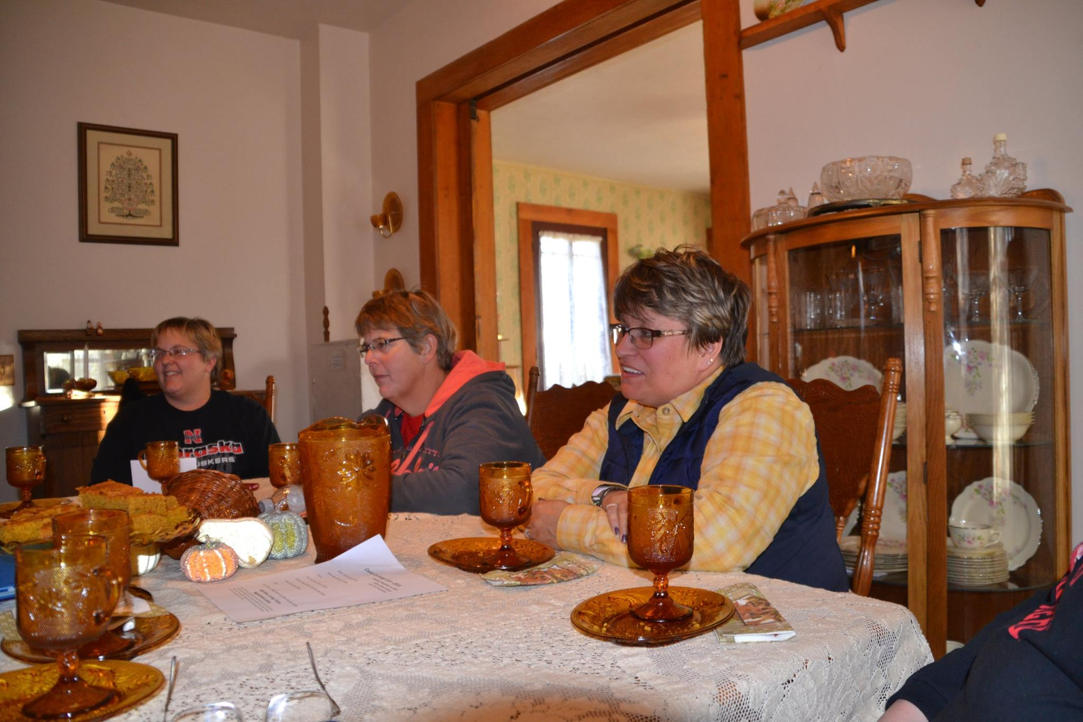
Recovering for the Future
Understanding trends and future needs
Appropriate funding and scope identified
Projects ready for funding
Designed with future needs in mind

Slide 31
Contact Information
Building Disaster-Resilient Places
John Cooper johntcooperjr@tamu.edu
Rebekka Dudensing rmdudensing@tamu.edu

Slide 32
Appendix
Notes:
We want to share with you an example of a goal that is “not so SMART.” The goal focuses on the response of the local volunteer fire department, something that is important in small towns or cities without full-time paid fire department staff. But many of the SMART elements are missing.
At the bottom of the slide, this goal has been revised to meet the five elements of a SMART goal. Take a look at the five labels assigned to different parts of the goal statement. Keep in mind that a goal does not have to be too long or technical to capture all the important SMART elements.

Slide 33
SMART Goals
Specific
Why is this goal important?
Measurable
How do you plan to measure progress towards your goal?
What is the end result as well as the milestones along the way?
Attainable
Do you have the resources to achieve the goal? (People, organizations, money, physical resources, skills, attitude, etc.)
Relevant
Time Framed
Is this an important enough goal for your community to pursue?
Where will you focus your efforts?
When do you want to achieve this goal?
What is the target date for accomplishing the goal?
What do you want to achieve?
Are there factors that might prevent you from achieving these goals?
Is it one that will bring benefit to your community?
Is it something that matters (or should matter) to your community?
Notes:
SMART is an acronym that helps define a solid goal. This slide outlines the characteristics of SMART goals and provides a few guiding thoughts for each.
S means Specific: Knowing what the community wants to achieve and where they want to focus their efforts is important. Some goals may be community-wide in focus while other goals may be targeted to a smaller geographic area or to a certain segment of the community’s vulnerable population. As you develop specific goals, think through why these goals are important to the disaster planning efforts of your community.
M means Measurable: Develop measures that will allow you to document whether you are moving in the right direction in terms of achieving your goals. Think about the ultimate outcomes you want to achieve and the measures you want to use to document your progress along the way.
A means Attainable: Avoid embracing goals at odds with the current or anticipated resources that will be available in your community. Consider goals that align with the assets of your community. These assets could be people, volunteer groups, local institutions, or physical resources.
R means Relevant: Is the goal something that the community is genuinely committed to tackling? Since your community may have a variety of goals it may want to pursue related to disaster preparation and management, taking a hard look as to the importance and relevance of each specific goal is vital. Consider whether each goal will bring benefit to the community at large, or at least to a segment of the community that may be especially vulnerable to the hazards your community is a risk of experiencing. If it will, then it can be judged as relevant.
T means Time-Framed: Having timelines for each of your goals is important. If you don’t have target dates or timeframes, then you are likely going to muddle along, having no clear sense of what key actions need to be undertaken and by when. In order to keep things on track, build a timeline of when your team goals are to be realized.

Slide 34
SMART Goal Example
ESF# 4: Firefighting
Example:
Not SMART – Improve coordination of local volunteer fire departments for responding to large scale fires.
SMART – By July 14, 2013, develop and adopt a county-wide communication system that will allow alerts to reach all county volunteer fire departments within ten minutes of a large scale fire detection.
Time-Framed
Attainable
Specific
Measurable
Relevant
Notes:
We want to share with you an example of a goal that is “not so SMART.” The goal focuses on the response of the local volunteer fire department, something that is important in small towns or cities without full-time paid fire department staff. But many of the SMART elements are missing.
At the bottom of the slide, this goal has been revised to meet the five elements of a SMART goal. Take a look at the five labels assigned to different parts of the goal statement. Keep in mind that a goal does not have to be too long or technical to capture all the important SMART elements.

