Slide 1

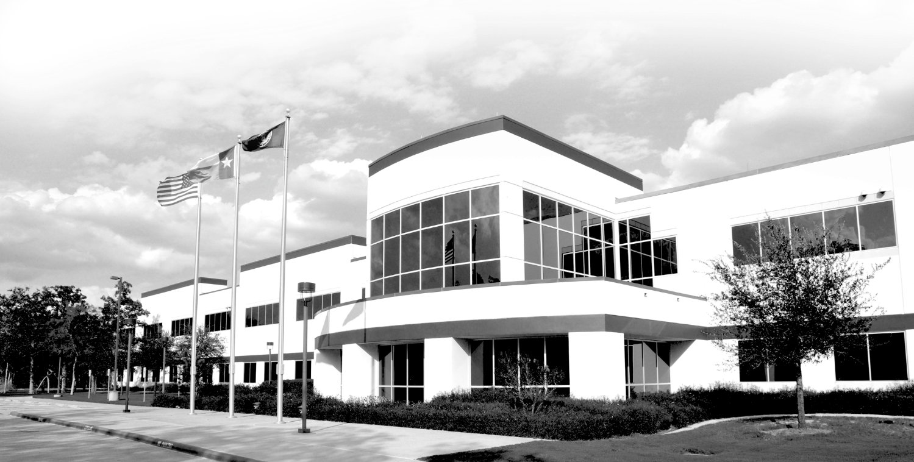
Introduction to Traffic Incident Management
SHRP2
Eric Johansen

Slide 2
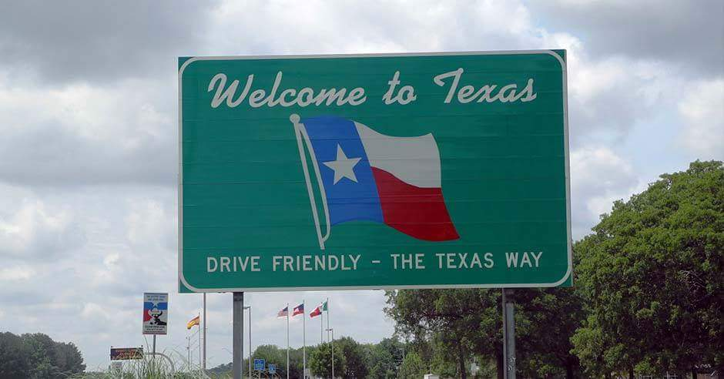
Traffic Incident Management

Slide 3
Definitions and Terms
Traffic Incident
Traffic Incident Management

Slide 4
Traffic Incident
“ is an emergency road user occurrence, a natural disaster, or other unplanned event that affects or impedes the normal flow of traffic.”
Question: Give some examples of traffic incidents

Slide 5
Traffic Incident Management
“ is the process of coordinating the resources of police, fire, emergency medical services, public works, traffic services, and towing services to detect, respond to, and clear traffic incidents as quickly as possible while providing overall scene safety for all responders and the traveling public.”

Slide 6
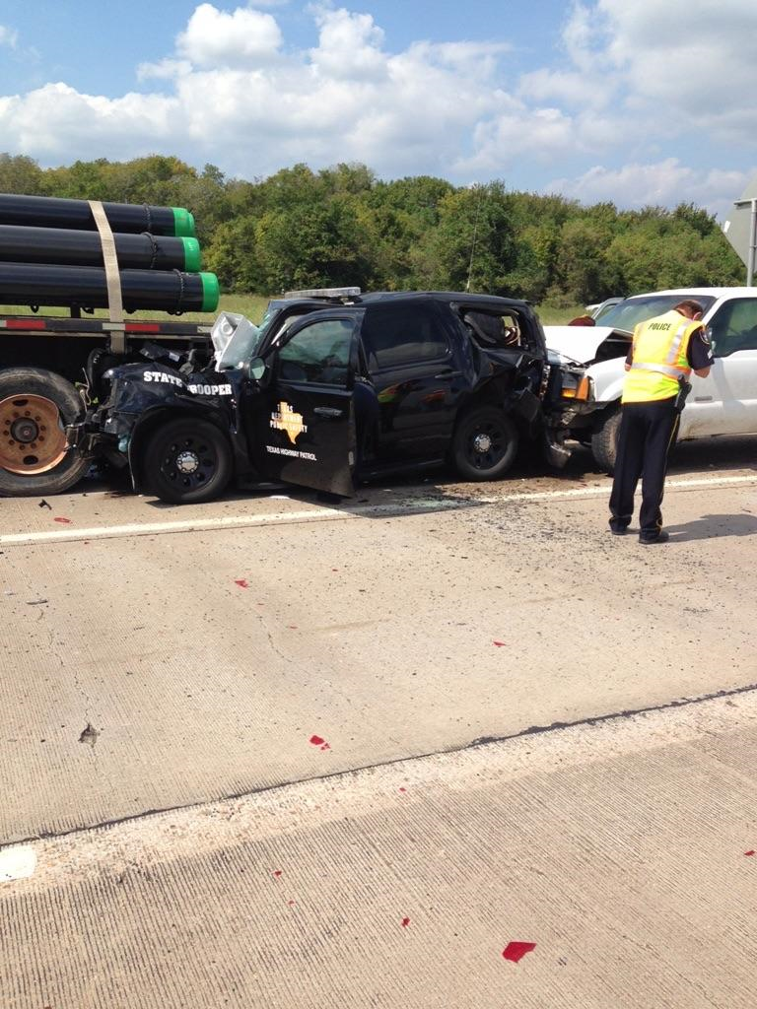
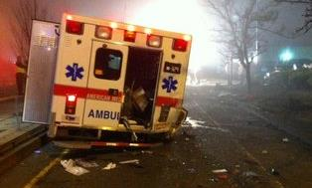
Impact of Traffic Incidents
High percentage of law enforcement deaths are caused by traffic incidents
25% of traffic congestion is caused by traffic incidents
20% of all incidents are secondary collisions.

Slide 7
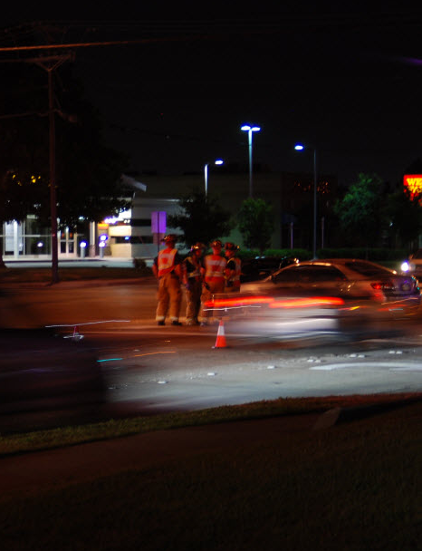
Emergency Responder Exposure to Traffic
Each injury crash can require…
2 + Law Enforcement
2 +Fire/Rescue
2 EMS
1 Towing & Recovery
____________________________________
= 9 Responders
Notes:
Injury crash response might vary from place to place, but lets assume 2 law enforcement, 4 fire, 2 EMS, and 1 tow operator typically respond to an injury crash
That is a total of nine responders potentially in harm’s way at each incident

Slide 8
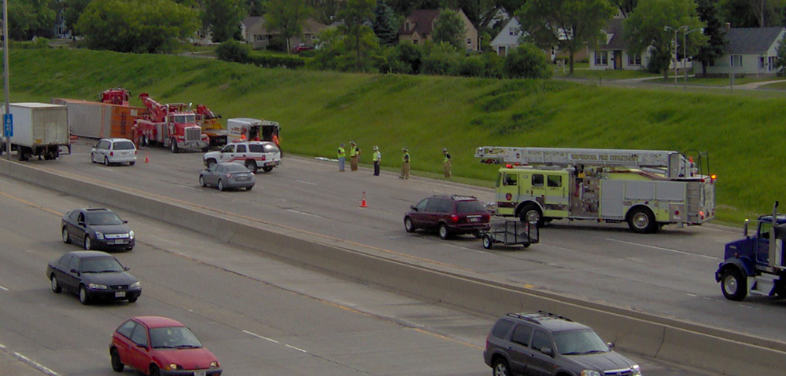
Emergency Responder Exposure to Traffic
That’s potentially 27 responders rolling out to a new injury crash every minute of every hour, 24/7/365
Notes:
With three injury crashes occurring every minute on average across the U.S., there is the potential for:
27 new responders to arrive at new injury crashes every minute
1,620 responders working at traffic-related crashes every hour
38,880 responders in a 24-hour period
The numbers represent a picture of responder exposure at injury traffic crashes; the degree of risk

Slide 9
Responder Struck-By Fatalities
In a typical year, the following number of responders are struck and killed:
12 Law Enforcement Officers
8 Fire and Rescue Personnel
60 Towing and Recovery Professionals
Several transportation professionals from DOTs, Public Works, and Safety Service Patrol Programs
Notes:
According to the National Law Enforcement Officers Memorial, over the past 24 years, an average of 12 officers are killed each year in struck-by incidents
The National Fallen Firefighters Memorial in Emmitsburg, MD indicated that statistics from 2010 are typical for firefighter struck-by deaths, about 5 per year
The International Towing and Recovery Hall of Fame and Museum in Chattanooga, TN tells us that about 60 tow operators are struck and killed each year
Aside from work zone deaths, transportation workers are also killed at incidents, though the exact numbers are difficult to pin down

Slide 10
Responder Fatality & Injury Factors
Lack of Situational Awareness
Failure to wear High Visibility Apparel
Failure to establish proper Temporary Traffic Control (TTC) zones.
Improper positioning of apparatus
Improper use of scene lighting

Slide 11
Benefits of Good Traffic Incident Management
TIM consists of a planned and coordinated multidisciplinary process to detect, respond to, and clear traffic incidents so that traffic flow may be restored as safely and quickly as possible
Effective TIM reduces the duration and impacts of traffic incidents and improves the safety of motorists, crash victims, and emergency responders
Notes:
TIM consists of a planned and coordinated multidisciplinary process to detect, respond to, and clear traffic incidents so that traffic flow may be restored as safely and quickly as possible
Reiterate that effective TIM has a direct impact on traffic congestion as well as the responder statistics and secondary crashes discussed in the previous slides

Slide 12
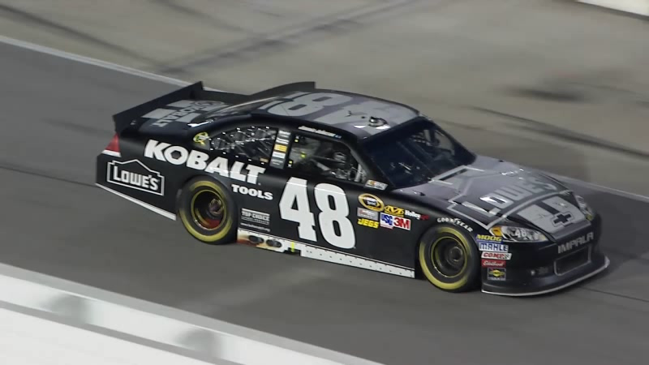
NASCAR Pit Stop – TIM Team Analogy
Video Courtesy of NASCAR
Notes:
Video: L1_V2 - NASCAR Pit Stop.wmv
Ask/Discuss: What analogies can be drawn between TIM and racing pit stops?
Incident Commander
Safety Officer
Sense of urgency
Clear roles and responsibilities
Use of technology
Practice and training
Success = Safety + Expedited Response

Slide 13
NASCAR Pit Stop
– TIM Team Analogy
NASCAR: quicker pit stops = the difference between winning and losing
  1960: 75 seconds (4-prong lug wrench)
  1963: 25 seconds (air/impact wrench)
  1990s/Today: 12 seconds
    Result of training, practice, and technology
Has TIM gotten stuck at “25 seconds”?
Notes:
In the early 1960s, NASCAR race teams recognized that quicker pit stops often made the difference between winning and losing races
Technology shortened these pit stops to around 25 seconds:
Spinning 4-prong lug wrench vs. use of the air impact wrench for example
Training and practice led to professional pit crews, reducing stops to what they are today, 12-15 seconds
The question has been raised – Has TIM gotten stuck at “25 seconds”?
We should be able to apply the same principles of training, practice, and technology to effect similar improvements in our incident clearance times

Slide 14
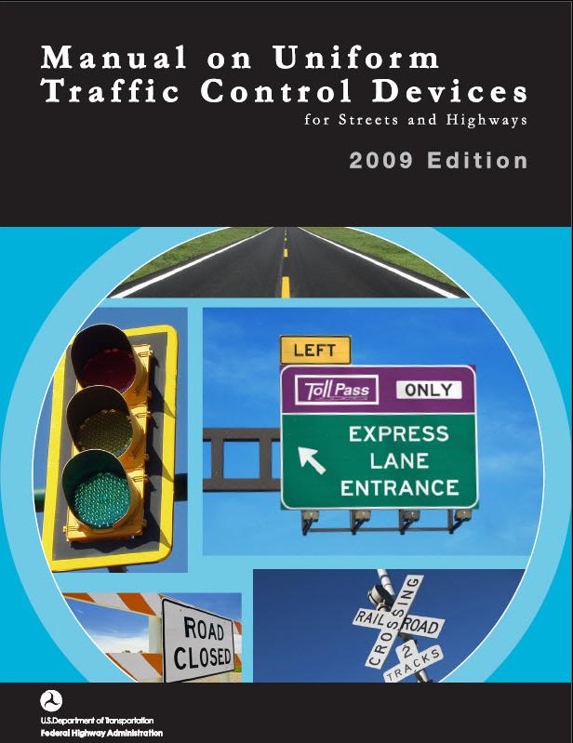
Manual on Uniform Traffic Control Devices (MUTCD)
Federal guideline for all traffic control nationwide
It also covers all “workers” on all streets, roadways, or highways
This course addresses what is required to adhere to MUTCD standards
Notes:
The Manual on Uniform Traffic Control Devices is commonly referred to as the MUTCD
The MUTCD is a national standard that was first published in 1935, and it has been maintained by FHWA since 1971
The current version was published in 2009, and the PDF is 864 pages
The manual promotes uniformity of traffic control devices like signs, signals, and markings, which improves safety and driver expectancy
There was extensive participation by practitioners in developing and evaluating the content of the MUTCD, including transportation and public safety

Slide 15
MUTCD Chapter 6I
Control of Traffic through Traffic Incident Management Areas
Includes the following 5 Sections:
  6I.01 – General (Information)
  6I.02 – Major Traffic Incidents
  6I.03 – Intermediate Traffic Incidents
  6I.04 – Minor Traffic Incidents
  6I.05 – Use of Emergency-Vehicle Lighting
Notes:
Part 6 of the MUTCD covers Temporary Traffic Control (TTC) zones, commonly known as highway construction or work zones
A subset of Part 6 is Chapter 6I (pronounced “six-eye”), which specifically addresses traffic incidents
Because they are emergency events of a temporary nature, traffic incidents are different from highway work zones and are not required to conform with the requirements of work zones
Review the five sections of Chapter 6I

Slide 16
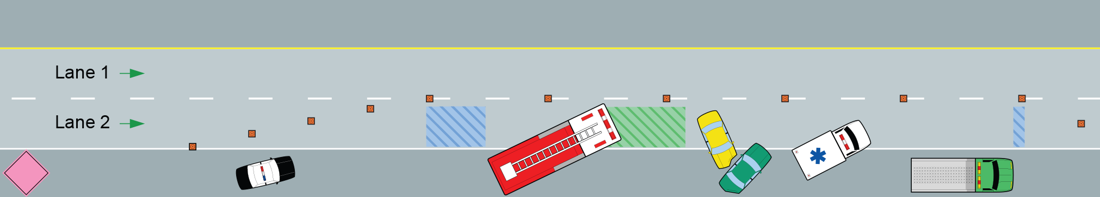
Traffic Incident Management Area
Incident Space
Buffer
Space
Advance Warning Area
Transition Area
Activity Area
Termination Area
Notes:
Animation: Click forward to make the Buffer and Incident Space labels appear
A Traffic Incident Management Area is a type of TTC zone
A Traffic Incident Management Area has four main components:
Advance Warning Area
Transition Area
Activity Area
Termination Area
The Activity Area is further comprised of a Buffer Space and an Incident Space [Click]
The parts of a Traffic Incident Management Area are covered in greater detail in Lesson 7
Note the general positioning of the responder vehicles, this will be covered more in Lesson 4

Slide 17
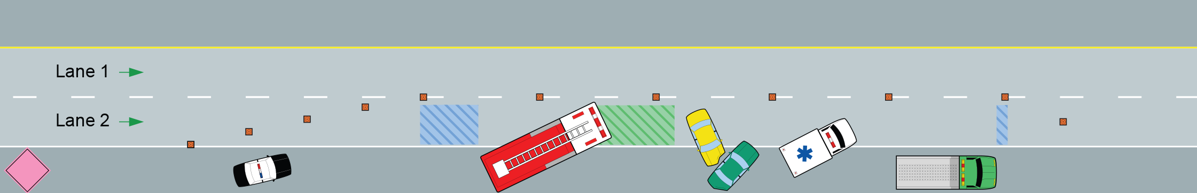
Advance Warning Area
Established upstream of the incident to alert drivers of the upcoming incident scene
Should be high priority for emergency responders
Placement of advance warning devices may need to be adjusted for situations near a corner, hill, or other reduced visibility situations
A shoulder taper, set up using traffic cones, may also be established in the Advance Warning Area
Notes:
All advance warning devices should be placed so that they will provide enough warning for vehicles to slow before reaching the incident and any queue that might form
Advance warning should be a high priority for responders, particularly in the cases of reduced visibility which will be discussed later
The shoulder taper is used to advise motorists that the shoulder is closed ahead
Due to limited resources (availability of cones) a typical Traffic Incident Management Area will likely not include a shoulder taper

Slide 18
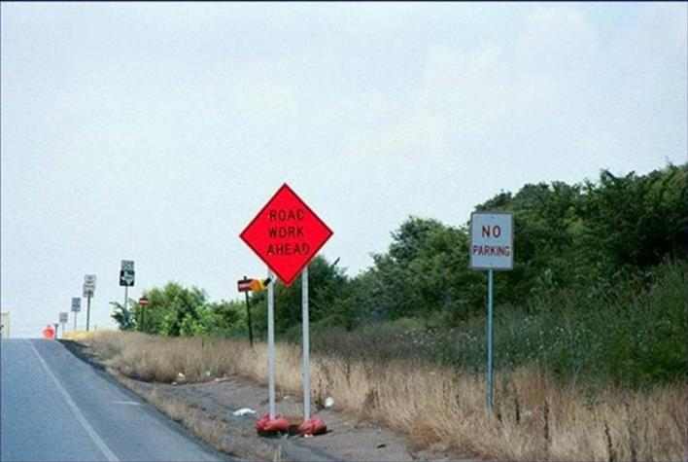
Advanced Warning Area

Slide 19
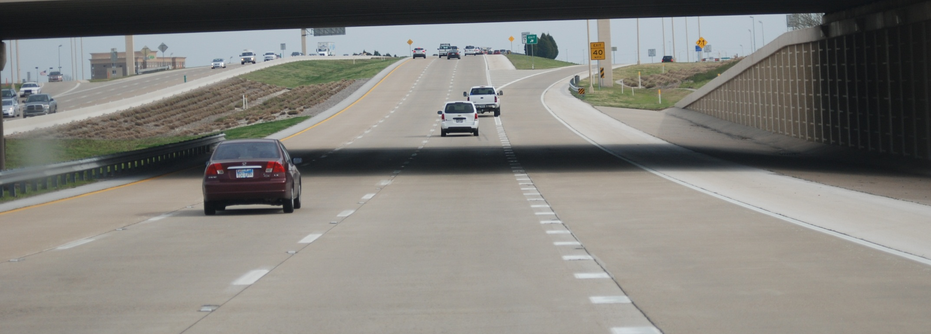
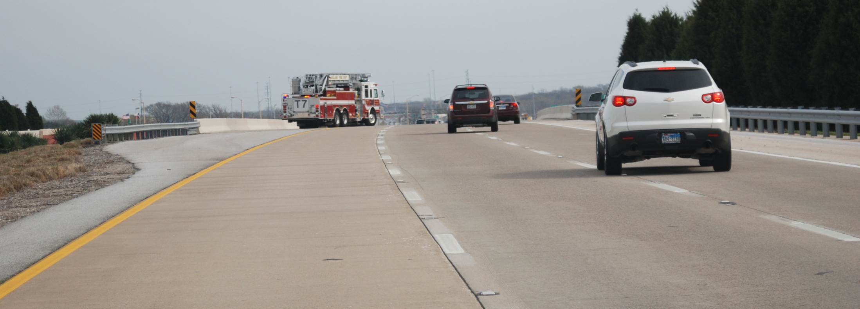
Advance Warning Considerations
– Limited Sight Distances
Additional advance warning may also be necessary due to limited sight distance
  Hills, curves, bridges, intersections, etc.
  Smoke, fog, darkness, etc.
Notes:
Animation: Click forward to make second picture appear
Another advance warning adjustment consideration involves limited sight distance
A small elevation or curvature in the roadway can obstruct a driver’s view, as can smoke, fog, and darkness
Once it has been determined the incident is a limited sight distance situation:
Position your vehicle further upstream of the scene than normal to serve as advance warning and keep your lights on
Contact other responding units and advise them of the exact location and request they position for extended advanced warning
Setup temporary warning and traffic control with available cones and signs

Slide 20
Provide Advanced Warning at Traffic Incidents – NFPA 1500
8.7.5 One or more of the following warning devices shall be used to warn oncoming traffic of the emergency operations and the hazards to members operating at the incident:
  (1) Fluorescent and retro-reflective warning devices such as traffic cones
  (2) Federal Highway Administration (FHWA)-approved 48 in. by 48 in. retro-reflective signs stating "Emergency Scene Ahead" (with directional arrow overlay)
  (3) Illuminated warning devices such as highway flares
  (4) Other warning devices appropriate to warn oncoming traffic of the emergency operations.

Slide 21
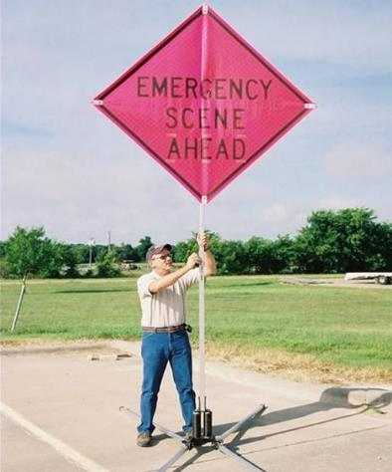
Emergency Scene Signs
TMUTCD states that warning and guide signs used in TTC may have black letters and fluorescent pink background.
NFPA 1500 specifies that signs used in TTC shall be 48”x48” retro-reflective and state “Emergency Scene Ahead”

Slide 22
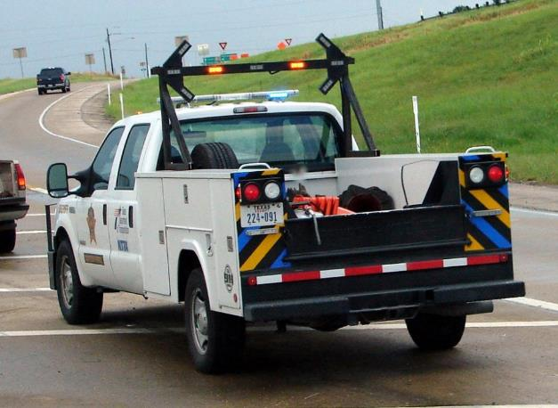
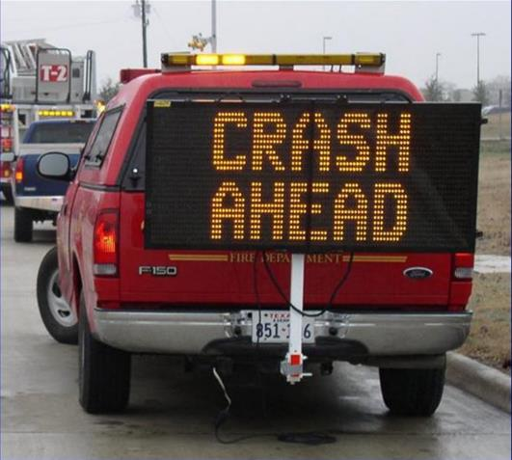
Portable Changeable Message Signs
Notes:
Responders have options that can be deployed quickly

Slide 23
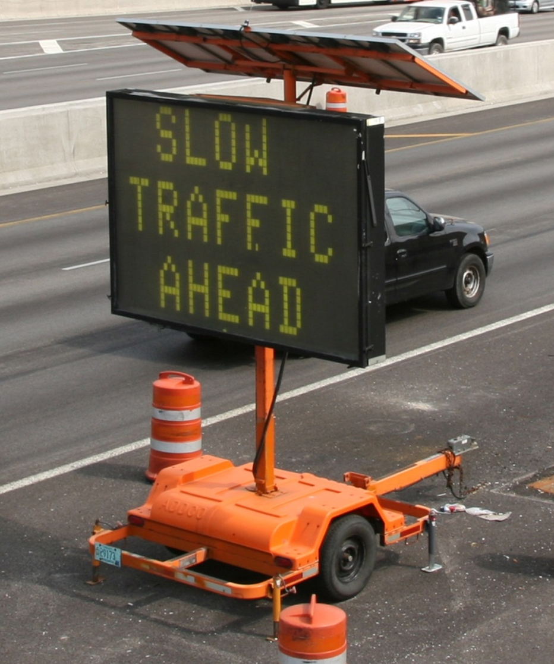
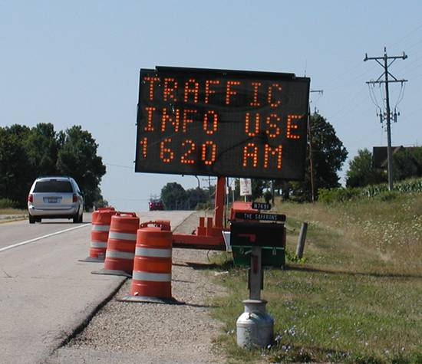
Portable Changeable
Message Signs (PCMS)
Notes:
Similarly, portable changeable message signs (PCMS) can also be used for advance warning
The State DOT, local transportation agency, or public works department is typically responsible for deploying PCMS
Private traffic control companies and/or asset management companies may also be used by transportation agencies

Slide 24
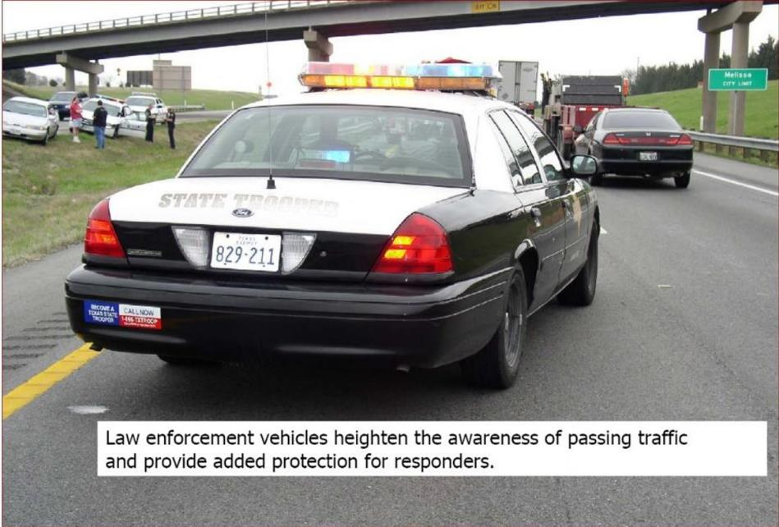

Slide 25
Transition Area and Tapers
Section of roadway where drivers are redirected out of their normal path
Transition Areas usually involve the strategic use of tapers
Tapers can be set up using cones or flares
  Skip lines provide a useful guide for measuring distances
Any taper is better than no taper
Notes:
Paraphrase slide content

Slide 26
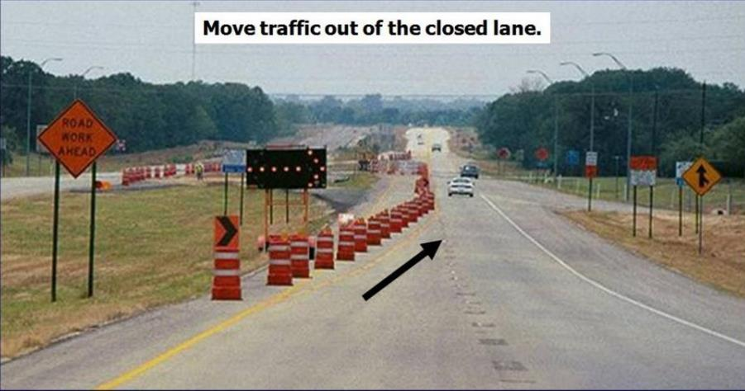
Transition Area

Slide 27
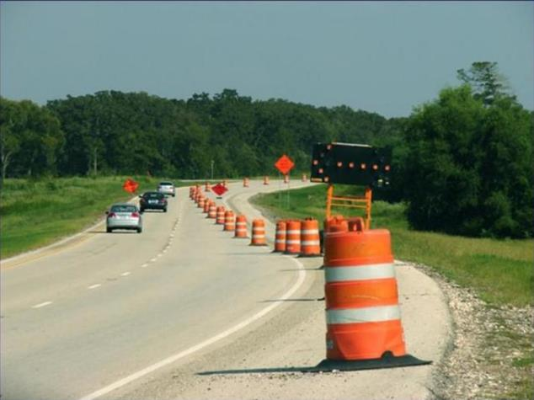
Drivers are accustomed to being guided by drums and cones with work zones.

Slide 28


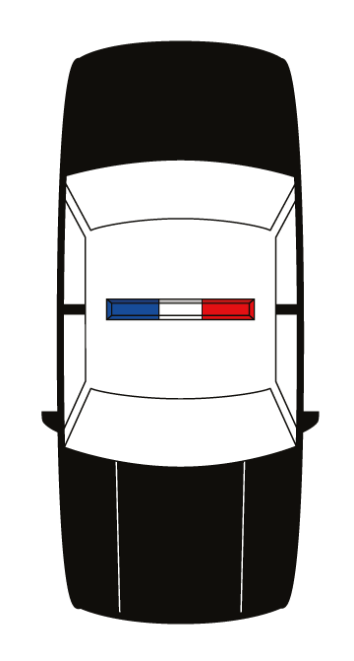
Taper Setup
Lesson 7
Notes:
Animation: Click forward to start taper set up, placement of each cone requires two clicks for a total of 11 clicks
Florida Gulf Coast University in Ft. Myers worked on a Justice Department grant related to nighttime traffic control devices
As a related issue, they developed a deployment technique that fills a historical training gap
The deployment of 5 cones to block one traffic lane is demonstrated
In this example, the skip lines are used to guide taper set up
The methodology has the responder use the refuge of the shoulder throughout deployment
The responder retrieves available cones from the trunk placing one at the rear of the responder vehicle on the edge line
Walking along the shoulder, facing traffic, a cone is subsequently placed on the edge line at each skip line (alternatively, they can be placed every 10 paces)
When the last cone has been placed on the edge line, the responder begins walking backwards until the next cone is reached
The responder takes one lateral step into the travel lane and places the cone, immediately returning to the shoulder – facing traffic
The responder again walks backwards until the next cone is reached and then takes two lateral steps into the travel lane to place the cone, immediately returning to the shoulder
The steps are repeated until all cones are deployed

Slide 29
Incident Space
Location where the incident has occurred and emergency responders are working
A blocking vehicle should be positioned at the upstream end of the Incident Space to protect workers from impacts by errant vehicles
Cones should continue alongside the Incident Space to help define the boundary between responders working and moving traffic
Notes:
The Incident Space is also called the work space or activity space in temporary traffic control zone terminology
Once traffic control devices are in place, the blocking vehicle is positioned at the upstream end of the incident space to protect workers and civilians
The MUTCD also uses the term shadow vehicle to describe the blocking vehicle
As outlined in the MUTCD, the blocking (or shadow) vehicle should be positioned a sufficient distance in advance of responders to absorb contact (Illustrated by green area on graphic)
The distance to the scene should not impede access to responder gear and not allow errant vehicles to travel around the blocking vehicle and re-enter the lane prematurely
Cone placement alongside the Incident Space can help dissuade premature re-entry

Slide 30
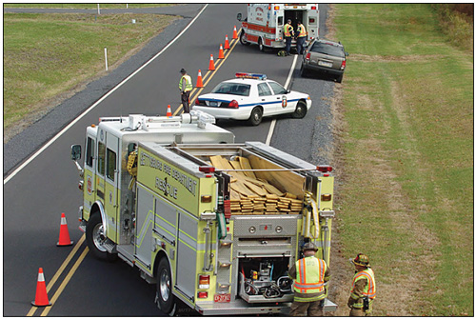
Vehicle and Responder Positioning
NFPA 1500 chapter 8.7- Fire apparatus shall be positioned in a blocking position so that if it is struck, the apparatus will protect members and other persons at the incident scene
Notes:
When this was instituted, no one told Law enforcement that were going to start doing or why ?

Slide 31
Responder protection begins with a
Physical Block - NFPA 1500
8.7.3 Apparatus and warning devices shall be placed to take advantage of topography and weather, conditions (uphill / upwind) and to protect fire fighters from traffic.
8.7.4.1 When acting as a shield, apparatus warning lights shall remain on.
8.7.4.2 All additional responding vehicles, when arriving on the scene, shall be positioned beyond the traffic barrier unless their function requires placement before the barrier.
8.7.4.3 Apparatus shall be placed at an angle to the incident that maximizes safety.
8.7.4.4 The blocking apparatus shall be placed at least 50 feet behind the first operating unit to create a safe working area.

Slide 32
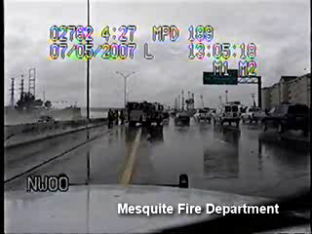
Blocking Vehicle Struck-By
Notes:
Video from Mesquite Texas where a motor vehicle crash was being worked by responders
Fire apparatus was providing a protective block
Fire crew had just entered their vehicle and were preparing to depart
Dash cam from the law enforcement vehicle at the scene that was providing advance warning

Slide 33
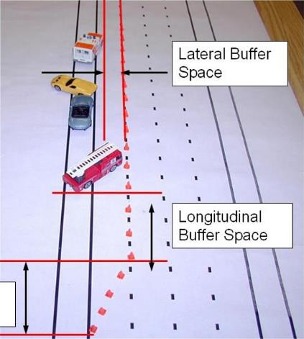

Buffer Space
Transitional Space moves motorist away from the accident/work lane .
Longitudinal Buffer allows distracted motorist time to stop prior to hitting a blocking vehicle.
Lateral Buffer gives ESO members room to perform extrication and patient packaging for transport.

Slide 34
Traffic Control
While not specifically authorized to control traffic under the Texas Transportation Code, firefighters are often the only resource available to perform traffic control.
8.7.11 Members used for traffic control purposes shall receive training that is commensurate with their duties and in accordance with any applicable state and local laws and regulations.
A.8.7.11 Proper training on traffic control can be obtained from local or state highway departments, law enforcement and other agencies involved with controlling the roadway traffic.

Slide 35
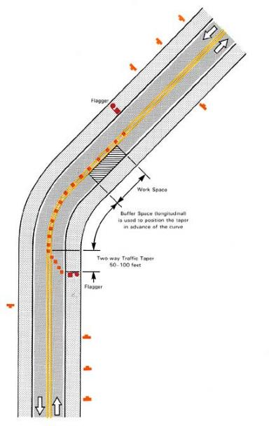
Incidents Requiring Alternating Traffic
Flaggers station should be preceded by advanced warning sign(s).
Flagger stations should be illuminated at night
TMUTCD requires trained “qualified” flaggers or uniformed law enforcement officers.

Slide 36
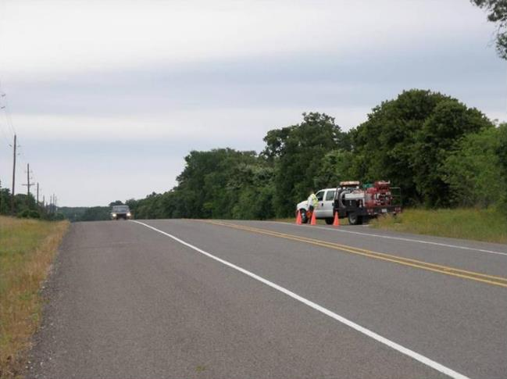
Traffic Incident Lane Closure on a two-lane, two-way roadway
Advanced Warning

Slide 37
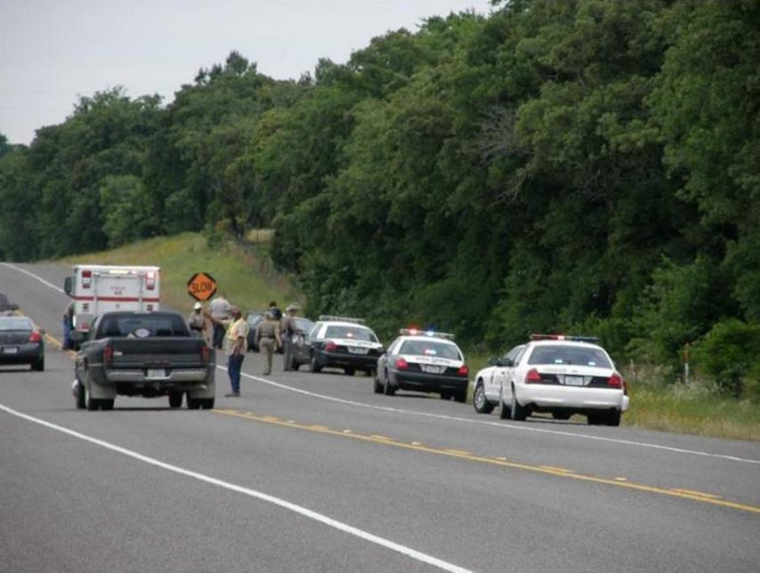
Unprotected Flagger

Slide 38
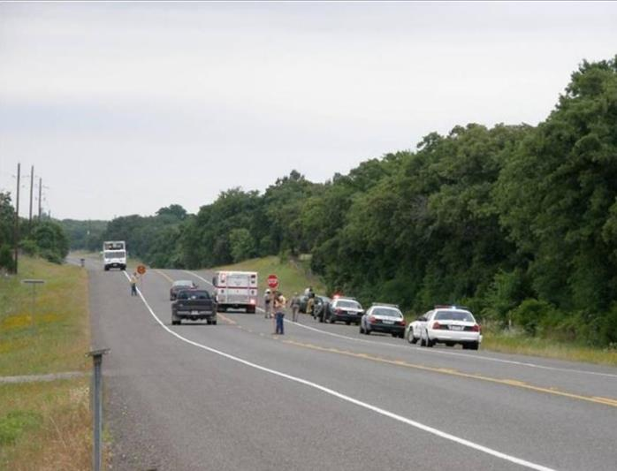
Who Should be directing Traffic???
541.002. GOVERNMENTAL AUTHORITIES (4) "Police officer" means an officer authorized to direct traffic or arrest persons who violate traffic regulations.

Slide 39
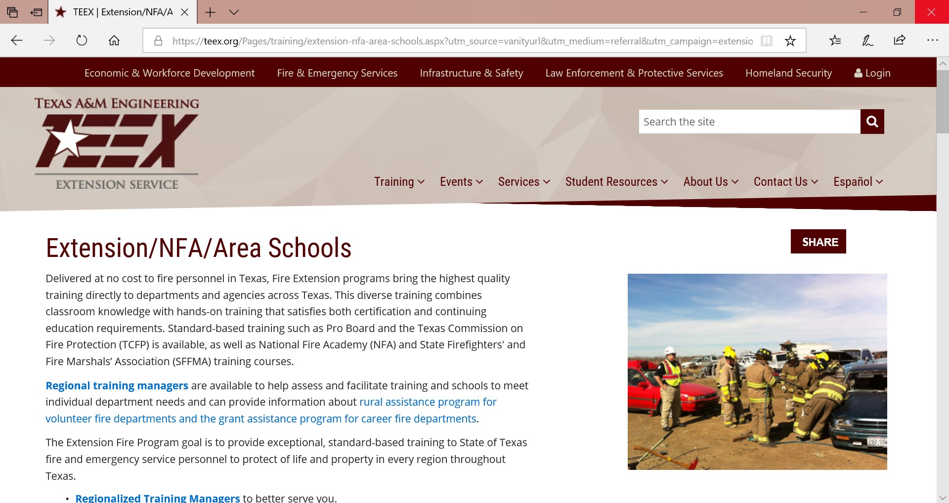
Where can I get this training?

Slide 40
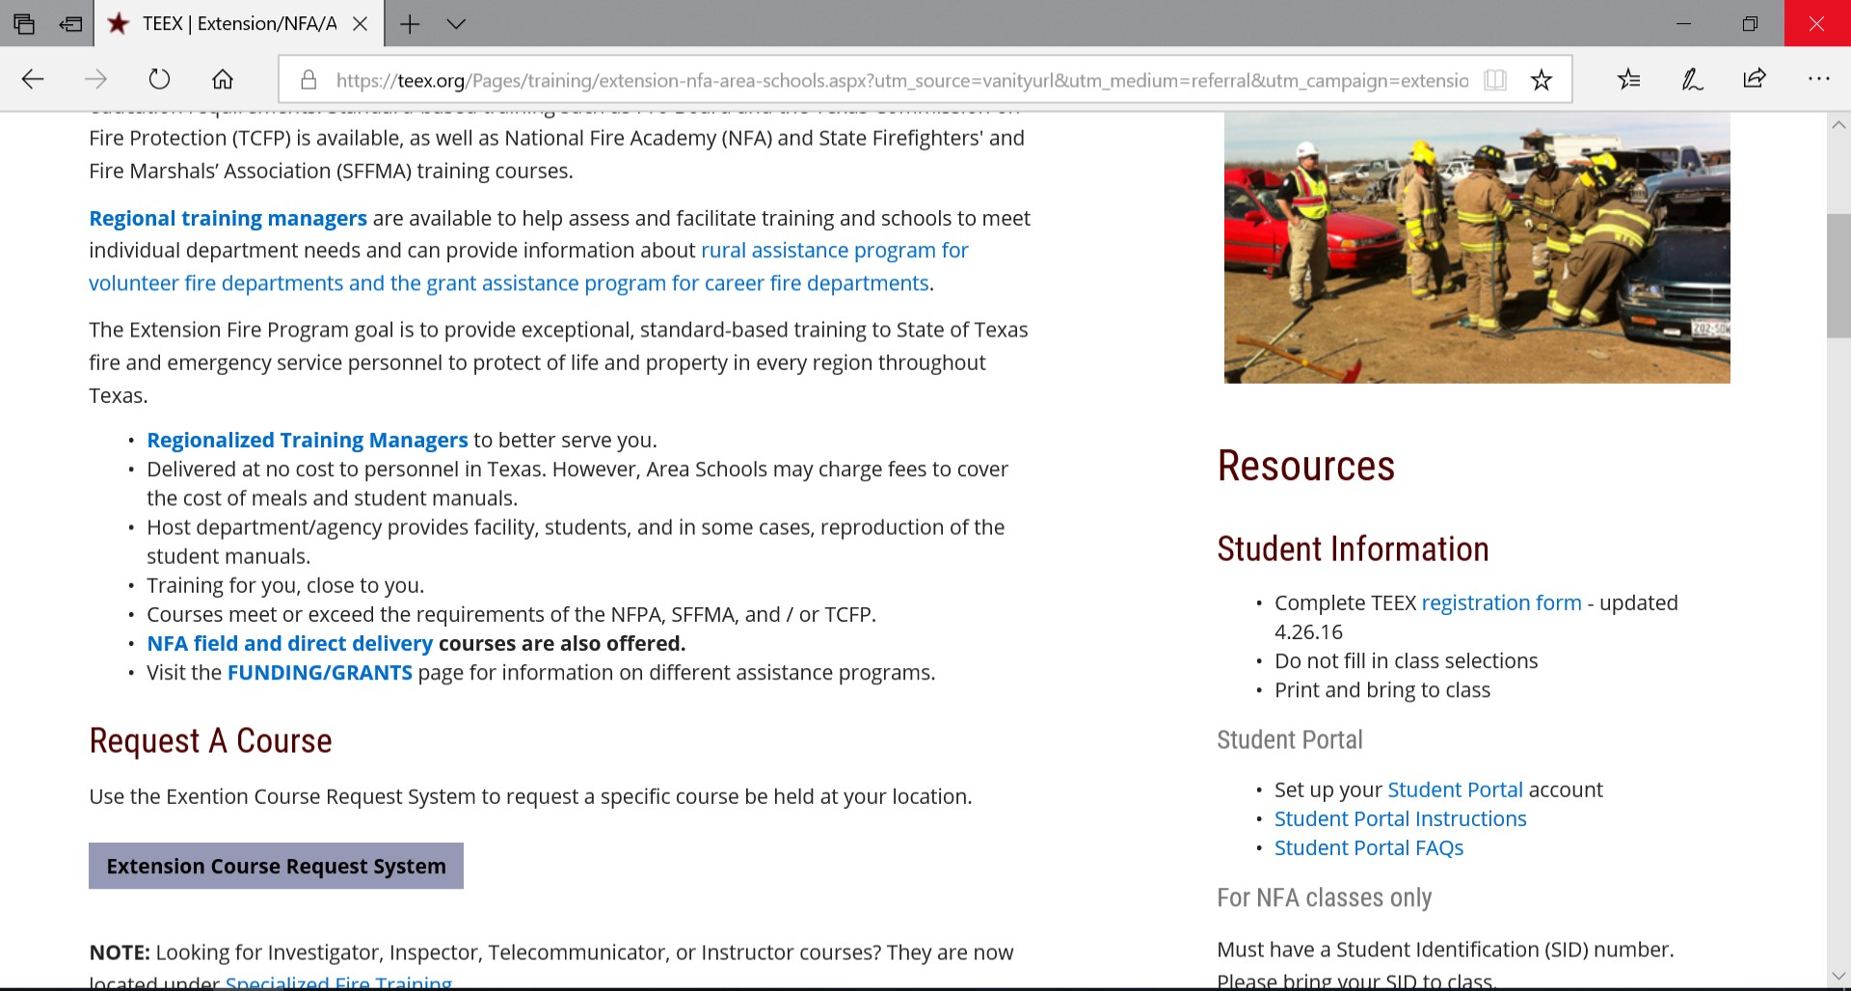

Slide 41
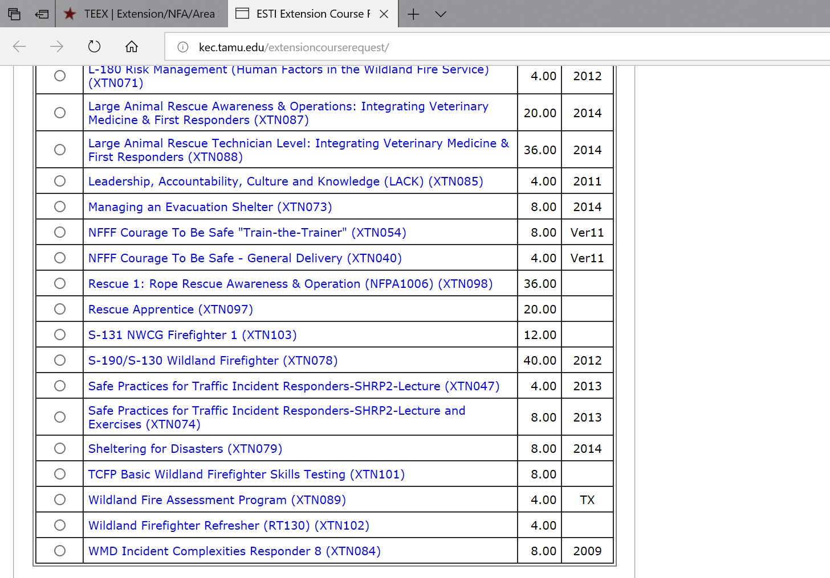

Slide 42
Summary
You have learned that TTC provides for safe movement of road users, and protects workers and responders. You have also been introduced to NFPA 1500, which describes the recommended methods for using emergency vehicles in the TTC zone. You have learned requirements of chapter 6.I in the TMUTCD, the proper use of traffic cones and the management of roadway space.
Finally, we would like to Thank You for your participation in this class.
BE SAFE!

Slide 43
