Slide 1



How to investigate an internal complaint without a hint of retaliation
Joe Bontke, M.Ed
EEOC Houston District Office
713 651 4994 desk
713 907 2855 cell
joe.bontke@eeoc.gov
Notes:
The Growing Problem of Workplace Incivility: How to Reduce Rudeness, Encourage Courtesy & Create a More Professional Atmosphere
From raunchy reality shows to parent brawls at Little League games, incivility seems to be everywhere – so it's no surprise that rudeness has also invaded the workplace.
Squabbling employees, screaming managers, colleagues who never respond to emails, co-workers who send texts while you're talking to them… all these people seem to have forgotten the basic rules of courtesy and respect. Offensive behavior among colleagues carries a high price, because "civility" at work means more than just good manners. Respectful treatment creates the foundation for cooperation between individuals and collaboration among departments. When people are rude and disrespectful to one another, they are much less likely to share information, contribute helpful suggestions, or offer assistance with problems

Slide 2

What’s in your “backpack”
It’s what we “bring” to work
It’s who I am
It’s my “stuff”
Notes:
In today's highly-competitive, fast-paced, always-connected business arenas, personal and online interactions often lack the common courtesies and considerations that promote smooth and harmonious human relationships. The result outcome can be unnecessary coarseness, tension and uneasiness that may have an impact both internal and external to the organization.
Civility means finding common ground as a place for mutual respect and the practice of considerate, kind and responsible behavior on a consistent basis, regardless of disagreements or differences between parties. Like civility, protocol addresses commonly expected behaviors.

Slide 3
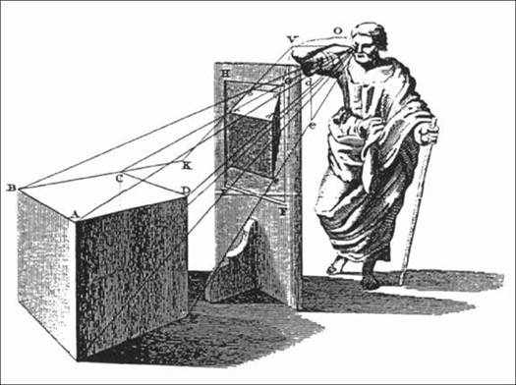
What is perspective?
from Taylor (1719)
Notes:
a particular attitude toward or way of regarding something; a point of view.
"most guidebook history is written from the editor's perspective"

Slide 4

What is perspective?
Notes:
I saw an artist painting at Time Sq. and thought what I waist of time and paint
Until I saw what she saw
a particular attitude toward or way of regarding something; a point of view.

Slide 5
Obligations of Employers
Make the workplace free of unlawful discrimination, harassment and retaliation
Promptly and confidentially investigate complaints of discrimination, harassment and retaliation
Where discrimination, harassment and retaliation may have occurred, take prompt and appropriate remedial action
(i.e., discipline commensurate with the offense)

Slide 6
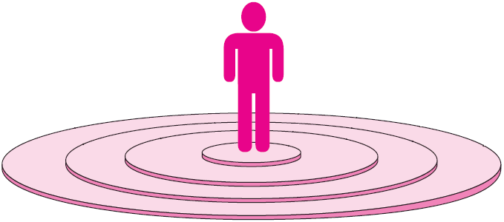
Personal Space in the U.S.
Intimate distance
18”
Personal distance
18” to 4’
Social distance
4’ to 8’
Public distance
8’ to 10’
Adapted from Personal Space Categories for Those in the United States

Slide 7


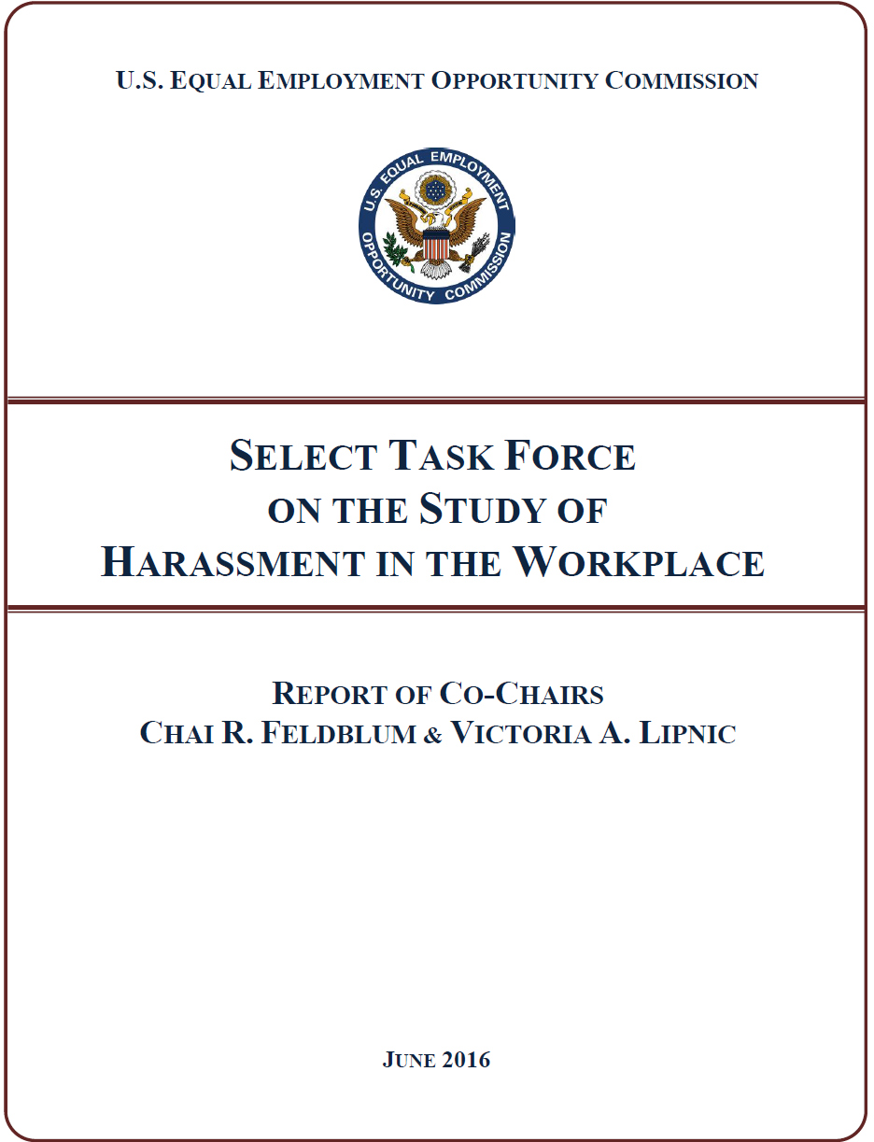
Rebooting Harassment Prevention
Harassment continues to be one of the most frequently raised complaint—
over 30% of all private sector cases
43% of Federal sector cases
#solveharassment
A Bipartisan Effort
Report available at:
www.eeoc.gov/task_force/ harassment/report.cfm
Notes:
Two Commissioners of the U.S. Equal Employment Opportunity Commission (EEOC), Co-Chairs of a Select Task Force on the Study of Harassment in the Workplace, called on stakeholders to double down and "reboot" workplace harassment prevention efforts at a meeting of the EEOC in Washington today. Commissioners Chai R. Feldblum and Victoria A. Lipnic highlighted for their fellow Commissioners the key findings and recommendations of a report they developed after 14 months of study of workplace harassment with the Select Task Force.
Convened in 2015, the Select Task Force was comprised of 16 members from around the country, including representatives of academia from various social science disciplines, legal practitioners on both the plaintiff and defense side, employers and employee advocacy groups, and organized labor.
Here are some point from the executive summery:
Workplace Harassment Remains a Persistent Problem. Almost fully one third of the approximately 90,000 charges received by EEOC in fiscal year 2015 included an allegation of workplace harassment. This includes, among other things, charges of unlawful harassment on the basis of sex (including sexual orientation, gender identity, and pregnancy), race, disability, age, ethnicity/national origin, color, and religion. While there is robust data and academic literature on sex-based harassment, there is very limited data regarding harassment on other protected bases. More research is needed.
Workplace Harassment Too Often Goes Unreported. Common workplace-based responses by those who experience sex-based harassment are to avoid the harasser, deny or downplay the gravity of the situation, or attempt to ignore, forget, or endure the behavior. The least common response to harassment is to take some formal action – either to report the harassment internally or file a formal legal complaint. Roughly three out of four individuals who experienced harassment never even talked to a supervisor, manager, or union representative about the harassing conduct. Employees who experience harassment fail to report the harassing behavior or to file a complaint because they fear disbelief of their claim, inaction on their claim, blame, or social or professional retaliation.
There Is a Compelling Business Case for Stopping and Preventing Harassment. When employers consider the costs of workplace harassment, they often focus on legal costs, and with good reason. Last year, EEOC alone recovered $164.5 million for workers alleging harassment –and these direct costs are just the tip of the iceberg. Workplace harassment first and foremostcomes at a steep cost to those who suffer it, as they experience mental, physical, and economic harm. Beyond that, workplace harassment affects all workers, and its true cost includes decreased productivity, increased turnover, and reputational harm. All of this is a drag on performance – and the bottom-line.
It Starts at the Top – Leadership and Accountability Are Critical. Workplace culture has the greatest impact on allowing harassment to flourish, or conversely, in preventing harassment. The importance of leadership cannot be overstated – effective harassment prevention efforts, and workplace culture in which harassment is not tolerated, must start with and involve the highest level of management of the company. But a commitment (even from the top) to a diverse, inclusive, and respectful workplace is not enough. Rather, at all levels, across all positions, an organization must have systems in place that hold employees accountable for this expectation. Accountability systems must ensure that those who engage in harassment are held responsible in a meaningful, appropriate, and proportional manner, and that those whose job it is to prevent or respond to harassment should be rewarded for doing that job well (or penalized for failing to do so). Finally, leadership means ensuring that anti-harassment efforts are given the necessary time and resources to be effective.
Training Must Change. Much of the training done over the last 30 years has not worked as a prevention tool – it’s been too focused on simply avoiding legal liability. We believe effective training can reduce workplace harassment, and recognize that ineffective training can be unhelpful or even counterproductive. However, even effective training cannot occur in a vacuum – it must be part of a holistic culture of non-harassment that starts at the top. Similarly, one size does not fit all: Training is most effective when tailored to the specific workforce and workplace, and to different cohorts of employees. Finally, when trained correctly, middle-managers and first-line supervisors in particular can be an employer’s most valuable resource in preventing and stopping harassment.

Slide 8
The EEOC concluded that trainings have failed as a prevention tool because they are “too focused on simply avoiding legal liability.”
Notes:
The EEOC concluded in a 2016 report that trainings have failed as a prevention tool because they are “too focused on simply avoiding legal liability.”
Last year, the EEOC’s task force on workplace harassment found only three studies that have evaluated the effectiveness of training programs over time at companies. And the most recent study on the subject was 15 years old.
“It was a jaw-dropping moment for some of us,” Victoria Lipnic, the agency’s acting chair, said.
An important question now: Will companies respond to the #MeToo movement by pouring more money into trainings or will they focus on developing other solutions?

Slide 9

Civility
Be kind, for everyone you meet
is fighting a hard battle.
-- Plato or someone else
Notes:
Be Kind; Everyone You Meet is Fighting a Hard Battle
Plato? Philo of Alexandria? Ian MacLaren? John Watson?
This blog post is based on a question that was posed at the wonderful blog used by the quotation expert Fred Shapiro who is the editor of one of the best reference works in this area: The Yale Book of Quotations. Fred Shapiro’s posts appear on the Freakonomics blog.
Question: This question is from Glossolalia Black.
Be kind, for everyone you meet is fighting a hard battle.
It is attributed to Plato on this little thing I have up in my office, but I was told by a friend that it wasn’t him.
Fred Shapiro replied “this sounds anachronistic for Plato by almost 2500 years” and then invited readers to attempt to trace the quotation.
Quote Investigator: The websites ThinkExist, Quotations Page, and Brainy Quote do have this quotation listed under the august name of Plato.
Philo of Alexandria is another popular choice when assigning attribution, e.g., QuotationsBook credits Philo. Sometimes Anonymous gets the nod. QI was able to trace the saying back more than one-hundred years to its likely origin. The original aphorism did not use the word “kind”. Instead, another surprising word was used.

Slide 10

At age 14, George Washington compiled a list of
“110 Rules of Civility & Decent Behaviour”…
Rule #6 –
Sleep not when others speak…
Sit not when others stand,
Speak not when you should hold your peace,
Walk not on when others stop.
Notes:
By age sixteen, Washington had copied out by hand, 110 Rules of Civility & Decent Behavior in Company and Conversation. They are based on a set of rules composed by French Jesuits in 1595. Presumably they were copied out as part of an exercise in penmanship assigned by young Washington's schoolmaster.
And he was President of the United States, but I would go there

Slide 11

Life is a Relational Experience
The quality of our lives depends on the quality of our relationships.
Whether we like it or not, we are wax upon which others leave their mark.
Pier Massimo Forni
Notes:
Pier Massimo Forni (born 1952[1]), a native of Italy, is an award-winning professor at Johns Hopkins University, where he has taught since 1985.[2] Dr. Forni has published several books, including his 2002 best-seller Choosing Civility: The Twenty-Five Rules of Considerate Conduct.[3] He co-founded and currently directs the Civility Project at Johns Hopkins,[4] the purpose of which is to assess the significance of civility, manners and politeness in contemporary society.

Slide 12
What’s your civility ?
Assess Yourself
http://www.christineporath.com/assess-yourself/
 | Never | Almost Never | Rarely | Sometimes | Often | Almost Always | Always
Neglect saying please or thank you
Use email when face-to-face is needed
Take too much credit for collaborative work
Email/text during meetings
Keep people waiting needlessly
Talk down to others
Delay access to information or resources
Please indicate how often you…

Slide 13
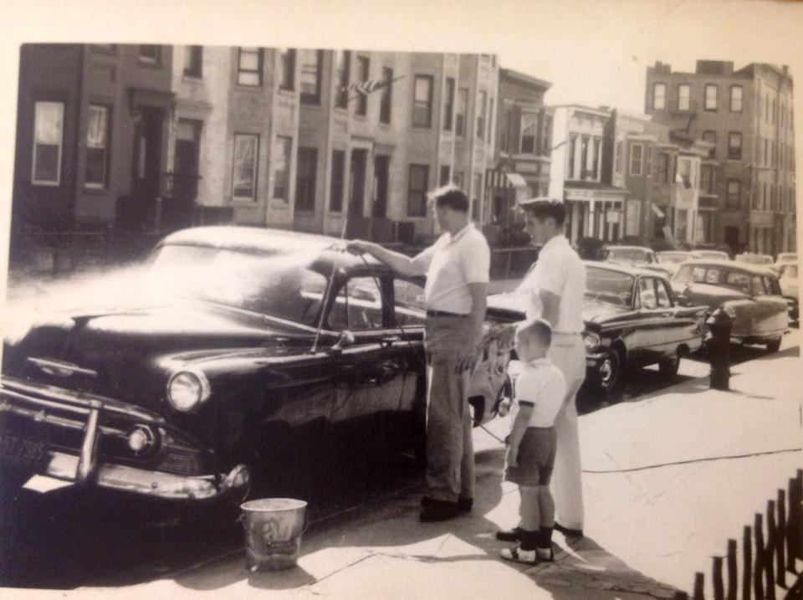
Notes:
the state of decency in American life?
Whether it’s divisive, finger-pointing politicians, the daily “shout” shows, vicious cyberattacks, hate crimes, or everyday social-media incivility, our public and community life is increasingly nasty and debased.
Let me introduce two of my hero’s, Ed Bontke was an “Archie Bunker” Conservative & His Brother-in-Law, Patrick Brennan, a Liberal Democrat (I’m the little guy, many sizes ago) the car, 1953 Chevy.
During the Johnson administration, I remember these two men arguing politics at the kitchen table with never a cross word between them only about the issues.
Why can’t we just do that?
Civil discord across the aisle is at the heart of a Democracy. It is upon this civility that our brave, imperiled democracy depends.

Slide 14
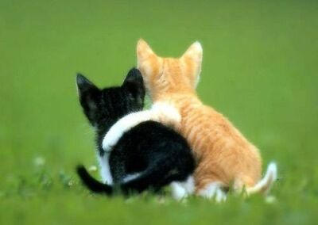
Civility & Respect in the Workplace
Civility is behavior that:
Shows respect toward another
Causes another to feel valued
Contributes to mutual respect, effective communication and team collaboration
Notes:
My only real definition today.
For our discussion on workplace civility. The second definition is most important. We need to make others feel valued. This creates relationship on which everything else stands.
Judge boss and my boss. We had a friendship outside of work. He hired me to work for this other person. This director and a long and strong working relationship with him.???????

Slide 15

How to define fairness

Slide 16

If you don’t take me seriously…
I will find someone to make you.
Notes:
http://maxpixel.freegreatpicture.com/Law-Rule-Lawyer-Books-Hammer-Court-Paragraphs-719068 CC0 Public Domain Free for commercial use

Slide 17

Gift-Getting Behavior
Thank You
I appreciate it
I know just what I’ll do with it.
Notes:
https://www.pexels.com/photo/black-gift-box-190930/ CC0 License
We established: ee’s choose when to let us know about a problem.
the sooner the employee lets us know, the better
the earlier we learn of a problem, the easier it will be to solve it.
So when an employee complains, they are giving us an opportunity. When you give someone something you don’t have to give them, what do we call it? A gift.
ASK: What are we supposed to say when someone gives us a gift, even one we don’t want to get? (Thank you, I appreciate it, I know just what to do with it.)
These are the core principles of receiving a complaint. Thank them, tell them you appreciate their trust in you and acknowledge that the organization has a process to address their concerns.
if we don’t use our gift-getting language, we risk them feeling we are rejecting the gift, and they will become hurt and angry.
In a study of over 1,000 people who complained to their employer about harassment or abusive conduct, they repeatedly described those things that created a perception of fairness or unfairness. These are things that made them want to stay or made them feel their employer was the enemy.

Slide 18

ALWAYS
Thank you.
I appreciate your trusting me enough to bring this to my attention.
We take these things seriously.
If what you describe is happening, it shouldn’t be.
We will take steps to get to the bottom of this right away.
Notes:
https://www.pexels.com/photo/adult-birthday-birthday-gift-box-360624/CC0 License
My staff took issue with some of this language, esp 4th bullet
(If what you describe is happening, it shouldn’t be.)
Could sound like doubt/skepticism
MAIN IDEA: DON’T overpromise… but do let them know you take this very seriously, you will treat their concern with proper concern
Understand these ideas, then make the language your own

Slide 19
NEVERS
Why are you just bringing this forward now?
I have a hard time believing…
What was your part in it?
Why do you think they did those things?
Have you told them to stop?
Notes:
https://www.pexels.com/photo/adult-birthday-birthday-gift-box-360624/ CC0 License
Point out they will be receiving a laminated card that lists these important responses because they are so important.
Important : when employee comes to you with a fresh complaint, it’s NOT the time to start asking the who, what, where and why questions. Right now, the goals are:

Slide 20
Goals of Complaint Handling
Let the employee know you will take them seriously.
Let the employee know that how they feel matters.
Let the employee know that, if what they describe is happening, it will stop.
Let the employee know you will take action.
Notes:
https://www.pexels.com/photo/black-gift-box-190930/ CC0 License
• To let the employee know you will take them seriously
• To let them know that how they feel matters
• To let them know that if what they describe is happening, it will stop
INTRODUCE ACTIVITY:
In groups of three: Count out as A, B and C.
Hand out “Always & Nevers” card

Slide 21
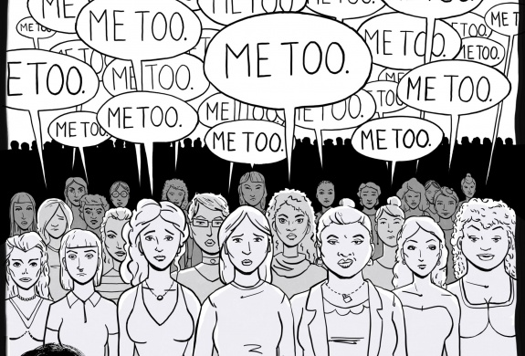
#MeToo
In October 2017, Harvey Weinstein, a very powerful producer in the movie industry for decades, was accused of sexual harassment by more than thirty women—
including famous
Gwyneth Paltrow,
Kate Beckinsale,
Ashley Judd,
Rose McGowan
Angelina Jolie
Notes:
From ADL.org
Weinstein is not the first famous person accused in recent years of sexual harassment. That list includes Bill Cosby, comedian, actor, and author; Roger Ailes, previous FOX News Chairman and others. They were accused by numerous women of sexual misconduct and have had resulting professional, financial and reputational setbacks. Further, the founder and CEO of Uber, was forced out amid allegations that he tolerated a company culture of sexual harassment.
A few days after the Weinstein allegations came to light, actress Alyssa Milano tweeted: "If you've been sexually harassed or assaulted, write 'me too' as a reply to this tweet.” The hashtag actually originated ten years ago by Tarana Burke, a survivor of sexual assault. After Milano tweeted the message, women in droves—some famous and many not—used #MeToo to share their experiences of sexual harassment and sexual assault that occurred over their lifetimes. These posts flooded Facebook, Instagram and Twitter; in less than 24 hours, there were over 12 million posts, comments and reactions in response to #MeToo.

Slide 22
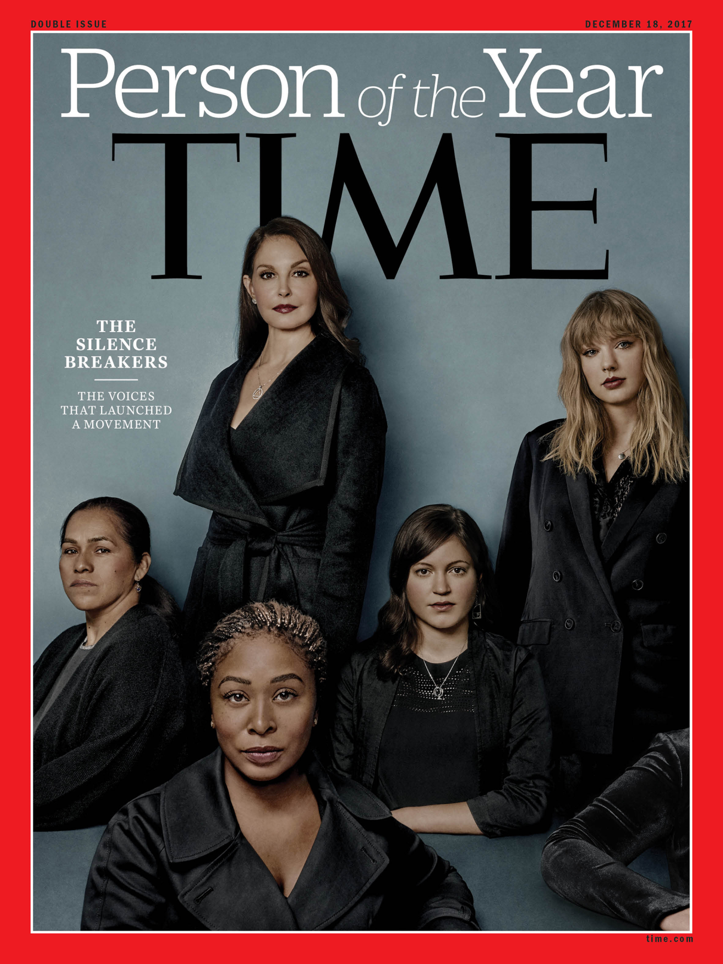
#MeToo
First it was a story.
Then a moment. Now, months after women began to come forward in droves to accuse powerful men of sexual harassment and assault, it is a movement.
Time magazine has named “the silence breakers” its person of the year for 2017, referring to those women, and the global conversation they have started.
Notes:
First it was a story. Then a moment. Now, two months after women began to come forward in droves to accuse powerful men of sexual harassment and assault, it is a movement.
Time magazine has named “the silence breakers” its person of the year for 2017, referring to those women, and the global conversation they have started.
The magazine’s editor in chief, Edward Felsenthal, said in an interview on the “Today” show on Wednesday that the #MeToo movement represented the “fastest-moving social change we’ve seen in decades, and it began with individual acts of courage by women and some men too.”
Movie stars are supposedly nothing like you and me. They're svelte, glamorous, self-­possessed. They wear dresses we can't afford and live in houses we can only dream of. Yet it turns out that—in the most painful and personal ways—movie stars are more like you and me than we ever knew.
In 1997, just before Ashley Judd's career took off, she was invited to a meeting with Harvey Weinstein, head of the starmaking studio Miramax, at a Beverly Hills hotel. Astounded and offended by Weinstein's attempt to coerce her into bed, Judd managed to escape. But instead of keeping quiet about the kind of encounter that could easily shame a woman into silence, she began spreading the word.
"I started talking about Harvey the minute that it happened," Judd says in an interview with TIME. "Literally, I exited that hotel room at the Peninsula Hotel in 1997 and came straight downstairs to the lobby, where my dad was waiting for me, because he happened to be in Los Angeles from Kentucky, visiting me on the set. And he could tell by my face—to use his words—that something devastating had happened to me. I told him. I told everyone."
She recalls one screenwriter friend telling her that Weinstein's behavior was an open secret passed around on the whisper network that had been furrowing through Hollywood for years. It allowed for people to warn others to some degree, but there was no route to stop the abuse. "Were we supposed to call some fantasy attorney general of moviedom?" Judd asks. "There wasn't a place for us to report these experiences."
Finally, in October—when Judd went on the record about Weinstein's behavior in the New York Times, the first star to do so—the world listened. (Weinstein said he "never laid a glove" on Judd and denies having had nonconsensual sex with other accusers.)
When movie stars don't know where to go, what hope is there for the rest of us? What hope is there for the janitor who's being harassed by a co-worker but remains silent out of fear she'll lose the job she needs to support her children? For the administrative assistant who repeatedly fends off a superior who won't take no for an answer? For the hotel housekeeper who never knows, as she goes about replacing towels and cleaning toilets, if a guest is going to corner her in a room she can't escape?
Like the "problem that has no name," the disquieting malaise of frustration and repression among postwar wives and homemakers identified by Betty Friedan more than 50 years ago, this moment is born of a very real and potent sense of unrest. Yet it doesn't have a leader, or a single, unifying tenet. The hashtag #MeToo (swiftly adapted into #BalanceTonPorc, #YoTambien, #Ana_kaman and many others), which to date has provided an umbrella of solidarity for millions of people to come forward with their stories, is part of the picture, but not all of it.
This reckoning appears to have sprung up overnight. But it has actually been simmering for years, decades, centuries. Women have had it with bosses and co-workers who not only cross boundaries but don't even seem to know that boundaries exist. They've had it with the fear of retaliation, of being blackballed, of being fired from a job they can't afford to lose. They've had it with the code of going along to get along. They've had it with men who use their power to take what they want from women. These silence breakers have started a revolution of refusal, gathering strength by the day, and in the past two months alone, their collective anger has spurred immediate and shocking results: nearly every day, CEOs have been fired, moguls toppled, icons disgraced. In some cases, criminal charges have been brought.
Emboldened by Judd, Rose McGowan and a host of other prominent accusers, women everywhere have begun to speak out about the inappropriate, abusive and in some cases illegal behavior they've faced. When multiple harassment claims bring down a charmer like former Today show host Matt Lauer, women who thought they had no recourse see a new, wide-open door. When a movie star says #MeToo, it becomes easier to believe the cook who's been quietly enduring for years.

Slide 23
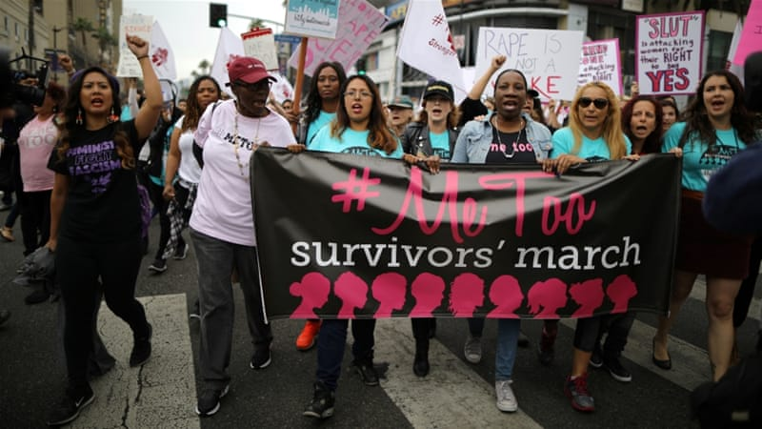
Women in low-wage US farm jobs say #MeToo
Notes:
the Alianza Nacional de Campesinas, an organisation representing about 700,000 current and former farmworker women, published an open letter in solidarity with women who have come forward across the US to share stories of sexual harassment and assault.
Several women accused Hollywood producer Harvey Weinstein of sexual assault, and many more have come forward with stories of sexual abuse at the hands of powerful men working in media, politics, sports and other areas. Women from around the world have used the hashtag #MeToo on social media to share their experiences and show solidarity with one another
While many of the women coming forward worked in the US entertainment industry, Alianza wrote that its members - despite not working "under bright stage lights or on the big screen" - understood "the hurt, confusion, isolation and betrayal that you might feel.
"Even though we work in very different environments, we share a common experience of being preyed upon by individuals who have the power to hire, fire, blacklist and otherwise threaten our economic, physical and emotional security," their letter reads.
Farmworker women are especially vulnerable to sexual harassment and abuse at work because of "a severe imbalance of power" between employers and supervisors and the workers, many of whom are immigrants, according to a 2012 Human Rights Watch report.

Slide 24

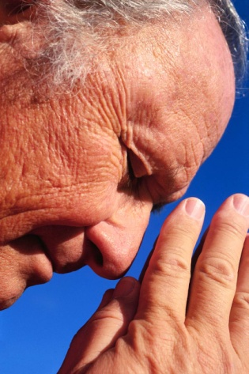



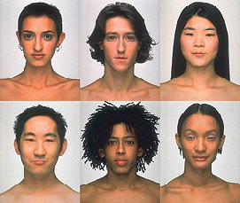


8 protected categories
religion
color
disability
race
genetic information
sex +
pregnancy
age (>40)
national origin
Notes:
failure to hire, termination, demotion, terms and conditions, failure to promote, failure to reasonably accommodate, hostile environment, retaliation, etc.
WHO IS PROTECTED?
employee
temporary worker
job applicant
former employee
some interns
undocumented workers too!
who can be liable?
employer
For most statutes, 15+ employees in 20 calendar weeks in the calendar year of discrimination or preceding year
20+ employees for ADEA
1+ for EPA
labor organization
temporary employment agency or staffing firm

Slide 25

EEOC 2017 Charge Receipts by Type
Notes:
Here is another way of looking at our work (compare National & TX trends)

Slide 26

Retaliation
EEOC statutes protect individuals who
  Oppose an unlawful employment practice
  File a complaint, testify, assist or participate in an investigation, proceeding or hearing concerning prohibited discrimination
  Request a reasonable accommodation (religion or disability)
Notes:
All four statutes enforced by the EEOC prohibit retaliation
Adverse Actions: “anything that would chill employer from complaining”
Harassment and intimidation
Denial of employment benefits
Discharge, discipline, demotion, reassignment, denial of promotion
Unjustified evaluations and reports
Acceleration of disciplinary action
Undeserved negative reference

Slide 27

Discrimination and
Harassment
Notes:
SAY: Finally, we reach behavior that is against the law. While most employers attempt to discourage uncivil behavior, and many outright prohibit abusive behavior, prohibiting harassment based on protected class is a matter of federal and state law.
If I described abusive behavior happening to me in the workplace, but it included racial slurs, or targeted me because of my religion, the conduct would move from unfortunate and damaging to unlawful. Let’s unpack that.
Most Americans are familiar with the concept of workplace discrimination. We know that you cannot refuse to hire someone because of their religion, pay someone less because of their race or because they are living with a disability, or hire someone but tell them that people of their gender or national origin don’t get promoted. Equality in hiring, pay and promotion has been the law since the Civil Rights Act of 1964.
The idea behind anti-discrimination laws is to ensure everyone has the same opportunity for economic advancement without regard to their identity.
Once discrimination law was in place, the EEOC began receiving charges of discrimination from workers across the country. These charges included allegations that workers were being harassed because of their race, color, sex, national origin and religion. For example, workers said that their co-workers or bosses made offensive comments to them; isolated or excluded them; or physically assaulted them because of the color of their skin, the country of their birth, the place they chose to worship or their gender. The workers argued that these experiences made it difficult for them to do their jobs, and even forced some of them to quit. Courts took note, and held along with the EEOC that this type of conduct is illegal.
When Congress wrote the discrimination laws, the legislators recognized that some workers might hesitate to come forward to report discrimination out of fear that they would be punished for doing so. Because of this, they included provisions in these laws that make it illegal to retaliate against workers for reporting discrimination, participating in a discrimination investigation or lawsuit, or opposing discrimination.

Slide 28
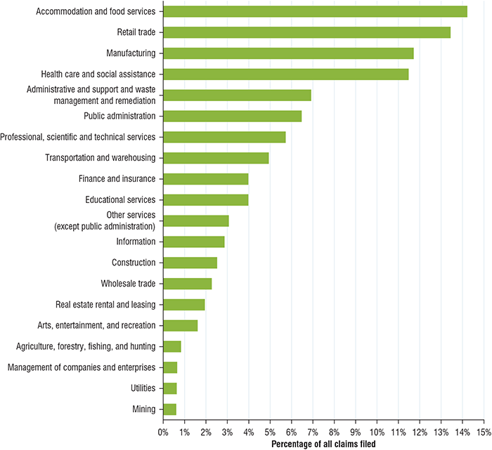

Slide 29
Generational Groups
The Builders (prior 1945) 73 years old+
Baby Boomers (1946-1963) 72 - 55
Generation X (1964-1980) 54 - 38
Millennials (1981-2000) 37 - 18
Linksters (2000- today) 17- 0

Slide 30
“universal” Dynamics ?
Define these terms
  Appropriate
  Casual
  Team player
  Effective communication
Notes:
30

Slide 31
NUMBER ONE RULE:
All investigations are about the same thing:
Getting to the truth
There are two things that separate each investigation:
  What you are investigating
  The conclusion

Slide 32
What is Truth?

Slide 33


Slide 34
Finished files are the re-
sult of years of scientif-
ic study combined with the
experince of many years
of experts.

Slide 36
Finished files are the re-
sult of years of scientif-
ic study combined with the
experince of many years
of experts.

Slide 37



Is your perception ….
Sometimes your truth?
Sometimes we have to take another look at
what we think we know

Slide 38
What Triggers An Investigation?
Someone makes a formal or informal complaint
  Offended person
  Third party (an observer)
  Verbal report
  Written report
Formal charge from EEOC or a state agency counterpart
Inappropriate behavior (employer has “notice” of – next slide)

Slide 39
What is Notice to the Employer?
Complaint of harassment to supervisor, human resources, etc.
Conduct committed in the presence of a supervisor or other employer representative constitutes notice
If the conduct is pervasive in the workforce, it can be argued that the employer has “constructive knowledge”
Employer cannot be liable for conduct of which he or she had no notice
  Affirmative defense
  Objectionable objects in plain view?
  No knowledge in private work areas or no routine supervisor access

Slide 40
A Complaint is Made
– Now What?
First impressions are lasting impressions
Be neutral
  Listen without making any judgments
  Place yourself in the complainant’s situation
Obtain as much detailed information as possible from the complainants)
5 W’s (who, what, when, where, why) & How
Separate complainants for interviews
ID issues to be resolved, witnesses and documents
Notes:
Discuss (per the slide) how to interview a complainant.
Invite audience participation into how Nancy could have done better in bringing the complainant out. Note its better to get the bad news early.

Slide 41
More ….
Take notes! Don’t rely on your memory
Ask about immediate needs
Address confidentiality
Discuss retaliation (not a one time discussion)
Don’t make promises you can’t keep
Advise the complainant of the next steps you plan to take
Time line to complete investigation & to report back to the complainant.
Notes:
Discuss (per the slide) how to interview a complainant.
Invite audience participation into how Nancy could have done better in bringing the complainant out. Note its better to get the bad news early.

Slide 42
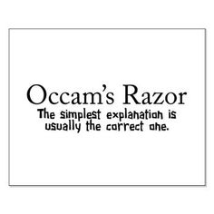
OCCAM’S RAZOR
states that the explanation of any phenomenon should make as few assumptions as possible
Notes:
Occam’s razor is a principle attributed to the 14th-century English logician and Franciscan friar William of Ockham. Originally, a tenet of the reductionism philosophy of nomination, it is more often taken today as a heuristic maxim that advises economy, parsimony or simplicity in scientific theories

Slide 43
HOW DOES OCCAM’S RAZOR APPLY TO INVESTIGATIONS?
The simplest answer is usually the correct answer (Or, as Einstein put it “As simple as possible, but no simpler.)
Occam’s Razor = KIS principle (Keep It Simple)
In other words: If you hear something roaring, It’s probably a lion not a rabbit.

Slide 44
PROCESS THAT PROVIDES A PROMPT, THOROUGH AND IMPARTIAL INVESTIGATION:
WHAT IS PROMPT?
  Van Zant v. KLM Royal Dutch Airlines, 80 F.3d 708, 715 (2d Cir. 1996)
    Employer’s response prompt where it began investigation on the day that complaint was made, conducted interviews within two days, and fired the harasser within in ten days
  Steiner v. Showboat Operating Co., 25 F.3d 1459, 1464 (9th Cir. 1994)
    Employer’s response to complaints inadequate despite eventual discharge of harasser where it did not seriously investigate or strongly reprimand supervisor until after plaintiff filed charge with state FEP agency. cert. denied, 513 U.S. 1082 (1995)

Slide 45

A PROMPT, THOROUGH AND IMPARTIAL INVESTIGATION:
As soon as management learns about alleged discrimination, it should determine whether a detailed fact-finding investigation is necessary.
Notes:
The individual conducting the investigation must be able to objectively gather and consider the relevant facts.
The accused should not have supervisory authority over the individual conducting the investigation and should not have any direct or indirect control over the investigation.

Slide 46

Components of an Investigation
Records
Interviews
Other
  Background
  Credibility assessment
Conclusion

Slide 47
Preparing for the Interview
Setting the stage
  Staging the interview room
  Investigative partner or a recording device
Preparing to questions
  Write questions out…never “wing it!”
  Let them talk…they aren’t interviewing you
Dress for success
  Know your audience
  A tie is appropriate for the CEO…
  …but maybe not for your peers
Notes:
Be aware of the way the room is set up. It is important that the room invite conversation and not hostility. You are not an interrogator you are an interviewer.

Slide 48
Choosing Between Informal
& Formal Processes
Consider the nature and severity of the conduct at issue
Every complaint does not require a full-fledged formal investigation
May use informal processes where appropriate, possible

Slide 49
Informal Processes
Less stressful for everyone
Quicker, more flexible, involves fewer people
Best option for “win-win” for all
  Mutually satisfactory outcome for both
Appropriate for low level concerns
Wide range of strategies
  Reasonable expectation that the action taken will resolve the problem
Voluntary

Slide 50
Factors Pointing to a Formal Process
Previous complaints against the same person
Multiple aggrieved individuals
Offender has received previous warnings or disciplinary actions
Alleged conduct is particularly serious
Evidence of or serious concern about retaliation
May be the only way to protect a person unfairly accused
May be the only way to put an end to a complaint for a person who is unable to “let go and move on”

Slide 51
Timely Response
Prompt action is essential
No clear definition of how to define “prompt action”
If possible, upon receipt of the complaint or at least within 24 hours
  May not be realistic
Concluded as soon as possible
  Without compromising thoroughness

Slide 52

Confidentiality
Avoid promises of absolute confidentiality
  Confidentiality does not equal anonymity
  Will be maintained to the extent possible
Only those who need to know
  Relevant supervisory personnel
  Respondent
  Witnesses
    Name of complainant
    Information provided becomes part of investigation report
    Report may be subject to disclosure under certain proceedings

Slide 53

Selection Options for the Investigator(s)
Options:
  Single person
  Team of two
  Committee of three
  Attorney?
Internal – e.g., Human Resources Dept.
External - Retaining an attorney as an investigator:
  Report is not protected under attorney-client or attorney work product privilege
  Attorney may have ethical issues that will bar her from representing the employer in the administrative process and/or lawsuit

Slide 54
QUESTIONS TO ASK COMPLAINANT
Who, what, where, when and how. Who committed the alleged harassment? What exactly occurred or was said? When did it occur and is it still ongoing? Where did it occur? How often did it occur? How did it affect you?
  Make sure you obtain specifics at the beginning of your investigation and clarify these specifics with the complainant before launching your investigation.

Slide 55
QUESTIONS TO ASK COMPLAINANT
How did you react? What response did you make when the incidents occurred or afterwards?
How did the harassment affect you? Has your job been affected in any way?
Where there any witnesses? Other victims?
Was any Supervisory official aware of the conduct?

Slide 56
QUESTIONS TO ASK COMPLAINANT
Are there any persons who have relevant information? Was anyone present when the alleged harassment occurred? Did you tell anyone about it? Did anyone see you immediately after episodes of alleged harassment?
Was there similar conduct by others?
Is there documentation of the incident?
How would you like to see this matter resolved?

Slide 57
QUESTIONS TO ASK THIRD PARTIES
What did you see or hear? When did this occur?
What did the complainant tell you? When did they tell you this?
Why do you believe you were named as a witness?
Are you aware of the same or similar conduct occurring previously?

Slide 58
QUESTIONS TO ASK THIRD PARTIES
Do you know of any other relevant information?
Are there other persons who have relevant information?
Were other witnesses present? If the witness is hesitant to offer additional witnesses, promise confidentiality.
Do you believe the allegation is plausible?

Slide 59
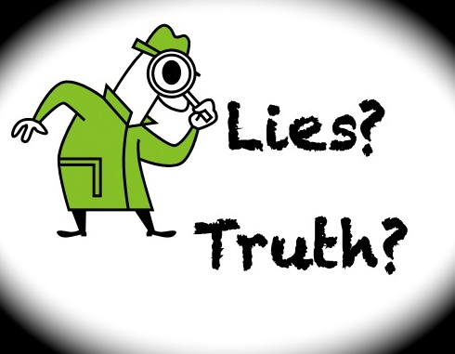
CREDIBILITY DETERMINATIONS
Inherent plausibility: Is the testimony believable on its face? Does it make sense?
Motive to falsify: Did the person have a reason to lie?

Slide 60
CREDIBILITY DETERMINATIONS
Corroboration: Is there witness testimony such as eye- witnesses: people who saw the person soon after the alleged incident(s)? Did people discuss the incident(s)? Is there physical evidence (such as written documentation) that corroborates either party’s testimony?
Did Internet evidence corroborate witness testimony?
What about audio or video surveillance within the workplace?
Emails? Voice mails? Text messages?
Notes:
You can make decisions based on information learned from internet sources. For example, let’s say that a co-worker was accused of being anti-Catholic? And, three employees testified that they believed this accusation to be true. But, on their myspace page they had a link to Catholic Charities and a plea to people to donate to the Mother Theresa Food Bank? Then you went to the Catholic Church web site and saw pictures of this person with their brother who just entered the priesthood. You also notice on their job application that they list their college as Notre Dame. All this can be used to make a credibility determination.

Slide 61
CREDIBILITY DETERMINATIONS
Past record:
  Did the accused have a history of similar behavior in the past?
  Does the complainant have a history of making false accusations?
  Other than the obvious, does anyone have a vested interest in the outcome of the case?
  Did you find anything on the Internet that supported the accused or alleged victim?

Slide 62
GATHERING DOCUMENTS
Documents with comparative information can be one of the most valuable sources of information during an internal investigation.
  Hiring documents
  Performance evaluations
  Reprimands
  Discharge documents
  Promotions
  Voice mail
  Emails
  Text messages
  Internet postings (blogs)

Slide 63
ONE MORE THING:
It’s Your Job to be Neutral.
REPEAT
It’s Your Job to be Neutral!

Slide 64
The Investigator
Investigators should be:
Credible & Objective – and be regarded as such
Trustworthy with confidential & sensitive information
Flexible as new allegations may be identified during the investigation/inquiry
Language appropriate - fully bi-lingual, bi-cultural, or have a certified translator
Culturally sensitive - Patience and persistence
Gender sensitive - assault, rape cases

Slide 65
The Investigator (cont.)
Investigators should be competent:
Trained and experienced
Understand applicable laws & knowledgeable about agency policies.
Neutral and objective
Good interviewing, writing & communication skills with a variety of individuals
Well-organized
Capacity to act as a good witness in the case of a subsequent proceeding
Not intimated nor does s/he intimidate

Slide 66
Investigator’s Responsibilities
Analyze the allegations
Develop an investigative plan
Interview all parties (in person)
  Written signed statements
Keep the complainant and respondent informed of the progress of the investigation
Review all relevant documentation
Analyze the information gathered
Prepare a written report

Slide 67
Identify Who to Interview
The complainant
The alleged offender
Anyone who directly observed an incident
Any other witnesses identified by the complainant or accused
Anyone who created any relevant documents
The complainant’s supervisor
The accused’s supervisor

Slide 68

Location of the Interviews
Impact on confidentiality
Impact on the comfort levels
of the interviewees
No fishbowl conference rooms
Preferably away from the worksite
  Conference room of nearby hotel
  Office of the external investigator

Slide 69
Interview Tips
For each interviewee, remember the 5 W’s —who, what, when, where, why & how
At onset of interview:
  express your appreciation for the employee’s time and cooperation
  briefly explain the matter you are investigating
  address the reason for the interviewee’s participation in the process

Slide 70
Interview Tips (con’t)
emphasize the agency’s commitment to a complete evaluation of the complaint
emphasize confidentiality or need-to-know basis, but do not promise interviewee that s/he will never be revealed
emphasize the anti-retaliation policy
don’t give the impression there is any time limit on the interview—especially when interviewing the complainant and accused

Slide 71
Interviewing Tips (cont.)
Start interviews soon after situation arises.
Maintain objectivity.
Take good notes or record, if appropriate, but be up front about it.
Never promise absolute confidentiality.
Start out with general questions and work up to more detailed questions.
Listen and follow up on new information.
Avoid confrontational or accusatory questions.
Watch body language.
Use silence to your advantage.
Notes:
If you wait too long to begin interviews, memories may change, people may be influenced by others, etc..
Maintain your objectivity and do not prejudge or make assumptions. Never indicate that you believe or do not believe someone. Gather facts and remain neutral.
Take good notes. Make sure what was said is what you wrote. If you are recording the interview advise the person up front about it – even though the law in some states do not require it. Shows you are up front about the investigation and do not intend to skew the interview.
You cannot guarantee absolute confidentiality. You might have to provide documents, etc. to EEOC if a charge is filed. Also, sometimes it is necessary to provide certain data to investigate it. However, you can assure an individual that the company will ensure confidentiality to the best extent possible.
Starting out with general questions relaxes people - work up to more detailed questions to pin witnesses down on the details. Repeat important questions, but with different wording, to see whether the witness changes their answer or story.
Be prepared to come up with on the spot follow up questions as new information is presented.
Do not engage in a confrontational or accusatory exchange – you are to be neutral and remain objective
You may have to make credibility assessments on individual’s you interview. Watch their b body language – see what it tells you. Are they fidgeting and will not look in your eyes when they answer a question, etc..
Silence is a very powerful tool. People feel the need to fill in periods of silence and if you wait in silence after a question or after they say something – it encourages them to say more.

Slide 72

GENERAL TOPIC – BROAD QUESTIONS
WORK ENVIRONMENT CULTURE
SPECIFIC QUESTIONS
DOCUMENTS

Slide 73
Interviewing Involved Parties
Complainant or alleged victim:
  Who? What? When? Where? Get details.
  How did conduct affect you?
  How did you react? What was your response?
  How frequent was the conduct?
  Were there witnesses?
  Anyone else subjected to this?
  Any documentation?
  Any other relevant information?
Notes:
Things you want to get from the Complainant or alleged victim
Details – who did it? What was the nature of the conduct? When did it happen? Where did it occur? Get details, details, details. Now is not the time to be uneasy about asking certain things or hearing certain unpleasant things. It is part of the job. Get over it. Pin down times, places, events as precisely as possible. For example, an individual has complained of racial harassment including racial slurs, jokes, etc.. Get specifics, what slurs were used, what were the jokes…
How did conduct affect you? – you want to know how the person felt about the action, incident – may clue you in to potential damages claims, etc.
How did you react? What was your response? Important information to establish their reaction to the actions or incidents. Why is this important? What if they complain of the use of racial slurs by someone and their response was to laugh and use a racial slur when talking back to the person? This might put a different perspective on it as opposed to if in the same situation – they expressed their uneasiness with the comments and asked the person to stop. This sheds a different light.
Frequency? Why is frequency important? Frequency vs. severity in workplace harassment complaints. Helps you establish if it is on going behavior or wide spread, etc..
Witnesses? Did the person tell anyone about it? Did anyone see the person after the episodes of alleged harassment or actions? Did anyone see or hear it directly?
Others? Maybe the person knows of current or former employees who had the same issues - these give you additional witnesses to determine patterns of behavior, etc.
Documentation? Helps you identify any documentation which might be useful in the investigation.

Slide 74
Interviewing Involved Parties
Accused or alleged offender:
  Response to the allegations?
  If they deny, ask why the complainant would say these things?
  Any other persons with relevant information or who witnessed events?
  Any documentation?
  Anyone else ever make these allegations?
  Any other relevant information?
Notes:
Response to the allegations? Get their responses, in detail. Get their response down precisely.
If they deny – ask why they think the person made these allegations? This can help you with motive and credibility assessments.
Other persons/witnesses –
Documentation:
Anyone else make these allegations? Why would you ask this? --- identify a pattern?

Slide 75

“I Don’t Remember”
“Let me tell you what we have learned so far”
“Is there anything else that you would like to add?”
“Who else do you believe we should speak to?”
“Here is my number. Call me if you think of anything else after our meeting”
“Do you have any questions for us?

Slide 76
Dangerous Words
When discussing possible harassment & discrimination,
be careful that these words don’t come out of your
mouth:
  That’s how they do things where he comes from.
  It’s just a joke. Lighten up.
  We’ve never had a complaint, so we don’t have a problem.
  That kind of behavior is part of growing up.
  It’s a matter of hormones. We can’t control that.
  If we had to discipline every employee who uses bad language, we’d never get anything else done.
  It’s just a prank that got out of hand.

Slide 77
More Dangerous Words
  Oh well, boys will be boys.
  It’s just teasing – no big deal.
  I know he/she didn’t mean anything like that.
  It’s your fault for dressing so sexy.
  You need to learn to handle these things.
  Just ignore it.
  He puts his arms around everyone.
  Why can’t you learn to accept a complaint?
  You must have wanted it, otherwise you would have told him no.

Slide 78
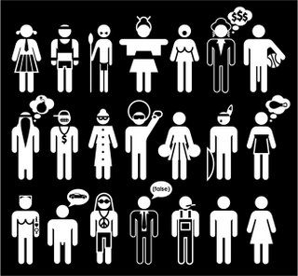
Stereotypes
An oversimplified image or statement applied to a whole group of people, without regard for the individual.

Slide 79
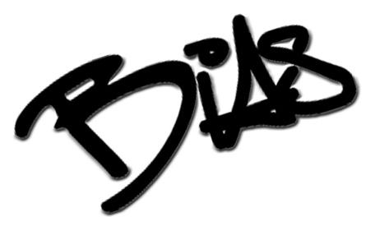
Bias
Bias is a predisposition to see events, people or items in a positive or negative way.
Bias is an attitude or belief.

Slide 80
Fill in the blank
A woman's place is in the ___________.

Slide 81
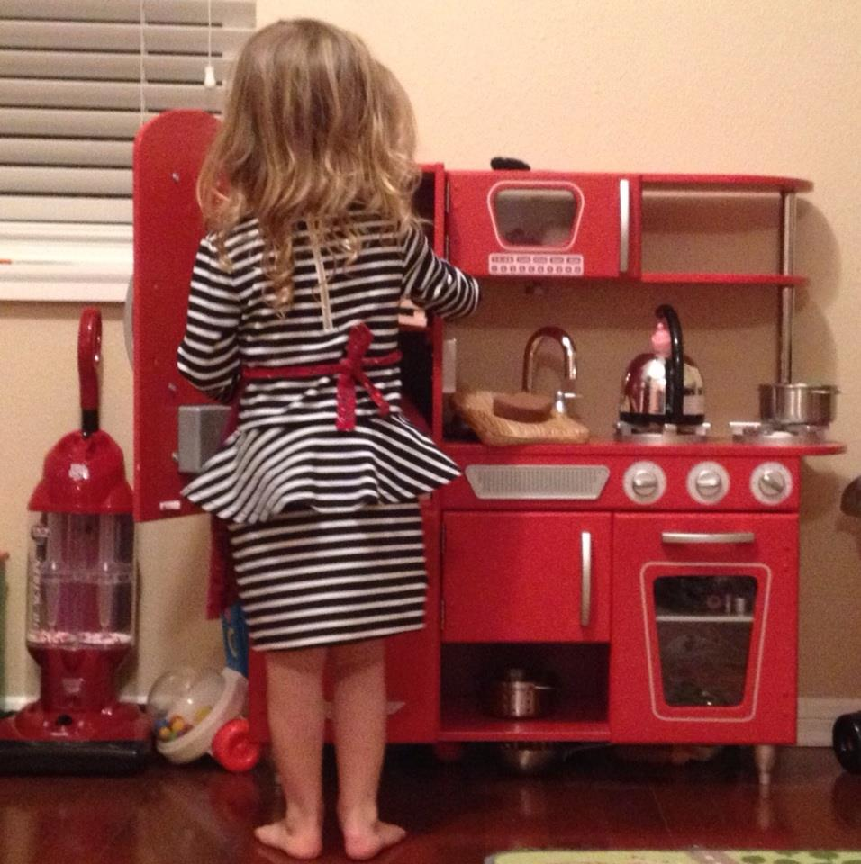
  Enforcing Equal Pay Laws
  The next
Equal Pay Day
is April 6, 2019.
This date symbolizes
how far into 2019
women must work
to earn what men earned
in 2018
Notes:
Finish this statement for me A womans place is In the -----------
This is my grand daughter and if I have anything to do with it this is the last kitchen she’ll ever work in
The EEOC will target compensation systems and practices that discriminate based on gender. Among the many strategies to address these issues, the Commission particularly encourages the use of directed investigations and Commissioner Charges to facilitate enforcement.

Slide 82
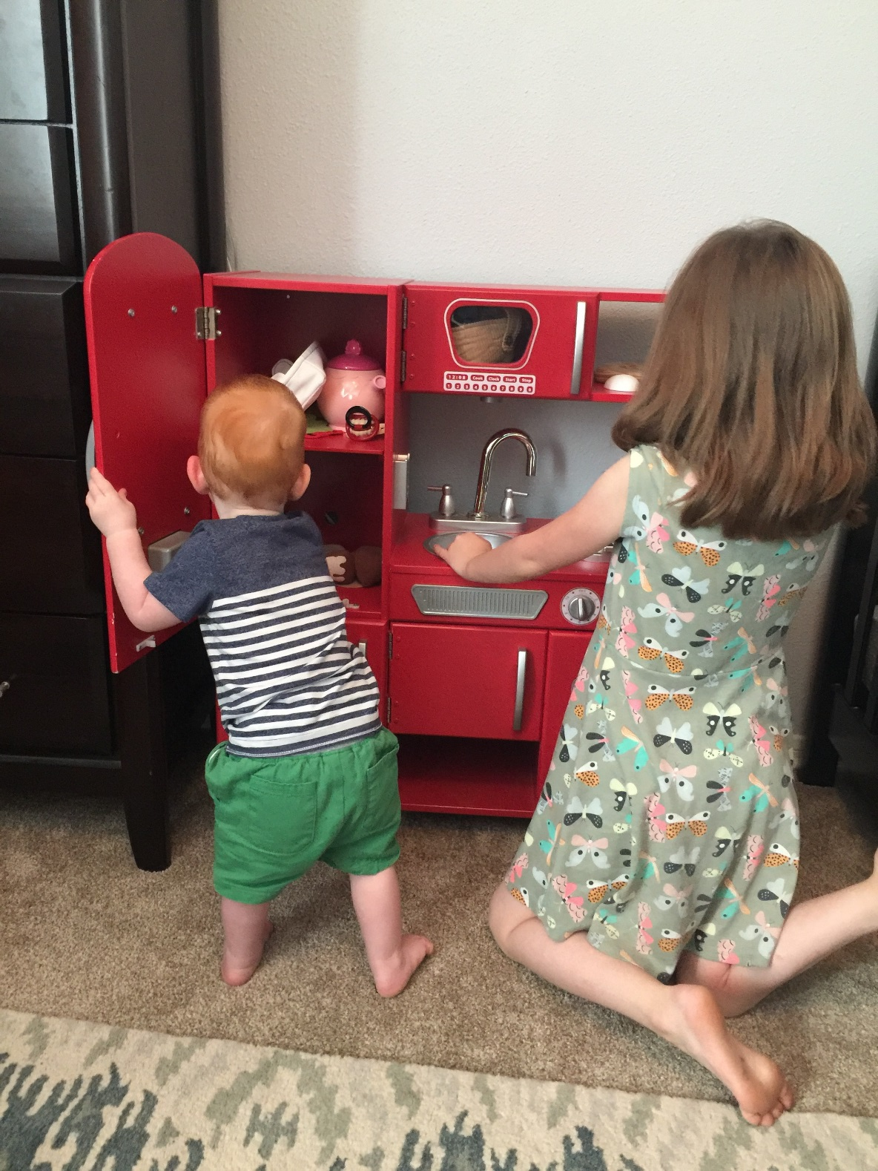
Don’t we need to leave the world better then we found it?

Slide 83
Witnesses
  Failure to interview potential witnesses identified by the complainant may be viewed as a flawed investigation
  Lack of witnesses is common, especially in more egregious harassment cases
    Does not undermine complainant’s allegation
  Take statement or make report
  Again, ensure confidentiality
  & non-retaliation

Slide 84
Interviewing Third Parties
  Ensure confidentiality and non-retaliation
  What did you see or hear?
  What did the complainant or accused tell you?
  Are there other persons who may have seen or heard something or that have relevant information?
  Any other relevant information?
Notes:
Third parties are your “witnesses”. These are people who will help you assess credibility of the allegations and they are not only eyewitnesses, but can also be people who saw the complainant shortly after the events or incidents, and people who may have spoken with the involved parties about the incidents/events. They can attest to reactions, manners of behavior, how someone looked or acted right after an incident, etc…
What did you see or hear? – details, details, details, when, where, etc.
What were they told? Maybe the person did not witness anything but they were told about the incidents or events after they happened. Get details…what told, when, by whom, what was said…
Other persons…
Relevant info

Slide 85
“Similarly Situated” Individuals
      Similar qualifications
      Hourly versus salaried
      Bargaining unit versus non-bargaining unit
      Non-supervisory versus supervisory
      Same department/similar functions
      Probationary versus non-probationary
      Same stage of disciplinary process
      Employer had notice of both complainant’s and comparator’s violations
      Same time period/policies

Slide 86
Credibility Assessment
Should not be based on friendships – remove yourself from the investigative process if necessary.
Should be based on facts and demeanor, not instinct alone.
For each interviewee assess the following factors:
  Body language
  Reactions to allegations or questions—argumentative? defensive? hostile?
  Logic & consistency of the interviewee’s story

Slide 87

Documents & Evidence
Personnel Files
Files kept by managers
Medical files? (only if relevant to the investigation)
Expense files
Documents held by the claimant and/or witnesses

Slide 88

Electronic-type Evidence
Computer disks
External hard drives
E-mails – Retention Policies
Voicemails
Cameras, Phones and PDA’s
Internet searches

Slide 89
Reaching a Determination
Conducted the interviews.
Reviewed the documents – policies & procedures, personnel files, emails, etc.
Gathered any additional information.
  Prepare report that contains description of issues at hand, list witnesses and documents used as evidence, summarize information, make credibility assessments and present a finding of fact.
  Recommend action, if appropriate
Notes:
You have completed your investigation and now must organize everything. Prepare your report and include the description of the issues at hand, who is involved, etc. List the witnesses you talked with and the documents you looked at. Summarize that information. Make your credibility assessments. Explain why you determined someone more credible than another person. Present your finding – your ultimate conclusion.
You may or may not be tasked with recommending an action. If not, then just present the facts. If you are, make your recommendation on the action that is to be taken.

Slide 90
Reaching a Determination
Cases are usually not clear cut
However, it is critical that a conclusion is reached based on the investigation/inquiry
The conclusion should be supported by the documents, interviews and the investigator’s impression

Slide 91

Post Determination
In All Cases . . .
Reiterate anti-harassment, anti-discrimination policy
Reiterate anti-retaliation policy
Offer refresher training to supervisors and/or employees

Slide 92

Become groups of two
One becomes person A
The other person B

Slide 93
As a manager, how would you react to the following scenario?
Duane, an employee in another department, confides in you that his female supervisor Kathleen keeps referring to him as “hot.” She tells off-color jokes, and presses him for details on what he does after work.
Duane admits feeling uncomfortable around Kathleen, but insists that neither you nor any other manager mention it to Kathleen because the situation is embarrassing.
He tells you he’s “just venting” and says he’s confident he can work this out on his own.

Slide 94
Would you:
a. Coach Duane on how to handle the situation?
b. Have an off-the-record-conversation with Kathleen, telling her to stop the jokes and inappropriate comments around Duane?
c. Notify your HR Manager immediately?
Notes:
The correct answer is c.
Employment law states that employees have a right to work in a harassment-free environment, and that employers are largely responsible for maintaining a harassment-free and discrimination-free workplace. There are more than a dozen classes of employees protected under Federal and/or state law, including race, sex, age, religion, disability and sexual orientation.
In the scenario above, Duane may be “just venting” but consider his complaint in light of a recent New York State jury verdict. In February 2009, a jury in Queens awarded a nurse at Flushing Hospital $15 million for a sexual harassment allegation against a doctor. The jury found that the hospital was aware of the doctor’s inappropriate behavior toward female employees, but overlooked it despite complaints. The verdict attributed fault for the sexual harassment evenly between the hospital and the doctor.
Verdicts of this nature are becoming increasingly common. In 2009, the Equal Employment Opportunity Commission (EEOC) recovered $376 million for employees who filed harassment complaints. The EEOC attributed this “near-historic” sum to multiple factors, including greater accessibility of the EEOC to the public, economic conditions, increased diversity in the workforce, increased awareness of workplace rights, and changes to the agency’s intake practices that cut down on the steps needed for an individual to file a charge.

Slide 95
So what is an employer’s first line of defense against a harassment or discrimination lawsuit?
Employers can begin by protecting employees with a zero tolerance rule that is backed up with formal policies and complaint procedures.
Employers also must be willing to conduct prompt, impartial and well-documented investigations when necessary and be prepared to take appropriate, corrective action when required.
Notes:
Tip: Promptly report complaints to HR — Supervisors should immediately contact HR, or those individuals charged with enforcing the company’s anti-harassment policy, to report harassment complaints.
HR should instruct supervisors to report complaints even if made anonymously, if the supervisor does not think the complained of conduct amounts to harassment, or if the supervisor believes the complainant will report it to HR on his/her own. Further, complaints of harassment should be reported even if the complainant asks that it not be reported.

Slide 96
Conducting an Investigation
There are many misconceptions about internal investigations.
Here are five common missteps employers often make when responding to employee complaints:
Notes:
Tip : Identify the best person to conduct the investigation — When determining who will be responsible for conducting the investigation, employers should aim to identify someone who can remain impartial, objective, and fair throughout the investigation. Companies should also consider whether the investigation is best suited to be conducted by internal resources, or if they should engage a third party to investigate.
Factors to weigh include the severity of the complaint, the identity of the accused, the adequacy of internal resources, and the risk of legal liability. In some cases, the company can protect documentation related to the investigation as attorney “work product” if inside or outside counsel is involved in the investigation.

Slide 97
Error #1: A complaint must be in writing to trigger an investigation
FACT: when an employee complains about alleged harassment or discrimination, an investigation must be conducted regardless of whether the company’s procedure for lodging complaints was followed.
An employee is not required to put a complaint in writing, and need not even use the words “discrimination” or “harassment” in order to trigger an investigation.
Notes:
Tip: Promptly initiate and conclude the investigation — The investigator should immediately initiate the investigation and share the timeline for the investigation with the complainant and the accused. If there are unavoidable delays, the reason for the delay should be documented and, where appropriate, should be communicated to the complainant and the accused.

Slide 98
Error #2: Employee has a “right” to decline an investigation.
The obligation to investigate arises when an employee complains about facts or circumstances that would cause a reasonable person to conclude that the complaint was based on discriminatory conduct.
It is sufficient that the employee complains to any supervisor or member of management.
Once a supervisor or member of management is aware of the allegations, the company must conduct an investigation of some kind – even if the employee asks the supervisor or manager to do nothing about the complaint.
Notes:
Tip: Take immediate and necessary remedial measures — At the start of the investigation, the investigator should consider whether any temporary measures need to be taken. For example, if appropriate, the complainant may be reassigned or the accused may be placed on leave. When taking such measures, however, employers should avoid taking any actions that may appear to be retaliatory.

Slide 99
Error #3: No need to make this “official,” time will tell if a complaint is legitimate.
It is important to move quickly if you hear or suspect someone has been harassed or is working in a hostile work environment.
If an investigation is necessary, it should be handled by an HR professional or a manager trained in conducting internal investigations.
It’s also a good idea to have a second, impartial manager serve as a witness during interviews.
Both the interviewer and witness should take detailed notes of each conversation.
Notes:
Tip No. 8: Take prompt, remedial action — After all interviews have been conducted (and any credibility issues have been resolved), the employer should promptly determine whether any discrimination, harassment, and/or retaliation has occurred. If the complained of conduct occurred, the employer should take reasonable and appropriate disciplinary action against the accused, including termination if warranted. It is important that any action taken against the accused be done only after a thorough investigation is completed.

Slide 100
Error #4: A few informal “off-the-record” conversations with co-workers might be more effective than an investigation.
Undocumented conversations will provide little support if legal action is taken.
The purpose of an investigation is to gather facts and identify issues.
Prior to beginning the investigation, scripted questions should be prepared to guide conversations and to ensure all relevant issues are addressed.
During the initial interview, the complainant should be asked if he/she feels confident that an impartial resolution can be reached, and what his or her expectations are for the outcome of the situation.
Notes:
Tip : Document the investigation — The investigator should document the entire investigation process – not only the who, what, where, when, and how of the investigation, but also any remedial or corrective actions that were taken and the reasons for such actions. The best practice is for the investigator to presume the documentation will be reviewed during an EEOC or other agency investigation or trial.

Slide 101
Error #5: Only workers who witnessed the event are relevant to an internal investigation.
the interviewer should conduct interviews with both direct witnesses and background witnesses.
Background witnesses might be supervisors or other co-workers who did not witness the event but might have information that could help explain what occurred.
Notes:
Tip: Interview all potential witnesses — Investigators should interview every witness connected with the alleged misconduct, typically beginning with the complainant, even if the complainant provided a written statement.
The investigator should ask each witness to identify any other individuals who may have witnessed the alleged incident and if there is anyone else with whom the investigator should speak. All identified witnesses should be interviewed, including former employees when possible.

Slide 102
Next Steps
A final report that presents the factual findings of the internal investigation and includes any conflicting or inconsistent information should be reviewed by the an employment attorney, HR manager and other appropriate senior managers.
This group then determines the next steps which may include corrective action.
Notes:
Tip: Keep the concerned parties informed — After a determination has been made, the employer should meet separately with the complainant and the accused to explain the investigation process, the results, and any disciplinary action that may be taken. If the results of the investigation are inconclusive, this should be also be communicated.
The complainant should also be encouraged to report any further instances of harassment or retaliation. Likewise, the investigator should remind the accused of the company’s EEO and anti-harassment policies and that he/she must not retaliate against the complainant or anyone who cooperated in the investigation.

Slide 103
Safeguarding against retaliation
Once a decision has been reached, the investigator or appropriate manager should meet with the accused to explain the results of the investigation.
The manager should affirm that retaliation is prohibited, and clearly state options if the outcome of the investigation is disputed.
Notes:
Tip No. 7: Take steps to avoid retaliation — Do not retaliate against the complainant, and take steps to avoid any appearances of retaliation. Investigators should inform all individuals involved in the investigation that the company will not tolerate any form of unlawful harassment or retaliation against the complainant or anyone participating in the investigation and document that the warning was given.

Slide 104
Safeguarding against litigation
An employee handbook clearly outlining the organization’s policies against discrimination, harassment and workplace violence is one of the most important steps responsible employers can take to protect employees and reduce the risk of legal action stemming from harassment or discrimination.
Notes:
Tip: Be consistent — All complaints, even those that may seem trivial, should be thoroughly investigated. Employers should treat all employees accused of similar wrongful conduct in the same fashion, regardless of the status of the parties involved.

Slide 105
Training supervisors on harassment prevention is another important step as they serve as your company’s first line of defense.
It also is advisable that every employee receive annual training on civility in the workplace.
The training should review your policies regarding complaint procedures and clarify the consequences of violating these policies.
Employees also should be assured that they will not face retaliation for filing a complaint, regardless of the outcome.

Slide 106
Resources
EEOC Select Task Force on the Study of Harassment in the Workplace https://www.eeoc.gov/eeoc/task_force/harassment/index.cfm
Checklists and Chart of Risk Factors for Employers
https://www.eeoc.gov/eeoc/task_force/harassment/checklists.cfm
Workplaces Respond to Domestic and Sexual Violence
https://www.workplacesrespond.org/page/harassment-employers/
National Women’s Law Center Sexual Harassment in the Workplace
https://nwlc.org/resources/thats-harassment/

Slide 107
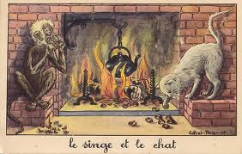
Cat’s Paw Theory
Notes:
A 17th century French fable called “The Monkey and the Cat” played a role in an HR-related case ruled on by the U.S. Supreme Court afew years ago. And you should know about the ruling to keep your company out of court.
Here’s the modern day scenario: Someone at your staffing company, a non-decision maker when it comes to hiring and firing, bears ill will or bias towards an employee or a temp. The discriminator schemes to influence the decision maker resulting in a write-up or a firing. This occurs even though the decision makers themselves were merely acting on (false) information. Can the decision maker be held liable for that?
The Supreme Court says yes. Here’s how it relates to the French fable.
In the fable, a clever monkey convinces a naïve cat to retrieve some chestnuts from a fire where they are roasting. For her part, the cat burns her paw while the monkey then grabs and eats the chestnuts. From this story, the term “cat’s paw” has come to mean a “tool” or “one used by another to accomplish his purposes."
In employment discrimination cases, a “cat’s paw” scenario is presented where a biased staffer of an employer, who lacks decision making power, uses the formal decision maker as a dupe to deliberately trigger a discriminatory employment action with bias as the motivating force.
Here’s how that got an HR VP and the company she worked for in trouble.
Vincent Staub worked for Proctor Hospital of Peoria, Illinois. He also was an Army reservist. Staub claimed that after 10 years, things became strained at work. He said the person who took over scheduling in the hospital's diagnostic imaging department where he worked, gave Staub problems when his reservist schedule conflicted with his hospital work schedule.
Staub complained about the scheduling problems to his department head. He said not only did she fail to address the problems, but even went so far as to make disparaging comments about reservists.
Staub was then called up for active duty. He only served 92 days, but still faced complaints from his supervisors that his absence put strain on the department.
One additional time Staub notified his supervisors that he would have to report to "soldier readiness processing," a precursor to active deployment. Within a few weeks of that notice, Staub said he received a written warning from the hospital for “failing to follow orders.”
Eventually Staub was fired by Proctor’s Vice President of Human Resources Linda Buck. She said she made the ultimate decision but relied on information given her by Staub’s supervisors, one of who had called his military duties “bulls**t.”
The department head also made a comment that Staub’s reserve duties consisted of “a bunch of smoking and joking and was a waste of taxpayer’s money.”
After his firing, Staub sued under the Uniformed Services Employment and Reemployment Rights Act of 1994 (USERRA), arguing that his firing was based on discrimination against him for his military reserve membership.
A jury in federal court found in favor of Staub. They said Staub persuaded the jury that the deputy director of the department fed false information to the HR decision maker, and that this was motivated by his membership in and activities with the military reserve. In other words, the “cat’s paw.”
The Seventh Circuit reversed and dismissed the case. However, the Supreme Court took it up and ruled on March 1st in favor of Staub. The court said, “An employer is liable under the Uniformed Services Employment and Reemployment Rights Act of 1994 for its management-level employee's antimilitary bias if that bias is intended to cause an adverse employment action.”
Of course it has implications beyond discrimination merely for military service.
The takeaway? Before firing someone for a poor performance review, the Supreme Court says you better ensure those reviews are based on actual performance, and not bias or discrimination or the motives of someone who wants to get someone else fired.

Slide 108
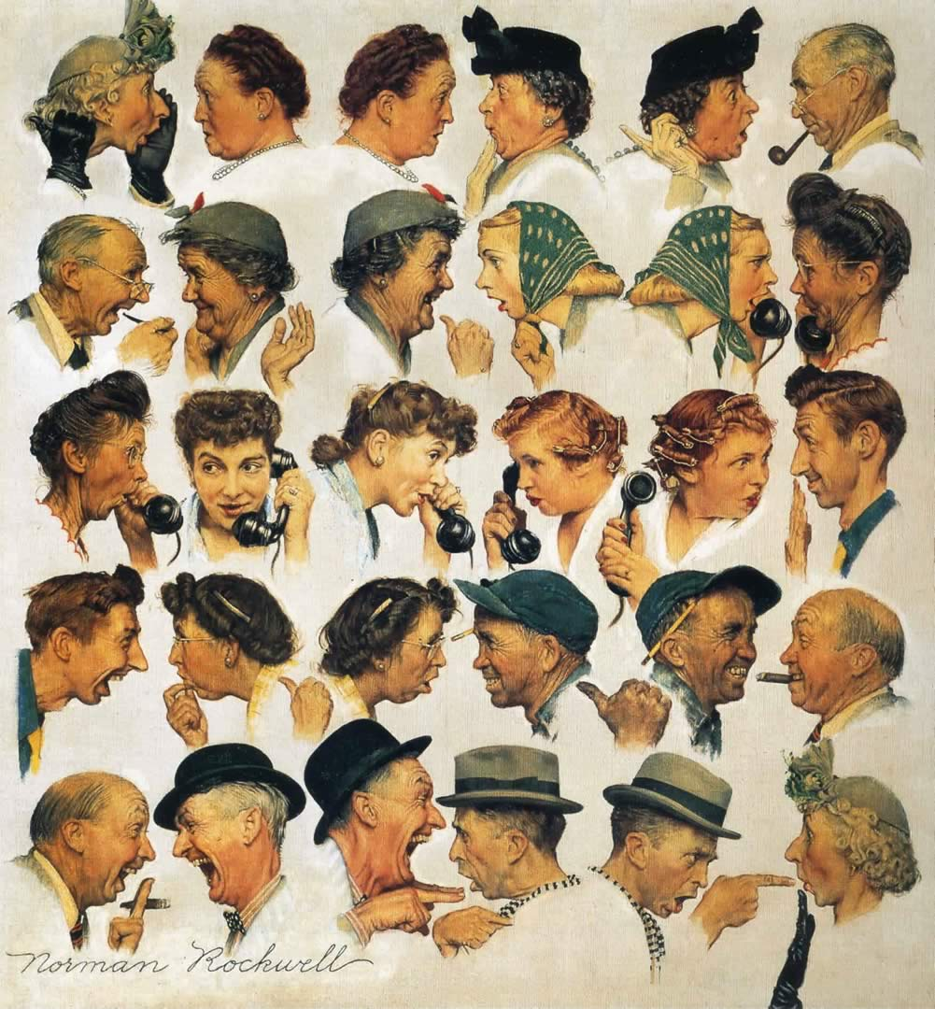
Playing Nice with Others
All I Really Need To Know I Learned In Kindergarten
http://www.robertfulghum.com/

Slide 109
Play Nice!
Share everything.
Play fair.
Don't hit people.
Put things back where you found them.
Clean up your own mess.
Don't take things that aren't yours.
Say you're sorry when you hurt somebody.
Wash your hands before you eat.
Flush.
All I Really Need To Know I Learned In Kindergarten
http://www.robertfulghum.com/

Slide 110




Any Questions, Comments, Concerns or Complaints
Joe Bontke, M.Ed.
EEOC Houston
Outreach and Education Coordinator
713 651 4994 office
713 907 2855 cell
@EEOC_Houston
Joe Bontke
joe.bontke@eeoc.gov
or
EEOC Training Institute
www.eeotraining.eeoc.gov

