Slide 1

Community-Based Strategic Planning
Elevating Trust in Local Government

Slide 2


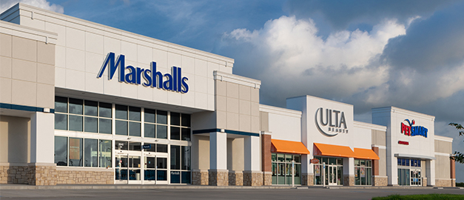
Creating a Vision Forward
More than $20B in industrial expansions
1.5M sq. ft. in retail
4,000 homes in the development process

Slide 3
Community-Based Strategic Plan
What it is not:
A Master Plan
A General Plan
A Comprehensive Plan
Community-based strategic planning is the process of engaging community stakeholders in a conversation regarding the governmental activities and investments they believe will most likely lead to a higher quality of life for those who work and live there.

Slide 4

Parable of the
Chicken Sandwich

Slide 5


Slide 6


Slide 7


Slide 8


Slide 10
We could be engaged in similar behavior
I had already determined what would make me happy and ordered accordingly.
The manager demonstrated little interest in what I had ordered.
He attempted to persuade me to accept something I didn’t want.
He was frustrated when I rejected it.

Slide 11
“Some communities allow the future to happen to them. Successful communities decide the future is something they can create.”
National Civic League

Slide 12
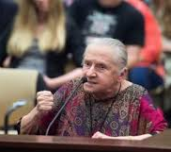
Community
Involvement
Addressing the Risk
of Citizen Ire
People are many times angry because they feel disengaged.
Community-based strategic planning is an effective education tool.
Promotes a sense of ownership.
The best ideas come from our collective efforts.

Slide 13

Symptoms of a Disengaged Citizenry
Low voter turn-out
Elective failures
Anemic citizen participation in civic life
Extremism

Slide 14

According to a ICMA State of the
Profession Survey …
62% have a strategic plan.
Smaller governments are less likely to have a strategic plan.
77% link their strategic plan to budget process.
29% involved citizens in the strategic planning process.

Slide 15
“Communities that take the time to educate their residents and then offer them the opportunity to participate in activities such as local strategic planning and financial decision making are undoubtedly more likely to experience greater success in these areas.”
ICMA – Citizen Engagement:
An Outgrowth of Civic Awareness

Slide 16
The broader the base of participation
The greater the plan’s survivability
and likelihood that it will be used.
Likelihood of Survivability and Successful Implementation
Degree of Public Participation in Plan Formation

Slide 17
“The central purpose . . . To provide West Jordan with a tool that can be used by elected officials and city staff to guide goal setting and focus efforts on those things that residents have identified as their highest priorities.”
West Jordan Utah 2013-2018
Community Strategic Plan

Slide 18

If it ain’t
broke . . .
Greater capacity to align programs with citizen expectations.
Political empowerment to say no to the few and shrill.
Greater accountability and transparency.
Greater ability to identify and eliminate waste.
Greater ability to keep out of the weeds.
Expedited and facilitated annual goal setting.

Slide 19

Community-Based Strategic Planning in Action

Slide 20
Strategic Planning Process
2021-
22
Year 5 Implementation
Year 4 Implementation/
Strategic Planning Process
2020- 21
Year 3 Implementation
2019- 20
Year 2 Implementation
2018-19
Year 1 Implementation
2017-
18
Strategic Planning Process
SPAC Kick-off; Imagine Baytown; Strategic Plan Finalized by SPAC; Strategic Plan adopted by Council January 2017
2016-
17

Slide 21
Planning for the Planning
Elected Body Support
November 2015 Council Retreat
January 2016 Council hires Tanner, LLC
February 2016 Council appoints Strategic Planning Advisory Committee (SPAC) members
  9 member committee
  Mix of people in “The 50” and outside of the “The 50”
  Utilized the Baytown Sun’s 20 under 40 list of young leaders
SPAC Develops Project Plan
March 2016 SPAC Kick-off meeting is held
  Community outreach plan developed
  Ground rules developed
  Timeline developed
  Name developed to market the project (Imagine Baytown)

Slide 22
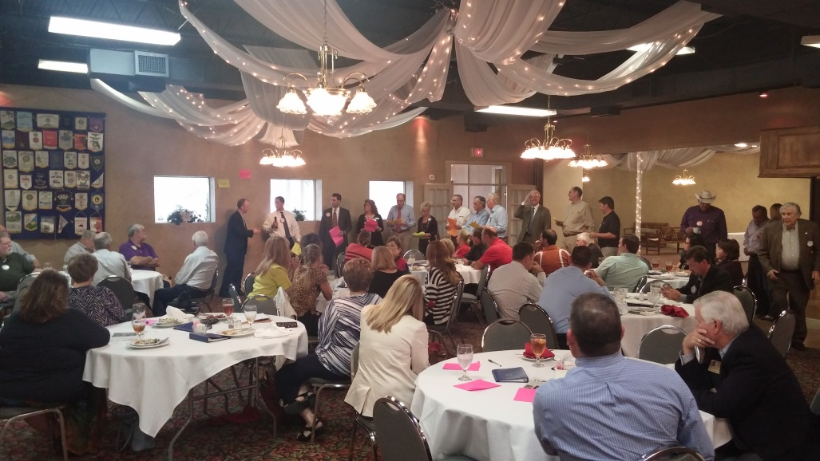

Imagine Baytown
Community Outreach
One-page survey available online and in print
  Printed in both English and Spanish
Community Dialogue Sessions held in each Council district
Stakeholder Dialogue Sessions held with City employees, Chamber members, Non-profits, Rotary, Kiwanis, Pilot Club

Slide 23
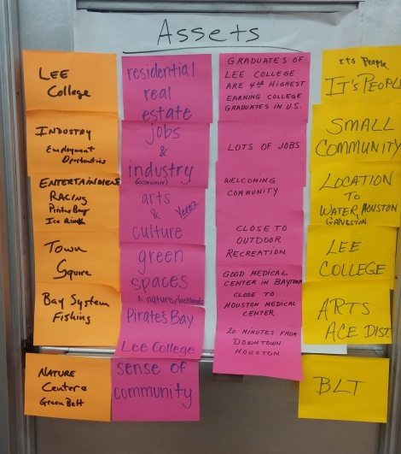
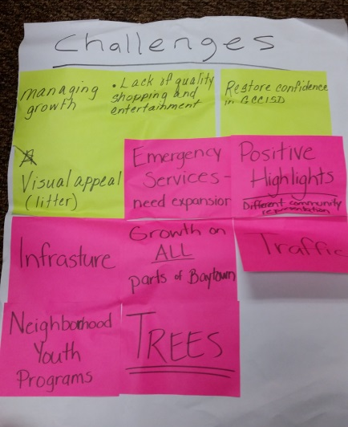
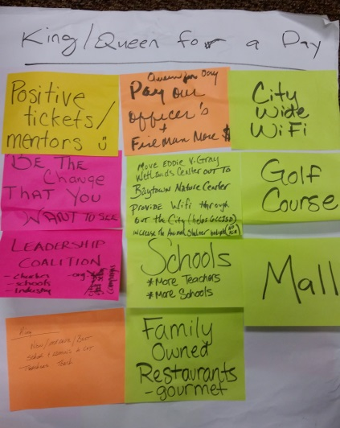
Imagine Baytown
SPAC Develops the Strategic Plan
Data consolidated into general findings
Broad categories of themes developed
SPAC lays out five (5) strategic directives
Formal strategic plan document created by SPAC
  Primary Directive
  Five (5) Strategic Directives
  Key Initiatives & Key Performance Indicators

Slide 24
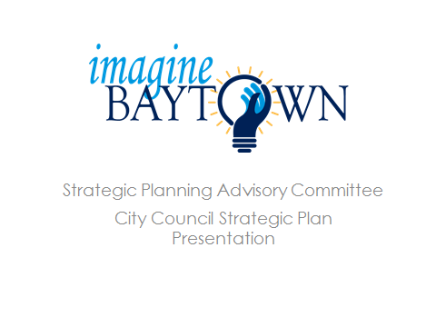
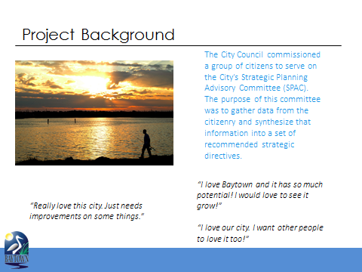
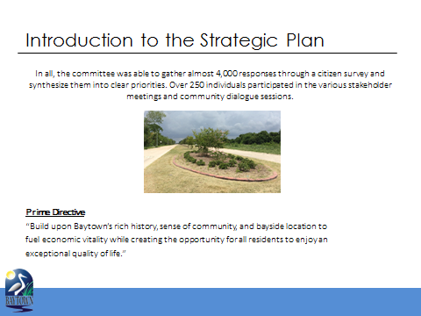
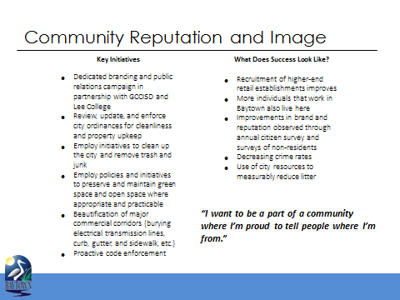
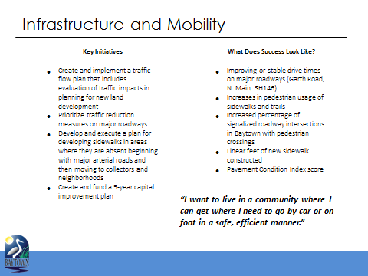
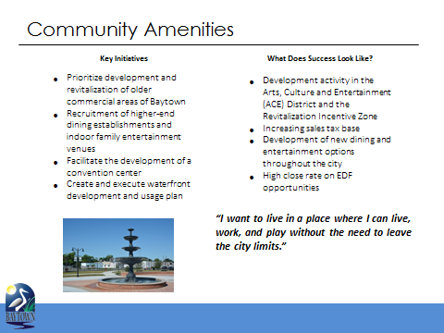
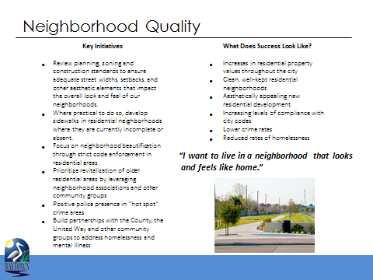
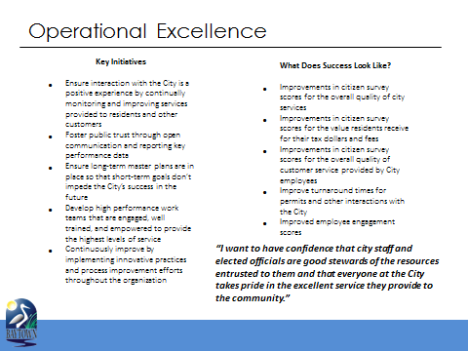
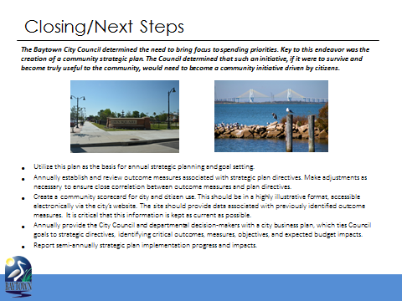

Slide 25
Implementation Process
Jan
Celebrate and report out to Community
Dec
SPAC Review Meeting
Oct
Implementation Year ends and begins
May-Sept
Budget developed and adopted
Jan-Mar
Implementation plan developed by Council

Slide 26
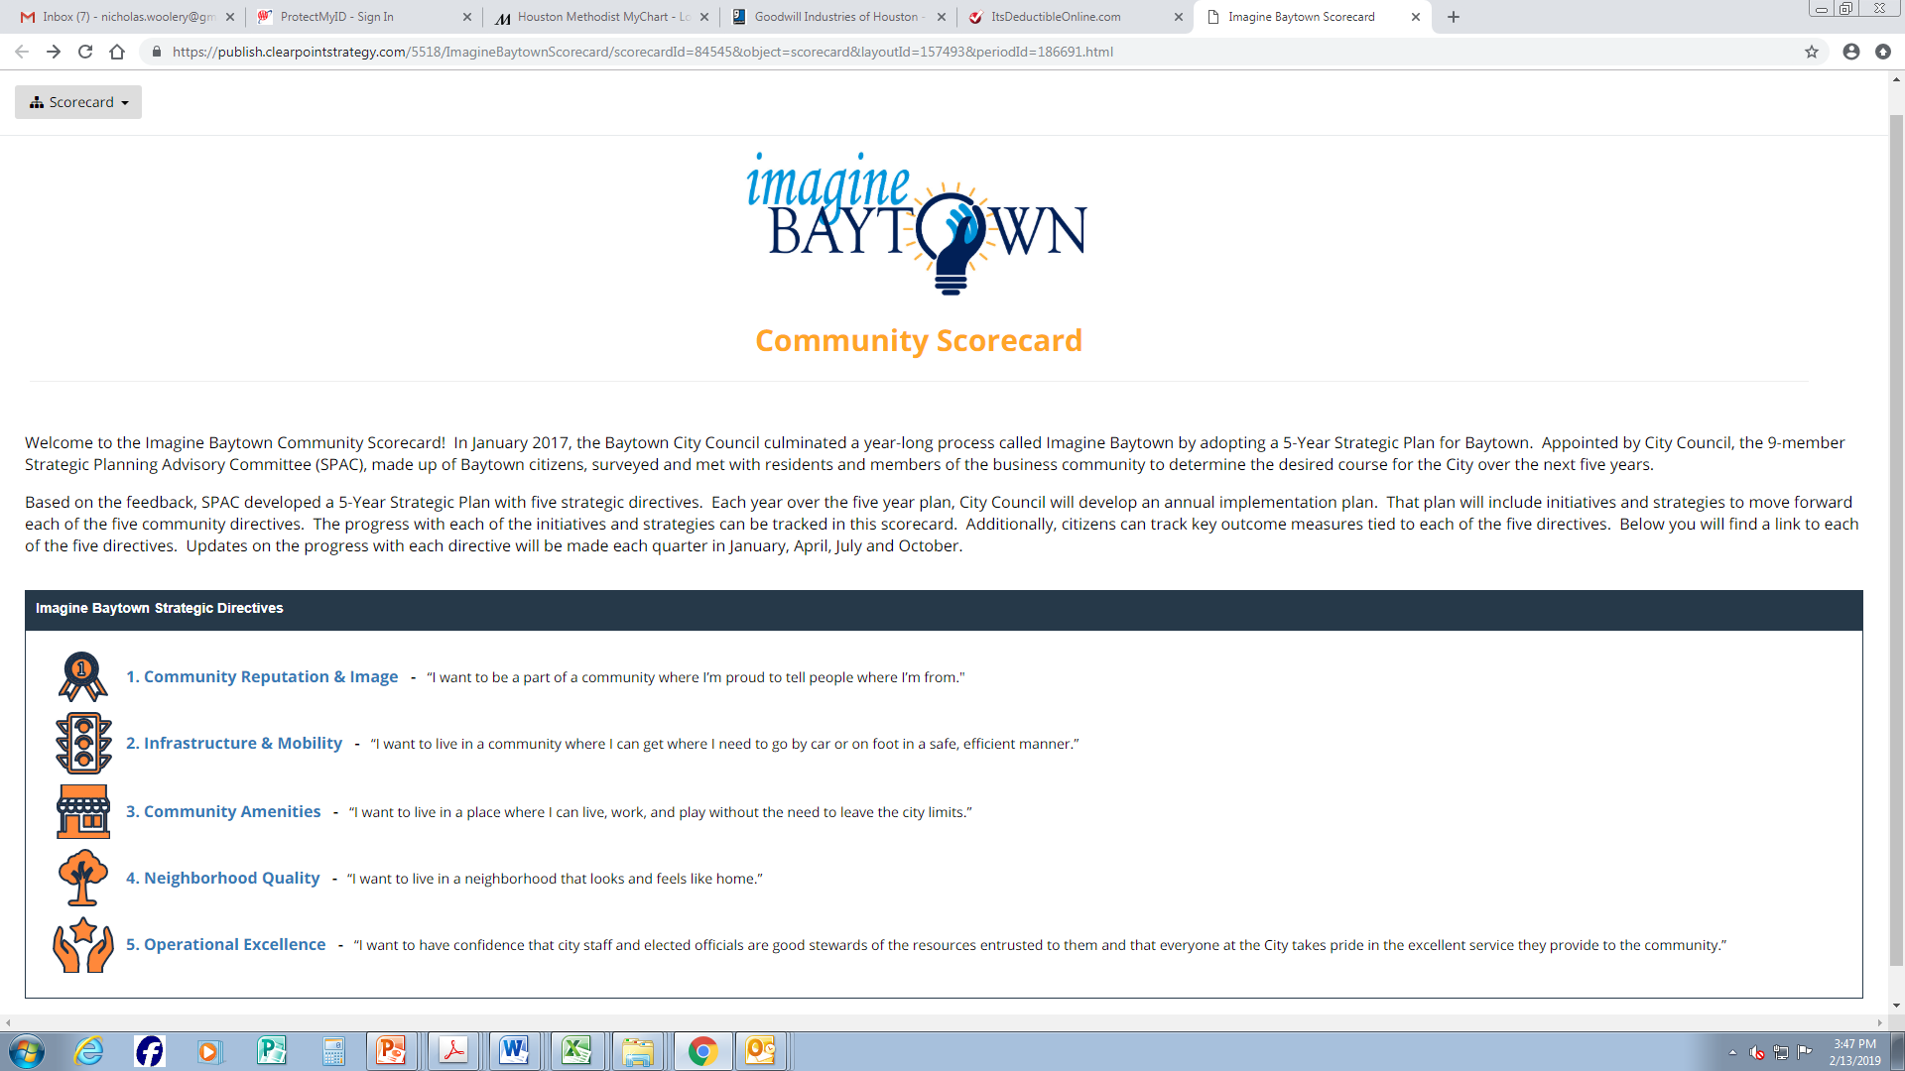

Slide 27
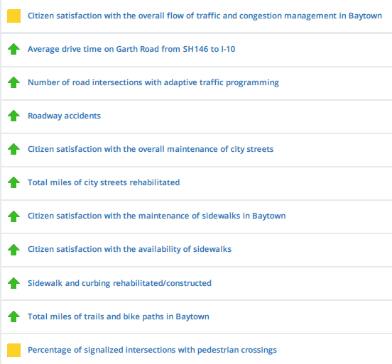
Infrastructure & Mobility
Outcome Measures
Key Successes
San Jacinto Boulevard Phase 1 completion
Santavy from Garth to San Jacinto completed
Major progress on Hunt Road from San Jacinto Boulevard to N. Main
Beginning of Centerpoint LED conversion
Major sidewalk installation project on Garth, Baker and N. Main
Adaptive traffic programming installed at nine additional intersections

Slide 28
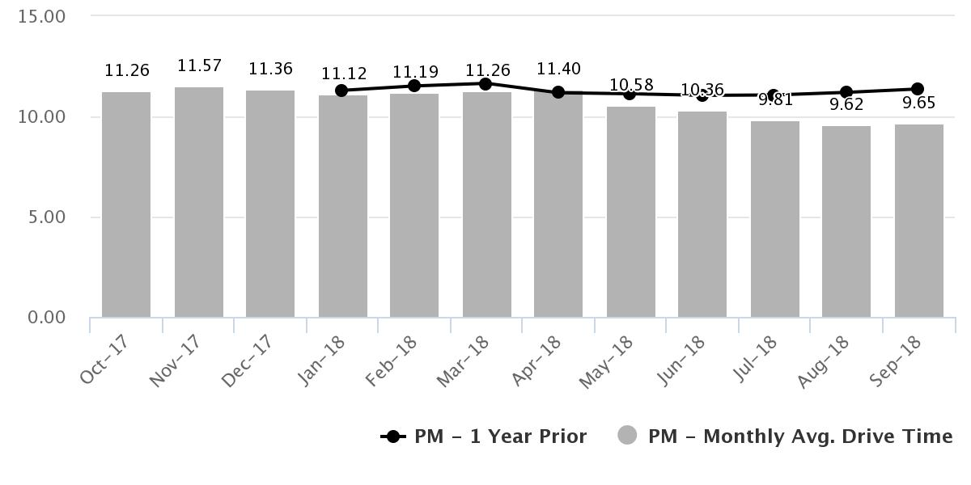
Infrastructure and Mobility
Average drive time – northbound Garth Rd (146 to I-10)
1 min 43 sec reduction in one year

Slide 29
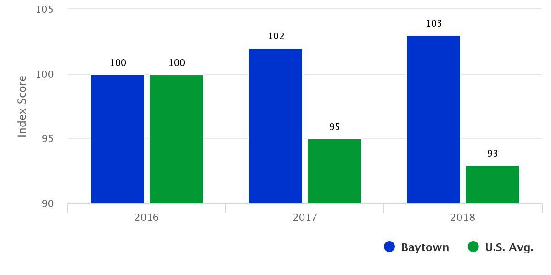
Operational Excellence

Slide 30
Community-Based Strategic Planning
Elevating Trust in
Local Government

