Slide 1

CULVERTS DESIGN, INSTALLATION & INSPECTION
PRARTHANA BANERJI, P.E., CFM
County Engineer
Brazos County
Road & Bridge Department
February 20, 2019

Slide 2
INTRODUCTION
CULVERT OVERVIEW
CULVERT DESIGN CONSIDERATIONS
CULVERT DESIGN
      HYDROLOGY
      HYDRAULICS
METHODS OF ANALYSIS
BRAZOS COUNTY CULVERT DATA
BRAZOS COUNTY CULVERT REGULATIONS
DESIGN PROJECT
INSTALLATION
BRAZOS COUNTY CONSTRUCTION AND INSPECTION REGULATIONS
INSPECTIONS

Slide 3
CULVERT OVERVIEW
CULVERT DEFINITION :
Conveys surface water through a roadway embankment or away from the roadway right-of-way (ROW) or into a channel along the ROW.
Must also support construction and roadway traffic and earth loads; therefore, involves both hydraulic and structural design.
The hydraulic and structural designs must be such that minimal risks to traffic, property damage, and failure from floods
Are considered minor structures, but are of great importance to adequate drainage and the integrity of the facility.
Are usually covered with embankment and are composed of structural material around the entire perimeter, although some are supported on spread footings

Slide 4
CULVERT OVERVIEW CONT.
For efficiency, engineers should design culverts to operate with the inlet submerged during flood flows, if conditions permit.
Any culvert with a clear opening of more than 20-feet, is considered a bridge by FHWA, and is designated a bridge class culvert.
The appropriate structure (either bridge or culvert) should be chosen based on the following criteria:
  construction and maintenance costs
  risk of failure
  risk of property damage
  traffic safety
  environmental and aesthetic considerations
  construction expedience.
Although the cost of individual culverts is usually relatively small, the total cost of culvert construction constitutes a substantial share of the total cost of roadway construction.

Slide 5
CULVERT DESIGN CONSIDERATIONS
Economics
Site Data
Culvert Location
Waterway Considerations
Roadway Data
Allowable Headwater
Outlet Velocity
End Treatments
Traffic Safety
Culvert Selection
Culvert Shapes
Multiple Barrel Boxes
Design versus Analysis
Culvert Design Process
Design Guidelines and Procedure for Culverts

Slide 6
CULVERT DESIGN CONSIDERATIONS CONT.
Site Data
The topographic survey should provide sufficient data for locating the culvert and identifying information on all features affected by installation of the culvert, such as elevations and locations of houses, commercial buildings, croplands, roadways, and utilities.
If the project is small, LiDAR data (GIS) and aerials can be used to determine drainage areas, flow velocities and time of concentrations along with the general site information.
Culvert Location
The culvert location affects hydraulic performance of the culvert, stream and embankment stability, construction and maintenance costs, and safety and integrity of the roadway.

Slide 7
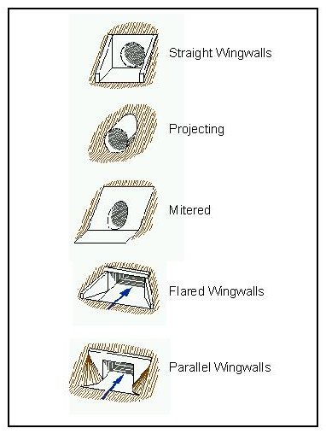
CULVERT DESIGN CONSIDERATIONS CONT.
Waterway Considerations
The installation of a culvert through a roadway embankment may significantly constrict the floodplain. Therefore, pre-construction data should be collected to predict the consequences of the culvert alteration.
End Treatments
End treatments serve several different purposes but typically act as a retaining wall to keep the roadway embankment material out of the culvert opening.
Secondary characteristics –
hydraulic improvements
traffic safety,
debris interception,
flood protection,
prevention of piping

Slide 8
CULVERT DESIGN CONSIDERATIONS CONT.
Culvert Selection
Total culvert cost can vary considerably depending upon the culvert type.
Primary factors affecting culvert type selection are economics, hydraulic properties, durability, and strength.
Culvert type selection includes :
  meet design life
  culvert shapes
  number of culvert barrels
Select a material that satisfies hydraulic and structural requirements at the lowest cost.
Material availability and ease of construction both influence the total cost of the structure.

Slide 9
CULVERT DESIGN
HYDROLOGY
Peak Design Flow
Hydrographs
Computer Models
SITE DATA
Culvert Location
Waterway Data
Roadway Data
CULVERT HYDRAULICS
Types of Control (Inlet/Outlet)
Headwater Elevation
Outlet Velocity
Continue to adjust configuration until headwater elevation and outlet velocity are within allowable limits.

Slide 10
CULVERT DESIGN - HYDROLOGY
Commonly used Stormwater Runoff Calculation - The Rational Method
Appropriate for estimating peak discharges for small drainage areas.
Used for areas of up to about 200 acres with no significant flood storage.
In the case with Urban Subdivisions, used for areas of up to 50 acres with no significant flood storage.
Not be used for determining or estimating storage or discharge requirements for design of detention facilities.
Its use is strictly limited to small drainage areas discharging to the secondary drainage system.

Slide 11
CULVERT DESIGN - HYDROLOGY CONT.
The Rational Method formula shall be expressed as:
𝑄=𝑐𝑖𝐴
Where the variables are defined below.
• “Q” is the discharge in cubic feet per second (cfs).
• “c” is a coefficient, having no units(average runoff characteristics of the land cover within the drainage area delineated for a designated design point)
• “i” is the rainfall intensity in units of inches per hour (in/hr.).
• “A” is the area of land in acres that contributes stormwater runoff

Slide 12
CULVERT DESIGN - HYDROLOGY CONT.
Assumptions and Limitations:
The method is applicable if “tc” for the drainage area is less than the duration of peak rainfall intensity.
Rainfall intensity is uniform throughout the duration of the storm.
Rainfall is distributed uniformly over the drainage area.
The rational method does not account for storage in the drainage area. Available storage is assumed to be filled.
The contributing area “A” of runoff shall not exceed 200 acres in rural areas with no significant flood storage and 50 acres in urban areas with no significant flood storage.

Slide 13
CULVERT HYDRAULICS
Features of the culvert entrance - INLET CONTROL
Features at the downstream end - OUTLET CONTROL
Inlet controls at the lower flows and outlet control takes over for the higher flows, as a general rule.
INLET CONTROL:
Occurs when flow capacity of the culvert entrance is less than the flow capacity of the culvert barrel.
Depends primarily on the geometry of the culvert entrance. Sharp entrance has less capacity.
Usually occurs during lower flows.
OUTLET CONTROL:
Occurs when flow capacity is controlled by the tailwater conditions or the flow capacity of the culvert barrel.

Slide 14
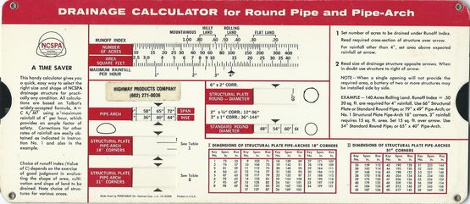
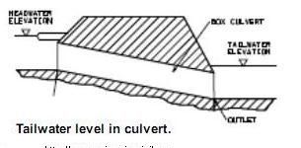
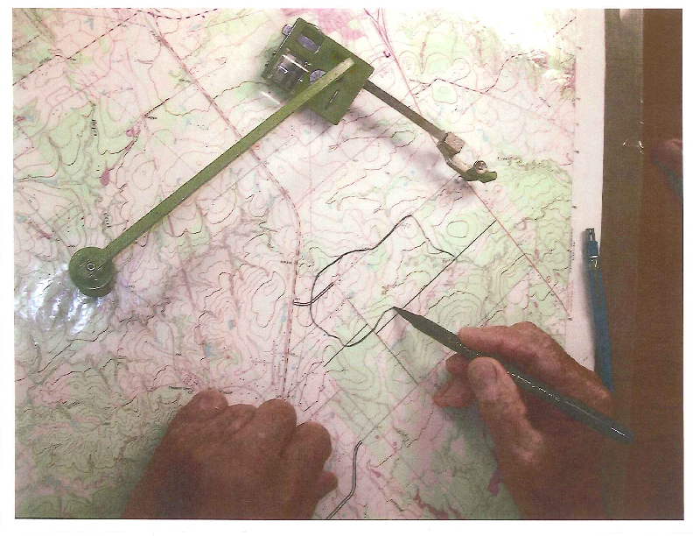
METHODS OF ANALYSIS
Hand calculation method

Slide 15
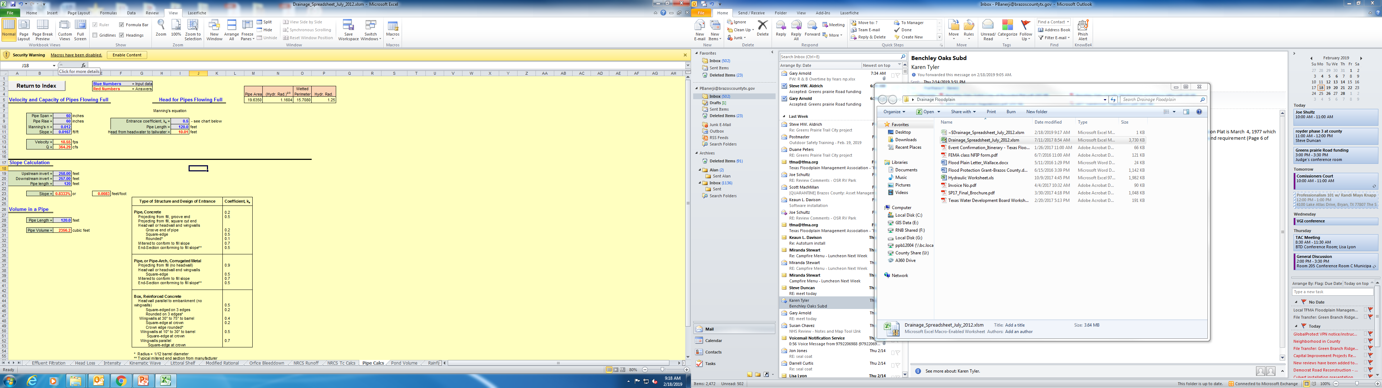
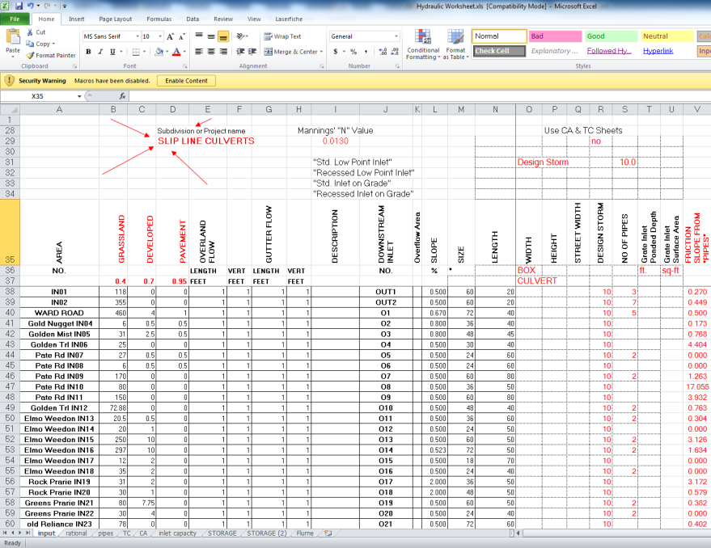
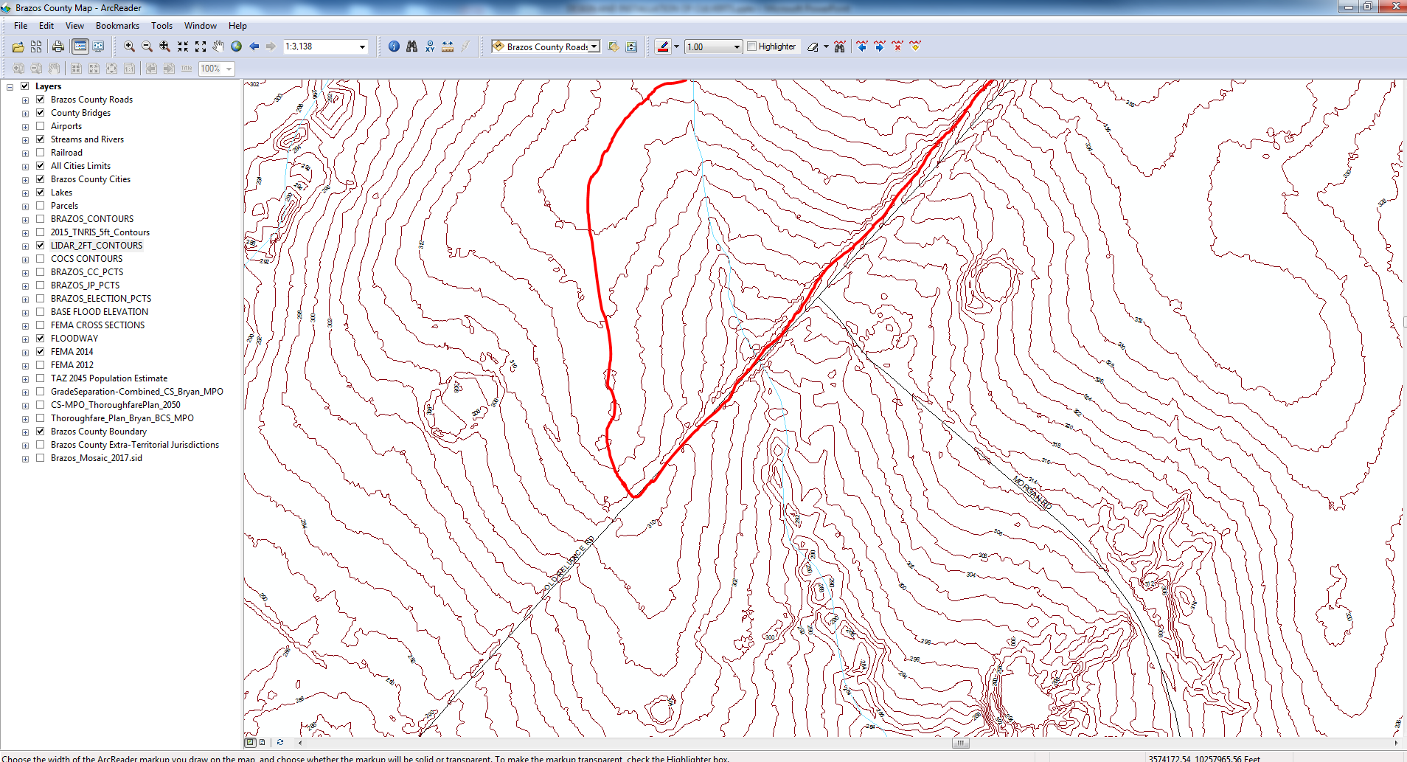
METHODS OF ANALYSIS
Arc-GIS & MS Excel

Slide 16
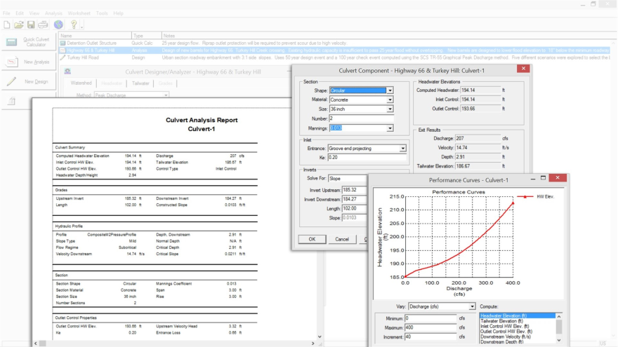
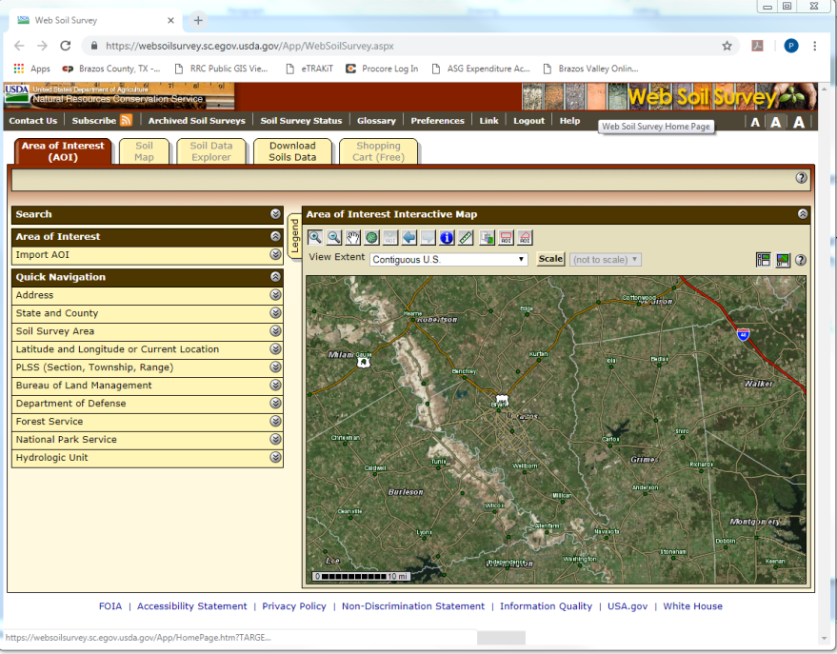
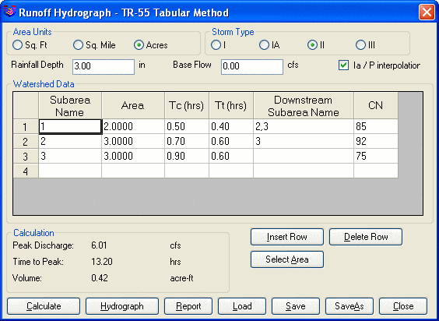
METHODS OF ANALYSIS
Win-TR 55 is a free program from USDA that can be used to model less complex watersheds.
The watersheds are limited to 25 sq mile and the sheet flow length is limited to 100 ft.
Uses the Rational Method for runoff calculation.
https://websoilsurvey.sc.egov.usda.gov/App/HomePage.htm

Slide 17
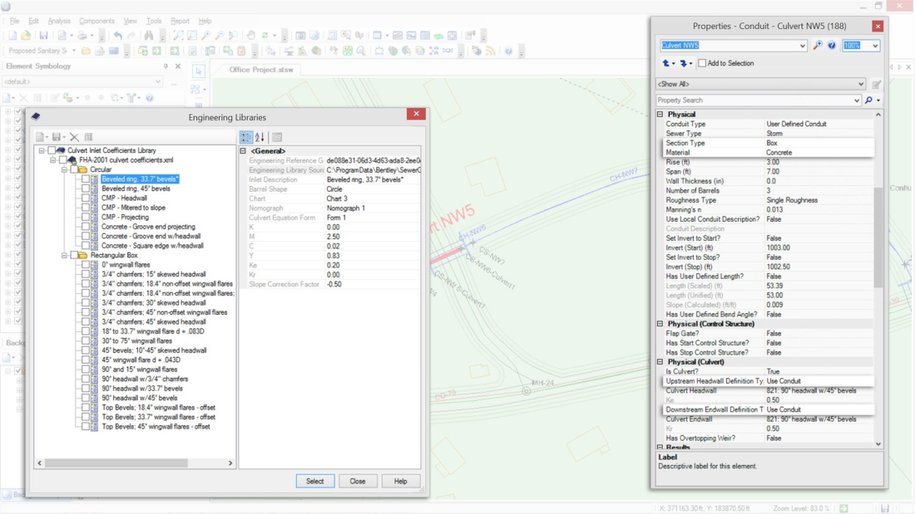
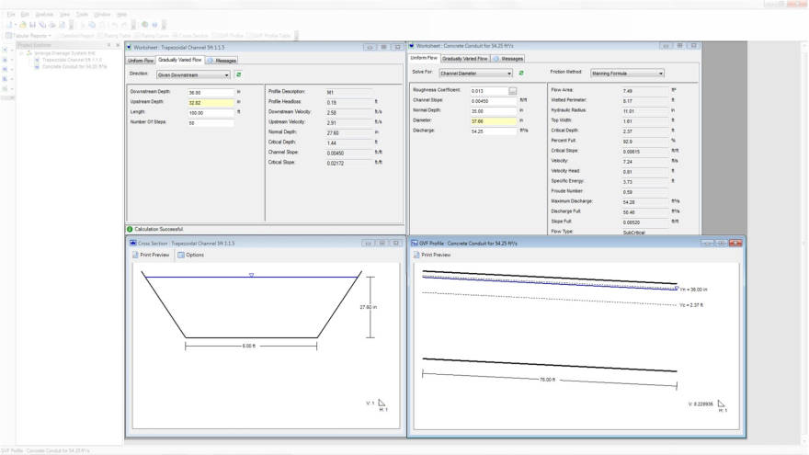
METHODS OF ANALYSIS
Spreadsheet is an error-prone process
Use FEMA-approved CulvertMaster to effectively analyze
  simple barrel crossings
  complex embankment cross-drain systems,
  different shapes and sizes,
  special tailwater considerations,
CulvertMaster

Slide 18
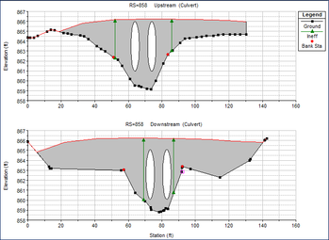
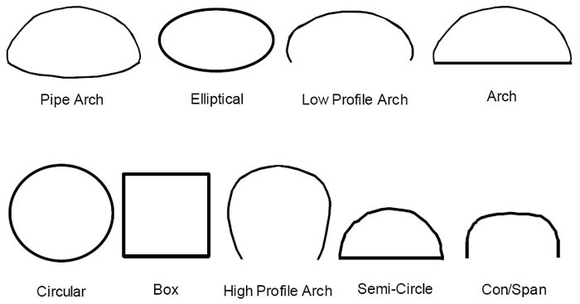
METHODS OF ANALYSIS
HEC-RAS has the ability to model single culverts; multiple identical culverts; and multiple non-identical culverts.
The culvert routines in HEC-RAS are similar to the bridge routines
The layout of cross sections, the use of the ineffective areas, the selection of loss coefficients, and most other aspects of bridge analysis apply to culverts as well.
HEC-RAS has the ability to model nine of the most commonly used culvert shapes.
HEC-RAS
Use HEC-RAS For: • FEMA “AE” Zones • Bridge Class Culverts Or Culverts Serving Drainage Areas Greater Than One Square Mile • Low Water Crossings • Sensitive Drainage Conditions

Slide 19
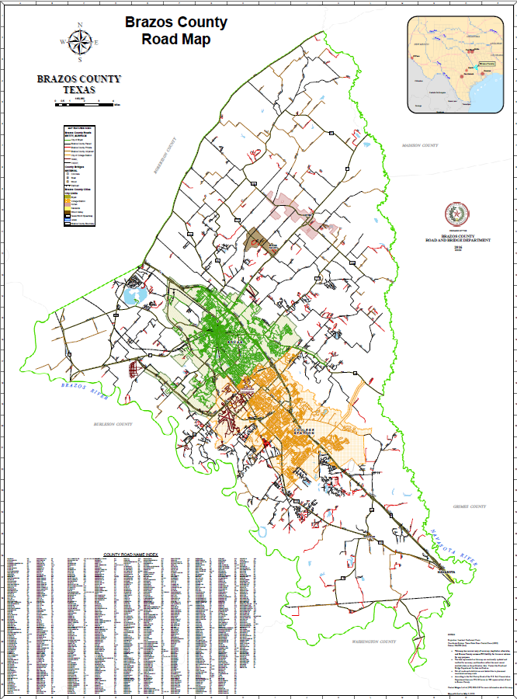
BRAZOS COUNTY ROAD & BRIDGE DEPARTMENT
Responsibilities & Services
Acquiring right-of-way for public works projects
Brazos County constructs new roads and bridges
Brazos County maintains a total of 455.21 miles of road and 56 different bridges
County subdivision plat reviews
Maintaining road signs and setting speed limits
Manage drainage
Permitting of construction, residential, or commercial
Planning of area transportation
Providing maps for public and internal use

Slide 20
BRAZOS COUNTY CULVERT DATA
757 Water Crossing Structures mapped under Brazos County Roads
Largest inventoried pipe size 80"
Smallest inventoried pipe size 8"
Most structures are round culverts, however we do have some box culverts
Most older structures are corrugated inside but many newer pipes are not
Most common failures are a result of being crushed, embedded, and rusted out
Materials – STEEL, POLY, CORRUGATED METAL, REINFORCED CONCRETE, BLK HDPE, DUROMAXX, GRAY DOUBLE WALL HDPP

Slide 21
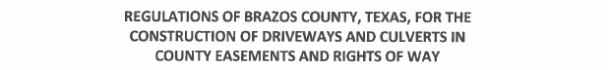
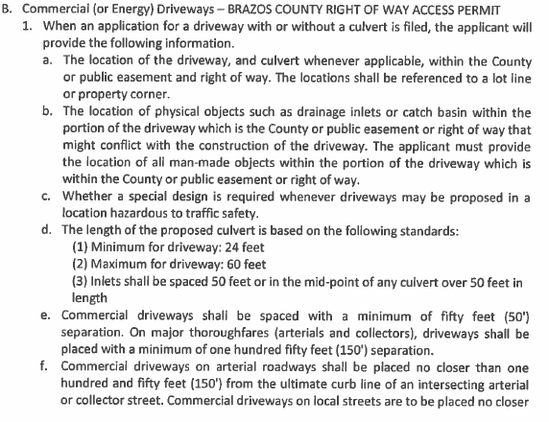
COUNTY REGULATIONS
https://www.brazoscountytx.gov
Residential driveways
Commercial driveways

Slide 22

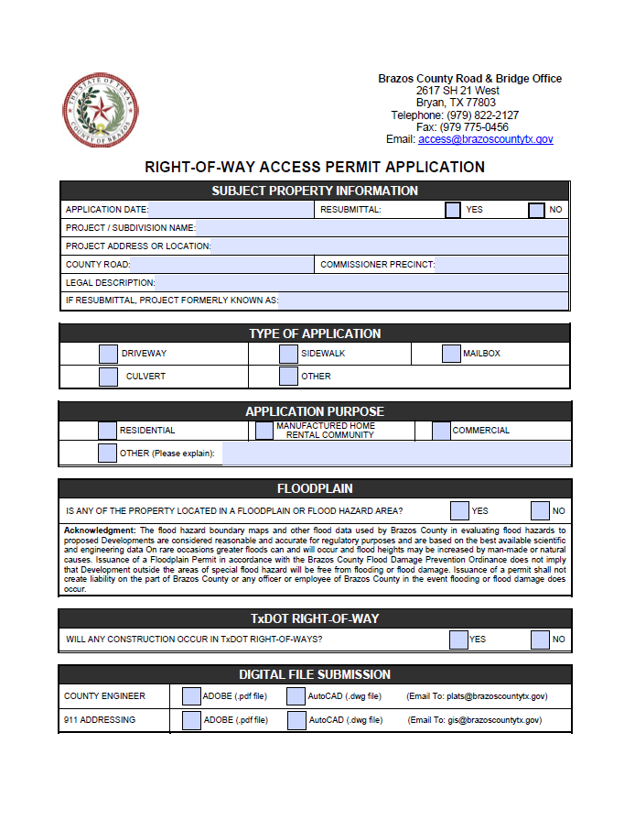
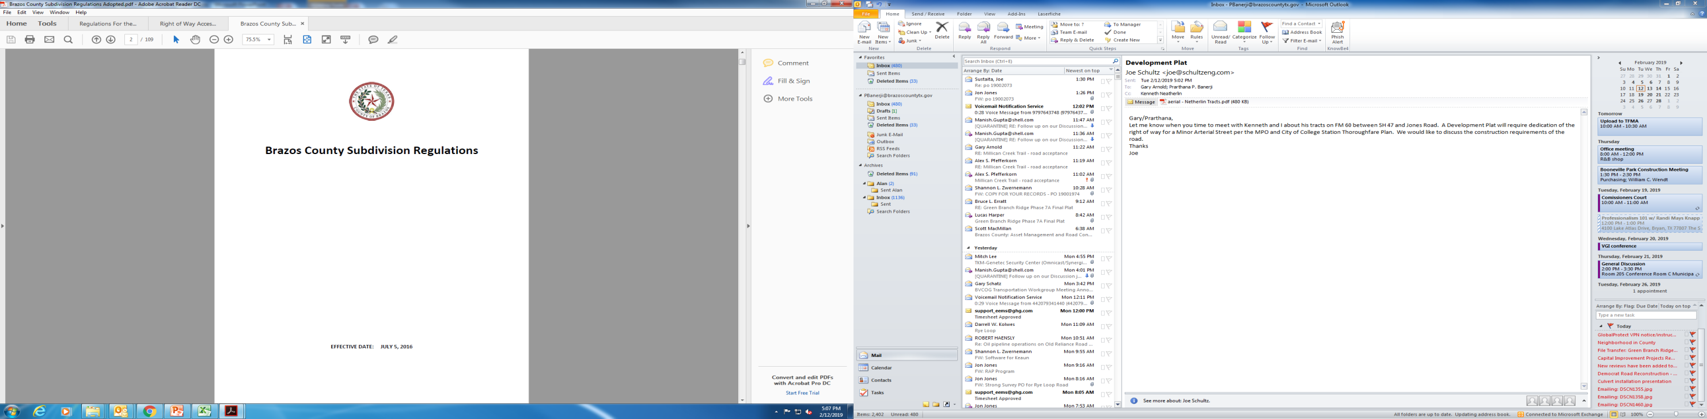
COUNTY REGULATIONS CONT.

Slide 23
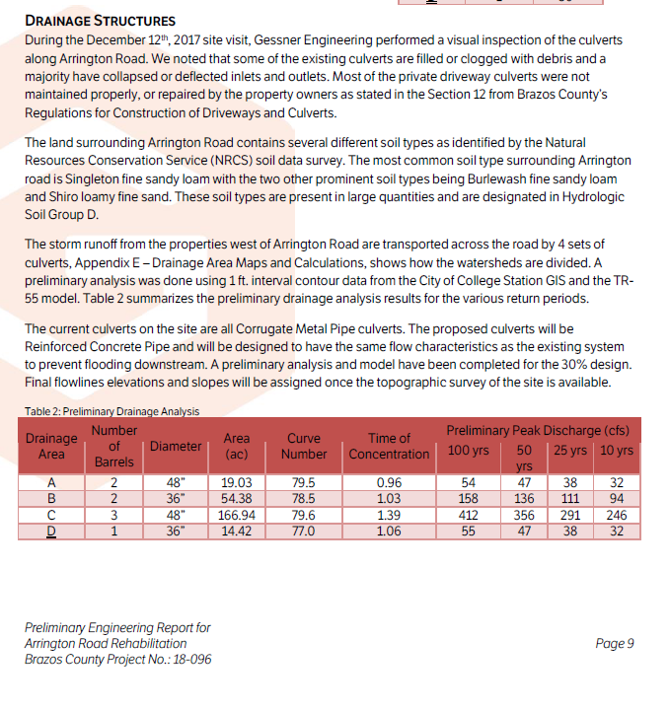
ARRINGTON ROAD – DESIGN PROJECT

Slide 24
ARRINGTON ROAD – DESIGN PROJECT

Slide 25
ARRINGTON ROAD – DESIGN PROJECT

Slide 26
ARRINGTON ROAD – DESIGN PROJECT

Slide 27
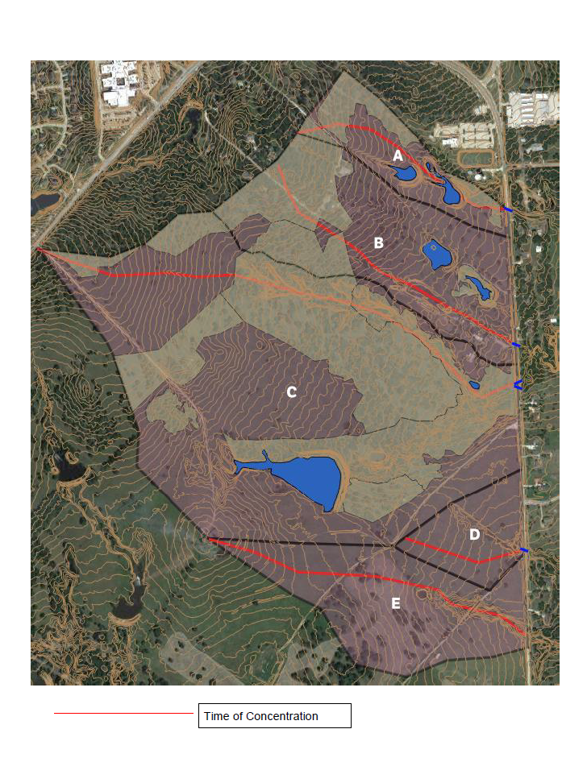
ARRINGTON ROAD – DESIGN PROJECT

Slide 28
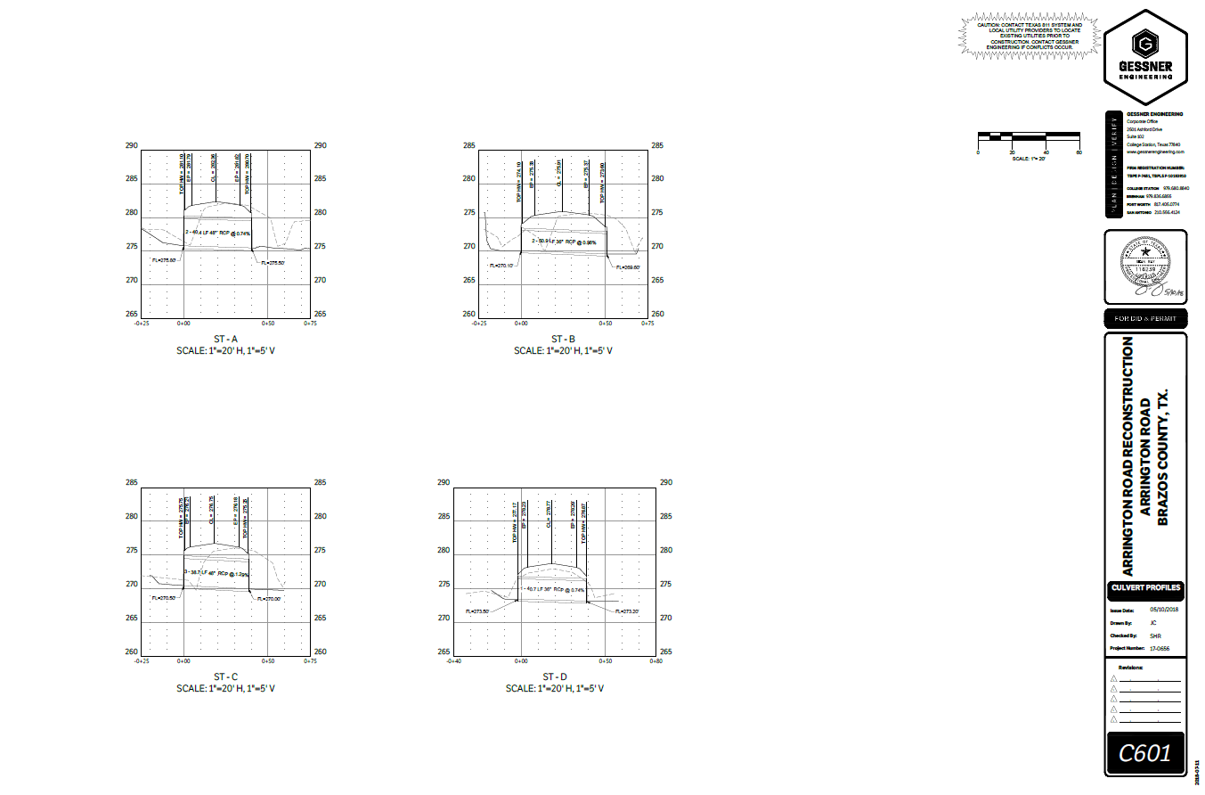
ARRINGTON ROAD – DESIGN PROJECT CONT.
Prop.2-36” RCP

Slide 29
INSTALLATION
LOCATE UTILITIES
Fiber
Gas
BARRICADE & SIGNAGE
Traffic Control Devices
EXACAVATION
Hot-Mix
Seal Coat
INSTALLATION
Sawcut (for Asphalt Roadways)
FINISHING
Backfill (Cement Sand)
Electric
Water
Culvert
Gravel
Compaction
HYDROLOGY

Slide 30
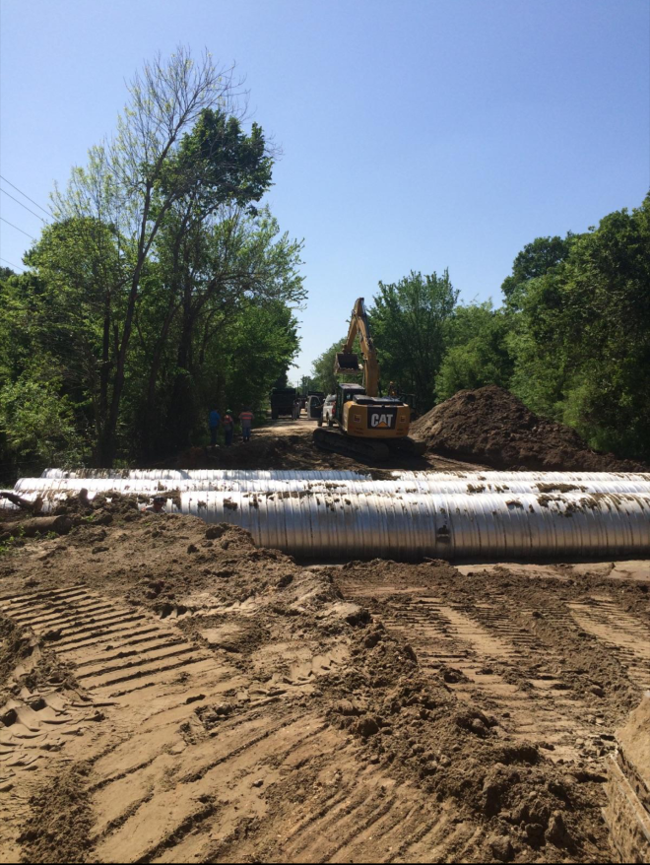
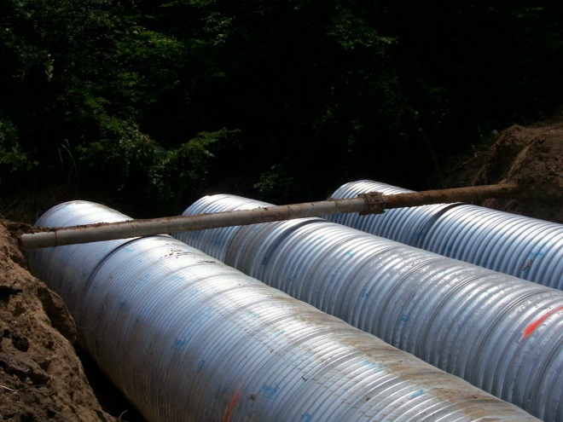
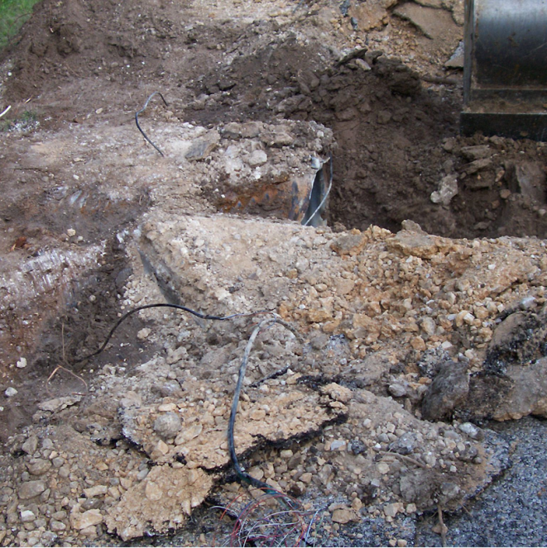
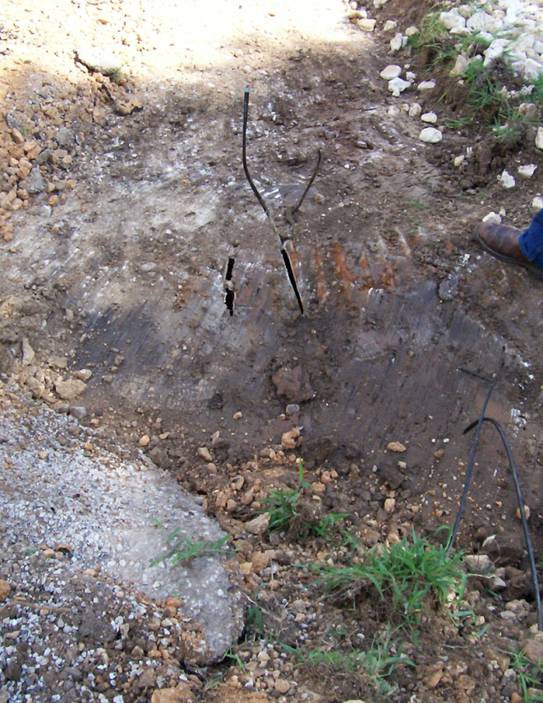
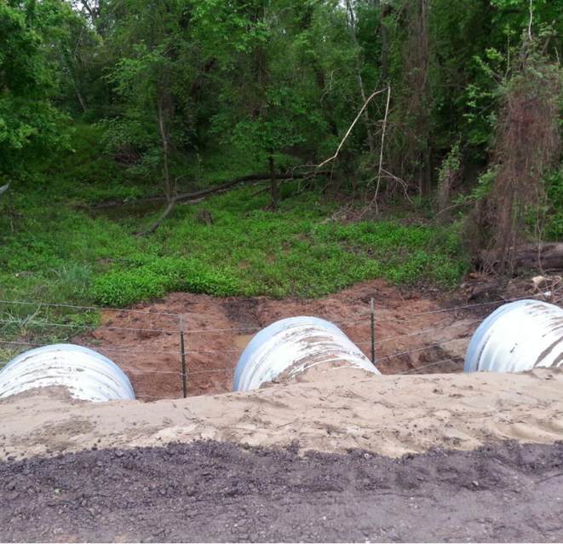
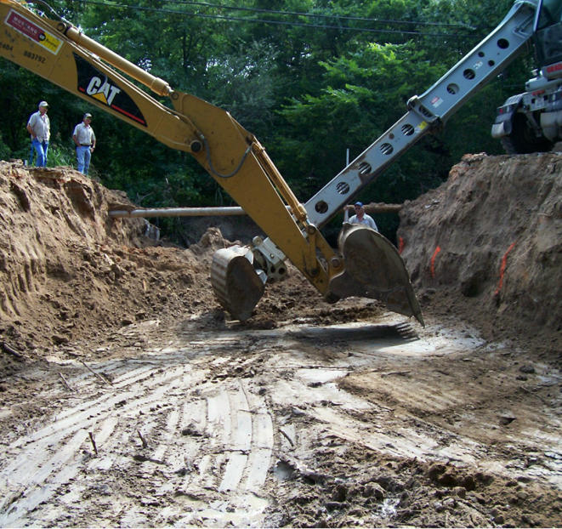
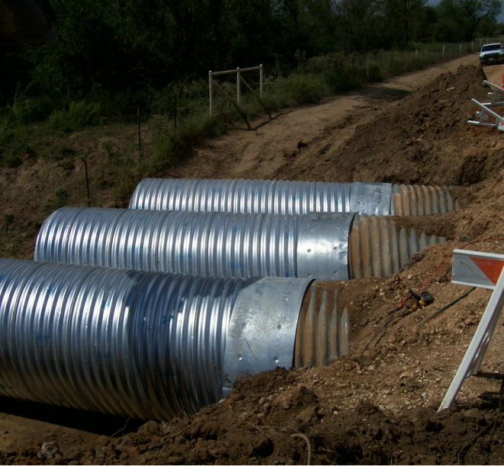
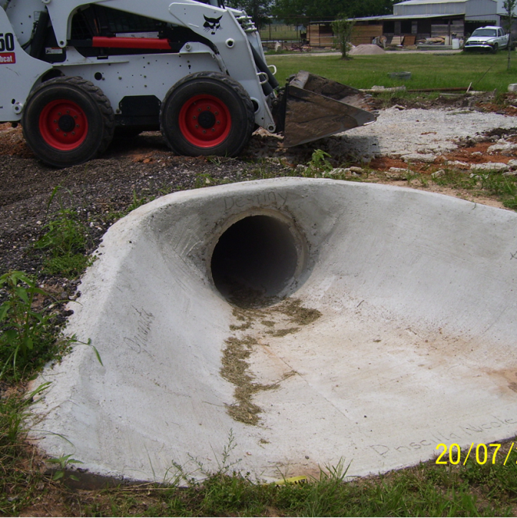
INSTALLATION
HYDROLOGY

Slide 31
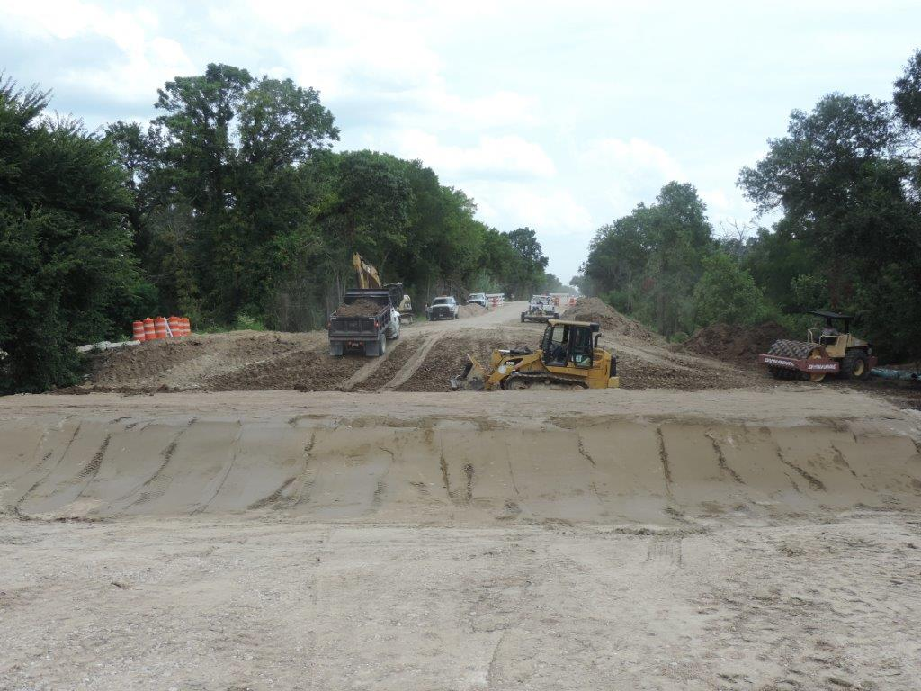
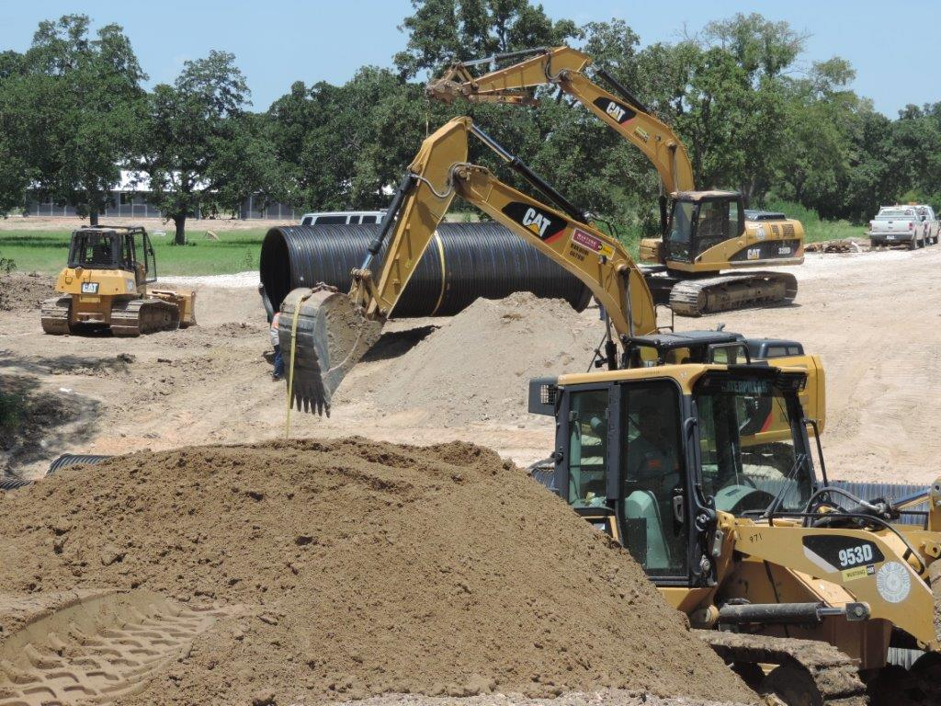
CONSTRUCTION & INSPECTION REGULATIONS
HYDROLOGY

Slide 32
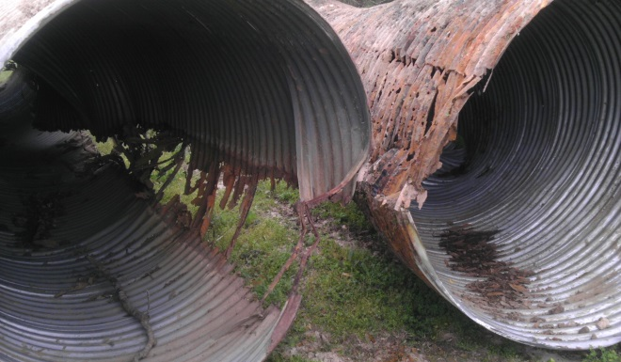
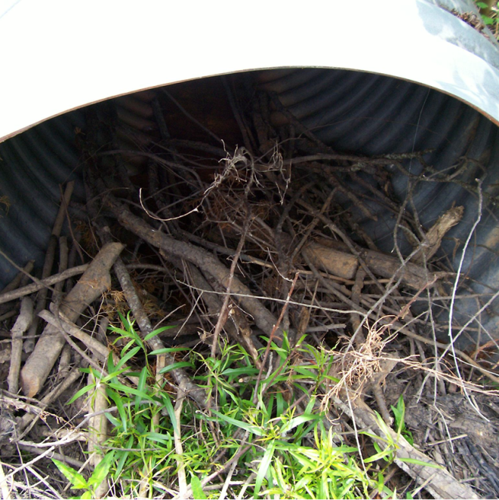
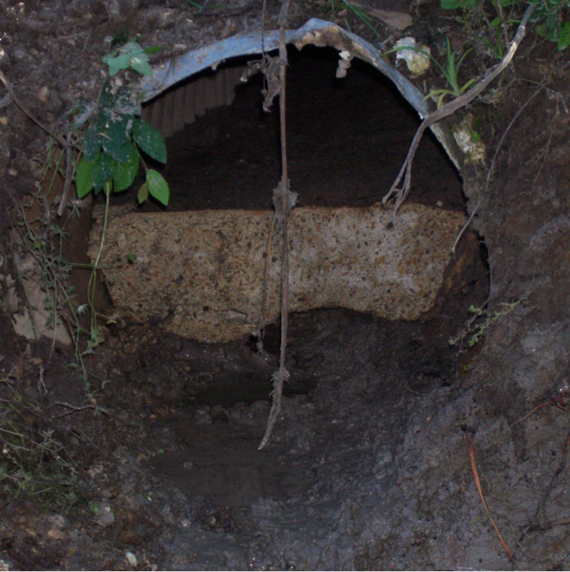
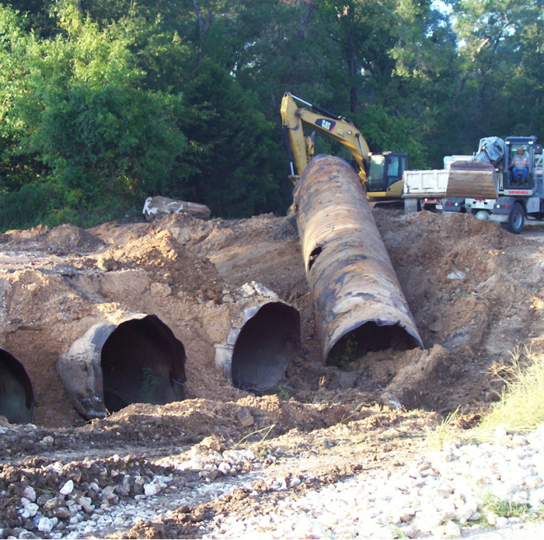
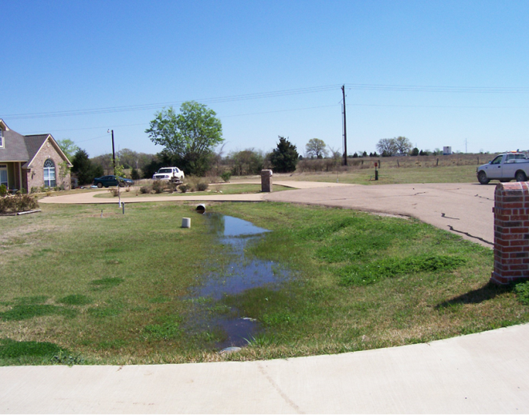
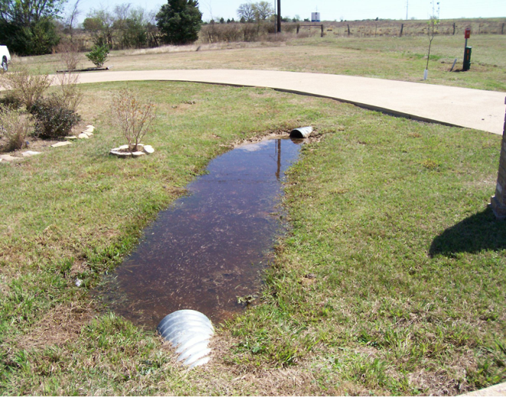
INSPECTIONS

Slide 33
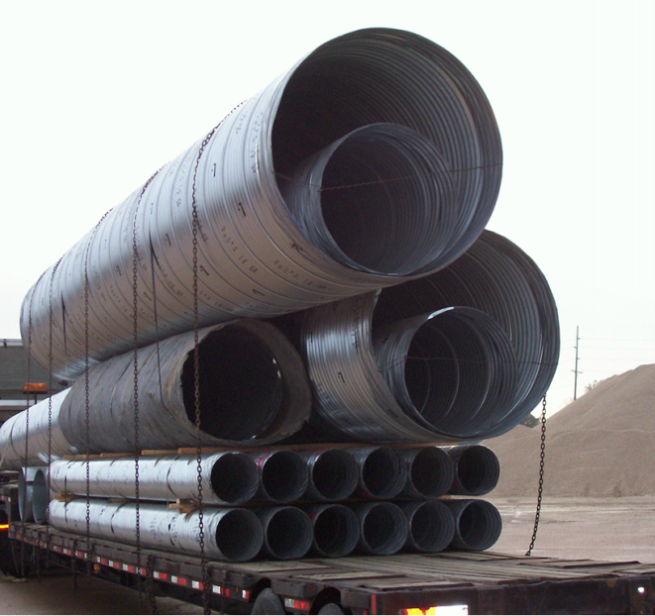
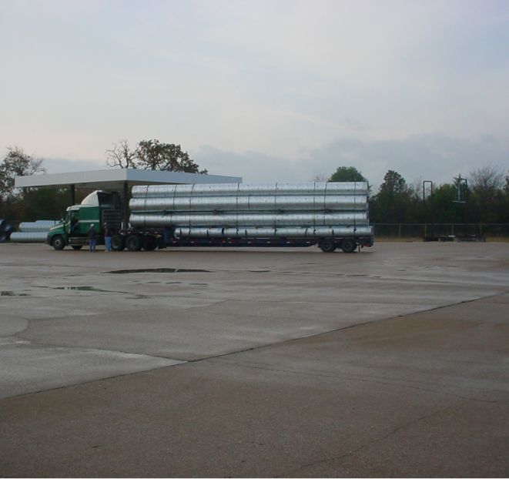
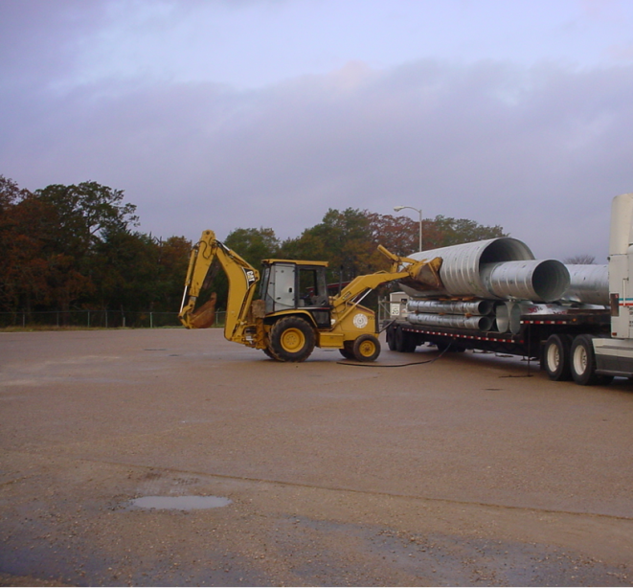
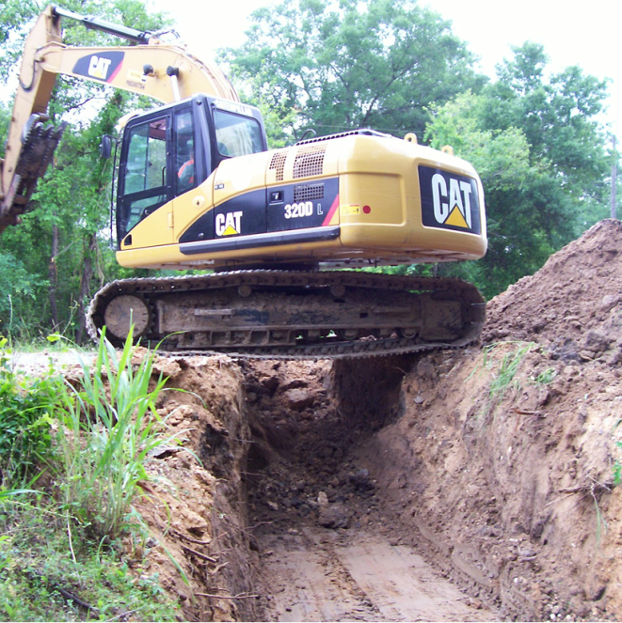
QUESTIONS?

