Slide 1
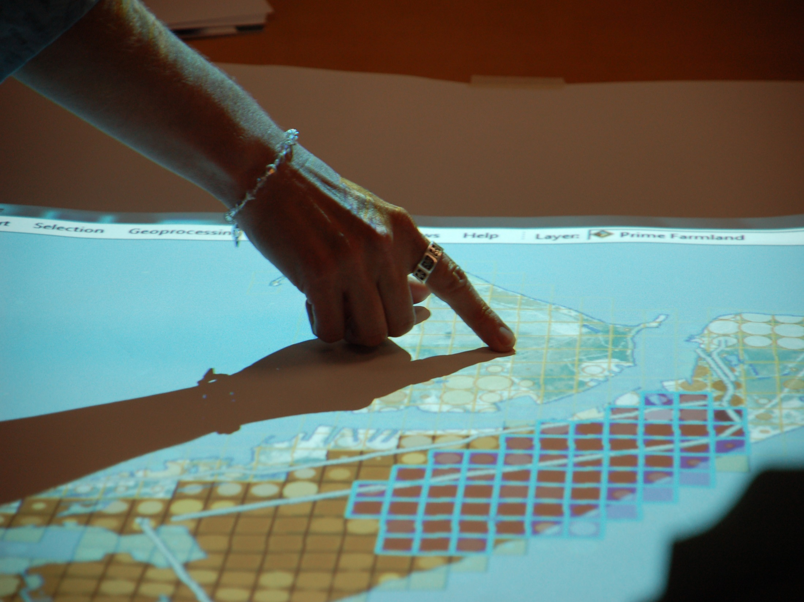



Navigating Your Community to a Resilient Future
February 20, 2019

Slide 2
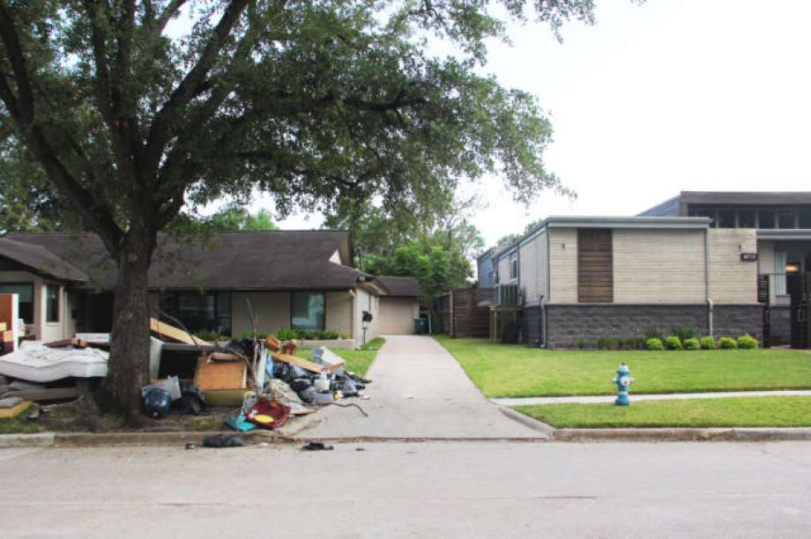
What does resilience mean?
What is the recipe for a resilient community?

Slide 3
Blanchard’s Dirty Dozen
Disaster Losses Are Enormous
The US Is Becoming More Vulnerable
Disaster Looses Are Going Up
Projected to Get Even Worse
Disasters Impact Differentially
Past & Current Practices are Not Effective Enough
Disasters Don’t Kill People- People Kill People
Disasters Stem From Failure to Manage Risk
Failure Is Primarily Governmental
This is Primarily a Political Problem
We Must Create a Culture of Disaster Prevention
Disaster Emergency Management Needs to Continue To Evolve
Education is Key

Slide 4
Blanchard’s Dirty Dozen
Disaster Losses Are Enormous
The US Is Becoming More Vulnerable
Disaster Looses Are Going Up
Projected to Get Even Worse
Disasters Impact Differentially
Past & Current Practices are Not Effective Enough
Disasters Don’t Kill People- People Kill People
Disasters Stem From Failure to Manage Risk
Failure Is Primarily Governmental
This is Primarily a Political Problem
We Must Create a Culture of Disaster Prevention
Disaster Management Needs to Continue To Evolve
Education is Key

Slide 5
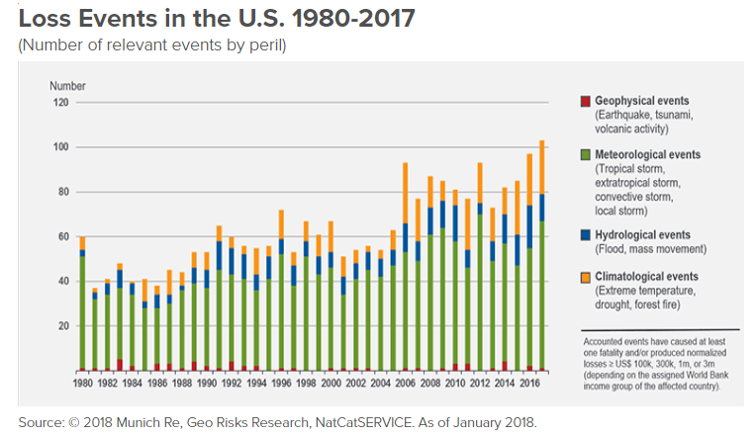
Loss Events in the U.S. 1980-2017

Slide 6
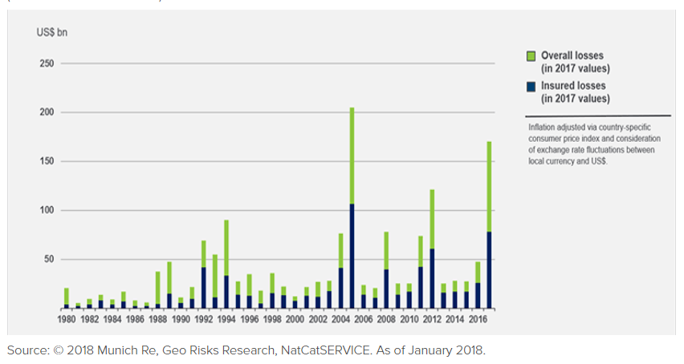
Inflation Adjusted Overall & Insured Losses 1980-2017

Slide 7
Average Claims from Harvey
$115,000
$95,000
$16,000
$4,600
FEMA Grants
Auto Flood Insurance Claims
Residential NFIP Claim
Commercial Flood Insurance Claims

Slide 8
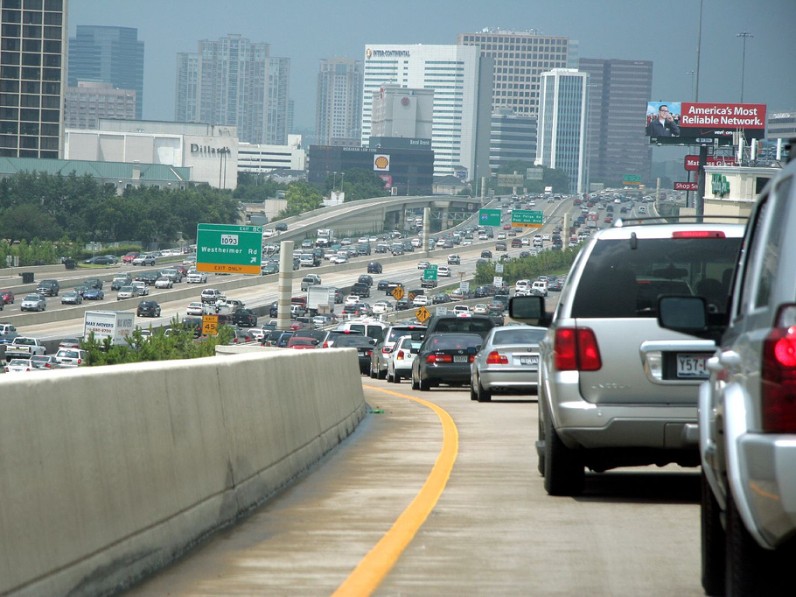
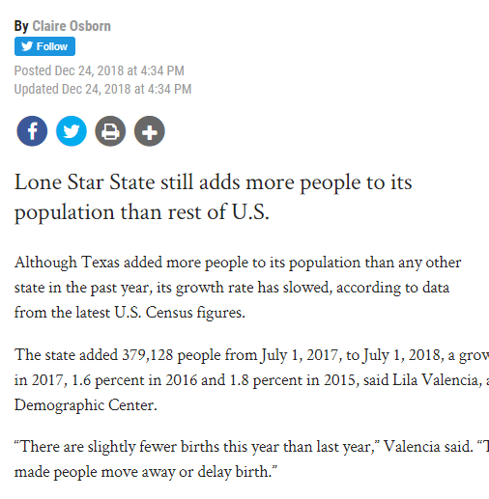
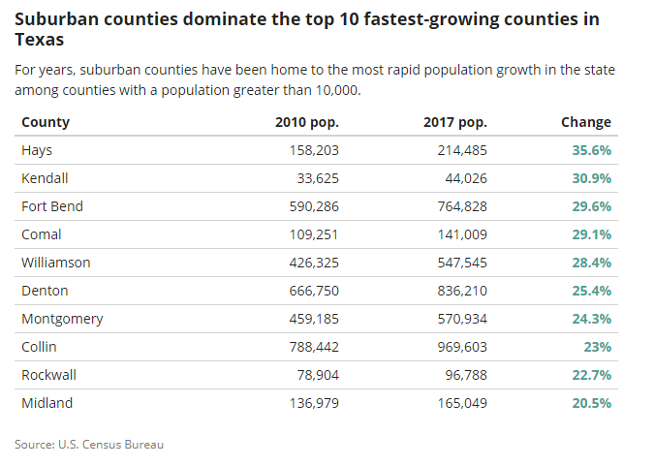

Slide 9
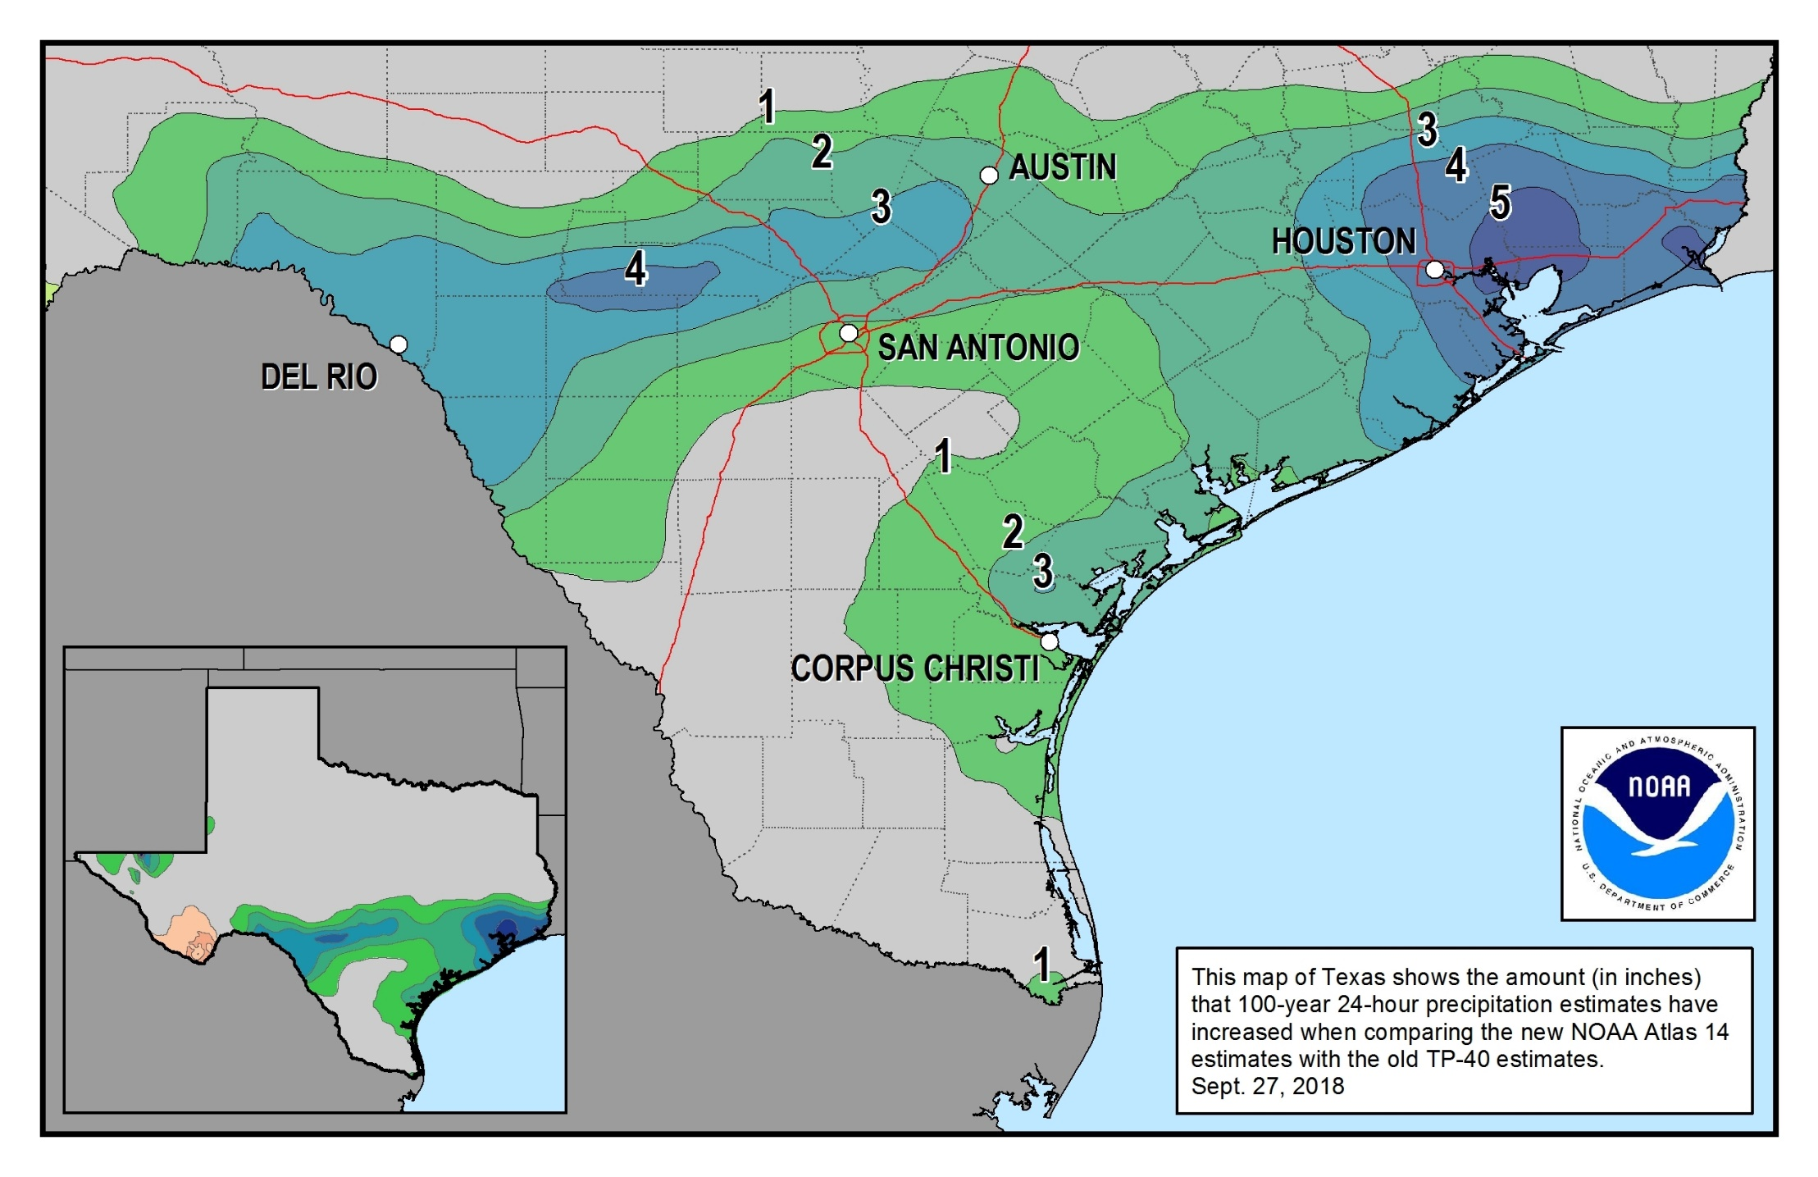
NOAA Atlas 14, Vol 11

Slide 10
Blanchard’s Dirty Dozen
Disaster Losses Are Enormous
The US Is Becoming More Vulnerable
Disaster Looses Are Going Up
Projected to Get Even Worse
Disasters Impact Differentially
Past & Current Practices are Not Effective Enough
Disasters Don’t Kill People- People Kill People
Disasters Stem From Failure to Manage Risk
Failure Is Primarily Governmental
This is Primarily a Political Problem
We Must Create a Culture of Disaster Prevention
Disaster Management Needs to Continue To Evolve
Education is Key

Slide 11
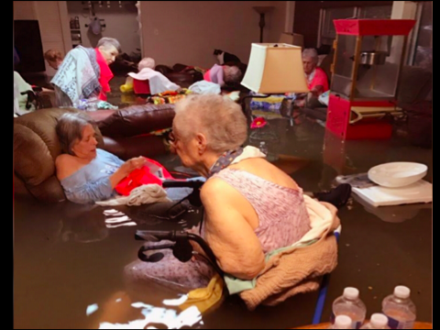

Slide 12
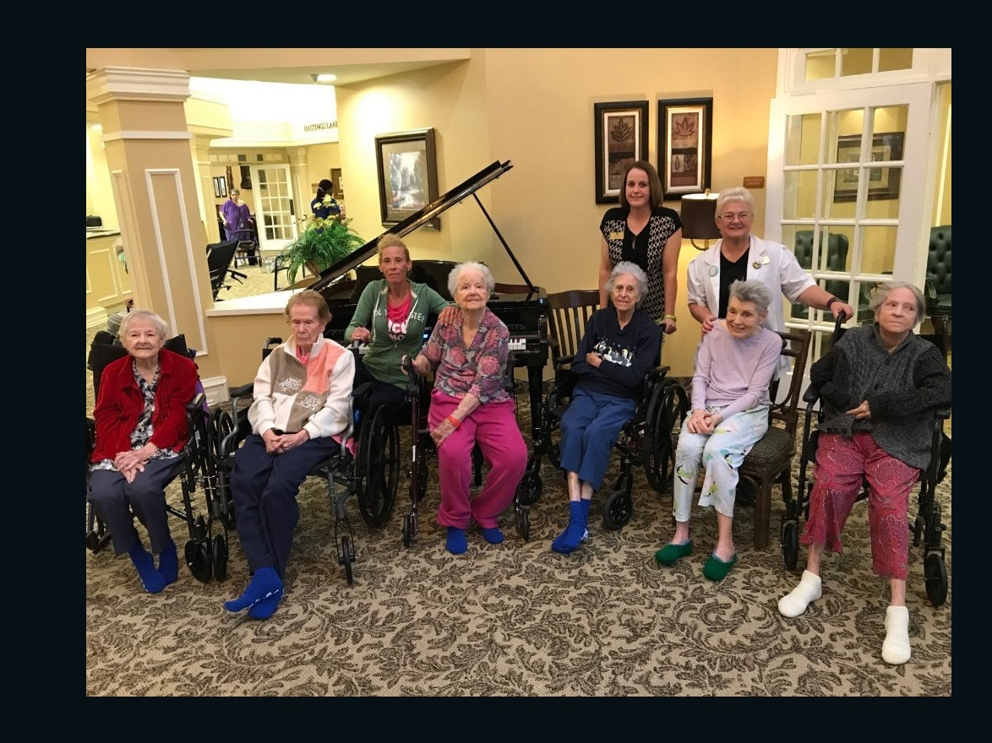

Slide 13
Blanchard’s Dirty Dozen
Disaster Losses Are Enormous
The US Is Becoming More Vulnerable
Disaster Looses Are Going Up
Projected to Get Even Worse
Disasters Impact Differentially
Past & Current Practices are Not Effective Enough
Disasters Don’t Kill People- People Kill People
Disasters Stem From Failure to Manage Risk
Failure Is Primarily Governmental
This is Primarily a Political Problem
We Must Create a Culture of Disaster Prevention
Disaster Management Needs to Continue To Evolve
Education is Key

Slide 14
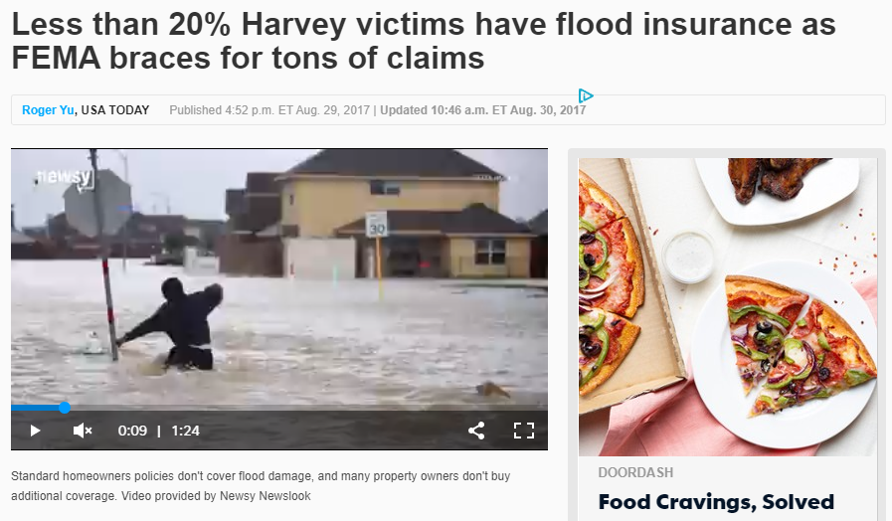
Perhaps mitigation is too expensive?
The most expensive buildings are those that are devastated
- $17,586
- $12,000
- $14,000
Hardening Features for New Construction
NPV 30 years, NFIP X zone
Elevated New Construction
-$115,000
Residential Flood Insurance Claims/Loss

Slide 15
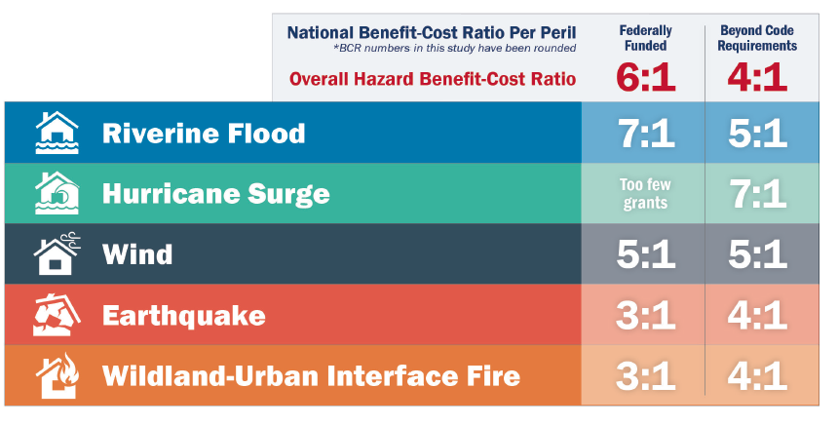
Mitigation Saves: 2017 Interim Report

Slide 16
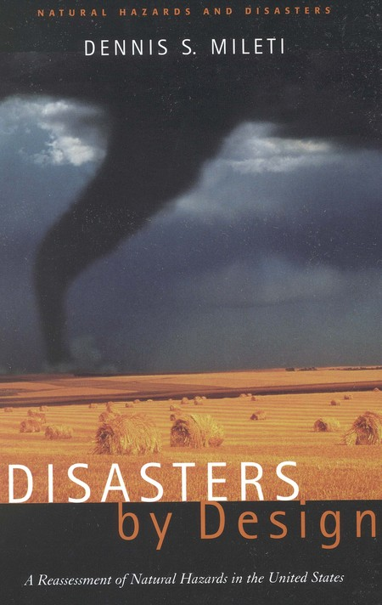
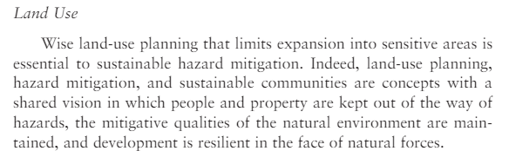
Mitigation Practice Number One: Land Use Planning
Zoning isn’t the only way to manage development: Texas counties can require subdivision review, direct capital investments in transportation, water supply, wastewater, and enact floodplain regulations.

Slide 17
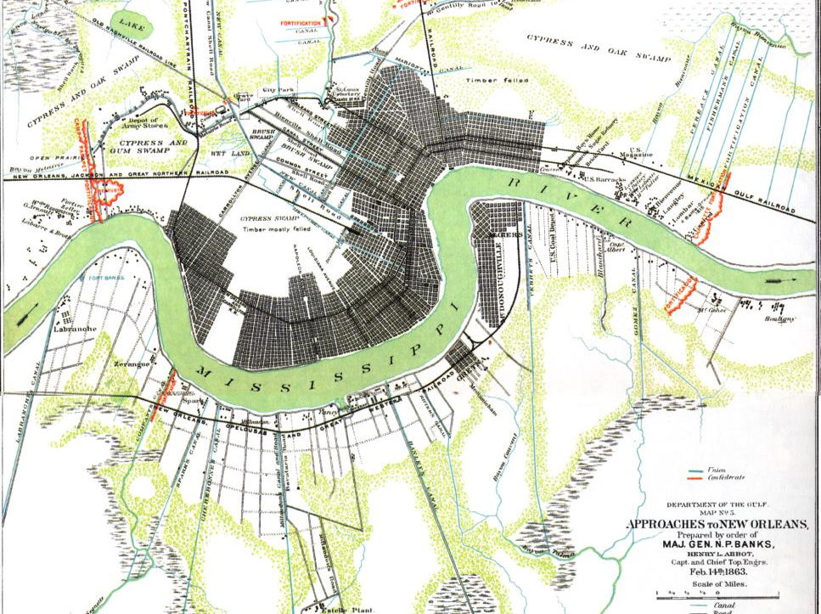

Slide 18
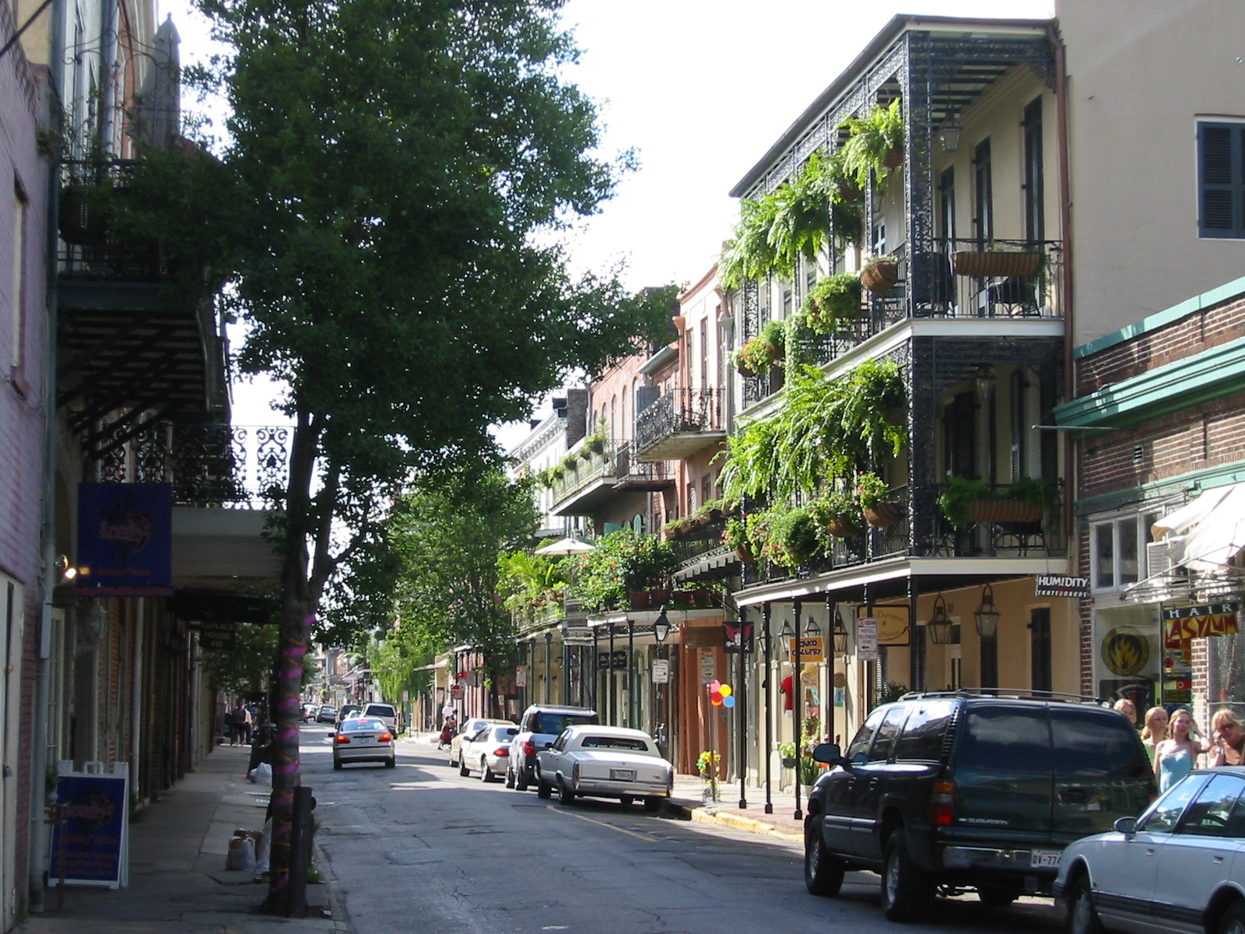
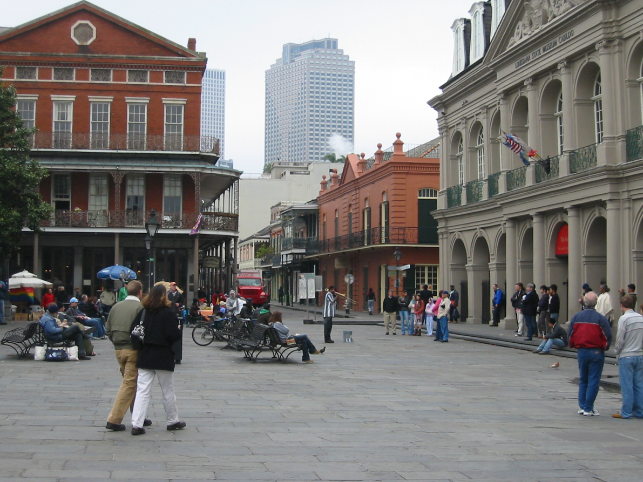

Slide 19

Thought Exercise: Could New Orleans have been a more Resilient City?

Slide 20
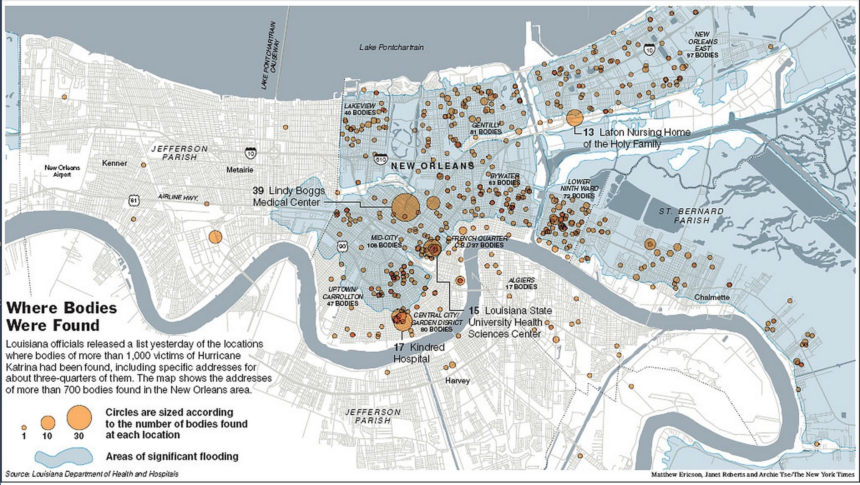

Slide 21
Blanchard’s Dirty Dozen
Disaster Losses Are Enormous
The US Is Becoming More Vulnerable
Disaster Looses Are Going Up
Projected to Get Even Worse
Disasters Impact Differentially
Past & Current Practices are Not Effective Enough
Disasters Don’t Kill People- People Kill People
Disasters Stem From Failure to Manage Risk
Failure Is Primarily Governmental
This is Primarily a Political Problem
We Must Create a Culture of Disaster Prevention
Disaster Management Needs to Continue To Evolve
Education is Key

Slide 22
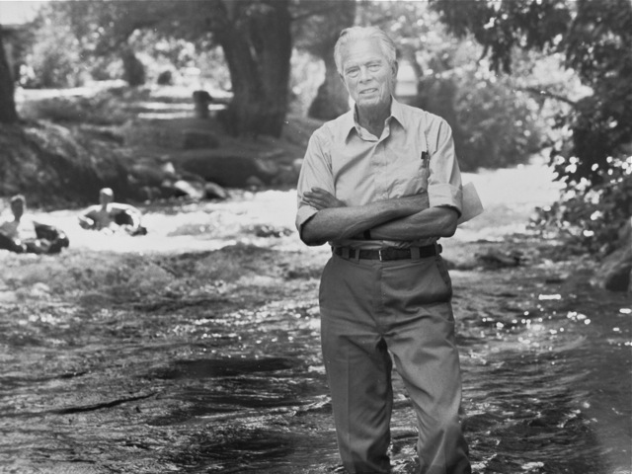
“FLOODS ARE ACTS OF GOD, BUT FLOOD LOSSES ARE LARGELY ACTS OF MAN”
- Gilbert White

Slide 23
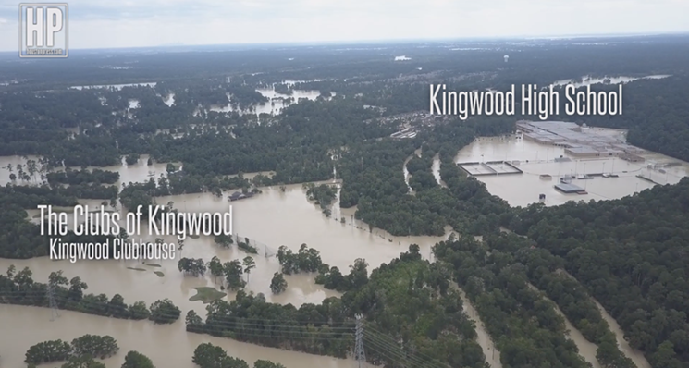
Failure to Manage Risk (Hazard ≠ Risk)
100 Year
10 Year

Slide 24
Politics & Words Matter…
“It can’t happen here”
“We have other priorities”
“We need the development and tax revenue”
“Opposition is too strong. We have to pick our battles”
“There isn’t public support”
“This will hinder economic development”
“Our message isn’t getting through to leadership, to the public”
“We need incentives to act”
Then disaster strikes:
“Why did it happen here?”
“We couldn’t have known.”

Slide 25
Blanchard’s Dirty Dozen
Disaster Losses Are Enormous
The US Is Becoming More Vulnerable
Disaster Looses Are Going Up
Projected to Get Even Worse
Disasters Impact Differentially
Past & Current Practices are Not Effective Enough
Disasters Don’t Kill People- People Kill People
Disasters Stem From Failure to Manage Risk
Failure Is Primarily Governmental
This is Primarily a Political Problem
We Must Create a Culture of Disaster Prevention
Disaster Management Needs to Continue To Evolve
Education is Key

Slide 26
Blanchard’s Dirty Dozen Breakdown
Disaster Losses Are Enormous
The US Is Becoming More Vulnerable
Disaster Losses Are Going Up
Projected to Get Even Worse
Disasters Impact Differentially
Past & Current Practices are Not Effective Enough
Disasters Don’t Kill People- People Kill People
Disasters Stem From Failure to Manage Risk
Failure Is Primarily Governmental
This is Primarily a Political Problem
We Must Create a Culture of Disaster Prevention
Disaster Management Needs to Continue To Evolve
Education is Key

Slide 27

“A compass, I learnt when I was surveying, it'll point you True North from where you are standing, but it's got no advice about the swamps and deserts and chasms you'll encounter along the way. If in pursuit of your destination you plunge ahead, heedless of obstacles, and achieve nothing more than to sink in a swamp, what's the use of knowing True North?”

Slide 28
Blanchard’s Dirty Dozen, Sorted
Disaster Losses Are Enormous
The US Is Becoming More Vulnerable
Disaster Losses Are Going Up
Projected to Get Even Worse
Disasters Impact Differentially
Disasters Don’t Kill People- People Kill People
Failure Is Primarily Governmental
This is Primarily a Political Problem
Effective Practices are not Used Enough
Disasters Stem From Failure to Manage Risk
We Must Create a Culture of Disaster Prevention
Disaster Management Needs to Continue To Evolve
Education is Key
Swamps,
Deserts,
& Chasms
Advice

Slide 29
Blanchard’s Stratagems for Becoming a More Resilient Community
Disaster Impact Differentially
  Recognize that hazards falls hardest on populations without the resources to respond and recover
Effective Practices are not Used Enough
  Mitigation, Structural practices, and Land Use Planning Work: Use Them
Disasters stem from a Failure to Manage Risk
Managing hazards is not working; Focus on probability and vulnerability, i.e., risk
We Must Create a Culture of Disaster Prevention
  We’re great at response, Now let’s work on prevention- Think about capital investments and planning
Emergency/Disaster Management Needs to Continue To Evolve
  Integrative, communicative, cooperative, involve your public, lead
Education is Key
  Partner with universities, Knowledge generation and transfer (i.e., Extension)

Slide 30
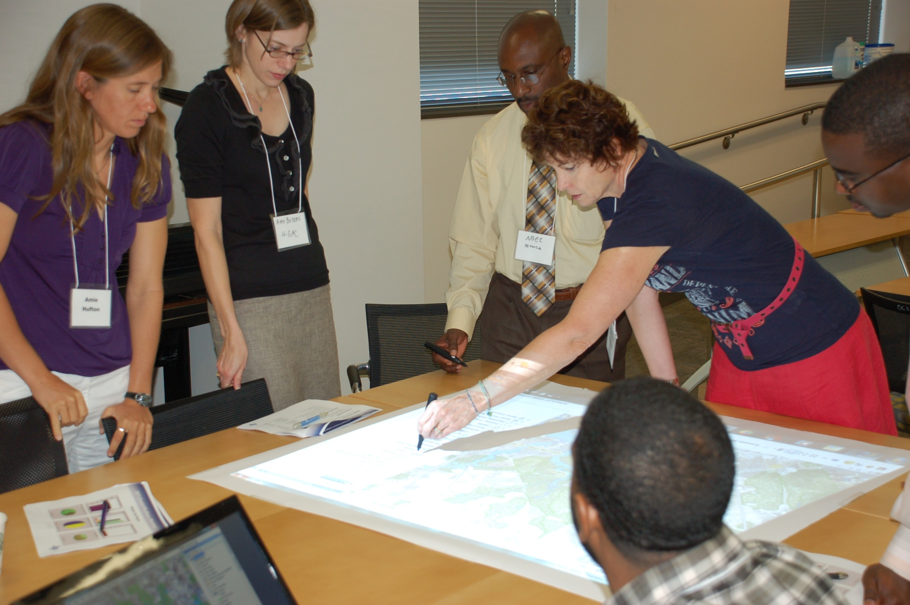
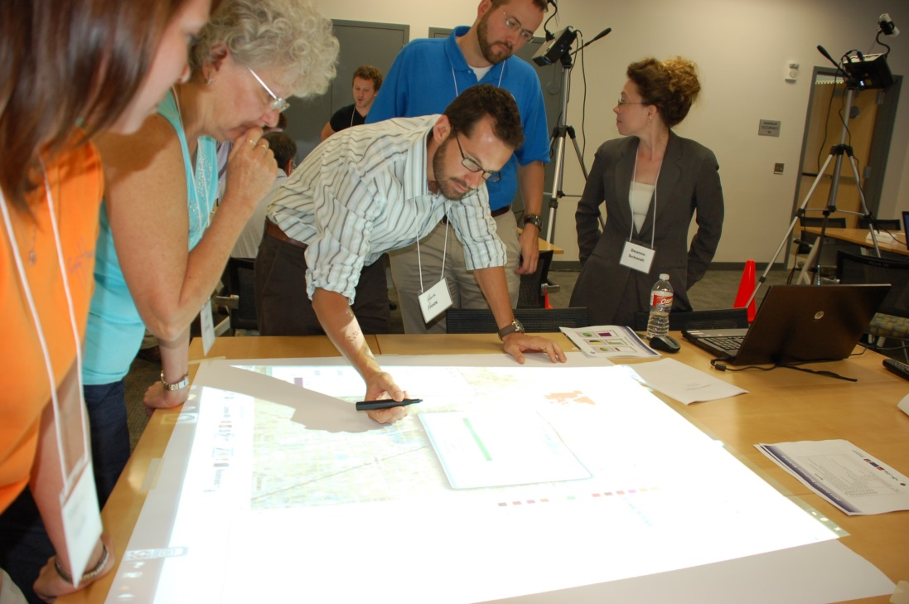
Community
Health
And
Resource
Management

Slide 31
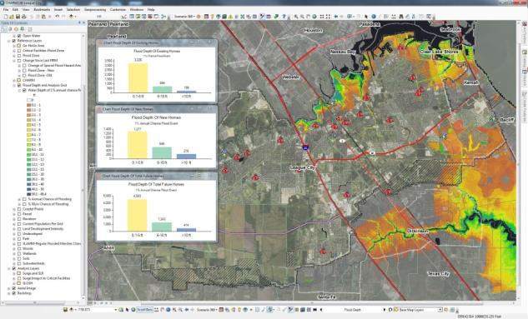
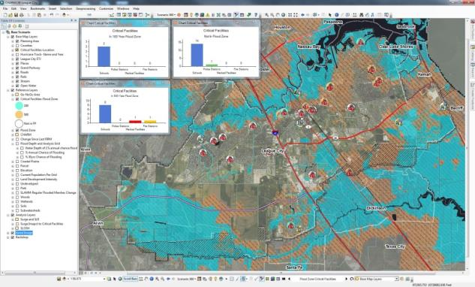
CHARM by the numbers
10 Participants per table
30+ Map Layers
100+ Live Updates
Customizable Development Styles
15 Pre-saved Layouts

Slide 32
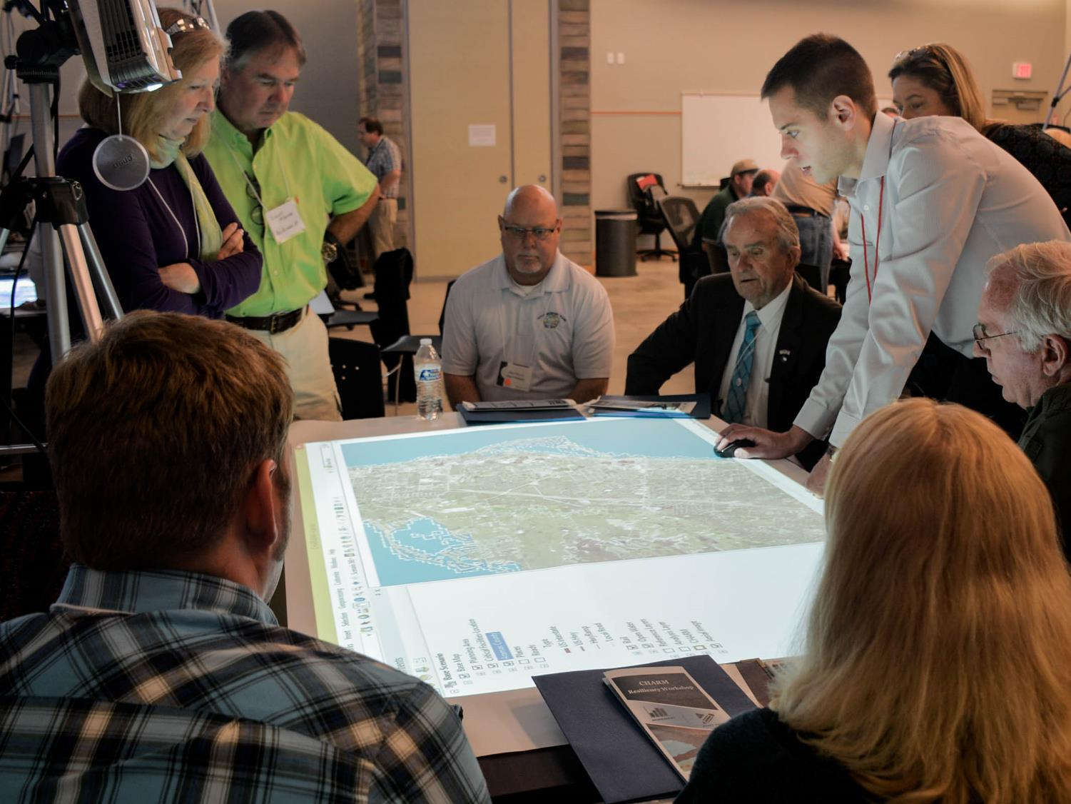

Critical Facilities Exercise
FEMA Resiliency Workshop
Rockport TX, March 2016
Notes:
We might be over estimating coordination and dialogue in the community

Slide 33
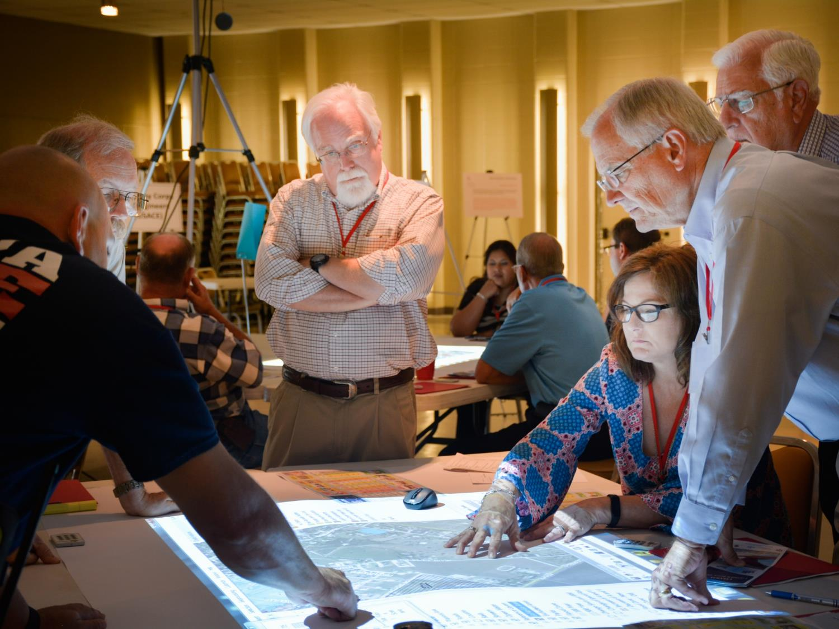
Go/No-Go Exercise
FEMA Resiliency Workshop
Jackson Co, June 2016
Notes:
No community is too small

Slide 34
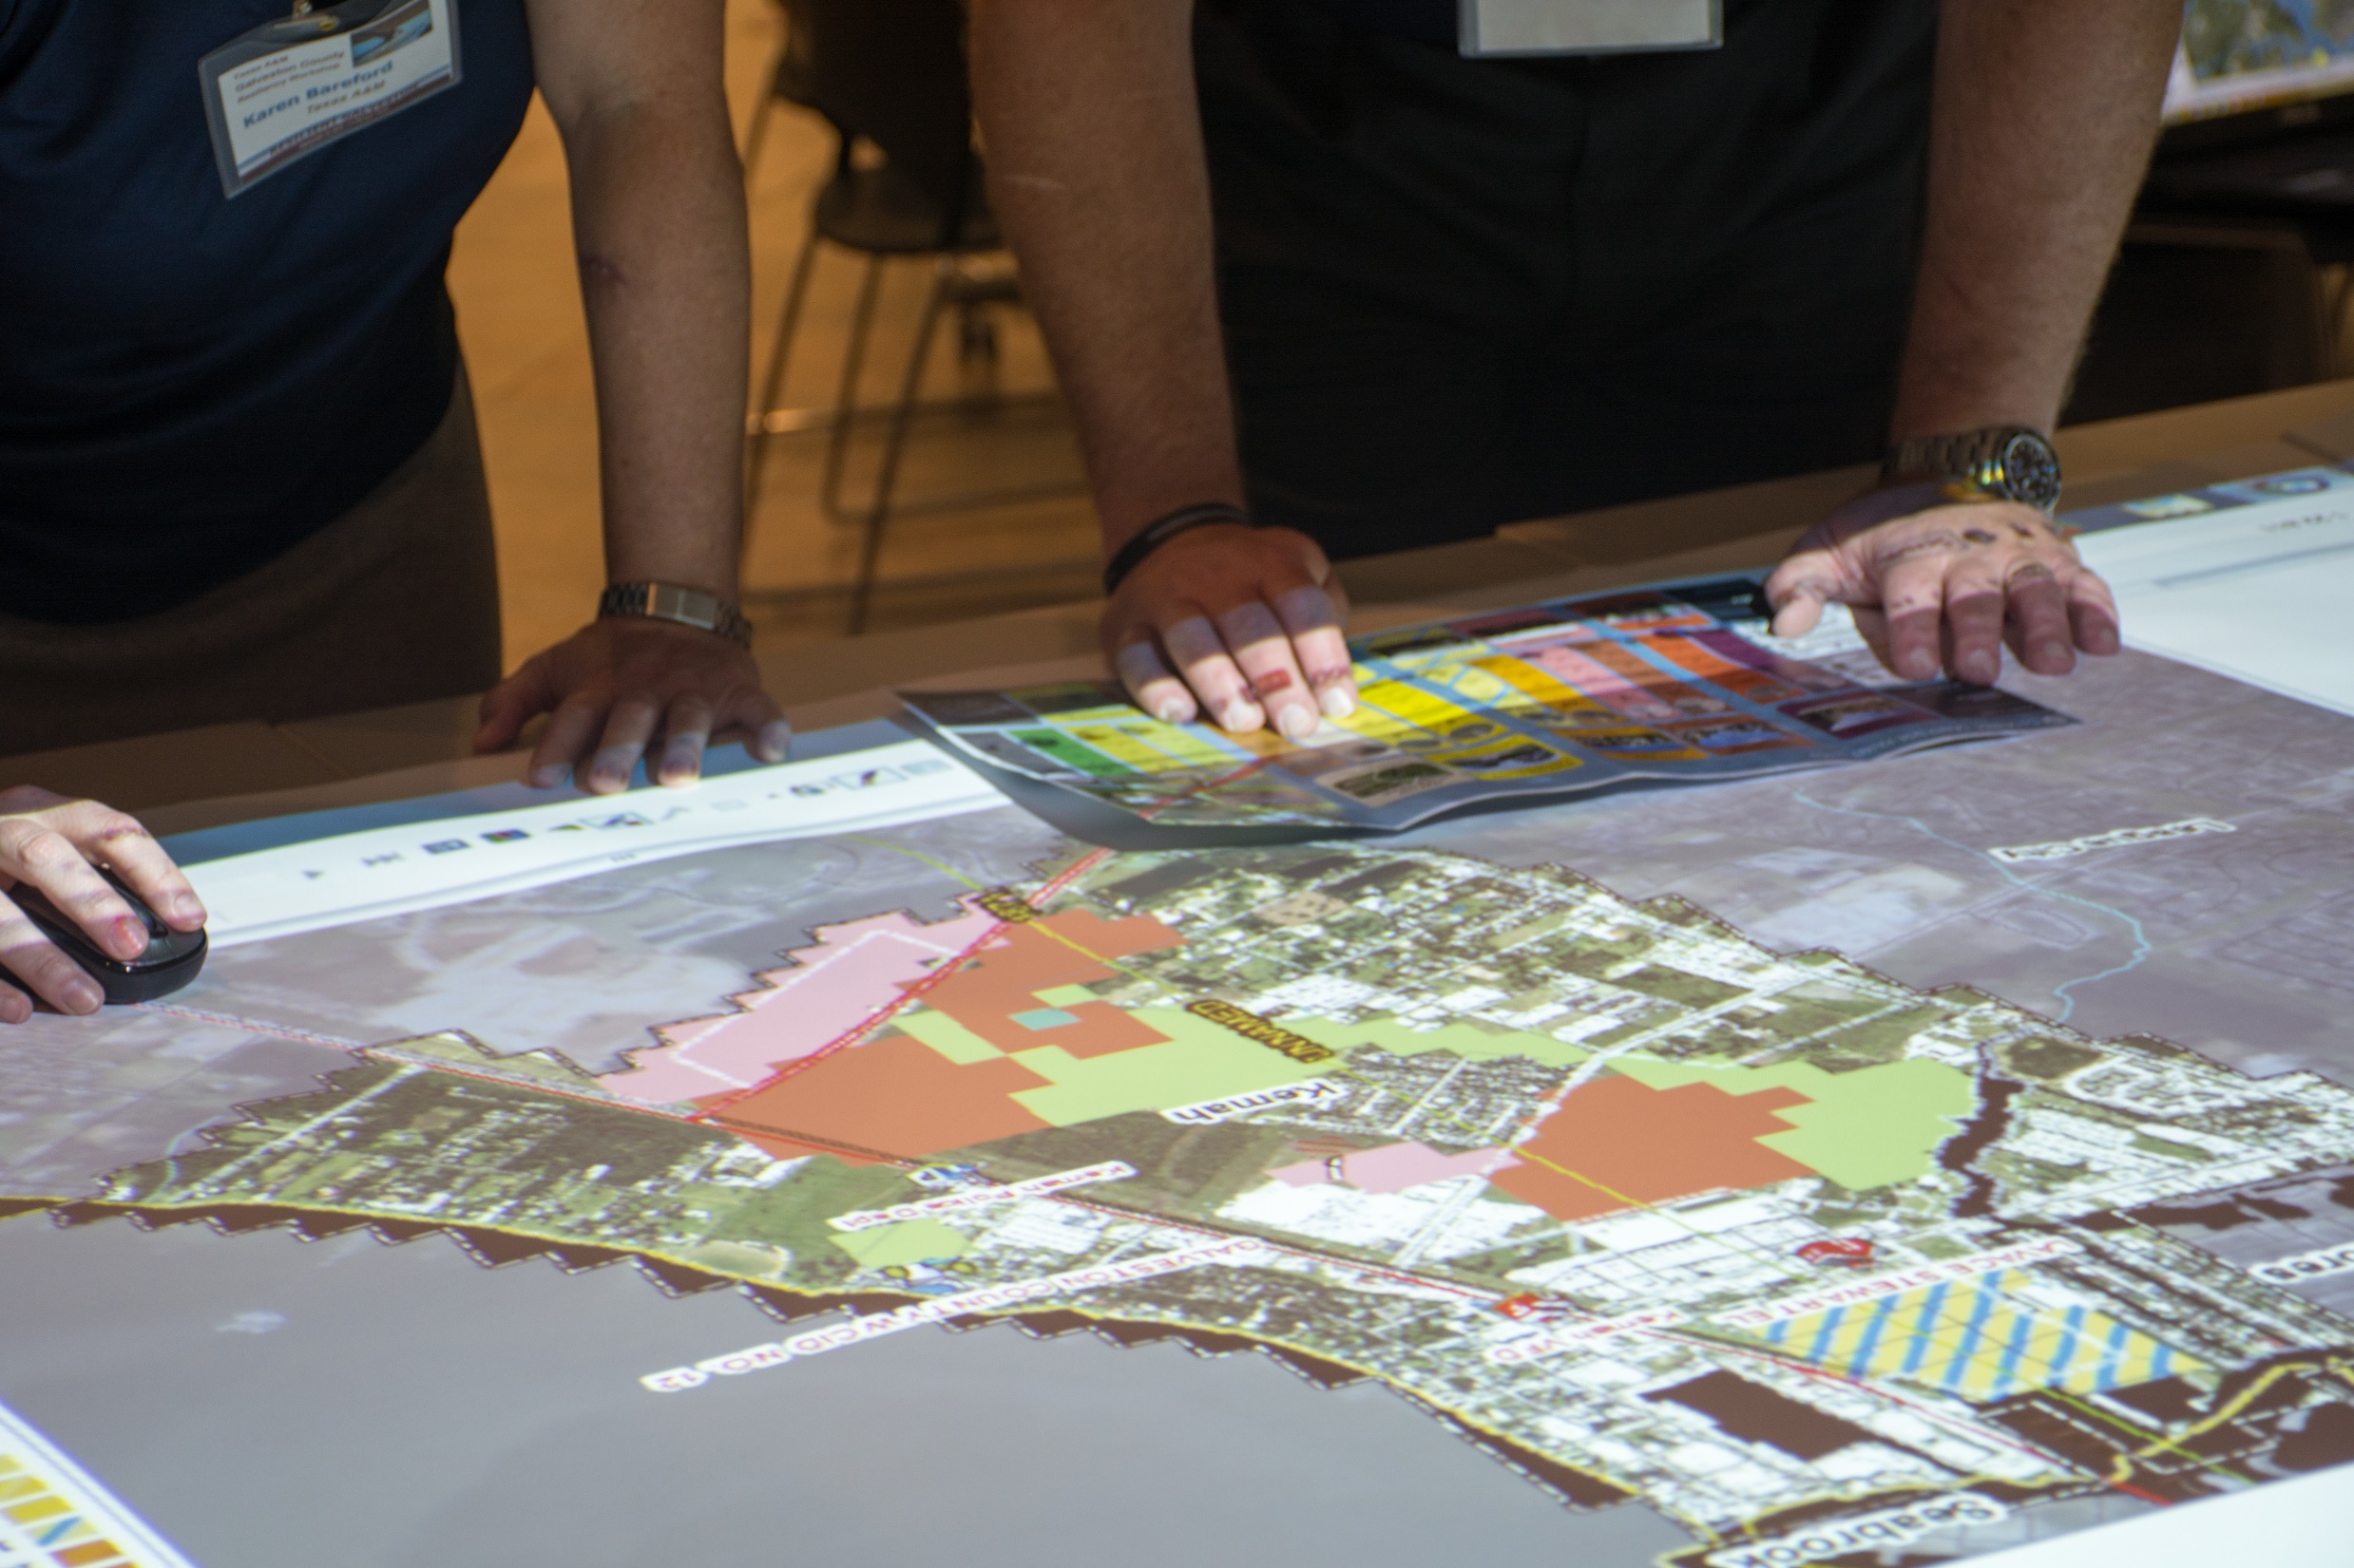
Future Land Use Exercise
FEMA Resiliency Workshop
Galveston, September 2016
Notes:
No concept is too basic

Slide 35
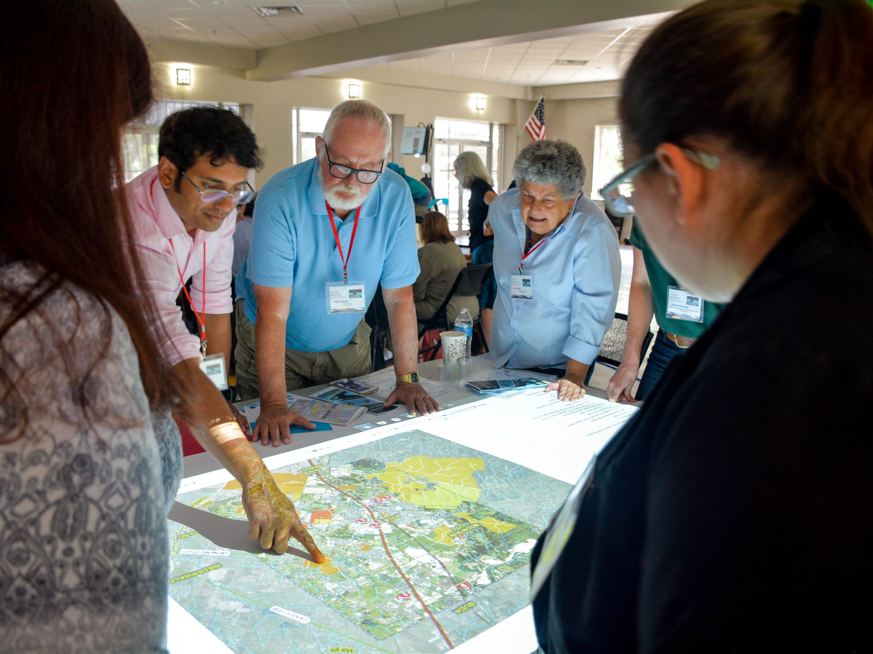
Buy Out Exercise
FEMA Resiliency Workshop
Hays Co, August 2017
Notes:
The stories and the values are there- use this platform to bring these stories out to the open

Slide 36
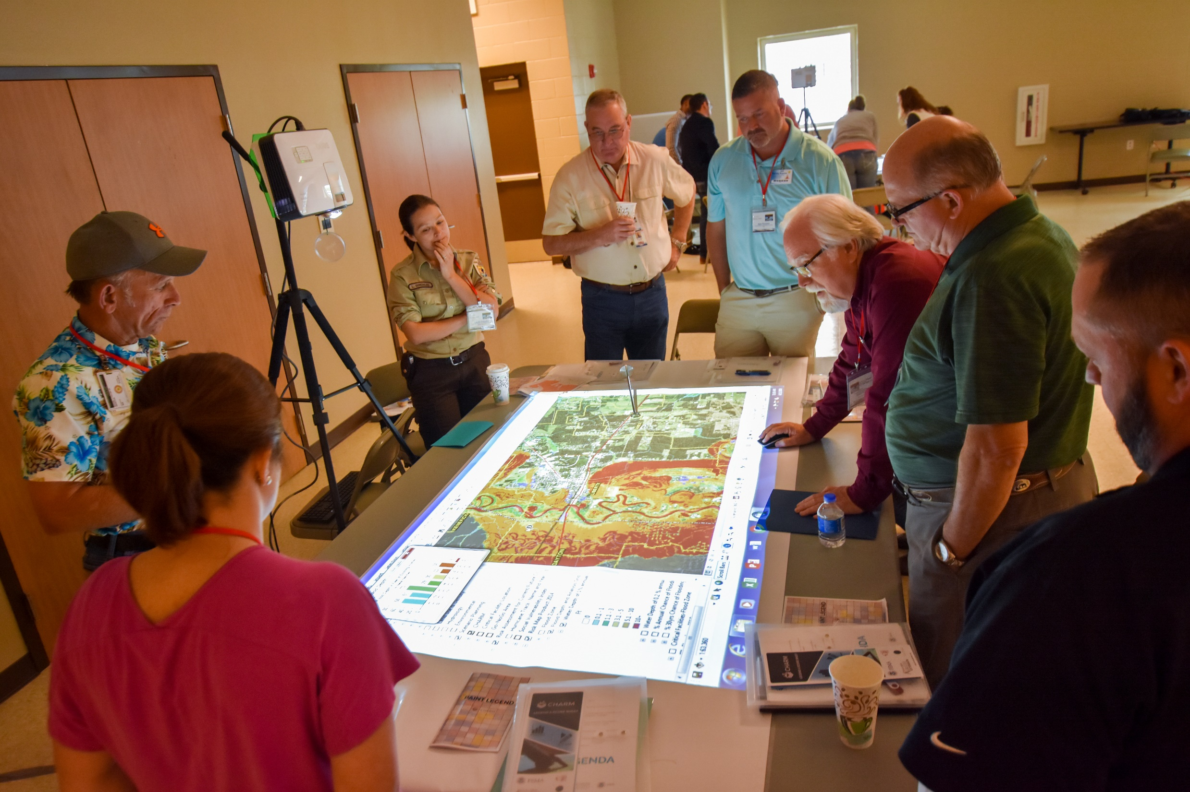
SOVI Exercise
FEMA Resiliency Workshop
Liberty Co, April 2018

Slide 37
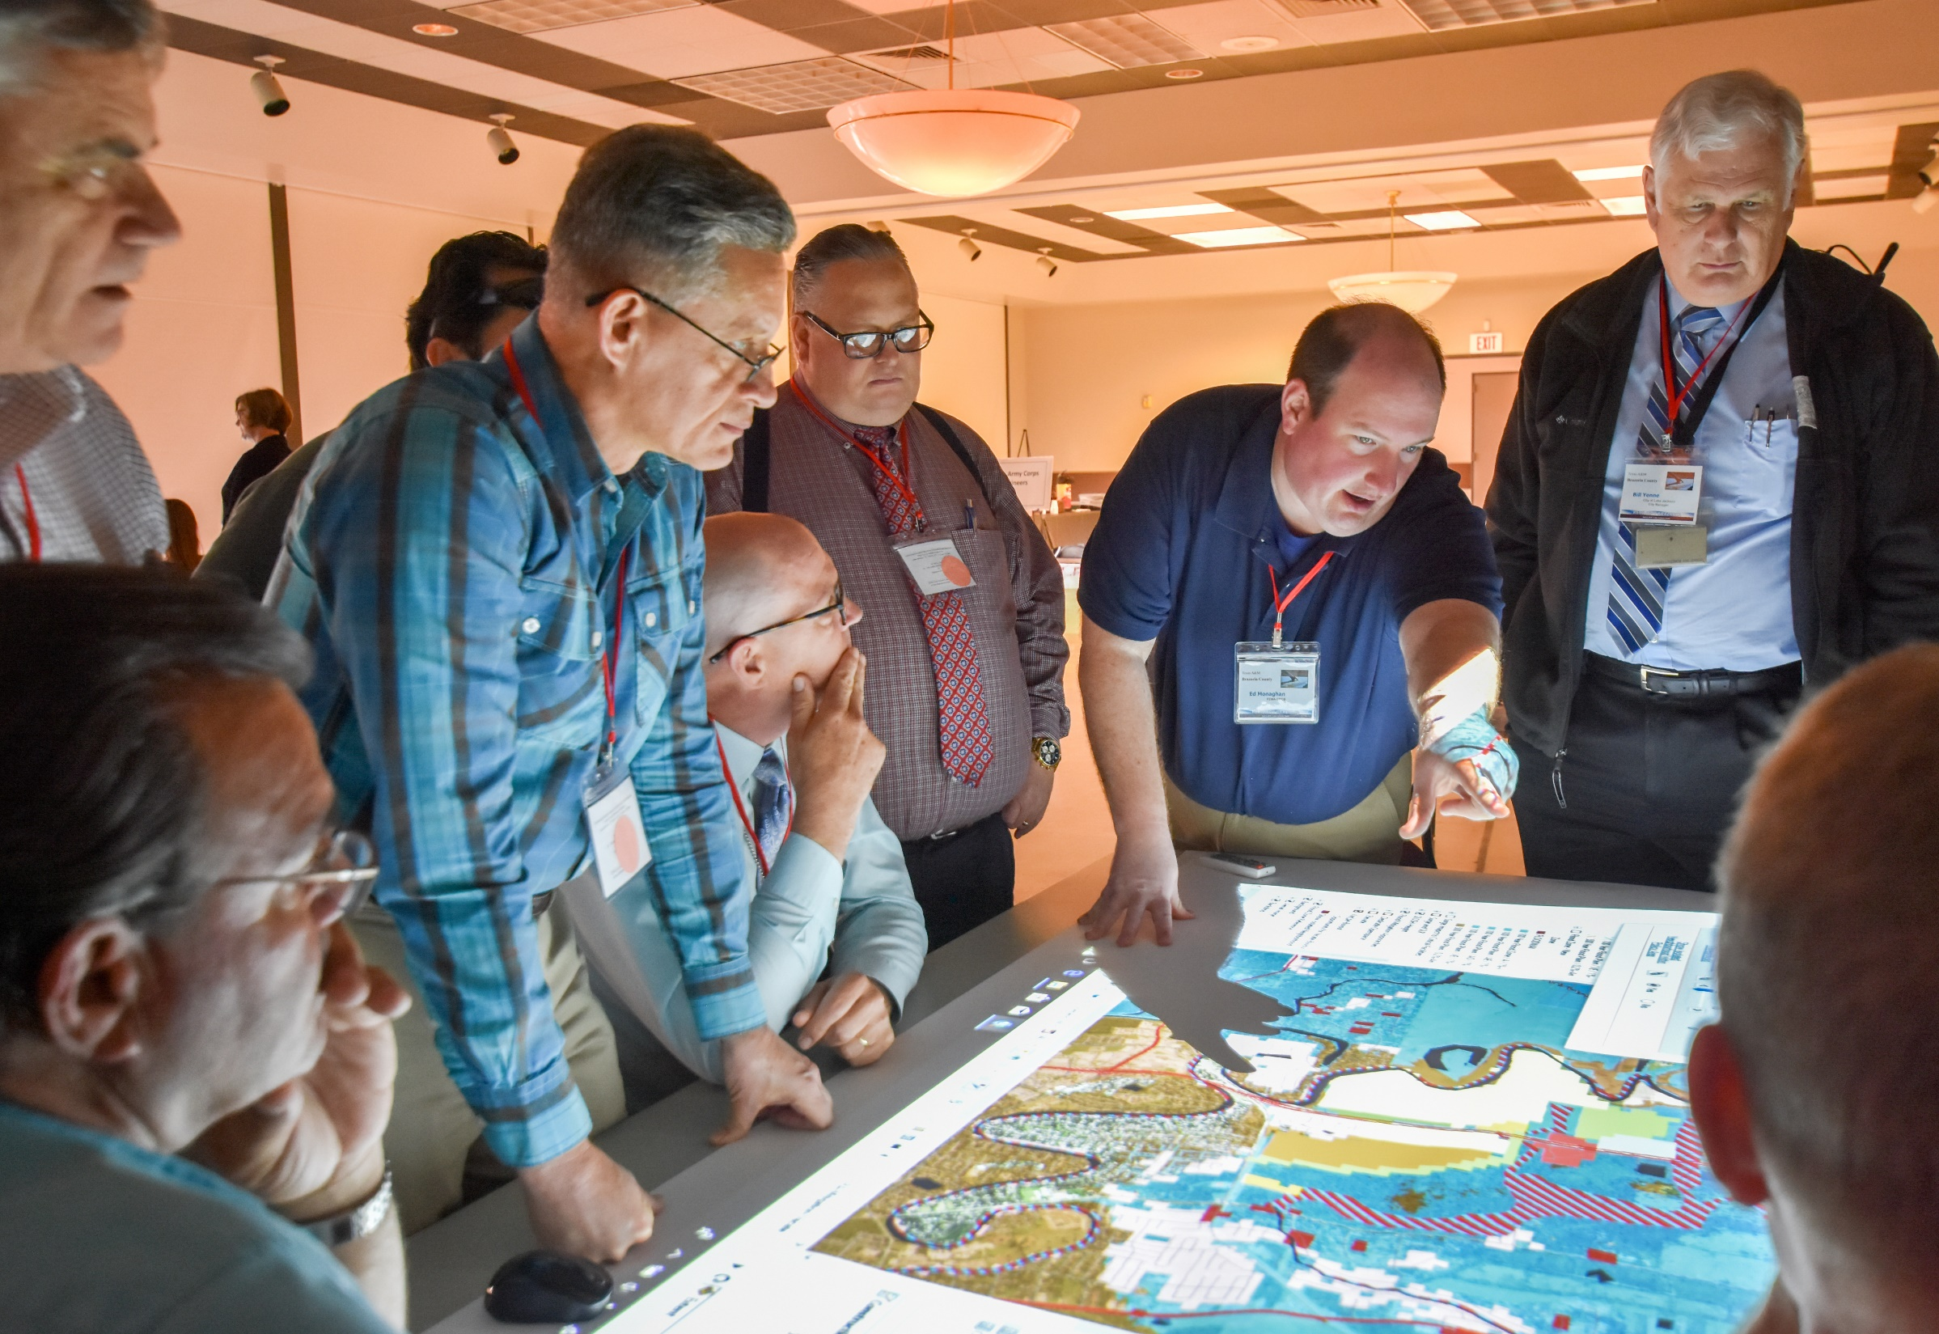
D/E/V Exercise
FEMA Resiliency Workshop
Brazoria Co, April 2018

Slide 38
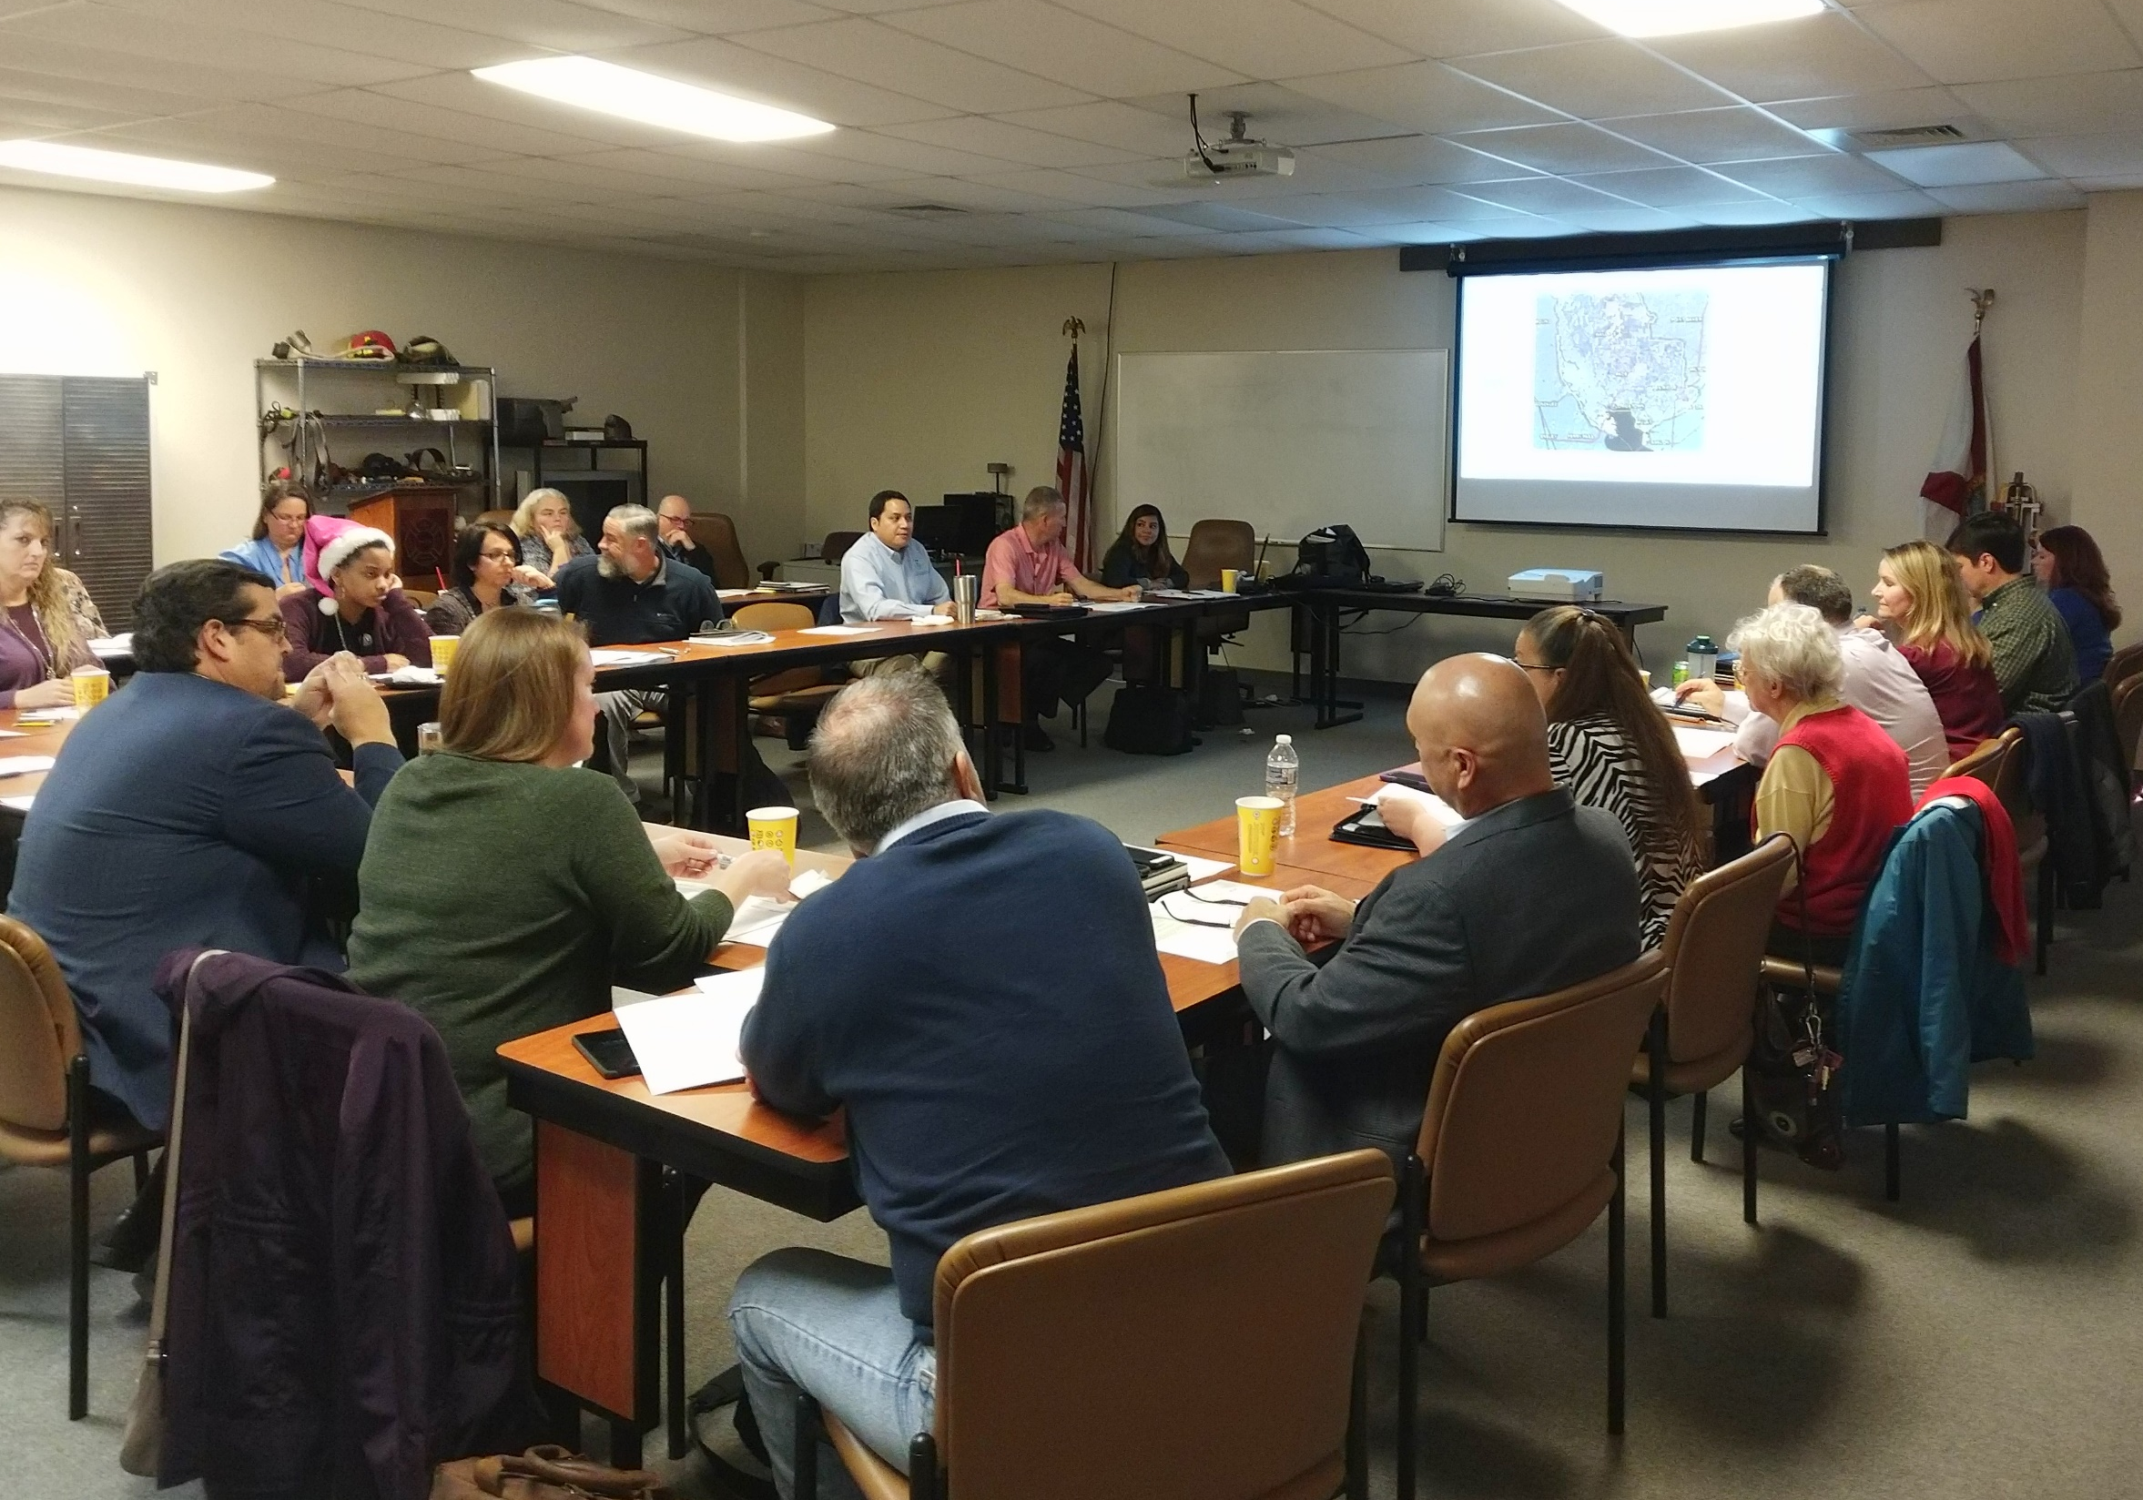
Resilience Index
CRI-CHARM Workshop
Santa Rosa FL, December 2018
Notes:
The stories and the values are there- use this platform to bring these stories out to the open

Slide 39
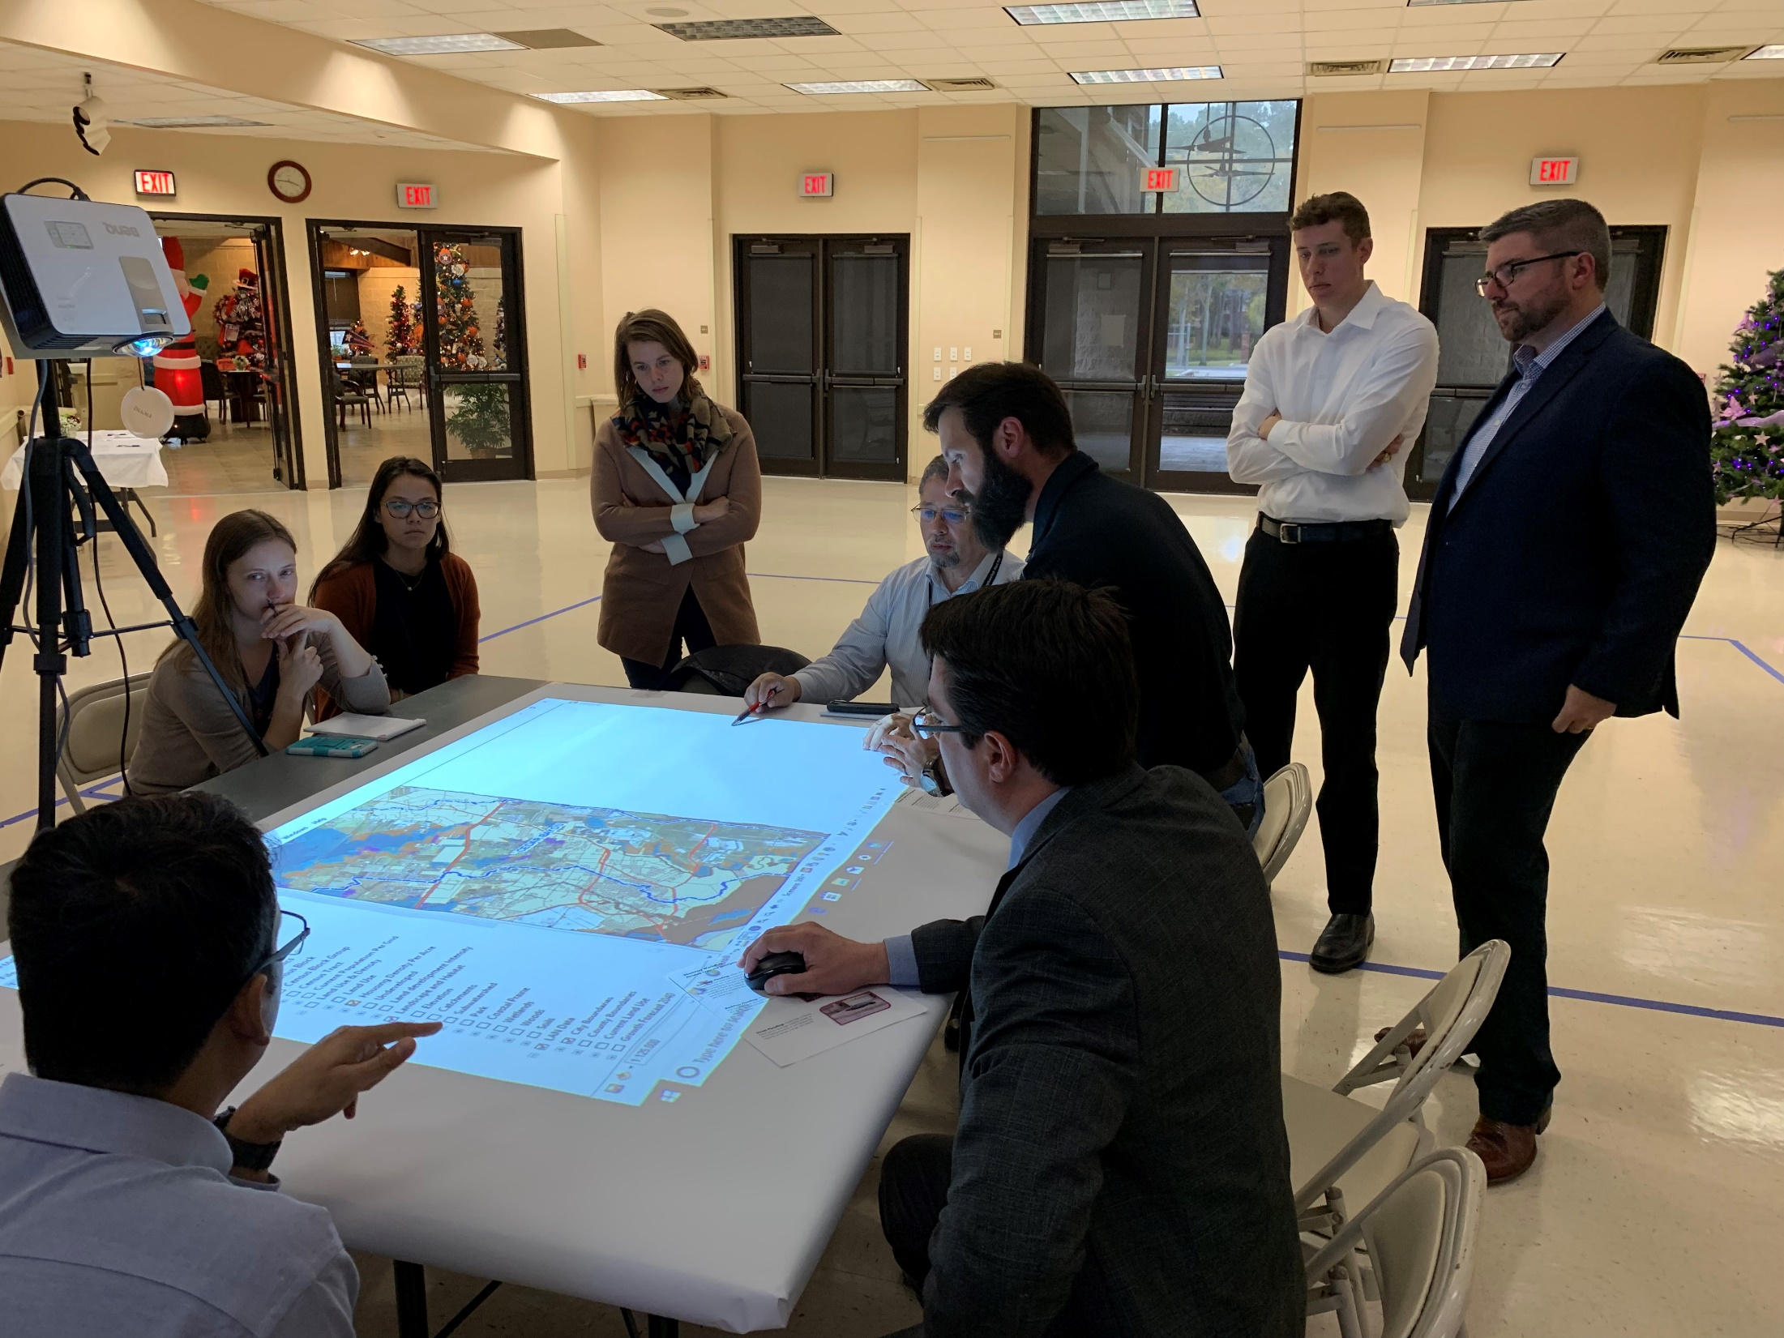
Discovery Workshops
LAN Consulting & HCFCD Cedar, Luce & Jackson Bayous November 2018
Notes:
The stories and the values are there- use this platform to bring these stories out to the open

Slide 40


TCWP.tamu.edu
CommunityCHARM.org
Steven Mikulencak, AICP
TCWP Planning Team Lead & Project Manager
smikulencak@tamu.edu

Slide 41
The Storm after the Storm or: How I Learned to Embrace Bureaucracy and Love Recovery

Slide 42
Timothy Little
Community Resilience and Recovery Planner
Texas Community Watershed Partners
Texas A&M AgriLife Extension
tlit@tamu.edu
communitycharm.org

Slide 43
Emergency Management
Prevention
Preparedness
Response
Recovery
Mitigation

Slide 44
Recovery:
Successful recovery ensures that we emerge from any threat or hazard stronger and positioned to meet the needs of the future. Recovery capabilities support well-coordinated transparent, and timely restoration, strengthening, and revitalization of infrastructure and housing; an economic base; health and social systems; and a revitalized cultural, historic, and environmental fabric.
*From Texas Emergency Management
Executive Guide FY 2017 Edition

Slide 45
HOW DOES THAT HAPPEN?!

Slide 46
Careful now, I’m going to use some FEMA speak….

Slide 47
Recovery – A Brief Overview
Public Assistance (PA)
Individual Assistance (IA)
National Disaster Recovery Support/Interagency Recovery Coordination (NDRS/IRC)

Slide 48
Public Assistance (PA)
Debris Removal
Emergency Protective Measures
Permanent Restoration of infrastructure

Slide 49
PA: Categories
Category A: Debris Removal
Category B: Emergency Protective Services
Category C: Roads and Bridges

Slide 50
PA: Categories
Category D: Water Control Facilities
Category E: Public Buildings and Equipment

Slide 51
PA: Categories
Category F: Utilities
Category E: Parks, Recreational Facilities and Other Facilities

Slide 52
PA: Process

Slide 53
Complicated right?

Slide 54
Individual Assistance (IA)
Provides financial assistance and services to people in federal declaration areas whose property is damaged or destroyed and the losses are not covered by insurance.

Slide 55
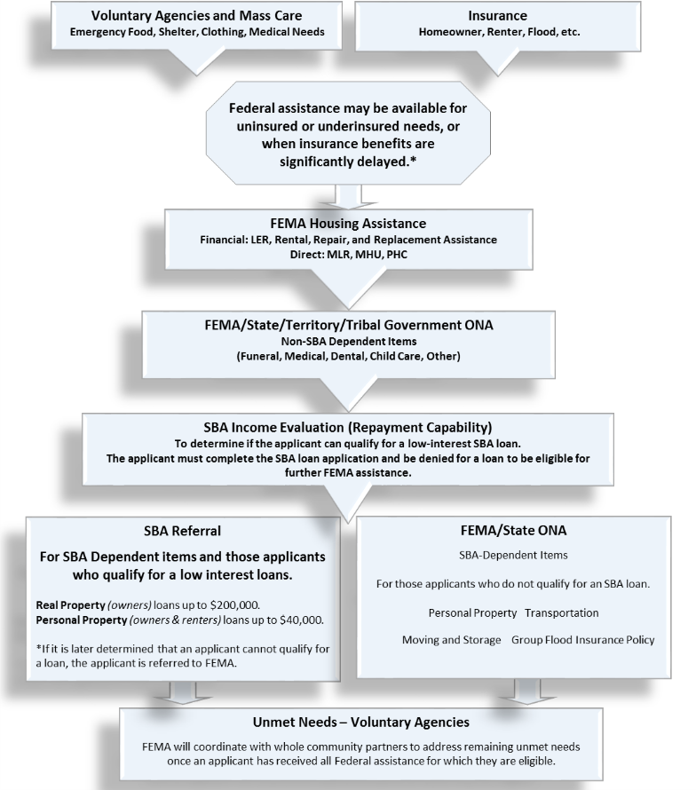
IA: Sequence of Delivery

Slide 56
IA:
Individual and Household Program
Crisis Counseling Program
Disaster Case Management
Disaster Unemployment Assistance

Slide 57
IA:
Disaster Legal Services
Disaster Supplemental Nutritional Assistance Program

Slide 58
IA:
Transitional Shelter Assistance
Direct Housing

Slide 59
IA: Other Support
Assist local jurisdictions in setting up donation center, volunteer reception areas and long-term recovery committees.

Slide 60
IA: Other Support
Provide guidance to local officials in the creating Disaster Recovery Centers for survivors.
Build capacity and resilience in local jurisdictions

Slide 61
National Disaster Recovery Support / Interagency Recovery Coordination
(NDRS/IRC)

Slide 62
Coordinates Recovery Efforts with other Federal Partners to help bring more funding and assistance to counties and communities.

Slide 63
NDRS/IRC:
Community Planning and Capacity Building
Housing
Economic Development
Natural and Cultural Resources
Infrastructure
Health and Social Services

Slide 64





NDRS/IRC: Federal Partners

Slide 65
Many of you may still be going through ongoing disaster recovery efforts in your constituency.

Slide 66
It ain’t easy, is it?

Slide 67
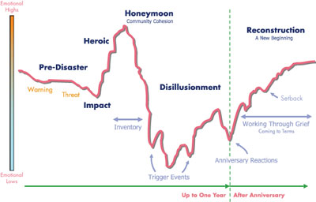
*From Linda Langston
Director of Strategic Relations
National Association of Counties

Slide 68
We may be separated by physical distance, but as Texans and as AgriLife Extension, we are here to help!

Slide 69

communitycharm.org

Slide 70
Timothy Little
Community Resilience and Recovery Planner
Texas Community Watershed Partners
Texas A&M AgriLife Extension
tlit@tamu.edu
communitycharm.org

