Slide 1
Consequences of Suspended or Invalid Driver Licenses
Garry Merritt, General Counsel
and Director of Legal and Legislative Services
garrym@county.org
(512) 478-8753
Impaired Driving Summit Occupational Driver’s Licenses
June 29, 2017 Judge Laura A. Weiser
Uvalde, TX Judicial Resource Liaison

Slide 2
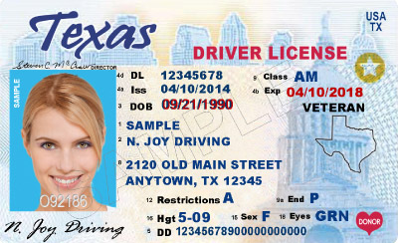
Downward Spiral:
A Driving While License Invalid (DWLI) conviction can lead to jail time, fines, surcharges, and a longer suspension.
A subsequent conviction leads to a higher level charge.
Notes:
Driving While License Invalid or Driving While License Suspended

Slide 3
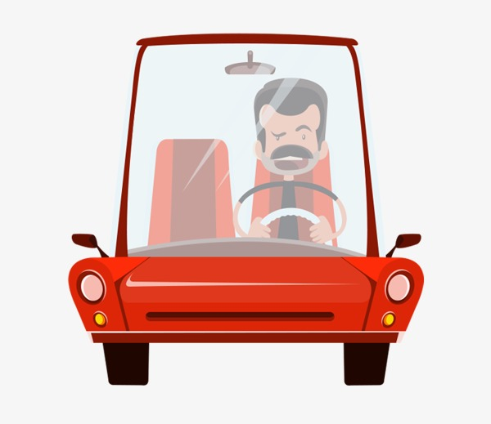
Some Staggering Statistics
2017 – 3,425 people were booked into the Travis County Jail for the crime of DWLI.
2018 – 1.4 million drivers licenses suspended for not paying surcharges.
Notes:
Hoffberger, C. (2018, Sept. 21). How to jail the poor. The Texas Tribune. Retrieved from https://www.austinchronicle.com/news/2018-09-21/how-to-jail-the-poor/
Sundaram, A. (2019, Feb. 13) Texas’ Driver Responsibility Program might finally face reform. The Texas Tribune. Retrieved from https://www.texastribune.org/2019/02/13/texas-lawmakers-push-fix-driver-responsibility-program

Slide 4
Overview
Ways a license can get suspended or revoked
ALR Hearings
DWLI Convictions
Driver Responsibility Program
Occupational Drivers Licenses

Slide 5
Lots Of Ways To Get License Suspended
Under TC 521.292, DPS determines the license holder:
has operated a motor vehicle on a highway while the person's license was suspended, canceled, disqualified, or revoked, or without a license after an application for a license was denied;
is a habitually reckless or negligent operator of a motor vehicle;
is a habitual violator of the traffic laws;
has permitted the unlawful or fraudulent use of the person's license;

Slide 6
More Ways To Get License Suspended
Under TC 521.292, DPS determines the license holder:
has committed an offense in another state or Canadian province that, if committed in this state, would be grounds for suspension;
has been convicted of two or more separate offenses of a violation of a restriction imposed on the use of the license;
has been responsible as a driver for any accident resulting in serious personal injury or serious property damage;

Slide 7
Even More Ways To Get License Suspended
Under TC 521.292, DPS determines the license holder:
is under 18 years of age and has been convicted of two or more moving violations committed within a 12-month period; or
committed offense of fleeing or attempting to elude police.

Slide 8
Lots Of Ways To Get License Revoked
Under TC 521.294, DPS determines the license holder:
is incapable of safely operating a motor vehicle;
has not complied with the terms of a citation issued by a jurisdiction that is a party to the Nonresident Violator Compact of 1977 for a traffic violation to which that compact applies;
has failed to provide medical records or has failed to undergo medical or other examinations as required by a panel of the medical advisory board;

Slide 9
More Ways To Get License Revoked
Under TC 521.294, DPS determines the license holder:
has failed to pass an examination required by the director under
this chapter; or
has committed an offense in another state or Canadian province that, if committed in this state, would be grounds for revocation.

Slide 10
Even More Bad Stuff That Can Happen
Refusal to submit to blood or breath test under TC Chapter 724
Failure to pass test under TC Chapter 524
Request by cosignor of minor’s driver’s license application that DPS cancel the license (TC 521.304)
Death of cosignor on minor’s application for driver’s license application

Slide 11
Even More Bad Stuff That Can Happen
Recommendation by juvenile court to suspend a provisional license (TC 521.307)
Denial of renewal for failure to appear for complaint, citation or court order to pay a fine involving traffic law (TC 521.317)
Revocation of medical reasons, including chemical dependency (TC 521.319) (effective on judgment of court that the person is incapacitated to act as operator of mv or order of involuntary treatment)
Graffiti (PC 38.08; TC 521.320)

Slide 12
Even More Bad Stuff That Can Happen
… minors with alcohol, adults with alcohol, adults making alcohol available to minors, contempt in JP or municipal court, fraud offenses, fictitious license plates or registration, fraudulent government records, sex offenders, stealing fuel, racing on public street, drug offenses, …

Slide 13
ALR Hearings
- In municipal court or JP court where person resides (TC 521.300)
So … may not be the place where the violation occurred
Preponderance of the evidence (TC 521.301)
Whether the grounds for suspension or revocation stated in the notice are true

Slide 14
ALR Hearings Appeal
Heard in CCL in county in which person resides or, if there is no CCL, in the county court (TC 521.308)
Trial on appeal is a trial de novo
Person has the right to a jury
Filing of the appeal stays the suspension or revocation until earlier of 90 days after appeal petition is filed or the date the trial is completed and judgment rendered

Slide 15
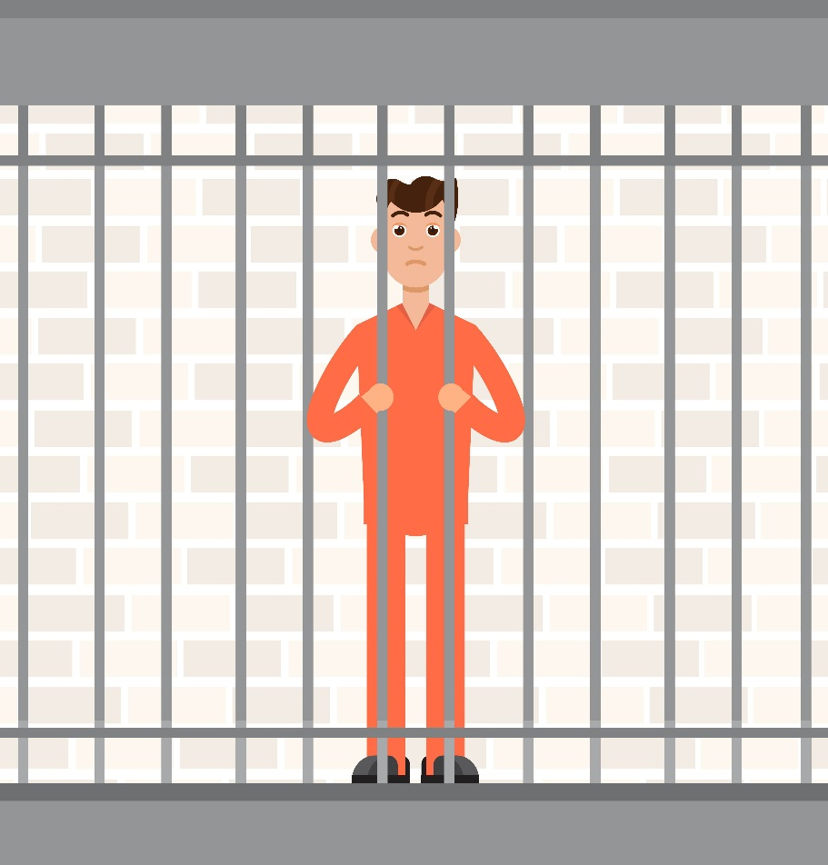
DWLI convictions stack – Individual caught driving while their license is invalid may receive enhanced punishment. Second offense can be a Class B, meaning possible jail time and a much higher fine. (Trans. Code 521.457(f)(1)-(2).
Notes:
No license – have to walk or catch a ride; Money (fines, fees, surcharges); Jail

Slide 16
Transportation Code § 521.457 (a)
Person commits an offense of DWLI if they operate a mv on a highway:
After their license has been canceled under TC 521 if they do not have a license that was subsequently issued under TC 521.
During a period that their license is suspended or revoked under Texas law.
While their license is expired if it expired during a period of suspension.
After renewal of their license has been denied, if they do not have a license subsequently issued under TC 521.

Slide 17
Transportation Code § 521.457 (b)
Catch All Provision:
Person commits an offense of DWLI if they are the subject of an order that prohibits them from obtaining a license and they operate a mv on a highway:

Slide 18
Penalties
- Class C misdemeanor under TC 521.457(e) unless enhancements apply
Up to a $500 fine
- Class B misdemeanor under 521.457(f) or (f-1) if:
previously convicted of DWLI
previously convicted of allowing operation of a vehicle while registration is suspended (TC 601.371)
operating the vehicle with no insurance (TC 601.191)
license previously suspended for operating a motor vehicle while intoxicated
Up to 180 days in county jail
A fine up to $2000
Notes:
Transportation Code § 521.457 DWLI

Slide 19
Penalties
Class A misdemeanor under TC 521.457(f-2) if the person:
was operating the vehicle with no insurance and
caused or was at fault in a motor vehicle accident that resulted in serious bodily injury to or death of another person
Up to one year in county jail
A fine up to $4000
Notes:
Transportation Code § 521.457 DWLI

Slide 20
Driver Responsibility Program
(Trans. Code, Chapter 708)
DPS can assess surcharges to individuals based on certain traffic offenses.
Proceeds from the program help pay for the emergency trauma care system.
For DWLI conviction, surcharge is $250 per year X 3 three years.
Failure to pay the surcharge, enter into a payment plan, or request an administrative hearing = automatic 90 day suspension of driving privileges.
Once suspended, the driver is responsible for a driver’s license reinstatement fee.
Additional fees, on top of original fine and surcharges, include admin fees, reinstatement fees, license issuance fees and payment plan fees.

Slide 21
Amnesty and Incentives
(Trans. Code § 708.157)
- Periodic Amnesty Program – DPS may establish a periodic amnesty program for drivers on which a surcharge has been assessed on their licenses;
- Incentive for Compliance – DPS shall offer a driver with surcharges an incentive for compliance and efforts at rehabilitation, including a reduction of surcharges;
- Indigency Program – DPS shall establish shall establish an indigency program for drivers on which a surcharge has been assessed on their licenses. The driver must provide evidence of indigency to the court in which they are convicted (Trans. Code § 708.158).

Slide 22
December, 2018
Austin Community Law Center and Washington-based Equal Justice Under the Law filed a lawsuit against the state of Texas on behalf of four individuals and “others similarly situated” –claiming the DRP is unfair to low-income offenders.
Seeking a judgment to “prevent DPS from issuing or processing driver’s license suspensions for unpaid surcharges under the DRP and the reinstatement of licenses which were previously suspended for failure to pay the DRP surcharges.”
Notes:
Civil Action No. 5:18-cv-1265
Graciela Rodriguez, Charles Stevens, Khalid Salahuddin, Nathan Alexander v. Steven Mach, Chairman of the Texas DPS Commission, Steven McCraw, Director of the Texas DPS, Skylor Hearn, Deputy Director of Administration and Services of the Texas DPS, Amanda Arriaga, Division Director of the Driver License Division of the Texas DPS, Greg Abbott, Governor of Texas

Slide 23
86th Legislative Session
To date, at least 10 bills have been filed in an attempt to fix or repeal the Driver Responsibility Program this session.
Lawmakers have tried to appeal or reform the program in the past. HB 2068 from the 85th would have abolished the Driver Responsibility Program. The bill passed the House, but was never considered by the Senate.
Roadblock – DRP pays for half of the emergency trauma care system, approximately $144 million.
Notes:
Sundaram, A. (2019, Feb. 13) Texas’ Driver Responsibility Program might finally face reform. The Texas Tribune. Retrieved from https://www.texastribune.org/2019/02/13/texas-lawmakers-push-fix-driver-responsibility-program

Slide 24
Occupational Drivers Licenses

Slide 25
Why Grant an ODL?
Up to 75% of offenders with suspended or revoked DLs continue to drive.
Without liability insurance.
Source: NHTSA

Slide 26
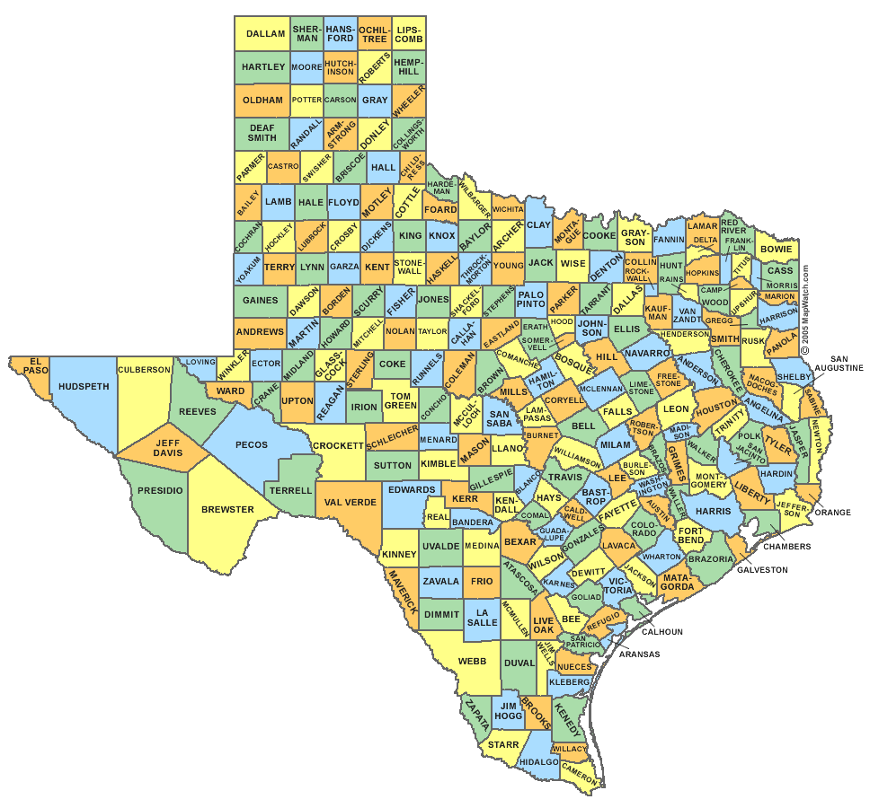
Jurisdiction
Your court is in the county where the petitioner resides
OR
Your court is where the conviction originated
Trans. Code § 521.242(a)
Notes:
Transportation Code §521.242(a)

Slide 27
Petition for Occupational Drivers License
The Petition must set forth in detail the person’s “essential need” for an ODL:
To and from work
To and from school
In the performance of essential household duties (buying groceries, etc)
Trans. Code § 521.242

Slide 28
Eligibility
Petitioner had a valid driver’s license from Texas or another state or country
The license has not been revoked or cancelled
If there is a waiting period, that period has been satisfied.
Person has provided an SR22

Slide 29
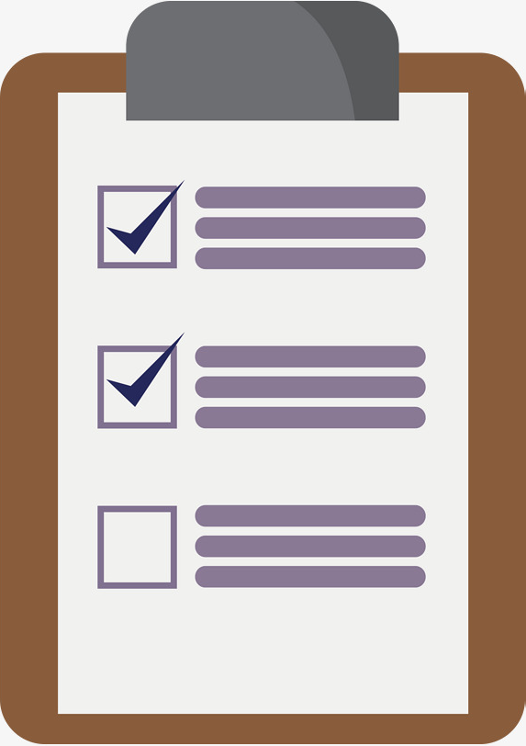
What Proof Should be Presented?
Notice
Jurisdiction
Basis of Suspension
Residence of Petitioner
Court where conviction occurred
Trans. Code § 521.243
Notes:
Texas Transportation Code §521.243

Slide 30
What else might you want from the prosecutor?
Facts of the offense from which the suspension originated.
Pertinent criminal history if available.

Slide 31
You must consider the Petitioner’s Driving Record.

Slide 32
Required to Deny Petition
If Petitioner has been issued MORE THAN ONE ODL after a conviction in the last ten years.
Trans. Code § 521.242(b)(2)

Slide 33
Required to Deny Petition
If the Petitioner’s license has been revoked for a medical reason.
If the Petitioner’s license has been revoked for failing to pay child support.

Slide 34
Required to Deny Petition
If the Petitioner’s license is a COMMERCIAL DL.
If there is a required waiting period that has not been satisfied.

Slide 35
Waiting Periods
ALR Suspensions
2 alcohol or drug related ALR suspensions within 5 years
If just a contact without a conviction period is 90 days
If previous contact resulted in a DWI, Intox. Assault or Intox. Manslaughter conviction, period is 180 days.

Slide 36
Waiting Periods
Conviction Suspensions
2 or more DWI, Intox. Assault or Intox. Manslaughter convictions within 5 years
Period is one year from date of suspension

Slide 37
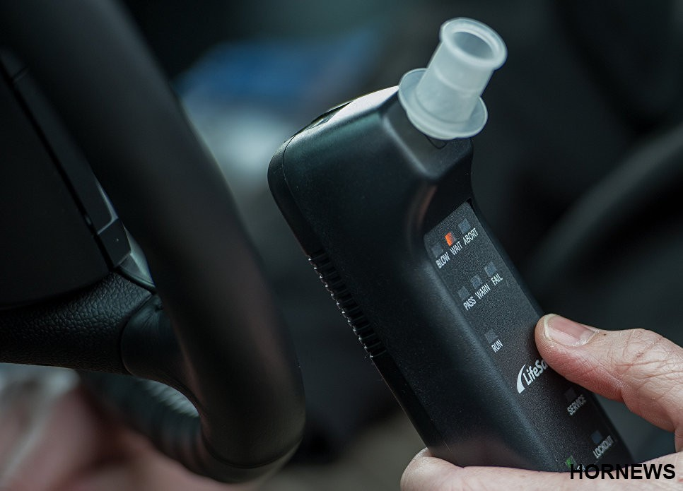
Ignition Interlock
License suspension for an offense under Sections 49.04-49.08 TPC
Ignition interlock devices allow individuals to continue working, attend school or treatment, and remain active in their communities.
May operate a vehicle if:
Obtains and uses an IID for the entire period of the suspension
Applies for and receives an ODL with an IID designation
Notes:
A large percentage of individuals with suspended licenses continue to drive. Ignition interlock devices allow such individuals to continue working, attend school or treatment, and remain active in their communities. Gives individuals the opportunity to continue to support themselves and their families.

Slide 38
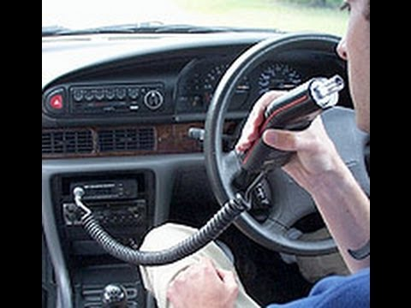
Ignition Interlock
No finding of essential needs necessary if:
Evidence of financial responsibility; and
Proof of installation of an IID on each motor vehicle owned or operated by the petitioner.
A person who is restricted to the operation of a motor vehicle equipped with an ignition interlock device may not be subject to any time of travel, reason for travel, or location of travel restrictions.

Slide 39
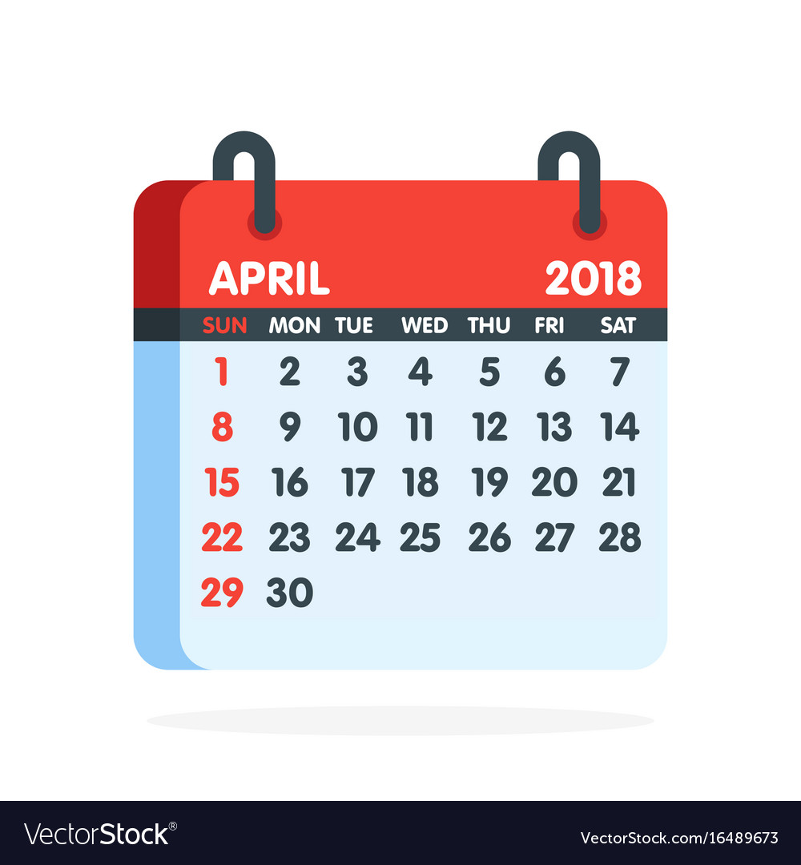
Term of ODL: ALR
ALR Breath/Blood Test Refusal: 180 days
ALR Breath/Blood Test Failure (.08 or greater): 90 days

Slide 40
Term of ODL: DWI Conviction
1st offense: 90-one year unless probated sentence
2nd or more: 180-2 years
2nd or more within 5 years: 1-2 years

Slide 41
Term of ODL: Other
Under 21: 1 year unless probated sentence then 90 days Ignition Interlock Device (IID) required
If Breath Alcohol Content (BAC) is greater than .15 then IID required
Drug conviction: 180 days

Slide 42
Indefinite Suspensions
Delinquent Surcharges
DWI Education or Drug Offender Program ordered but not taken
Liability Judgment for accident
Medical Revocation-NOT ELIGIBLE FOR ODL

Slide 43
ODL should have a term stated in the order.

Slide 44
Order for ODL
Geographical areas permitted
Days of the week and times permitted
(4 hours unless waived and then up to 12 hours in any 24 hour period)
Requirement of a driving log
A person who is issued an ODL must carry a certified copy of the court order when driving.
Notes:
§521.250

Slide 45
Conditions
Counseling.
Ignition Interlock-even if not mandated by statute.
Deleon v. State, 284 SW3rd 894 (Tex. App.-Dallas)
Petitioner required to submit to supervision from CSCD and pay a monthly administration fee up to $60.

Slide 46
Conditions
Petitioner required to submit to a substance abuse evaluation and comply with any recommended treatment
Petitioner required to abstain from the use of alcohol or any other substance capable of or calculated to cause intoxication and submit to random periodic testing

Slide 47
If Order Violated
Court can revoke or amend for good cause at any time.
Due Process required.

Slide 48
What If Circumstances Change?
Order may be amended to reflect changes in:
Suspension dates
Places and times of travel
Conditions and requirements

Slide 49
FAQs
Q: If I don’t order an ignition interlock when one is required, will DPS order one?
A: NO. Do not rely on DPS to enforce or add interlock requirements. This is not in the scope of DPS. DPS does not ever initiate interlock requirements or interlock orders to add to a driver license. DPS only enters or removes interlock restrictions received from the court.

Slide 50
FAQs
Q: What if Petitioner is driving a company car?
A: A person may operate a motor vehicle without the required interlock if:
Required to operate a motor vehicle in course and scope of employment
Vehicle is owned by employer
Person who is restricted does not control employer
Employer is notified of the interlock restriction
Notes:
§521.246

Slide 51
Questions? Give us a ring!

